Slide 1
Good Morning....

Slide 2
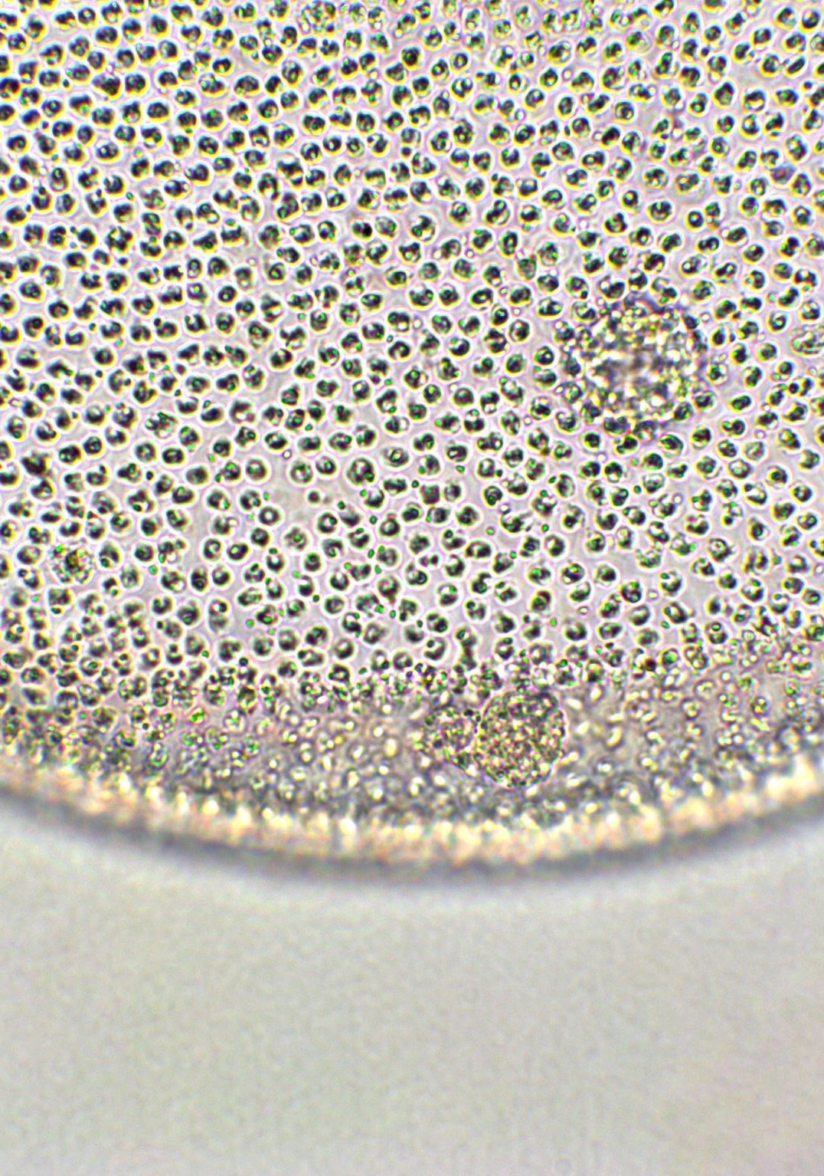
Pathogenesis of Periodontal Diseases

Slide 3
Learning objectives
ROLE OF BACTERIAL INVASION
ROLE OF EXOTOXIN
ROLE OF CELL Cell constituent
ROLE OF ENZYMES
EVASION OF HOST RESPONSES
THE HOST DERIVED BONE RESORBIN AGENTS
ROLE OF CYTOKINES

Slide 4
INTRODUCTION:
The pathogenic potential of the bacteria within the plaque
varies from gingiva site to site. Small amounts of plaque
can be tolerated without causing periodontal disease, may be because of the bost defence.

Slide 5
ROLE OF BACTERIAL INVASION:
Bacteria that initially colonize the periodontal
environment most likely attach to the pellicle or saliva-
coated tooth surface, e.g. adherence of A. viscosus through
fimbriae on the bacterial surface to a proline-rich protein found on saliva coated tooth surface.

Slide 6
Bacterial attachment to the pre-existing plaque is studied
by examining the adherence between different bacterial
strains (coaggregation), e.g. A. viscosus with S. sanguis.
These are important in the colonization of the periodontal

Slide 7
ROLE OF EXOTOXINS
A. actinomycetemcomitans produces an exotoxin referred
to as leukotoxin because of its toxic effect on the human
polymorphonuclear neutrophils (PMNs). The production of
leucotoxin may enable A. actinomycetemcomitans to evade the host defance.

Slide 8
ROLE OF CELL CONSTITUENTS
Cell constituents of both gram-positive and gram-negative
bacteria include endotoxins, bacterial surface components
and capsular components.
Endotoxin or lipooligosaccharide (LOS) previousaly termed as lipopolysacharide is found in outer membrane of gram negative bacteria.

Slide 9
Peptidoglycan: A cell wall component may affect a variety
of host responses including complement activation,
immunosuppressive activity and stimulation of the
reticuloendothelial system. It helps in the bone resorption
and in stimulating macrophages to produce prostaglandin and collagenase.

Slide 10
ROLE OF ENZYMES
The bacterial enzymes that are capable of contributing to
the disease process include collagenases, hyaluronidase,
gelatinase, aminopeptidase, phospholipases and alkaline and acid phostatase.
Destruction of periodontal tissues is by degradation of
collagen. P. gingivalis and some strains of A. actinomy-
cetemcomitans have been found to produce collagenase.

Slide 11
Bacterial hyaluronidase is capable of altering gingival
permeability by allowing the apical proliferation of the
junctional epithelium along the root surfaces. Hyaluronidase
is found in high concentrations in periodontal pocket.

Slide 12
EVASION OF HOST RESPONSES
Bacterial factors can also indirectly compromise the host
tissues. These factors influence both the cellular and humoral immune responace.
For example,
1. Inhibition of PMNs by leukotoxin chemotactic
inhibitors, decreased phagocytosis.
2. Immunoglobulins are inactivated by proteases.
3. Lymphocyte alterations
4. Endotoxicity
5. Catalase reaction.

Slide 13
Influence of host response on periodontal disease
Aspecta of disease:
Bacterial Colonization
Host Factor:
Subgingivally, antibody, complement in crevicular fluids inhibits adherenc and
coaggregation of bacteria and potentially reducess theire number by lysis.

Slide 14
2.Bacterial Invasion:
Antiboy Componant:
1. Mediated lysis reduces bacterial counts.
2. Neutrophils as a consequence of chemo-
taxis, phagocytosis and lysis reduces

Slide 15
Tissue destruction:
By antibody-mediated hypersensitivity,
destruction cell-mediated immune responses. Activation
of tissue destruction factors such as collagenase.

Slide 16
Healing and Fibrosis:
Lymphocytes and macrophages producechemotactic factors for fibroblasts, fibroblast activating factor.

Slide 17
2.Most peptides and proteins Chemotactic for neutrophil.
secreted by and macrophages. And macrophages.
. Are antigenic. 3.Enzym:es: Damage host cell
Damage host cells.
• Degrade connective tissue
matrix.

Slide 18
4. Lipopolysaccharide:. . Activate complemen.
Dalamage host cell and
Alveolar bone resobation.
is antigenic.
5. Polysaccharide plaque • Polyclonal B-cell activator.
matrix and bacterial • Are antigenic.
capsule
6. Other toxins, acids. , • Damage host cells.
reducing agents • Are antigenic.

Slide 19
Mechanism which results in changes in epithelium
Mechanism. . Effect
1. Bacterial toxins, e.g. • Cytotoxic to keratinocytes
Endotoxins • Disruption of normal
epithelial turnover and
differentiation
2. Bacterial enzymes • Damage to keratinocytes
3. Release of enzymes • Damage of keratinocytes
from neutrophils
4. Complement activation • Cell damage

Slide 20
5. Production of TNF. • Decreased → keratinocyte
and interferon G by proliferation
activated T-lymphocytes
6. Production of IL-1 by. • Increased → keratinocyte
Macrophages proliferation

Slide 21
Impact of microorganisms on inflammation and immunity
Microbes and products . Effect
1. Microorganisms. • Activate componant
• Activate neutrophils and
macrophages.
• Are antigenic.

Slide 22
2. Enzymes • Damage host cells.
• Degrade connective tissue
matrix.
• Activate and degrade
complement.
• Degrade antibody.
• Are antigenic.

Slide 23
3.Most peptides and. • Chemotactic for neutrophils
proteins secreted by. and macrophages.
Microorganisms • Are antigenic.
4. Lipopolysaccharide • Activate complement.
• Damage host cells and
alveolar bone resorption.

Slide 24
5. Polysaccharide plaque • Polyclonal B-cell activator.
matrix and bacterial • Are antigenic.
capsule
6. Other toxins, acids, • Damage host cells.
reducing agents • Are antigenic.

Slide 25
Mechanisms which result in changes in connective tissue
Mechanism. Effects
1. Bacterial toxins, e.g. • Cytotoxic to keratinocytes
Endotoxins. • Disruption of normal
epithelial turnover and
differentiattion.
2. Bacterial enzymes • Damage to keratinocytes

Slide 26
3.Release of enzymes. • Damage of keratinocytes
from neutrophils
4. Complement activation • Cell damage
5. Production of TNF. • Decreased → keratinocyte
and interferon G by proliferation
activated T-lymphocytes
6. Production of IL-1 by • Increased → keratinocyte Macrophages. proliferation

Slide 27
Mechanisms which result in changes in connective tissue
Mechanisms Effects
Bacterial toxins, e.g. • Toxic to fibroblasts
endotoxins • Decrease in collagen
production.
Production of IL-1 and. • Increased secretion of colla-
TNF genase and proliferations

Slide 28
Production of TGF and • Stimulation of fibroblast
Platelet derived chemotoxin proliferation,
growth factors (PDGF) matrix synthesis and
attempts at repair.
Products of tissue damage • Stimulation of fibroblast cells

Slide 29
Pathogenic immune reactions
Types Description. Definition . , Examples
Type-I Anaphylactic Antigen reacts with Urticaria, hay
cells sensitized by fever, asthma,
v IgE antibodies and food allergies.
release mediators

Slide 30
THE HOST DERIVED BONE RESORBING AGENTS
Cytokines
• IL-1
• TNF
• TGF-β
• IL-6

Slide 31
ROLE OF CYTOKINES
Meaning “cell protein” is used for molecules which transmit
information or signals from one cell to another. Interleukins,
growth factors, chemokines and interferon belong to the
family of cytokines. They act on fibroblasts, macrophages,
keratinocytes and PMNLs to release matrix metallo-
proteinases (MMPs) that degrade connective tissue matrix.
However, most findings show that tissue destruction that
occurs in periodontal disease is mainly due to host response to the bacterial and their product.

Slide 32
Important Cytokines Associated
with Periodontal Disease
1. IL-1: It is produced predominantly by macrophages and
lymphocytes. Fibroblasts, platelets and keratinocytes and
endothelial cells also release IL-1. It upregulates
adhesion molecules on endothelial cells, lymphocytes,
neutrophils and monocytes. It activates T and B
lymphocytes and promotes antibody production. IL-1α
and IL-1β are potent stimulators of connective tissue
destructions.

Slide 33
2. IL-2: Monocytes and T lymphocytes produce IL-2. It
stimulates T cells and enhances clonal expansion of beta
cells into plasma cells.
3. IL-4, IL-5 and IL-10: They are produced by TH2 cells
and help in the activation of beta cells into plasma cells
and down regulate monocytic response.

Slide 34
4. IL-6: It is released by lymphocytes, fibroblasts and
monocytes. Lipopolysaccharide, IL-1 and tumor necrosis
factor alpha upregulates the secretion of the IL-6. It is
believed to be responsible for conversion of blood
monocytes into osteoclasts.
5. IL-8: It is secreted by monocytes, keratinocytes and
fibroblasts. It is a strong chemoattractant of PMNLs at
low concentrations.

Slide 35
6. TNF: Tumor necrosis factor are produced by macro-
phages and release lymphotoxins. They stimulate the
proliferation of osteoclast precursor cells and also
activate the mature osteoclasts to resorb bone. It augments
leukocyte chemotaxis, degranulation, adherence to
endothelial cells and its ability to kill bacteria.
7. Prostaglandin E2: Sources are macrophages and
fibroblasts. IL-1 induces its production. It is a potent
mediator of osteoclastic resorption..

Slide 36
8. Matrix metalloproteinases (MMPs): These are a family
of enzymes capable of degrading connective tissue
matrix. These enzymes are secreted in the latent form
by fibroblasts, macrophages, keratinocytes and PMNLs,
e.g. collagenase, gelatinase, stromalysin, matrilysin.
IL-1 play an important role in upregulation of MMPs

Slide 37
Prostaglandins and leukotrienes have been detected in
biologically-active concentrations in the inflammatory
exudates, leukotrienes C4, D4, and E4 known as slow
reacting substances of anaphylaxis (SRS-A) are released

Slide 38
Thank you

