Slide 2
Biological aspect of dental implant
Presented by :Rutuja dahiphale

Slide 3
Contents :
Definition
• Implant geometry (Macro design)
Implant surface characteristics ( micro design)
Osseointegration
Soft tissue consideration

Slide 4
Definition :
Dental implant :-
A prosthetic device of alloplastic material Implanted into the oral the oral tissues beneath the mucosa, periosteal layer and or within the bone to provide retention and support for a removal or fixed prosthesis.

Slide 6
Endosseous implants
Blade implants
Blade implants were unserted into the jaw bone after mucoperiosteal flap elevation.
They were tapped in place in a narrow trench made with a rotary bur.
• One or more posts pierced through the mucoperiosteum after suturing of the flaps.
a few week healing, a FPD is fabricated by a classicmethod and cemented on top of it
BLADE I.: A flat, blade-shaped end osseous implantwhich derives its support from a horizontal length ofbone. Most commonly made of metcil, it can beperforated, smooth, fluted, textured, coated, wedgeshaped, and/or multi-hecided.

Slide 7
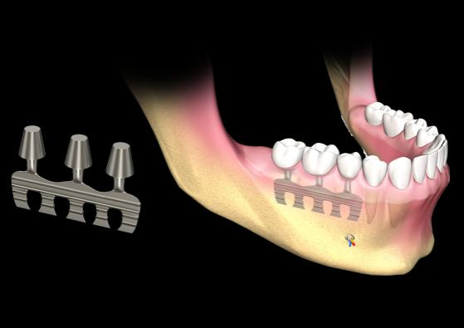

Slide 8
Pins :
Three diverging pins were inserted either transgingivally or after reflection of mucoperiosteal flaps in holes drilled by spiral drills.
At the point of convergence, the pins were interconnected withcement to ensure the proper stability because of their divergence.

Slide 9
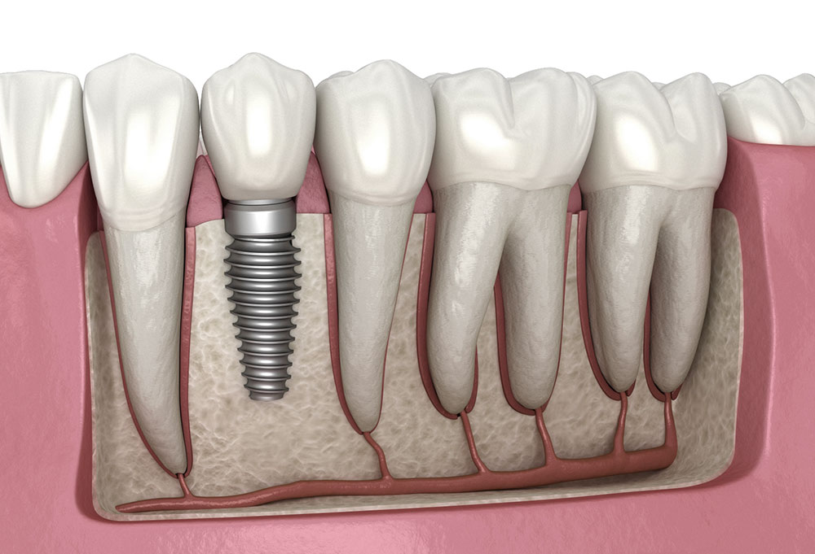

Slide 10
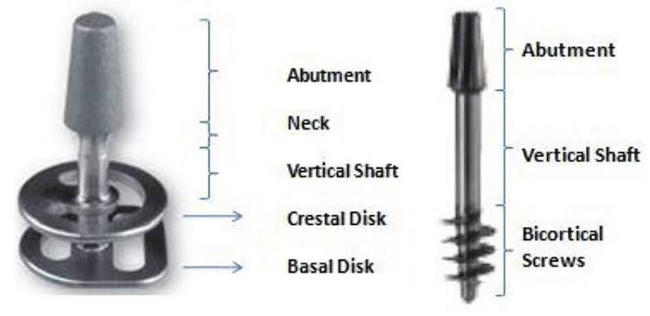
Disk implants
They are rarely used at present.
The concept was developed by Scortecci. It is based on the lateral introduction into the jaw bone of a pin with a disk on top.
Once introduced into the bone volume, the implant has strong retention against extraction forces.

Slide 11
Cylindrical implants
Hollow
Full cylindrical
Straumann and co workers introduced hollow cylinders in mid 1970s
.• Implant stability would benefit from the large bone to implant surfaces provided by means of the hollow geometry.
Holes (vents) favour the ingrowth of bone to offer additional fixation
Full cylindrical implants were used by Kirsch and becameavailable under the name of IMZ.•
The long term survival rates were unacceptable, leading limited use of this implant type currently.

Slide 12
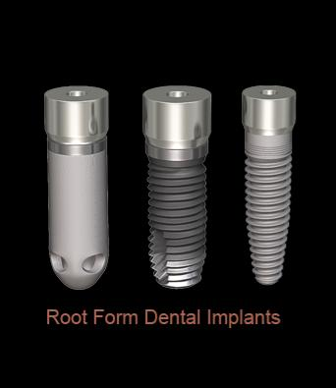

Slide 13
Transmandibular implants
They were developed to retain the dentures in the edentulous lower jaw.•
The implant was applied through submandibular skin incision.“
staple bone" implant developed by Small, consisted of a splint adapted to the to lower border of mandible.
erDr. Firos other model introduced by Bosker ,has two metal splints,one below the lower border of mandible and one intraorally to connect four post piercing through soft tossues

Slide 14
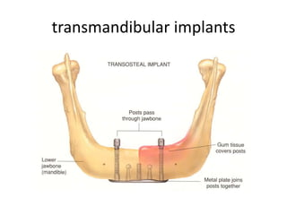

Slide 15
Subperiosteal implants
They are customized according to plaster model derived from an impression of the exposed jawbone, prior to the surgery planned for implant insertion.
They are designed toretain the overdenture.
They are rarely used.
It was used In treatment of atrophic mandible.

Slide 16
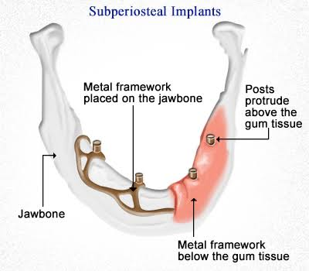

Slide 17
Implant surface characteristics (micro design)
Biomechanics involved in Implantology includes
The nature of the biting forces on the implants
Transferring of the biting forces to the interfacial surfaces
The interfacial tissue reaction
Surface plays an important role in biological interactions. Surface modifications have been applied to metallicbiomaterials in order to improve the
Mechanical ,Chemical, Physical properties such as
- Wear resistance
-Corrosion resistance
-Biocompatibility and surface energy, etc.

Slide 18
Additive process –
It modifies the microstructure and chemical nature of the implant surface by adding materials to existing surface.
Materials which can be used are
Surface coatings
Carbon, glass, ceramic coating
Hydroxyapatite coating
Ca-P coating
Composite coating
Titanium Nitride coating
Titanium plasma spraycoating
Titania film coatingAdditive

Slide 19
Subtractive processes
It modifies the microstructure and chemical nature of implant by removing or altering the existing surface.
The roughness of implant surface can be modifies by
- Sand blasting
-Machining
- Dual acid etched technique

Slide 20
Micro rough surfaces•
Better bone apposition
Higher percentage of bone in contact with the implant•
Influence the mechanical properties of the interface
Stress distribution
Bone remodelling

Slide 22
Osseointegration•
Defined as direct bone deposition on the implant surface. Characterized by structural and functional connection between ordered, living bone and the surface of a load-bearing implant without intervening soft tissue
• Compared to as direct fracture healing, in which the fragment ends become united by bone, without intermediate fibrous tissue or fibrocartilage formation.

Slide 23
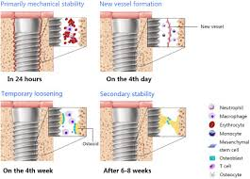

Slide 24
Prerequisites for osseointegration
Material and surface properties
Primary stability and adequate load
Stages
incorporation by woven bone formation;4 to 6 weeks
adaptation of bone mass to load (lamellar and parallel-fibered bone deposition); and Second month
adaptation of bone structure to load (bone remodeling).Third month

Slide 25
Formation of woven bone
The first bone tissue formed is woven bone characterized by a random, felt-like orientation of its collage fibrils, numerous, irregularly shaped osteocytes and, at the beginning, a relatively low mineral density.
It grows by forming a scaffold of rods and plates and thus is able to spread out into the surrounding tissue at a relatively rapid rate

Slide 26
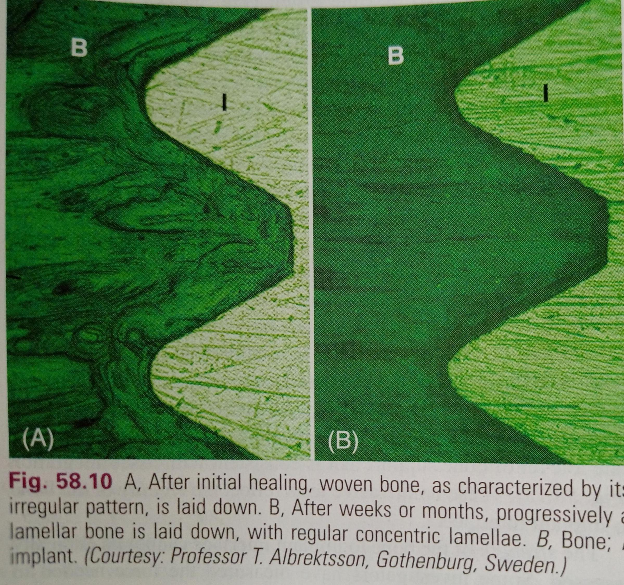

Slide 27
Adaptation of bone mass to load
(deposition of parallel-fibered and lamellar bone)
lamellar bone, or towards an equally important but less known modification called parallel- fibered bone
Three surfaces qualified for deposition of fibered and lamellar bone
Woven bone formed in the first period of OG
Pre-existing or pristine bone surface
The implant surface

Slide 28
1.Woven bone
Deposition of more mature bone on the initially formed scaffold results in reinforcement and often concentrates on the areas where major forces are transferred from the implant to the surrounding original bone.
2. Pre-existing or pristine bone
The trabeculae become necrotic due to the temporary interruption of the blood supply at surgery. Reinforcement by a coating with new, viable bone compensates for the loss in 60 bone quality (fatigue), and again may reflect the preferential strain pattern resulting from functional load.
3. Implant surface
Bone deposition in this site increases the bone-implant interface and thus enlarges the load-transmitting surface. Extension of the bone-implant interface and reinforcement of pre-existing and initially formed bone compartments are considered to represent an adaptation of the bone mass to load.

Slide 29
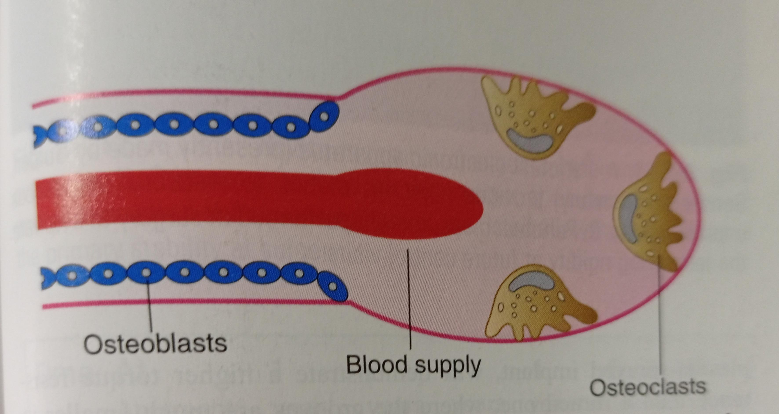
Adaptation of bone structure to load
(bone remodeling and modeling)
Last stage of OGI
starts around the third month and, after several weeks of increasingly high activity, slows down again, but continues for the rest of life
Remodeling starts with osteoclastic resorption, followed by lamellar bone deposition. Resorption and formation are coupled in space and time.

Slide 30
The cutting cone advances with a speed of about 50 pm per day, and is followed by a vascular loop, accompanied by perivascular osteoprogenitor cells.
Remodeling in the third stage of osseointegration contributes; toan adaptation of bone structure to load in two ways: •
It improves bone quality by replacing pre-existing, necrotic bone and/or initially formed, more primitive woven bone with mature, viable lamellarbone
.It leads to a functional adaptation of the bone structure to load by changing the dimension and orientation of the supporting elements.

Slide 31
Soft tissue consideration:
The healthy soft, keratinized tissues facing teeth and implants frequently have a pink color and a firm consistency.
The two tissues have several microscopic features in common. The gingiva as well as the keratinized, peri-implant mucosa is lined by a well-keratinized oral epithelium that is continuous with a junctional epithelium that is about 2 mm long.
The interface between epithelial cells and the titanium surface is characterized by the presence of hemi desmosomes and abasal lamina.
Capillary loops in the C/T under the junctional and sulcular epithelium around implant appear normalThe thickness of the epithelium is 0.5mm

Slide 32
The average direction of the collagen fiber bundles of thegingiva is parallel with the implant.
Even if perpendicular then they are never embedded as in the case of dentogingival and dentoperiosteal fibers around the teeth.•
The fiber bundles also have cuff like orientation - soft tissueseal around the implant.
The vascular supply of the peri implant gingival or oral alveolar mucosa is more limited than that around natural teeth.

Slide 33
