Slide 1


Slide 2
Classification of Periodontal Diseases
Presented by
Dr. Trupti Giri

Slide 3
Classification –
Definition- Classification is the systematic collection of data or knowledge and its arrangement in sequential manner in order to facilitate its understanding or knowledge.

Slide 4
Need for classification-
It allows for logical and systematic separation and organization of knowledge about the disease, so that one may reason.
From the signs and symptoms seen in patient to presumed etiological history.
Form the presumed etiological history to identification of the condition
Form there to the prescribed course of treatment.

Slide 5
Uses-
To understand the etiology and pathology of the disease
For logical, systematic separations and organization of knowledge about disease.
For purpose of diagnosis, prognosis and treatment planning.
Helps to communicate among clinicians, epidemiologists, public health workers.

Slide 6
Where were we?
juvenile periodontitis (prepubertal, localized and generalized);
early-onset periodontitis (formally prepubertal, juvenile and rapidly
progressive);
adult periodontitis;( This classification system is heavily age
dependent: a cut-off point of 35 Years)
acute necrotizing ulcerative periodontitis;
refractory periodontitis.

Slide 7
Where are we now?
The following changes were implemented:
Gingival disease category introduced.
‘Adult periodontitis’ replaced by ‘chronic periodontitis’.
‘Refractory disease’ category removed.
‘Early-onset periodontitis’ replaced by ‘aggressive periodontitis’.
The implications of systemic diseases on periodontal status were
expanded and more comprehensively defined.
‘Necrotizing periodontal diseases’ were introduced to cover both
‘necrotizing periodontitis’ and ‘necrotizing gingivitis’.
‘Periodontal abscess’ and ‘periodontal-endodontic’ lesions were added.
A category for developmental or acquired lesions was introduced.

Slide 8
History
Calssification of various forms of periodontitis
AAP World Workshop in Clinical
Periodontics (1988)
European Workshop in Periodontology
(1993)
AAP International Workshop for
Classification of Periodontal
Diseases(1999)

Slide 9
AAP World workshop in Clinical PERIODONTICS-(1988)
FORMS OF PERIODONTITIS DISEASE CHARCTERISTICS
1) Adult periodontitis- Age of onset >35 years, slow rate of disease
progression, no defects in host defenses
2) Early-onset periodontitis (may be prepubertal, juvenile or rapidly progressive) -Age of onset <35 years, rapid rate of disease progression, defects in host defenses,associated with specific microflora.
3) Periodontitis associated with systemic disease -Systemic Diseases that predispose Rapid rate of periodontotitis Diseases:diabetes, down’s
syndrome, HIV infection.
4) Necrotizing ulcerative periodontitis -Similar to ANUG but with associated clinical attachment loss.
5) Refractory periodontitis Recurrent, periodontitis that does not
respond to treatment.

Slide 10
European workshop in Clinical PERIODONTICS- (1993)
FORMS OF PERIODONTITIS DISEASE CHARCTERISTICS
Adult periodontitis Age of onset:4th decade of life, slow rate of disease progression, no defects
in host response.
Early-onset periodontitis Age of onset : before 4th decade of life, rapid rate of disease progression,
defects in host response.
Necrotizing periodontitis Tissue necrosis with attachment and bone loss.

Slide 11
AAP International Workshop For Classification of PERIODONTAL DISEASES
Chronic Periodontitis
Aggressive Periodontitis
Periodontitis as a manifestation of Systemic Diseases.

Slide 12
Classification of Periodontological Diseases
Gingival Diseases
A. Dental plaque-induced gingival diseases
B. Non-plaque-induced gingival lesions
Periodontal Diseases.
A. Chronic periodontitis
B. Aggressive periodontitis
C. Periodontitis as a manifestation of systemic diseases
D. Necrotizing periodontal diseases
E. Abscesses of the periodontium
F. Periodontitis associated with endodontic lesions
G. Developmental or acquired deformities and conditions

Slide 13
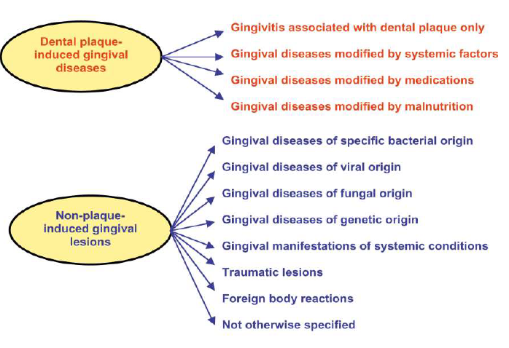
Gingival Diseases

Slide 14
Non-plaque induced Gingival Diseases
1. Gingival diseases of specific bacterial origin
a. Neisseria gonorrhoea-associated lesions
b. Treponema pallidum-associated lesions
c. streptococcal species-associated lesions
d. other
2. Gingival diseases of viral origin
a. herpes virus infections
1) primary herpetic gingivostomatitis
2) recurrent oral herpes
3) varicella-zoster infections
b. other

Slide 15
3. Gingival diseases of fungal origin
A) candidal infections
1) generalized gingival candidosis
b. linear gingival erythema
c. histoplasmosis
d. other
4. Gingival lesions of genetic origin
a. hereditary gingival fibromatosis
b. other

Slide 16
5. Gingival manifestations of systemic conditions
A) mucocutaneous disorders
1) lichen planus
2) pemphigoid
3) pemphigus vulgaris
4) erythema multiforme
5) lupus erythematosus
6) drug-induced
7) other

Slide 17
B) allergic reactions
1) Dental restorative materials
a) mercury
b) nickel
c) acrylic
d) other
2) Reactions attributable to
a) toothpastes/dentifrices
b) mouthrinses/mouthwashes
c) chewing gum additives
d) foods and additives

Slide 18
6) Traumatic lesions (factitious, iatrogenic,
accidental)
a. chemical injury
b. physical injury
c. thermal injury
7) Foreign body reactions

Slide 19
PERIODONTITIS
THE DISEASES PERIODONTITIS CAN BE SUBCLASSIFIED
INTO THE FOLLOWING THREE MAJOR TYPES BASED ON
CLINICAL ,RADIOGRAPHIC, HISTORICAL ,AND
LABORATORY CHARACTERISTICS:
• CHRONIC PERIODONTITIS
Chronic periodontitis is a common disease of the oral cavity consisting of chronic inflammation of the periodontal tissues that is caused by accumulation of profuse amounts of dental plaque.

Slide 20
THE FOLLOWING CHARACTERISTICS ARE
COMMON TO PATIENTS WITH CHRONIC
PERIODONTITIS:
• Prevalent in adults but can occur in children.
• Slow to moderate rate of progression.
Modified or associated with:
• Systemic diseases such as diabetes mellitus and HIV infection.
• Environmental factors such as cigarette smoking and emotional stress.
• Local factors predisposing to periodontitis

Slide 21
Classification of Chronic Periodontitis
Localized form
Generalized form
Slight form
Moderate form
Severe form

Slide 22
AGGRESSIVE PERIODONTITIS THE FOLLOWING CHARACTERISTICS ARE COMMON TO PATIENTS WITH AGGRESSIVE PERIODONTITIS:
• RAPID ATTACHMENT LOSS AND BONE DESTRUCTION
• AMOUNT OF MICROBIAL DEPOSIT INCONSITENT WITH DISEASE SEVERITY
THE FOLLOWING CHARACTERISTICS ARE
COMMON BUT NOT UNIVERSAL :
• Diseased sites infected with actinobacillus
actinomycetemcomitans
• Increased prostaglandins and interleukins

Slide 23
1. CLASSIFICATION OF AGGRESSIVE
PERIODONTITIS:
A. LOCALIZED FORM
B. GENERALISED FORM
LOCALIZED FORM
• Localized first molar or incisor disease with proximal
attachment loss at least two permanent teeth ,one of
which is a first molar.
GENERALISED FORM
• Usually affecting persons under 30 years of age.
• Generalised proximal attachment loss affecting at least
three teeth other than first molars and incisors.
• Poor serum antibody response to infecting agents.

Slide 24
Periodontitis As manifestations of systemic conditions
A. Associated with hematological disorders
1. Acquired neutropenia
2. Leukemias
3. Other
B. Associated with genetic disorders
1. Familial and cyclic neutropenia
2 Down syndrome
3. Leukocyte adhesion deficiency syndromes
4. Papillon-Lefèvre syndrome
5. Chediak-Higashi syndrome

Slide 25
6. Histiocytosis syndromes
7. Glycogen storage disease
8. Infantile genetic agranulocytosis
9. Cohen syndrome
10. Ehlers-Danlos syndrome
11. Hypophosphatasia

Slide 26
Developmental or Acquired Deformaties And conditions
A. Localized tooth-related factors that modify or predispose to plaque-induced gingival diseases/periodontitis
1. Tooth anatomic factors
2. Dental restorations/appliances
3. Root fractures
4. Cervical root resorption and cemental tears

Slide 27
B. Mucogingival deformities and conditions around teeth
1. Gingival/soft tissue recession
• facial or lingual surfaces
• interproximal (papillary)
2. Lack of keratinized gingiva
3. Decreased vestibular depth
4. Aberrant frenum/muscle position
5. Gingival excess
• pseudopocket
• inconsistent gingival margin
• Excessive gingival display
• gingival enlargement
6. Abnormal color

Slide 28
C. Mucogingival deformities and
conditions on edentulous ridges
1. Vertical and/or horizontal ridge deficiency
2. Lack of gingiva/keratinized tissue
3. Gingival/soft tissue enlargement
4. Aberrant frenum/muscle position
5. Decreased vestibular depth
6. Abnormal color
D. Occlusal trauma
1. Primary occlusal trauma
2. Secondary occlusal trauma

Slide 29
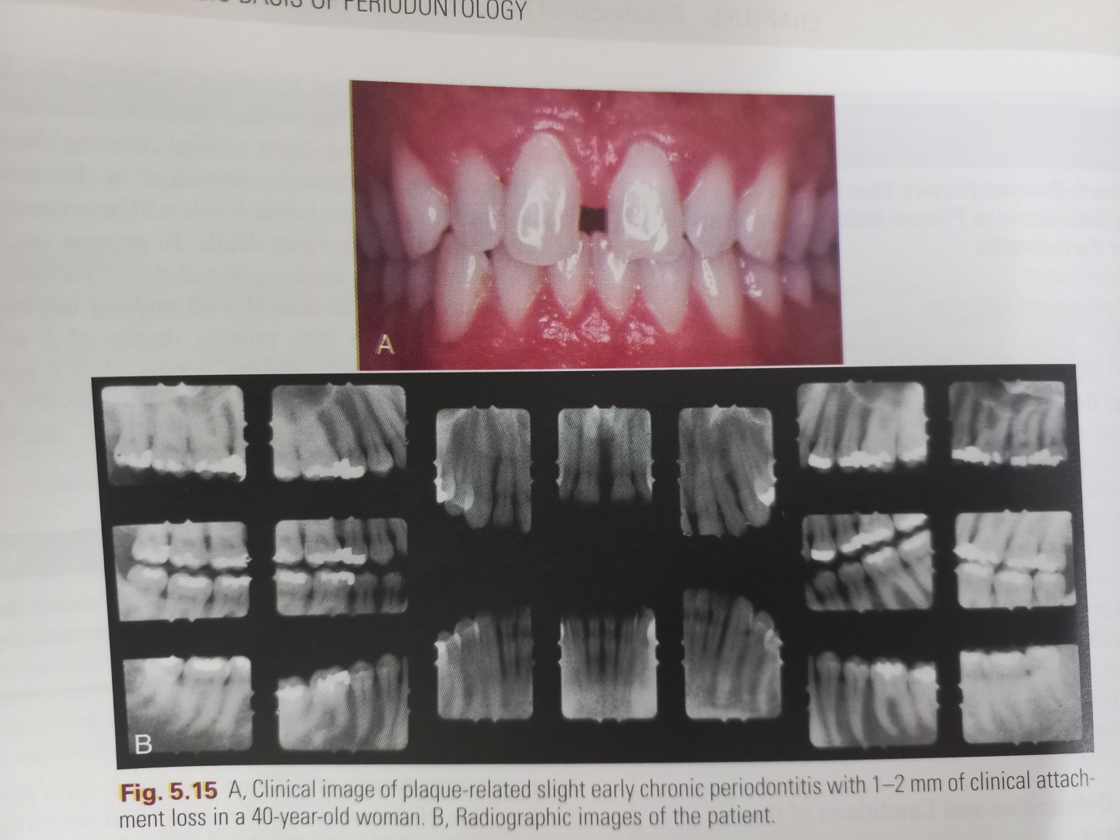

Slide 30
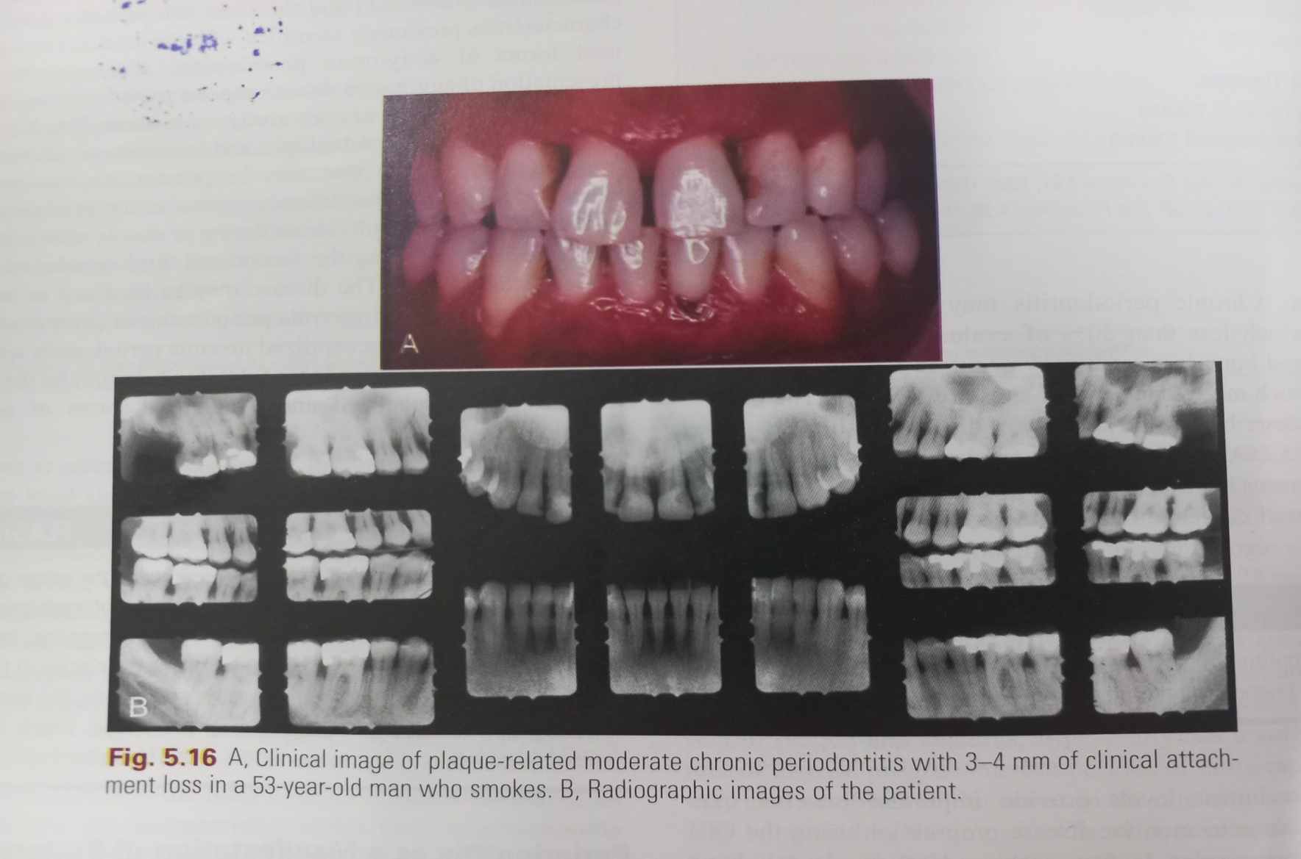

Slide 31
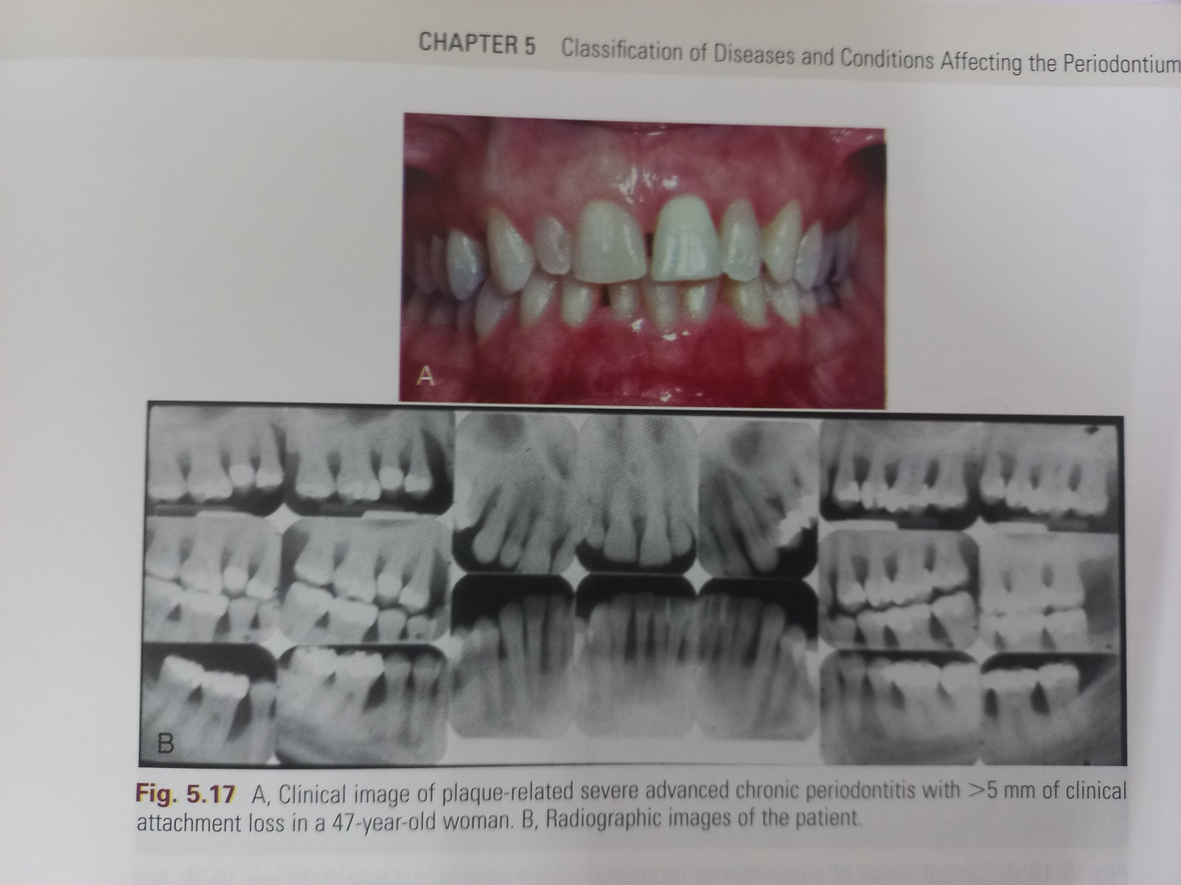

Slide 32
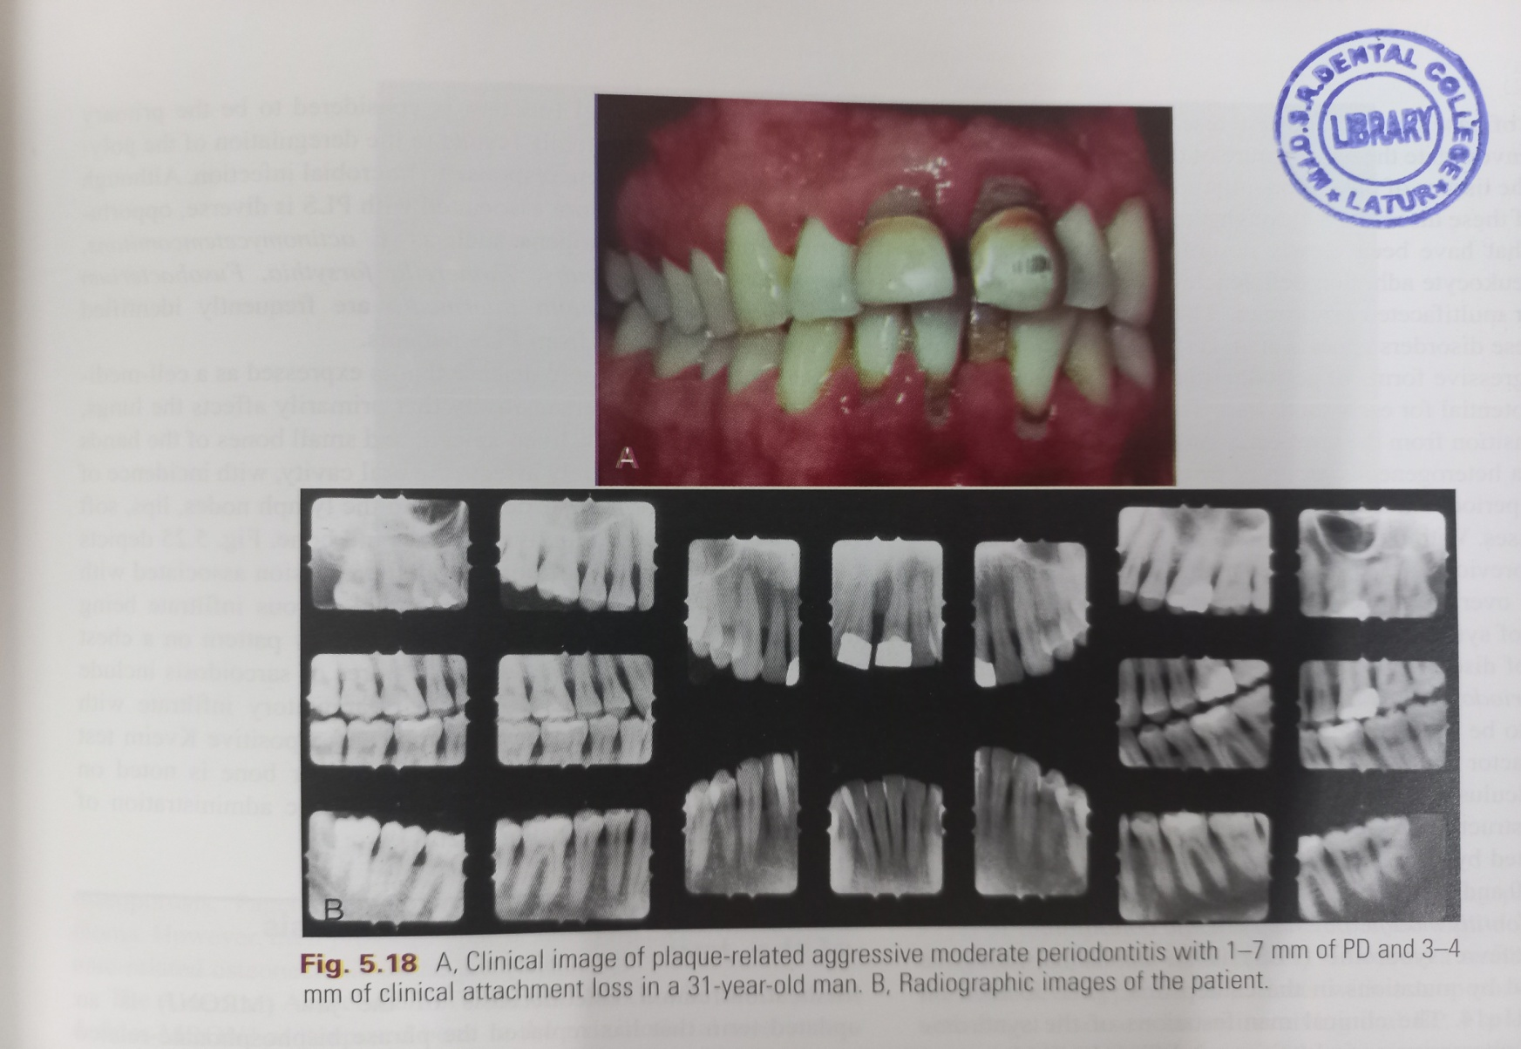

Slide 33
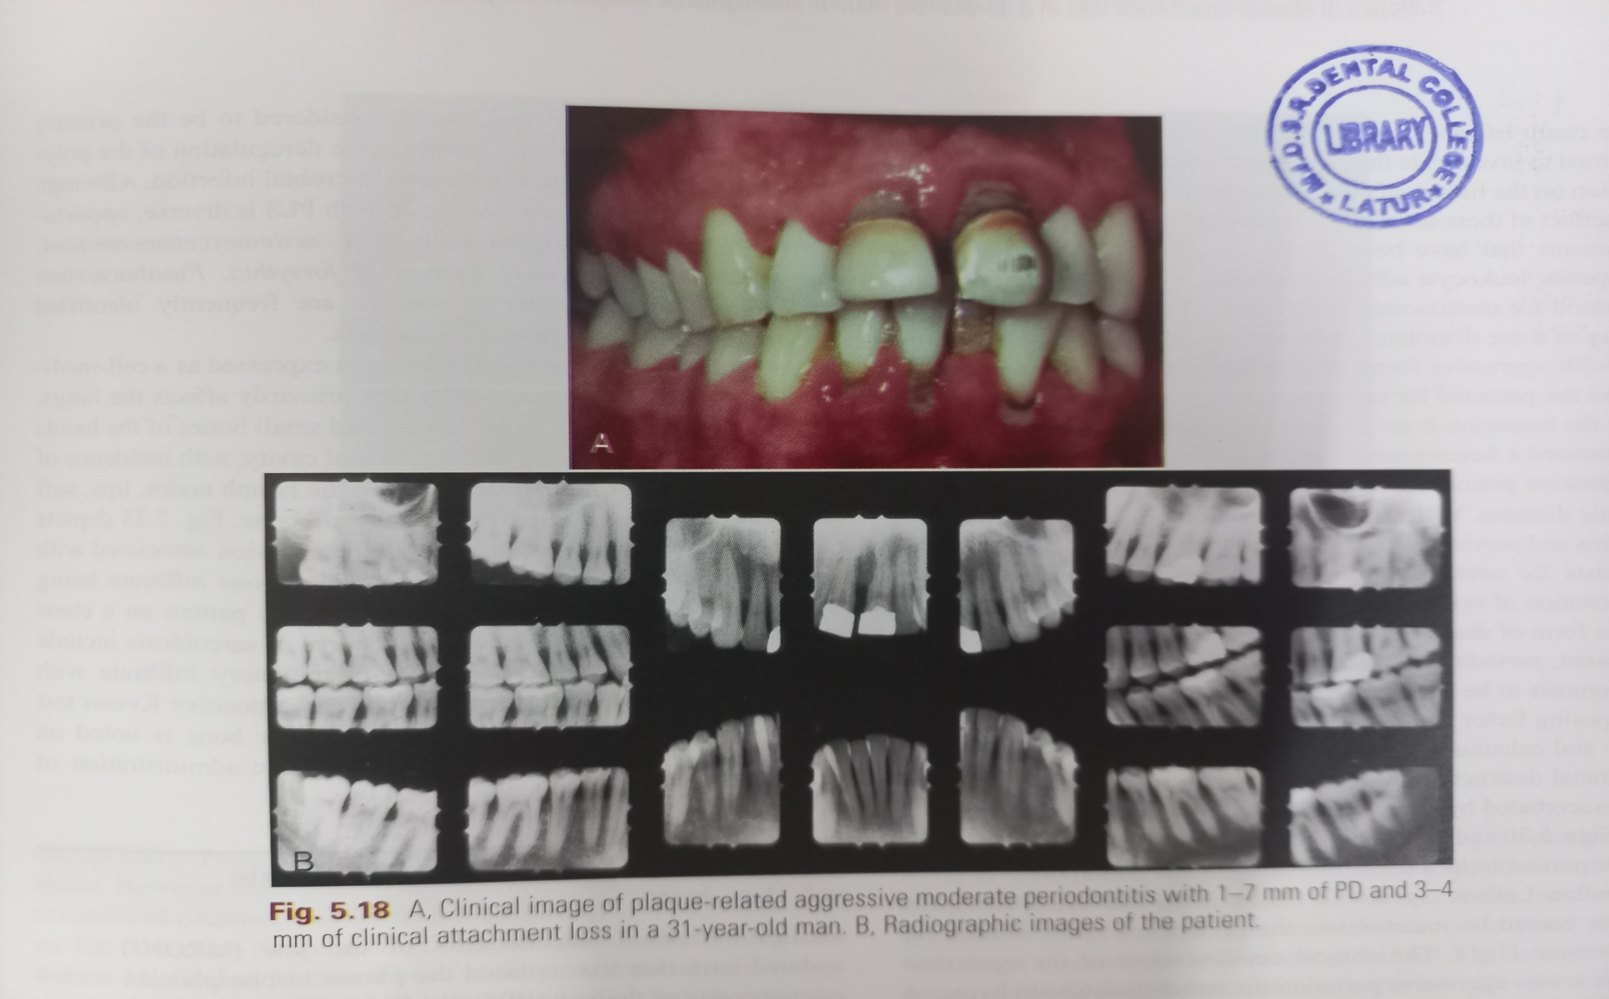

Slide 34
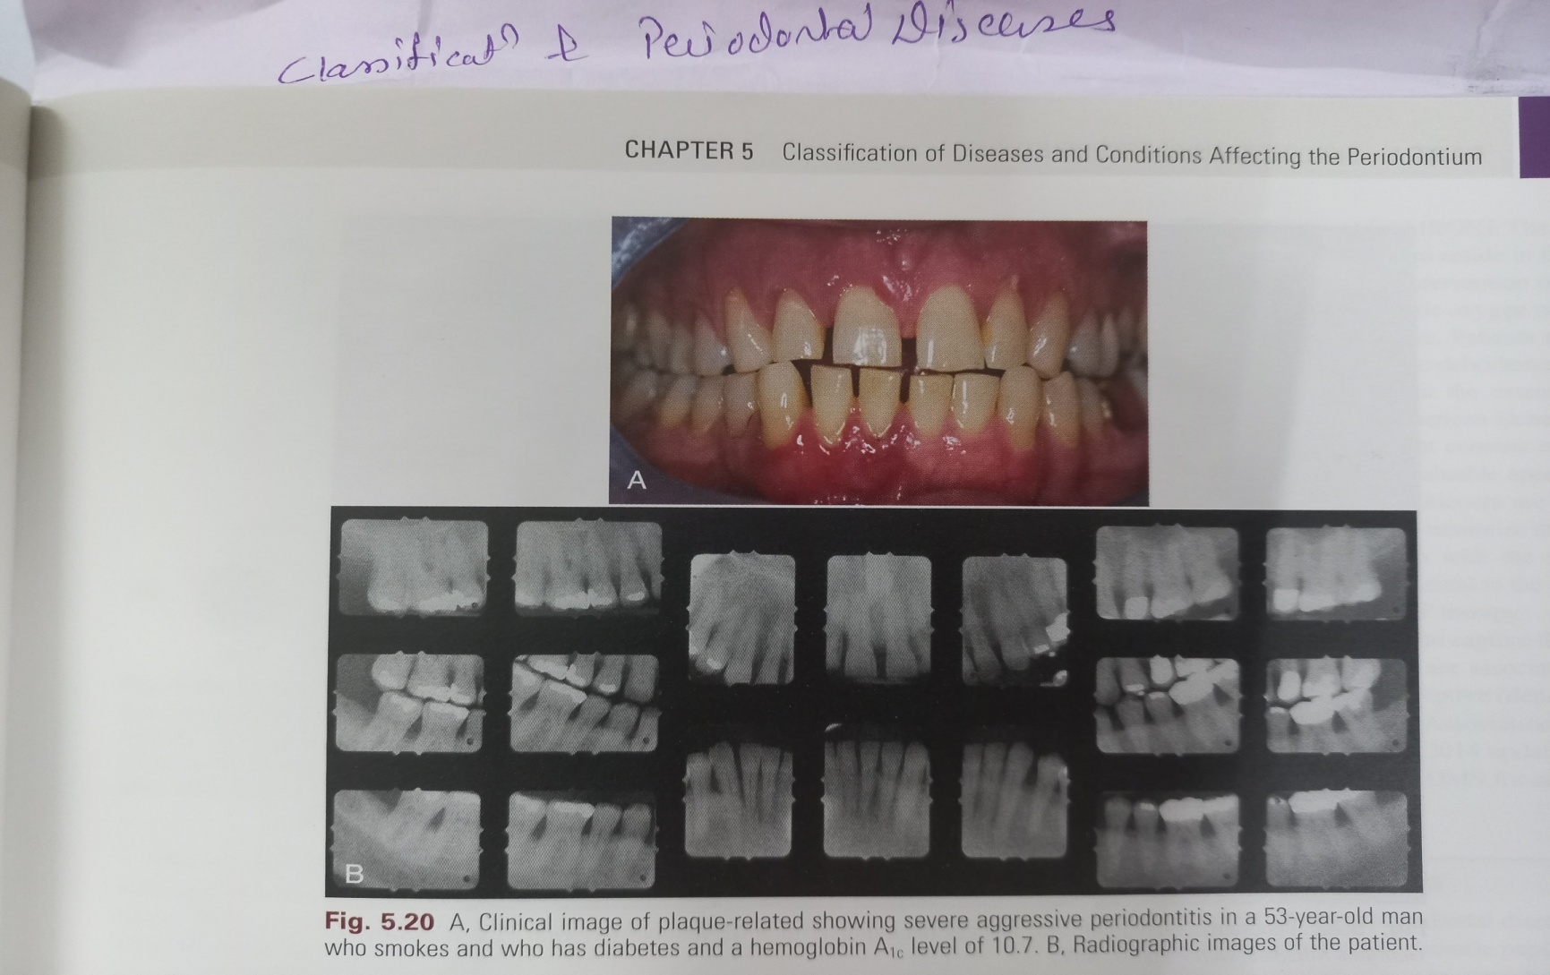

Slide 36
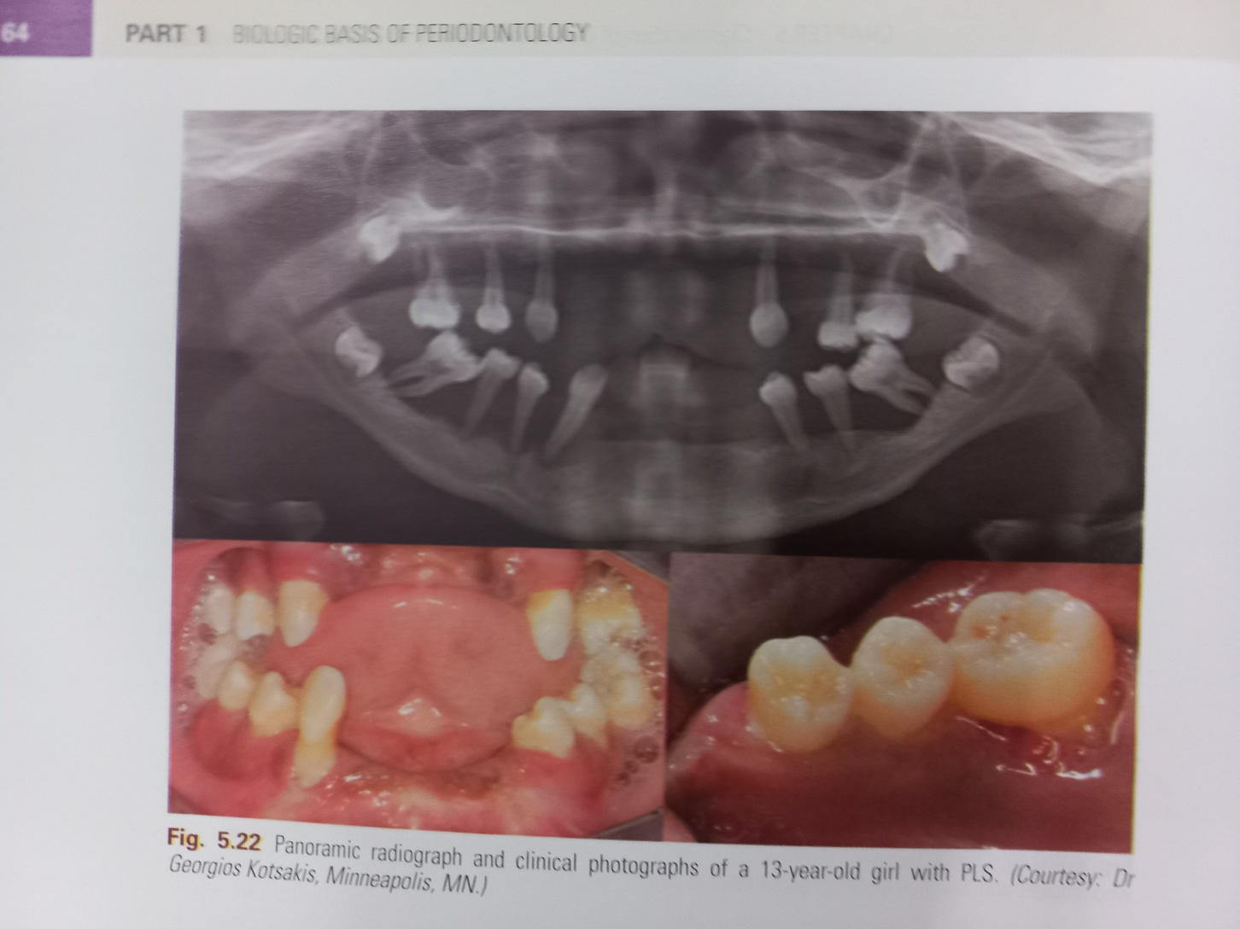

Slide 37
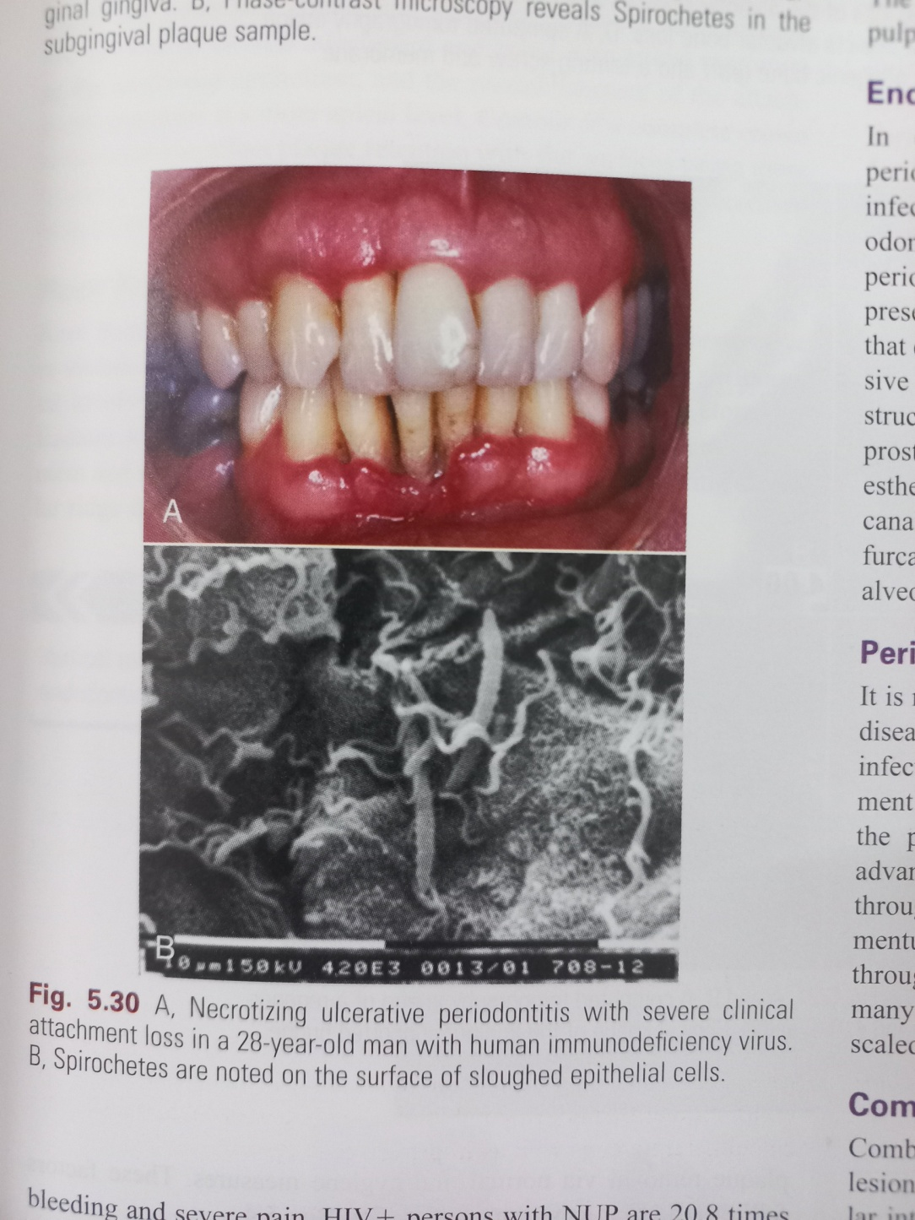

Slide 38
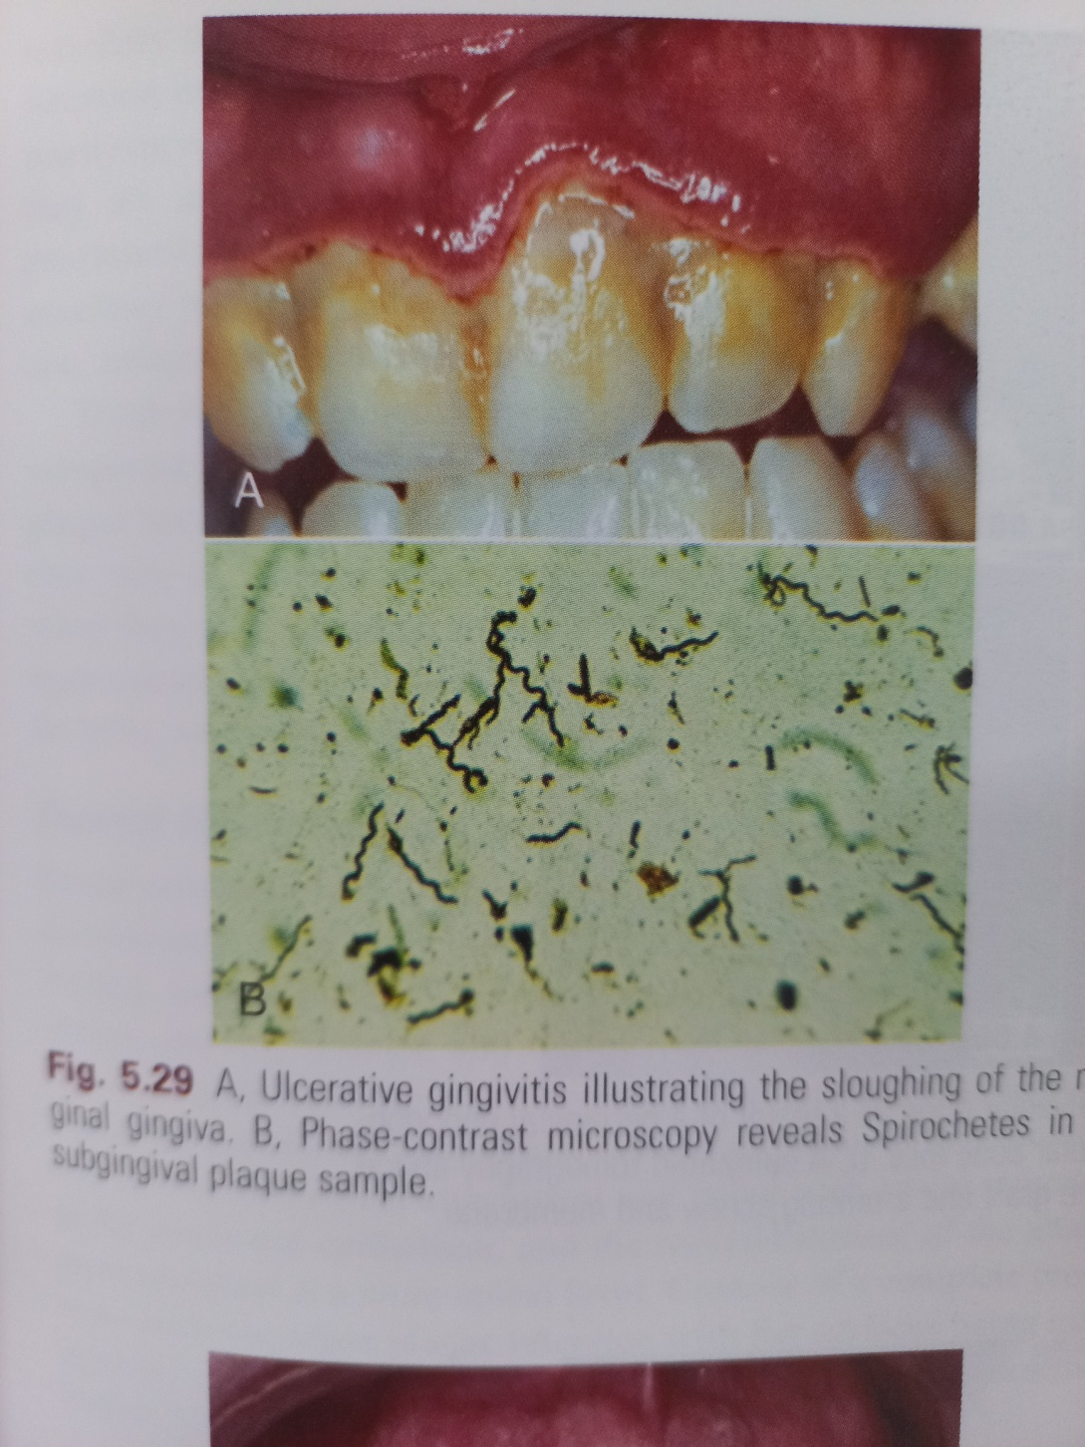

Slide 39


