Slide 1
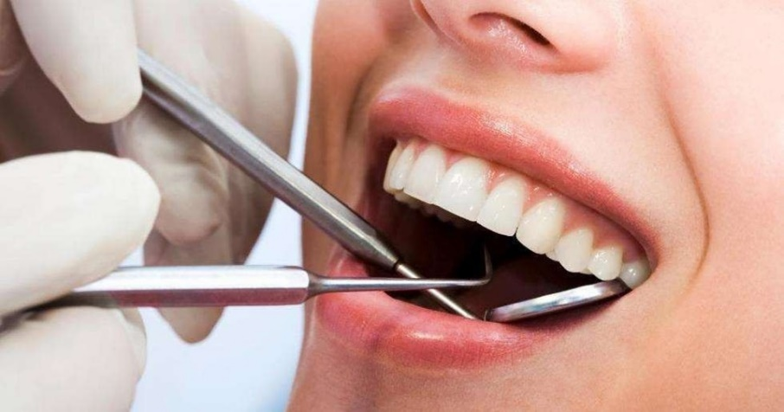
SUPPORTIVE PERIODONTAL THERAPY
MAINTENANCE PHASE RECALL/RE-EVALUATION
SUPERVISED RE-CALL PROGRAMME
PRESENTED BY:
KURESHI NAVAL ANJUM

Slide 2
DEFINITION
Procedures performed at selected intervals to assist the
periodontal patient in maintaining oral health. _{-GPT 2001.}
Therapeutic measures to support the patient’s own efforts to
control and to avoid re‐infection. _{- Jan Lindhe.}

Slide 3
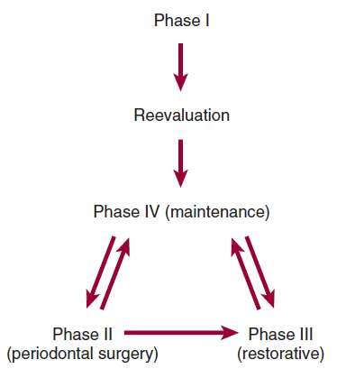
CORRECT SEQUENCE OF TREATMENT

Slide 4
RATIONALE FOR SPT
Limitation of mechanical subgingival debridement
Recolonization of pocket
Long JE (weak attachment)
Subgingival scaling alters the microflora of periodontal
pockets
To prevent interception

Slide 5
GOALS OF SPT
3 main goals according to the AAP position paper (1998)
To prevent or minimize the recurrence and progression of periodontal disease in patients who have been previously treated for gingivitis, periodontitis and for peri-implantitis.
To prevent or reduce the incidence of tooth loss by monitoring the dentition
To locate and treat other diseases or conditions found in the oral cavity in a timely manner

Slide 6
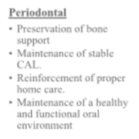
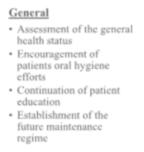
OBJECTIVES OF SPT
Periodontal
Preservation of bone
support
Maintenance of stable CAL.
Reinforcement of proper
home care.
Maintenance of a healthy and functional oral environment
General
Assessment of the general
health status
Encouragement of patients oral hygiene efforts
Continuation of patient education
Establishment of the future maintenance regime

Slide 7
Schallhorn and Snider (1981)
Preventive maintenance therapy
Periodontally healthy individuals.
Trial maintenance therapy
Mild to moderate periodontitis
Compromised maintenance therapy
Medically compromised patients where active
therapy is not possible.
Post-maintenance treatment therapy
maintenance for prevention of recurrence of disease
TYPES OF SPT

Slide 8
MAINTENANCE PROGRAM (CARRANZA)
1. Examination and Evaluation (14 mins.)
2. Maintenance R_{x} and oral hygiene
reinforcement (36 mins.)
SPT
3. Report, Cleanup, and Scheduling (10 mins.)

Slide 9
PART- 1: EXAMINATION AND EVALUATION
Patient greeting
Medical history changes
Oral hygiene status
Gingival changes
Pocket depth changes
Mobility changes
Occlusal changes
Dental caries
Oral pathologic examination
Restorative, prosthetic, and implant status
Examination of prosthesis/abutment components;
Evaluation of
implant stability;
Occlusal examination;
Other signs and symptoms of disease activity.

Slide 10
RADIOGRAPHIC EXAMINATION OF RECALL PATIENTS
Clinical caries or high-risk
factors for caries
Posterior bite-wing examination at
12 to 18-month intervals.
Periodontal disease not under good
control.
Root form
Periapical and/or vertical bite-wing radiographs of problem areas every 12 to 24 months; full-mouth series every 3 to 5 years
dental implants
Periapical or vertical bite-wing radiographs at 6, 12, and 36 months after prosthetic placement, then every 36 months unless clinical problems arise.
Clinical caries and no high-risk factors for caries.
Posterior bite-wing examination at 24 to 36-month intervals.
History of periodontal treatment with
disease under good control.
Bite-wing examination every 24 to 36 months; full- mouth series every 5 years.

Slide 11
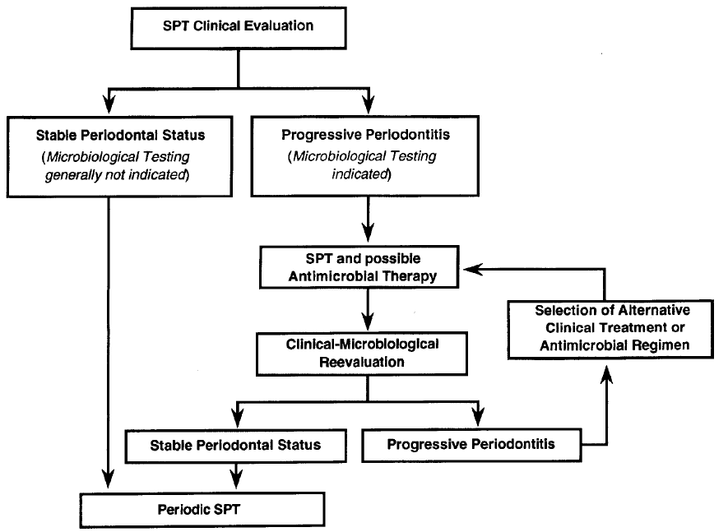
MICROBIAL TESTING

Slide 12
PART-2: MAINTENANCE TREATMENT AND ORAL HYGIENE REINFORCEMENT
Oral hygiene reinforcement
Scaling
Polishing
Chemical irrigation or site-specific antimicrobial placement

Slide 13
PART-3: REPORT, CLEANUP, AND SCHEDULING
Write report in chart.
Discuss report with patient.
Clean and disinfect operatory.
Schedule next recall visit.
Schedule further periodontal treatment.
Schedule or refer for restorative or prosthetic treatment.

Slide 14
FREQUENCY OF SPT
Ramfjord et al. (1993) For most patients with gingivitis but no previous attachment loss, supportive periodontal treatment twice a year.
For patients with a previous history of periodontitis, 3 months interval (less than 6 months)
Various clinical trails suggest- four times a year.

Slide 15
December 2015

Slide 16
CLASSIFICATION OF POST-TREATMENT PATIENTS (MERIN)

Slide 18
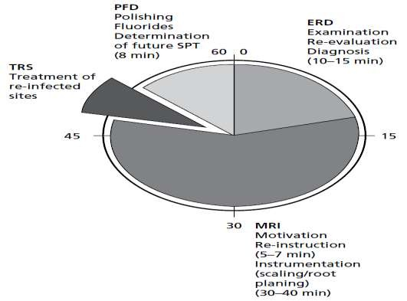
SPT PROGRAMME (LINDHE)

Slide 19
EFFECTIVENESS OF SPT (FOR PATIENTS WITH GINGIVITIS)
Axelsson and Lindhe (1974-1976): demonstrated that gingivitis could be prevented by regular professional cleaning in children aged 7 to 14 years.
Axelsson and Lindhe (1981): reduced caries and BOP
Badersten et al.(1990): Routine mechanical subgingival debridement of shallow bleeding sites at SPT visits results in attachment loss.

Slide 20
Gingival conditions improved by 60% and tooth loss was reduced by about 50% (Lovdal et al. 1961)
The mean loss of probing attachment was only 0.08 mm per surface as opposed to 0.3 mm in the control group
(Suomi et al. 1971).

Slide 21
EFFECTIVENESS OF SPT (FOR PATIENTS WITH PERIODONTITIS)
Nyman et al. (1977) reported on 25 patients for 2 years (No SPT)
Regular SPT at 3-4 times a year allows disease monitoring Early detection and Rx
Nyman et al. (1975)
Test OHI and SPT
2 weeks
Control OHI and SPT
6 months

Slide 22
Dahlen et al. (1992) Professionally delivered supragingival toothcleaning, in combination with self-performed plaque control for 2-year period effectively change the quantity and the composition of the subgingival microbiota
Hellstrom et al. (1996) same protocol has a significant effect on the subgingival microbiota of moderate to deep periodontal pockets clinically.

Slide 23
(Lindhe & Nyman 1984)
75 patients with extremely advanced periodontitis,
recurrent infection occurred in only very few sites during a 14‐year period of effective SPT.
recurrent periodontitis was noted at completely unpredictable time intervals, in about 25% of the patient population (15 of 61)

Slide 24
30‐YEARS PLAQUE‐CONTROL-BASED MAINTENANCE PROGRAM
Axelsson et al. 2004
375 test and 180 control
The test group- prophylactic visits every second month for the first 2 years and every 3–12 months (according to their individual needs) over 3–30 years
very few teeth were lost (0.4–1.8)
1.2–2.1 new carious lesions (>80% secondary caries) 2–4% of all sites exhibited attachment loss of ≥2 mm.

Slide 25
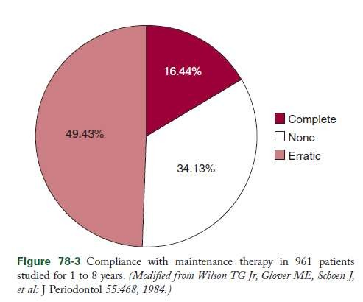
COMPLIANCE AFFECTING SPT
Wilson stated that “Patients who comply to suggested recall visits are periodontally healthy and keep their teeth
longer.”

Slide 26
IMPROVING COMPLIANCE
Wilson suggests:
Counselling them about their condition, the role of treatment and the importance of compliance
Simplify instructions to patients
Teach them self performed plaque control
Acccommodating patient needs
Positive reinforcement

Slide 27
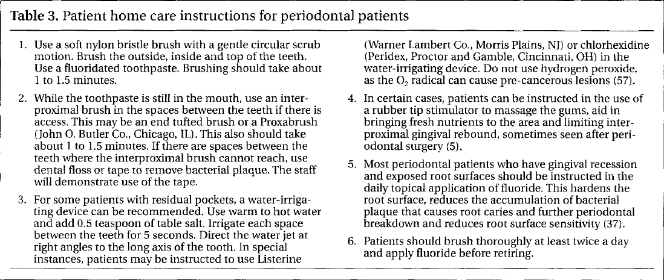
WRITTEN INSTRUCTION

Slide 28
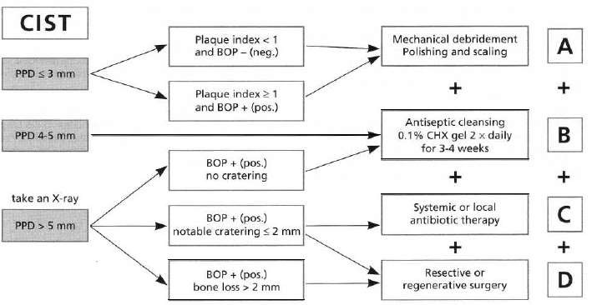
MAINTENANCE OF IMPLANTS
Lang et al. 2004,
Cumulative Interceptive supportive Therapy

Slide 29
MAINTENANCE INTERVALS FOR IMPLANT PATIENTS
Patients with both teeth and implants should see the periodontist as often as necessary to keep the periodontium and peri-implant tissues healthy.
Totally edentulous patients with implants should be
seen at least once per year.

Slide 30
Conclusion and recommendations
SPT should be based on profile of risk assessment
No scientific evidence for subgingival debridement of sites with BOP without concomitant increase in pocket depth. (it should better be avoided)
SPT minimizes the risk of periodontal disease progression and tooth mortality
In absence of long-term evaluation of SPT for dental implants, same principles of SPT that is used for periodontitis is also apropriate

Slide 31
RECOMMENDATION FOR RESEARCH
Studies are needed:
to evaluate the efficacy of supragingival Rx alone as
compared to subgingival debridement
To assess the value of antibiotics as adjunct and stand alone Rx during SPT
Patient based factors must be considered in analysis
Prospective and multicenter studies to findout efficacy of SPT

Slide 32
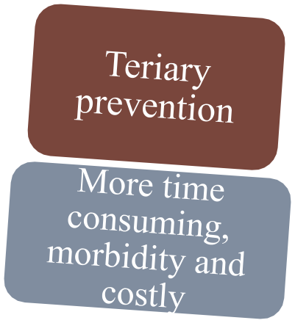
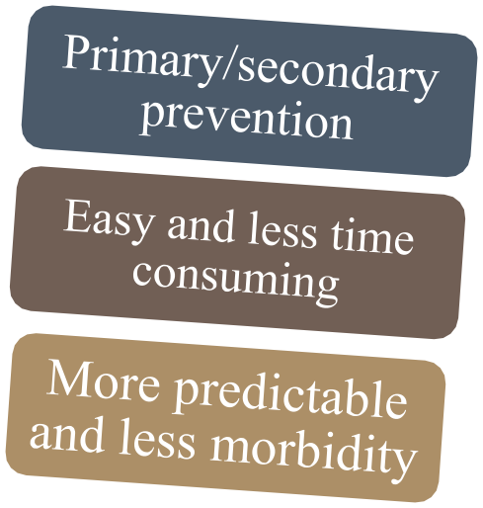
Incterceptives
SPT

Slide 33
REFRENCES:
American Academy of Periodontology. Glossary of Periodontal Terms. 4th ed.
Chicago: American Academy of Periodontology; 2001. p. 39.
Kerry GJ. Supportive periodontal treatment. Periodontology 2000, vol. 9, 1995, 176-185.
Renvert S. Supportive periodontal therapy. Periodontology 2000, vol. 36, 2004,
179–195.
Hancock EB. Preventive strategies and supportive treatment. Periodontology 2000, vol. 25, 2001, 59–76.
Wilson TG Jr. Supportive periodontal treatment introduction - definition, extent of need, therapeutic objectives, frequency and efficacv. Periodontology 2000, vol. 12, 1996, 11-15.
Slots J. Microbial analysis in supportive periodontal treatment. Periodontology 2000. Voz. 12, 1996, 56-59.
Farooqi AO. Appropriate recall interval for periodontal maintenance: A
systematic review. J evid base dent pract 2015;15:171-181.

Slide 34
THANK YOU

