Slide 1
Good morning

Slide 2
Periodontal – Restorative Interrelationship presented by Dipali Balaji Waghmare (Intern)

Slide 3
The relationship between periodontal health & the restoration of teeth is intimate & inseparable. For long term survival of restoration the perio dontium must remain healthy or vice-versa

Slide 4
BIOLOGIC CONSIDERATION
ESTHETIC CONSIDERATIONS
OCCLUSAL CONSIDERATIONS
SPECIAL CONSIDERATIONS

Slide 5
BIOLOGIC CONSIDERATIONS
Margin Placement & Biologic Width:
Biologic Width:
The C\T attachment occupies 1.07mm of space above the crest of alveolar bone &that the junctional epithelium below the base of the gingival sulcus ocupies another 0.97mm of space above the C\T attachment.

Slide 6
Evaluation of Biologic-Width 1) By Radiographs 2) By using a Periodontal probe

Slide 7
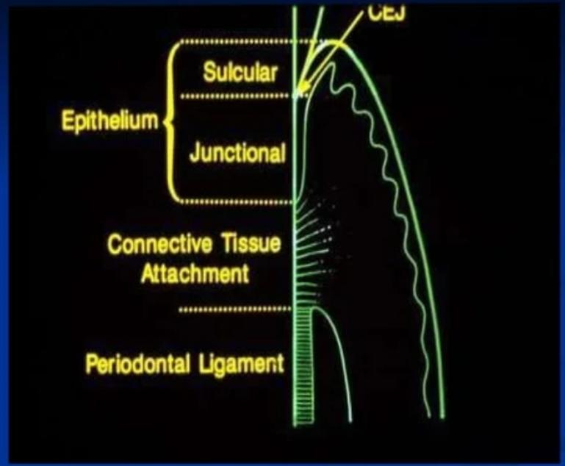

Slide 8
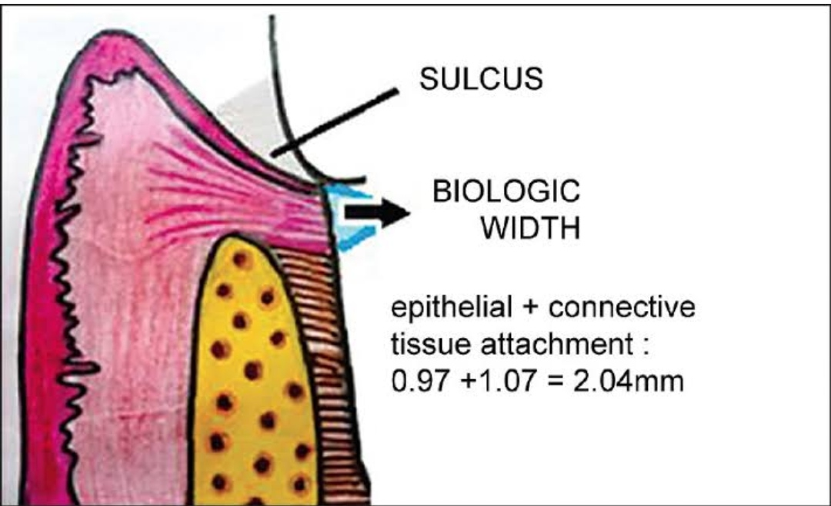

Slide 9
Correction of Biologic-Width Violation 1.SURGICALLY:
By removing bone away from proximity to the restorative margins.
Drawback: High risk of inter papillary recession. 2. ORTHODONTICALLY:
By extruding the tooth out of the socket.
Two Methods
■ By applying low extrusive forces
■ By rapid orthodontic extrusion

Slide 10
Margin Placement
1) Supragingival
2) Equigingival
3) Sub gingival Supra-Gingival Margin Placed in Non-esthetic area Least impact on periodontium Equi-gingival Margin At the crest of marginal gingiva

Slide 11
More impact on periodontium
More plaque retentive-Gingival Inflammtion
Subgingival margin
Below the gingiva Greatest biologic risk May voilates the gingival attachment apparatus

Slide 12
restoration is extended sub-gingivally for ■ For adequete resistance& retention ■ To make significant contact & contour
■To mask the tooth-restoration interface gingivally.
Too Sub-Gingivally located margins may results.....
■ Unpredicted bone loss
■ Gingival tissue recession

Slide 13
Other factors inducing Gingival recesion are ■ Trauma from restorative procedures ■Thickness of gingiva ■ Gingival Form- scalloped\Flat

Slide 14
MARGIN PLACEMENT GUIDELINES i. If the sulcus probes 1.5mm or less,Place the margin 0.5mm below the gingival crest. ii. If sulcus probes more than 1.5mm- Place the margin 1\2 depth of the sulcus below the crest.
iii. If sulcus probes more than 2.0mm, Esp. On facial aspect-Gingivectomy should be done & create a 1.5mm sulcus –Apply Rule No. 1

Slide 15
CLINICAL PROCEDURE ■The Supra-gingival & Sub-gingival margins are very simple to place but the sub-gingival margin placement is rather difficult. ■So, Prior the placement of margin sub-gingivally the preparation should be extended to the free gingival margin facially & inter-proximally. ■The steps are as follows:

Slide 16
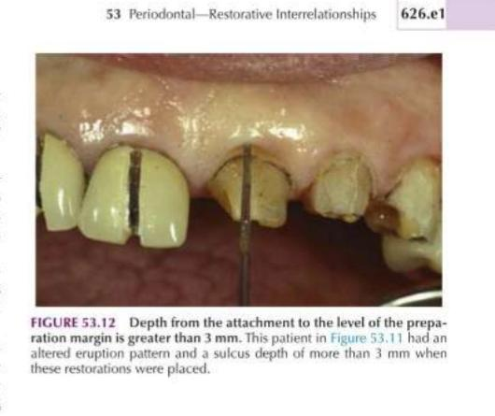
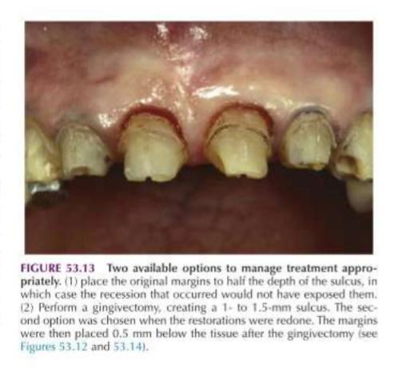

Slide 17
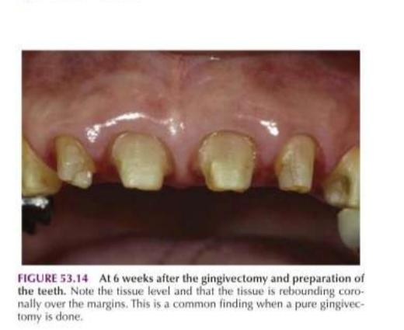

Slide 18
TISSUE RETRATION
For protection from abrasion 2) For proper access BY GINGIVAL RETRACTION CORDS For Rule 1 Margin ■ 2 Cords are used ■ 1 cord is placed 0.5mm below the prepared margin.
■ 2nd Cord is displaces the first cord apically & sits b\w the margin & tissue.

Slide 19
For Rule 2 Margin 1) 2 Large diameter Cords are used. Thick cord is placed for impression. 2) Electro-surgery is necessary to remove overhanging tissues.

Slide 20
This process: 1) Protects the tissues 2) Creates the correct axial reduction Establishes a desired sub-gingival level margin.

Slide 21
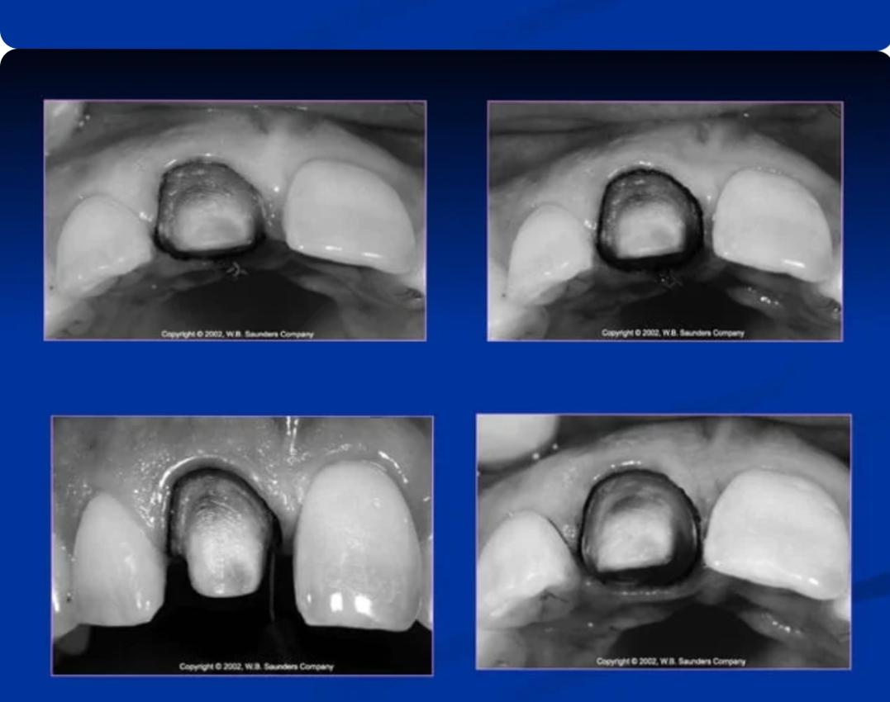

Slide 24
PROVISIONAL RESTORATION 3 Critical areas which must be appropriate to maintain the health & position of the Gingival tissues: 1. Marginal Fit 2. Contour 3.Surface finish

Slide 25
Poorly adapted margins, Over contoured or under contoured restoration & Rough or Porous surface can cause: ■ Inflammation ■Gingival Recession ■ Overgrowth

Slide 26
MARGINAL FIT ■ Open margins can provide shelter for micro-organisms and may be responsible for inflammatory response.

Slide 27
CROWN CONTOUR
Ideal contour provides access for hygiene & has fullness to cre create desired gingival form and good esthetics

Slide 28
.
SUB-GINGIVAL DEBRIS ■ Leaving debris below the tissue during the restorative procedure can cause adverse Pdl. Changes.
Causes: ■Retraction cords ■ Impression material ■ Provisional materialCROWN CONTOUR ■ Cements –Temporary/permanent

Slide 29
HYPERSENSITIVITY TO
DENTAL MATERIALS ■Non-Precious alloys shows hyper sensitive inflammatory response.

Slide 30
ESTHETIC CONSIDERATIONS
Inter-proximal Embrasure Form
Any change in shape or form of embrassure
Change in height & form of the papilla
Food impaction, Accumulation of micro-organisms & Plaque accumulation

Slide 31
Too Wide Embrasure – Flattened & Blunt Papilla Too Narrow Embrasure – Inflammed Papilla Ideal Embrasure – Healthy & pointed Papilla Restorative Correction of Open Gingival Embrasure
2 Causes: -In adequete papillary height due to bone loss -Highly located inter-proximal contact

Slide 32
This can be Corrected by Restorative Procedure
1)Direct Bonded Restoration – Move the contact towards papilla 2) Indirect Restoration – Contour & Embrassure form should be established in provisional restoration

Slide 33
Management of Gingival Embrassure form with Pdl. Recession Anterior Region: ■ Carry the inter-proximal contact towards papilla ■ In multiple units – Porcelain Papillae on restoration using tissue coloured ceramic.
Posterior Region: ■ Contacts should be moved far enough apically.

Slide 34
Pontic Design
4 Types
1) Sanitary 2) Ridge-lap 3) Modified Ridge-lap 4) Ovate – Ideal Form, Highly esthetic, Most Commonly used in Maxillary Anterior Region

Slide 35
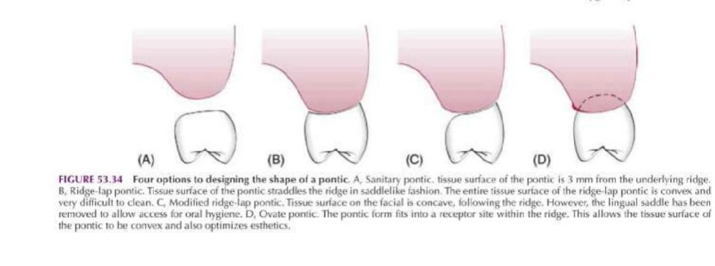
Pontic designs

Slide 36
OCCLUSAL CONSIDERATIONS ■ Excessive occlusal load or trauma is a primary factor in Pocket formation, Gingival changes and Osseous & C\T destruction. ■ Excessive occlusal force results in radiographic changes, Widening of Pdl. Spaces, Crestal funneling,Alteration in furcation bone quality & Variation in appearance of lamina dura.

Slide 37
SPECIAL CONSIDERATIONS Restoration of Root – Resected Tooth ■ One piece cast or core is indicated ■ Development of appropriate contour for hygienic access ■ Avoid any excess convexities

Slide 38
Splinting Apllied to: ■ Bonded External Appliances ■ Intra Coronal Appliances
■ Indirect Cast Restorations ■ Any inflammation of the Pdl,. Supporting tissues must be controlled before making a decision for splinting Bcoz Inflammation may cause mobility in presence of normal occlusal forces & Pdl. Support.

Slide 39
Anterior Aesthetic Surgery ■ More Imp. In Anterior Region ■ Gingivectomy, Apically displaced flaps with osseous recontouring & Use of Orthodontics in positioning the gingiva apically or coronally by Extruding or Intruding the teeth. ■Computer Imaging for Visual preview ■ A Stone cast of patient’s own teeth may be used – Composite or Acrylic veneer is constructed on the cast extending gingivally in a correct position.

Slide 40
Pdl. Treatment before Restorative Management Sequence of Treatment: ■ Extraction of “Hopeless” teeth – Construction of Temp. Partial denture ■ Periodontal Therapy is performed ■ 2 month after Pdl. Therapy – Relocate the margins – Construct the Final Restoration

Slide 41
Phase 1 Therapy 1. Controlling active dental diseases 2.Pdl. Surgical Procedures: Crown lengthening surgery – To prevent exposure of crown margin & Root surface after placement.
Ridge – augmentation: For correcting Ridge discrepancies –
2 Techniques 1) The Roll Technique 2) The C\T Tissue Tunnel Technique

Slide 42
Thank
you !!

