Slide 1
Periodontal plastic and esthetic surgery
Presented by; Trupti Gaike (int)

Slide 2
Definition:
periodontal plastic surgery is defined as the surgical procedures performed to correct or eliminate anatomic, developmental, or traumatic deformities of the gingiva or alveolar mucosa.
1996 World Workshop in Clinical Periodontics renamed mucogingival
surgery as periodontal plastic surgery
It include the following areas:
• Periodontal-prosthetic corrections
• Crown lengthening
• Ridge augmentation

Slide 3
• Ridge augmentation
• Aesthetic surgical corrections
• Coverage of the denuded root surface
• Reconstruction of papillae
• Aesthetic surgical correction around implants
• Surgical exposure of unerupted teeth for orthodontics

Slide 4
Objectives:
Five objectives of periodontal plastic surgery are :
1. Problems associated with attached gingiva
2. Problems associated with a shallow vestibule
3. Problems associated with an aberrant frenum
4. Aesthetic surgical therapy
5. Tissue engineering

Slide 5
1.Problems Associated With Attached Gingiva
The ultimate goal of mucogingival surgical procedures is the creation or widening of attached gingiva around teeth and implants. The width of the attached gingiva varies in different individuals and on different teeth of the same individual.
However, several studies have challenged the view that a wide, attached gingiva is more protective against the accumulation of bioilm than a narrow or a nonexistent zone. No minimal width of attached gingiva has been established as a standard necessary for gingival health.
Teeth with subgingival restorations and narrow zones of keratinized gingiva have higher gingival inlammation scores than teeth with similar restorations and wide zones of attached gingiva. In these cases, techniques for widening the attached gingiva are considered pre-prosthetic periodontal surgical procedures.

Slide 6
Widening the attached gingiva accomplishes four objectives:
1. Enhances plaque removal around the gingival margin
2. Improves aesthetics
3. Reduces inlammation around restored teeth
4. Allows gingival margin to bind better around teeth and implants
With attached gingiva

Slide 7
2.Problems Associated With a Shallow Vestibule:
Another objective of periodontal plastic surgery is the creation of vestibular depth when it is lacking. Gingival recession displaces the gingival margin apically, reducing vestibular depth, which is measured from the gingival margin to the bottom of the vestibule
Minimal attached gingiva with adequate vestibular depth may not require surgical correction if proper atraumatic hygiene is practiced with a soft brush

Slide 8
3.Problems Associated With an Aberrant Frenum:
An important objective of periodontal plastic surgery is correction of frenal or muscle attachments that may extend coronal to the mucogingival junction.
A frenum that encroaches on the margin of the gingiva can interfere with bioilm removal, and the tension on the frenum tends to open the sulcus. In these cases, surgical removal of the frenum is indicate

Slide 9
4.Aesthetic Surgical Therapy:
Recession of the facial gingival margin alters the proper gingival symmetry and results in an aesthetic problem. The interdental papilla is also important to satisfy the aesthetic goals of the patient.
A missing papilla creates a space that many call a black hole. Regeneration of the lost or reduced papilla is one of the most dificult goals in aesthetic periodontal plastic surgery
Another area of concern is an excessive amount of gingiva in the visible area. This condition is often called as a gummy smile,and it can be corrected surgically by crown lengthening.

Slide 10
5.Tissue Engineering:
The future of periodontal plastic surgery will encompass the use of tissue-engineered products at the recipient site to reduce donor site morbidity. Results of numerous experimental and clinical studies support the clinician’s use of a minimally invasive approach to periodontal plastic surgery.

Slide 12
Techniques to Increase Attached Gingiva
To simplify and better understand the techniques and the result of the surgery, the following classiications are presented:
1.Gingival augmentation apical to the area of recession.
The donor graft tissue (i.e., pedicle or free) is placed on a recipient bed apical to the recessed gingival margin. No attempt is made to cover the denuded root surface where there is gingival and bone recession.

Slide 13
2. Gingival augmentation coronal to the recession (i.e., root cover-age)
The donor graft tissue (i.e., pedicle or free) is placed covering the denuded root surface. Apical and coronal widening ofattached gingiva enhances oral hygiene procedures, but only the latter can correct an aesthetic problem.

Slide 14
Gingival Augmentation Apical to Recession
Techniques for gingival augmentation apical to the area of recession place the free gingival autograft or the free connective tissue autograft in a recipient site created in a area apical to the recession.
Another technique is the apically positioned lap, which is possible if there is some keratinized gingiva that can be placed in a more apical position. This is essentially an apical pedicle lap.

Slide 15
1.Free Gingival Autografts
Free gingival grafts are used to create a widened zone of attached
gingiva. They were initially described by Bjorn12 in 1963 and have
been extensively used

Slide 16
Classic technique⚫
The classic technique was proposed by Sullivan & Atkins (1968) and modified by Millers in 1985)
Steps in classic technique
. Step 1 - Preparation of the recipient site
Step 2 - Preparation of donor site
Step 3-Transfer and immobilization of the graft
Step 4 Protection of the donor site

Slide 17
Step 1
1. The purpose of this step is to prepare a firm connective tissue bed to receive the graft.
2. The area of recipient bed is demarcated by first placing a horizontal incision at the level of CEJ on either side in the inter-dental tissues. Two vertical incisions ex- (tending from incision line are placed 4-5 mm apical (to recession. A horizontal incision is made at apical termination connecting the vertical incisions.
3. A split incision is made to dissect the epithelium andouter portion of connective tissue, within the demar-cated area.
4. Periosteum should be left covering the bone.

Slide 18
Step 2
1. A tin foil template is made on the recipient site and transferred to the donor site.
2. Donor sites are - palatal mucosa, attached gingiva, masticatory mucosa of edentulous area etc. 3. Place the template over the donor site and make a shallow incision around it with # 15 blade
4. Remove the donor tissue with the help of microtome. Ideal thickness of graft is between 1-1.5 mm.

Slide 19
Step 3
1. Remove the excess clot from the recipient site be- cause thick clot interferes with vascularization of graft.
2. Graft is immediately transferred to the recipient site and immobilized by suturing to the periosteum of adjacent attached gingiva with adequate no. of sutures.
3. Exert pressure against the graft for a few minutes to eliminate thick blood clot, between the graft and re- cipient bed, to eliminate the dead space.

Slide 20
Step 4
1. Cover the donor site with a PD pack for 1 week and repeat if necessary
2. Modified Hawley's retainer is useful to cover the pack on the palate and cover the edentulous ridges.

Slide 22
2.Free Connective Tissue Autografts
The connective tissue autograft technique was originally described by Edel36 and is based on the fact that the connective tissue carries the genetic message for the overlying epithelium to become keratin-ized. Only connective tissue from beneath a keratinized zone can be used as a graft (eFig. 65.5).
The advantage of this technique is that the donor tissue is obtained from the undersurface of the palatal lap, which is sutured back in primary closure. Healing is by irst intention. The patient has less discomfort postoperatively at the donor site. Another advantage of the free connective tissue autograft is that improved aesthetics can be achieved because of a better color match of the grafted tissue to the adjacent areas.

Slide 24
Several techniques are used for gingival augmentation coronal to recession (i.e., root coverage):
1. Free gingival autograft
2. Free connective tissue autograft
3. Pedicle autografts
• Laterally (horizontally) positioned pedicle lap
• Coronally positioned lap; includes semilunar pedicle
4. Subepithelial connective tissue graft (i.e., Langer method)
5. Guided tissue regeneration (GTR)
6. Pouch and tunnel technique (i.e., coronally advanced tunnel
technique)

Slide 25
Free Gingival Autograft
Successful and predictable root coverage has been reported using free gingival autograft
The Classic Technique
Step 1:
Root planing. Root planing is performed with the application of saturated citric acid for 5 minutes on the root surface. The
application of citric acid has not been validated by some studies,but numerous clinicians practice this technique.

Slide 26
Step 2:
Recipient site preparation. Make a horizontal incision in the interdental papillae at right angles to create a margin against
which the graft can have a butt joint with the incision. Vertical incisions are made at the proximal line angles of adjacent teeth, and the retracted tissue is excised. Maintain an intact periosteum in the apical area.

Slide 27
Steps 3 and 4.
Follow the step-by-step technique described for the classic gingival graft earlier in this chapter. This technique results in predictable coverage of the denuded root surface but may cause aesthetic color discrepancies with the adjacent gingiva because of a lighter color.

Slide 28
Free Connective Tissue Autograft
The free connective tissue technique was described by Levine in 1991.58 The difference between this technique and the free gingival
autograft is that the donor tissue is connective tissue .
The following is a step-by-step surgical description of the free connective tissue autograft technique:
Step 1:
Divergent vertical incisions. Divergent vertical incisions are made at the line angles of the tooth to be covered, creating a partial-thickness lap to at least 5 mm apical to the receded area.
Step 2:
Suturing. The apical mucosal border is sutured to the peri-osteum using a gut suture.

Slide 29
Step 3:
Scaling and root planing. Thoroughly scale and root plane the exposed root surface. The facial prominence on the root surface
is also reduced, which is a favorable anatomy onto which the donor tissue is placed.
Step 4:
Obtaining the graft. From the palate, obtain a connective tissue graft. The donor site is sutured after the graft is removed.

Slide 30
Step 5:
Transferring the graft. Transfer the graft to the recipient site, and suture it to the periosteum with a gut suture. Good stability
of the graft must be attained with the minimal number of sutures.
Step 6:
Covering the graft. The grafted site should be covered with sterile foil before placing the dressing.

Slide 31
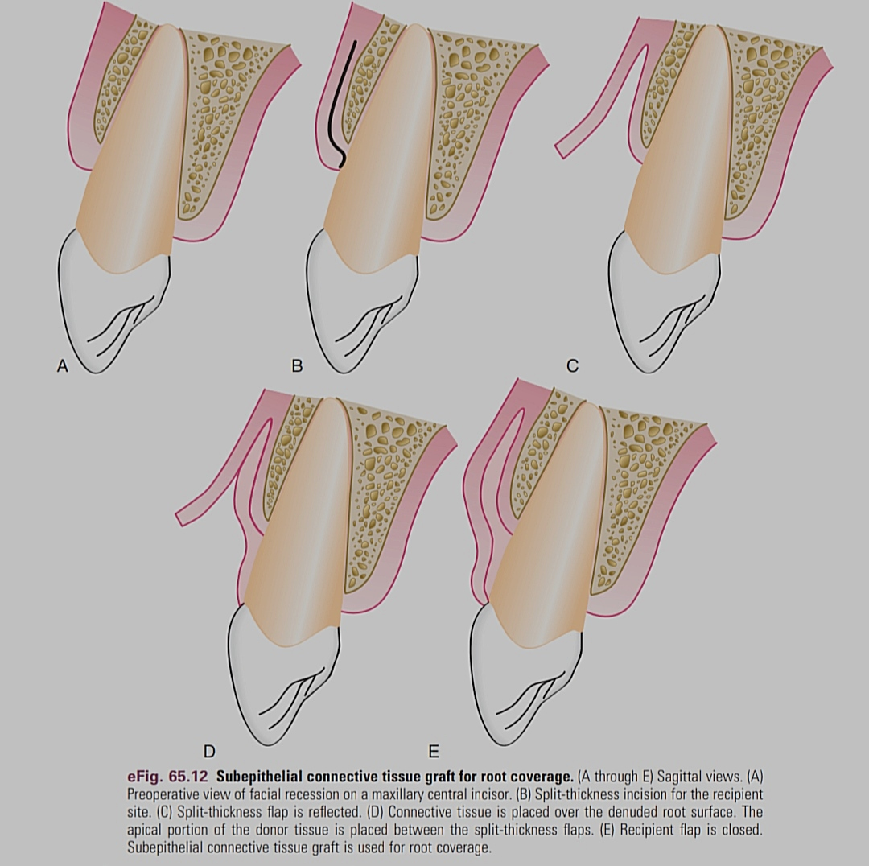
Subepithelial Connective Tissue Graft
The subepithelial connective tissue graft
(i.e., Langer procedure) is indicated for
larger and multiple defects with good
vestibular depth and gingival thickness
to allow a split-thickness lap to be elevated.
technique was described by Langer and Langer in 1985.57

Slide 32
Techniques to Deepen the Vestibule
Adequate vestibular depth is important for oral hygiene and retention of prosthetic appliances. Numerous surgical techniques have been proposed to accomplish deepening of the vestibule. The classic clinical studies in the early 1960s by Bohannan13–15 indicated that deepening of the vestibule by non–free-graft procedures were not successful when evaluated years later.
Predictable deepening of the vestibule can be accomplished only by the use of free autogenous graft techniques and their variants (discussed earlier).

Slide 33
The important clinical aspect in deepening the vestibule is proper preparation of the recipient site. The recipient site must be covered by immobile periosteal tissue. If there is a lack of periosteal connective tissue, donor tissue may be placed over the bone. The donor tissue can be free gingival or connective tissue, but it must be placed over a nonmobile recipient site

Slide 34
Techniques to Remove the Frenum
Frenectomy and Frenotomy
Frenectomy and frenotomy refer to surgical procedures that differ in degree. Frenectomy is complete removal of the frenum, including its attachment to underlying bone, and it may be required in the correction of an abnormal diastema between the maxillary central incisors. Frenotomy is relocation of the frenum, usually in a more apical position.
Procedure
Step 1. After anesthetizing the area, engage the frenum with a hemostat inserted to the depth of the vestibule.

Slide 35
Step 3. Make a similar incision along the undersurface of the hemostat.
Step 4. Remove the triangular resected portion of the frenum the hemostat. This exposes the underlying ibrous attachment to the bone.
Step 5. Make a horizontal incision, separating the ibers, and bluntly dissect to the bone.

Slide 36
Step 6. If necessary, extend the incisions laterally, and suture the labial mucosa to the apical periosteum. A gingival graft or con-nective tissue graft is placed over the wound.
Step 7. Clean the surgical ield with gauze sponges, and apply pressure until the bleeding stops.
Step 8. Cover the area with dry, sterile aluminum foil, and apply the periodontal dressing.
Step 9. Remove the dressing after 2 weeks, and redress if necessary. One month is usually required for the formation of an intact mucosa with the frenum attached in its new position.

Slide 37
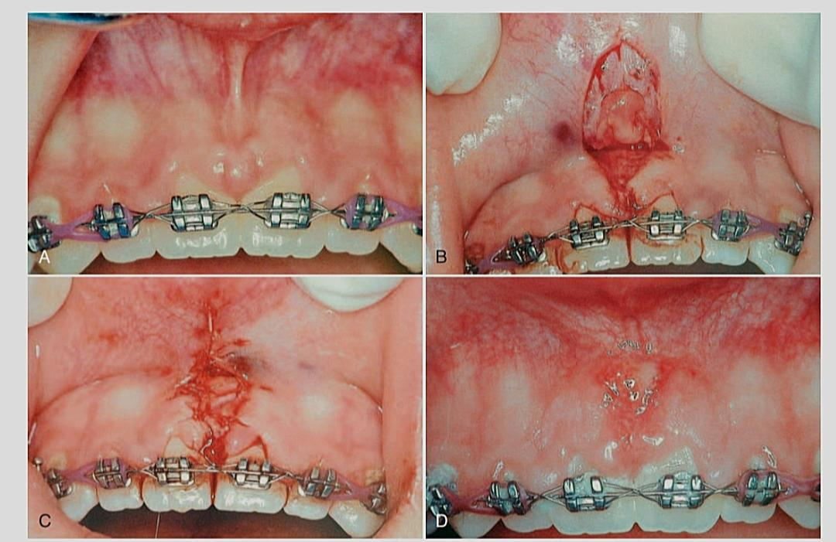

Slide 38
Techniques to Improve Aesthetics
The maxillary anterior area in a patient with a high lip line may cause concerns about the aesthetic appearance of gingival tissues. This area is called the aesthetic zone, and it requires special con-sideration in restorative, periodontal, and implant therapy.
Root Coverage
Papilla Reconstruction
Therapy to Correct Excessive Gingival Display:
Excessive gingival display (i.e., gummy smile) is an aesthetic concern for many patients. This appearance may be caused by a skeletal problem called vertical maxillary excess, by dentoalveolar extrusion, or by incomplete exposure of the anatomic crown, often referred to as altered passive eruption.

Slide 40
Tissue Engineering
Tissue engineering and the use of biologic mediators in periodontal plastic surgery have become a reality as the result of research and the demand for noninvasive surgical procedures by patients and clinicians.
The passive and active categories recognize the roles cells play
in tissue engineering. Passive engineering involves the following treatments and materials:
1. Therapies based on GTR-based therapies; barrier membranes
2. Biologically based acellular dermal matrix (ADM)

Slide 41
Active engineering involves the following treatments and materials:
1. Enamel matrix derivative (EMD)
2. Growth factors: recombinant human platelet-derived growth factor-BB (rhPDGF-BB) plus beta-tricalcium phosphate (β-TCP) plus collagen wound dressing
3. Cell therapy
• Autologous ibroblast: Isolagen
• Bilayered cell therapy (BLCT): Celltx
• Human ibroblast-derived dermal substitute (HFDDS): Dermagraft

Slide 42
THANK YOU

