Slide 1
FURCATION INVOLVEMENT
Presented by : sadhana dhaygude
Department of – periodontics and implantology

Slide 2
Contents
➡ Introduction
➡ Terminology
➡Classification of furcation involvement-
➡ Etiology
➡ Diagnosis
➡Treatment planning

Slide 3
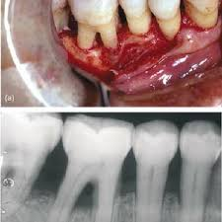
Introduction
The furcation lesion defect represents a serious complication in periodontal therapy due to inaccessibility to adequate instrumentation, presence of root concavities, and furrows making proper cleaning of the area difficult.
Thus, loss of periodontal attachment in the furcation area is a condition that requires careful evaluation and management in order to achieve stability of dentition.

Slide 4
DEFINITION
Glickman (1950)
Commonly occurring condition in which the bifurcation and trifurcation of multi- rooted teeth are denuded by periodontal disease.
Prichard (1965)
Bifurcation and trifurcation involvements are common periodontal lesions which occur as a result of gingival inflammation and bone resorption adjacent to and within the furca of multi- rooted teeth
Goldman & Cohen (1968)
Extension of pocket into the interradicular area of bone in multirooted teeth

Slide 5
ETIOLOGY
MICROBIAL DENTAL PLAQUE
LOCAL ANATOMIC AND DEVELOPMENTAL FACTORS
DENTAL CARIES/PULPAL DEATH
TRAUMA FROM OCCLUSION
IATROGENIC FACTORS
VERTICAL ROOT FRACTURES

Slide 6
MICROBIAL DENTAL PLAQUE
The primary etiological factor in the development of furcation defects is the microbial dental plaque (Ammons et al., 2002).
Microbial dental plaque is the microorganism colony found on the outer surface of the tooth, covering the tooth like a biofilm (Socransky and Haffajee, 2002; Marsch, 2004).
Plaque's bacteria are generally in harmony with the host and they consumeendogenous nutrients (Salivary proteins and glycoproteins).
The existence of endogenous bacteria cause the formation of a low amount ofacid and the settlement of exogenous microorganisms (Marsh, 2000; Wilks,2007).

Slide 7
ROOT TRUNK LENGTH
In a study of mandibular first and second molars, It was reportedthat the mean root trunk longth was 3.14 mm on the buccal aspect, and 4.17 mm on the lingual aspect
Marietats et al 1998)
The root trunk surface area for mandibular and maxillary molarsaverages 31% and32% of the total root surface area respectively(Dunlap & Gher 1985.Gher & Dunlap 1985)
Therefore, horizontal attachment loss leading to furcation invasioncompromises the root trunk, resulting in the loss of one third of the totalperiodontal support of the tooth (Hermann et al 1981. Grant etal. 1981)

Slide 8
The root trunk length plays a significant role in both the prognosis and treatment of the tooth.
A molar with a short root trunk is more vulnerable to furcat involvement, but has a batter prognosis after treatment since less parodontal destruction has presumably
Alternatively, a furcation-involved molar with a long root trunk and short roots may not be a candidate for root resection, since these tooth lose more periodontal support with furcal invasion.

Slide 9
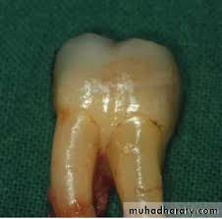
LOCAL DEVELOPMENTAL ANOMALIES
→ Cervical enamel projections
Ectopic deposits of enamel apical to the level of the normal CEJ with a tapering form and extending towards or into the furcation areas are called Cervical enamel projections.
It has been observed that CEP'S occur in 13% of multirooted teeth

Slide 10
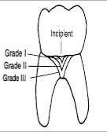
CLASSIFICATION OF CEP
Masters & Husins. Periodontol 1564
Grade 1: Distinct change in CEJ contour, with enamel projecting toward the bifurcation (<1/3 of the root trunk)
Grade II: CEP approaching the furcation, but not actually making contact with it (>1/3)
Grade III: CEP extending into the furcation proper

Slide 11
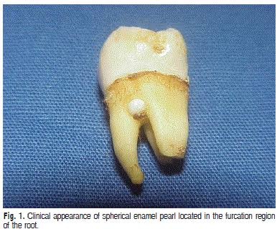
Enamel Pearl
The prevalence of enamel pearls is less than that of cervical enamel projections.
Moskow & Canut (1990), reported an incidence of 2.6% (range 1.1-9.7%)
Like CEPS, enamel pearls contribute to the etiology of furcation involvement by preventing connective tissue attachment.

Slide 12
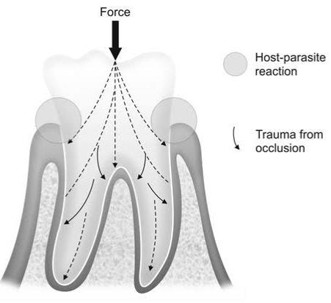
TRAUMA FROM OCCLUSION
Glickman et al (1961), reported that furcations are some of the more susceptible areas of the periodontium to excessive occlusal forces, and suggested the periodontal fiber orientation in furcation areas facilitated a more rapid spread of inflammation and accounted for the increased susceptibility to occlusal forces
Lindhe & Svanberg 1974, stated that trauma from occlusion coupled with gingival inflammation has been implicated in greater alveolar bone loss in experimental animals. The heavy occlusal load on molar teeth may render them susceptible to Increased bone loss in the furcation areas if inflammation is present

Slide 13
Wang et al. (1994),
reported that teeth with mobility and furcation involvement were more likely to lose attachment and to be extracted
Waerhaug (1980),
however, has suggested that increased mobilityis a late symptom, rather than the cause of furcation defects.

Slide 14
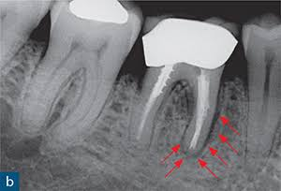
VERTICAL ROOT FRACTURES
Lommel et al. (1978), reported that vertical root fractures are associated with rapid, localized alveolar bone loss.
Furcation defects can result if the fracture extends into the furcation area. A poor prognosis is often given in these situations

Slide 15
IATROGENIC FACTORS
Overhanging restorations present iatrogenic predisposing factors that may lead to furcation involvement
Wang et al (1993), in a study of 134 maintenance patients reported that molars with a crown or a proximal restoration had a significantly higher percentage of fur gation involvement than non-restored teeth.
While only 39.1% of molars without restorations had furcation involvement, 52.8% of molars with class II restorations and 63.3% of molars with crowns were found to have furcation involvement

Slide 16
Classifications of Furcation Involvement
1. Based on horizontal attachment loss
Glickman's classification (1953)
Hemps classification (1975)
2. Based on Horizontal and vertical components
Tarnow and Fletcher's classification (1984)3.
3. Based on Combination of these findings and morphology of bonedeformity
Easley and Drennan's classification (1969)

Slide 17
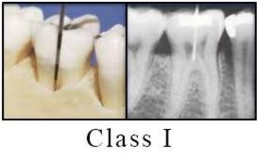
Glickman's Classification(1953)
GRADE 1 . Incipient Furcation:
- Incipient or early stage
- Soft-tissue lesion or pocket extending into flute of
furcation
- Inter-radicular bone → intact or slight bone loss
- No radiographic evidence of bone loss

Slide 18
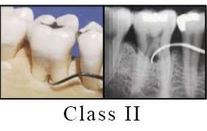
GRADE II Furcation
Pocket formation & loss of inter-radicular bone of varying depthsinto the furcation but not through and through
Portion of PDL and bone remain intact
Distinct horizontal destruction of furcation area is present
Cul de sou with a horizontal component
Partial penetration of probe Extent of horizontal probing early or advanced
Radiographs may or may not depict involvement esp. is max

Slide 19
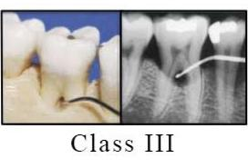
GRADE III Communicating or Through and ThroughFurcation •
# Destruction of bone and connectivepesue was all the way through the furcation
# Bone is not attached to the dome offurcation
# Early grade III involvement openingfilled with soft tissue
-Pocket formation completely probable to the opposite side of the Sooth
- Radiographic evidence → small triangular radiolucency

Slide 20
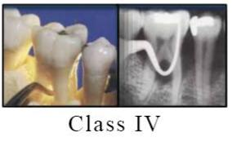
GRADE IV
Interdental bone is destroyed and the soft tissues recede apically so the furcationopening is seen clinically
Tunnel exists between the roots of affected tooth
Periodontal probe passes readily from one aspectto other aspect

Slide 21
Modification of Glickman's ClassificationFedi et al 2000 Vandersall DC, Concise encyclopedia ofPeriodontology Blackwell Munksgaard 2007)
GRADE II degree I.
VERTICAL COMPONENT OF >1MMBUT <3MM
GRADE II degree II.
VERTICAL COMPONENT OF >3MMBUT NOT THROUGH & THROUGH

Slide 22
Hamp, Nyman & Lindhe's Classification (1975)
CLASS I
Horizontal loss of periodontal support not exceeding one-third of the width of the tooth
CLASS II
Horizontal loss of periodontal support exceeding one-third of the width of the tooth, but not encompassing the total width of the furcation area
CLASS III
Horizontal "through-and-through" destruction of the periodontaltissues in the furcation area

Slide 24
TARNOW AND FLETCHER VERTICAL CLASSIFICATION 1984
Vertical component of furcation measured from floor of the furca to the roof of the furca
SUBCLASS A
Vertical destruction to one third ofthe total inter radicular height (3 mm or less).
SUBCLASS B
Vertical destruction reaching two thirds of the inter radicular height (4 to 6 mm).
SUBCLASS C
Inter radicular osseous destruction to or beyond the apical third (> 7 mm).

Slide 25
RADIOGRAPHS IN FURCATION DIAGNOSIS
Should include paralleling, periapical & bitewing techniques
Sometimes superimposition of palatal root or thick bone may obscure thefurcation
Slightest radiographic change in furcation area should be investigated clinically, especially if there is bone loss an adjacent roots.
Whenever there is marked bone loss in relation to a single molar root, it may be assumed that the furcation is also involved.

Slide 26
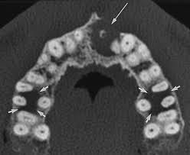
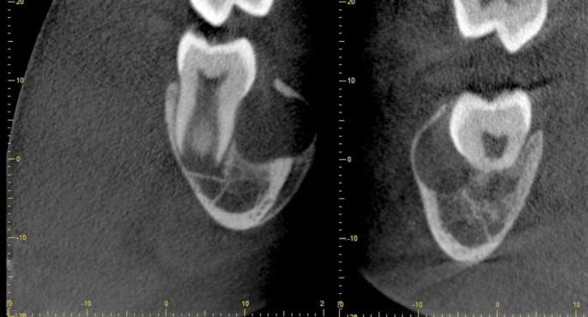
OTHER DIAGNOSTIC AIDS-
CONE BEAM COMPUTED TOMOGRAPHY (CBCT)
TRANSVERSE CTCROSS SECTIONAL CT

Slide 27
Misch et al 2006
When compared to periodontal probing and 2D intraOral radiography 3D CBCT scanning was found to be more effective in assessing periodontal structures
Qiao J wang et al 2014
In a study comparing intrasurgical assessment of maxillary furcations to those assessed by CBCT observed there was agreement between both assessments the mean length of the root trunk and the width of the furcation entrance revealed by CBCT were consistent with their respective intrasurgical values, though CBCT underestimated vertical and horizontal bone loss in the maxillary furcae
milena Cimbaljvic et al 2015
revealed that the number of Fl detected by means of CBCT was larger than by means of periodontal probing
In cases where surgical treatment is necessary, CBCT may be suggested as an adjunct tool for Fl assessment

Slide 28
Prognosis for individual teeth depend on:
1. Morphology of the bone deformity
2. Tooth morphology
3 Chronicity of the destructive process.
4. Clinical crown to clinical root ratio
5. Mobility. Tooth mobility caused by inflammation and trauma from occlusion may be correctable, but mobility resulting from loss of alveolar bone alone is likely to be connected
6. Patients age and general health

Slide 29
AIM OF TREATMENT
Treatment of a defect in furcation region of multi-rooted teeth is intended to meet the objectives.
The elimination of microbial plaque from the exposed surface of root complex
Prevent further attachment loss
The establishment of anatomy of affected surface that facilitates proper self performed plaque control
Eliminating trauma & correcting Pulpal pathology

Slide 30
Factors to consider in Treatment of Furcation involved Molars
TOOTH-RELATED FACTORS
Degree of furcation involvement
Amount of remaining periodontal support
Probing depth
Tooth mobility
Endodontic conditions & root root canal anatomy
Available sound tooth substance
Tooth position & occlusal antagonism

Slide 31
. PATIENT-RELATED FACTORS
➡Strategic value of the tooth in relation to the overall plan
➡Patient's functional and esthetic demand
➡Patient's age and health conditions
➡Oral hygiene capacity

Slide 32
Three broad strategies of furcation therapy (Kalkwarf & Reinhardt R.A 1988)•
l Maintenance of the existing Furcation
Scaling and root planing
Obstruction of Furcation
Il Increasing access to the Furcation
Gingivectomy/Apical positioned flap
Odontoplasty. }
osteoplasty / ostectomy } Furcationplasty
III Elimination of the Furcation
Root amputation/ Tooth resection
Bicuspidization

Slide 33
FURCATION INVOLVEMENT DEGREE I→
Non-surgical Treatment
(Oral Hygiene measurements and Scaling and Root planning)
Obliteration of furcation by restorative materials
Furcation Plasty

Slide 34
NON-SURGICAL APPROACH
1st approach to all types of furcation involvements
Non surgical Scaling & root planing oftan suffices in resolution of theinflammatory condition
Class 1 lesions
Shallow cul de sac defects
Healing re-establishes normal gingiva anatomy with properly apted soft sues and morphology optimal for good patient control
May be the treatment of choice if surgery is contraindicated foredical or psychological reasons

Slide 35
Fleischer et al (1989)
Level of experience play an important role in furcation debridement, especially with closed debridement.
Maria et al (1966), Parashis et al (1993) & Fleischer at al
More effective calculus removal achieved with open than closed scaling and root planing
Kalka et al. (1988), Schroer et al. (1991) and Wang et al. (1994)
Using clinical parameters, no advantage of open debridement over closed was observed

Slide 36
CHEMOTHERAPY
The difficulties of performing adequate debridement in furcations by mechanical means have prompted experimentation with chemotherapeutic agents in these areas
Needleman & Watts (1997) - 1% metronidazole gel imgation into furcation areas with grade II and III involvements during periodontal maintenance + subgingival scaling.
Result-Clinically, no further improvement was seen for the furcations treated with metronidazole.

Slide 37
• Nylund & Egelborg (1993):
Subgingival irrigation with tetracycline for 3 months+ mechanical debridement in furcations with grade 1, II and involvements.
result One-year evaluation of attachment levels and pocket depths showed clinically negligible (1 mm) variation in both tetracycline and saline-imigated furcations

Slide 38
Tonetti et al (1992): Tetracycline fibers exert a significant adjunctive pocketdepth and bleeding/reduction over that produced by scaling & root planing alone, although this finding is confined only to the first 3 months following fiber insertion.
Result-No difference between treatments could be observed, however, at the 6-month follow-up visit
Overall, the results from the studies above do not lend clear acceptance to the implementation of adjunctive local drug therapy in furcation involvements, regardless of the degree of severity.

Slide 39
→However a study done by AR Pradeep at al(2012) on clinical efficacy of subgingivally delivered 12-mg simvastatin in the treatment of individuals with class II furcation defects used as an adjunct to scaling and root planing Vs SRP placebo showed that the simvastatin administered group had a significantly greater gain in mean RVAL and RHAL (P<0.05). Furthermore significantly greater mean percentage of bone fill was found (25.16%) compared with placebo group (1.54%)

Slide 40
ODONTOPLASTY
Reshaping of tooth coronal to furcation to improve access for plaque control
Widens entrance of the furca & reduces horizontal depth of the furcation involvement
Removes plaque retentive areas like grooves, CEPs, cervical enamel pearls smooth areas
Advised for Grade & II lesions
Potential Complications-
Hypersensitivity
Pulpal imitation → permanent change
Pulp exposure
Increased risk of root caries

Slide 41
FURCATION PLASTY
it is a resective surgical treatment associated with odontoplasty and osteoplasty.
It is used mainly at the buccal and lingual furcations
Procedure:
Reflection of a full thickness flap
Removal of inflammatory soft tissue
Odontoplasty to eliminate or reduce the horizontal component of the defect and to widen the furcation entrance)
Recontouring of the alveolar bone crest to reduce the buccal-lingual dimension of bone in the furcation area
Positioning and suturing of the flap

Slide 42
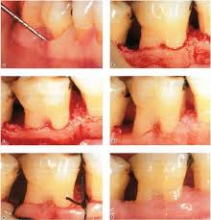
The purpose of performing furcation plasty is the establishment of a soft tissue papilla which covers the entrance to the inter-radicular periodontal tissues

Slide 43
FURCATION INVOLVEMENT DEGREE II
Furcation plasty
Tunnel preparation
Root resection
Tooth extraction
Guided tissue regeneration
Emdogain/PRF

Slide 44
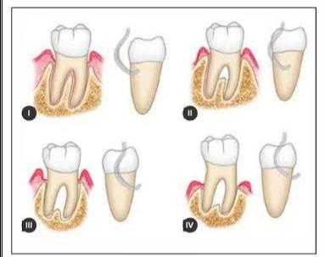
TUNNEL PREPARATION
Intentional creation of a Class IV furcation with entrance accessible for oral hygiene procedure
Done in advanced lesions ie. Deep Grade II and Grade III lesions
It can be utilized only when the furcation entrance dimension wide enough and coronally located to allow for an easy utilization of cleaning devices

Slide 45
Usually done in mandibular molars for clear two way access.
Implemented sometimes in maxillary molars.
However, one of the three roots may have to be resected to improve accessibility to the furcation area.
(Heliden et al. 1989)
Patients with low caries index & good plaque control
(Highfeld et al. 1978)

Slide 46
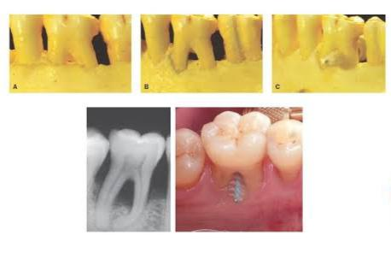
During surgery, bone m reshaped to obtain a scalloped morphology and the soft tissues are apically positioned
Care must be taken that the space obtained under the roof of the furcation should allow proper plaque removal

Slide 47
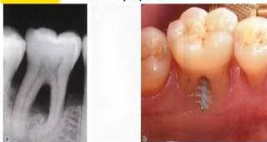
Tunneling often fails because of decay in the furcation area (Lindhe, 1983).
Hellden and colleagues (1989) concluded that teeth with tunnel preparations have a considerably better prognosis thanthat previously reported.

Slide 48
DISADVANTAGES
Potential development of root caries.
Sensitivity
Exposure to patent lateral canals that will require endodontictherapy in the future.
Requirement that a patient should have good manual dexterity to maintain optimal oral hygiene.

Slide 49
FURCATION INVOLVEMENT DEGREE III
Tunnel preparation
Root resection
Tooth Extraction

Slide 50
ROOT SEPARATION AND RESECTION(RSR)
Root separation involves the sectioning of the root complex and the maintenance of all roots
Root resection involves the sectioning and the removal of one or two roots of a multi-roated tooth
RSR is frequently used in cases of deep degree Il and degree Il furcation involved molars*
Can be done on vital or endodontically treated teeth

Slide 51
FACTORS TO BE CONSIDERED
The length of the root trunk
The divergence between the root cones
The length and the shape of the root cones
Fusion between root cones
Amount of remaining support around individual roots
Stability of individual roots
Access for oral hygiene devices

Slide 52
INDICATIONS OF RSR
Teeth that are critically important to the overall dental treatment plan
Teeth that have sufficient attachment remaining for function.
Teeth for which a more predictable or cost-effective method of therapy is not Available. Examples are teeth with furcation defects that have been treated successfully with endodontics but now present with a vertical root fracture, advanced bone loss, or caries on the root
Teeth in patients with good oral hygiene and low activity for caries
Root-resected teeth require endodontic treatment and usually cast restorations

Slide 53
EXTRACTION
Extraction is the treatment of choice, when: (Lindhe 1997)
1) The patient's oral hygiene will not maintain the tooth.
2) The patent does not choose to comply with restorative recommendations without which the tooth cannot survive.
3) Adjacent teeth would serve as adequate abutments
4) Financial considerations preclude acceptance of treatment.
5) Extraction will improve the prognosis of the adjacent teeth by improving bone levels resulting from socket fill

