Slide 1
Periodontal regenerative n reconstructive surgery
Presented by:-
Dr. Trupti giri

Slide 7
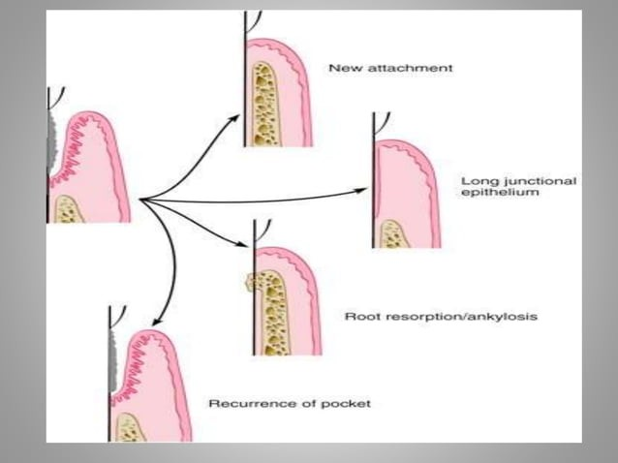

Slide 28
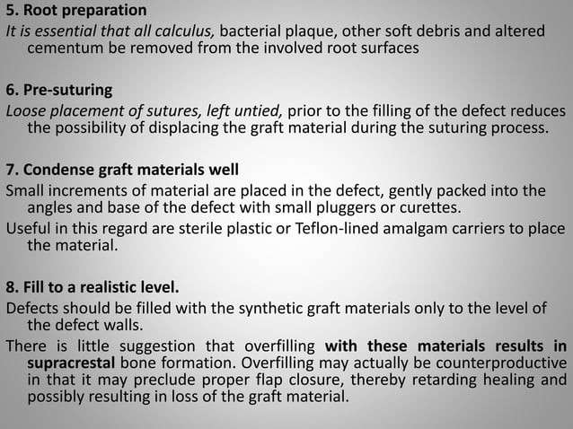

Slide 63
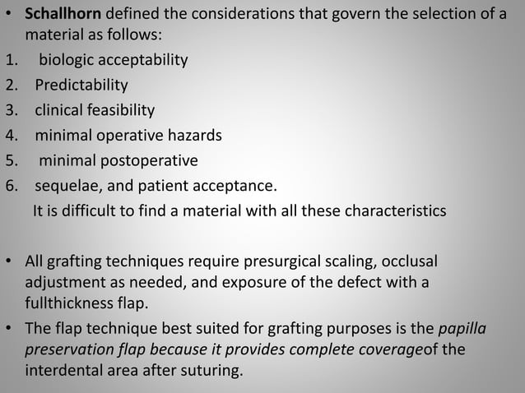

Slide 95
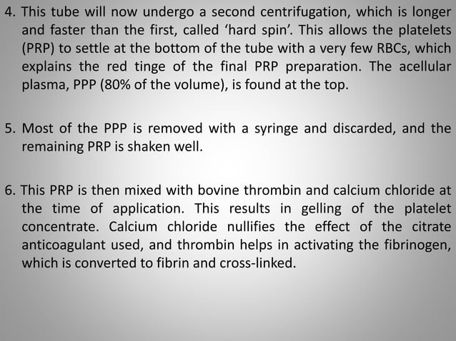

Slide 99
