Slide 1
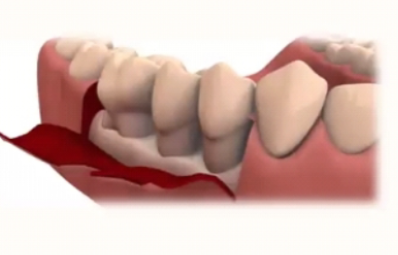
PERIODONTAL FLAP
Guided by:
Dr. Vishnudas Bhandari
Dr. Omkumar Baghele
Dr. Gauri Ugale
Dr. Raghavendra Metri
Dr. Mukesh Ardale
Dr. Sukanya Vyavhare
Dr. Poonam Kedar
Presented by:
Dr. Khushbu Bezalwar
(II nd year PG)

Slide 2
Index
Introduction
History
Rationale of periodontal surgery
Indications and contraindications
Classifications
Fundamentals of periodontal surgery
Flap designs
Healing after flap surgery
Complications of flap surgery
Conclusion
References

Slide 3
Introduction
Periodontal therapy is directed at disease prevention, slowing or arresting disease progression, regenerating lost periodontium, and maintaining achieved therapeutic objectives.
The main objective of periodontal surgery is to contribute to the long term preservation of periodontium by facilitating plaque removal and plaque control, and it can serve this purpose by:

Slide 4
Creating accessibility for proper scaling and root planing
Establishing a gingival morphology that facilitates the patients self-performed plaque control.
Regeneration of periodontal attachment lost due to destructive disease

Slide 5
A periodontal flap is a section of the gingiva and/or alveolar mucosa surgically elevated from the underlying tissues to provide visibility and access to the bone and root surface
Carranza
Flap is defined as separation of section of tissue from the surrounding tissue except at its base
Glossary of periodontal terms

Slide 6
HISTORY
“The connection between the gums and the teeth induces me to treat particularly of the diseases which are common to the gums." He mentions the importance of the removal of deposits, scarification of the gums with a lancet, and cutting excessive gum tissue with a scissors”.
In 1746, Pierre Fauchard of Paris, looked upon as the "Father of Dentistry," wrote the first textbook on dentistry.
In 1862, Robitzeck of Vienna described an operation involving several teeth, in which he excised all the abnormally appearing gum tissue by means of a straight incision through the soft tissue to the alveolar process. This was followed by a scraping of the exposed alveolar bone.

Slide 7
In a book by Pickerell in 1912 called, "Stomatology in General Practice," an operation for pyorrhea was described and named, "Gingivectomy." With special curettes, curved scissors, etc., he removed all the "infected gum tissue.
Neumann's first mention of flap surgery in the treatment of periodontal disease appears in the first edition of his text "Pyorrhea Alveolaris and its Treatment,“ published in Berlin in 1912.

Slide 8
In 1915, Cieszynski, outlined certain guiding principles for the gingival flap approach.
In the same year G. V. Black spoke of the surgical treatment of pockets and this was done by, "cutting away as far as, or a little beyond, the point to which the disease has reached, which generally means some cutting away of the margin of the alveolar process as well as soft tissue."
In 1916, Widman gave the modification of Neumann’s flap which was later published in 1918.

Slide 9
In 1931, Kirkland's flap which was the most conservative of them all.
In 1950s-Staffileno developed Partial thickness palatal flap.
1954, Nabers described a procedure called “repositioning of the attached gingiva.” For the first time, a mucoperiosteal flap was apically positioned after treatment.
1960-Wilderman developed Full thickness flap.
In 1962, Friedman coined the term “apically reposition flap”.

Slide 10
In 1965, Melvin L. Morris introduced flaps for reattachment ‘unrepositioned mucoperiosteal flap’
In 1966 Robinson, he developed the Distal Wedge procedure
•In 1974 Ramfjord; Nissle, Modified Widman flap

Slide 11
In 1979, Carranza classified flap as full thickness flap and partial thickness flap.
In 1985- Takei Et Al introduced PAPILLA PRESERVATION FLAP
In 1990, Carranza classified flap according to their placement as non-displaced and displaced flaps.
In 1995 Cortellini et al, introduced Modified papilla preservation flap and in 1999 simplified papilla preservation flap

Slide 12
Rationale of periodontal surgery
To gain surgical access to deep or tortuous pockets for adequate debridement and smoothing of root surfaces.
To facilitate plaque control by reduction or elimination of potential plaque retention areas.
To provide an adequate restorative and prosthetic environment.
For periodontal regenerative therapy
To improve esthetics, e.g. ., gummy smile

Slide 13
INDICATIONS
Areas with irregular bony contours, deep craters & other defects usually require surgical approach.
Pockets on teeth in which a complete removal of root irritants is not considered clinically possible may call for surgery. This occurs frequently in molar & premolar areas.
In cases of furcation involvement of grade II or III, a surgical approach ensures the removal of irritants, any necessary root resection or hemisection also requires surgical intervention.
Intrabony pockets on distal areas of last molars, frequently complicated by mucogingival problems, are usually unresponsive to nonsurgical methods .

Slide 14
contraindications
Patient of advanced age where teeth may last for life without resorting to radical treatment.
The presence of systemic disease, such as severe cardiovascular disease, malignancy, kidney or liver disease, blood disease and bleeding disorders, uncontrolled diabetes., etc. consultation with physician is essential
Where through subgingival scaling and conscientious home care will remove or control the lesion
Where patient motivation is inadequate
In the presence of acute infection
Where the prognosis is so poor that tooth loss inevitable

Slide 15
classification
Based on bone exposure after reflection:
Full thickness flap
Split/partial thickness flap
Based on flap placement after surgery:
Non displaced flap
Displaced flap
Based on Management of Papilla:
Conventional flap
Papilla Preservation flap

Slide 16
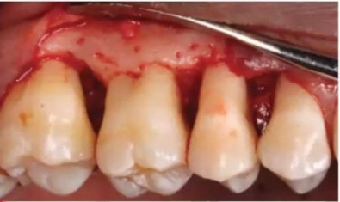
Based on bone exposure after reflection
In a full-thickness flap, all of the soft tissue, including the periosteum, is reflected to expose the underlying bone.
This type of flap is also called the mucoperiosteal flap
Indicated when resective or regenerative osseous surgery is contemplated
Contraindicated where access to bone is not required; presence of dehiscence and fenestration; areas where alveolar bone is thin

Slide 17
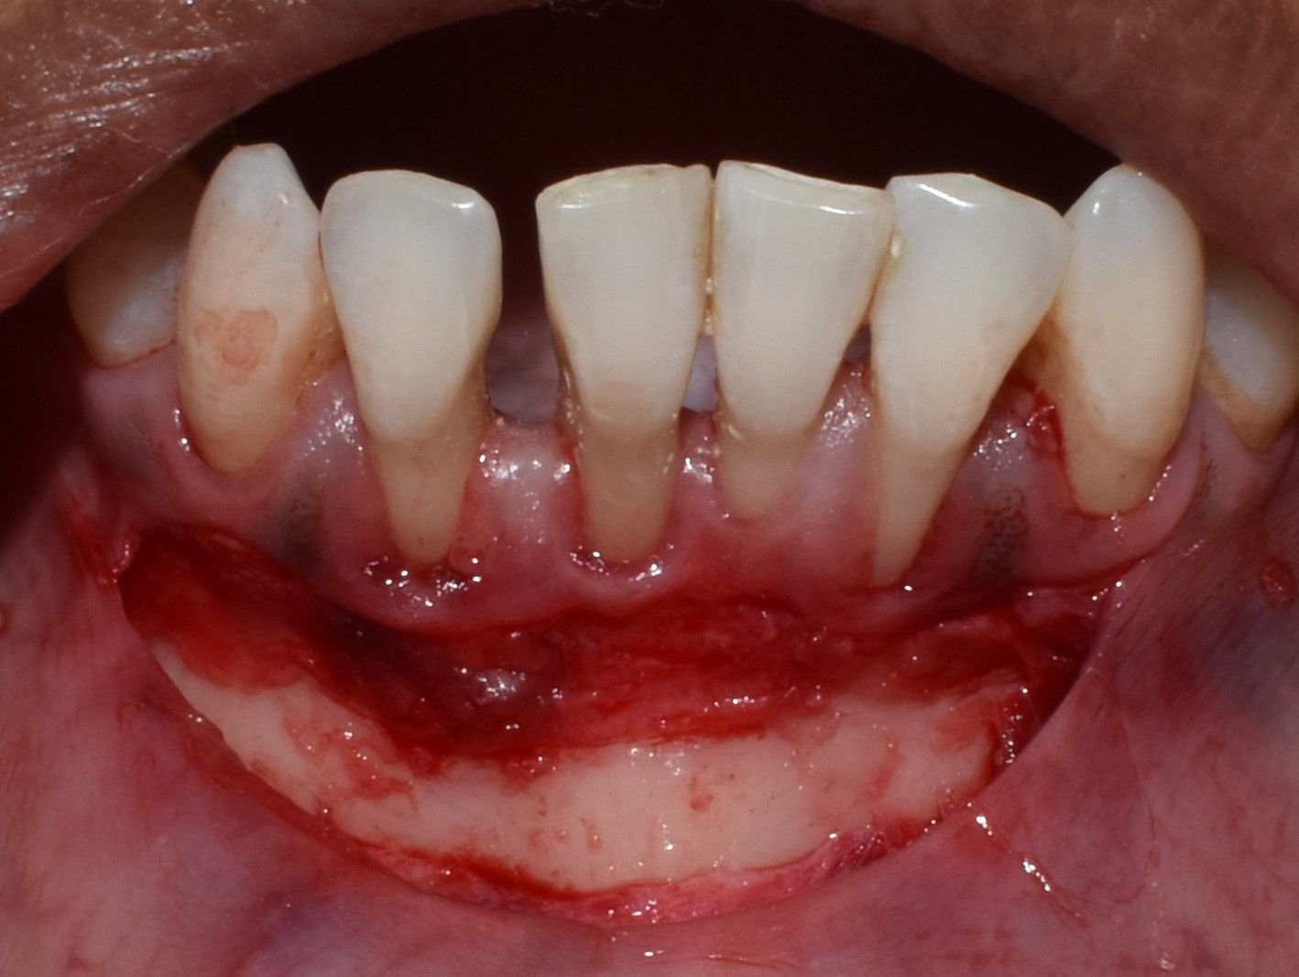
The partial-thickness flap includes only the epithelium and a layer of the underlying connective tissue.
The bone remains covered by a layer of connective tissue that includes the periosteum.
This type of flap is also called the split-thickness flap
Is indicated when the flap is to be positioned apically or when exposure of bone is not desired.

Slide 18
Variables | Full Thickness (Mucoperiosteal) | Partial Thickness (Mucosal)
Healing | Primary intention | Secondary intention
Degree of difficulty | Moderate | high
Pocket elimination | Yes | Yes
Osseous surgery, resective | Yes | No
Periosteal retention | No | Yes
Relocation of frenum | Yes | Yes
Widen zone of keratinized gingiva | No | Yes
Increase attached gingiva | Yes | Yes
Combine with other mucogingival procedures | No | Yes
Suture variability | Low | High
Presence of thin periodontium | No | Yes
Bleeding and tissue trauma | Limited | Greater

Slide 19
Based on flap placement after surgery
Nondisplaced flaps, when the flap is placed and sutured in its original position
Eg- Modified Widman flap, undisplaced flap
Displaced flaps, which are placed apically, coronally, or laterally to their original position
Eg- coronally positioned. Laterally positioned and apically positioned flap

Slide 20
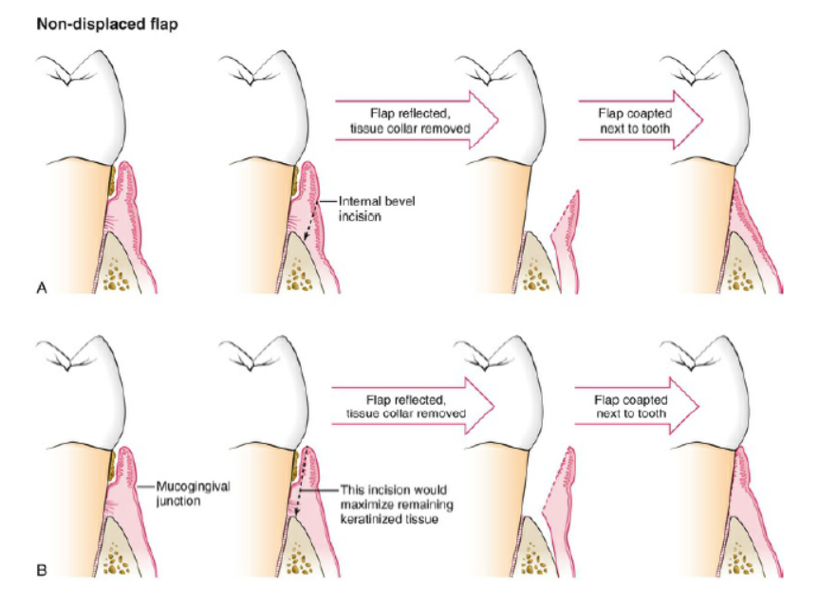

Slide 21
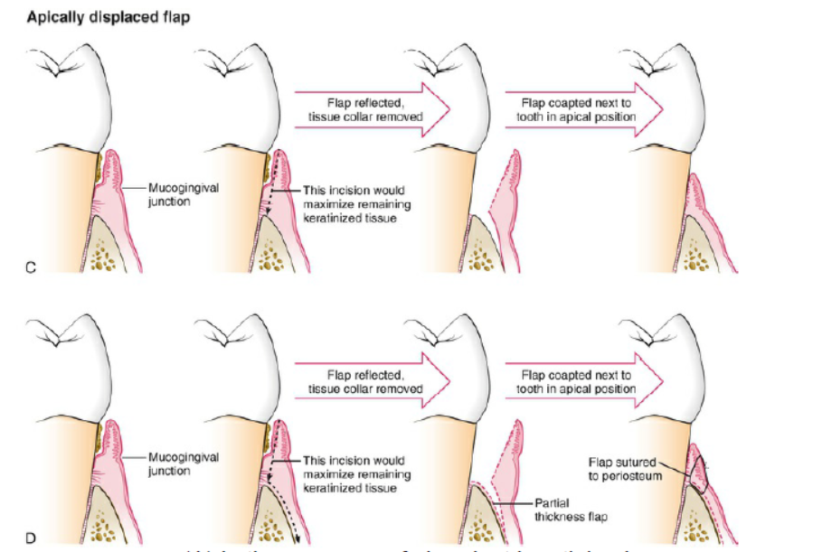

Slide 22
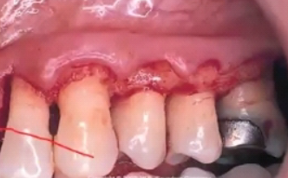
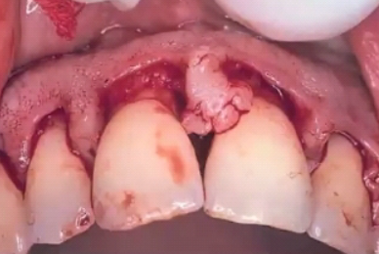
Based on management of papilla
Conventional flap
Papilla is spilt at centre under the contact point and included in both buccal and palatal/ lingual flaps
Eg- Modified Widman flap, undisplaced flap, and apically displaced flap
Papilla preservation flap
Papilla is included in one of the flaps by semi-circular incision

Slide 23
Fundamentals of periodontal surgery
Incisions
Papilla management
Flap elevation
Flap coaptation and closure

Slide 24
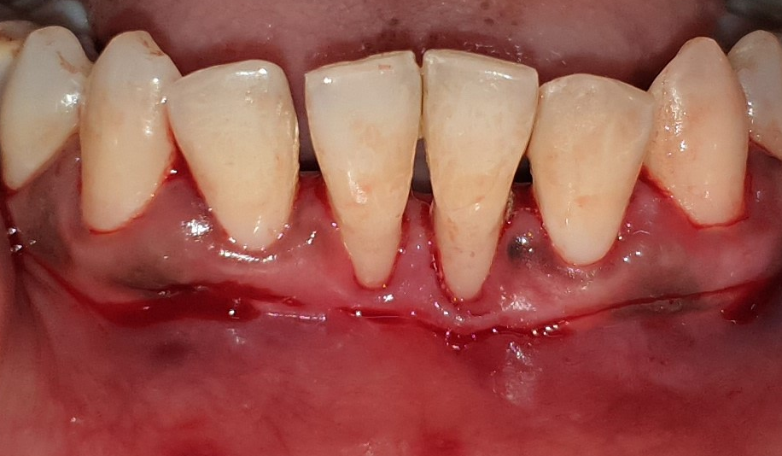
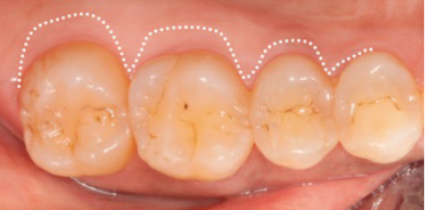
Incisions
Scalloped incision
A horizontal incision that follows the scalloped morphology of the gingival architecture is called a scalloped incision. The scalloped incision is advantageous in preserving the interdental architecture in gingivectomy and in creating surgical papillae and preserving soft tissue over the interdental areas to allow coverage of the interdental bone in flap surgery.
Horizontal incision
It is directed along the gingiva in a mesial or distal direction. Flaps can be reflected with the use of only horizontal incision if sufficient access can be obtained.

Slide 25
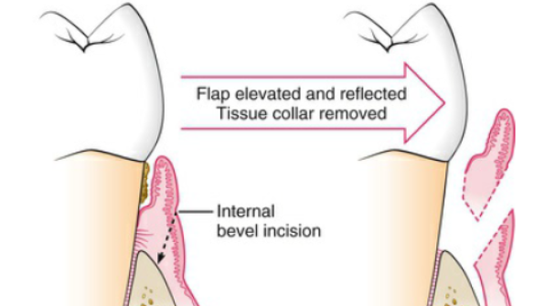
The internal bevel incision, also called the reverse/inverse bevel incision.
The internal bevel incision starts at the surface of the gingiva and is directed apically to the bone crest. It is the incision from which the flap is reflected to expose the underlying bone and root.
The internal bevel incision accomplishes three important objectives:
(1) it removes the pocket lining;
(2) it conserves the relatively uninvolved outer surface of the gingiva, which, if apically positioned, becomes attached gingiva; and
(3) it produces a sharp, thin flap margin for adaptation to the bone–tooth junction.

Slide 26
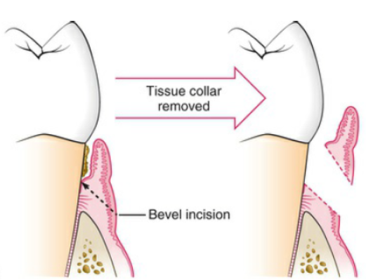
The external bevel incision starts at the surface of the gingiva apical to the periodontal pocket and is directed coronally toward the tooth apical to the bottom of the periodontal pocket.
The external bevel incision, or simply bevel incision, is used primarily in gingivectomy, and it can be made with a scalpel or a knife.

Slide 27
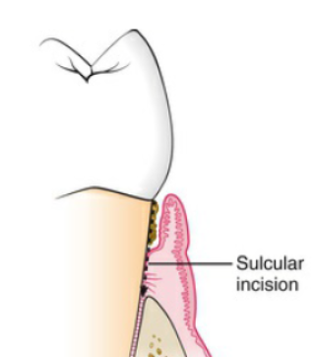
The Crevicular incision is also called intercrevicular incision, intracrevicular incision, sulcular incision, intrasulcular incision, and intersulcular incision. It starts in the gingival crevice and is directed apically through the junctional epithelium and connective tissue attachment and down to the bone.
Indications
Narrow band of attached gingiva
Thin gingiva and alveolar process
Shallow periodontal pocket
Desire to lessen the post operative gingival recession
As a secondary incision of usual flap surgery
In bone graft or GTR

Slide 28
The crestal incision is also called the marginal incision. It starts at the surface of the gingiva at the gingival margin and is directed apically down through the epithelium and connective tissue to the bone.
The Submarginal incision starts at the surface of the gingiva apical to the gingival margin and can be external bevel or internal bevel.
In resective periodontal surgery, the marginal and submarginal scalloped incisions are frequently used to create flaps with thin margins and to leave a collar of tissue around the tooth that contains the epithelium of the pocket lining and the adjacent granulomatous tissue.
This collar of tissue is discarded after flap elevation.
The marginal incision maximizes the remaining keratinized tissue, whereas the submarginal scalloped incision allows for more aggressive soft tissue resection and reduction of the periodontal pocket.

Slide 29
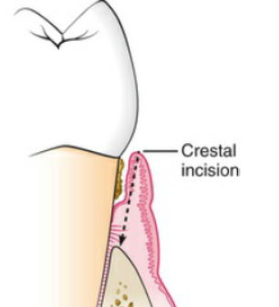
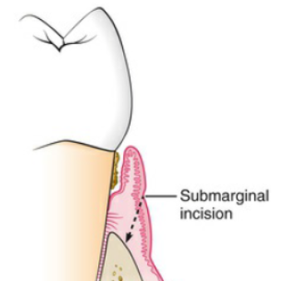
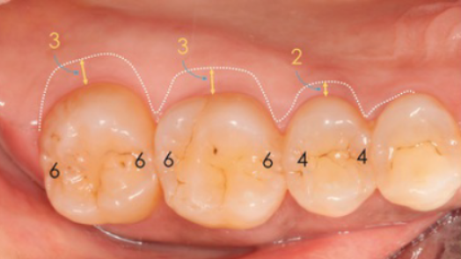
When the submarginal scalloped incision is used, how submarginal
should be incision be? It depends on two of three factors, depending on the location:
(1) the transgingival interdental probing depth, (2) the mucogingival junction, and (3) the depth of the palatal vault.

Slide 30
Vertical incision should not a) Spilt the papilla; b) be placed over a root prominence; c) the length of the flap should not be longer than width of flap; d) the base of the flap should not be narrow than the margin of the flap.
The Vertical or oblique releasing incisions can be used on one or both ends of the horizontal incision, depending on the design and purpose of the flap.
Vertical incisions at both ends may be necessary if the flap is to be apically displaced.
Vertical incisions must extend beyond the mucogingival junction to reach the alveolar mucosa; this allows for the release of the flap to be displaced.

Slide 31
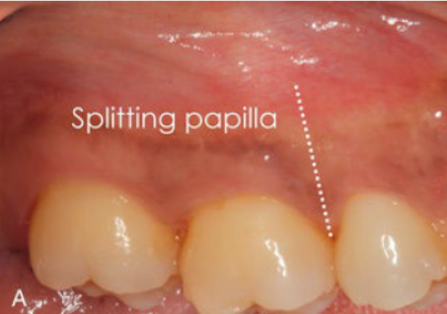
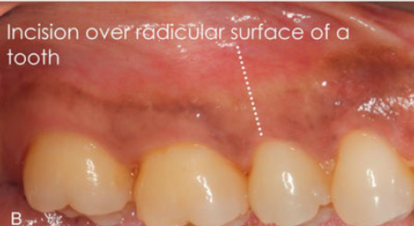
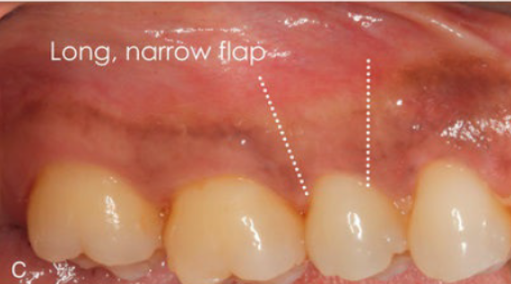
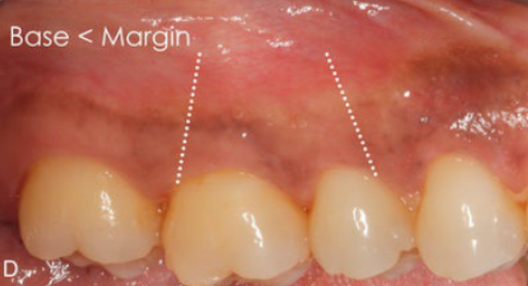

Slide 32
Periosteal releasing incisions, given at the base of the flap severing the underlying periosteum.
It is used when coronal or lateral advancement of a flap onto the root or crown of the tooth is indicated.
It allows tension free coronal positioning of the flap to cover exposed root surface and to provide primary closure over barrier membranes used in guided tissue and guided bone regeneration.

Slide 33
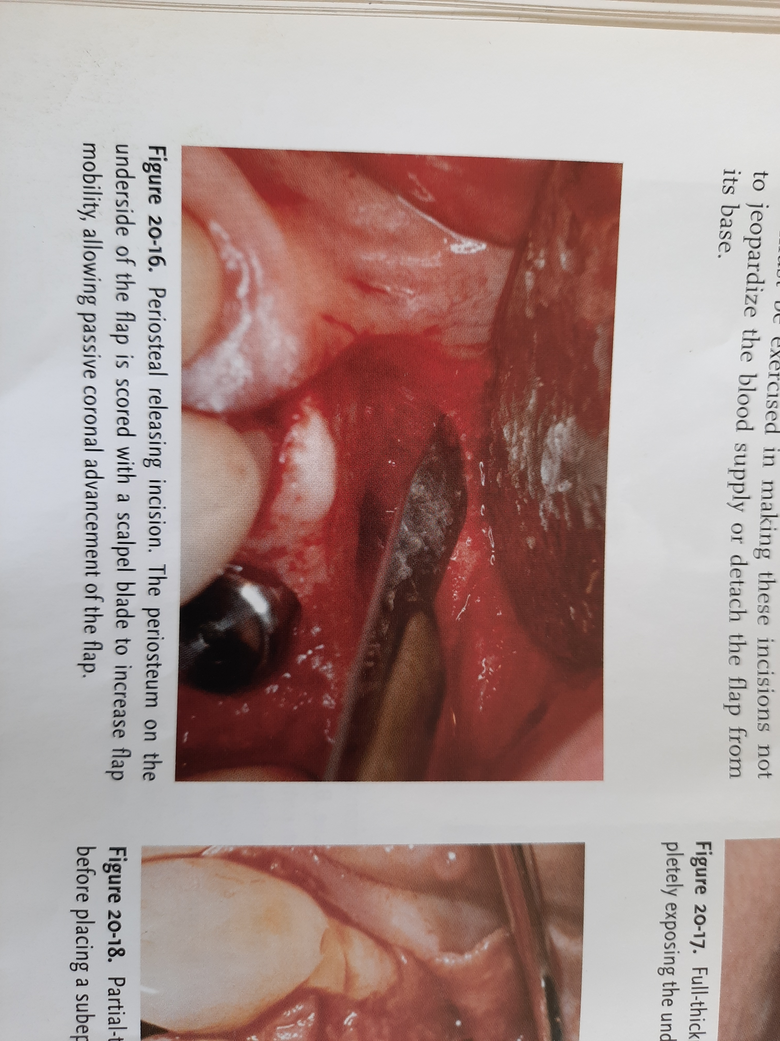
Great care must be exercised in making these incisions not to jeopardize the blood supply or detach the flap from its base.

Slide 34
Thinning incision or internal incision or undermining incision, extending from gingival margin towards the base of the flap to decrease the bulk of connective tissue on the underside of the flap.
Such incisions are used as part of distal or mesial wedge procedures and also to thin bulky papillae.

Slide 35
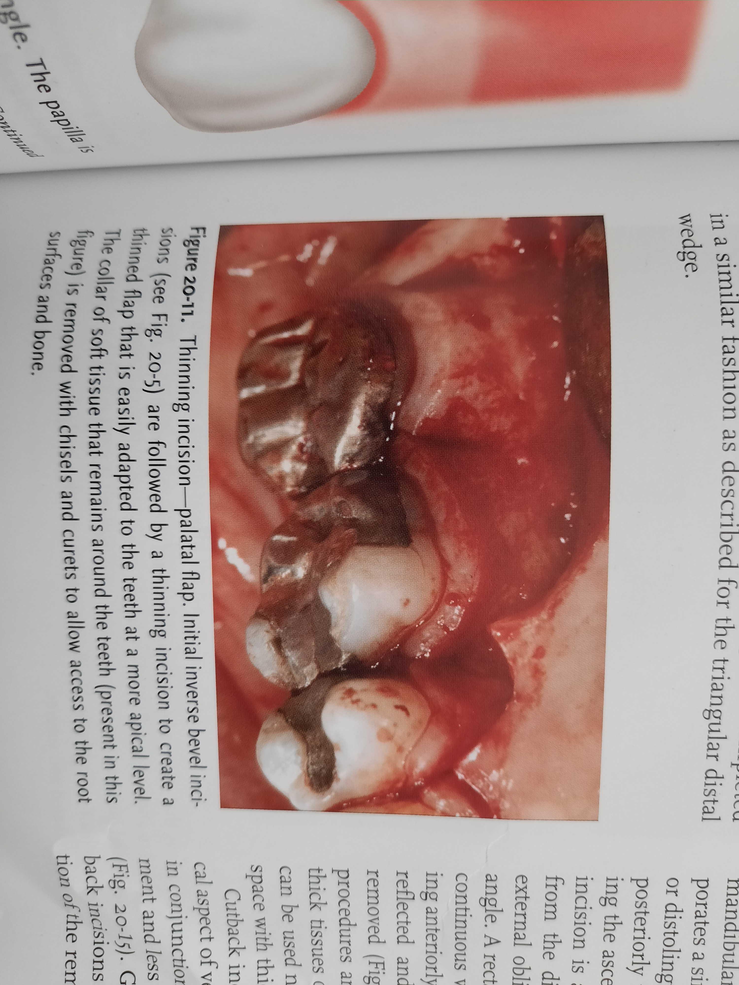
This incision performed either in conjunction with flap reflection(that is reflecting the flap as it is thinned) or after completing the flap reflection
Thinning of bulky tissues, using internal approach, allows for better flap adaptation and provides greater patient comfort than thinning tissues with an external bevel incision

Slide 36
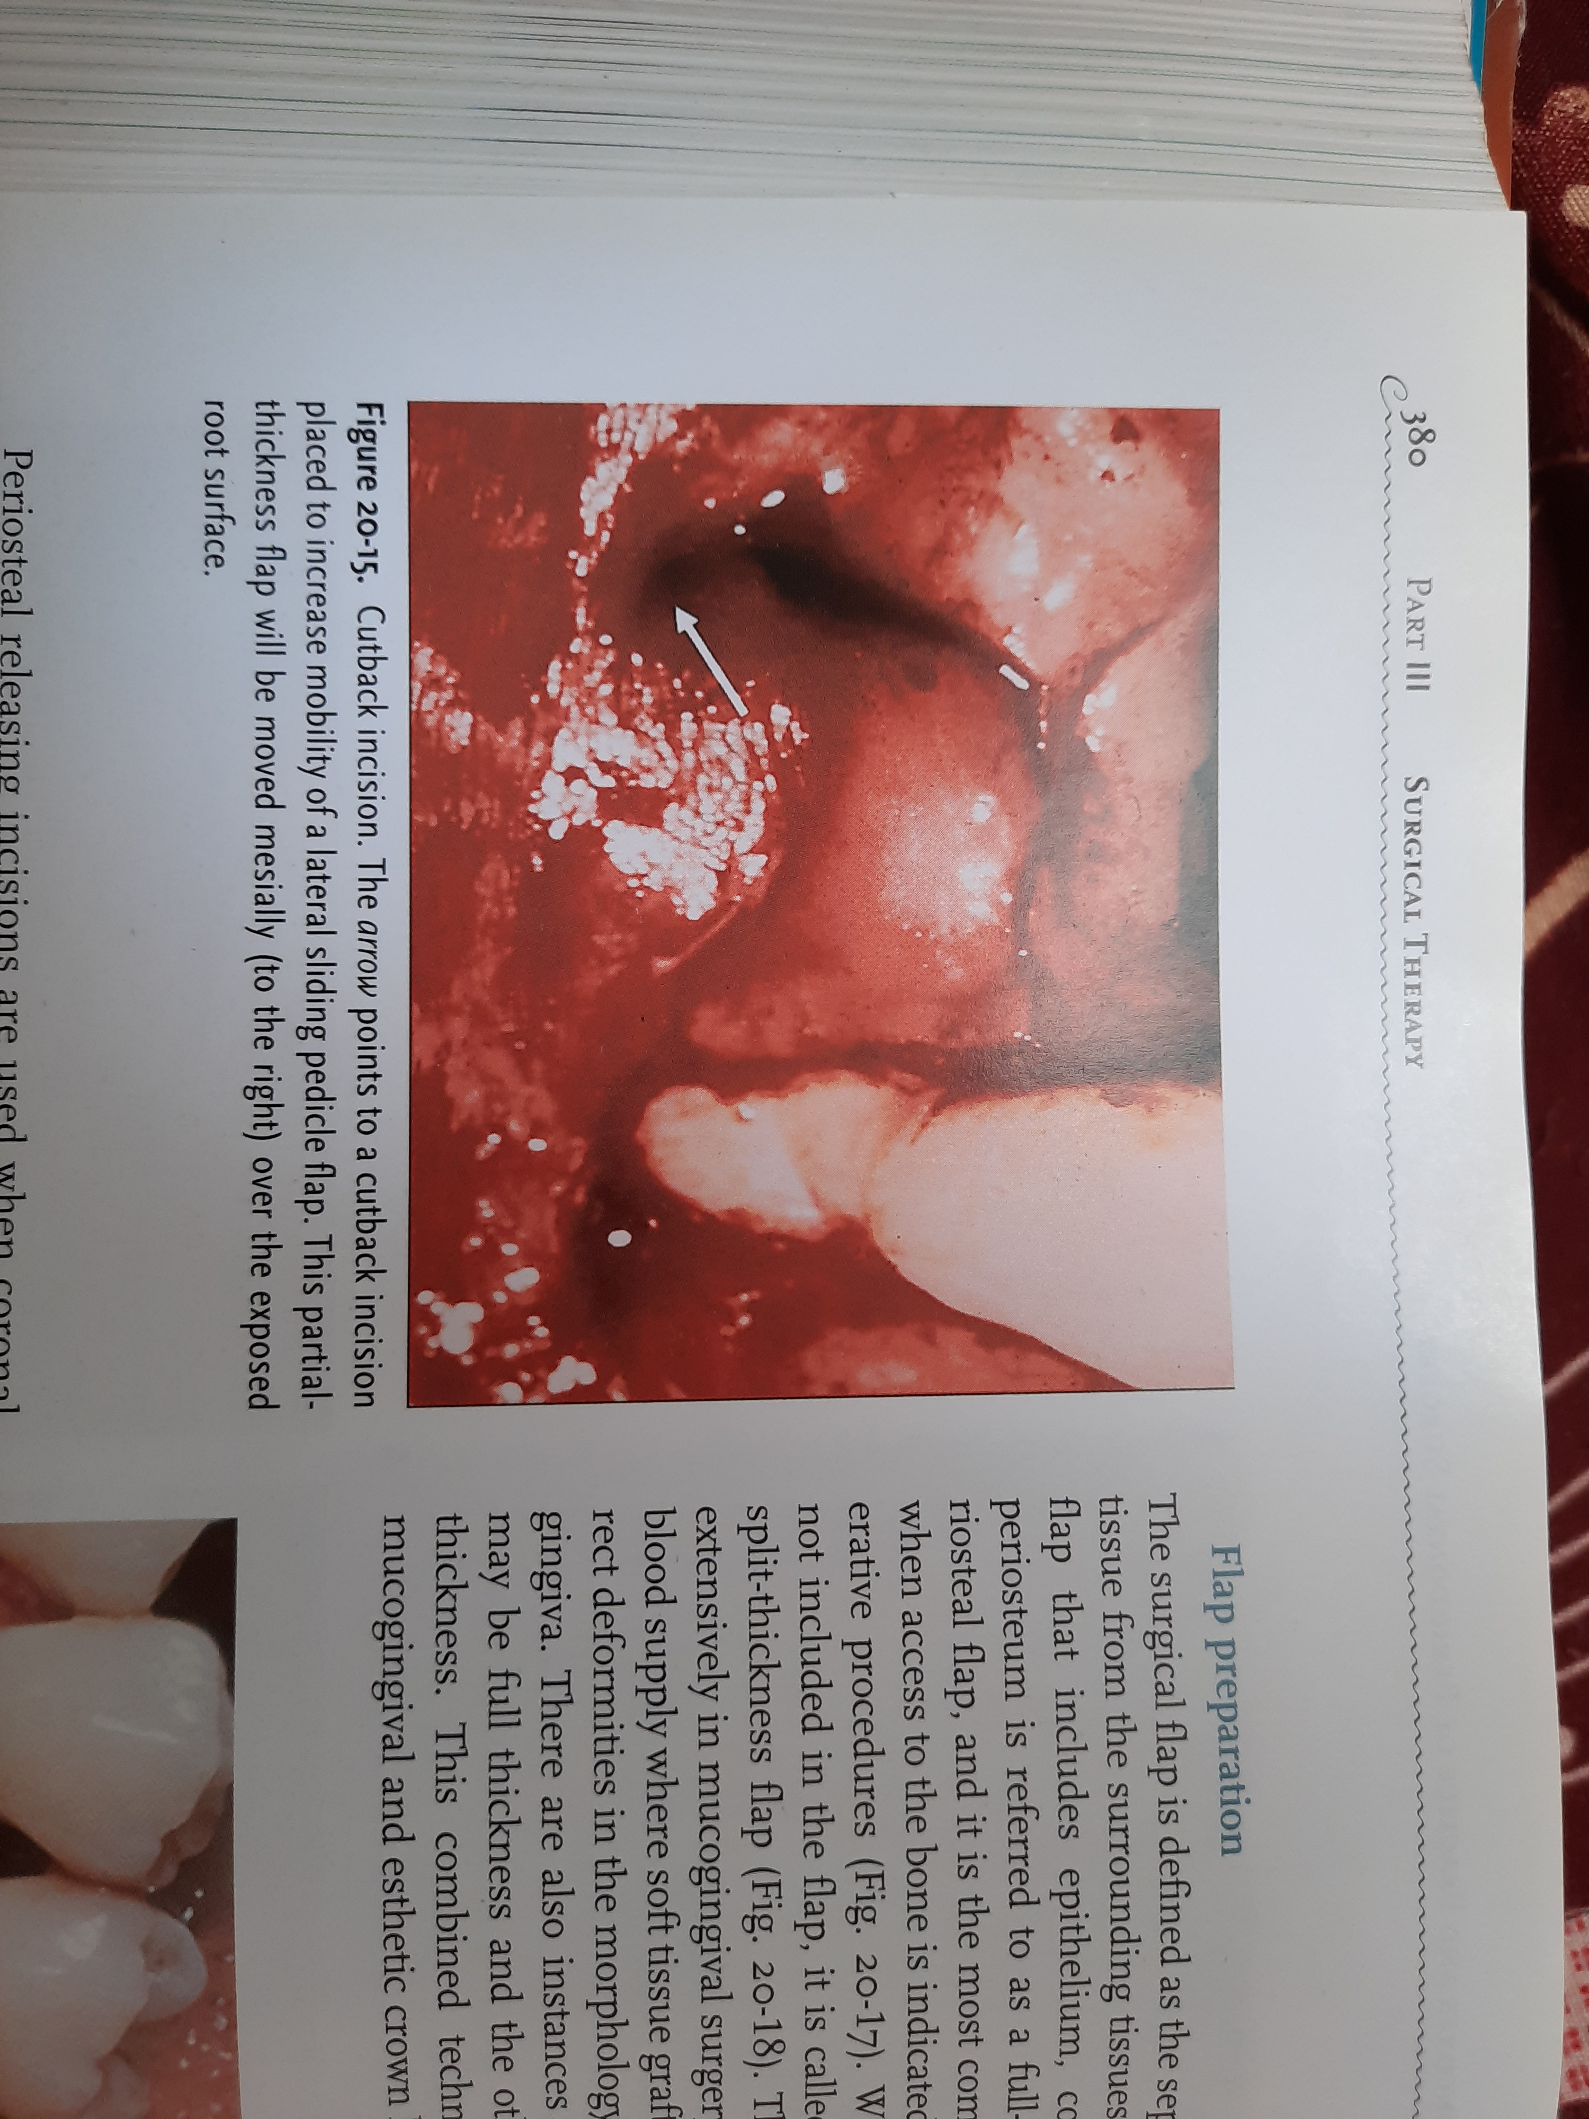
Cutback incision, are small incisions made at apical aspect of vertical releasing incisions, and they are used in conjunction with pedicle flaps to allow greater movement and less tension when the flaps are moved laterally.

Slide 37
Flap designs
Gingivectomy
Original Widman flap
Neumann flap
Kirkland flap
Modified Widman flap
Undisplaced flap
Apically displaced flap and MARF
Papilla preservation flap and modifications
Distal molar flap

Slide 38
Gingivectomy
Robicsek (1884) pioneered the so-called gingivectomy procedure.
Gingivectomy was later defined by Grant et al. ( 1979) as being "the excision of the soft tissue wall of a pathologic periodontal pocket".
The surgical procedure, which aimed at "pocket elimination", was usually combined with recontouring of the diseased gingiva to restore physiologic form.
Gingivectomy. The straight incision technique
(Robicsek 1884).
Gingivectomy. The scalloped incision technique
(Zentler 1918).

Slide 39
Indications
Elimination of suprabony pockets if the pocket wall is fibrous and firm
Elimination of gingival enlargements
The presence of furcation involvement(without associated bone defects) where there is wide zone of attached gingiva.
A gingival abscess, that is an abscess contained entirely by soft tissue
A pericoronal flap
Contraindications
1. Access to bone required
2. Narrow zone of keratinized tissue
3. Aesthetics
4. Patients with high postoperative risk of bleeding

Slide 40
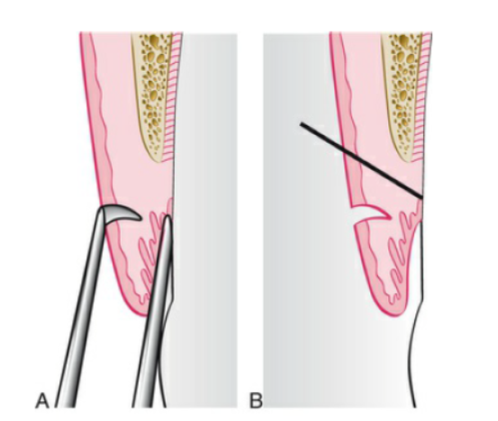
Marking the depth of a suprabony pocket. (A) A pocket marker in position. (B) The beveled incision extends apical to the perforation made by the pocket marker.

Slide 41
Gingivectomy procedure

Slide 42
Original Widman flap
The first detailed descriptions of the use of a flap procedure for pocket elimination was published in 1918 by Leonard Widman.
A mucoperiosteal flap design aimed at removing the pocket epithelium and the inflamed connective tissue, thereby facilitating optimal cleaning of the root surfaces.

Slide 43
Sectional releasing incisions
A scalloped reverse bevel incision is made outlining the gingival margin to connect two releasing incisions
A mucoperiosteal flap exposed and the collar of inflamed tissue removed
The buccal and lingual flaps were laid back over the alveolar bone and secured in this position with interproximal sutures

Slide 44
Advantages
Less discomfort for the patient, since healing occurred by primary intention and
It was possible to reestablish a proper contour of the alveolar bone in sites with angular bony defects.
Widman pointed out the importance of placing the soft tissue margin at the level of the alveolar bone crest, so that no pockets would remain.
The surgical procedure resulted in the exposure of root surfaces. Often the interproximal areas were left without soft tissue coverage of the alveolar bone.

Slide 45
Neumann flap (1920)
Intracrevicular incision
Full thickness flap elevated
Sectioning releasing incisions
Removal of pocket epithelium and granulation tissue with curette and root surface debridement
Thinning of the flap to allow proper adaptation

Slide 46
Modified flap operation(1931)
In1931 Kirkland described a surgical procedure to be used in the treatment of "periodontal pus pockets".
The procedure was called the modified flap operation, and is basically an access flap for proper root debridement.
The modified flap operation did not include-
(1) extensive sacrifice of non-inflamed tissues and
(2)apical displacement of the gingival margin. Since the root surfaces were not markedly exposed thereby, the method could for esthetic reasons be useful in the anterior regions of the dentition.

Slide 47
The incision is given intracrevicularly through the bottom of the pocket on both the labial and the lingual aspects of the interdental area.
The gingiva was retracted labially and lingually to expose the diseased root surfaces which were carefully debrided. Angular bony defects were curetted.
The exposed root surfaces are subjected to mechanical debridement
The flaps are replaced to their original position and sutured.

Slide 48
Apically repositioned flap (1954)
The terminology used for the first type of operation is the apically repositioned flap (previously called "Repositioning of the Attached Gingiva") by Nabers in 1954 ; for the second it is the apically displaced flap (originally known as the "pushback“).
It was later modified by Ariaudo & Tyrrell (1957) who advocated the use of two vertical incisions instead of one.
In 1962 Friedman proposed the term apically repositioned flap to more appropriately describe the surgical technique introduced by Nabers.

Slide 49
Friedman emphasized the that, at the end of the surgical procedure, the entire complex of the soft tissues ( gingiva and alveolar mucosa) rather than the gingiva alone was displaced in an apical direction.
Thus, rather than excising the amount of gingiva which would be in excess after osseous surgery (if performed), the whole mucogingival complex was maintained and apically repositioned.
This surgical technique was used on buccal surfaces in both maxillas and mandibles and on lingual surfaces in the mandible, while an excisional technique had to be used on the palatal aspect of maxillary teeth.

Slide 50
Factors determining the position of apically positioned flap.
Width and thickness of gingiva.
Thickness of marginal alveolar bone.
Amount of periodontal pocket to be eliminated.
Clinical crown length required for restorative/prosthetic treatment and esthetics.
Length of root trunk.

Slide 51
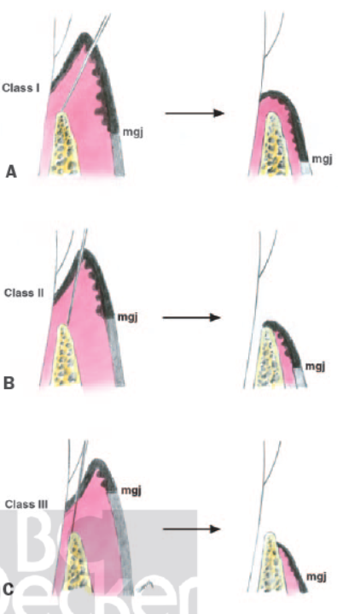
Friedman and Levin classification(1964)
A, Class I. More than adequate keratinized tissue; initial incisions buccal to the crest of gingiva and apically positioned to cover bone.
B, Class II. Adequate keratinized tissue; initial incision at the crest of gingiva and flap positioned only to the crest of bone.
C, Class III. Minimal or inadequate keratinized gingiva; sulcular incision and flap positioned apically to below
the crest of bone to increase keratinized gingiva

Slide 52
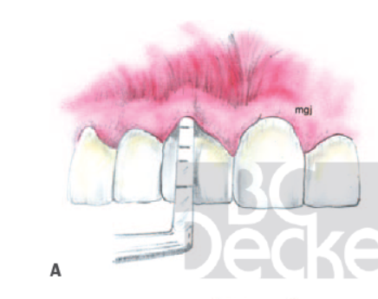
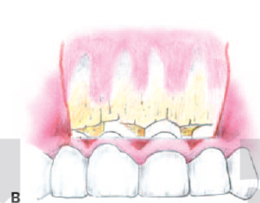
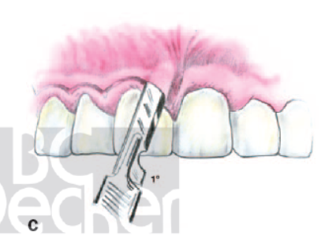
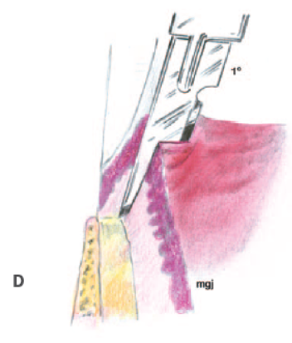
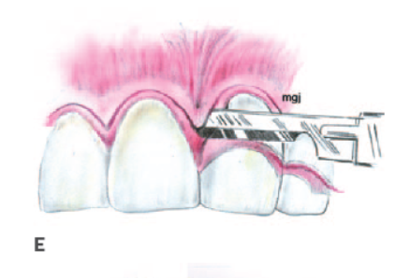
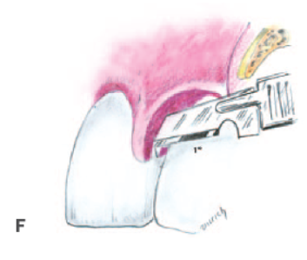
A and B, Deep pockets and bone loss with pockets probing to the mucogingival junction
C and D, Primary scalloped, inverse-beveled incision made down to the crest of bone. This primary incision thins the tissue. Vertical incisions are used to outline the flap.
E and F, The papilla is dissected to create a partial-thickness flap and thus remove the thick triangular wedge of interproximal tissue

Slide 53
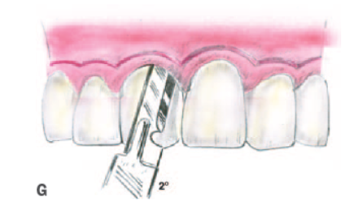
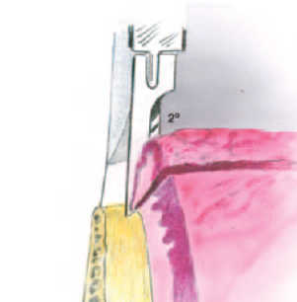
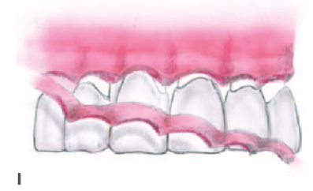
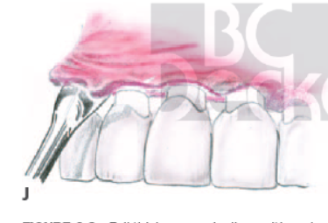
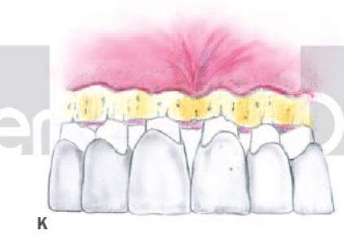
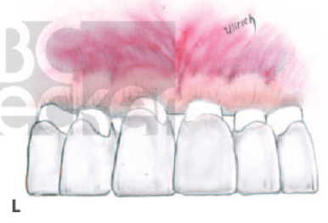
F
G and H, A secondary sulcular incision down to the crest of bone frees the inner flap of tissue
I, Scalers are used to remove the inner flap of tissue.
The flap is raised with a periosteal elevator.
K, Osseous resective measures are implemented
L, The flap is apically positioned to the crest of bone and sutured

Slide 54
full thickness apically repositioned flap
Pockets that extend beyond the mucogingival junction
Areas of minimal keratinized gingiva
Inductive or resective osseous surgery required
Enhance cleansibility
Facilitate restorative procedures
Unaesthetic or asymmetric gingival topography
Indications
Esthetic considerations
Inadequate keratinized gingiva
Teeth having a poor prognosis: excessive mobility, a poor crown-to-root ratio, and advanced attachment loss
Contraindications

Slide 55
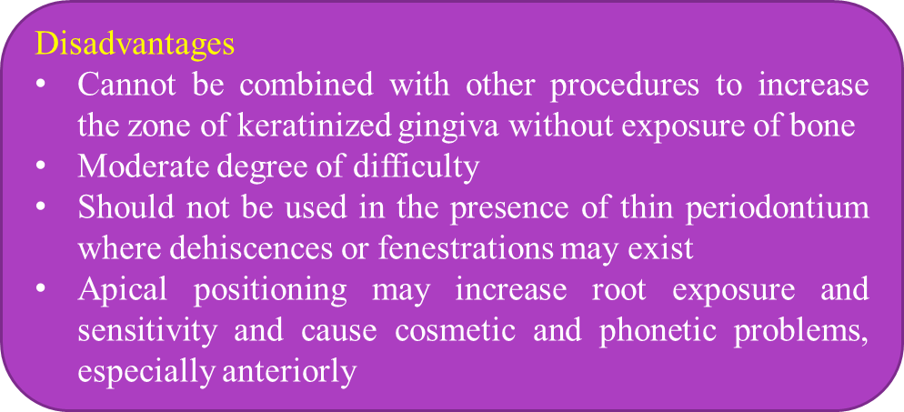
Advantages
Pocket elimination
Preservation of existing keratinized gingiva
Ability to perform inductive or osseous resective procedures
Relocation of frenulum
Primary intention healing
Access to roots for definitive scaling and root planing
Flaps can be positioned apically or coronally or unpositioned

Slide 56
Partial thickness apically repositioned flap
Indications
Areas of thin periodontium or prominent roots in which dehiscences or fenestrations may be present.
A need to increase the zone of keratinized gingiva
Contraindications
When the gingiva and mucosa covering the alveolar process are thin
Lack of keratinized gingiva
Narrow vestibular depth.
When extensive osseous surgery is required.
Large Intrabony defect requiring bone regeneration and restoration

Slide 57
Advantages
Eliminate pockets
Protect underlying bone (i.e., donor site of pedicle flap)
Can be combined with other mucogingival procedures to increase the zone of keratinized gingiva
Permit periosteal suturing for flap stabilization and exact positioning
Disadvantages
Cannot be used for osseous surgery without resulting in a ragged, torn periosteum
High degree of difficulty to perform
Secondary intention healing

Slide 58
BEVELLED flap
Friedman described a modification of the “ apically repositioned flap", which he termed the beveled flap.
This flap is indicated in periodontal pockets on the palatal aspect of the teeth.
Since there is no alveolar mucosa present on the palatal aspect of the teeth, it is not possible to reposition the flap in an apical direction.

Slide 59
In order to prepare the tissue at the gingival margin to properly follow the outline of the alveolar bone crest, a conventional mucoperiosteal flap is first resected.
The tooth surfaces are debrided and osseous recontouring is performed.
The palatal flap is subsequently replaced and the gingival margin is prepared and adjusted to the alveolar bone crest by a secondary scalloped and beveled incision.
The flap is secured in this position with interproximal sutures.

Slide 60
a) A primary incision is made intracrevicularly through the bottom of the periodontal pocket and b) a conventional mucoperiosteal flap is elevated
Scaling, root planing and osseous recontouring is performed in the surgical area
The palatal flap is replaced and a secondary, scalloped, reverse bevel incision is made to adjust the length of the flap to the height of the remaining alveolar bone.
The shortened and thinned flap is replaced over the alveolar bone and in close contact with the root surfaces.

Slide 61
Modified apically repositioned flap( 1999)
Modification of apically repositioned flap was proposed by Carnio (1999).
Unlike the apically positioned flap, it preserves the marginal gingiva thus avoiding the risk of recession.
It is recommended in cases where attached gingiva is desired.

Slide 62
Before the incisions were made, the level of crestal bone was probed to detect the presence of any bone dehiscence.
An iodine solution was used to stain the alveolar mucosa and to outline the width of keratinized and attached gingiva
A horizontal beveled incision was made in attached portion of the keratinized gingiva slightly apical to the alveolar crest. The mesial and distal extensions of the initial horizontal incision were determined by size of tooth and the gingival contour.

Slide 63
Two vertical incisions were placed on mesial and distal ends connecting the horizontal incision.
These incisions extended beyond mucogingival junction.
A spilt thickness flap was elevated, moved apically, and positioned at the desired level.

Slide 64
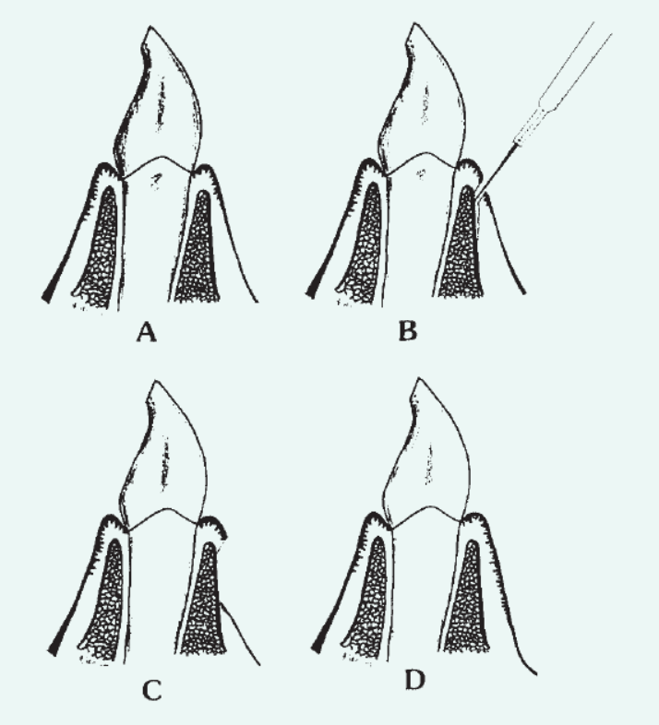

Slide 65
Undisplaced flap(1965)
The undisplaced flap was described by Morris(1965), named as ‘Unrepositioned Morris mucoperiosteal flap.’
The undisplaced flap may be the most frequently performed type of periodontal surgery. For the undisplaced flap, the submarginal scalloped internal bevel incision is initiated at a distance from the tooth that is roughly one-half to two-thirds the interdental transgingival probing depth.

Slide 66
This incision can be accomplished only if sufficient attached gingiva remains apical to the incision. Therefore, the two anatomic landmarks, the transgingival interdental probing depth and the mucogingival junction, must be considered to evaluate the amount of attached gingiva that will remain after surgery.
The internal bevel incision should be scalloped to create surgical papillae, which are essential to covering the interdental bone.
Proper placement of the flap margin at the alveolar crest during closure is important to prevent either recurrence of the pocket or exposure of bone.

Slide 67
Step 1: The periodontal probe is inserted into the gingival crevice and penetrates the junctional epithelium and connective tissue down to bone.
Step 2: The mucogingival junction is assessed to determine the amount of keratinized tissue.
Step 3:The initial placement of the submarginal scalloped internal bevel incision is based on the transgingival interdental probing depth and the mucogingival junction. The incision is made parallel to the long axis of the tooth and directed down to the alveolar bone. A short mesial vertical incision may be employed to allow flap release on the palate or to avoid extension of the horizontal incision into the aesthetic area.

Slide 68
Step 4: Full-thickness flaps are reflected 1 mm apical to the mucogingival junction.
Step 5: The crevicular is made in the gingival crevice to detach the attachment apparatus from the root.
Step 6: The gingival collar and granulation tissue are removed with curettes. The root surfaces are scaled and planed.
Step 7: Osseous recontouring is performed to eliminate defects and re-establish positive architecture.

Slide 69
Step 8: The flaps are coapted on the alveolar crest with the flap margin well adapted to the roots. The flaps may be trimmed and rescalloped if necessary.
Step 9: The flaps are stabilized with sutures and covered with a surgical dressing.

Slide 70
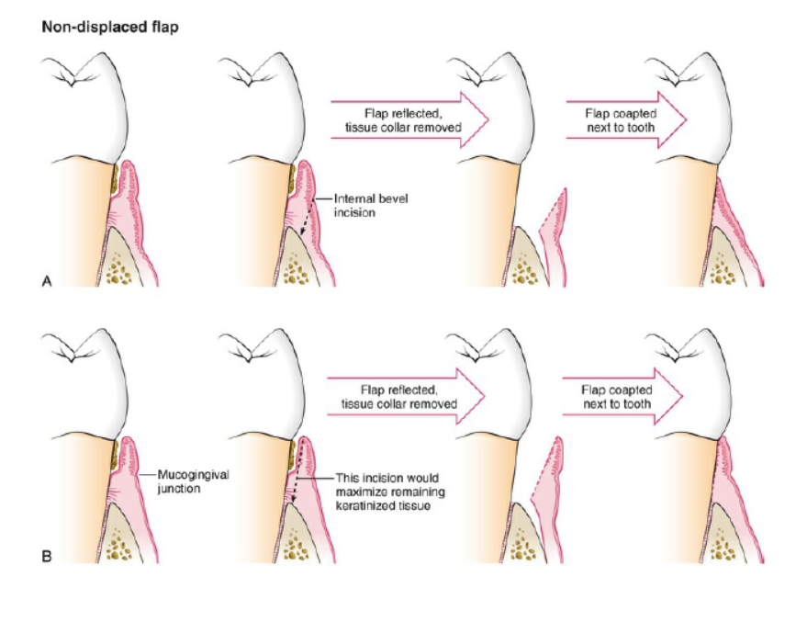

Slide 71
Distal wedge flap(1966)
The treatment of periodontal pockets on the distal surface of distal molars is complicated by the presence of bulbous tissues over the tuberosity or by a prominent retromolar pad.
The most direct approach to pocket elimination in such cases in the maxilla is the gingivectomy procedure.
However, when only limited amounts of keratinized tissue are present, or none at all, or if a distal angular bony defect has been diagnosed, the bulbous tissue should be reduced in size rather than being removed in toto. This may be accomplished by the distal wedge procedure (Robinson 1966).

Slide 72
Objectives of wedge procedure
Eliminate periodontal pockets
Maintain and preserve attached gingiva
Make area accessible to instruments
Lengthen the clinical crown

Slide 73
Flap design of wedge procedure
Three flap designs are used in wedge procedure: square, linear, triangular.
A flap design is determined by size of edentulous ridge, maxillary tuberosity, retromolar triangle,the thickness of the soft tissue, difficulty of access, band of attached gingiva of the abutment tooth, depth of periodontal pocket and degree of osseous defect on the edentulous side of the abutment, clinical crown length required as an abutment for restorative/prosthetic treatment.

Slide 74
Selection of incision in the wedge procedure

Slide 75
Square incision-
This technique allows conservation of keratinized tissue and maximum closure. It also provides greater access to the underlying bony topography and the distal furcation. It is indicated where the tuberosity is longer.
Using a no. 15 blade, two parallel inverse beveled thinning incisions are made. They begin at the distal end of the edentulous area and are continued to the tooth. Two more incisions are made to free the flaps, one in the sulcus adjacent to the tooth and the other at the terminal end of the operative field. The blade is directed toward the buccal and palatal aspects of the edentulous ridge as the incisions are made.

Slide 76
Periosteal elevators are used to raise the flaps buccally and lingually or palatally.
Kirkland or Orban knives may be used to remove the wedge of tissue down to the bone. After the bone is exposed and the necessary osseous surgery and scaling and root planning have been complete, interrupted sutures are used for closure.

Slide 77
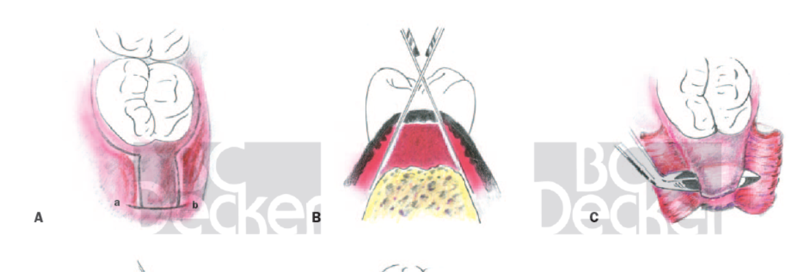
A, Occlusal view with incisions outlined. Note two parallel incisions over tuberosity joined by distal releasing incision (a, b). B, Cross-sectional view shows proper blade angulation in making initial incisions. C, Kirkland knife is used to remove the wedge.

Slide 78
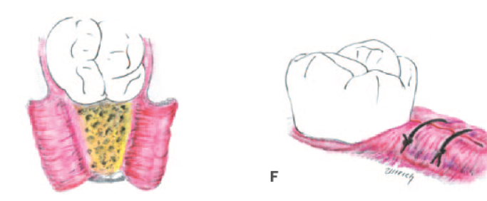
D
E
D, Flaps reflected and tissue being removed from tuberosity using a periodontal knife and Bone exposed for correction of osseous irregularities. E, Final suturing.

Slide 79
Triangular incision-
This requires an adequate zone of keratinized tissue and can be used in a very short or small tuberosity.
A triangular incision is made distal to the last molar using a no. 12 or no. 15 scalpel blade. Using scalers, hoes, or knives, the triangular wedge of tissue is removed
The walls of the wedge are thinned or undermined, using scalpel blades to allow proper adaptation to the underlying bone. Periosteal elevators are used to reflect the flap. It is sometimes necessary to use small releasing incisions at the apex of the incision to relieve tension. Once the osseous corrective procedures have been completed and the teeth scaled, root planed, and flushed of debris, primary closure is done by interrupted sutures

Slide 80
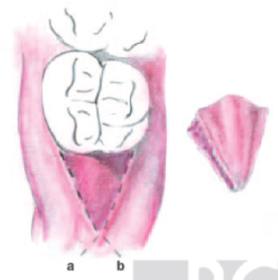
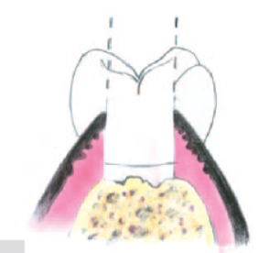
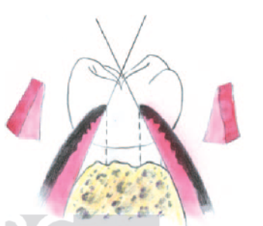
A, Outline of triangular incision distal to the molar. Note the outline of two small releasing incisions (a, b), which can
be used if needed. B, Cross-sectional view showing wedge removal and thick tissue. C, Undermining incisions are used to thin the tissue.

Slide 81
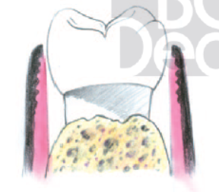
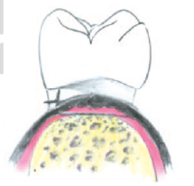
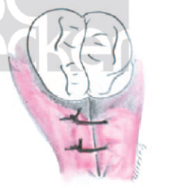
D, Reflection of flaps for osseous correction. E and F, Cross-sectional and occlusal views of sutured tissue.

Slide 82
Linear incision- A linear distal wedge incorporates two parallel incisions over the crest of the tuberosity that extend from the proximal surface of the terminal molar to the hamular notch area. The distance between two linear incisions is determined by thickness of the tissues, with wider separation of the incisions in the thicker tissue.
Vertical releasing incision placed perpendicular and at the posterior aspect of the linear wedge will allow greater access to the underlying bone.
The parallel linear incision are blended into scalloped incisions at the distal of the terminal tooth and are extended for the buccal and palatal access.
Thinning incision and removal of distal wedge are completed and sutures are placed.

Slide 83
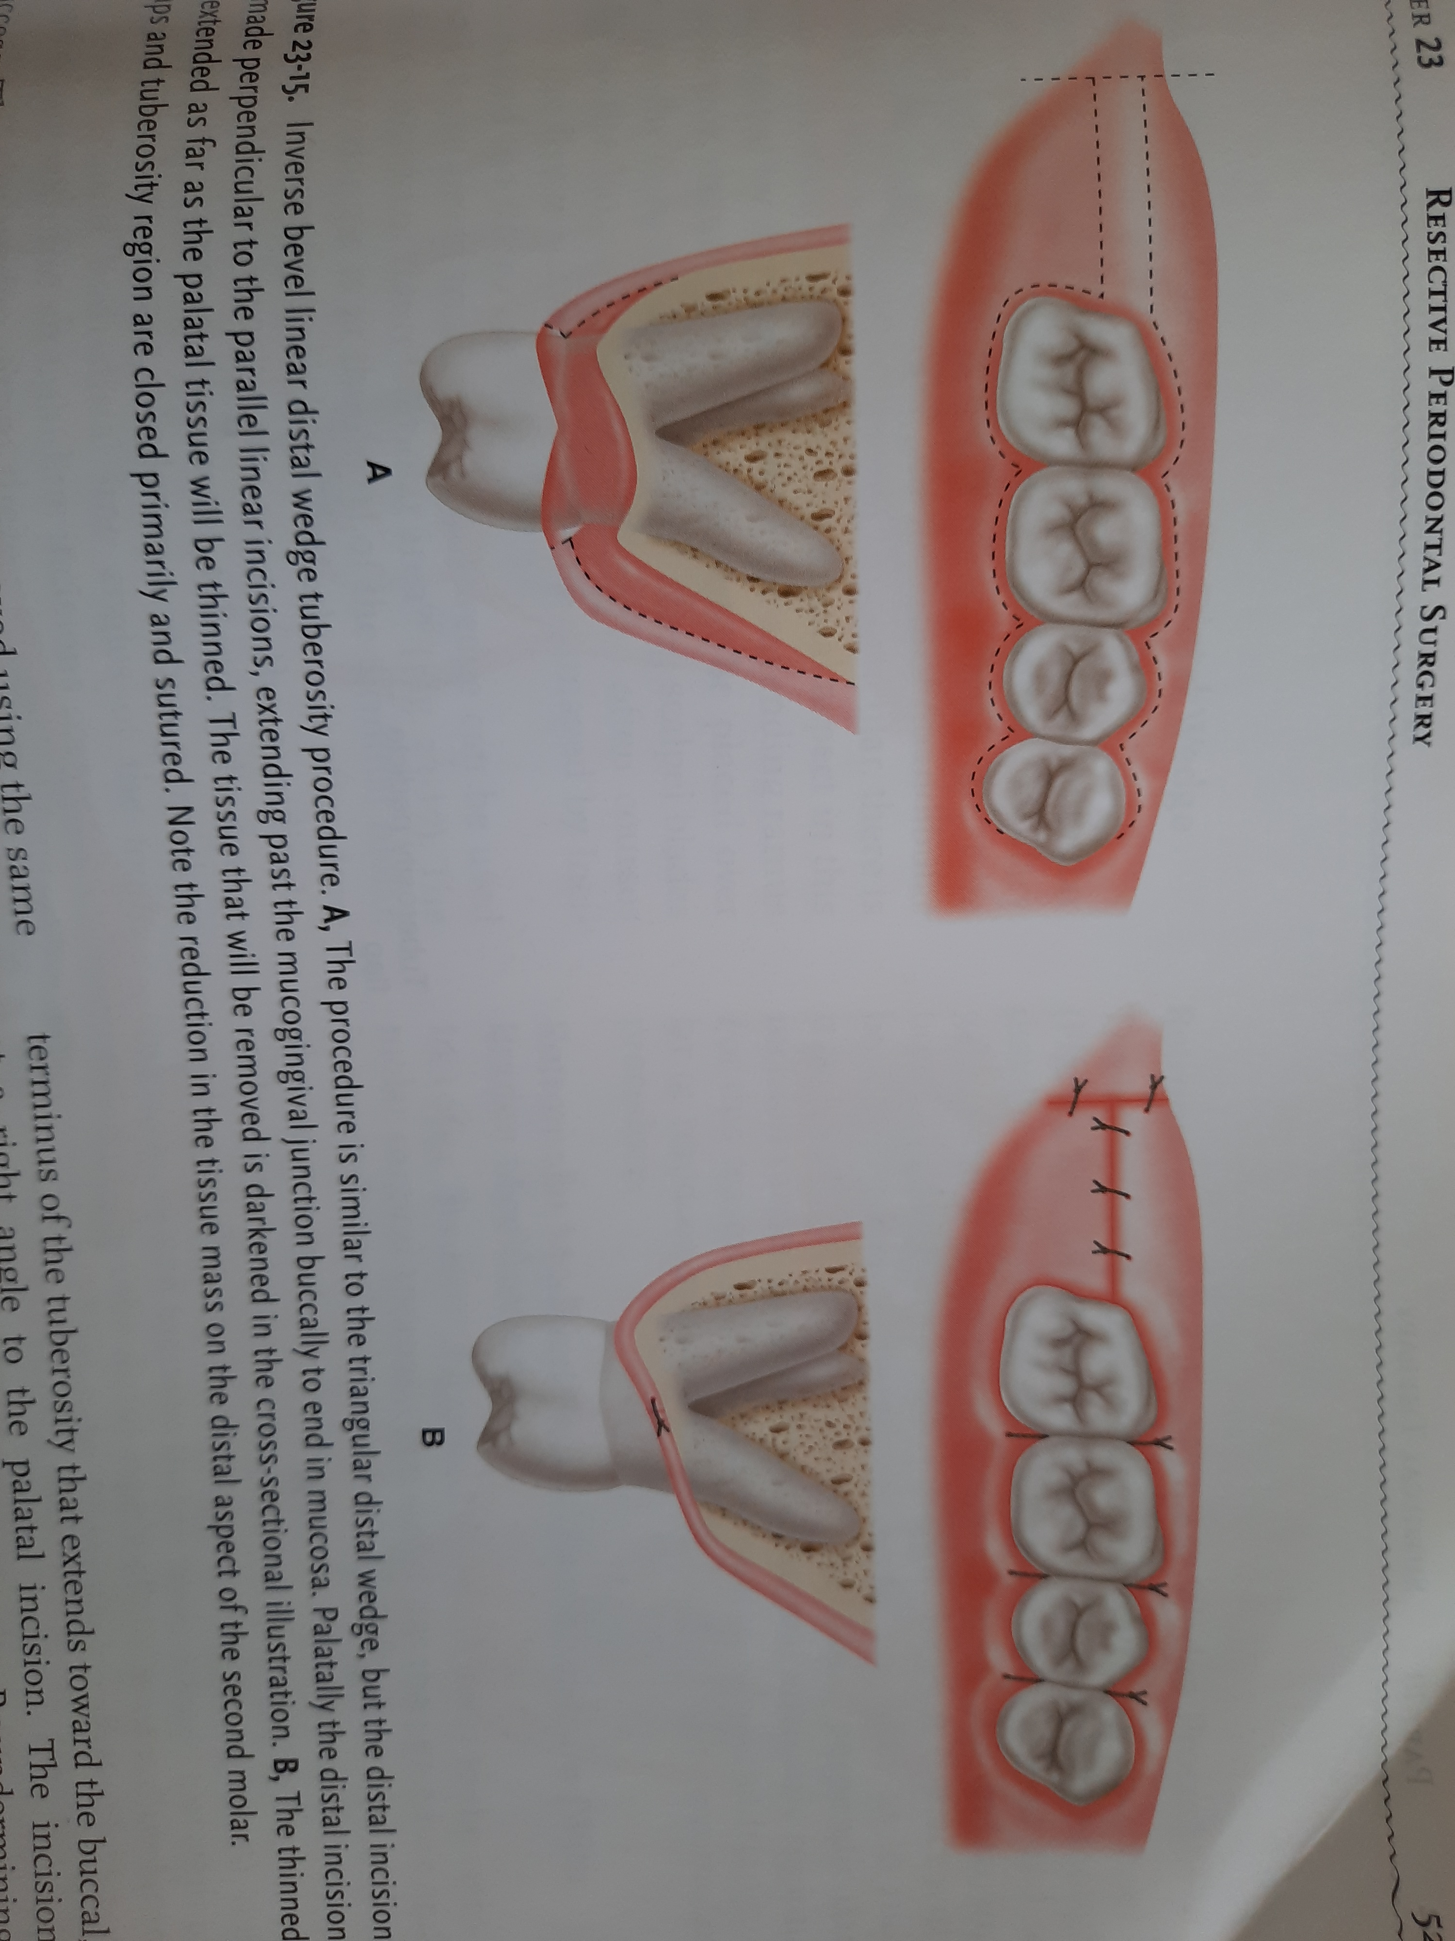
A- the procedure is similar to triangular wedge except ,the distal incision is made perpendicular to linear incisions, extending pass the mucogingival junction buccally to end in mucosa. The tissue that will be removed is given in cross-section. B- the thinned flap and tuberosity region are closed primarily and sutured

Slide 84
Trap door procedure(pedicle flap or pedicle incision)-
It was designed to manage maxillary tuberosity region in the presence of pocket depths.
It provides excellent access to bone deformities and complete coverage of tuberosity.

Slide 85
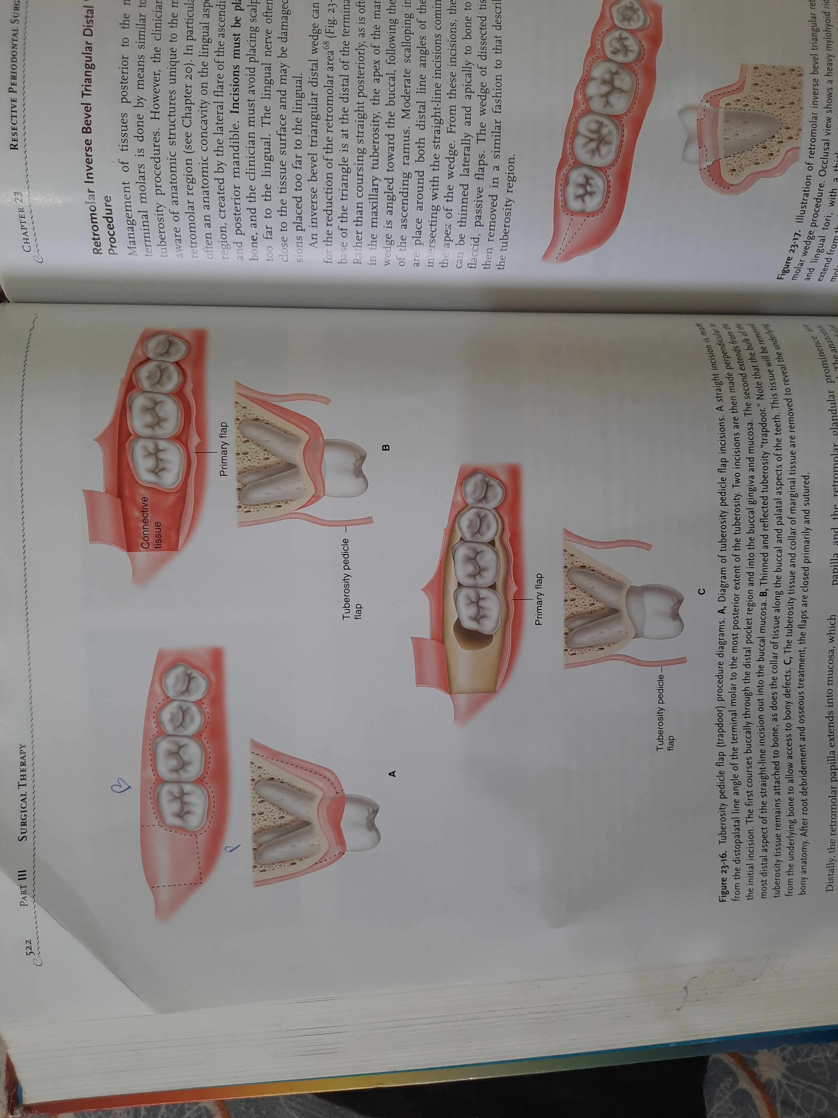
The initial incision, an inverse beveled straight line palatal incision extending from distopalatal line angle of the terminal molar to the most posterior extent of tuberosity.
Two incisions are made perpendicular to initial incisions. The first courses buccally through the distal pocket region and into the buccal gingiva and mucosa. The second extends from the more distal aspect of the straight line incision out into the buccal mucosa
B
P

Slide 86
Thinned and reflected tuberosity “trapdoor”.
Note the bulk of the tuberosity tissue remains attached to bone, as does the collar of tissue along the buccal and palatal aspects of the teeth

Slide 87
The collar tissue is removed from the underlying bone to allow access to the bony defects.

Slide 88
Modified Widman flap( 1974)
Ramfjord & Nissle (1974) described the modified Widman flap technique, which is also recognized as the open flap curettage technique.

Slide 89
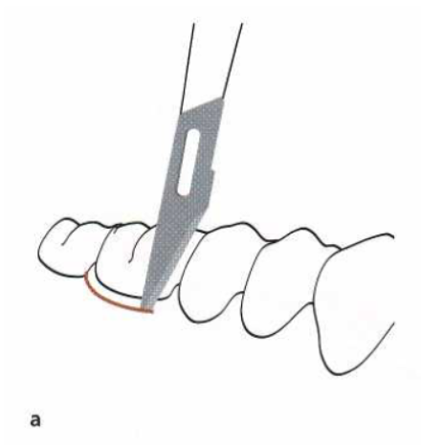

The initial incision, which may be performed with a Bard-Parker knife (No. 11), should be parallel to the long axis of the tooth and placed approximately 1 mm from the buccal gingival margin in order to properly separate the pocket epithelium from the flap.

Slide 90


Following careful elevation of the flaps, a second intracrevicular incision (a) is made to the alveolar bone crest (b) to separate the tissue collar from the root surface.

Slide 91


A third incision made in a horizontal direction and in a position close to the surface of the alveolar bone crest separates the soft tissue collar of the root surfaces from the bone.

Slide 92
The pocket epithelium and the granulation tissues are removed by means of curettes. The exposed roots are carefully scaled and planed, except for a narrow area close to the alveolar bone crest in which remnants of attachment fibers may be preserved. Angular bony defects are carefully curetted.
Following the curettage, the flaps are trimmed and adjusted to the alveolar bone to obtain complete coverage of the interproximal bone.
If this adaptation cannot be achieved by soft tissue recontouring, some bone may be removed from the outer aspects of the alveolar process in order to facilitate the all-important flap adaptation.

Slide 93


(a) Following proper debridement and curettage of angular bone defects, the flaps are carefully adjusted to cover the alveolar bone and sutured. (b) Complete coverage of the interdental bone as well as close adaptation of the flaps to the tooth surfaces should be accomplished.

Slide 94
Advantages
1. Minimal bone removal
2.Immediate close postsurgical contact of healthy collagenous tissue with the tooth surface
3. Maximum conservation of periodontal tissue
4. Esthetic desirability
5. Facilitation of oral hygiene
6. Less root exposure with less sensitivity
7. Less mechanical trauma than closed curettage
Disadvantages
1. Technically demanding and exacting
2. Requires a high degree of technical skill
3.Interproximal flaps require exact placement
4. Immediate unfavourable interproximal contours when dressings are first removed

Slide 95
Papilla preservation flap(1985)
To preserve the interdental soft tissues for maximum soft tissue coverage following surgical intervention involving treatment of proximal osseous defects, Takei et al. (1985) proposed a surgical approach called papilla preservation technique.
It is indicated in Embrasures wide enough to permit passage of the interproximal tissue.

Slide 96
Procedure
Buccally, interproximally, and palatally/lingually, the flaps are relieved with intrasulcular incisions, keeping the blade adjacent to the tooth.
Vertical incisions are made palatally/lingually adjacent to the papillae that are to be moved.
The vertical incisions are extended far enough apically so that they will be at least 3 mm apical to the margin of the interproximal bony defect and 5 mm from the gingival margin.
The vertical incisions are joined by a horizontal incision, which can be made with a Kirkland knife

Slide 97
For flap reflection, a curette or interproximal knife is used to free the interdental tissue from the underlying tissue.
With a blunt instrument, the papilla is carefully pushed through the embrasure, and excessive granulation is removed from the underside with a sharp scissors or curette.
Overthinning is to be avoided. Both the flap and the papilla are reflect off the bone with a periosteal elevator.
Once the defect area is debrided and filled, the flaps are repositioned and the papilla is pushed back through the embrasure and sutured with interrupted or horizontal mattress sutures

Slide 98


B
A, Palatal view with incisions outlined
B, Completion of palatal incisions

Slide 99



D
E
C
C, A periosteal elevator is used to reflect individual papillary flaps.
D, A blunt instrument used to push tissue buccally, exposing underlying osseous deformities and subgingival root deposits. Defects debrided, root scaled, and root planed
E, Flaps sutured palatally. Suturing should avoid papillary compression, which may result in loss of interproximal tissue height

Slide 100





Slide 101





Slide 102
Advantages
1. Aesthetically pleasing
2. Primary coverage of implant material
3. Prevention of postoperative tissue craters
Disadvantages
1. Technically difficult
2. Time consuming

Slide 103
Modified papilla preservation flap(1995)
A technique proposed by Takei et al., achieved primary closure in the interproximal space, but maintaining it over time is more elusive in most situations when a barrier membrane is used.
Furthermore, whenever regeneration of the suprabony component is attempted by overfilling the intrabony defect or by placing a barrier membrane coronal to the interproximal alveolar bone crest, a substantial coronal positioning of the flaps is required to obtain primary closure of the interproximal area. This objective can hardly be achieved with current surgical techniques.

Slide 104
To obtain both coronal positioning of the flap and primary closure of the interdental space prior to attempting regeneration of the suprabony component of the defect, Cortellini et al. (1995) proposed technique as modified papilla preservation flap.

Slide 105
Procedure
A buccal and interproximal intrasulcular primary incision to the alveolar crest, involving the two teeth neighboring the defect, was performed.
A horizontal incision with a slight internal bevel was then traced in the buccal gingiva of the interdental space at the base of the papilla.
This incision was connected with the primary incision in the most apical portion of the buccal gingival margin of the neighboring teeth.

Slide 106
A full thickness buccal flap was elevated to the level of the buccal alveolar crest. The buccal and interproximal primary incision was then continued intrasulcularly in the interproximal space to reach the palatal line angle and extended to the palatal aspect.
A buccal horizontal incision was performed in the interproximal supracrestal connective tissue, just coronal to the bone crest, to dissect the papilla. The papilla was elevated towards the palatal aspect.

Slide 107
Following extension of the palatal incision, a full thickness palatal flap including the interdental papilla was subsequently elevated to fully expose the interproximal defect. The tissue thickness of the papilla was reduced. The defect was fully debrided and scaling and root planing performed.
To allow the coronal positioning of the buccal flap in the absence of tension, vertical releasing incisions extending into the alveolar mucosa were placed in the interproximal spaces mesial and distal to the teeth neighboring the defect.

Slide 108
The buccal flap was then released with a split thickness incision. An interproximal membrane was adapted and positioned supracrestally as close as possible to the CEJ.
The occlusive portion of the membrane extended at least 3 mm beyond the margin of the defect.
The membrane was firmly secured to the neighboring teeth with sling sutures. Then both the flaps were sutured.

Slide 109


Intrasulcular incision to the alveolar crest
A horizontal incision given at the base of papilla and the buccal flap is reflected. The papilla is been mobilized by performing a buccal horizontal incision in the interproximal supracrestal connective tissue just coronal to the alveolar crest.

Slide 110


The papilla is elevated from the buccal aspect
The intrasulcular incision is continued in palatal aspect. The elevated papilla is pushed on palatal side.

Slide 111
Simplified papilla preservation flap(1999)
A novel surgical procedure specifically designed to access interdental spaces in the regenerative treatment of deep intrabony defects is presented.
This procedure (simplified papilla preservation flap. SPPF) was designed to provide surgical access to interproximal bony defects while preserving interdental soft tissues, even in narrow interdental spaces and posterior teeth.

Slide 112
Following local anesthesia, first incision was traced across the defect-associated papilla.The incision started from the gingival margin at the buccal line angle of the involved tooth to reach the mid-interproximal portion of the papilla under the contact point of the adjacent tooth.
This oblique incision was carried out keeping the blade parallel to the long axis of the teeth to avoid excessive thinning of the remaining interdental tissues.

Slide 113
The first oblique interdental incision was continued intrasulcurally in the buccal aspect of the teeth neighboring the defect and extended to partially dissect the papillae of the adjacent interdental spaces. These incisions allowed the elevation of a buccal flap and exposure of 2 to 3 mm ot alveolar bone.
The remaining tissues of the defect-associated papilla were carefully dissected from the root surfaces of the 2 neighbouring teeth, A buccolingual horizontal incision was then performed at the base of the papilla as close as possible to the interproximal bone crest, taking care to ovoid a lingual/ palatal perforation.

Slide 114
Intrasulcular incisions were performed in the lingual/palatal aspect of the 2 teeth neighboring the defect and extended to the interdental papillae of the adjacent interdental spaces.
A full thickness lingual/palatal flap was gently elevated, starting from the extremities of the intrasulcular incisions. This interproximal papillary tissues at the defect site were gently elevated along with the lingual/palatal flap

Slide 115
A full-thickness lingual/palatal flap including the interdental tissues was then elevated to fully expose the interproximal defect. The defect was fully debrided and the root surfaces were carefully scaled and planed with a combination of manual and sonic instruments
An interproximal membrane was adapted and positioned just coronal to the interproximal alveolar crest.The membrane extended at least 3 mm beyond the margin of the defect and was secured to the neighboring teeth with resorbable sling sutures. Then the buccal and lingual/palatal flaps were sutured.

Slide 116


Presurgical appearance of the area that will be accessed with the SPPF. The defect is located on the mesial aspect of the maxillary right lateral incisor
First oblique incision in defect associated
papilla begins of gingival margin of mesiobuccal line angle of lateral incisor Blade is kept parallel to the long axis of the tooth and reaches the midpoint of the distal surface of the central incisor just below the contact point.

Slide 117


First oblique incision continues intrasulcularly in the buccal aspect of the lateral and central incisors, extending until the adjacent papillae, and a buccal full-thickness flap is elevated to expose 2 to 3 mm of bone. Note the defect-associated papilla still in place.
Buccolingual horizontal incision of base of the papilla is as close as possible to the interproximal bone crest. Care is taken ta avoid a lingual/palatal Perforation.

Slide 118


Intrasulcular interdental incisions continue in the palatal aspect of the incisors until the adjacent partially dissected papillae. Full-thickness palatal flap including the interdental papilla is elevated.
Infrabony defect following debridement. Note the position of the bone crest on the distal aspect of the central incisor.

Slide 119


Membrane is positioned to cover defect and 2 to 3 mm of remaining bone and secured of neighboring teeth. Horizontal internal mattress suture runs from the base of the keratinized tissue ot the midbuccal side of the central incisor to a symmetric location at the base of the palatal flap. This suture causes no direct compression of the midportion of the membrane, preventing its collapse into the defect.
Primary closure and complete coverage of the membrane are obtained.

Slide 120
Healing after flap surgery
Immediately after suturing, a connection between the flap and the tooth or bone surface is established by a blood clot.
One to 3 days after flap surgery, the space between the flap and the tooth or bone is thinner. Epithelial cells migrate over the border of the flap, and they usually contact the tooth at this time.
One week after, an epithelial attachment to the root has been established by means of hemidesmosomes and a basal lamina. The blood clot is replaced by granulation tissue derived from the gingival connective tissue, the bone marrow, and the periodontal ligament.
One month after surgery, a fully epithelialized gingival crevice with a well-defined epithelial attachment is present.
Two weeks after surgery, collagen fibers begin to appear parallel to the tooth surface

Slide 121
Full-thickness flaps, which denude the bone, result in superficial bone necrosis after 1 to 3 days. Osteoclastic resorption follows and reaches a peak at 4 to 6 days and then declines thereafter. This results in a loss of bone of about 1 mm cubic; the bone loss is greater if the bone is thin.
Osteoplasty with the use of diamond burs results in areas of bone necrosis with a reduction in bone height, which is later remodeled by new bone formation.

Slide 122
Postsurgical complications
The risks of surgery include pain, swelling, blood loss, reaction to medications, and infection. Other potential risks include root sensitivity, flap sloughing, root resorption or ankylosis, some loss of alveolar crest, flap perforation, abscess formation, and irregular gingival contours.
The incidence of these complications is low (1%) as reported by Pack & Haber. They found only infections in 884 operation. performed without antibiotics, while 1 infection was noted in 43 operations with antibiotic coverage.

Slide 123
Curtis et al. also compared the incidence and severity of postoperative complications and pain among flap surgery, osseous surgery and mucogingival surgery. They reported only 5.5% of 304 treated cases had experienced moderate to severe pain.
If postoperative complications occur, they should be managed by prompt and appropriate treatment, which may include control of bleeding, adequate analgesics or antibiotics.

Slide 124

Postsurgical management

Slide 125
Clinical outcomes of flap surgery

Slide 126

Elaborate from Linde

Slide 127


Slide 128


Slide 129


Slide 130


Slide 131
Single buccal flap, MIST

Slide 132
summary
Periodontal surgery is an adjunct to nonsurgical periodontal therapy, and should occur only once the patient has demonstrated effective biofilm control.
The primary objective of periodontal access surgery is access for root instrumentations.
The secondary objective of periodontal access surgery is pocket reduction through soft tissue resection, osseous resection, or periodontal regeneration.

Slide 133
Periodontal flap surgery is the most widely used surgical procedure for periodontal pocket therapy.
Periodontal flaps are advantageous and versatile in providing not only access for root instrumentation but also access for osseous surgery and periodontal regeneration.
Flap surgery also allows for primary closure, which enhances wound healing and minimizes patients' discomfort.
Papilla preservation techniques are useful in regenerative therapy, as well as minimizing recession and loss of interdental papilla in the aesthetic area.

Slide 134
The “distal wedge” procedure is popular and widely practiced, it is perhaps one of the most difficult procedures to execute well due to the location of the surgical site, as well as the challenges presented by the anatomy of the mandibular retromolar pad and the maxillary tuberosity.
The distal wedge procedure is not simply removing a “wedge of tissue” distal to the terminal molar to reduce or eliminate a pocket.
Well-executed distal terminal molar flap surgery requires the flaps to approximate intimately to allow for primary closure and in an apical position to achieve pocket reduction.

Slide 135
Short-term and long-term success of periodontal access surgery is dependent on biofilm control and long-term maintenance.
The patient must understand the etiology of the periodontal disease and its prevention. Surgery in the absence of effective biofilm control and maintenance will result in failure and recurrence of disease.

Slide 136
references
Lindhe J. Clinical periodontology and implant dentistry. Lang NP, Karring T, editors. Oxford: Blackwell Munksgaard; 2003 Jun.
Newman MG, Takei H, Klokkevold PR, Carranza FA. Newman and Carranza's Clinical Periodontology E-Book. Elsevier Health Sciences; 2018 May 29.
Rose LF, ...[et al.]. Periodontics: medicine, surgery, and implants. St. Louis^ eMissouri Missouri: Elsevier Mosby; 2004 Aug 6.
Eley BM, Soory M, Manson JD. Periodontia. Elsevier Health Sciences; 2012 Feb 28.

Slide 137
Cohen ES. Atlas of cosmetic and reconstructive periodontal surgery. PMPH-USA; 2007.
Sato N. Periodontal surgery: a clinical atlas. Quintessence Pub Co; 2000.
Hom-Laywang & Henry Greenwell: Surgical periodontal therapy. Periodontology 2000, Vol. 25, 2001, 89–99.
Beckham LC, Cederbaum AD, Levy L, O'Connell R, Salkind A. A history of periodontal surgery and suggested changes in terminology and nomenclature. The Journal of Periodontology. 1962 Apr;33(2):101-4.
Borchard R, Erpenstein H. Incisions and Tissue Management in Periodontal Surgery. Periodontal Practice Today. 2004 Apr 1;1(2).
Gold SI. Robert Neumann: a pioneer in periodontal flap surgery. Journal of periodontology. 1982 Jul;53(7):456-9.

Slide 138
Ramfjord SP, Nissle RR. The modified Widman flap.J Periodontol;1974
Cortellini P, Prato GP, Tonetti MS. The modified papilla preservation technique. A new surgical approach for interproximal regenerative procedures. Journal of Periodontology. 1995 Apr;66(4):261-6.
Cortellini P, Prato GP, Tonetti MS. The simplified papilla preservation flap. A novel surgical approach for the management of soft tissues in regenerative procedures. International Journal of Periodontics & Restorative Dentistry. 1999 Dec 1;19(6).
Carnio J, Miller Jr PD. Increasing the amount of attached gingiva using a modified apically repositioned flap. Journal of periodontology. 1999 Sep;70(9):1110-7.

Slide 139
Thank you

