Slide 1
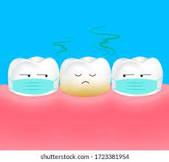
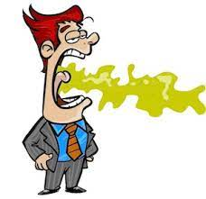
HALITOSIS
GUIDED BY :
Dr. Vishnudas Bhandari
Dr. Om Baghele
Dr. Gauri Ugale
Dr. Raghavendra Metri
Presented by :
-Dr. Surbhi Patil
(MDS-II)

Slide 2
CONTENTS
INTRODUCTION
SYNONYMS
HISTORY
CLASSIFICATION
EPIDEMIOLOGY
SOCIO‑ECONOMIC AND PHYSIOLOGICAL ASPECTS
ETIOLOGY
ASSOCIATION BETWEEN HALITOSIS AND PERIODONTAL DISEASE
DIAGNOSIS
EXAMINATION
TREATMENT
CONCLUSION

Slide 3
INTRODUCTION
Breath odor can be defined as the subjective perception after smelling someone’s breath.
(Carranza 13th edition)
Breath that is offensive to others, caused by a variety of reasons including but not limited to periodontal disease. bacterial coating of tongue, systemic disorders, and different types of food.
(GPT)
It can be pleasant, unpleasant, or even disturbing,if not repulsive.

Slide 4
SYNONYMS :
Bad or foul breath
Breath malodour
Oral malodour
Foetor ex-ore
Foetor oris
Stomato dysodia

Slide 5
DAYS OF YORE
Modern literature on bad breath dates back to a monograph published by Howe in the nineteenth century.
Since the 1960’s, Dr. Joseph Tonzetich of Columbia, who unfolded the biologic basis for oral malodor, has been a pre-eminent researcher in this field.
In fact, Hippocrates is credited with having cited the nose as being ‘a true diagnostic guide’.
Although the term halitosis was introduced by Listerine Company in 1921, bad breath is not merely a modern affliction.

Slide 6
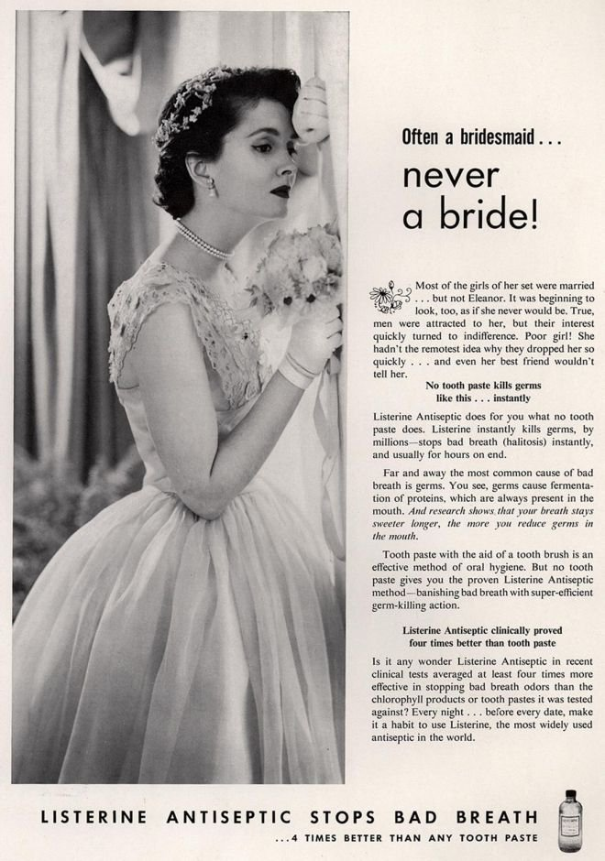
The phrase ‘always a bridesmaid, never a bride’, was actually created as part of a 1930’s ad campaign for Listerine mouthwash.
The problem of halitosis has been documented since years having been mentioned in some form or the other in the papyrus manuscripts, by Hippocrates, Romans, Hindus, Christians and the Buddhist monks.
The Romans used mechanisms to hide halitosis, such as perfumed tablets, chewing leaves and stalks of plants.
In Antiquity, having a fragrant breath meant exhaling the sweetness of life and asserting the purity of a person's soul.

Slide 7
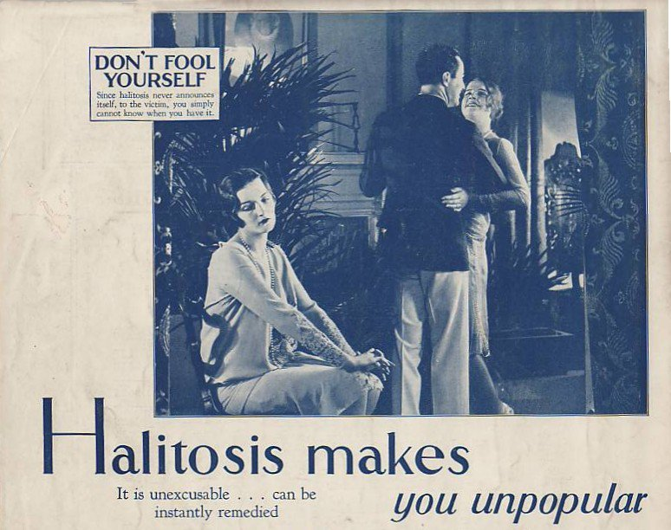
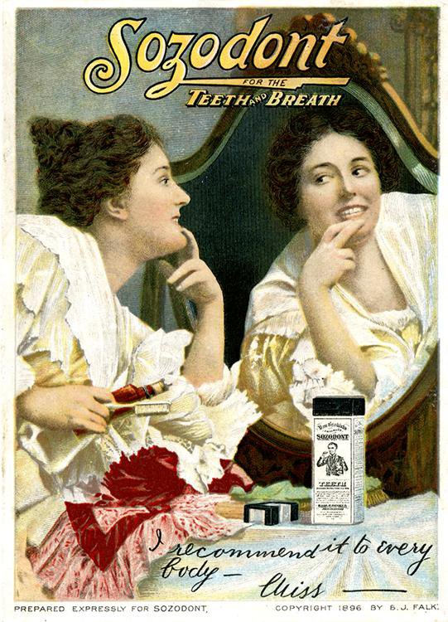

Slide 8
During Christianity, the devil's supreme malignant odor smelled of sulfur, and it was presumed that sins produced a more or less bad smell.
This association is complex, as the predominant smell in halitosis is often sulfur.
Archeological excavations in garbage deposits from the 19th century found earthenware pots with tooth powders.
Announcements at that time disseminated the properties of "Chinese tooth powders", "tooth elixirs", "tooth opiates", confirming special interest in the elimination of bad breath and in cleanliness of the mouth.

Slide 9
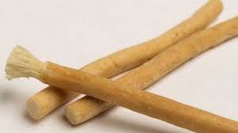
Another example comes from the Talmud, dating back more than two thousand years, which reports that, in view of some conditions, such as one of the partner's bad odor for example, the matrimonial license, called Ketuba, can be legally broken.
A treaty in Islamic literature from the year 850 talked about dentistry, referring to the treatment of fetid breath, and recommended the use of siwak when breath had changed or at any time when getting out of bed.
This recommendation was probably aimed at minimizing the smell or morning or physiological halitosis.
The Hindus consider the mouth as the body's entry door and, therefore, insist that it be kept clean, mainly before prayers.

Slide 10
The ritual is not limited to teeth brushing, but includes scraping the tongue with a special instrument and using mouthwash.
Buddhist monks in Japan also recommended teeth brushing and tongue scraping before the first morning prayers.
It is noticeable that oral hygiene in combination with tongue scraping has been performed for many years but that, despite its efficacy, dentists rarely prescribe and teach this scraping practice

Slide 11
CLASSIFICATION :-
The three main categories of halitosis are
genuine halitosis
pseudo-halitosis and
halitophobia.
Genuine halitosis is the term that is used when the breath malodor really exists and can be diagnosed organoleptically or by measurement of the responsible compounds.
A distinction should be made between physiologic and pathologic halitosis

Slide 12
Transient disturbing odors caused by food intake (e.g., garlic, onions, and certain spices), smoking, or medications (e.g., metronidazole) do not reveal a health problem and are common examples of physiologic halitosis.
The same is true for “morning” bad breath, as habitually experienced on awakening. This malodor is caused by decreased salivary flow and increased putrefaction during the night, and it spontaneously disappears after breakfast or after oral hygiene measures.
A persistent breath malodor, by definition, does reflect some pathology (pathologic halitosis).
When the origin of pathologic halitosis can be found in the oral cavity, one speaks of oral malodor. When an obvious breath malodor cannot be perceived but the patient is convinced that he or she suffers from it, this is called pseudo-halitosis

Slide 13
Important Terms for the Diagnosis of Bad Breath :-
Genuine halitosis - Malodor that can be verified objectively
Physiologic halitosis - Malodor that is transient and caused by physiologic factors, such as food intake or smoking
Oral malodor or intraoral halitosis - Obvious malodor originating from the oral cavity
Extraoral halitosis - Bad breath originating from pathologic conditions outside the oral cavity

Slide 14
Pseudo-halitosis - Malodor that cannot be perceived objectively even though the patient complains of its existence. This condition can be improved by oral hygiene instruction and counseling.
Halitophobia - No malodor that can be perceived objectively after treatment of halitosis or pseudo-halitosis even though the patient persists in believing that halitosis exists

Slide 15
NEW CLASSIFICATION :-
Aydin M, Harvey-Woodworth CN. Halitosis: a new definition and classification. British dental journal. 2014 Jul 11;217(1):E1-.

Slide 16
Type 0 :- Halitosis represents the sum of the physiologic contributions of oral, airway, gastroesophageal, blood-borne and subjective halitosis that are potentially present in every healthy person, in any combination.
All healthy individuals have a certain level of bacterial activity in the mouth and on respiratory tract mucosa.
In addition there is a potentially a negligible amount of gas leakage from the gastroesophageal tract, and blood gases are transferred to the exhaled breath during gas exchange in pulmonary alveoli.
Therefore, minimal amounts of types 1 - 5 potentially exist in health.

Slide 17
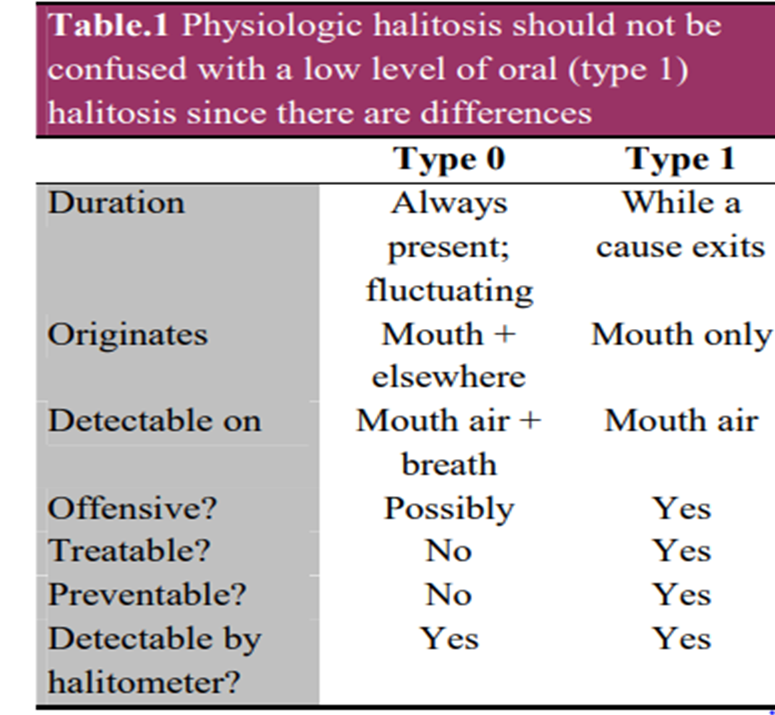
One or multiple types may exist in any combination at any time, varying according to many different factors, including hydration, oral hygiene, microbiota, salivary flow rate, nature of last food consumption, biochemical, hormonal, mechanic activity of the body, fasting, sleep, digestive enzyme profile in gut,etc.
It is distinguished from oral halitosis as follows :-

Slide 18
The gases that contribute to Type 1 (oral) halitosis are :
VSC,
volatile organic compounds (VOC) and
nitrogen containing gases (amines).
The main VSC involved are hydrogen sulphide (H2S), methyl sulfide (CH3SH, or methyl mercaptan, MM), and dimethyl sulfide ((CH3)2S, DMS).
Nearly 700 different compounds have been detected orally, including indole, skatole, acetic acid and short chain acids (e.g. butyric, valeric, isovaleric, lactic, caproic, propionic and succinic acids)
The gases responsible for oral halitosis are byproducts of protein and glycoprotein putrefaction by the oral microbiota.

Slide 19
The dorso-posterior tongue is the most important halitogenic site, by virtue of having both the largest surface area and the highest bacterial load, within a densely populated biofilm.
The most common factors include poor oral hygiene, plaque stagnation areas, gingivitis, tongue coating; and account for ~85% cases.
Other possible origins of oral halitosis include: periodontal disease, acute necrotizing ulcerative gingivitis, osteoradionecrosis, large carious cavities, blood/thrombi (e.g. extraction sockets), ulceration, interdental food packing, oral prostheses (dentures, orthodontic appliances, bridges).

Slide 20
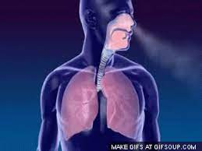
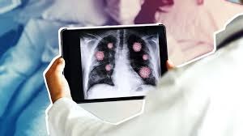
Type 2 halitosis: Airway halitosis Type 2 halitosis originates from the respiratory tract itself (rhinosinusitis, tonsillitis, pharyngitis, laryngitis, bronchitis, pneumonia), anywhere from nose to alveoli.
Odorous gases produced by various respiratory pathoses, held in the exhaled breath and expressed via the nose or mouth.
Other respiratory tract causes of halitosis include : bronchiectasis, pneumonia, tuberculosis, nasal foreign bodies, rhinoliths, atrophic rhinitis (ozena), abscesses (peritonsillar, nasopharnygeal, lung), and carcinomas (nasal, sinuses, pharyngeal, lung).

Slide 21
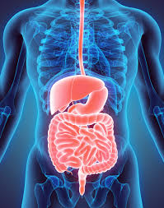
Type 3 halitosis: Gastroesophageal halitosis : Type 3 halitosis is leakage of odorant volatiles from the stomach via the esophagus to the mouth and nose.
A degree of gastroesophageal reflux is considered normal, occurring in almost all individuals several times per day.
In a study of 14 healthy individuals, 1.2 ml/10 min gas leakage from the stomach to the esophagus whilst lying horizontal and 6.8 ml/10 min while sitting was demonstrated.
If odorous, this constitutes the physiologic part of gastroesophageal halitosis.

Slide 22
Pathologic level of gastroesophageal halitosis is said to occur due to i) gastroesophageal reflux disease (GERD), ii) Helicobacter pylori related gastritis, or iii) other causes e.g. gastrocolic fistulae, Zenker diverticulum and hypopharyngeal diverticulae.
Type 4 (blood-borne) halitosis : is where volatile chemicals in the systemic circulation can transfer to exhaled breath during alveolar gas exchange and cause halitosis.
Volatiles are endogenously produced, mostly by-products of biochemical metabolic processes.
Methylated or low carbon containing alkanes, cyclic hydrocarbons, alcohols and aldehydes have an especially pungent odour when they exceed specific odour thresholds for the individual or his/her social environment, constituting pathologic Type 4 halitosis.

Slide 23
Type 5 halitosis: Subjective halitosis
Subjective halitosis is a halitosis complaint without objective confirmation of halitosis by others or halitometer readings.
Type 5 halitosis can be misdiagnosed if there are measurement errors or transient symptoms.
It can be considered normal for even mentally healthy individuals to worry occasionally about to be having halitosis.

Slide 24
EPIDEMIOLOGY
Only few studies have documented the prevalence of oral malodor.
Moreover, these studies used different methodologies, ranging from self-reported breath malodor to more objective assessments such as measurement of volatile sulfur compounds (VSCs).
Because self reported halitosis correlates weakly with objective measurements and tends to overestimate the problem, data should be interpreted carefully.
These studies have been performed in different parts of the world.
Despite the different approaches of these studies, the results point out that about one in four to one in three subjects has persistent bad breath.

Slide 25
If a VSC level of 75 ppb (limit for social acceptance) is used as a threshold for halitosis, the prevalence reported in the different populations can be calculated as 23% (late morning group) and 20% for the Japanese and Chinese studies, respectively.
In line with this, a prevalence of 27.5% and 29.8% for the Chinese and Israeli groups, respectively, can be calculated when an organoleptic score of at least 2 is considered as being representative for halitosis.
From large-scale inventories in multidisciplinary outpatient clinics for breath odor no sex predominance seems to exist for bad breath, although other studies indicate a higher prevalence in women.

Slide 26
It has also been observed that women seek treatment more often than men. Age can range from 2 years to more than 80 years.
No association was found between increased age and oral malodor.
Most of the patients had been complaining about breath malodor for several years before seeking proper advice.

Slide 27
SOCIO‑ECONOMIC AND PHYSIOLOGICAL ASPECTS
A transient breath malodor is noticed when waking up in the morning in more than half of the adult population.
The real concern of the population is the breath malodor which remains during the day and which can cause social and/or relational problems.
In spite of high prevalence of breath malodor, only a few patients visit dental clinics seeking treatment.

Slide 28
This fact has been termed the “bad breath paradox”, since people suffering from bad breath often remain completely unaware of this fact.
In 1971, Pruse-Phillips described an “Olfactory Reference Syndrome”, in which, patients claim to actually perceive a malodor that others cannot detect.
One type of Olfactory Reference Syndrome with most of the characteristics described by Pruse-Phillips is delusional halitosis

Slide 29
ETIOLOGY
In most patients, breath malodor originates from the oral cavity.
Tongue coating is the predominant cause of oral malodor.
Furthermore, periodontal diseases (gingivitis and periodontitis) are the second most important causative factors.
A large-scale study including 2000 patients with halitosis complaints showed that for those patients whose bad breath could be objectively detected, the cause was mostly found within the oral cavity (90%).

Slide 30
Tongue coating (51%), gingivitis or periodontitis (13%), or a combination (22%) accounted for the majority of the cases.
Because a large part of the population has tongue coating or gingivitis/periodontitis, the risk always exists that an intraoral condition is too easily considered as the cause, whereas more important pathologic conditions are overlooked.
Indeed, for a minority of patients (4% in the same study), extraoral causes could be identified, including ear, nose, and throat (ENT) disorders, systemic diseases (e.g., diabetes), metabolic or hormonal changes, hepatic or renal insufficiency, bronchial and pulmonary diseases, or gastroenterologic disorders

Slide 31
INTRAORAL CAUSES
Tongue coating,
poor oral hygiene,
gingivitis, and
periodontitis are the predominant causative factors.
It is the result of the degradation of organic substrates by anaerobic bacteria. During the process of bacterial putrefaction, peptides and proteins present in saliva, food debris, gingival crevicular fluid, interdental plaque, shed epithelial cells and blood are hydrolyzed to sulfide-containing and non–sulfide-containing amino acids, which can be further metabolized.
The proteolytic degradation of sulfur-containing amino acids (cysteine, cystine and methionine) by gram-negative bacteria produces sulfur containing gases such as hydrogen sulfide (H2S) and methylmercaptan (CH3SH).

Slide 32
The most commonly involved bacteria are Porphyromonas gingivalis, Prevotella intermedia, Prevotella nigrescens, Aggregatibacter actinomycetemcomitans, Campylobacter rectus, Fusobacterium nucleatum, Peptostreptococcus micros, Tannerella forsythia, Eubacterium spp., and spirochetes.
A study by Niles and Gaffar made clear that these gram-negative species in particular cause an unpleasant smell by the production of sulfur compounds.
However, because of the large microbial diversity found in patients with halitosis, it is suggested that breath malodor is the result of complex interactions among several bacterial species.

Slide 33
One study indicated that some gram-positive microorganisms, such as Streptococcus salivarius, also contribute to oral malodor production by deglycosylating salivary glycoproteins, thus exposing their protein core to further degradation by gram-negative microorganisms
More recently, the presence of Solobacterium moorei, a gram-positive bacterium, has also been linked to oral malodor.

Slide 34
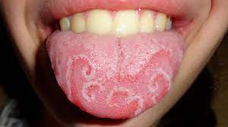
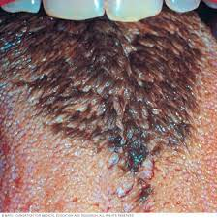
Tongue and Tongue Coating
The dorsal tongue mucosa, with an area of 25 cm3 , has a very irregular surface topography.
The innumerable depressions in the tongue surface are ideal niches for bacterial adhesion and growth, sheltered from cleaning actions.
Moreover, desquamated cells and food remnants also remain trapped in these retention sites and consequently can be putrefied by the bacteria.
A fissured tongue (deep fissures on the dorsum, also called scrotal tongue or lingua plicata) and a hairy tongue (lingua villosa) have an even rougher surface.

Slide 35
Accumulated food remnants intermingled with exfoliated cells and bacteria form a coating on the tongue dorsum.
The latter cannot be easily removed because of retention by the irregular surface of the tongue dorsum.
As such, the two factors essential for putrefaction (bacteria and their nutrients) are united.
Several investigators have identified the dorsal posterior surface of the tongue as the primary source of oral malodor.
Indeed, high correlations have been reported between tongue coating and odor formation

Slide 36
In both healthy individuals and patients with periodontitis with or without complaints of oral halitosis, a significant positive correlation was found between the presence or amount of tongue coating and levels of VSCs and/or organoleptic scores of the mouth odor.
In a group of 2000 patients visiting a multidisciplinary halitosis clinic, significant correlations were found between organoleptic scores and tongue coating.
In another study, it was also observed that the amount of tongue coating was significantly greater in the halitosis-positive group compared with the halitosis-negative group.
Morita and Wang found that the volume of tongue coating and the percentage of sites with bleeding on probing were significantly associated with oral malodor.

Slide 37
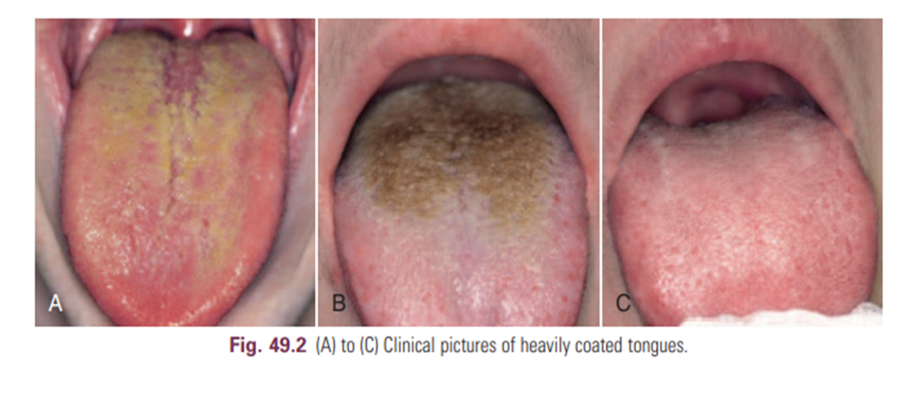
In 1992, Yaegaki and Sanada demonstrated that even in patients with periodontal disease, 60% of the VSCs were produced from the tongue surface.
Research has showed that the strongest determinant of the presence of tongue coating is suboptimal oral hygiene.
Other influencing factors were periodontal status, presence of a denture, smoking, and dietary habits.

Slide 38
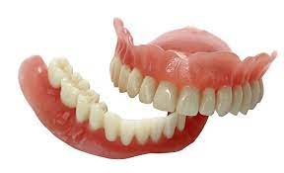
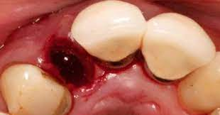
Dental Disorders
Possible causes within the dentition are deep carious lesions with food impaction and putrefaction, extraction wounds filled with blood clots, and purulent discharge leading to important putrefaction.
Other causes include interdental food impaction in large interdental areas and crowding of teeth favoring food entrapment and accumulation of debris.
Acrylic dentures, especially when kept continuously in the mouth at night or not regularly cleaned, can lead to infections (e.g. candidiasis), which produce a typical smell.
The denture surface facing the gingiva is porous and retentive for bacteria, yeasts, and debris, which are compounds needed for putrefaction

Slide 39
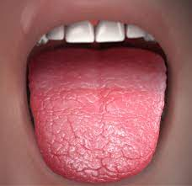
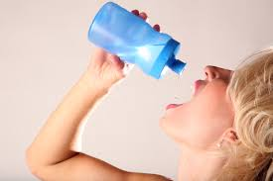
Dry Mouth
Saliva has an important cleaning function in the oral cavity.
Patients with xerostomia often present with large amounts of plaque on teeth and extensive tongue coating.
The increased microbial load and the escape of VSCs when salivary flow is reduced explain the strong breath malodor.
Several studies link stress with VSC levels, but it is not clear whether this can simply be explained by a reduction of salivary flow.
Other causes of xerostomia are medication, alcohol abuse, Sjögren syndrome (a common autoimmune rheumatic disease), and diabetes.

Slide 40
Periodontal Infections
A relationship between periodontitis and oral malodor has been shown.
However, periodontally healthy patients can suffer from halitosis, not all patients with gingivitis and/or periodontitis complain about bad breath, and some disagreement exists in the literature over to what extent oral malodor and periodontal disease are related.
Bacteria associated with gingivitis and periodontitis are indeed able to produce VSCs.
Several studies have shown that VSC levels in the mouth correlate positively with the depth of periodontal pockets (the deeper the pocket, the more bacteria, particularly anaerobic species) and that the amount of VSCs in the breath increases with the number, depth, and bleeding tendency of the periodontal pockets.

Slide 41
VSCs aggravate the periodontitis process by increasing the permeability of the pocket and mucosal epithelium, therefore exposing the underlying connective tissues of the periodontium to bacterial metabolites.
Methylmercaptan enhances interstitial collagenase production, interleukin-1 production by mononuclear cells, and cathepsin B production, thus further mediating connective tissue breakdown.
Furthermore, the reaction of hydrogen sulfide with collagen can alter the protein structure, thereby rendering the periodontal ligament and bone collagen more susceptible to destruction by proteases.
Investigators have shown, in cases of gingivitis and periodontitis, a decrease in the content of acid-soluble and total collagen in the affected tissues.

Slide 42
These findings suggest that increased production of VSCs may accelerate the progression of periodontal disease.
Toxic VSCs are able to damage the periodontal tissues and create even more loss of attachment.
Some studies, however, have shown that when the presence of tongue coating is taken into account, the correlation between periodontitis and oral malodor is much lower, thus indicating that tongue coating remains a key factor for halitosis.
The prevalence of tongue coating is six times higher in patients with periodontitis, and the same bacterial species associated with periodontal disease can also be found in large numbers on the dorsum of the tongue, particularly when tongue coating is present.

Slide 43
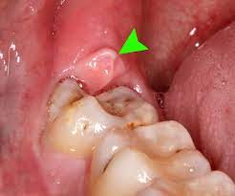
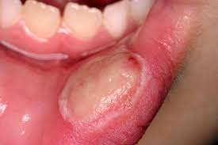
Other relevant malodorous pathologic manifestations of the periodontium are pericoronitis, major recurrent oral ulcerations, herpetic gingivitis, and necrotizing gingivitis/periodontitis.
Microbiologic observations indicate that ulcers infected with gram-negative anaerobes (i.e., Prevotella and Porphyromonas species) are significantly more malodorous than noninfected ulcer.

Slide 44
Extraoral Causes
For a minority of patients, extraoral causes can be identified, including ENT disorders, systemic disease (e.g., diabetes or kidney disease), metabolic or hormonal changes, hepatic or renal insufficiency, bronchial and pulmonary diseases, or gastroenterological disorders.
Moreover, multiple causes may be present at the same time, and over the course of time the etiology may shift.
Extraoral halitosis can be subdivided into two types: non–bloodborne halitosis and blood-borne halitosis.
Non–blood-borne halitosis is uncommon, and most information about it comes from case reports.

Slide 45
Non–blood-borne halitosis encompasses, for example, throat infections, nasal infections, infections of the respiratory system, lung diseases, and stomach disorders
Blood-borne halitosis is the result of bad-smelling metabolites that can be formed or absorbed at any place in the body (e.g., the liver, the gut) and transported by the bloodstream to the lungs.
Exhalation of these volatiles in the alveolar air then causes halitosis, at least when the concentrations of the bad-smelling metabolites are suficiently high.
The extraoral causes are much more difficult to detect, although they can sometimes be recognized by a typical odor.

Slide 46
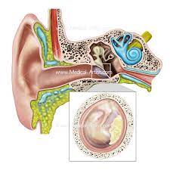
Ear, Nose, and Throat
During chronic or purulent tonsillitis, the deep crypts of the tonsils accumulate debris and bacteria, especially periopathogens, resulting in putrefaction. In the crypts, even calculus (e.g., subgingivally) can be formed (tonsilloliths or tonsil stones).
Other examples include acute pharyngitis (viral or bacterial) and postnasal drip.
The latter is a rather common condition, which is perceived by patients as a liquid flow in the throat originating from the nasal cavity.
It is often associated with chronic sinusitis or regurgitation esophagitis, in which the acidic contents of the stomach reach the nasopharynx and cause mucositis.

Slide 47
Ozena (caused by Klebsiella ozaenae) is a rare atrophic condition of the nasal mucosa, with the appearance of crusts that cause a very strong breath malodor.
Finally, a foreign body in a nasal or sinus cavity can cause local irritation, ulceration, and subsequent putrefaction (e.g., children and mentally handicapped persons tend to put objects such as peas or wet paper in the nose)

Slide 48
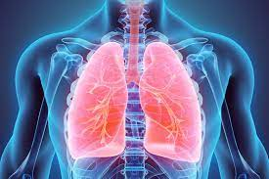
Bronchi and Lungs
Pulmonary causes include chronic bronchitis, bronchiectasis (infection of standing mucus secretion in cystic dilations through walls of bronchioles), pneumonia, pulmonary abscess, bronchial carcinoma, and carcinoma of the lung.

Slide 49
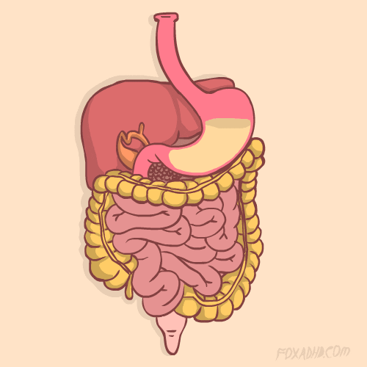
Gastrointestinal Tract
Contrary to common public opinion, even among medical physicians, gastrointestinal disorders are rarely responsible for bad breath.
The following may be responsible for less than 1% of malodor cases:
A Zenker diverticulum, Regurgitation esophagitis, Intestinal gas production, Helicobacter pylori infection, etc

Slide 50
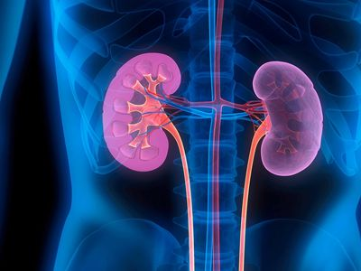
Kidney
Kidney insuficiency, primarily caused by chronic glomerulonephritis, leads to an increase of the amines, dimethylamine and trimethylamine, causing a typical fishy odor of the breath.

Slide 51
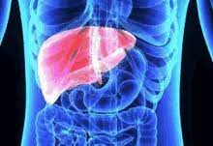
Liver
Patients with various degrees of hepatocellular failure and/or portosystemic shunting of blood may acquire a sweet, musty, or even slightly fecal aroma of the breath, termed fetor hepaticus, which has been mainly attributed to the accumulation of dimethyl sulfide.
Moreover, if the metabolizing function of the liver fails, the concentrations of certain metabolites normally processed in the liver will increase, and they will enter the systemic circulation again and be exhaled

Slide 52
Systemic Metabolic Disorders
Uncontrolled diabetes mellitus results in the accumulation of ketones, which have a sweet smell, like the odour of rotten apples.
Insulin resistance leads to an increase of triglycerides and free fatty acids, and ketones (e.g., acetone, acetoacetate, and hydroxybutyrate) are formed during lipolysis

Slide 53
Trimethylaminuria
Trimethylaminuria is a hereditary metabolic disorder that leads to a typical fishy odor of the breath, urine, sweat, and other bodily secretions.
Trimethylaminuria is an enzymatic defect that prevents the transformation of trimethylamine to trimethylaminoxide, resulting in abnormal amounts of this molecule.

Slide 54
Hormonal Causes
At certain moments during the menstrual cycle, a typical breath odor can develop; partners are often well aware of this odor.
Evidence also indicates that VSC levels in the expired air are increased twofold to fourfold around the day of ovulation and in the perimenstrual period.
Increases in VSCs are smaller in midfollicular phases after repeated diagnosis of an absence of bad breath, the patient cannot accept the absence of halitosis.
This condition has been associated with obsessive-compulsive disorder and hypochondria.

Slide 55
Well-established personality disorder questionnaires (e.g., Symptom Checklist ) allow the clinician to assess the patient’s tendency for illusional breath malodor.
Having a psychologist or psychiatrist at the malodor consultation can be especially helpful for such patients.
Because of the complexity of this disorder, a malodor consultation is thus preferably multidisciplinary, combining the knowledge of a periodontologist or dentist, an ENT specialist, an internist (if necessary), and a psychologist or psychiatrist.
In a study of 2000 patients, 16% were diagnosed with pseudo-halitosis or halitophobia.

Slide 57
Halitosis Induced by Medication
According to the results of the present literature review, the following drugs may be directly responsible for oral malodour :
1. Dimethyl Sulfoxide - A significant side-effect of dimethyl sulfoxide (DMSO) is an odor and taste in the mouth similar to garlic due to the pulmonary excretion of a small percentage of DMSO as dimethyl sulfide.
The volatile sulfur compounds (VSCs) methyl mercaptan (CH3 SH) and hydrogen sulfide (H2 S) contain a free thiol (-SH group), which immediately reacts with blood, resulting in irreversible binding and oxidation, thereby preventing transportation from the blood into the alveolar air and thus into the breath.
But dimethyl sulfide (CH3 SCH3 ), a neutral molecule that is stable in blood, is transported from the blood into alveolar air and breath. The neutral nature of most volatiles found in halitosis makes them difficult to remove from breath, unlike the very reactive thiol methyl mercaptan (CH3 SH) and hydrogen sulfide (H2 S) also found in halitosis.

Slide 58
2. Cysteamine - is used to treat patients with nephropathic cystinosis and can be metabolized to dimethyl sulfide (CH3 SCH3 ), a malodorous compound stable in blood.
3. Nitrates and Nitrites - Nitrates are used to treat or prevent angina and the chest pain caused by heart disease.
In the oral cavity, anaerobic bacteria in the deep crypts at the base of the tongue reduce nitrate to nitrite in the course of respiration.
Some of this nitrite is reduced to nitric oxide (NO) in the oral cavity, contributing to levels of NO measured in exhaled breath; NO reacts with foul-smelling volatile organosulfur compounds

Slide 59
4. Disulfiram - Disulfiram (Antabuse) is used in the treatment of alcohol dependence.
Carbon disulfide (CS2 ) is a product of the metabolism of disulfiram; it is stable in blood and can be transported from the blood into alveolar air and breath.
Acetone is a product of normal metabolism and appears in the breath of all individuals, but disulfiram increases acetone levels in blood.
5. Penicillamine - Penicillamine has proved an essential drug for treating rheumatoid arthritis and is a degradation product of penicillin antibiotics.
It has a close structural relation to cysteine, a sulphur-containing amino acid.

Slide 60
The microbial degradation of both cysteine and penicillamine produces hydrogen sulfide (H2 S) and sulfhydryl anion (HS- ), a strong reducing agent that decreases the redox potential within the tongue biofilm, and so raises the pH favouring the growth of Gram-negative bacteria and activating enzymes including serine protease, important in the putrefaction process.
Bacterial interactions with specific substrates – amino acids such as cysteine, methionine, tryptophan, arginine, and lysine – biotransform them into odourous compounds that may cause oral malodour.
6. Chloral hydrate Chloral hydrate is a widely used sedative agent in pediatric dentistry.
It is a colorless substance with a penetrating acrid odor and a slightly bitter taste.

Slide 61
7. Suplatast Tosilate : Suplatast tosilate is an anti-allergic agent that suppresses cytokine production.
Dimethyl sulfide (CH3 SCH3 ), metabolized from suplatast tosilate, is a potential cause of halitosis due to the volatile (CH3 SCH3 ) dissolved into the blood and exhaled through alveolar gas exchange.
8. Paraldehyde : Paraldehyde is administered intravenously for the emergency treatment of epilepsy. It is a colorless liquid with a pungent odor and a disagreeable taste.

Slide 62
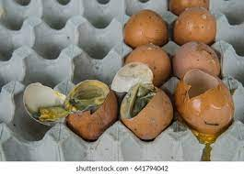
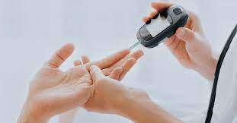
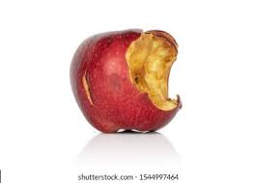
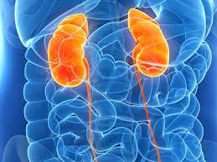
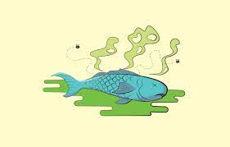
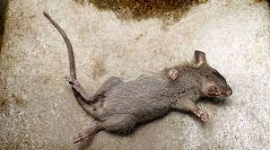
Specific character of breath odor:
Smell | Condition | Accumulation product
Rotten eggs | - | VSC;s
Dead mice | Liver insufficiencies | Aliphatic acids (butyric, isobutyric, propionic)
Rotten apples | Unbalanced insulin dependent diabetes | Ketones
Fish odor | Kidney insufficiency | Diethylamine and triethylamine

Slide 63
ASSOCIATION BETWEEN HALITOSIS AND PERIODONTAL DISEASE
Different lines of evidence have demonstrated this association between halitosis and periodontal disease :
State of gingival health: In experimental gingivitis, the amount of VSCs expelled in mouth air was significantly higher in subjects with gingivitis compared to control subjects.
Moreover, salivary VSC production increased with gingival inflammation and conversely decreased with the return to gingival health.

Slide 64
Severity of periodontitis :
In periodontitis, different studies have shown a correlation between VSC concentration in mouth air and increased pocket depth.
However, some studies have failed to demonstrate positive correlations between periodontitis severity and halitosis.
Using a group of 16 patients seeking treatment for oral halitosis, De Boever found that tongue odour was negatively correlated with probing depths suggesting an inverse relationship between malodour and periodontal parameters.

Slide 65
Similarly, Bosy et al did not find a relationship between periodontal disease and the prevalence or severity of halitosis.
In addition to the lack of correlation between halitosis and the presence/absence of periodontal disease, the intensity of halitosis based on VSC concentration was 19% less in periodontally healthy subjects (mean 111 ppb) than in subjects with periodontitis (mean=136 ppb).

Slide 66
Correlation between the presence of a pathogenic microflora in the subgingival microbiota and halitosis
In 1981, Pitts et al studied the correlations between odour scores and microbiological findings in crevicular samples of periodontally healthy subjects.
They found that odour scores were significantly correlated with the concentration of overall bacterial populations and that higher levels of crevicular bacteria were associated with greater odour scores.
In 1994, Bosy et al examined the association of trypsin-like activity detected by the BANA (Benzoyl-DL-arginine-2- Naphthylamide) test in 4 subgingival samples of 127 patients with floss odour.
They found a moderately strong correlation between the BANA scores of the four tooth sites with floss odour.
They also found when periodontitis was present, 87.5% of tooth sites were BANA positive as compared with 74.4% of tooth sites positive in healthy individuals

Slide 67
VSC’s: Origin and Relation to Periodontitis
VSCs are mainly produced through putrefactive activities of bacteria present in saliva, the gingival crevice, the tongue surface, and other areas.
The substrates are sulfur-containing amino acids which are found free in saliva, gingival crevicular fluid, or produced as a result of proteolysis of protein substrates.
Apart from the presence of gram-negative anaerobic bacteria, certain physical-chemical conditions are needed for the production of odoriferous gases.
These conditions such as pH, pO2 , and Eh are usually determined by the bacterial metabolism

Slide 68
VSC’s are highly toxic to tissues even at extremely low concentrations and, therefore, may play a role in the pathogenesis of inflammatory conditions affecting the periodontium.
Different in vitro studies have demonstrated that VSC’s alter the permeability of oral and junctional epithelium increasing bacterial invasion.
They are toxic to fibroblasts, altering their morphology and function, alter the metabolism of fibronectin, and interfere in the enzymatic and immunological reactions leading to tissue destruction while showing an increase in the release of interleukin-1 and prostaglandin E2 .
Takeuchi et al indicated that H2 S inhibits cell proliferation and induces cell cycle arrest via the expression of p21Cip1 in Ca9-22 cells.

Slide 69
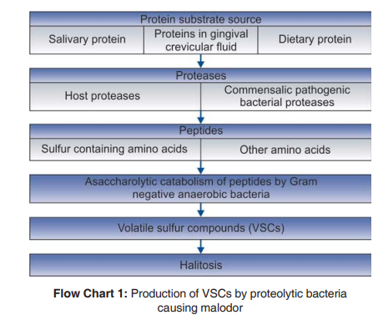

Slide 70
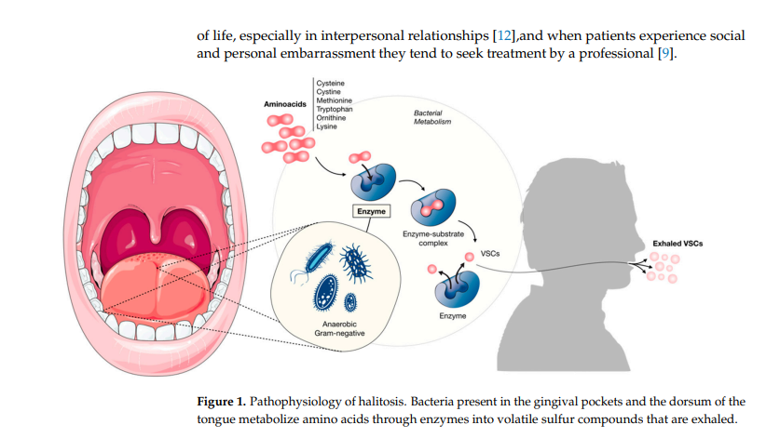

Slide 71
Course of a Halitosis Consultation
Preconsultation patient information
Anamnesis
Organoleptic examination
Examination of the breath with portable sulfur monitor
Oropharyngeal examination
Explanation of halitosis and instructions for oral hygiene
If necessary, explanation of additional therapy

Slide 72
Diagnosis of Malodor
Preconsultation Approach :- A proper diagnostic approach starts with providing the right information to the patient before the appointment.
It is recommended that the patient does not eat garlic, onions, or spices for 2 days before the consultation because they can cause bad breath and body odor that can last from several hours to 2 days.
To remove confounding odors, the patient is also instructed to refrain from alcohol, coffee, and smoking during the 12-hour period before the consultation.
For the same reason, it is advisable not to use chewing gum, mints, drops, or mouthrinses during the 8 hours preceding the appointment, both for the patient and for the oral malodor judge.

Slide 73
The day of the consultation, the use of fragranced shampoo, body lotion, and perfume should also be avoided, so as not to disturb the organoleptic ratings.
In most halitosis consultations, the patient is asked not to eat or drink on the morning of the examination.
However, if breakfast is consumed, morning bad breath can be excluded.
The patient should be encouraged to bring a confidant to the consultations who can identify whether the perceived odor is the one previously noticed.
Some of these guidelines are crucial not only for the organoleptic evaluation, but also for a correct interpretation of the results obtained with certain breath analyzers.

Slide 74
Anamnesis :- Each consultation should start with thorough questioning about the breath malodor, eating habits, and medical and dental history.
This can be done with a questionnaire that the patient fills out in the waiting room and/or verbally at the beginning of the consultation, depending on the preference of the examiner and the practical possibilities.
To start with, the patient should be asked about the frequency of the halitosis (e.g., constantly, every day), the time of appearance during the day (e.g., after meals can indicate a stomach hernia), when the problem first appeared, and whether others have identified the problem (to exclude imaginary breath odor).
In addition, the medical history has to be recorded, with an emphasis on
medications and systemic diseases of the ENT, lungs, liver, kidneys,
stomach, and pancreas.

Slide 75
The dental history includes questions assessing the frequency of dental visits, the use of mouthrinses, the presence and maintenance of a dental prosthesis, and the frequency of and instruments used for toothbrushing, interdental cleaning, and tongue brushing and scraping.
Finally, the patient is asked about smoking, drinking, and dietary habits.

Slide 76
Examinations
After obtaining a thorough anamnesis, the clinician checks whether an unpleasant odor can be perceived and inspects the mouth to detect possible causes of bad breath.
Different ways exist to examine the breath, the easiest and least expensive way is to smell the breath.
However, several devices are on the market that mainly detect VSCs

Slide 77
Organoleptic Rating (Hedonic assessment)
Even though devices are available, organoleptic assessment by a judge is still the gold standard in the examination of breath malodor.
It is the easiest and most often used method because it gives a reflection of the everyday situation when halitosis is noticed.
Moreover, the human nose can smell 10,000 different odors, many more than any device on the market.

Slide 78
In an organoleptic evaluation, a trained and preferably calibrated “judge” sniffs the expired air and assesses whether it is unpleasant by using an intensity rating
Scoring is normally done according to the intensity scale of Rosenberg,
where 0 represents the absence of odor,
1 is barely noticeable odor,
2 is slight malodor,
3 is moderate malodor,
4 is strong malodor,
and 5 is severe malodor.

Slide 79
In this six-point system, 0 indicates a concentration of odorant below a threshold, 1 to 4 are increasing occupancy of receptor binding sites, and 5 is assumed to be close to saturation.
To avoid bias, it is advisable that the organoleptic assessment precedes all other measurements
In an organoleptic assessment, the judge smells a series of air samples as follows:

Slide 80
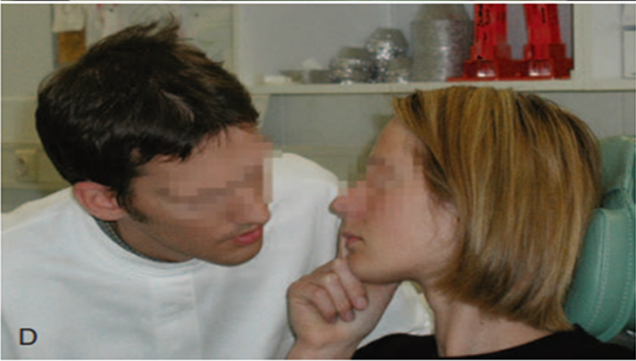
1. Nasal breath odor: The subject expires through the nose while keeping the mouth closed. When the nasal expiration is malodorous yet the air expired through the mouth is not, an ENT problem can be suspected.
2. Oral cavity odor: The subject opens the mouth and refrains from breathing while the judge places his or her nose close to the mouth opening (approximately 10 cm from the patient’s mouth).

Slide 81
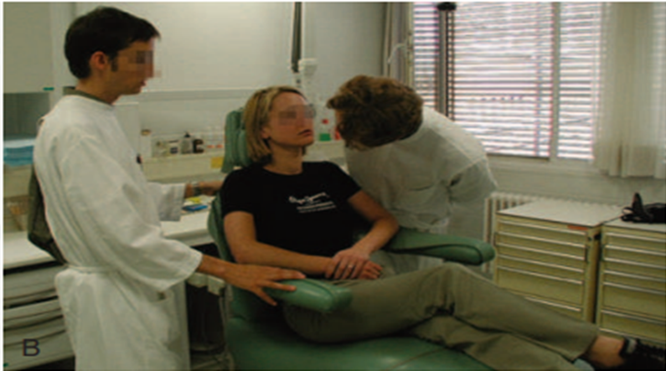
3. Oral cavity odor: The patient counts from 1 to 10. This reveals the same as described earlier, but favors oral malodor because of drying of the palatal and tongue mucosa.
4. Tongue coating: The judge smells a tongue scraping from the posterior part of the tongue, obtained with an odorless plastic spoon or tongue scraper, at a distance of approximately 5 cm from his or her nose. This odor resembles that emanating from the tongue dorsum

Slide 82
5. Dental floss odour test: This test is used to assess the odour originating from the interdental regions. The examiner passes a sufficient length of unwaxed floss through the interdental regions of posterior teeth. The odour is assessed by holding the floss about 3cms from the nose.

Slide 83
Although the organoleptic assessment is still the gold standard for diagnosis of halitosis, the method also has some important drawbacks.
The assessment can, for example, be influenced by several aspects, such as the position of the head, hunger, and the experience of the judge.
Odor judges are also supposed to rest their nose for several minutes between tests to avoid habituation.
The most important disadvantage of the method, however, is that it clearly has a degree of subjectivity.

Slide 84
Self-Examination
Smelling one’s own breath by expiring into the hands in front of the mouth is not relevant because the nose becomes used to the odor, and the smell of the skin and soap used for handwashing may interfere.
Moreover, studies have shown that self-assessment of oral malodor is notoriously unreliable, and one should be careful with such information obtained from the patient

Slide 85
It can be worthwhile to involve the patients in monitoring the results of therapy by self examination, especially when intraoral cause ids identified.
For example: this can motivate the patient to continue the oral hygiene instructions.
Following self testing can be done:

Slide 86
Smelling a metallic or nonodorus plastic spoon after scraping back of the tongue.
Smelling tooth pick after introducing it in interdental area.
Smelling saliva spit in small cup or spoon (especially when allowed to dry for few seconds so that putrefaction odors can escape from the liquid).
Licking the wrist allowing it to dry (reflects saliva contribution to malaodor)

Slide 87
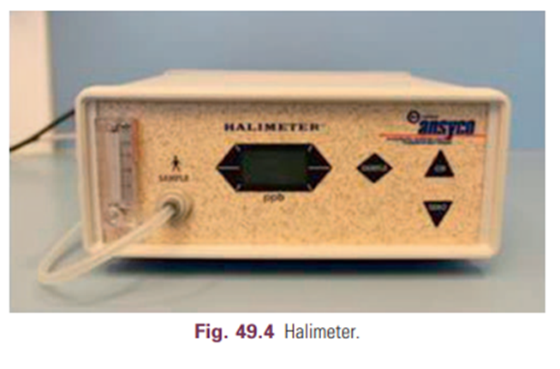
Portable Volatile Sulfur Monitor : The Halimeter
The Halimeter is an electronic device that detects the presence of VSCs such as hydrogen sulfide and methylmercaptan in breath.
The instrument cannot discriminate among the different sulfur compounds. The sensitivity for methylmercaptan is five times lower than for hydrogen sulfide, and the device is almost insensitive to dimethyl sulfide.
Moreover, ethanol and other compounds can disturb the measurements.

Slide 88
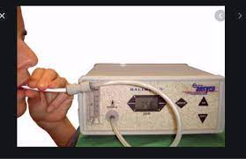
To allow an increase in concentration of VSCs, the patient has to keep his or her mouth closed for 2 to 3 minutes before sampling.
The mouth air is aspirated by inserting a drinking straw fixed on the flexible tube of the instrument.
The straw is kept inside the mouth, preferably above the posterior part of the tongue dorsum, not touching the oral mucosa or the tongue, while the subject keeps the mouth slightly open and breathes through the nose.

Slide 89
The sulfur meter uses a voltametric sensor that generates a signal when exposed to sulfur-containing gases.
Using a recorder or specific software, a graphic presentation can be obtained, called a haligram, which gives the response as a function of time
For the most optimal results, the manufacturer recommends performing three measurements and using the average value.

Slide 90
Between measurements, it is important to allow the meter to restabilize before repeating. The monitor needs regular calibration and replacement of the sensor biannually.
The Halimeter is easy to use as a chair-side test and is relatively inexpensive.
Patients are usually less embarrassed by this examination than by organoleptic assessment

Slide 91
An important drawback of the device is that it detects only sulfur compounds and thus is useful only for intraoral causes of halitosis.
7,50,000

Slide 92
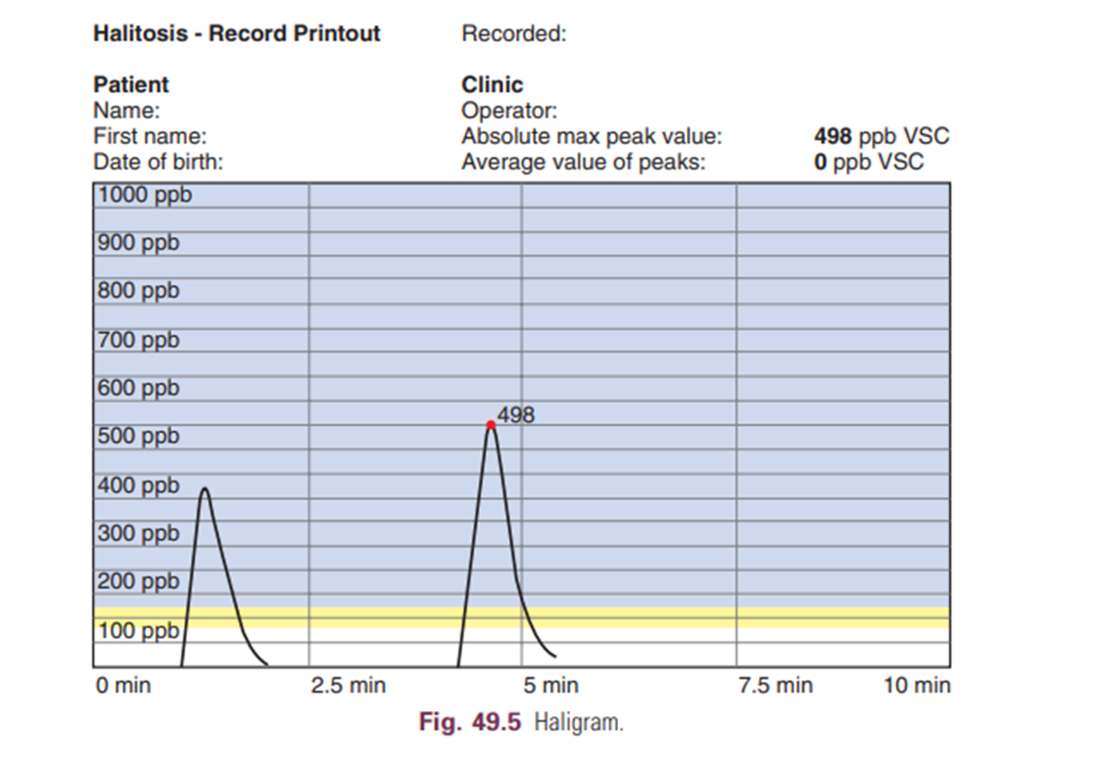
Yaegaki and Sanade recommended a value of 75 ppb as the limit for social acceptance, whereas the Halimeter’s manufacturer proposes 150 ppb.
Following this recommendation, the sensitivity and specificity of the device for the organoleptic score have been calculated to be 63% and 98%, respectively.
In patients with oral malodor, VSC concentrations can easily reach 300 to 400 ppb

Slide 93
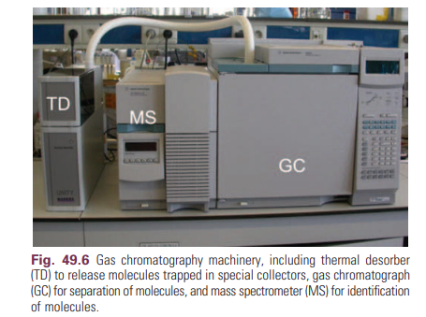
Gas Chromatography
A gas chromatograph can analyze air, saliva, or crevicular fluid
About 100 compounds have been isolated from the headspace of saliva and tongue coating, including ketones, alkanes, sulfur containing compounds, and phenyl compounds.

Slide 94
The most important advantage of the technique is that when coupled with mass spectrometry, it can detect virtually any compound when using adequate materials and conditions, moreover, it has very high sensitivity and specificity.
Elaborate gas chromatography is available only in specialized centers but is especially useful for identifying nonoral causes.
It is expensive and requires trained personnel.

Slide 95
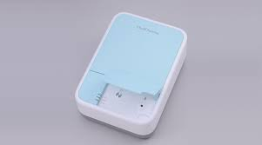
A small, portable “gas chromatograph” (OralChroma, Nissha FIS, Inc., Japan) has been introduced, which makes this technique available for periodontal clinics.
More recently, the second generation of this portable gas chromatograph was introduced: the OralChroma CHM-2.
The CHM-2 is a little bit smaller than the First-generation OralChroma, the measurements only take half the time, and it comes with optimized software.
Sample collection is done by use of a disposable syringe, which is inserted two-thirds of the way into the oral cavity.

Slide 96
The patient must close the mouth for 30 seconds before sample collection, and afterward the sample is injected into the gas chromatograph.
The analysis starts automatically.
A software packet, OralChroma Data Manager, collects the data from the OralChroma and graphically displays the sensor responses on a computer screen.

Slide 97
After 4 minutes for the OralChroma CHM-2, the process is completed, and the concentrations of the three gases are displayed in either ng/10 mL or ppb (nmol/mol) .
The accompanying software packet gives a clear overview of the VSC measurement.
However, with the OralChroma CHM-1, sometimes these graphics are not correct because the place of the VSCs is incorrectly assigned in the chromatogram.
The OralChroma has the capacity to measure the concentration of the three key sulfur compounds (hydrogen sulfide, methylmercaptan, and dimethyl sulfide) separately.

Slide 98
This can be helpful for a differential diagnosis.
A high concentration of methylmercaptan compared with hydrogen sulfide indicates, for example, periodontitis.
If only hydrogen sulfide is increased, a problem with oral hygiene may exist.
Dimethyl sulfide can indicate an extraoral cause.

Slide 99
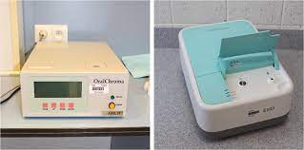
Just like the Halimeter, the OralChroma cannot detect compounds other than sulfur compounds, and some intraoral and extraoral causes can thus be overlooked.
The apparatus needs calibration and the sensor and column need to be replaced every 2 years

Slide 100
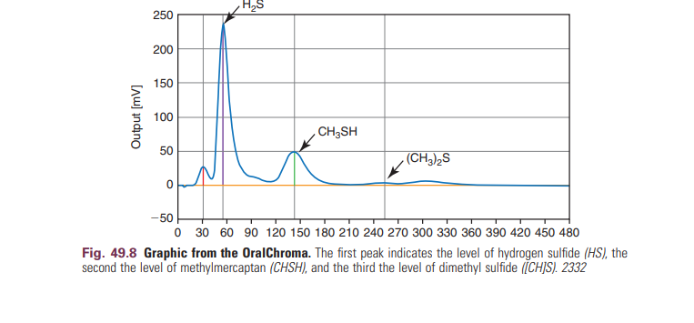
CHM 1 -795 $
CHM 2 - 6 Lakhs

Slide 101
Dark-Field or Phase-Contrast Microscopy
Oral malodor is typically associated with a higher incidence of motile organisms and spirochetes, so shifts in their proportions allow monitoring of therapeutic progress.
Another advantage of direct microscopy is that the patient becomes aware of bacteria present in plaque, tongue coating, and saliva.

Slide 102
Oropharyngeal Examination
The oropharyngeal examination includes inspection of deep carious lesions, interdental food impaction, wounds, bleeding of the gums, periodontal pockets, tongue coating, dry mouth, and the tonsils and pharynx (for tonsillitis and pharyngitis).
The tongue coating can be scored with regard to thickness and surface.
Several methods have been proposed for thickness; Gross and coworkers in 1975 proposed an index ranging from 0 (no coating) to 3 (severe coating).

Slide 103
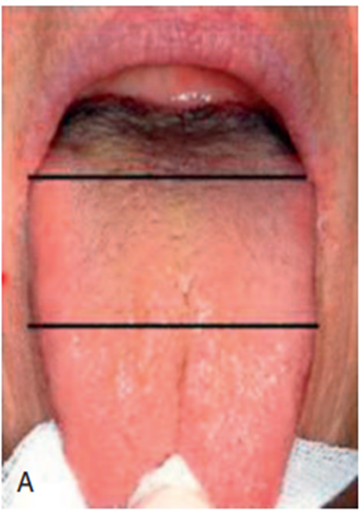
Miyazaki assessed tongue-coating status according to area:
0 = none visible,
1 = less than one-third of the tongue dorsum covered,
2 = less than two-thirds, and
3 = more than two-thirds

Slide 104
Winkel and coworkers considered both the extension and the thickness of the tongue coating.
The dorsum of the tongue is divided into six areas, three in the posterior and three in the anterior of the tongue.
The tongue coating in each sextant is scored as follows: 0 = no coating, 1 = light coating, and 2 = severe coating.
A score of 1 is given when the pink color underneath the coating is still visible; when this is not the case, 2 is given. Attention should be paid to the morphology of the tongue.

Slide 105
Electronic Nose
Electronic noses are chemical sensors that have been used in recent times for a quantitative assessment of malodor associated with food and beverages.
The FF-1 odor discrimination analyzer (Electronic nose, Shimadzu Corporation) was used by Tanaka M et al.
The setup comprises a pre-concentrator, an array of six metal oxide semiconductor sensors selected for their different sensitivities and selectivities to fragrant substances, and a pattern recognition software.

Slide 106
The instrument can be set to various modes such as the “all note measurement mode” which is the standard setting used for measuring all volatile substances and the “top note measurement mode” which primarily measures volatile substances with a low boiling point.
The results of their preliminary study showed that main compounds related to oral malodor were volatile substances with a low boiling point

Slide 107
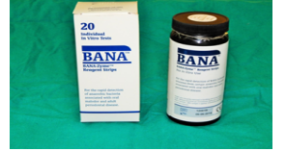
BANA TEST
BANA TEST : The BANA test was developed by Dr. Walter Löesche and coworkers at Michigan University, being the result of more than 15 years of research.
BANA-Enzymatic test™ kit (Ora Tec Corporation, Manassas, USA) is a rapid and reliable chair side diagnostic test, which can be performed in about 15 min time, that can give information about the presence of three anaerobic bacteria in subgingival plaque samples, namely, Porphyromonas gingivalis, Treponema denticola and Bacteroides forsythus but cannot differentiate them

Slide 108
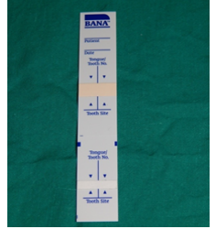
Principle of BANA test
Peptidases of T.denticola, P.gingivalis, and B. forsythus can hydrolyze the peptide analog N-benzoyl-DL-arginine-2 naphthylamide (BANA).
The BANA reagent strips are plastic cards to which separate reagent containing matrices are affixed.
The lower white reagent matrix is impregnated with BANA.

Slide 109
Subgingival plaque samples are applied to this lower matrix.
The upper reagent matrix contains a chromogenic diazo reagent (fast black K).
Peptidase in certain anaerobic micro-organisms associated with periodontal diseases can hydrolyze the peptide analog BANA.

Slide 110
The upper reagent matrix, reacts with one of the hydrolytic products of the enzyme reaction, forming a permanent blue color.
The blue color appears in the upper reagent matrix and is permanent.

Slide 111
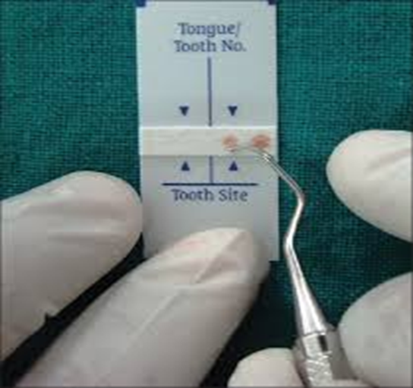
Method to use bana test kit :-
To obtain specimens for testing, sites should be cleared of supragingival plaque.
A Gracey curette may be used to obtain subgingival plaque specimens, which are placed on the lower matrix.
Before taking another specimen, wipe the curette with a clean piece of cotton or other suitable wipe to prevent carry-over of plaque.

Slide 112
Then the upper matrix is moistened with saline solution and the strip is folded at the given mark so as the two matrices come in contact.
It is incubated for 5 minutes at 55°C temperature. If there is no reaction the strip can be incubated for 10 min or 15 min at 55°C.
After interpretation of the results, the strips should be sealed with non-porous transparent tape and stored individually.

Slide 113
Interpretation of results
A permanent blue coloration on the upper matrix is found if BANA positive species are present when the test matrix is opened after incubation.
If the concentration of bacterial species is higher, the blue colour will be darker.
According to the result, the test can be positive, weak positive, or negative.

Slide 114
A BANA positive result indicates the presence of (more than 10,000 colony-forming units) of bacterial species in each plaque sample.
A BANA negative result indicates the absence of the three pathogenic species, or if present, in reduced numbers (less than 10,000 colony forming units) in each plaque sample.
The results obtained by the BANA test can be categorized as: 1. Strongly Positive – Blue Colour 2. Weakly Positive – Faint Blue Colour 3. Negative – No Colour
20,000 rs ( 20 test strips)

Slide 115
Salivary incubation test
First time, Marc Quirynen et al carried out a study to evaluate salivary incubation and halitosis.
Non-invasive test for the patient and helps to identify various compounds that contribute to oral malodor.
To measure halitosis, saliva was collected in a glass tube and incubated at 37 °C in an anaerobic chamber under an atmosphere of 80% nitrogen, 10% carbon dioxide, and 10% hydrogen for 3-6 hrs.

Slide 116
After incubation, an examiner evaluates the odor.
The salivary incubation test has much less influenced by external parameters such as smoking, drinking coffee, eating garlic, onion, spicy food, and scented cosmetics.

Slide 117
DIAMOND PROBE/PERIO 2000
These probes are designed to detect sulphide concentration of various forms in gingival sulci.
The system combines a conventional Michigan 'O' Probe style dental probe with a sulphide sensor, which measures probing depth, bleeding on probing and sulphide levels.
The micro-sulphide sensor responds to sulphide ions and measures metabolic products of many anaerobic bacteria and, indirectly bacterial activity.

Slide 118
The reaction of the sulphide ions with the sensor generates a measurable voltage that is proportional to the sulphide concentration.
Therefore, the presence of high sulphide levels indicates a higher level of anaerobic bacterial activity.
The probe tip was gently inserted into the base of the gingival sulcus and moved along with light pressure.

Slide 119
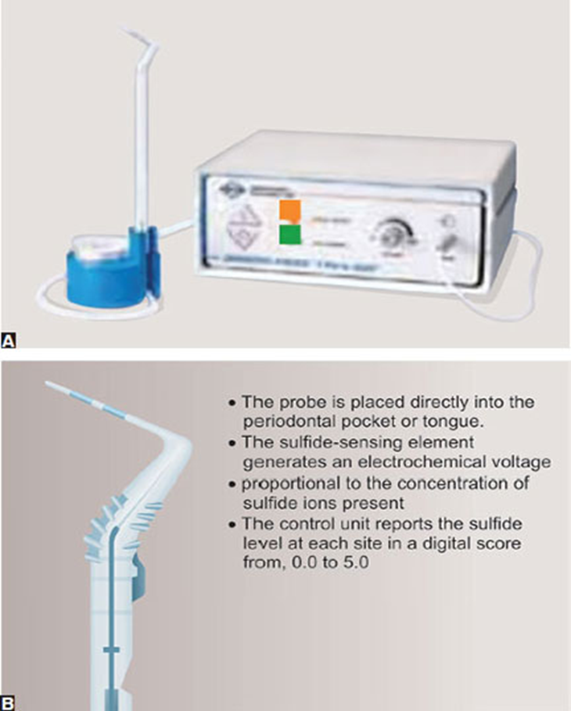
As the probe moved along the sulcus, the three parameters were recorded.
If the presence of sulphide was indicated above threshold (>0.5), the light on the front of the display panel would change colours depending on sulphide concentrations and an audible tone would sound

Slide 120
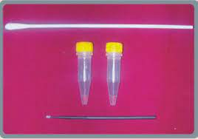
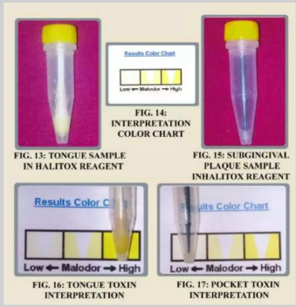
Halitox™ : Halitosis Linked Toxins is a quick, simple, colorimetric test that detects both VSC’s and polyamines like putrescine and cadaverine.
The kit consists of two testing vials that contain specific reagent chemicals.
The only thing that comes in contact with the patient is a sterile cotton tipped swab used to obtain a tongue scraping sample or packet sample.
The colour chart contains 3 colour scale- low toxin, moderate toxin and high toxin.

Slide 121
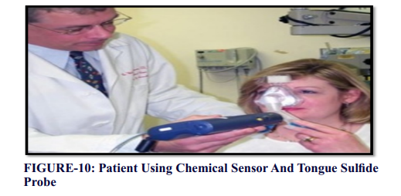
Tongue Sulfide Probe (Diamond General Development Corp., Ann Arbor, MI, USA):
The sulfide level on the tongue dorsum (pS level) was determined using the tongue sulfide probe.
Sensors for VSC's have been integrated into periodontal probes and paddles which can be placed directly into the pocket or on to the tongue, again yielding significant co-relation with organoleptic scores.

Slide 122
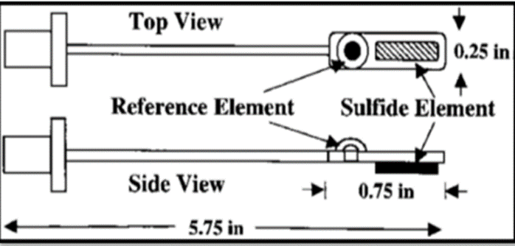
The tongue sulfide probe size was developed to determine the sulfide levels on the tongue dorsum.
The localization of tongue odor was quantitatively assessed using this newly developed tongue probe in a chairside setting appears to be simple, reliable, and clinically user friendly tool
Diagram of tongue sulfide probe. The sulfide-sensing element generates an electrochemical voltage proportional to the concentration of sulfide ions present. This voltage is measured relative to the operating point of the reference element.

Slide 123
BREATH CHECKER
Fitscan breath checker : It detects and measures the presence of breath odors (VSCs). It measures odor in seconds and results are displayed similar to organoleptic method.
Tanita BreathAlert™ : is an innovative palm-size monitor that detects and measures the presence of VSC’s and hydrocarbon gases in mouth air.
6300 Rs

Slide 124
The β-galactosidase tests quantify, by means of chromogenic substrates, bacterial enzymes involved in the initial degradation of oral mucin.
β-Galactosidase is one of the main enzymes responsible for the removal of carbohydrate side chains, a limiting step in the proteolysis of glycoproteins.
It has been demonstrated that the presence of the enzyme accounts for the presence of oral malodor independent of the VSC level.

Slide 125
The ninhydrin method is a colorimetric test to determine amino acids and low-molecular-weight amines.
These compounds are, like VSCs, final products of bacterial proteolysis.

Slide 126
TREATMENT
The treatment of oral malodor (with an intraoral origin) should preferably be cause related.
1. Mechanical reduction of intraoral nutrients (substrates) and microorganisms
2. Chemical reduction of oral microbial load
3. Rendering malodorous gases nonvolatile
4. Masking the malodor

Slide 127
Treatment need | Description
TN 1 | Explanation of halitosis and instructions for oral hygiene (support and reinforcement of patient's own self-care for further improvement in their oral hygiene)
TN 2 | Oral prophylaxis, professional cleaning and treatments for oral diseases, especially periodontal diseases
TN 3 | Referral to a physician or medical specialist
TN 4 | Explanation of examination data, further professional instruction, education and reassurance
TN 5 | Referral to a clinical psychologist, psychiatrist or other psychological specialists

Slide 129
I. MECHANICAL REDUCTION OF INTRAORAL NUTRIENTS AND MICROORGANISMS
Because of the extensive accumulation of bacteria on the dorsum of the tongue, tongue cleaning should be emphasized.
Previous investigations demonstrated that tongue cleaning reduces both the amount of coating (and thus bacterial nutrients) and the number of bacteria and thereby improves oral malodor effectively.

Slide 130
Cleaning of the tongue can be done with a normal toothbrush, but preferably with a tongue scraper if a coating is established.
Tongue cleaning using a tongue scraper reduces halitosis levels by 75% after 1 week.
This should be gentle cleaning to prevent soft tissue damage.

Slide 131
It is best to clean as far backward as possible; the posterior portion of the tongue has the most coating.
Tongue cleaning should be repeated until almost no coating material can be removed.
The gagging reflex is often elicited, especially when using brushes, practice helps to prevent this.

Slide 132
Interdental cleaning and toothbrushing are essential mechanical means of dental plaque control.
A one-stage full-mouth disinfection, combining scaling and root planing with the application of chlorhexidine, reduced organoleptic malodor levels up to 90% in one study.
In another study by the same investigators, initial periodontal therapy had only a weak impact on VSC levels, except when combined with a mouthrinse containing chlorhexidine

Slide 133
Chewing gum may control bad breath temporarily because it can stimulate salivary flow.
The salivary flow itself also has a mechanical cleaning capability.
Not surprisingly, therefore, subjects with extremely low salivary flow rate have higher VSC ratings and tongue coating scores than those with normal saliva production.

Slide 134
A Cochrane review in 2006, which compared randomized controlled trials for different tongue cleaning methods, concluded that there was a weak, but statistically significant, difference in the reduction of VSC levels when scrapers or cleaners were used instead of toothbrushes.

Slide 135
II. CHEMICAL REDUCTION OF ORAL MICROBIAL LOAD
Together with toothbrushing, mouth rinsing has become a common oral hygiene practice.
Formulations have been modified to carry antimicrobial and oxidizing agents, impacting the process of oral malodor formation.
Some of these agents have only a temporary effect on the total number of microorganisms in the oral cavity.

Slide 136
Chlorhexidine
Chlorhexidine is considered the most effective antiplaque and antigingivitis agent.
Its antibacterial action can be explained by disruption of the bacterial cell membrane by the chlorhexidine molecules, thus increasing its permeability and resulting in cell lysis and death.
Because of its strong antibacterial effects and superior substantivity in the oral cavity, chlorhexidine rinsing provides significant reductions in VSC levels and organoleptic ratings.

Slide 137
In several studies, a 0.2% CHX mouthrinse produced significant reductions in volatile sulfur-containing compound levels and in organoleptic scores. Similar results with 0.12% CHX-(di)gluconate were reported in combination with teeth and tongue brushing.
Unfortunately, as mentioned in some trials, chlorhexidine at a concentration of 0.2% or greater also has some disadvantages, such as increased tooth and tongue staining, unpleasant taste, and some temporary reduction in taste sensation

Slide 138
Essential Oils :
Previous studies evaluated the short-term effect (3 hours) of a Listerine rinse (which contains essential oils) compared with a placebo rinse.
Listerine was found to be only moderately effective against oral malodor (±25% reduction vs. 10% for placebo of VSCs after 30 minutes) and caused a sustained reduction in the levels of odorigenic bacteria.
Similar VSC reductions were found after rinsing for 4 days.

Slide 139
Essential oils including hydro-alcohol solutions of thymol, menthol, eucalyptol, and methyl salicylate, have been used in mouthwashes to prevent periodontal disease.
Rinsing with an EOs mouthrinse can have longlasting effects in reducing anaerobic bacteria overall as well as Gram-negative anaerobes and VSC producing bacteria

Slide 140
Chlorine Dioxide
Chlorine dioxide (ClO2) is a powerful oxidizing agent that can eliminate bad breath by oxidation of hydrogen sulfide, methylmercaptan, and the amino acids methionine and cysteine.
Studies demonstrated that a single use of a chlorine dioxide–containing oral rinse slightly reduced mouth odor.

Slide 141
Two-Phase Oil-Water Rinse
Rosenberg and colleagues designed a two-phase oil-water rinse containing CPC.
The efficacy of oil-water-CPC formulations is thought to result from the adhesion of a high proportion of oral microorganisms to the oil droplets that is further enhanced by the CPC.

Slide 142
CPC is a Quaternary ammonium compound which inhibit bacterial growth
Some studies also demonstrated that the CPC mouthrinse presented the lowest impact in reducing VSCs of morning breath when compared with other products.
This fact could be supported by the observation that this quaternary ammonium compound agent is not substantive enough to promote an essential antibacterial activity.

Slide 143
Triclosan
Triclosan, a broad-spectrum antibacterial agent, has been found to be effective against most oral bacteria and has good compatibility with other compounds used for oral home care.
A pilot study demonstrated that an experimental mouthrinse containing 0.15% triclosan and 0.84% zinc (Zn++) produced a stronger and more prolonged reduction in mouth odor than Listerine rinse.

Slide 144
Flavoring oils or anionic detergents and copolymers are added to increase the oral retention.
Significant reduction of breath scores were observed after a single use as well as after a week (28% and >50%, respectively), with a similar effect on VSC levels (57% reduction after 1 week of using the paste).

Slide 145
Amine Fluoride or Stannous Fluoride
The association of amine fluoride with stannous fluoride resulted in encouraging reductions of morning breath odor, even when oral hygiene was insufficient.
More recent evidence supporting the use of this rinse has become available.

Slide 146
The formulation showed not only short-term but also long-term effects on malodor indicators in patients with obvious malodor.
Stannous fluoride has also been shown to be effective in the management of oral malodor as a component of a dentifrice, reducing both organoleptic scores and VSC levels.

Slide 147
Hydrogen Peroxide
Suarez and colleagues reported that rinsing with 3% hydrogen peroxide (H2O2) produced impressive reductions (±90%) in sulfur gases that persisted for 8 hours.

Slide 148
Oxidizing Lozenges
Greenstein and associates reported that sucking a lozenge with oxidizing properties reduced tongue dorsum malodor for 3 hours.
This antimalodor effect may be caused by the activity of dehydroascorbic acid, which is generated by peroxide-mediated oxidation of ascorbate in the lozenges.

Slide 149
Baking Soda
Baking soda dentifrices have been shown to confer a significant odor-reducing benefit for up to 3 hours.
The mechanism by which baking soda produces its inhibition of oral malodor is related to its bactericidal effects.

Slide 150
III. CONVERSION OF VOLATILE SULFUR COMPOUNDS
Metal Salt Solutions : Metal ions with an affinity for sulfur are efficient in capturing the sulfur-containing gases.
Zinc is an ion with two positive charges (Zn++), which will bind to the twice-negatively loaded sulfur radicals and thus reduce the expression of VSCs.
The same applies for other metal ions such as stannous, mercury, and copper.
Compared with other metal ions, Zn++ is relatively nontoxic and noncumulative and gives no visible discoloration.

Slide 151
Thus, Zn++ has been one of the most-studied ingredients for the control of oral malodor.
Schmidt and Tarbet reported that a rinse containing zinc chloride was remarkably more effective than a saline rinse (or no treatment) in reducing the levels of both VSCs (±80% reduction) and organoleptic scores (±40% reduction) for 3 hours.
As mentioned, Halita, a rinse containing 0.05% chlorhexidine, 0.05% CPC, and 0.14% zinc lactate, has been even more efficient than a 0.2% chlorhexidine formulation in reducing VSC levels and organoleptic ratings.

Slide 152
Chewing gum can be formulated with antibacterial agents, such as fluoride or chlorhexidine, helping to reduce oral malodor through both mechanical and chemical approaches.
Tsunoda and associates investigated the beneficial effect of chewing gum containing tea extracts for its deodorizing mechanism.

Slide 153
Epigallocatechin is the main deodorizing agent among the tea catechins.
The chemical reaction between epigallocatechin and methylmercaptan results in a nonvolatile product.
Waler compared different concentrations of Zn++ in a chewing gum and found that a 2-mg Zn++ acetate–containing chewing gum that remained in the mouth for 5 minutes resulted in an immediate reduction in VSC levels of up to 45%, but the long-term effect was not mentioned.

Slide 154
IV. MASKING THE MALODOR TREATMENT
Masking the malodor with rinses, mouth sprays, or lozenges containing volatiles with a pleasant odor has only a short-term effect.
Typical examples are mint-containing lozenges and the aroma of rinses without antibacterial components.

Slide 155
Another pathway is to increase the solubility of malodorous compounds in the saliva by increasing the secretion of saliva; a larger volume allows the retention of larger volumes of soluble VSCs.
The latter can also be achieved by ensuring proper liquid intake or using chewing gum.

Slide 156
V. PROBIOTICS
Other modalities
Several studies have shown that probiotic bacterial strains, originating from the indigenous oral microbiota of healthy humans, may have potential application as adjuvants for the prevention and treatment of halitosis.
The aim is to prevent the re-establishment of unwanted bacteria and thus limit the recurrence of oral malodor for an extended period.
Recently, several studies have been carried out to replace the bacteria responsible for halitosis with probiotics such as Streptococcus salivarius (K12), Lactobacillus salivarius or Weissellacibaria.

Slide 157
Furthermore, in vivo and in vitro studies revealed that Weisellacibaria isolates have the ability to inhibit the production of VSC, demonstrating that they have potential for the development of new probiotics for use in the oral cavity.
The use of a suspension of living non-pathogenic Escherichia coli bacteria also seems to have good results in the treatment of gut-caused halitosis

Slide 158
VI. OIL PULLING
The concept of oil pulling was familiarized by Dr. F. Karach in the 1990s in Russia.
Oil pulling therapy can be done using edible oil’s like sunflower or sesame oil.
For oil pulling therapy, a tablespoon of sesame oil is taken in the mouth, sipped, and pulled between the teeth for 10 to 15 min.

Slide 159
Oil pulling therapy should be followed by tooth brushing and is preferably done on empty stomach in the morning.
There is no scientific proof to accept oil pulling therapy as a treatment adjunct to cure halitosis.
The results showed that oil pulling therapy has been equally effective like chlorhexidine on halitosis and organisms, associated with halitosis.

Slide 160
VII. NATURAL HERBS FOR HALITOSIS RELIEF
Many herbs frequently used in the preparation of various beverages like herbal tea and alcoholic drinks contain volatile oils that are anti-bacterial and therefore can be useful for the natural treatment of halitosis.
It is consequently quite natural to think about using these herbs themselves as natural remedy for the relief of halitosis.

Slide 161
Some of the common herbs for the treatment of halitosis are as follows:
1. Thyme (Thymus vulgaris)
2. Eucalyptus (Eucalyptus globulus)
3. Peppermint (Menthapiperita)
4. Sage (Salvia officinalis)
5. Ginger (Zingiberofficinale)
6. Cardamom (Eletteria cardamomum)
7. Anise (Pimpinella anisum)
8. Cinnamon (Cinnamomum verum)
9. Fennel (Foeniculum vulgare)
10. Fenugreek (Trigonellafoenum graecum

Slide 162
Treatments for Extra-Oral Causes
Bearing in mind that halitosis presents a multifactorial complexity, treatment should be individualized and directed to each patient, rather than generalized .
Diagnosis and treatment involve a multidisciplinary team: primary healthcare clinician, dentist, otolaryngologist, nutritionist, gastroenterologist and clinical psychologist.
After a detailed clinical oral examination and anamnesis, that excludes intra-oral causes for halitosis, patients with signs or symptoms of systemic diseases that may be the cause of oral malodor, should be referred to the appropriate medical specialty.

Slide 163
HALITOPHOBIA
Imagined halitosis is poorly documented in the psychiatric literature.
Many of the cases with imagined halitosis described in the literature resemble the psychiatric syndrome of social phobia.
Generally, these patients believe that their oral malodor is related to social rejection or avoidance behaviors of the people with whom they interact.

Slide 164
Patients with halitophobia require referral for clinical psychology investigation and treatment for mental assessment and appropriate treatment
The ‘treatment’ of these patients is impossible, as they are not within the arguments presented by a physician.
Mostly, these patients hop from clinic/specialist to clinic/specialist to find an argument for their self-reported problem

Slide 165
CONCLUSION
Halitosis is a crippling social problem, surprisingly, a problem of this magnitude has been neglected by dental professionals, even though the most common cause is related to microbiota of oral cavity.
Its study is a growing science that may, at the surface, appear to be a simplistic exercise in curing a merely social problem.
Deeper investigation into the chemical compounds found in halitosis and their effect on tissues and cells may expand our understanding of cell function in normal and diseased tissue.

Slide 166
HALITOSIS
To summarize….
Genuine
Pseudo
Halitophobia
Type 0 – Physiologic
Type 1 – oral
Type 2 – airway
Type 3 – gastroesophageal
Type 4 – blood borne
Type 5 - subjective

Slide 167
ETIOLOGY
Intra oral causes :
- Poor oral hygiene
- Tongue coating
- Dry mouth
- Gingivitis
- Periodontitis
Extraoral causes :
ENT
Respiratory
Gastroesophageal
Liver & kidney disease
Metabolic disease
Trimethylaminuria
Hormonal
Medications

Slide 168
Specific character of breath odor:
Smell | Condition | Accumulation product
Rotten eggs | - | VSC’s
Rotten apples | Unbalanced insulin dependent diabetes | Ketones
Dead mice | Liver insufficiencies | Aliphatic acids (butyric, isobutyric, propionic)
Fish odor | Kidney insufficiency | Diethylamine and triethylamine

Slide 170
DIAGNOSTIC TESTS
Organoleptic assessement
Halimeter
Gas chromatography
Dark field/phase contrast microscopy
Oropharyngeal examination
Self examination
Electronic nose
BANA
Saliva incubation test
Diamond probe/ Perio 2000
Halitox
Breath checker
Ninhydrin method
β-galactosidase tests

Slide 171
TREATMENT
1. Mechanical reduction of intraoral nutrients (substrates) and microorganisms
2. Chemical reduction of oral microbial load
3. Rendering malodorous gases nonvolatile
4. Masking the malodor
5. Probiotics
6. Oil pulling
7. Natural herbs

Slide 172
REFERENCES
Michael G. Newman, Henry Takei, Perry R. Klokkevold, Fermin A.Carranza 13th edition
Drug-related oral malodour (halitosis): a literature review M. TORSTEN, G. GÓMEZ-MORENO, A. AGUILAR-SALVATIERRA Pharmacological Research in Dentistry Group, Faculty of Dentistry, University of Granada, Granada, Spain
Aydin M, Harvey-Woodworth CN. Halitosis: a new definition and classification. British dental journal. 2014 Jul 11;217(1):E1
Izidoro, C.; Botelho, J.; Machado, V.; Reis, A.M.; Proença, L.; Alves, R.C.; Mendes, J.J. Revisiting Standard and Novel Therapeutic Approaches in Halitosis: A Review. Int. J. Environ. Res. Public Health 2022, 19, 11303

Slide 173
Kini VV, Pereira R, Padhye A, Kanagotagi S, Pathak T, Gupta H. Diagnosis and Treatment of Halitosis: An Overview. J Contemp Dent 2012;2(3):89-95.
Marawar, Pramod, et al. "Halitosis: A silent affliction!" Chronicles of Young Scientists, vol. 3, no. 4, Oct.-Dec. 2012, p. 251.
Measurement of Oral Malodor: Current Methods and Future Prospects Mel Rosenberg" and Christopher A. G. McCulloch*
A plenary review of halitosis Dr. Jaishree Tukaram Khsirsagar, Dr. V Valarmathy, Dr. M Balamurugan and Dr. R Vishnupriya

Slide 174
Sanz M, Roldán S, Herrera D. Fundamentals of Breath Malodour. J Contemp Dent Pract 2001 Nov;(2)4: 001-017
Historical and social aspects of halitosis Marina Sá EliasRev. Latino-Am. Enfermagem 14 (5) • Oct 2006
Treatment Needs (TN) and practical remedies for halitosis J.M. Coil and K. Yaegak International Dental Journal (2002)

Slide 175
NO, THANK YOU

