Slide 1
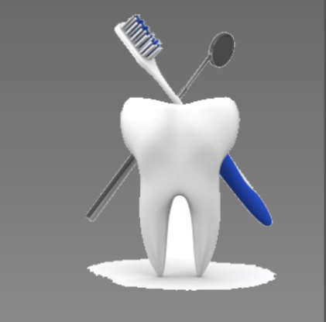
Mechanical plaque CONTROL
Guided by:
Dr. Vishnudas Bhandari
Dr. Omkumar Baghele
Dr. Gauri Ugale
Dr. Raghavendra Metri
Dr. Mukesh Ardale
Dr. Sukanya Vyavhare
Dr. Poonam Kedar
Presented by:
Dr. Khushbu Bezalwar
(I st year PG)

Slide 2
CONTENTS
INRODUCTION
MECHANICAL PLAQUE CONTROL
a) Toothbrush
b) Dentifrices
c) Methods of toothbrushing
d) Interdental aids
e) Gingival massage
f) Oral irrigation
g) Sequalae of incorrect use of mechanical plaque removal devices
h) Conclusion
i)References

Slide 3
INTRODUCTION
The need to prevent human disease is well recognized and, to the population as a whole, a high social priority.
For life-threatening diseases or those with severe morbidity, the case for the introduction of effective preventive measure is strong.
Periodontal diseases (gingivitis and periodontitis) are considered inflammatory diseases of microbiological origin.
Their most important risk factor is the accumulation of a plaque biofilm at and below the gingival margin, which is then associated with an inappropriate and destructive host inflammatory immune response.

Slide 4
Although not all patients with gingivitis will develop periodontitis, the management of gingivitis is considered as primary prevention strategy for periodontitis.
Plaque reduction/Plaque control has been the hallmark of preventive dentistry.
Plaque control is defined as the removal of microbial plaque and food debris from the oral cavity. The concept of plaque control is broadly based on factors of mechanical plaque control and chemical plaque control.

Slide 5
The mechanical plaque control is mainly achieved through tooth brushing either using a manual brush or using a motorized tooth brush or with the help of pressurized water pump system involving the use of water under pressure pumped through fine blunt needle or nozzle.
The chemical control of plaque includes organic or inorganic chemicals, which inhibit the accumulation, growth and survival of microbiota and debris.

Slide 6
MECHANICAL PLAQUE CONTROL
Self-care has been defined by the World Health Organization as all the activities that the individual takes to prevent, diagnose and treat personal ill health by self-support activities or by referral to a healthcare professional for diagnosis and care.
The self-care or home-use activities that contribute to the oral health status of an individual include toothbrushing by manual or electric means combined with interdental cleaning.
Claydon NC. Current concepts in toothbrushing and interdental cleaning. Periodontology 2000. 2008 Oct;48(1):10-22.

Slide 7
The benefits of optimal home-use plaque-control measures include the opportunity to maintain a functional dentition throughout life, a reduction in the risk of loss of periodontal attachment, optimization of esthetic values such as appearance and breath freshness, and also a reduced risk of complex, uncomfortable and expensive dental care.
The reviews on mechanical plaque control consider standard toothbrushing first, electric toothbrushing second and interdental cleaning last of all.
Axelson P. Mechanical plaque control. In: Lang NP, Karring T, editors. Proceedings of the 1st European Workshop on Periodontology. London: Quintessence Publishing Co. Ltd, 1993: 219–243.

Slide 8
This, despite the fact that in terms of risk analysis for the development of periodontal disease and caries, the interproximal areas carry most risk. Indeed, the importance of interproximal plaque control, and its effectiveness at reducing inflammation, are well documented.
It is appreciated that the toothbrush alone is capable of removing up to 1 mm of subgingival plaque, but is ineffective in the interproximal region.
Hence, the development of a variety of mechanical and electrical devices have been sanctioned, with the aim of enabling the user to achieve higher standards of interdental cleaning.
Lang NP, Ronis DL, Farghaly MM. Preventive behavior as correlates of periodontal health status. J Public Health Dent 1995: 55: 10–17

Slide 9
The toothbrush
Toothbrush is described as “the most classic and principal method employed in oral hygiene.”
According to ADA’s council of dental therapeutics “ It is designed primarily to promote cleanliness of teeth and oral cavity.”

Slide 10
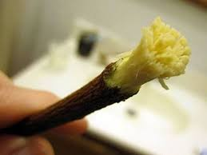
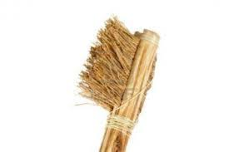
History
Chewing sticks were the first toothbrushes made by Babylonians as early as 3500 B.C.
These chew sticks are also called as Siwaks, which were small twigs that were frayed by chewing on the ends and rubbing the frayed ends against the teeth.
Bristle brushes (made from coarse, stiff hog’s hair attached to handles made of bone or bamboo) appeared in china around 1498.

Slide 11
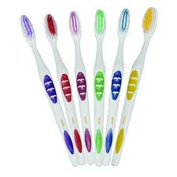
The first mass production of toothbrushes appeared in England around 1780, which were made by William Addis of Clerkenwald.
The first American to patent a toothbrush was HN Wadworth in 1857.
Mass production of toothbrushes in united states began after the civil war, around 1885.
Wallace H Carothere invented Nylon in 1937 and in 1938 it was produced and marketed.

Slide 12
Parts of toothbrushes
Handle: The part grasped in the hand during tooth brushing.
Head : It is the working end of tooth brush that hold bristles.
Tufts: Clusters of bristles secured into head.

Slide 13
Toothbrush bristles
Toothbrush bristles are grouped in tufts that are arranged in 3-4 rows.
Based on types of bristle material:
Natural bristles
Artificial filaments
Based on bristle hardness:
Soft brush: 0.007 inch(0.2 mm)
Medium brush: 0.012 inch(0.3 mm)
Hard brush: 0.014 inch(0.4 mm)

Slide 14
ADA Specification of toothbrush
Surface area : 2.54 to 3.2 cm
Brush length: 1-1.25 inches
Brush width: 5/16-3/8 inches
2-4 rows of bristles
5-12 tufts per row
No. of bristles : 80 to 85 per tuft

Slide 15
At the European Workshop on Mechanical Plaque Control, it was agreed that the features of an ideal manual toothbrush should include (Egelberg & Claffey 1998):
1. Handle size appropriate to user age and dexterity
2. Head size appropriate to the size of the patient’s mouth
3. Use of end-rounded nylon or polyester filaments not larger than 0.009 inches in diameter
4. Use of soft bristle configurations as defined by the acceptable international industry standards (ISO)
5. Bristle patterns which enhance plaque removal in the approximal spaces and along the gum line.

Slide 16
Dentifrices
A pharmaceutical formulation commonly prepared as a paste, gel, powder or liquid which is used to clean and/or polish teeth. Active ingredients to prevent caries and plaque accumulation or to desensitize teeth may be included.
(Glossary of periodontal terms)
A dentifrice is a substance used with a toothbrush for the purpose of cleaning accessible surfaces of teeth.
ADA(council on dental therapeutics, 2015)
Webster described the term dentifrice as derived from dens(tooth) and fricare(to rub).

Slide 17
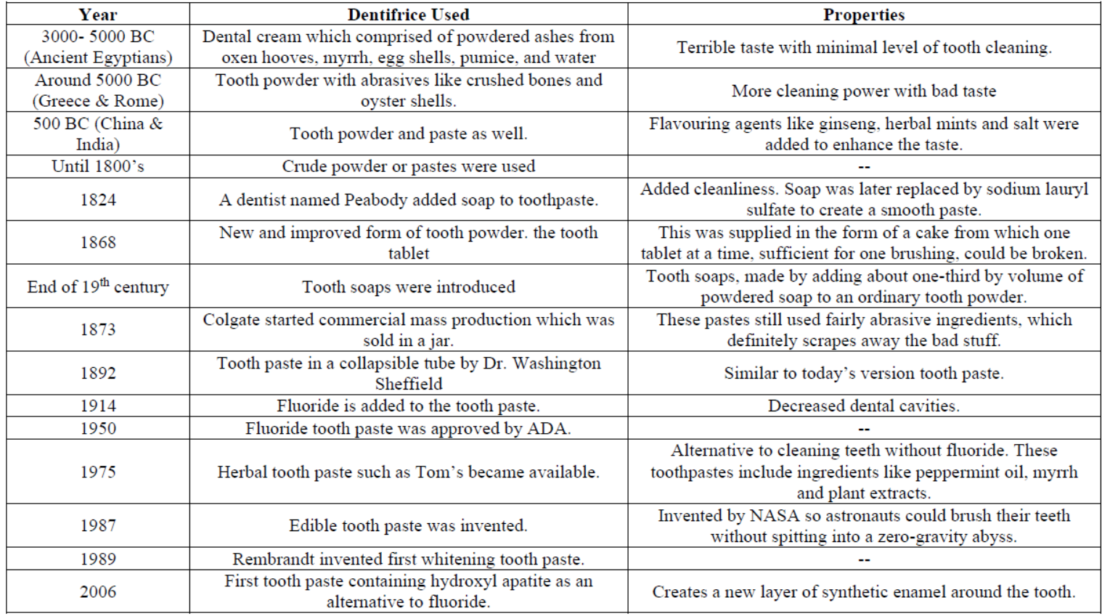
Evolution of dentifrices
Stuart L . Fischman; The history of oral hygiene products: how far have we come in 6000 years? Periodontology 2000, Vol. 15, 1997, 7-14

Slide 18
They are used mostly in the form of pastes, although powders and gels are also available.
The main functions of a toothpaste (in conjunction with tooth-brushing) are:
Minimizing build-up of plaque
Strengthening teeth against caries
Cleaning the teeth by removing stain
Removing food debris
Freshening the mouth.
A number of ingredients go to make up toothpaste and each has a role in either influencing the consistency and stability of the product or its function.

Slide 19
The major ingredients may be classified under the following headings:
The polishing or abrasive agent
A polishing or abrasive agent has two purposes.
Firstly, its mild abrasive action helps to eliminate plaque from the teeth, hence reducing plaque build up
Secondly, the abrasive agent removes stained pellicle from the teeth, polishes the surfaces, restores the natural luster and enhances enamel whiteness.
Naturally, the abrasive agent must be chosen very carefully, so that it can clean and polish without scratching or damaging the enamel or the much softer underlying tissue, dentine.

Slide 20
The abrasive system should be insoluble, inert, nontoxic and preferably white.
Commonly used abrasive materials include calcium carbonate, dicalcium phosphate dihydrate, alumina and silicas.
In choosing the agent, particular attention is paid to the size of the particles and their shape and hardness.
The greater the particle size, the greater is the abrasive action on both dentine and enamel. There is, however, a third very important factor: the hardness of the mineral used. If the mineral is harder than both dentine and enamel then greater is the abrasion.
The rate of abrasive wear is approximately inversely related to the tissue hardness.

Slide 21
The abrasive quality of dentifrices affects enamel slightly and is a much greater concern for patients with exposed root surfaces. Dentin is abraded 25 times faster and cementum even faster, 35 times the rate of enamel.
Therefore root surfaces with exposed dentin and cementum are easily abraded, leading to notching and tooth sensitivity.
It can be concluded that oral hygiene procedures that use abrasive toothpaste are the main cause of hard tissue damage, and it is possible that gingival lesions can also be produced.

Slide 22
The abrasivity of dentifrices is determined by the Relative Dentin Abrasivity (RDA).
The higher the score, the more abrasive is the dentifrice.
The upper limit recommended by the US Food and drug administration is 200 and the American Dental Association is 250.
Low abrasive dentifrices have RDA value below 70-80.
If the RDA value is over 100 the dentifrice is highly abrasive and it may damage the enamel, dentin and cemental surfaces.

Slide 23
The binder or thickener
The binder or thickener controls the stability and consistency of a toothpaste, and also affects the ease of dispersion of the paste in the mouth.
Choice of the correct binder and concentration is critical to ensure that the product can be readily squeezed from the tube and yet have a good appearance when it is on the toothbrush.
Commonly used thickeners can be divided into two classes –
Water soluble, including carrageenates, alginates and sodium carboxymethylcellulose.
Water insoluble, including magnesium aluminum silicate, sodium magnesium silicate and colloidal silica.

Slide 24
The surfactant agent
The surfactant agent provides the foam that eases the removal of food debris and aids dispersion of the product in the mouth.
Early dentifrices actually used soap, but mild synthetic detergents are now universally used to give better taste, foam and product stability.
The detergent used most widely by all major manufacturers is sodium lauryl sulfate, which has a history of decades of safe and effective use all over the world.
The most common used concentrations vary from 0.5–2 %

Slide 25
Sodium lauryl sulfate (C₁₂H₂₅NaO₄S) has antimicrobial properties and thus helps to preserve the toothpaste during manufacture and use.
The antimicrobial action of SLS is related to its adsorption and penetration through the porous cell wall followed by interaction with components of the cell membrane, lipids and proteins. The penetration of SLS into the membrane causes an increase in cell permeability of the bacteria, which may result in leakage of intracellular components and cell lysis.
Another positive role sodium lauryl sulfate has is to help to solubilize key ingredients such as flavors and certain antimicrobial agents.
It also shows negative impact that, in clinical studies oral epithelial sloughing, ulcerations and inflammation caused by SLS have been observed.

Slide 26
The humectant
A humectant is a material that helps to reduce loss of moisture from a preparation.
In toothpaste, the humectant minimizes plug formation in tube nozzles and improves the texture and feel of the product in the mouth.
It can also act as a sweetening agent.
Examples are: glycerin, sorbitol and polyethylene glycol. Glycerin and sorbitol are the humectants used most often.

Slide 27
The flavor
The choice of flavor is very important to the consumer. It renders the product pleasant to use and should leave a fresh taste in the mouth after use.
Soluble saccharin is usually added as an additional sweetening agent. The types of flavor used include peppermint oil, spearmint oil and wintergreen (methyl salicylate).
All around the world peppermint and spearmint are the most important flavor types. Other flavor materials such as wintergreen, aniseed, lemon oil and eucalyptus are also usually added to improve the acceptability of the flavor and to add individual notes to the flavors.
The sweetening agent
Sweeteners, such as sodium saccharin, sucralose and xylitol, work together with the flavour system by adding a degree of sweetness to the toothpaste but avoid the use of fermentable sugars. Xylitol likely has anti-caries potential when delivered continuously.

Slide 28
Therapeutic agents
A toothpaste is an excellent vehicle for delivering other oral health benefits, and for this reason many different therapeutic agents are added.
These include anticaries agents, antiplaque agents, anticalculus agents, antisensitivity agents and whitening agents.
Geoffrecy. Forward; Gum health product formulations: what is in them and why? Periodontology 2000, Vol. 15, 1997, 32-39

Slide 29
Active ingredients
Antibacterial | Prevent bacterial growth | Triclosan Delmopinol Metallic ions Zinc citrate trihydrate
Anticaries agent | Active agent: fluoride Inhibit demineralization Enhance remineralization Inhibit the enzyme activity in bacteria by acidifying the cells | Sodium monoflorophosphate Sodium fluoride Stannous fluoride
Anticalculus agent | Inhibit the mineralization of plaque | Pyrophosphates Zinc citrate Zinc chloride
Desensitizing agent | Decreases the sensitivity | Sodium fluoride Potassium nitrate Strontium chloride

Slide 30
Efficacy of dentifrices
The dentifrices with different antiplaque and anti-inflammatory agents enhance the mechanical action of toothbrushes in cleaning teeth.
Several studies have examined the effect of toothbrushing with and without dentifrice on plaque removal and the results have been inconclusive.
While one study established that brushing with a dentifrice contributed to greater plaque removal than brushing without it (Eid and Talic, 1991), many of them concluded that the use of dentifrices did not contribute essentially to instant mechanical plaque removal during manual toothbrushing (Paraskevas et al., 2006, 2007; Parizotto et al., 2003).

Slide 31
Valkenburg C., et al (2019), in systematic review reported that use of a dentifrice with tooth brushing had a weak additional inhibitory effect on plaque regrowth when compared with tooth brushing alone.
A Johannsen., et al (2019), in systematic review found that stabilized SnF₂ toothpaste had a positive effect on the reduction of dental calculus build-up, dental plaque, gingivitis, stain and halitosis.
A study by Solvatto AR (1992),Dentifrice containing potassium chloride (KCl) and sodium monofluorophosphate (MFP) was compared to a placebo dentifrice for effectiveness in alleviating dentinal hypersensitivity.The results demonstrated that the KCl/MFP dentifrice was significantly more effective than the placebo dentifrice in reducing dentinal hypersensitivity.

Slide 32
Toothbrushing methods
Many methods for brushing have being efficient and effective. These methods can be categorized primarily according to the pattern of motion as: (according to Greene, 1996)
Roll: Roll or modified stillman method
Vibratory: Stillman, charters, and bass method
Circular: Fones technique
Vertical: Leonard technique
Horizontal: Scrub technique

Slide 33
Classification of brushing technique according to direction of tooth brush movement
Horizontal reciprocating motion
Horizontal scrub technique
Vibratory motion
Bass(sulcular) brushing technique
Vertical sweeping brushing motion
Modified bass brushing
Modified stillman’s method
Leonard’s method
Smith–bell method
Rotary motion
Fone’s technique

Slide 34
Bass method
Indications:
For all patients for dental plaque removal adjacent to and directly beneath the gingival margins
Adaptable for open interproximal areas, cervical areas beneath the height of contour of the enamel, and exposed root surfaces.
Recommended for routine patients with or without periodontal involvement.

Slide 35
Technique:
Place the head of a soft brush parallel to the occlusal plane, with the brush head covering three to four teeth. This hygiene procedure begins at the most distal tooth in the arch and systematically proceeds mesially.
Place the bristles at the gingival margin, pointing at a 45- degree angle to the long axis of the teeth.
Exert gentle vibratory pressure using short, back-and-forth motions without dislodging the tips of the bristles. This motion forces the bristle ends into the gingival sulcus are as well as partly into the interproximal embrasures. The pressure should be firm enough to blanch the gingiva.

Slide 36
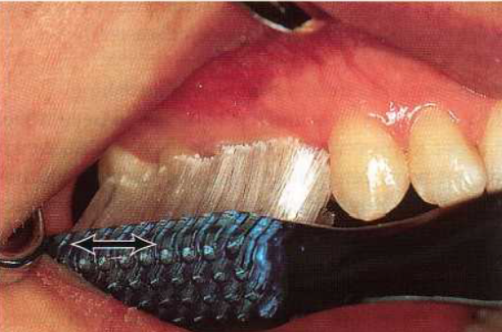
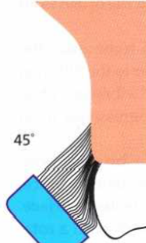
The Bass method of toothbrushing. The head of the toothbrush is in this illustration placed against the buccal surface of the posterior teeth o the right maxilla. Note the angulation of the bristles against the tooth and the direction (arrows of the motion).

Slide 37
Advantages:
Effective method for removing plaque adjacent to and directly beneath the gingival margin, cervical areas, and sulcus.
Provides good gingival stimulation.
Easy to learn.
Disadvantages:
Overzealous brushing may convert the very short strokes into scrub brush technique and cause injury to gingival margin.
Time consuming
Dexterity requirement is too high

Slide 38
Stillman method
Indications
For spongy gingival tissue where massaging is valuable.
For cleansing areas with progressive gingival recession and root exposure
Technique
Similar to the bass method, except that bristles are placed partly over the cervical portion of the teeth and partly on adjacent gingiva. It uses side rather then the ends of bristles and penetration of bristles into the sulcus is avoided. The brush is positioned at 45 degree to the long axis of tooth. The brush is activated with short back and forth motion and moved in coronal direction

Slide 39
Advantages
It provides gingival stimulation along the plaque and debris removal from cervical margins of teeth and wide embrasures
These technique requires patience for placing the tooth brush in different position.

Slide 40
Modified bass method
Indications:
As a routine oral hygiene measure.
Intrasulcular cleansing.
Technique:
The brush is positioned similarly to the Bass technique, but after applying the small movement in anterior-posterior direction, the bristles are swept in rolling motion applying a movement in occlusal direction. It is a combination of the Bass and the modified Stillman techniques.

Slide 41
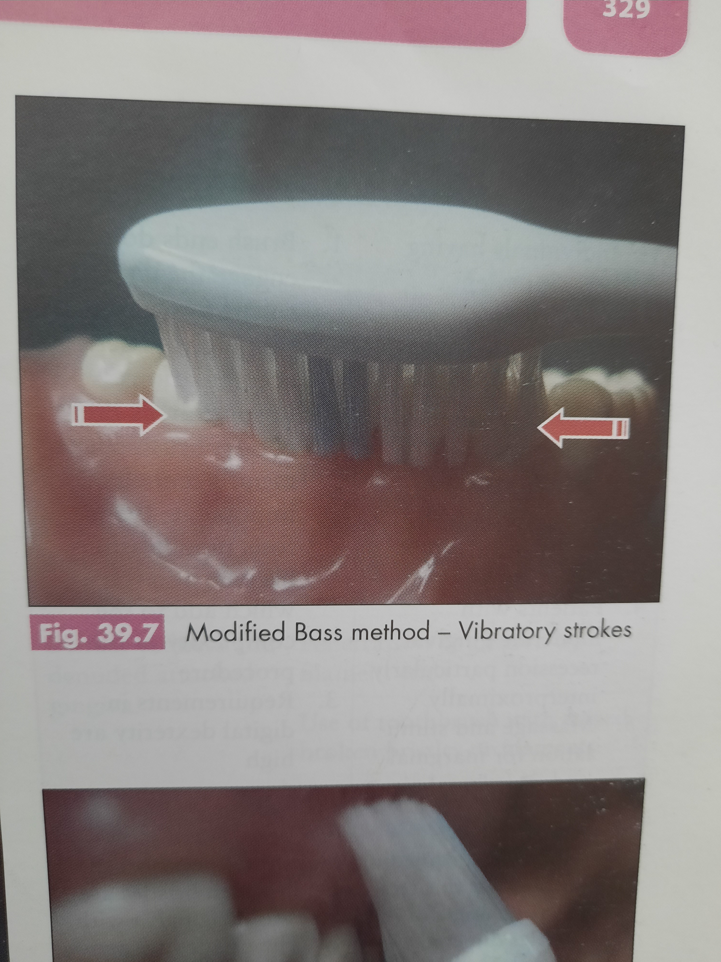
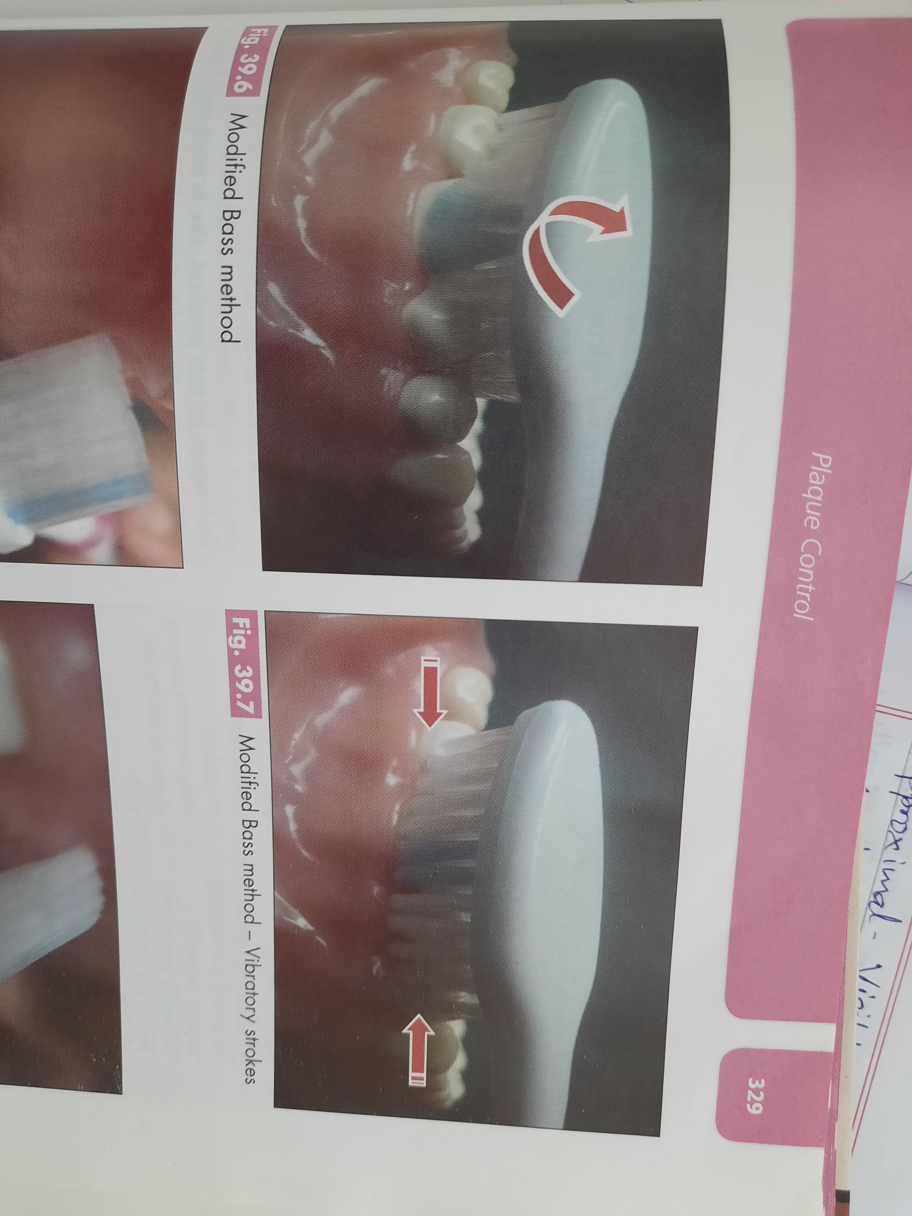
Modified bass method – short vibratory strokes
Sweeping motion toward the occlusal surface

Slide 42
Advantages:
Excellent sulcus cleaning
Good interproximal and gingival cleaning
Good gingival stimulation
Disadvantages:
Moderate dexterity of wrist is required

Slide 43
Modified Stillman Method
Indications:
Dental plaque removal from cervical areas below the height of contour of enamel and exposed proximal surface
General application for cleaning tooth surfaces and massaging the gingiva
Recommended for cleaning in areas with progressive gingival recession and root exposure to prevent abrasive tissue destruction.

Slide 44
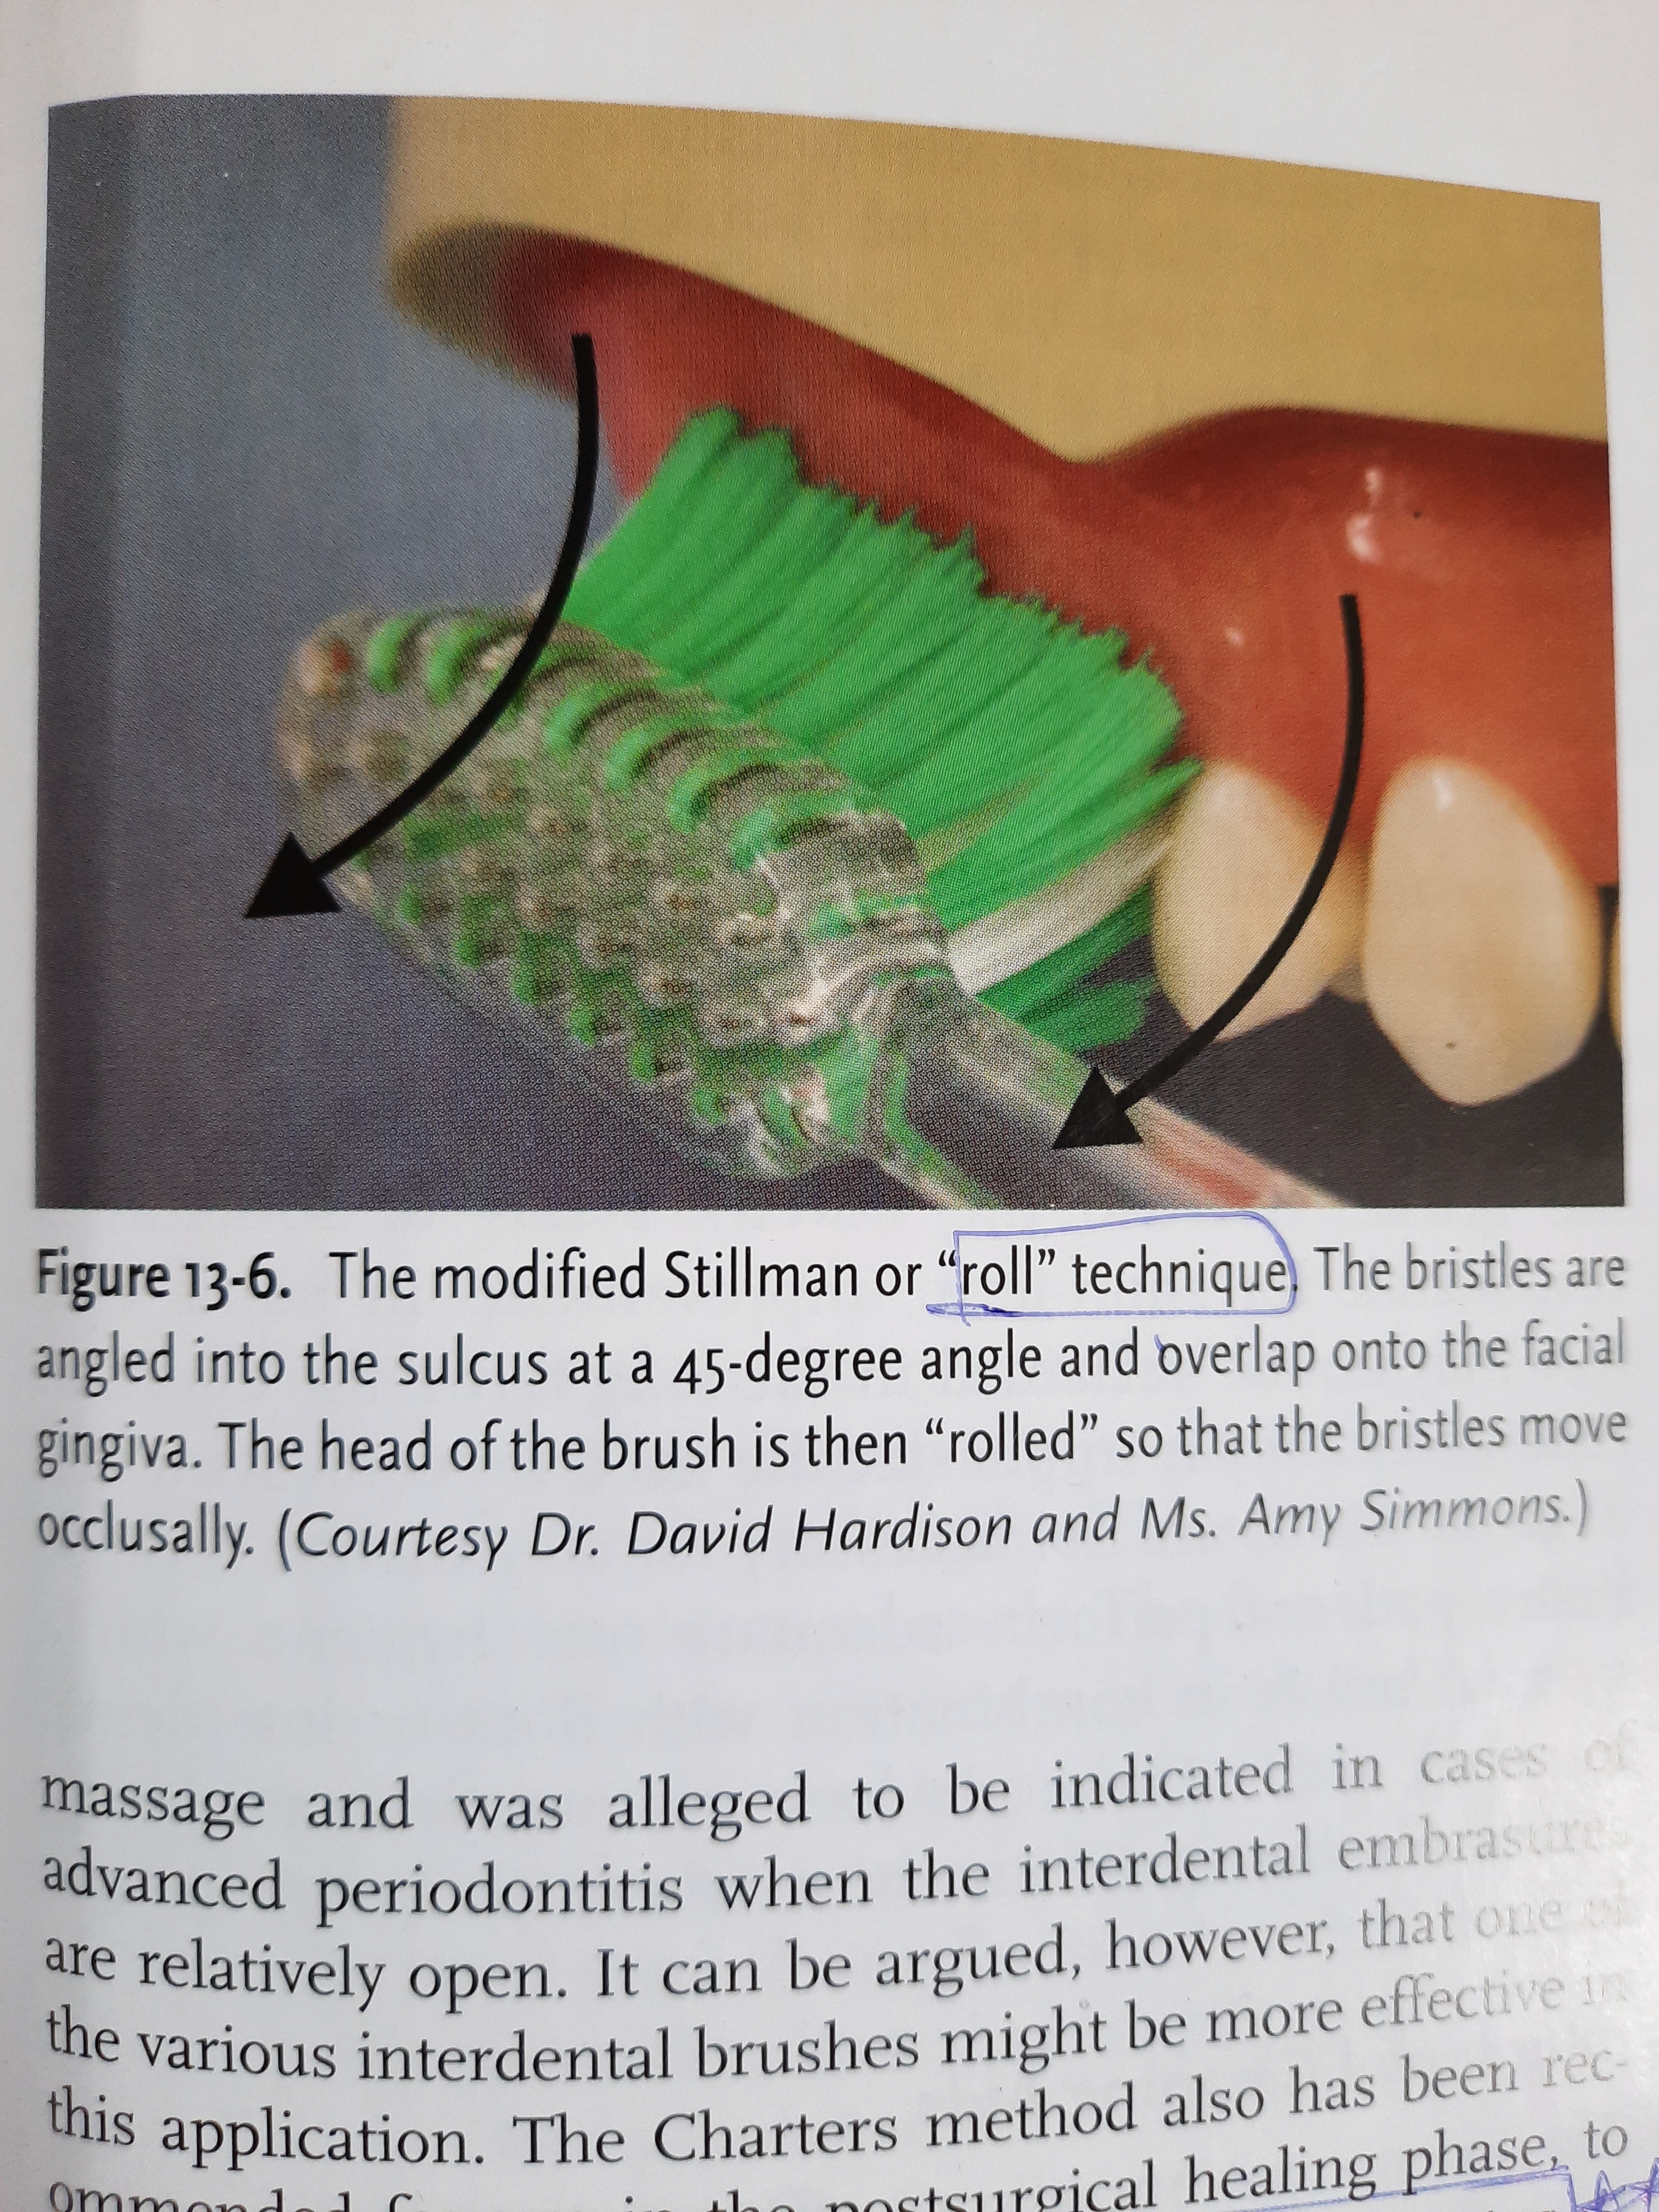
Technique:
The bristles are positioned partly on cervical aspects of teeth and partly on the adjacent gingiva.
The bristles are activated by short back and forth motions and simultaneously moved in coronal direction; the procedure is repeated systematically.

Slide 45
Disadvantages:
Time consuming
Improper brushing can damage epithelial attachment

Slide 46
Charters method
Indications:
Individuals having open interdental spaces with missing papilla and exposed root surfaces
Those wearing F.P.D or orthodontic appliances
For those patients who have had periodontal surgery.
Patients with moderate gingival recession particularly interproximally.
Massage and stimulation for marginal and interdental gingiva.

Slide 47
Technique:
The head of the brush is positioned in an oblique direction to the tooth surface, with the bristles directed towards the occlusal surface.
The brush is then moved back and forth with a rotatory motion.
Disadvantages:
Brush ends do not engage the gingival sulcus to remove subgingival bacterial accumulations.
In some areas the correct brush placement is limited or impossible.
Requirements in digital dexterity is high.

Slide 48
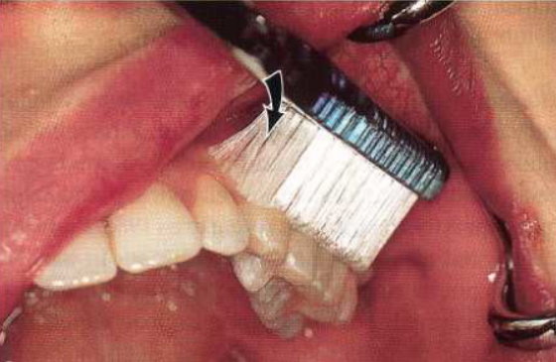
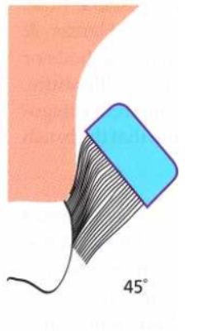
The Charters’ method of toothbrushing. The head of the toothbrush is placed
in the left maxilla. Note the angulation of the bristles against the buccal tooth surfaces. The bristles are forced into the interproximal areas.

Slide 49
Horizontal brushing(scrub method)
It is the most widespread technique and despite the efforts of the dental profession to instruct patients to adopt other more convenient brushing techniques, most individuals use such a technique since it is the simplest.
The head of the brush is positioned at a 90° angle to the tooth surface and then movement is applied horizontally.
The occlusal, lingual and palatal surfaces of the teeth are brushed with the mouth open and the vestibular surfaces are cleaned with the mouth closed.

Slide 50
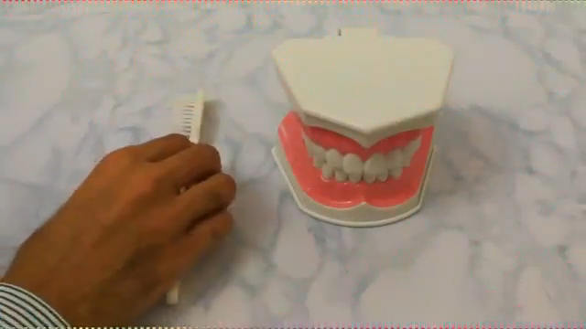

Slide 51
Advantages:
It is virtual free style of brushing and it requires vigorous horizontal, vertical, and circular motions
Disadvantages:
Ineffective at plaque removal
Tooth abrasion and gingival recession
Detrimental to general oral health

Slide 52
Circular or Fones method
Indications:
Young children and who do not have muscle development.
Technique:
The child is asked to stretch his/her arms such that they are parallel to the floor.
The chid is then asked to make big circles using the whole arm to draw circles in air.
The circles are reduced in diameter until very small circles are made in front of mouth.
Th chid is now ready to make circles on teeth with the toothbrush, making sure that teeth and gums are covered.

Slide 53
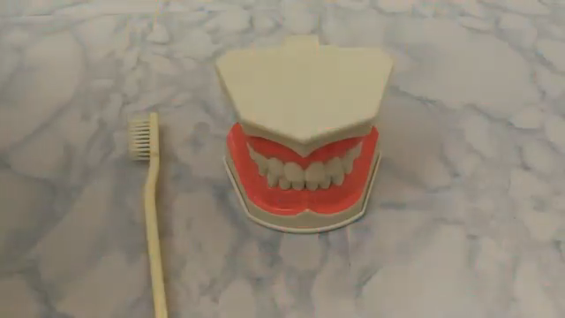

Slide 54
Advantages:
This technique has equal potential as that of bass techniquefor plaque removal and prevention of gingivitis
Easy to learn
Shorter time
Physically/emotionally handicaped individuals.
Patients who lack dexterity for more technical brushing method.
Gingiva provided with good stimulation

Slide 55
Disadvantages:
Possible trauma to gingiva
Interdental areas are not properly cleaned
Detrimental for adults who use the brush vigorously

Slide 56
Vertical method or Leonard ‘s method
Technique:
The bristles are placed at 90 degree angle to long axis of tooth.
Brush vigorously , without great pressure with a stroke mostly up and down on the tooth surfaces.

Slide 57
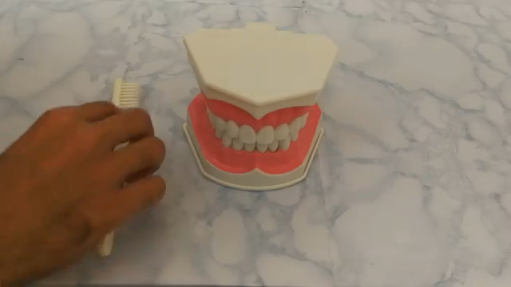

Slide 58
Physiological or smith method
This was described by smith and advocated later by bell.
Principle: toothbrush should follow the physiological pathway that food does when it transverse over the tissues in natural masticatory act.
Technique:
Bristles are pointed incisally or occlusally and then along and over the tooth surfaces and gingiva.
The motion is gentle sweeping from incisal to occlusal surface over to facial surfaces and progressing towards or over the gingiva.

Slide 59
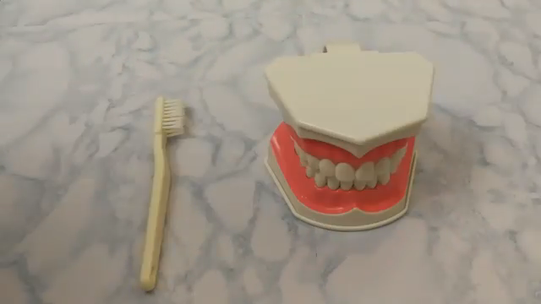

Slide 60
Frequency and effectiveness of tooth brushing
How often and how much plaque has to be removed in order to prevent gingivitis and loss of attachment has not been determined.
In cross-sectional studies, when the self-reported frequency of tooth cleaning has been related to caries and periodontal disease, the results have been equivocal, suggesting that disease is more related to quality of cleaning than to its frequency (Bjertness 1991).
In one study, dental students and young dental faculty with healthy periodontal condition were assigned to study groups with different cleaning frequencies over periods of 4-6 weeks. The results showed that brushing plus interdental cleaning once daily and also even every second day prevented the development of gingivitis (Lang et al. 1973).

Slide 61
From a practical standpoint, it is generally accepted that toothbrushing should be performed at least once a day, particularly in patients showing gingival inflammation, because in such cases the condition of the soft tissues favours plaque accumulation (Ramberg et al. 1994).
Thus, in spite of the lack of scientific basis, a general recommendation to brush the teeth twice daily is generally accepted.

Slide 62
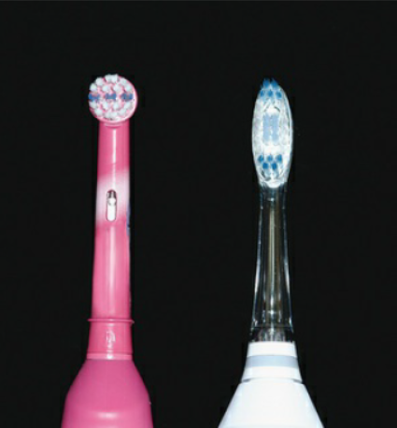
Powered toothbrush
Phrases similar to mechanical plaque control with manual toothbrush remains the mainstay of oral hygiene measures for the majority of the population.
It is well recognized, that the average person spends approximately 1 min brushing their teeth and in doing so removes approximately 60% of the plaque present around the teeth.
This leads to majority of improvements in design for the manual toothbrush which yield very little statistically significant improvement in plaque-removal efficacy.
This contrasts with the developments in powered toothbrushes where improvements in design have led not only to improvements in plaque removal efficacy for a given standard of toothbrushing, but have also resulted in high compliance levels.

Slide 63
History
1886-Powered toothbrushes were first advertised in Harper's Weekly.
1939-The prototype of the first electric toothbrush was developed in Switzerland by Dr. Phillippe- Guy Woogin, but it wasn’t released until 1954.
1960- Squibb marketed the first American made electric toothbrush called the Broxodent.
1961-General Electric introduced a rechargeable cordless toothbrush
1987-Interplak was the first rotary-action electric toothbrush for home use.
1992 - Sonic-powered toothbrushes were developed and were shown to remove more plaque in comparison to manual toothbrushes, especially in long-term studies

Slide 64
Generations of powered toothbrushes
Generation | Description | Example
First | Powered by electricity, battery powered | Broxodent
Second | Vibrating, reciprocal rotating head movement | Braun Oral-B Plaque remover, Interplak
Third | Sonic and ultrasonic | Rowenta Dentasonic Sonicare Ultrasonex

Slide 65
First generation: The first generation of power toothbrushes had a head resembling manual toothbrushes, and moved back and forth to simulate manual brushing. The problems encountered with these products included short working time and mechanical breakdown.
Second generation: The second generation had a uniquely rotating head and was powered by long-life/rechargeable batteries. It had increased efficacy compared to manual toothbrushes. The newer types incorporated the vibrating and reciprocal motion and additional features like pressure sensor and timer.

Slide 66
Third generation:
Sonic toothbrushes refer to those that can generate motions sufficiently rapid to produce a hum in the audible frequency of human range (20 Hz to 20,000 Hz). Any electronic toothbrushes with a motion speed higher than such limits are known as ultrasonic toothbrushes.
Sonic and ultrasonic toothbrushes not only clean accessible teeth surfaces through mechanical polishing, but also remove surface stains and bacteria through fluid pressure and shear forces by the high-frequency vibration of their bristles.

Slide 67
The bristle vibration produces acoustic energy, which is transmitted through saliva to the stains and bacteria.
However, the efficacy of sonic and ultrasonic toothbrushes has indeed been a question. It is shown that sonic toothbrushes work better than manual toothbrushes in terms of dental plaque removal.
The dynamic fluid motion generated by sonic toothbrushes was found to be significant. This motion enhances the removal of bacteria that is adhered to saliva-coated hydroxyapatite.

Slide 68
This induced suspension of aggregated A. viscosus in a fluid medium and the removal or fragmentation of fimbriae from the cell wall of A. viscosus.
Moreover, sonic toothbrushes generate acoustic energy that elicits irreversible damage on the cell walls of Treponema denticola.
Regarding the effect of sonic energy on oral microbial, Robrish et al. produced a hierarchy of microbial sensitivity to sonic energy from their study, with S. mutans being three times more resistant than A. viscosus.
Mclnnes, C.; Engel, D.; Moncla, B.J.; Martin, R.W. Reduction in adherence of actinomyces viscosus after exposure to low-frequency acoustic energy. Oral Microbiol. Immunol. 1992

Slide 69
However, the significance of their findings is greatly limited by the poor simulation of sonic energy generated from a laboratory sonifer, from that produced by commercial sonic toothbrushes.
Therefore, the significance of this advantage of the sonic toothbrushes remains debatable and further studies are necessary for consolidated conclusions.

Slide 70
The ultrasonic toothbrush, the UltraSonex®, claimed that ultrasonic waves generated by their toothbrushes can be transmitted subgingivally and thus help remove adhered bacterial plaque and disturb bacterial breeding resulting in significantly relieved inflammation.
As mentioned, one study did suggest that the ultrasonic toothbrush could reduce plaque and gingival inflammation significantly in the statistical sense, when compared with a manual toothbrush in a 30-day experiment.
However, the effect is negligible in the clinical sense as the patients had only minimal inflammation prior to the study.
Terezhalmy, G.T.; Gagliardi, V.B.; Rybicki, L.A.; Kauman, M.J. Clinical evaluation of the efficacy and safety of the ultrasonex ultrasonic toothbrush: A 30-day study. Compend. Contin. Educ. Dent. 1994

Slide 71
Considering the limit of this study, Brockmann et al. carried out further investigation on the use of ultrasonic toothbrushes to reduce marks, instead of mild, gingival inflammation when compared to standard manual toothbrushes.
They found that the removal of plaque and reduction in inflammation by the two toothbrushes is identically significant.
Forgas-Brockmann, L.B.; Carter-Hanson, C.; Killoy,W.J. The effects of an ultrasonic toothbrush on plaque accumulation and gingival inflammation. J. Clin. Periodontol. 1998,

Slide 72
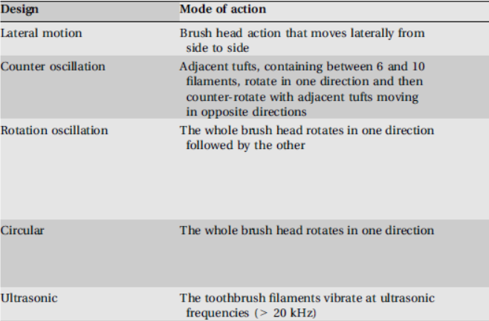
Classification of powered toothbrushes based on mode of action

Slide 73
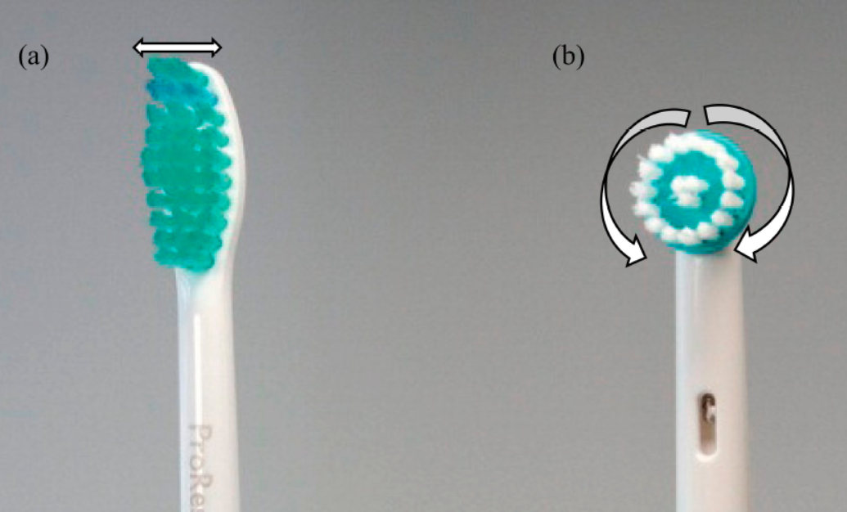
(a) A vibrational powered toothbrush; (b) a rotation-oscillation powered toothbrush

Slide 74
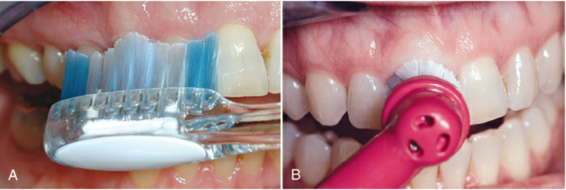
Positioning the powered toothbrush head and bristle tips so that they reach the gingival margin is critical to achieving the most effective cleaning results.
(A) Straight-head placement. (B) Round-head placement.

Slide 75
POWERED TOOTHBRUSHING METHODS
Most powered toothbrush manufacturers do not recommend a specific brushing method; however, the electric brushes should be used in a specified manner. The Swiss Dental Society, in 2001 developed an instruction manual. Instructions for brushes with a sweeping and /or oscillating rotary motion are as follows:
The brushes are positioned on the tooth surfaces in a 45- or 90-degree angle to the incisal plane.
Only when positioned should the brush be switched to "on."
The mouth should be almost closed
The brush should be moved slowly over and around each tooth for 3 to 5 seconds, making sure that the bristles clean the crevices between the teeth.

Slide 76
The brush head can be lifted distally and mesially into the interproximal areas; the brush always remains on a single tooth.
After a period of approximately 5 seconds, the brush is moved to the next tooth surface and repositioned.

Slide 77
Indications
For orthodontic patients
Those who are on supportive periodontal therapy
Patients with prosthodontic or endosseous implants.
For hospitalized patients
Individuals with low manual dexterity, such as children and the handicapped
Contraindications
Hypersensitivity- The vibration of powered toothbrushes can aggravate the sensitivity issues.
Patients with cardiac pacemakers -As they can result in electrical interference with the normal functioning of implantable cardiac devices.

Slide 78
Advantages
Plaque removal
Dental stain removal
Maintenance of peri-implant soft tissue
Salivary flow stimulation
Disadvantages
Potential epileptic seizures inducer
Toothpaste contamination
Notes:
One significant study carried out by Truhlar et al. in 2000 analyzed the
toothbrushing methods on 2966 implants [72]. The result showed that a counter-rotational powered
toothbrush was significantly better in plaque removal when compared to the manual ones from all
implant surfaces and at all recall intervals up to 24 months in their study [72]. The gingival index had
similar results [72]. Therefore, this study showed that the counter-rotational powered brushes are
potentially suitable as home-care regimens in the maintenance of optimal peri-implant soft tissue healthSialitron®, an
electronic saliva-stimulating system, has been one way to increase salivary flow by a three-minute
period electrostimulation [76]. However, this technology is no longer available. And even when it was
available, it was very costly for the general public [76]. This is why researchers had motivations in
looking for alternatives. Sonicare® toothbrushes are indeed a potentially
eective tool to stimulate saliva without the side eects of medication while with the extra benefit
of improving oral hygiene [73]. It is believed that there are four possible nerve pathways for the
sonic vibration to be transmitted into salivary stimulation. First, sonic vibration may overcome the
medication-induced inhibition on the salivary reflexes and thus increases the normal physiological
reflexes [76]. Second, sonic vibrations may “reflexively depolarize more autonomic nerve endings in
the salivary glands” [73,76]. Third, the vibration may cause tactile stimulation of the trigeminal, and
finally, the vibration may also induce bilateral stimulation of gustatory receptors [

Slide 79
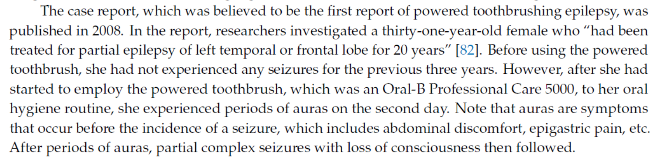
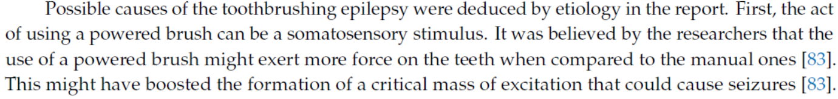
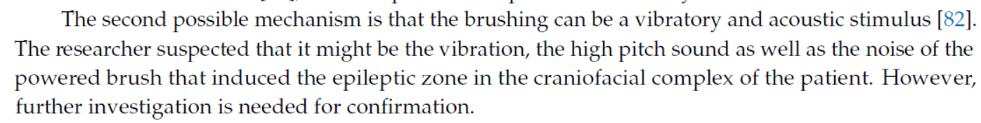
Notes:
Reflex epilepsy is a very uncommon disease in which an external stimulus or an internal mental
process induces the incidence of seizures [78]. External stimuli can be in visual form [78,79], such as
flickering lights in televisions; stimuli can also be in somatosensory form [78,80], such as touching
or rubbing; stimuli can as well be a proprioceptive one [78,79,81], such as movement of a limb;

Slide 80
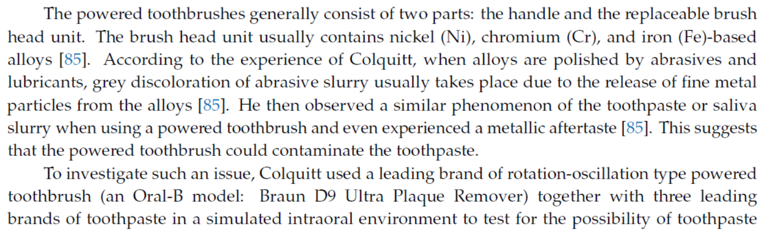

Slide 81
Efficacy of powered toothbrushes
The Clinical Research Associates (CRA) published a study conducted in 1998. In that study, six different toothbrushes were tested to decide whether sonic and ultrasonic powered toothbrushes have higher efficacy in plaque removal when compared to manual or other powered ones. The result showed that none of the powered toothbrushes had a substantially higher capability in plaque removal when compared to the manual ones.
In the Cochrane study(2003), the powered toothbrushes were compared to the the gingivae, staining, and calculus. The study reviewed 29 carefully selected clinical trials carried out between 1964 and 2001, which involved a total number of 2547 participants. After analyzing and processing the data, the reviewers concluded that only powered toothbrushes with rotation-oscillation action worked better than the manual ones in plaque removal and gingivitis.

Slide 82
In 2010, Deacon et al. had conducted another systematic review with meta-analysis of data to determine if any type of powered toothbrush performs better than the others. After analysis, they concluded that oscillation rotational brushes perform slightly better in gingivitis and plaque removal when compared to side-to-side brushes.
A study published in 2006, carried out by Papas et al., investigated the effect of powered toothbrushes in the stimulation of salivary flow in a xerostomic population.
The result was positive. Paired analysis on the MTB group that crossed over to the SC group demonstrated a significant boost in the salivary flow of subjects at all post-brushing visits. The end-of-study questionnaire revealed that 98.2% of subjects had enhanced salivary flow and 92.7% would employ Sonicare® toothbrushes to increase salivary flow.

Slide 83
In the study, Lea et al. made use of a scanning laser vibrometry to measure the bristle vibration of four powered brushes, namely Oral-B Sonic Complete; Oral-B Professional Care 8000 Series; Sonicare Elite and Ultrasonex.
It is noteworthy that only the Oral-B Professional Care 8000 Series is an oscillation rotation type powered brush while all the others are side-to-side vibrational type.
Lea et al. found that both the loading of toothbrush bristles and the use of toothpaste dampen the amplitude of the bristle vibration.
It was believed that the loading increased friction between bristles and tooth surface while the viscous nature of toothpaste resulted in a further damping effect. Thus, the combined damping effect was significant.

Slide 84
Interdental cleaning aids
The rationale for considering interdental cleaning is related to the fact that toothbrushing alone is considered to be optimally capable of thoroughly cleaning the flat surfaces of the teeth only .
That is to say, the buccal, lingual and occlusal surfaces, with the exception of pits and fissures, have the potential for maximum plaque removal, leaving the proximal and interdental areas untouched.
The implications are that these particular areas have a high risk of developing periodontal lesions in particular (and caries also) as the accumulation of microbial plaque is one of the prerequisites for periodontitis.
Claydon NC. Current concepts in toothbrushing and interdental cleaning. Periodontology 2000. 2008 Oct;48(1):10-22.

Slide 85
Tissue destruction associated with periodontal disease often leaves large, open spaces between teeth and exposed root surfaces with anatomic concavities and furcations.
These defects also occur after resective periodontal surgery.
The best example of an anatomic root concavity is the mesial root surface of the maxillary first bicuspid. With attachment loss, the concavity located on this mesial surface is exposed where plaque biofilm will accumulate.
These areas shelter plaque biofilm and are difficult for patients to clean with the toothbrush alone.

Slide 86
Many instruments are available for interproximal cleaning, and they should be recommended based on the size of the interdental spaces, the presence of furcations, root surface concavities, tooth alignment, and the presence of orthodontic appliances or other fixed prostheses.
Moreover, ease of use and patient cooperation are important considerations. Common aids for interdental hygiene are dental floss, interdental brushes, rubber tips, and wooden or plastic tips.

Slide 87
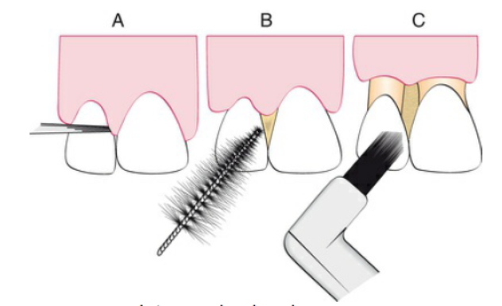
Classification of gingival embrasure
Class I – No gingival recession with interdental papilla filling the space
Class II - Moderate papillary recession
Class III – Complete loss of the interdental papilla

Slide 88
Interdental aids for embrasures types
Interdental Aid | Class I | Class II | Class III
Dental floss | +
Dental tape | +
Power flosser | +
Textured flosser |  | + | +
Floss holder | +
Floss threader | +
Interdental brush |  | + | +
End tufted brush |  |  | +
Toothpicks |  | + | +
Wooden or plastic picks |  | + | +

Slide 89
Dental floss
Dental floss is the most widely recommended tool for removing biofilm from proximal tooth surfaces.
The development of dental floss is attributed to Levi Spear Parmly, a New Orleans dentist. He recommended that a waxed silken thread be passed between the teeth “ to dislodge that irritating matter which no brush can remove and which is the real source of distress”.
Later, Dr Charles Bass, a Physician, developed nylon floss as a replacement for silk.

Slide 90
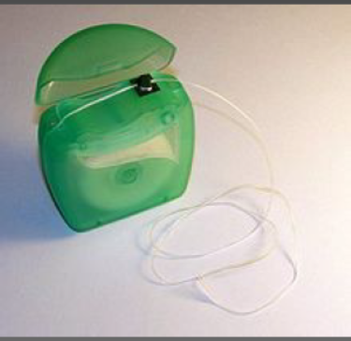
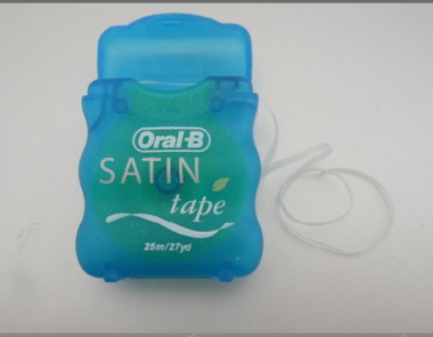
Dental floss available in various forms such as
Multifilament-twisted/ non-twisted
Bonded/non-bonded
Thick/thin
Waxed/non-waxed

Slide 91
Some prefer monofilament floss made of nonstick material because they are slick and do not fray. Clinical research has demonstrated no significant differences in the ability of the various types of floss to remove dental plaque biofilm.
Waxed dental floss was thought to leave a waxy film on proximal surfaces, thus contributing to biofilm accumulation and gingivitis. It has been shown, however, that wax is not deposited on tooth surfaces, and improvement in gingival health is unrelated to the type of floss used.
The purpose of wax was ostensibly to make flossing between tight contact easier.
Floss made with expanded polytetrafluoroethylene (ePTFE), which also improves access in tight contacts and equivalent to unwaxed floss as well.
Ciancio SG, Shibly O, Farber GA. Clinical evaluation of the effect of two types of dental floss on plaque and gingival health. Clinical preventive dentistry. 1992;14(3):14-8.

Slide 92
Technique for use of dental floss
The floss must contact the proximal surface from line angle to line angle to clean effectively. It must also clean the entire proximal surface, including accessible subgingival areas. Flossing technique requires the following:
1. Start with a piece of floss long enough to grasp securely; 12 to 18 inches is usually sufficient. It may be wrapped around the fingers, or the ends may be tied together in a loop.
2. Stretch the floss tightly between the thumb and forefinger or between both forefingers, and pass it gently through each contact area with a firm back-and-forth motion. Do not snap the floss past the contact area, because this may injure the interdental gingiva. In fact, zealous snapping of floss through contact areas creates proximal grooves in the gingiva.

Slide 93
3. Once the floss is apical to the contact area between the teeth, wrap the floss around the proximal surface of one tooth and slip it under the marginal gingiva. Move the floss firmly along the tooth up to the contact area and gently down into the sulcus again, repeating this up-and-down stroke two or three times. Then move the floss across the interdental gingiva, and repeat the procedure on the proximal surface of the adjacent tooth.
4. Continue through the whole dentition, including the distal surface of the last tooth in each quadrant. When the working portion of the floss shreds or becomes contaminated, move the floss to a fresh portion.

Slide 94
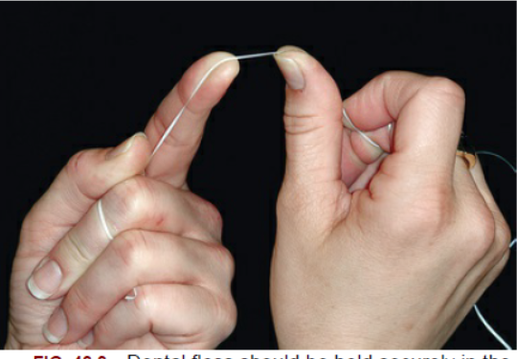
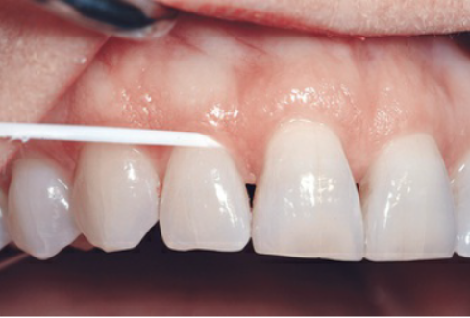
Dental floss should be held securely in the fingers or tied in a loop.
Dental floss technique. The floss is slipped between the contact
areas of the teeth and wrapped around the proximal surface, and removes plaque by using several up-and-down strokes. The process must be repeated for the distal surface of tooth.

Slide 95
Floss holder
A number of devices are commercially available to assist patients who have difficulty in flossing.
These are primarily plastic handles that hold floss in such a way as to serve as “ substitute fingers”.
It should be rigid enough to keep the floss taut when penetrating the contact area.
It should be simple to string the floss onto the holder.
Technique:
The floss is gently “sawed” through the interdental contact and once passed the contact, the floss is held against each interproximal surfaces and moved apicocoronally.

Slide 96
Some patients benefits from these devices, especially those who have difficulty in manual dexterity, but can be difficult to use initially.
The disadvantage of floss holders is that using them tends to be time consuming because they must be rethreaded frequently when the floss shreds.

Slide 97
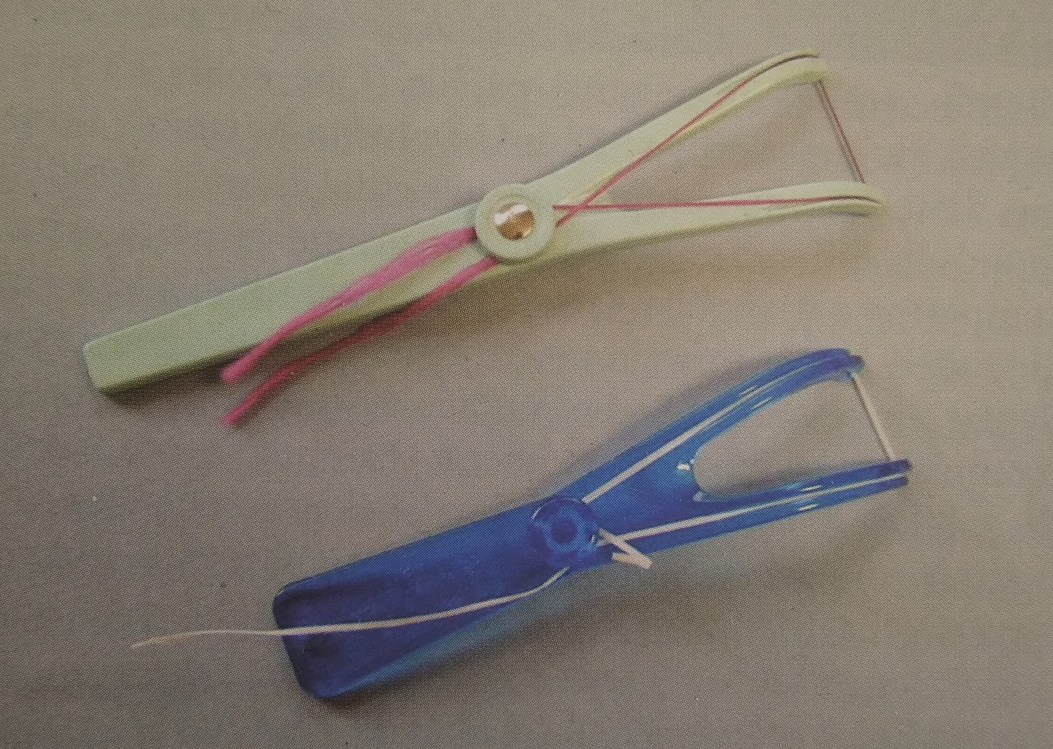
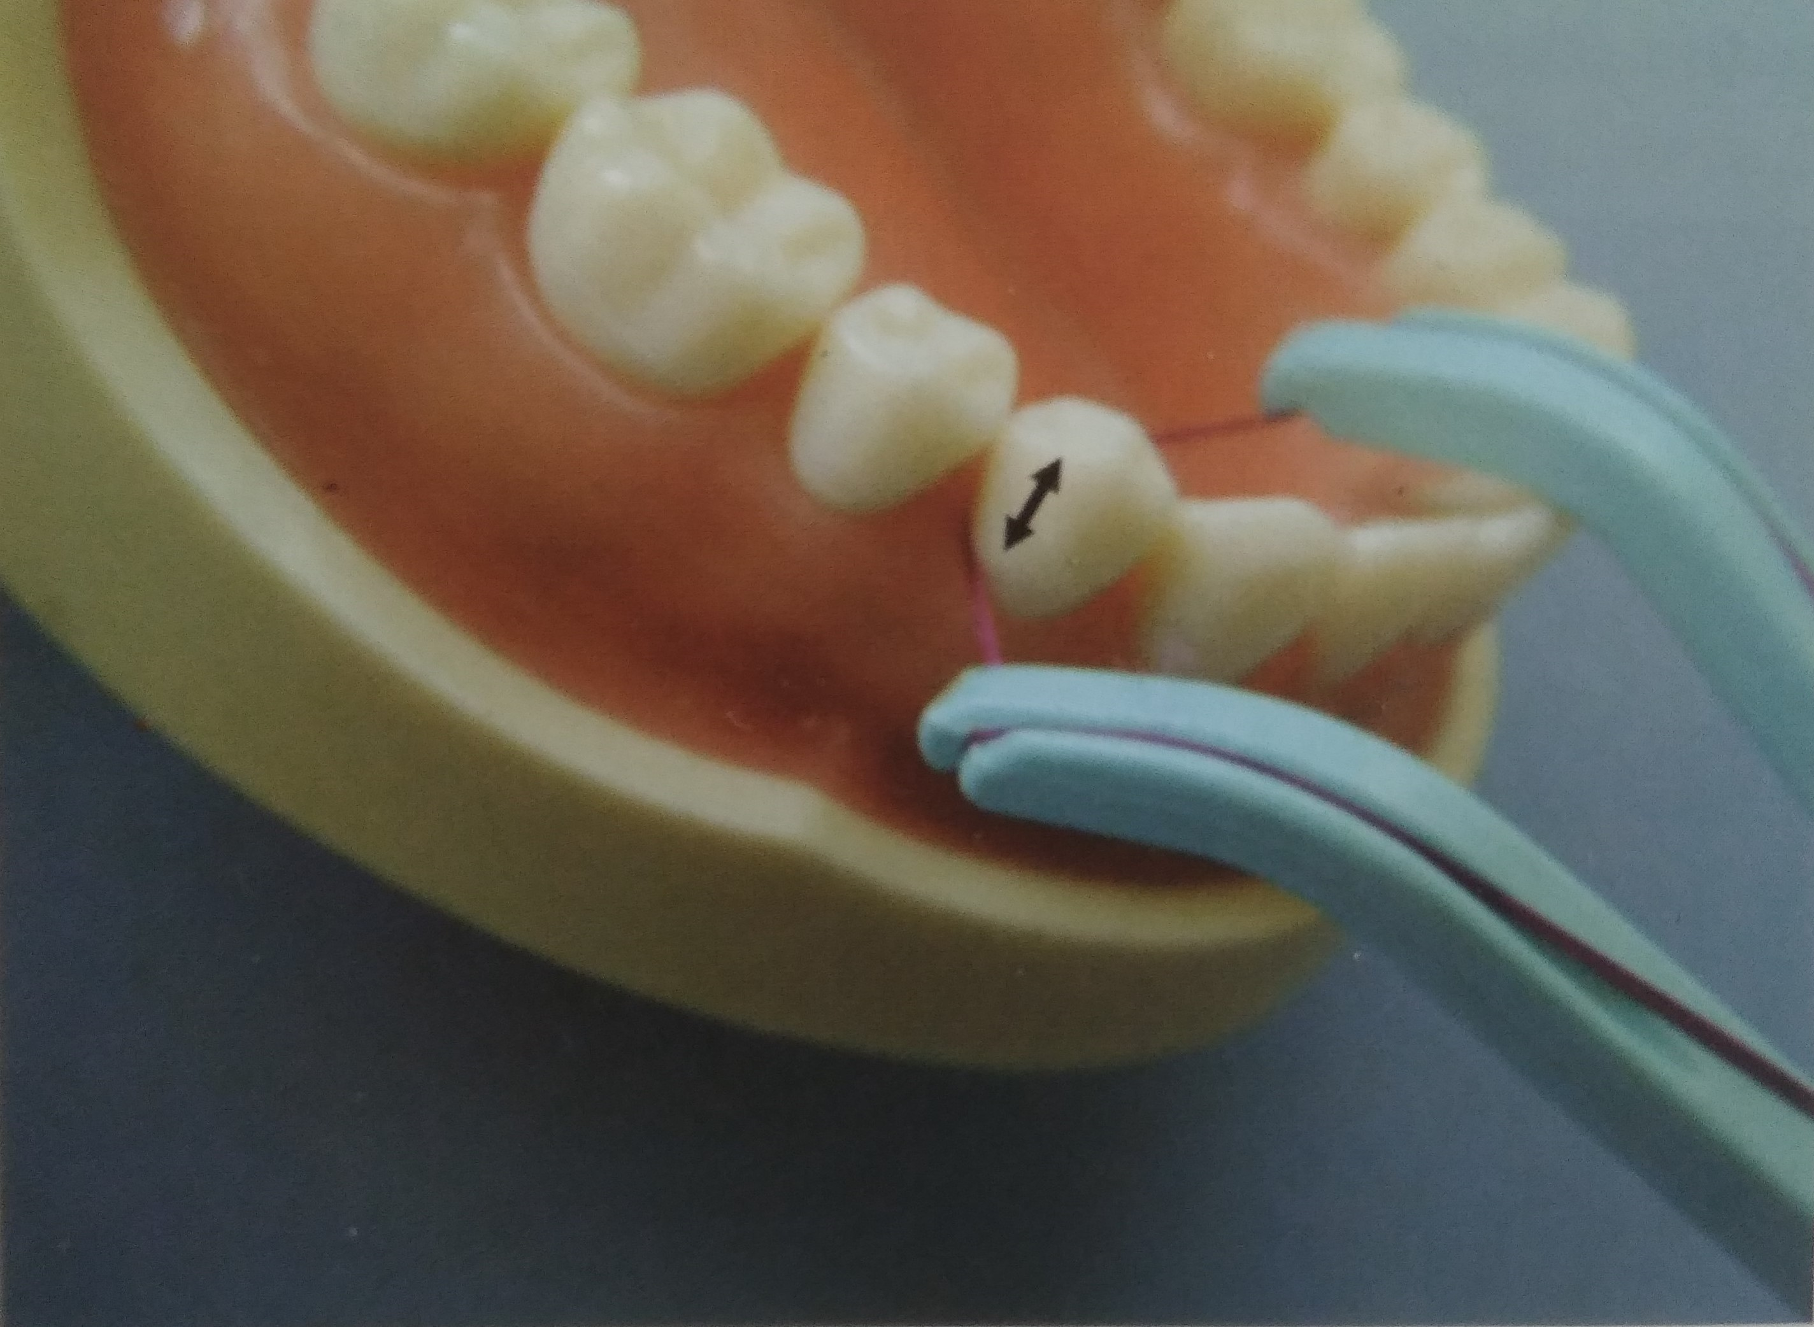
Floss holders have rigid handles with “yoke” at the end, over which dental floss is stretched. The patient holds the handle and passes the floss into each interproximal space.
The floss is worked gently passed the contact point. The handle can then be moved mesially and distally to bring the floss into contact with the interproximal tooth surfaces.

Slide 98
Floss threader
A floss threaders are often required to permit introduction of floss under the fixed prosthesis and orthodontic appliances.
It consist of an “eye” loop at one end, into which dental floss is passed.
Technique:
The end of floss threader is passed under the pontic or fixed partial denture connector from the facial aspect.
The floss is passed through the “eye” of the floss threader.

Slide 99
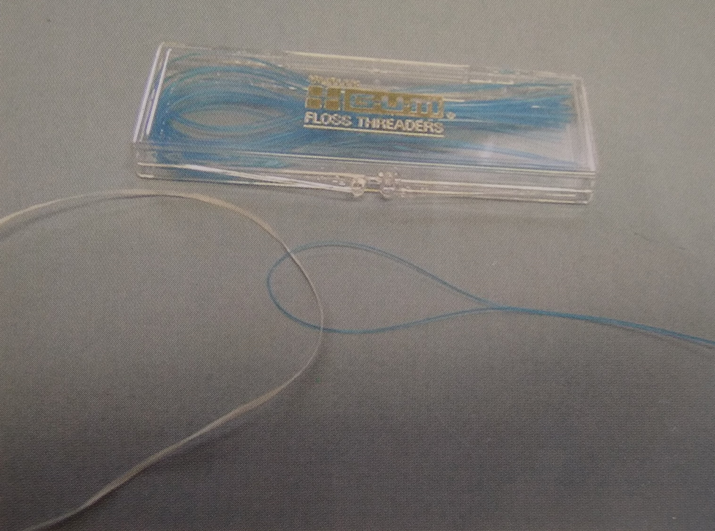
The floss threader has of an “eye” loop at one end, into which dental floss is passed

Slide 100
The end of the threader is grasped with fingers and the remainder of the floss threader is pulled through the lingual while the opposite hand grasp the two end of floss from the facial aspect.
Releasing one end of the floss and holding the other, the threader is pulled the rest of the way through to the lingual, carrying the free end of the floss along with it.
The floss can then be used to clean the intaglio surface (tissue side) of the pontic and the interproximal tooth surfaces facing the edentulous space using C-shaped configuration and apico-coronal motion.

Slide 101
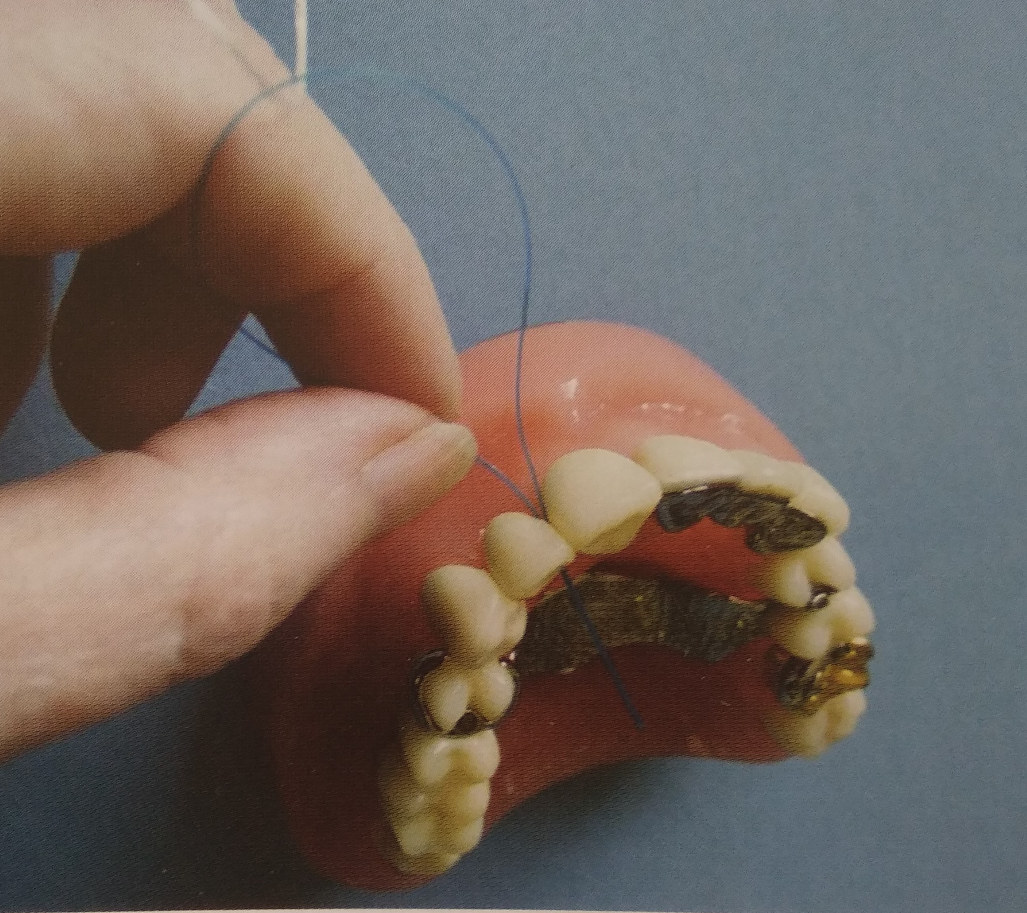
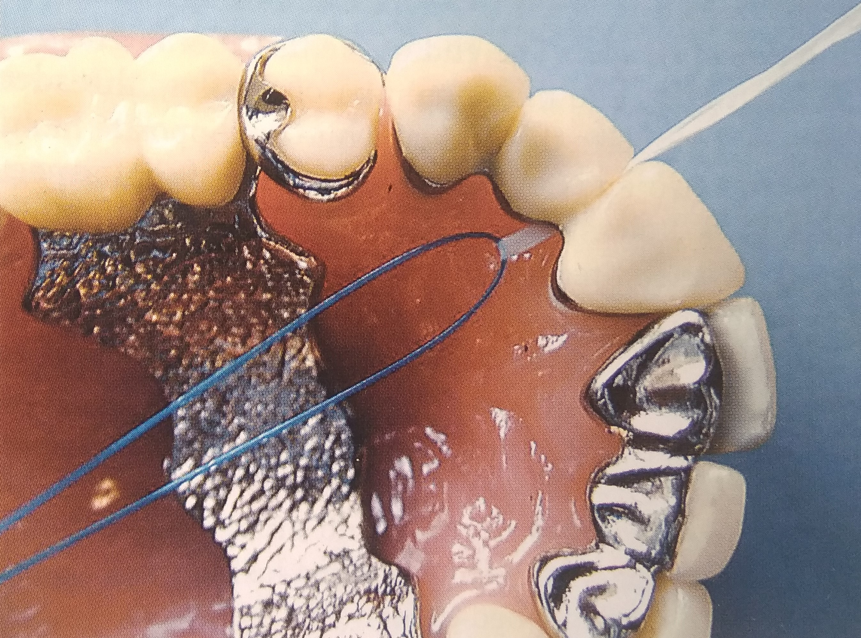
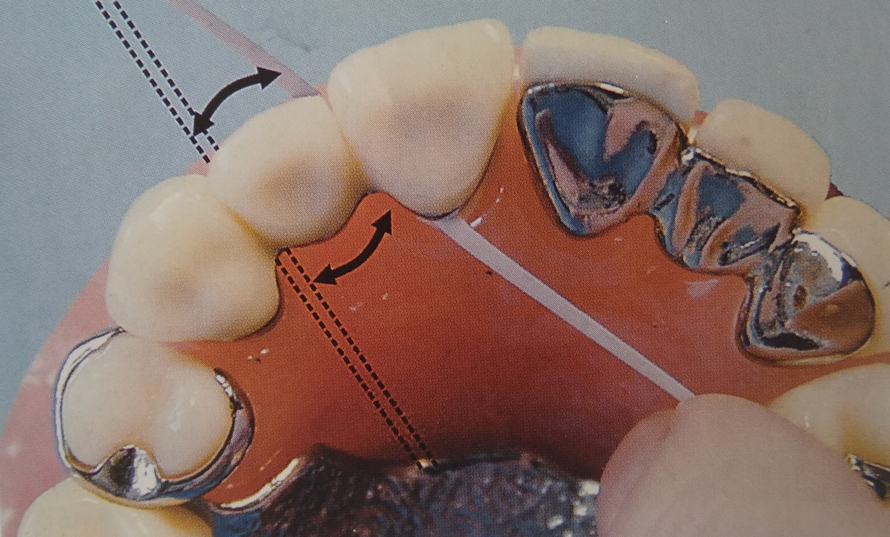
The end of floss threader is passed into the embrasure space between the retainer and pontic
The floss is inserted through the “eye” loop and the threader is passed through the lingual.
The floss is grasped on the facial and lingual and is passed along the tissue surface of the pontic

Slide 102
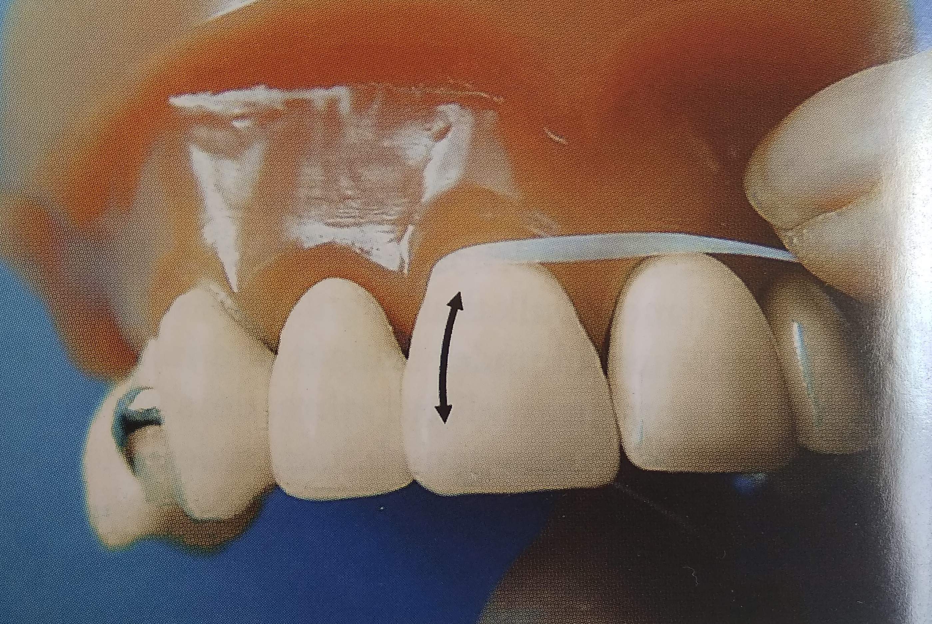
The floss is moved apico- coronally along the interproximal surfaces of abutment teeth

Slide 103
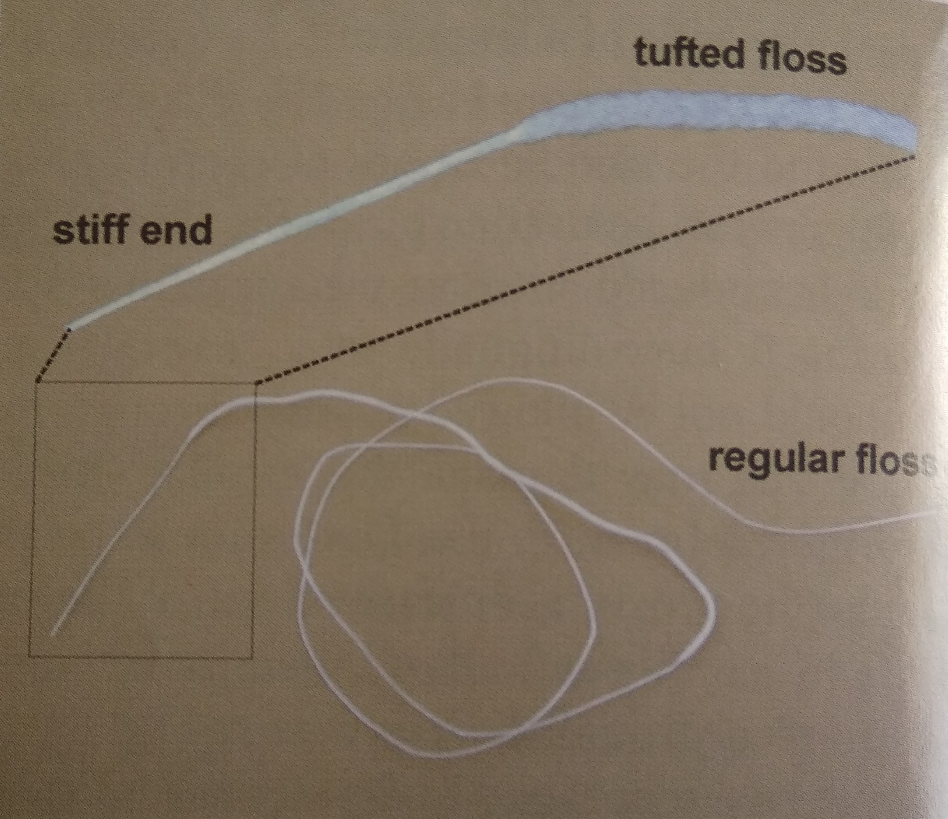
An alternative to floss threader is Superfloss, is a type of floss consisting of a terminal segment of stiff plastic that is used for inserting it beneath fixed partial dentures and through tight embrasures.
The remainder is composed of foam- like material that has more bulk than regular floss which is ideal for plaque removal.

Slide 104
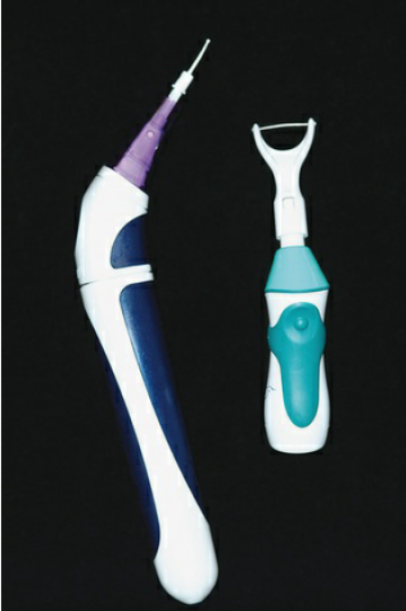
Powered flossing devices are also available. These devices are to be safe and effective, but they are no better at plaque biofilm removal than holding the floss with fingers.
Powered flossing devices can be easier for some patients to use than handheld floss. The tip is inserted into the proximal space, and a bristle or wand comes out of the tip and moves in a circular motion when the device is turned on (left). Alternately, the device moves the prestrung floss in short motions to provide interproximal cleaning (right).

Slide 105
Interdental brushes
The most effective plaque biofilm removal method for interdental areas, where the papilla does not completely fill the space, is the use of interdental brushes.
The concave root surfaces, such as the mesial aspect of the maxillary first bicuspid and furcation areas, are usually not cleaned efficiently with dental floss.
A comparison study of dental floss and interdental brushes used by patients with moderate to severe periodontal disease indicated that the interproximal brushes removed a greater amount of interproximal plaque biofilm and that the subjects found it easier to use these brushes than dental floss.
However, no difference was found when probe depth reductions or bleeding indices were compared
Christou V, Timmerman MF, Van der Velden U, Van der Weijden FA. Comparison of different approaches of interdental oral hygiene: interdental brushes versus dental floss. Journal of periodontology. 1998 Jul;69(7):759-64.

Slide 106
Technique:
An interdental brush of any style is inserted through the interproximal spaces and moved back and forth between the teeth with short strokes.
The diameter of the brush should be slightly larger than the gingival embrasures to be cleaned.
This size permits the bristles to exert pressure on both proximal tooth surfaces by working their way into concavities on the roots. The brush bristles must also reach the interdental gingival margin.

Slide 107
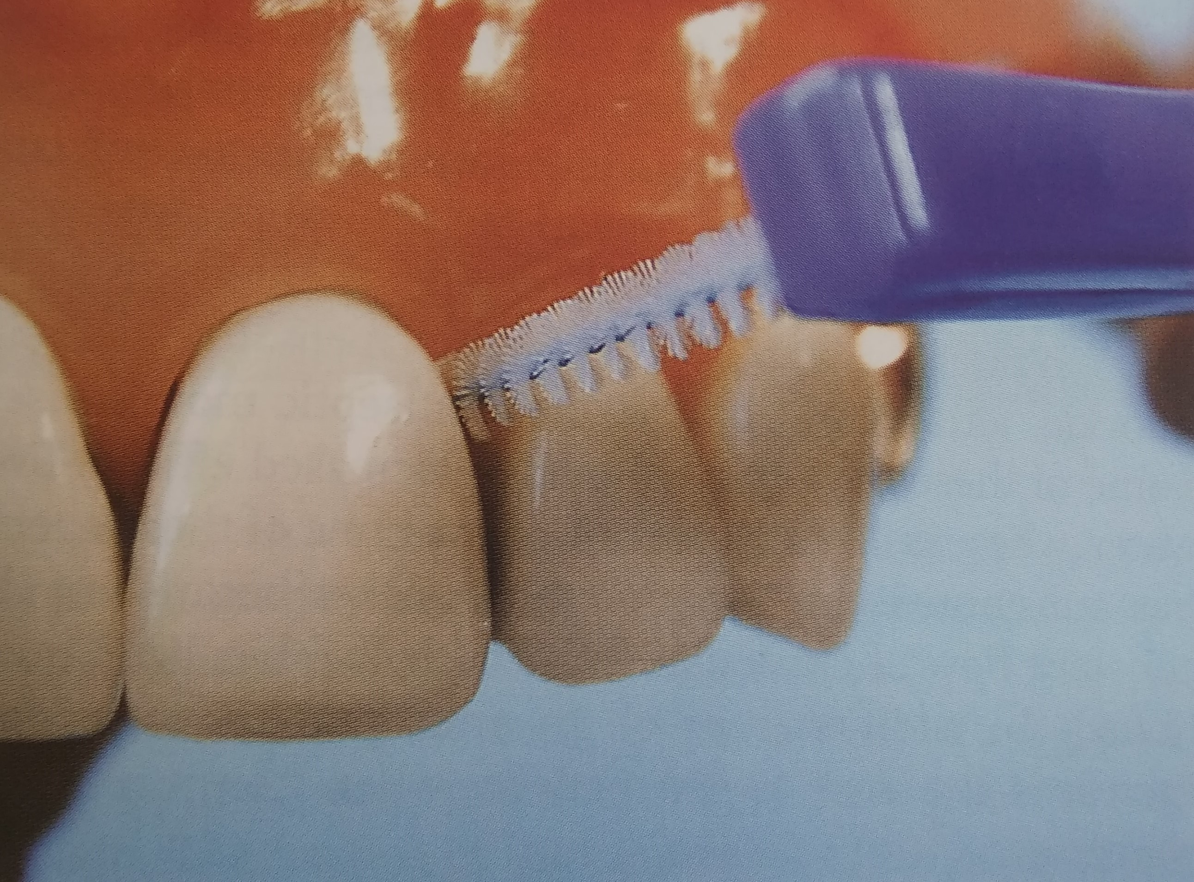
The interdental toothbrush is passed buccolingually in and out of the interdental space, the bristles clean the tooth surfaces

Slide 108
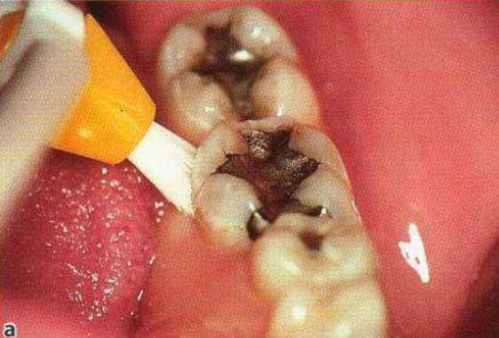
Single tufted brush
A single-tufted brush can be recommended in regions of the dentition not easily reached with other oral hygiene devices, e.g. furcation areas, distal surfaces of the most posterior molars and oral or lingual tooth surfaces with an irregular gingival margin

Slide 109
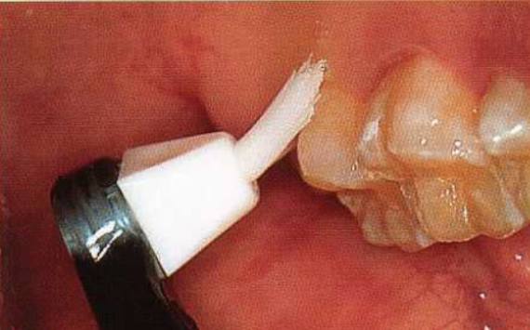
The palatal and distal surfaces of maxillary molars are cleaned by means of a single-tufted toothbrush.

Slide 110
Wooden toothpicks
These are the group of interproximal aids includes conventional round or flat toothpicks, in addition to triangular toothpicks designed for interdental cleaning such as Stim-U- Dent.
It has been suggested that these aids are better for situations in which there is slightly receded interdental papilla.
One study demonstrated the superiority of Stim-U-Dent to brushing alone, bot there was no comparison to dental floss.
Wolffe found no difference in efficacy of plaque removal when comparing a triangular woodstick, dental floss, and a single tufted brush in a group of patients with open interdental embrasures.
Barton J, Abelson D. The clinical efficacy of wooden interdental cleaners in gingivitis reduction. Clin Prev Dent. 1987 Nov;9(6):17-20.
Wolffe GN. An evaluation of proximal surface cleansing agents. Journal of clinical periodontology. 1976 Sep;3(3):148-56.

Slide 111
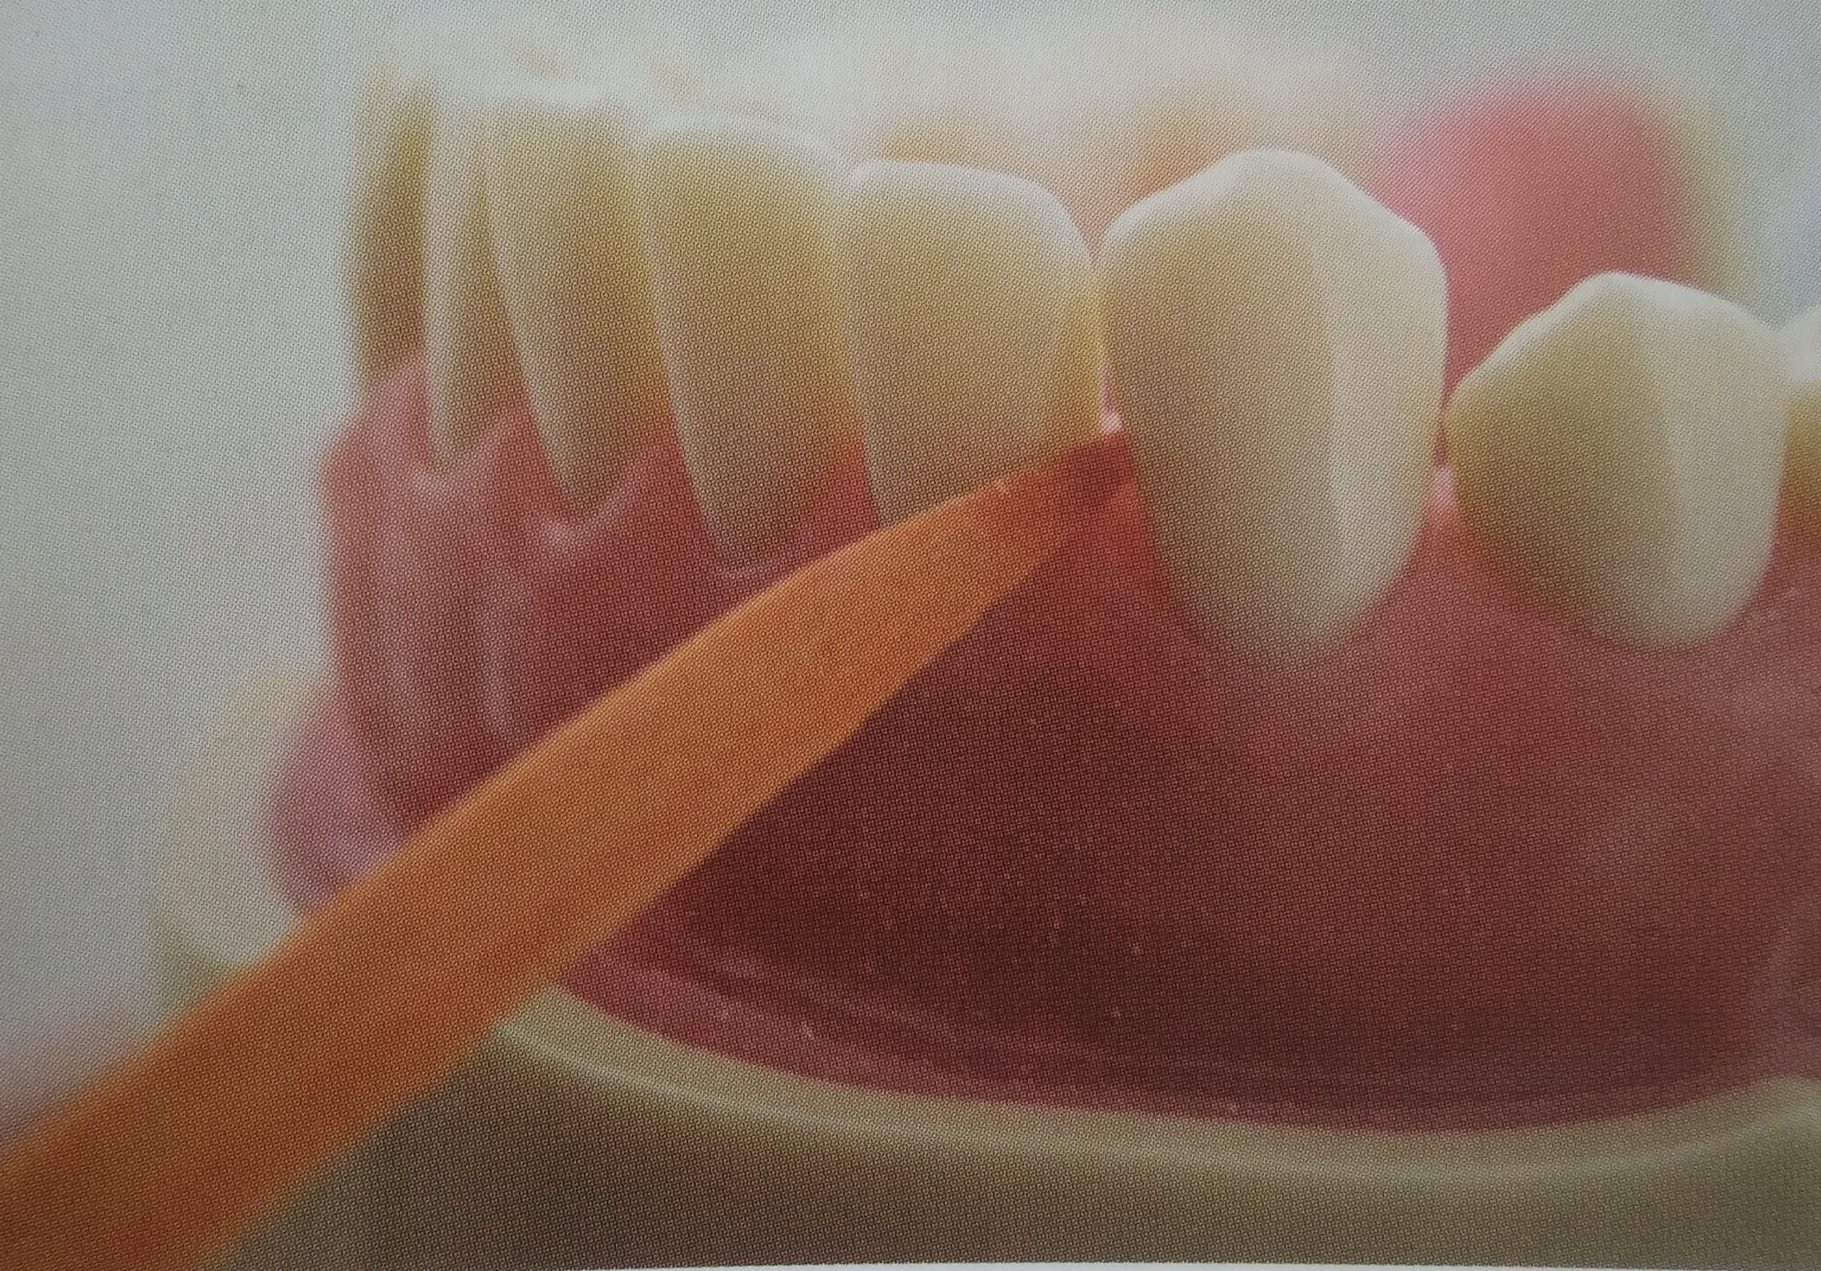
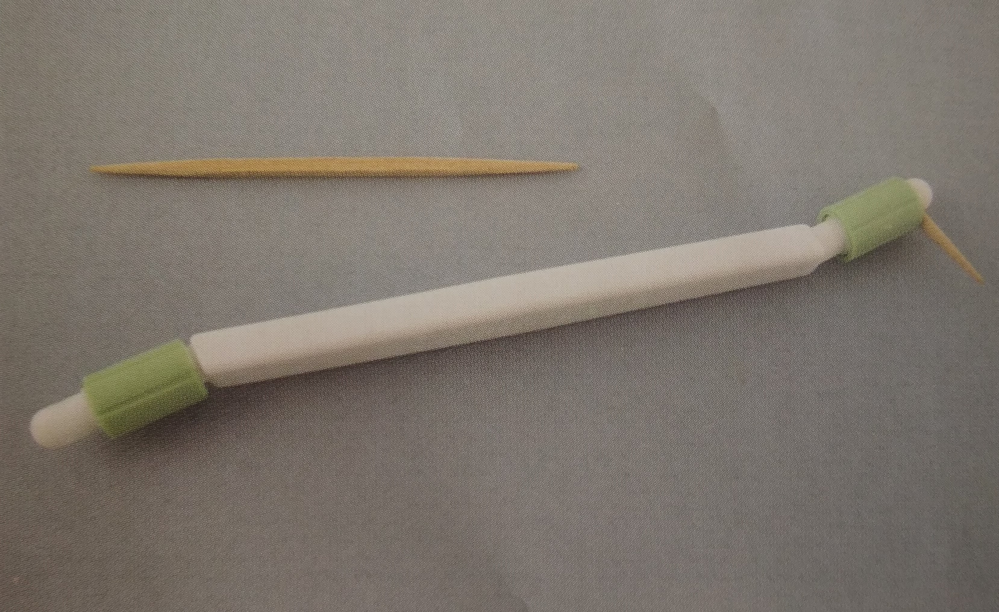
A wooden interdental cleaner with triangular cross section
A Perio-Aid consist of holder for a round tooth pick

Slide 112
The triangular woodstick is an effective aid, but it is somewhat difficult to use in posterior regions because the triangular cross-sectional design must pass into the embrasure space at an specific angle.
An variation on this is a plastic handle designed to hold the toothpick.
Once mounted on the handle, it is broken off so that it is only 5-6mm long.
The tip of toothpick is used to trace along the gingival margin and into the interproximal areas from both the facial and lingual surfaces of teeth.

Slide 113
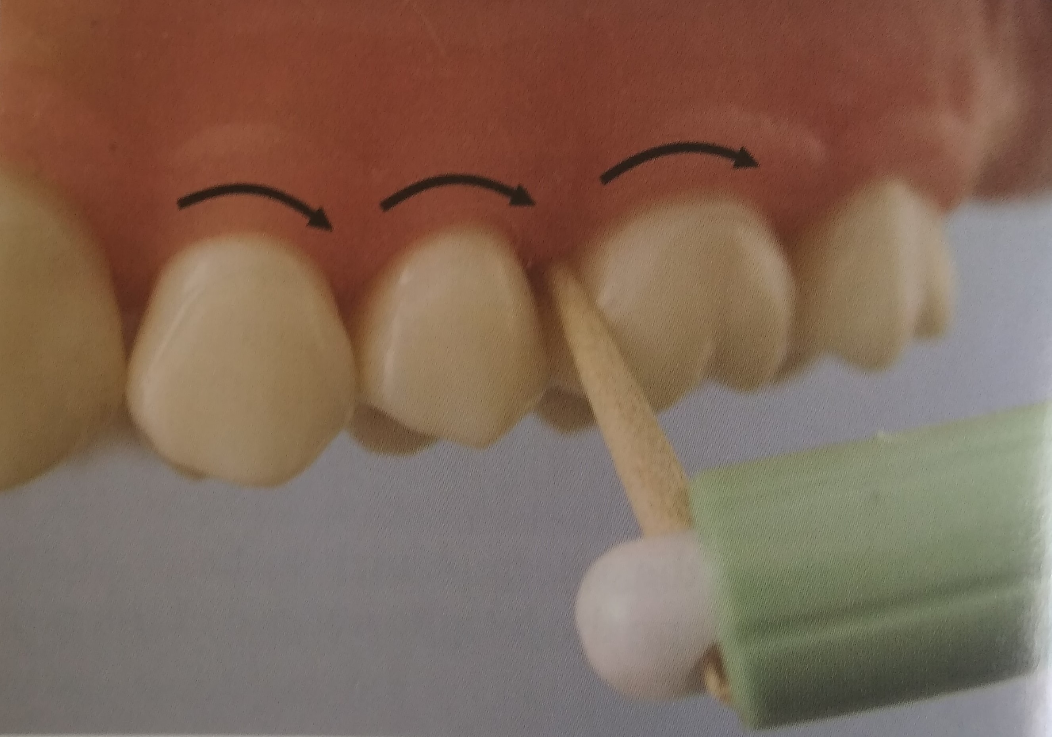
The end of the toothpick can be passed along the gingival margin and interproximal spaces

Slide 114
Toothpicks mounted on handles are efficient for cleaning along the gingival margin, can penetrate periodontal pockets and furcations, and permit patients to target their hygiene efforts at the gingival margin.
Soft triangular wooden picks or plastic picks are placed in the interdental space with the base of the triangle resting on the gingiva and the sides in contact with the proximal tooth surfaces .
The pick is then moved in and out of the embrasure several times to remove the biofilm. The disadvantage of triangular wooden or plastic tips is that they do not reach into the posterior areas or on the lingual surfaces.

Slide 115
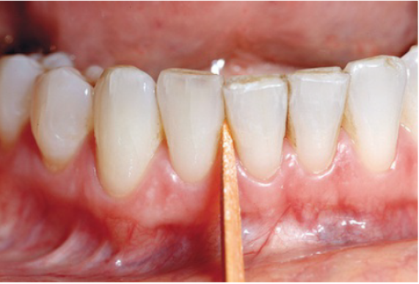
Triangular wooden tip: The tip is inserted between the teeth, with the triangular portion resting on the gingival papilla. The tip is moved in and out to remove plaque; however, it is very difficult to use on posterior teeth and from the lingual aspect of all teeth.

Slide 116

Rubber tips
Rubber tips are conical and are mounted on handles.
They are reusable and can be easily adapted to all proximal surfaces in the mouth.
The rubber tips that are mounted on handles with a curved shank, as in curettes, are excellent not only for cleaning the interdental spaces but also for demonstrating to the patient the location of the plaque biofilm during oral hygiene instruction.
The rubber tip should be placed into the embrasure space, resting on the gingiva, and used in a circular motion.
It can be applied to interproximal spaces and other defects throughout the mouth and is easily adaptable to lingual surfaces.

Slide 117
Gingival massage
Massaging the gingiva with a toothbrush or an interdental cleaning device produces epithelial thickening, increased keratinization, and increased mitotic activity in the epithelium and connective tissue.
The increased keratinization occurs only on the gingiva facing the oral cavity (oral epithelium), but not on the areas more vulnerable to microbial attack, which are the sulcular epithelium and the interdental areas where the gingival col is present.
Epithelial thickening, increased keratinization, and blood circulation have not been shown to be beneficial for restoring gingival health.
Cantor MT, Stahl SS. The effects of various interdental stimulators upon the keratinization of the interdental col. Periodontics. 1965;3(5):243-7.
Glickman I, Petralis R, Marks RM. The effect of powered toothbrushing plus interdental stimulation upon the severity of gingivitis. The Journal of Periodontology. 1964 Nov;35(6):519-24.

Slide 118
Improved gingival health associated with interdental stimulation is the result of inadvertent microbial plaque biofilm removal rather than the effects of gingival massage.
No clinical evidence indicates that massaging the gingiva is essential or necessary to attain gingival health.

Slide 119
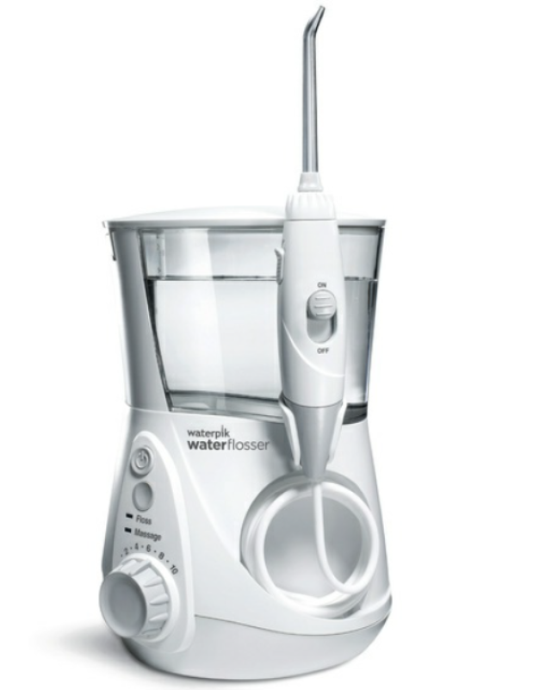
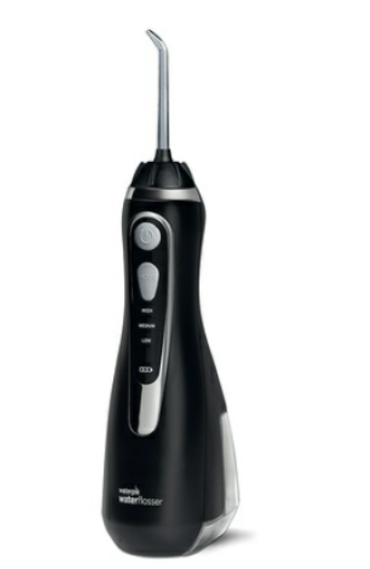
Oral irrigation
The dental water jet was invented by Dr. Gerald Moyer, a dentist, and John Mattingly, an engineer, in Ft. Collins, Colorado, in the late 1950s.
The dental water jet, also known as an oral irrigator, was introduced to the dental profession in Texas during the 1962 Dallas Dental Convention.

Slide 120
Mechanism of action
Pulsation and Pressure:
The physical action of the dental water jet centers on 2 critical components – pulsation and pressure. Pulsation creates a decompression phase that allows water or solution to penetrate subgingivally. It is followed by compression phase that expels bacteria and debris from the pocket.
Physiologically, pulsation, along with pressure and water velocity, creates shear hydraulic forces that are capable of removing bacterial biofilm from treated areas.
Bhaskar, S. N., Cutright, D. E., Gross, A., Frisch, J., Beasley, J. D., & Perez, B. (1971). Water Jet Devices in Dental Practice. Journal of Periodontology, 42(10), 658–664.

Slide 121
Clinical efficacy of home irrigation has been found for units that pulsate from 1200 to 1400 pulses per minute set at a minimum of 60 psi.
A variety of tips can be used with an oral irrigator. One type of tip is placed supragingivally at a 90-degree angle, and the other is placed slightly subgingivally.
Tips placed above the gingival margin result in a pocket penetration of 50% on average. The soft, site-specific subgingival tip penetrates to about 90% of the depth of pockets that are 6 mm or less and 64% of pockets that are 7 mm or greater.
Jahn CA. The dental water jet: a historical review of the literature. American Dental Hygienists' Association. 2010 Jun 1;84(3):114-20.
Eakle WS, Ford C and Boyd RL: Depth of penetration in periodontal pockets with oral irrigation. J Clin Periodontol J986; 13: 39-4
Braun RE, Ciancio SG. Subgingival delivery by an oral irrigation device. Journal of periodontology. 1992 May;63(5):469-72.

Slide 122
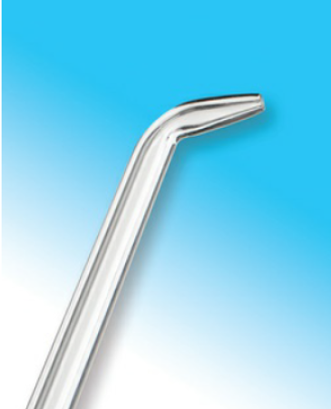
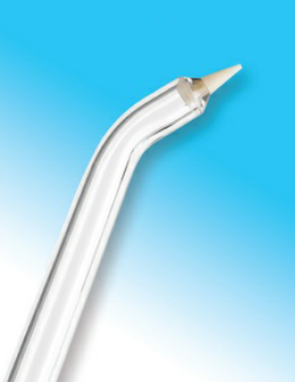
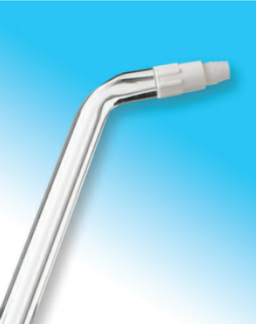

Jet tip
Site Specific tip
Tip with soft tapered bristles
Tip with soft filaments

Slide 123
Supragingival irrigation
The common home-use irrigator tip is a plastic nozzle with a 90-degree bend at the tip attached to a pump providing pulsating beads of water at speeds regulated by a dial.
Patients should be instructed to aim the pulsating jet across the proximal papilla, hold it there for 10 to 15 seconds, trace along the gingival margin to the next proximal space, and repeat the procedure.
The irrigator should be used for both the buccal and lingual surface.
Patients with gingival inflammation should start at low pressure, and they can increase the pressure comfortably to about medium as tissue health improves. Some individuals like to use the device on the highest pressure setting, with no reported harm. Patient comfort should be the guide for pressure setting.

Slide 124
Subgingival irrigation
Subgingival irrigation can be performed both in the dental office and at home by the patient. Home irrigation is performed by aiming or placing the irrigation tip or a blunt syringe tip at least 3 mm into the periodontal pocket.
Irrigation performed in the dental office, also called lavage or flushing of the periodontal pocket, as a one-time treatment after scaling and root planing has not been shown to improve clinical healing, and data do not support its use in improving therapeutic results.
Subgingival irrigation with an oral irrigator using chlorhexidine diluted to one-third strength performed regularly at home and after scaling, root planing, and in-office irrigation therapy produced significant gingival improvement compared with control subjects.
Drisko CH. Nonsurgical periodontal therapy. Periodontology 2000. 2001 Feb;25(1):77-88.
Greenstein G. Effects of subgingival irrigation on periodontal status. Journal of periodontology. 1987 Dec;58(12):827-36.

Slide 125
Subgingival irrigation has been shown to disrupt more than half the subgingival plaque biofilm and reach about half the depth of pockets, up to 7 mm, which is much farther apically than a toothbrush or floss can reach.
Boyd RL, Hollander BN, Eakle WS. Comparison of a subgingivally placed cannula oral irrigator tip with a supragingivally placed standard irrigator tip. Journal of clinical periodontology. 1992 May;19(5):340-4.

Slide 126
Sequalae of incorrect use of mechanical plaque control
Toothbrush trauma: Gingival alterations
Acute alterations | Precipitating factors
Scuffled epithelial surface with denuded underlying connective tissue | Horizontal or vertical toothbrushing method with pressure
Punctuate lesions that appear as red pinpoint spots | Over-vigorous placement and application of toothbrush
Diffuse redness and denuded attached gingiva | Penetration of gingiva by filaments ends. Use of toothbrush with frayed broken bristles or filaments

Slide 127
Chronic alterations
Usually appear on the facial gingiva because of the vigor with which toothbrush is used
Areas most commonly involved are around canines or teeth with Labio-/ bucco- version.
Recession | Changes in gingival contour
1. Appearance: Margin of the gingiva has receded toward the apex and cementum is exposed | Rolled, bulbous, hard, firm marginal gingiva in piled up or festoon shaped
2. Predisposing anatomic factors: Malposition of teeth Narrow band of attached gingiva cannot withstand pressures of brushing | Gingival cleft

Slide 128
Abrasion of the teeth:
It is loss of tooth substance produced by mechanical wear other than by mastication or defined as the pathologic wearing away of tooth substance through some abnormal mechanical process
Contributing factors
Hard toothbrush
Horizontal brushing
Excessive pressure during brushing
Abrasive agent in dentifrice
Prominence of tooth surface labially or buccally

Slide 129


Soft-tissue damage as a result of extensive toothbrushing. Note gingival recession on the buccal gingival surface of tooth 13
Note multiple ulcerations of the buccal gingival margin in the right maxilla

Slide 130


Hard-tissue damage (arrows) has resulted after extensive use of interdental brushes.

Slide 131
Conclusion
It is certain that for a motivated, well-instructed person with the time and skill, mechanical plaque control measures are sufficient to attain complete dental health.
The combination of toothbrushing plus interproximal oral hygiene aids such as dental floss, interproximal; brushes, floss threader, wooden sticks, rubber sticks etc proves the optimal method of controlling plaque accumulation, while gingivitis can be prevented by daily toothbrushing.
It can be concluded that there are no scientific studies to indicate that one specific manual toothbrush design is superior to another in the maintenance of gingival health, although some manual toothbrushes show benefit.

Slide 132
Powered toothbrushes are superior to their manual counterparts in their ability to remove plaque from the approximal areas but show equality on the flat or facial surfaces of the teeth.
Powered toothbrushes that are described as having a rotation oscillation movement have been shown to reduce plaque and gingivitis.
Daily at-home subgingival irrigation and lavage are useful for reduction of inflammation and maintenance for patients with residual deep pockets and those who struggle with mechanical interproximal cleaning devices
The greatest improvement in personal oral hygiene can be derived from the development of motivation and aptitude.

Slide 133
There is little evidence regarding guidelines for frequency of toothbrushing save that the minimum requirement is every 2 days to maintain health and that the common recommendation is twice per day.
An oral hygiene training program has to be based on risk analysis and tailored to the individuals needs by diagnosis, education and training, and needs-related oral hygiene.

Slide 134
References
Claydon NC. Current concepts in toothbrushing and interdental cleaning. Periodontology 2000. 2008 Oct;48(1):10-22
.
Boyd RL, Hollander BN, Eakle WS. Comparison of a subgingivally placed cannula oral irrigator tip with asupragingivally placed standard irrigator tip. Journal of clinical periodontology. 1992 May;19(5):340-4.
Drisko CH. Nonsurgical periodontal therapy. Periodontology 2000. 2001 Feb;25(1):77-88.
Greenstein G. Effects of subgingival irrigation on periodontal status. Journal of periodontology. 1987 Dec;58(12):827-36.
Jahn CA. The dental water jet: a historical review of the literature. American Dental Hygienists' Association. 2010 Jun 1;84(3):114-20.

Slide 135
Eakle WS, Ford C and Boyd RL: Depth of penetration in periodontal pockets with oral irrigation. J Clin Periodontol J986; 13: 39-4
Braun RE, Ciancio SG. Subgingival delivery by an oral irrigation device. Journal of periodontology. 1992 May;63(5):469-72.
Bhaskar, S. N., Cutright, D. E., Gross, A., Frisch, J., Beasley, J. D., & Perez, B. (1971). Water Jet Devices in Dental Practice. Journal of Periodontology, 42(10), 658–664.
Cantor MT, Stahl SS. The effects of various interdental stimulators upon the keratinization of the interdental col. Periodontics. 1965;3(5):243-7.
Glickman I, Petralis R, Marks RM. The effect of powered toothbrushing plus interdental stimulation upon the severity of gingivitis. The Journal of Periodontology. 1964 Nov;35(6):519-24.

Slide 136
Wolffe GN. An evaluation of proximal surface cleansing agents. Journal of clinical periodontology. 1976 Sep;3(3):148-56.
Barton J, Abelson D. The clinical efficacy of wooden interdental cleaners in gingivitis reduction. Clin Prev Dent. 1987 Nov;9(6):17-20.
Christou V, Timmerman MF, Van der Velden U, Van der Weijden FA. Comparison of different approaches of interdental oral hygiene: interdental brushes versus dental floss. Journal of periodontology. 1998 Jul;69(7):759-64.
Ciancio SG, Shibly O, Farber GA. Clinical evaluation of the effect of two types of dental floss on plaque and gingival health. Clinical preventive dentistry. 1992;14(3):14-8.
Deacon, S.A.; Glenny, A.-M.; Deery, C.; Robinson, P.G.; Heanue, M.;Walmsley, A.D.; Shaw,W.C. Dierent powered toothbrushes for plaque control and gingival health. Cochrane Database Syst. Rev. 2010.

Slide 137
Forgas-Brockmann, L.B.; Carter-Hanson, C.; Killoy,W.J. The eects of an ultrasonic toothbrush on plaque accumulation and gingival inflammation. J. Clin. Periodontol. 1998, 25, 375–379
Heanue, M.; Deacon, S.A.; Deery, C. Manual versus powered toothbrushing for oral health (cochrane review). Cochrane Database Syst. Res. 2003.
Diane Cummins; Vehicles: how to deliver the goods. Periodontology 2000, Vol. 15, 1997, 84-99
Stuart L . Fischman; The history of oral hygiene products: how far have we come in 6000 years? Periodontology 2000, Vol. 15, 1997, 7-14
Geoffrecy. Forward; Gum health product formulations: what is in them and why? Periodontology 2000, Vol. 15, 1997, 32-39

Slide 138
THANKYOU…

