Slide 1
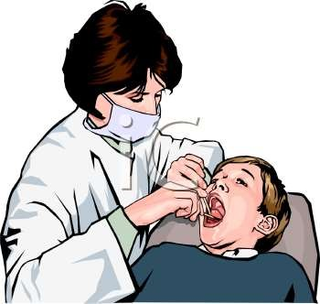
PERIODONTAL
TREATMENT OF
MEDICALLY
COMPROMISED
PATIENTS
PRESENTED BY:
KURESHI NAVAL ANJUM

Slide 2
COMPROMISED PATIENTS?
WHAT THE PERIODONTAL TREATMENT HAS TO DO WITH THE MEDICALLY
Many patients seeking dental care might have significant medical condition which may alter the course of their oral disease and therapy provided.
The therapeutic responsibility of clinician includes identification of medical problems and consultation with or referral of the patient to appropriate physician may be indicated.

Slide 3
Hemorrhagic disorders
Renal diseases
Liver diseases
Pulmonary diseases
Infectious diseases
Pregnancy
Medications and cancer therapies
Prosthetic joint replacement.

Slide 4
HEMORRHAGIC DISORDERS...........!!!!
. ,

Slide 5
Patients with a history of bleeding problems caused by the disease or drugs should be managed to minimize risks of hemorrhage.
Identification of these patients can be done by the following methods :
Health history
Clinical examination
Laboratory tests

Slide 6
1) HEALTH HISTORY
The health questioning should cover
History of bleeding after previous
surgery or trauma
Past and present drug history (drugs that interfere with hemostasis
are :
aspirin,anticoagulants,alcohol,anticancer drug,antibiotics)

Slide 7
3) illnesses associated with potential bleeding problems :
Generalized hemostatic defect or local defect bleeding from multiple sites, spontaneous or
excessive bleeding after injury
Inherited defect or acquired

Slide 8
Is bleeding suggestive of vascular, platelet or coagulation disorder ?
Vascular/platelet disorders – easy bruising,spontaneous bleeding from small vessels especially into skin (purpura and ecchymosis)
Coagulation disorders – hemarthrosis,muscle bleeds, bleeding after injury or surgery.

Slide 9
History of bleeding problems among relatives to know whether it is genetic in nature
Medical history Liver disease Renal disease Malignancies
Poor nutrition (vit k or c deficiency)

Slide 10
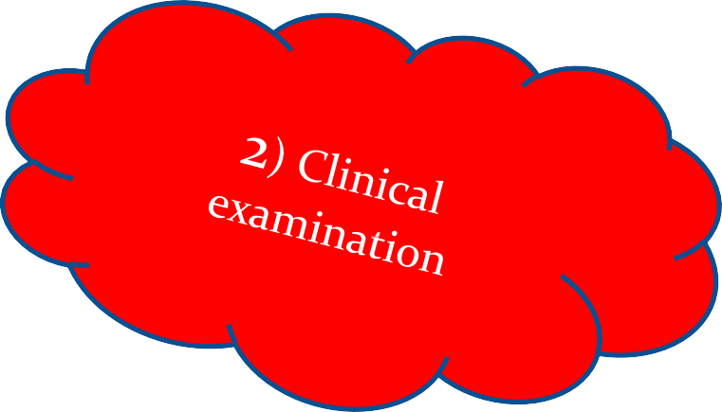
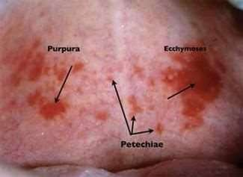
Ecchymoses Petechiae Hemarthrosis Epistaxis
GI bleeding
Soft tissue bleeding

Slide 11
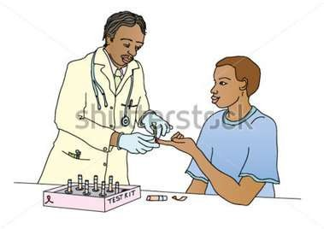
3) LABORATORY TESTS
It includes :
Bleeding time
Prothrombin time (PT)
Partial thromboplastin time (PTT)
Complete blood cell
count (CBC)
Tourniquet test
Coagulation time

Slide 12
PT – measures extrinsic and common pathways (factors I,II,VII and X)
Normal – INR = 1 Abnormal – INR > 1.5
PTT – measures intrinsic and common pathways (factors III,IX,XI,I,II,V,X,XII)
Normal : 25 -40 secs abnormal : >1.5 times normal
Platelet count (normal 1,50,000 – 3,00,000 / mm )
Bleeding time (normal 1 to 6 minutes)
3

Slide 13
Well…!! Now its time for the confirmation..Let’s hope for the best result..☺
Findings | causes
Platelet count | Peripheral destruction of platelets,abnormal bone marrow production
Abnormal bleeding time | Aspirin or NSAID therapy Liver disease,Vonwilebrand disease,DIC,acute leukemia
Abnormal aPTT | One of the hemophiliac states
Abnormal PT with or without abnormal aPTT | Abnormal reduction in the vit k dependent clotting factors (factors II,VII,IX,X) or factor V
Presence of more than 10 petechiae | Thrombocytopenia

Slide 14
HEMORRHAGIC DISORDERS…
It can be classified as
Coagulation disorders(inherited or acquired)
Disorder of vessels
Disorder of platelets (quantity or function)

Slide 15
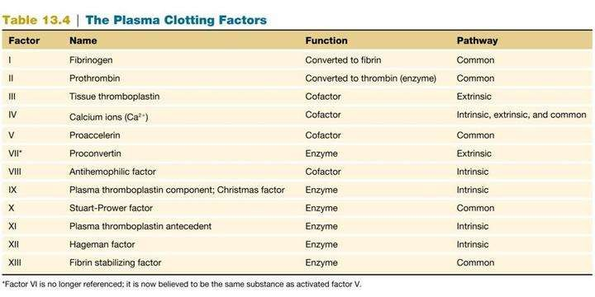

Slide 16
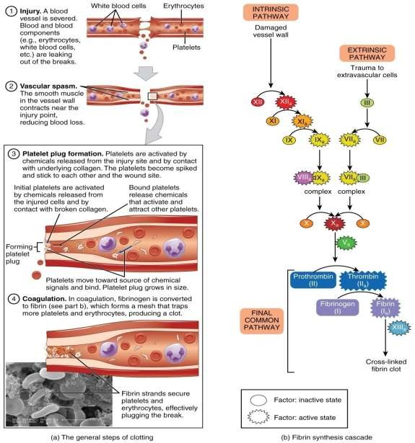

Slide 17
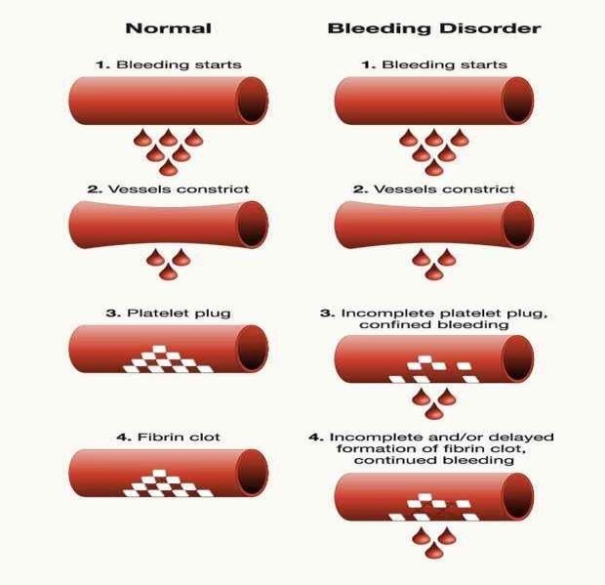

Slide 18
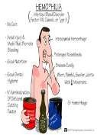
TYPE (inherited) | PROLONGED | NORMAL | TREATMENT
Hemophilia A (deficiency of factor viii) | PTT | PT Bleeding time | DDAVP(Desmopressin) factor VIII concentrate Fresh frozen plasma Fresh whole blood Tranexamic acid, e aminocaproic acid
 |  |  | (amicar)
Hemophilia B (deficiency of factor ix) | PTT | PT Bleeding time | Purified prothrombin complex concentrates Factor IX concentrates Fresh frozen plasma
Von willebrand’s disease (deficiency of von willebrand factor) | PTT Bleeding time Variable factor VIII deficiency | PT Platelet count | DDAVP Factor VIII Concentrate or cryoprecipitate

Slide 19
Acquired type
Liver disease
Renal disease
Anticoagulant therapy
Disseminated intravascular coagulation
Vit k deficiency

Slide 20
TREATMENT:
Probing,scaling,prophylaxis can be done without medical modification.
More invasive treatment such as local block anesthesia, root planing or surgery require prior physician consultation.
Complete wound closure and application of pressure will reduce hemorrhage.
Antihemostatic agents such as oxidized cellulose or purified bovine collagen may be placed over surgical sites or extraction sockets.

Slide 21
FOR PATIENTS UNDER ANTICOAGULANT MEDICATION:
The effectiveness of anticoagulation therapy is determined
by the PT laboratory test.
The recommended level of therapeutic anticoagulation for most patients is an INR of 2 to 3, with prosthetic heart valves it is in the range of 2.5 to 3.5
INR less than 3 – infiltration anesthesia,scaling,root planing .
INR less than 2 to 2.5 – block anesthesia, minor periodontal surgery, simple extractions
INR less than 1.5 to 2 – complex surgery or multiple extractions

Slide 22
FOR PATIENTS UNDER ANTI PLATELET MEDICATION :
Aspirin upto 325 mg per day – no need to discontinue the medication before periodontal procedures
Aspirin more than 325 mg per day – should discontinue the therapy 7 to 10 days before surgical procedures.

Slide 23
Thrombocytopenic purpura
Thrombocytopenia is defined as a platelet count of less than 100000/mm³
It may be seen in the cases of radiation therapy,chemotherapy,leukemia or infections
Purpuras are hemorrhagic diseases characterised by the extravasation of blood into the tissues under the skin or mucosa producing petechiae (small red patches) or ecchymoses (bruises)

Slide 24
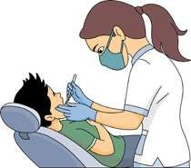
Periodontal therapy for patients with thrombocytopenic purpura
Removal of local irritants
Oral hygiene instructions and frequent maintenance visits
1
Scaling and root planning are safe (platelet count should not
be less than 60,000/mm ³ )
2
Local hemostatic measures should be applied
No surgical procedures should be done until the platelet
count of more than 80000/mm ³
Platelet transfusion may be required before surgery
3

Slide 25
Non thrombocytopenic purpura
It is due to either vascular wall fragility or thrombasthenia
Causes :
Vascular wall fragility – scurvy,infections,chemicals (phenacetin,aspirin),dysproteinemia
Thrombasthenia – von willebrand’s disease,aspirin ingestion,uremia

Slide 26
TREATMENT :
Direct pressure applied for atleast 15 minutes
Surgical therapy should be avoided

Slide 27
LEUKEMIA
Leukemia is a malignant progressive disease in which the bone marrow and other blood forming organs produce increased numbers of immature or abnormal leucocytes
The treatment plan is based on the effects of chemotherapy,bleeding tendency,susceptibility to infections

Slide 28
TREATMENT :
Refer the patient for medical evaluation and treatment
Monitor hematologic laboratory values such as bleeding time, coagulation time ,PT and platelet count
Administer antibiotic coverage before any periodontal treatment
Extract all hopeless, potentially infectious teeth atleast 10 days before chemotherapy (if systemic conditions allow)
Scaling,root planing should be performed
Topical hemostatic agents can be used
Twice daily rinsing with 0.12% chlorhexidine gluconate is recommended after oral hygiene procedures

Slide 29
ACUTE LEUKEMIA :
Antibiotic therapy combined with non surgical or surgical debridement is indicated.
CHRONIC LEUKEMIA :
scaling and root planing can be performed . periodontal surgery should be avoided.

Slide 30
AGRANULOCYTOSIS
It includes the cyclic neutropenia and granulocytopenia
Early,severe periodontal destruction
Periodontal treatment should be done during periods of disease remission
Treatment should be as conservative as possible
Scaling,root planing should be performed under antibiotic protection
Extraction can be done after consultation with the physician

Slide 32
RENAL DISEASES

Slide 33
Most common causes of renal failure are:
Glomerulonephritis
Kidney cystic disease Renovascular disease
Drug nephropathy
Obstructive uropathy hypertension

Slide 34
Renal failure may result in :
Severe electrolyte imbalances
Cardiac arrhythmias
Pulmonary congestion
Congestive heart failure
Prolonged bleeding
The patient in chronic renal failure has a progressive disease that ultimately may require dialysis or kidney transplantation.So , it is preferable to treat before ,rather than after
.transplant or dialysis.

Slide 35
ORAL MANIFESTATIONS OF RENAL DISEASE
Halitosis
Altered taste sensation
Xerostomia
Gingivitis
Enamel hypoplasia
Infections

Slide 36
TREATMENT :
Consult the patient’s physician
Monitor Blood Pressure (patients in end stage renal failure are usually hypertensive)
Check laboratory values : PTT,PT,bleeding time,platelet count,blood urea nitrogen(do not treat if <60 mg /dl) and serum creatinine (do not treat if <1.5 mg / dl)
Periodontal treatment should aim at eliminating inflammation or infection and frequent recall appointments should be scheduled
Drugs that are nephrotoxic or metabolized by the kidney should
not be given (eg: tetracycline,aminoglycoside antibiotics) .
Acetaminophen may be used for analgesia ,diazepam may be used for sedation . Local anesthetics such as lidocaine are generally safe

Slide 37
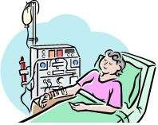
The patients who are receiving dialysis requires modification in treatment planing
Modes of dialysis :
1].Intermittent Peritoneal Dialysis (IPD) 2].Chronic ambulatory peritoneal dialysis (CAPD) 3].Hemodialysis

Slide 38
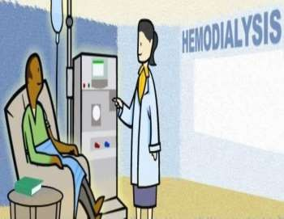
RECOMMENDATION FOR HEMODIALYSIS:
Screen for Hepatitis B and C antigens antibody before any treatment.
Provide antibiotic prophylaxis.
Periodontal treatment should be provided on the day after dialysis due to the effects of heparinization.
Be careful to protect the hemodialysis shunt or fistula when the patient is in dental chair.
If the shunt or fistula is placed in the arm do not cramp that limb and do not use that limb for injection of medication.
BP reading should be taken from the other arm.
Patients with leg shunts should avoid sitting with the leg dependent for more than 1 hour

Slide 39
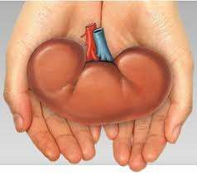
RECOMMENDATION FOR RENAL TRANSPLANT PATIENT
Hepatitis B and C screening
Determination of level of immune system compromise resulting from anti rejection drug therapy
Prophylactic antibiotics (using AHA recommendations or specific regimens based on physician consultation)

Slide 40
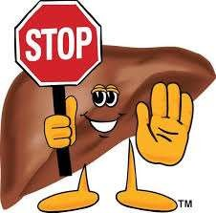
LIVER DISEASES

Slide 41
Liver is the site of production for most of the clotting factors, excessive bleeding during or after periodontal treatment may occur in patients with severe liver disease
Many drugs are metabolized in the liver. So the liver disease alters the normal drug metabolism

Slide 42
Major causes of liver diseases includes :
Drug toxicity
Cirrhosis
Viral infections (hepatitis B and C)
Neoplasms
Biliary tract disorders

Slide 43
ORAL MANIFESTATIONS OF LIVER DISEASE
Candidiasis
Angular cheilitis
Atropic glossitis
Petechiae
Lichen planus

Slide 44
TREATMENT :
Consultation with the physician concerning current stage of disease, risk for bleeding,potential drugs to be prescribed during treatment and required alterations to periodontal therapy.
Screening for hepatitis B and C
Check laboratory values for PT and PTT
Check laboratory values for INR
Teeth with severe bone and attachment loss, furcation invasion, periodontal abscesses or extensive surgical requirements should be extracted before the transplant procedure
Conservative ,non surgical periodontal therapy can be done
whenever possible
If surgery is required INR should be less than 2
Platelet count should be more than 80,000/mm³

Slide 45
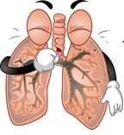
Pulmonary diseases

Slide 46
Pulmonary diseases range from obstructive lung diseases (eg: asthma,emphysema,bronchitis) to restrictive ventilatory disorders caused by muscle weakness,scarring,obesity or any condition that could interfere with effective ventilation
Acute respiratory distress may be caused by slight airway obstruction or depression of respiratory function.
Patients with acute respiratory distress might alter their position in attempts to improve their ventilatory efficiency

Slide 47
ORAL MANIFESTATIONS :
Xerostomia
Gingivitis
Halitosis
Candidiasis

Slide 48
TREATMENT :
Identify and refer patients with signs and symptoms (increased respiratory rate,cyanosis,,clubbing of the fingers,chronic cough,chest pain,hemoptysis,dyspnea and wheezing) of pulmonary disease to their physician regarding medications (antibiotics,steroids,chemotherapeutic agents) and severity of pulmonary disease

Slide 49
Avoid elicitation of respiratory depression or distress :
Minimize the stress of a periodontal appointment. patient with emphysema should be treated in the afternoon ,several hours after sleep to allow for airway clearance.
Avoid medications that could cause respiratory depression (e.g. :
narcotics,sedatives or general anesthetics).
Avoid bilateral mandibular block anesthesia which could cause increased airway obstruction
Position the patient to allow maximal ventilatory efficiency,keep
the patient’s throat clear and avoid excess periodontal packing
Do not use equipments that produce aerosols. eg: ultrasonic scalers.

Slide 50
For asthmatic patient – inhaler should be available
Infectious patients should not be treated unless the periodontal procedure is an emergency

Slide 51
PROSTHETIC JOINT REPLACEMENT

Slide 52
Antibiotic prophylaxis is recommended because of the high morbidity and mortality associated with the prosthetic joint infections.
Consultation with the patient’s orthopedic surgeon may help assess the risk for joint infection relative to current dental status and type of periodontal treatment planned.
Antibiotic prophylaxis before periodontal treatment is more common since the periodontal diseases are considered as high risk

Slide 53
Antibiotic regimens for prevention of prosthetic joint infections
Patient characteristics | Drug regimen
Patients not allergic to penicillin | Cephalexin,cephradine or amoxicillin : 2 g orally 1 hour before periodontal procedure
Patients allergic to penicillins | Clindamycin 600 mg orally 1 hour before dental procedure
Patients not allergic to penicillin but unable to take oral medication | Cefazolin 1 g or ampicillin 2 g i.m or i.v 1 hour before dental procedure
Patients allergic to penicillin and unable to take | Clindamycin 600 mg i.v 1 hour before dental procedure

Slide 54
PREGNANCY

Slide 55
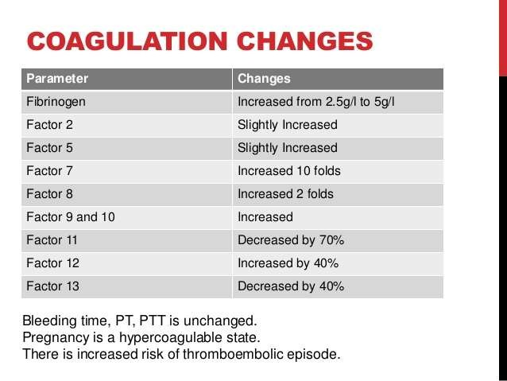

Slide 56
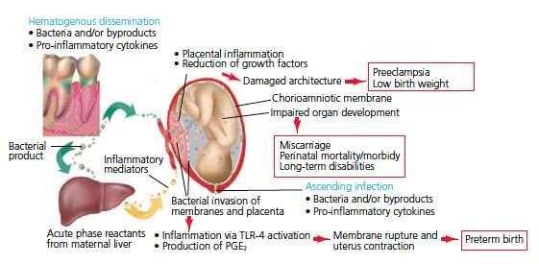
Oral manifestations of pregnancy includes pregnancy gingivitis, pregnancy tumour, tooth mobility, tooth surface loss.
periodontitis and pregnancy

Slide 57
The aim of periodontal therapy for pregnant patient is to minimize the potential inflammatory response related to pregnancy associated hormonal alterations.
Plaque control,scaling,root planing and polishing can be
performed.
The second trimester is the safest time to perform treatment.
The supine position of patient may cause the obstruction of venacava and aorta which leads to supine hypotensive syndrome.

Slide 58
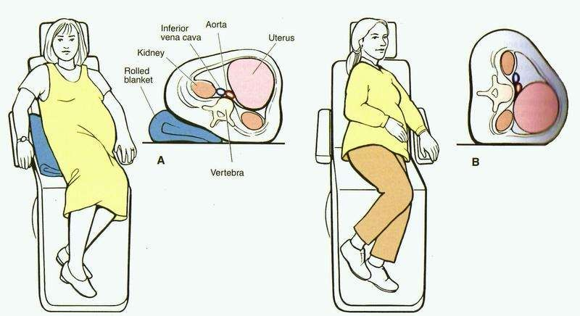
RECOMMENDED PATIENT POSITION IN DENTAL CHAIR

Slide 59
Patient should be placed on her left side or simply by elevating the right hip 5 to 6 inches during treatment
Appointments should be short and the patient should be allowed to change the position frequently
No medications should be prescribed ideally . But depending on the patient’s needs sometimes analgesics,antibiotics may be prescribed after reviewing the adversing effects on the fetus.
Safer drugs LA : lidocaine,prilocaine,etidocaine analgesics : paracetamol
antibiotics : amoxicillin
ADA has stated that “normal radiographic guidelines do not need to be altered because of pregnancy”

Slide 60
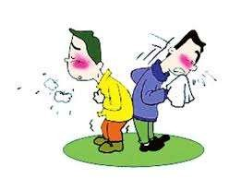
INFECTIOUS DISEASES

Slide 61
It includes
Hepatitis 2)HIV
3)Tuberculosis

Slide 62
HEPATITIS
Hepatitis A and E are both self-limiting infections with no associated
chronic liver disease.
Hepatitis B infection may result in chronic liver disease in about 5 - 10% of infected individuals.
Hepatitis D requires the presence of HBV for its survival.
Hepatitis C is the most serious of all viral hepatitis infection because of its high chronic infection rate. Only 15% of patients recover completely; 85% develop chronic HCV infection, which dramatically increases the risk for cirrhosis, liver Ca. and failure.
Hepatitis G appears as a co-infection with hepatitis A,B or C
TTV is often present in patients with hepatitis and chronic liver disease and it is also associated with HCV.

Slide 63
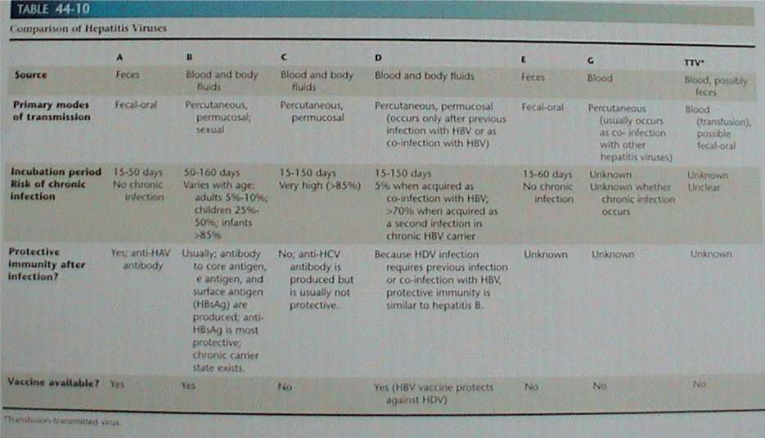

Slide 64
GUIDELINES FOR TREATING HEPATITIS PATIENTS
If the disease is active – do not provide periodontal treatment unless the situation is an emergency.
For patients with a past history of hepatitis consultation with the physician is necessary
For recovered HAV or HEV patients perform routine periodontal care.
For recovered HBV and HDV patients order HBsAg and anti HBs laboratory tests .Patients with anti HBs Positive and HBsAg negative may be treated routinely.

Slide 65
PRECAUTIONS TO BE USED IN THE CASE OF EMERGENCY TREATMENT :
If bleeding occurs during or after treatment,measure PT and
Bleeding time.
Usage of masks,gloves,eye shields,disposable gowns,disposable covers,headrest covers,covering light handles,drawer handles and bracket trays is also essential. After treatment all disposable items should be disposed.
Minimize aerosol production by not using ultrasonic instrumentation,air syringe or high speed handpieces. Prerinsing with chlorhexidine gluconate is highly recommended
All equipment should be scrubbed and sterilised
If a percutaneous or permucosal injury occurs during treatment of a HBV carrier , CDC guidelines recommend administration of Hepatitis B immune globulin (HBIG)

Slide 66
HIV

Slide 67
PERIODONTAL TREATMENT FOR HIV PATIENTS
HEALTH STATUS
INFECTION CONTROL MEASURES
GOALS OF THERAPY
SUPPORTIVE PERIODONTAL THERAPY
67

Slide 68
HEALTH STATUS
Should be determined from the health history, physical evaluation and consultation with the patient’s physician.
Treatment decisions will vary depending on the patient’s state of health
Information should be obtained regarding-
CD4+ T4 lymphocyte level
current viral load
difference from previous counts and load
H/o of drug abuse, multiple infections
present medications
68

Slide 69
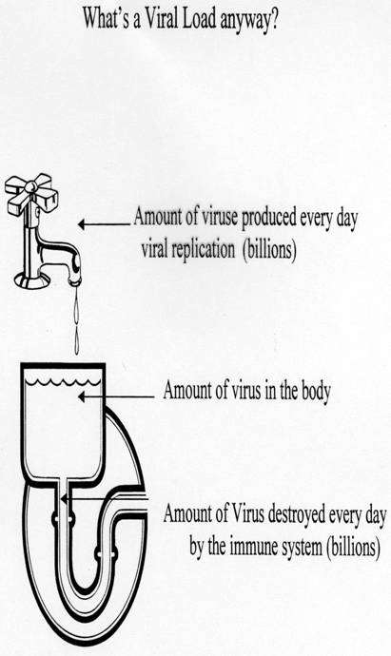
Viral load
Severity of illness is determined by
amount of virus in the body (increasing viral load) and the degree of immune suppression (decreasing CD4+ counts) Higher the viral load, the sooner immune suppression occurs
69

Slide 70
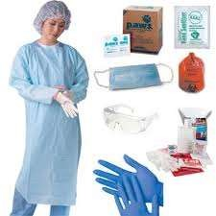
INFECTION CONTROL MEASURES
Control measures should be based on American Dental Association (ADA) and the Center for Disease Control and Prevention (CDC) .
A number of pathogenic microorganisms may be transmitted in the dental setting and these include:
Airborne pathogens - tuberculosis
Blood borne pathogens -HIV, HBV, HCV
Waterborne pathogens Legionella and Pseudomonas species
Mucosal/ skin borne pathogens VZV or HSV
70

Slide 71
GOALS OF THERAPY
Primary goals should be restoration and maintenance of oral health, comfort and function.
Treatment should be directed toward control of HIV-associated mucosal
diseases such as chronic candidiasis and recurrent oral ulcerations
Effective oral hygiene maintenance
Conservative, nonsurgical periodontal therapy should be a treatment
option for virtually all HIV + patients
NUP & NUS can be severely destructive to periodontal structures and should be treated appropriately.
71

Slide 72
SUPPORTIVE PERIODONTAL THERAPY
Patient should be encouraged to maintain meticulous personal oral
hygiene.
Recall visits should be conducted at short intervals (2 to 3 months)
Systemic antibiotic therapy should be administered with caution
Blood and other medical laboratory tests may be required to monitor the patients overall health status and consultation and co-ordination with the patient’s physician are necessary
72

Slide 73
TUBERCULOSIS

Slide 74
Patients with the tuberculosis should receive only emergency care following the guidelines
The sputum culture for mycobacterium tuberculosis should be done.
If the results are negative patients may be treated normally

Slide 75
MEDICATIONS AND CANCER THERAPIES

Slide 76
ANTICANCER DRUG
Bisphosphonate is used to treat cancer (i.v) and the individuals are at high risk for the development of osteonecrosis of the jaw.
Potential risk factors contribute to the development are steroid therapy,alcohol,smoking,poor oral hygiene,chemotherapy,radiotherapy,extractions,root canal treatment, periodontal infections, periodontal surgery and implant surgery.
Invasive treatment should be avoided
Caution and careful consideration of risks must be evaluated for individuals with a history of taking oral bisphosphonates for periods longer than 3 years

Slide 77
ANTICOAGULANT/ANTIPLATELET THERAPY
Traditional management of the patients on anticoagulant or antiplatelet therapy was to discontinue therapy about 3 to 5 (antiplatelet) or 7 to 10 (anticoagulant) days before planned surgical procedures
Since there is a increased risk of morbidity/mortality associated with the discontinuation of the therapy,simple extractions or periodontal surgery can be done without discontinuation of therapy
In the cases of intraoperative bleeding local measures are sufficient to control the bleeding.

Slide 78
CORTICOSTEROIDS
Corticosteroid administration is not required in the case of uncomplicated minor surgical procedures
Supplementation is indicated in the case of lengthy,major surgical procedures,those expected to have significant blood loss,those who have low adrenal function.
Low adrenal function can be identified with the ACTH stimulation test

Slide 79
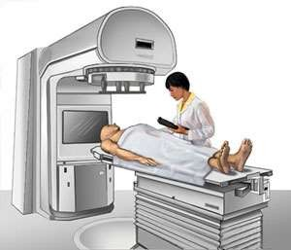
CHEMOTHERAPY
Treatment should be conservative and palliative
The treatment should be done before the day of chemotherapy when the white cell counts are above 2000/mm³
Teeth with a poor prognosis should be extracted , with thorough debridement of remaining teeth to minimize the microbial load
The clinician must teach and emphasize the importance of good oral hygiene
Antimicrobial rinses such as chlorhexidine is
recommended to prevent secondary infections

Slide 80
RADIATION THERAPY
The radiation therapy is used to treat head and neck
tumors.
The complications of radiation therapy includes :
Mucositis Xerostomia Trismus Radiation caries
Temporomandibular joint degeneration Gustatory alteration
Dysphagia Periodontal disease Osteoradionecrosis

Slide 81
BEFORE RADIATION THERAPY :
Teeth that are non restorable or severely periodontally diseased should be extracted atleast 2 weeks before radiation.
Extractions should be performed in a manner that allows primary closure.
Mucoperiosteal flaps should be elevated and teeth should be extracted in segments.
Alveolectomy should be performed allowing no bony spicules to remain and primary closure should be
provided without tension.

Slide 82
DURING RADIATION THERAPY
Patients should receive weekly prophylaxis
Oral hygiene instructions.
Professionally applied fluoride treatments.
Patients should be instructed to brush daily with a
0.4 % stannous fluoride or 1 % sodium fluoride gel. All remaining teeth should receive thorough debridement (scaling and root planing).

Slide 83
AFTER RADIATION THERAPY
Viscous lidocaine may be prescribed for painful mucositis
Salivary substitutes may be given for xerostomia
Radiation caries may be prevented by topical fluoride application daily and maintenance of good oral hygiene.
A 3 month recall interval is ideal.
NOTE : Tooth extraction after the radiation treatment involves a high risk for developing osteoradionecrosis.

Slide 84
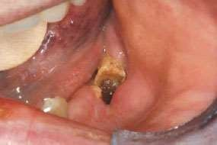
Example of osteoradionecrosis following dental extraction in a patient who had undergone radiotherapy for cancer at the base of the tongue.

Slide 85
Summary :
Coagulation disorders | Replacement of deficient factors
Thrombocytopenic purpura Non thrombocytopenic purpura | Platelet transfusion required before surgery Surgical therapy should be avoided
Pulmonary diseases | Minimise stress, avoid the factors that cause respiratory depression, emergency procedures alone can be done in the case of infectious conditions
Renal diseases | Treatment should be done before dialysis
Liver diseases | Teeth with severe bone and attachment loss, furcation invasion, periodontal abscesses or extensive surgical requirements should be extracted before the transplant procedure. Conservative ,non surgical periodontal therapy can be done whenever possible
pregnancy | Second trimester, patient position should be left lateral decubitus
Prosthetic joint replacement | Antibiotic prophylaxis

Slide 86
Anticancer drug | Invasive procedures increases the risk for osteonecrosis
Antiplatelet / anticoagulant drug | Simple extractions and periodontal surgery can be done without discontinuation of therapy
corticosteroids | Supplementation is required in the case of major and lengthy surgical procedures
chemotherapy | Treatment should be done before chemotherapy when wbc count is above 2000/mm ³
Radiation therapy | Treatment after radiation therapy causes osteoradionecrosis

Slide 87
THANK YOU

