Slide 1
Aggressive periodontitis

Slide 2
Learning objectives
What is aggressive periodontitis?
Distribution C/F ,R/F of it
Risk factors for it?

Slide 3
Periodontitis:
“It is defined as an inflammatory disease of supporting tissues of the teeth caused by specific micro-organisms or group of specific micro-organisms resulting in progressive destruction of periodontal ligament and alveolar bone with pocket formation, recession or both.”

Slide 4
Aggressive Periodontitis :
-Aggressive periodontitis generally affect systemically healthy individuals less than 30 years old, although patients may be older.
Aggressive periodontitis distinguished from chronic periodontitis by –
- age of onset
- rapid rate of disease progression
-nature and composition of associated subgingival micro flora
- alteration in host immune response
- familial aggression of diseased individual

Slide 5
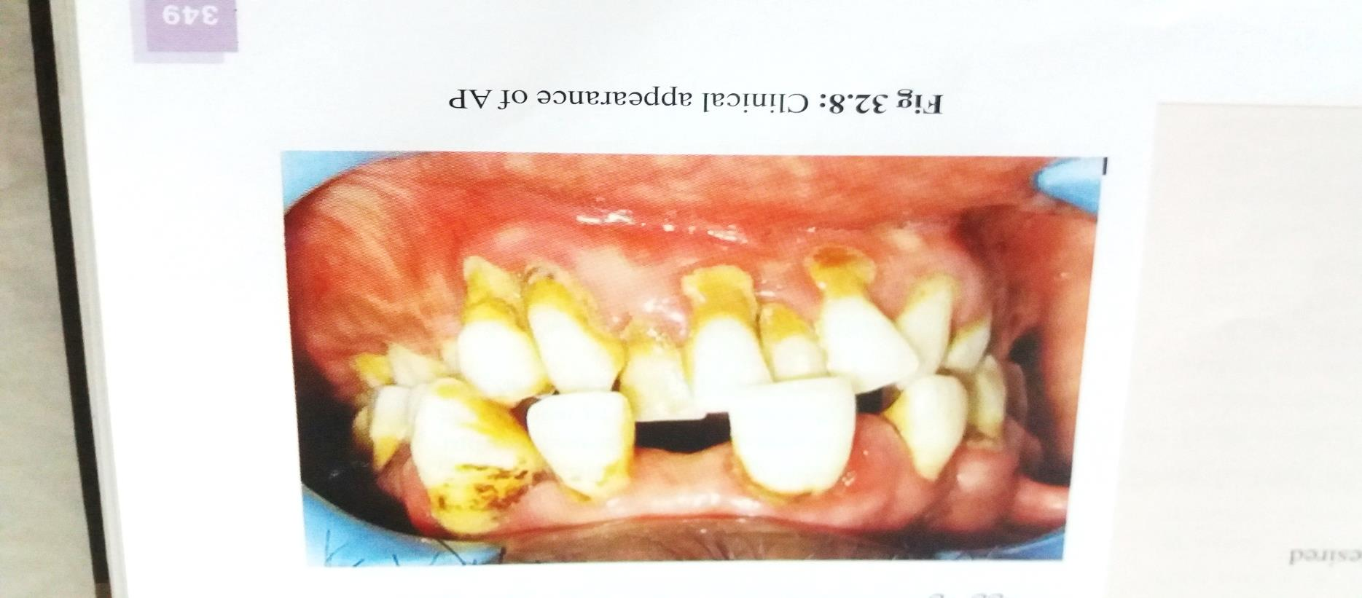
-Aggressive periodontitis is classified as:
1. Localized Aggressive periodontitis ( localized juvenile periodontitis).
2. Generalized aggressive periodontitis – (generalized juvenile periodontitis)
3. Rapidly progressive periodontitis

Slide 6
1.Localized Aggressive Periodontitis:
-“Localized aggressive periodontitis is having localized first molar or incisor presentation with interproximal attachment loss on at least two permanent teeth ,one of which is first molar ,and involving no more than two teeth other than first molar and incisors.”
Clinical features:
Age of onset : at puberty
The striking feature is lack of clinical inflammation despite the presence of deep periodontal pockets and advanced bone loss.

Slide 7
-The plaque that is present forms a thin biofilm on the teeth and rarely mineralizes to form calculus.
-Although the quantity of plaque may be limited, it often contains elevated levels of
A. actinomycetmcomitans , and in some patients porphyromonas gingivilis.
-It progresses rapidly.
-Rate of bone loss is three to four times faster than chronic periodontitis.

Slide 8
-Other features :
-Distolabial migration of maxillary incisor with diastema formation.
-Increasing mobility of maxillary and mandibular incisors and first molar.
-Sensitivity of denuded root surfaces to thermal and tactile stimuli.
-Deep ,dull, radiating pain during mastication.
-Periodontal abscess may form and regional lymph node enlargement may occur.
-In some patients the bone loss and progression of attachment loss may be self arresting.

Slide 9
-Prevalence by Age and Gender :
- It affects both males and females .
- Seen between puberty to 20 years of age .
- Blacks are at much higher risk.
- Black male > black female.
- While ,White female> white male

Slide 10
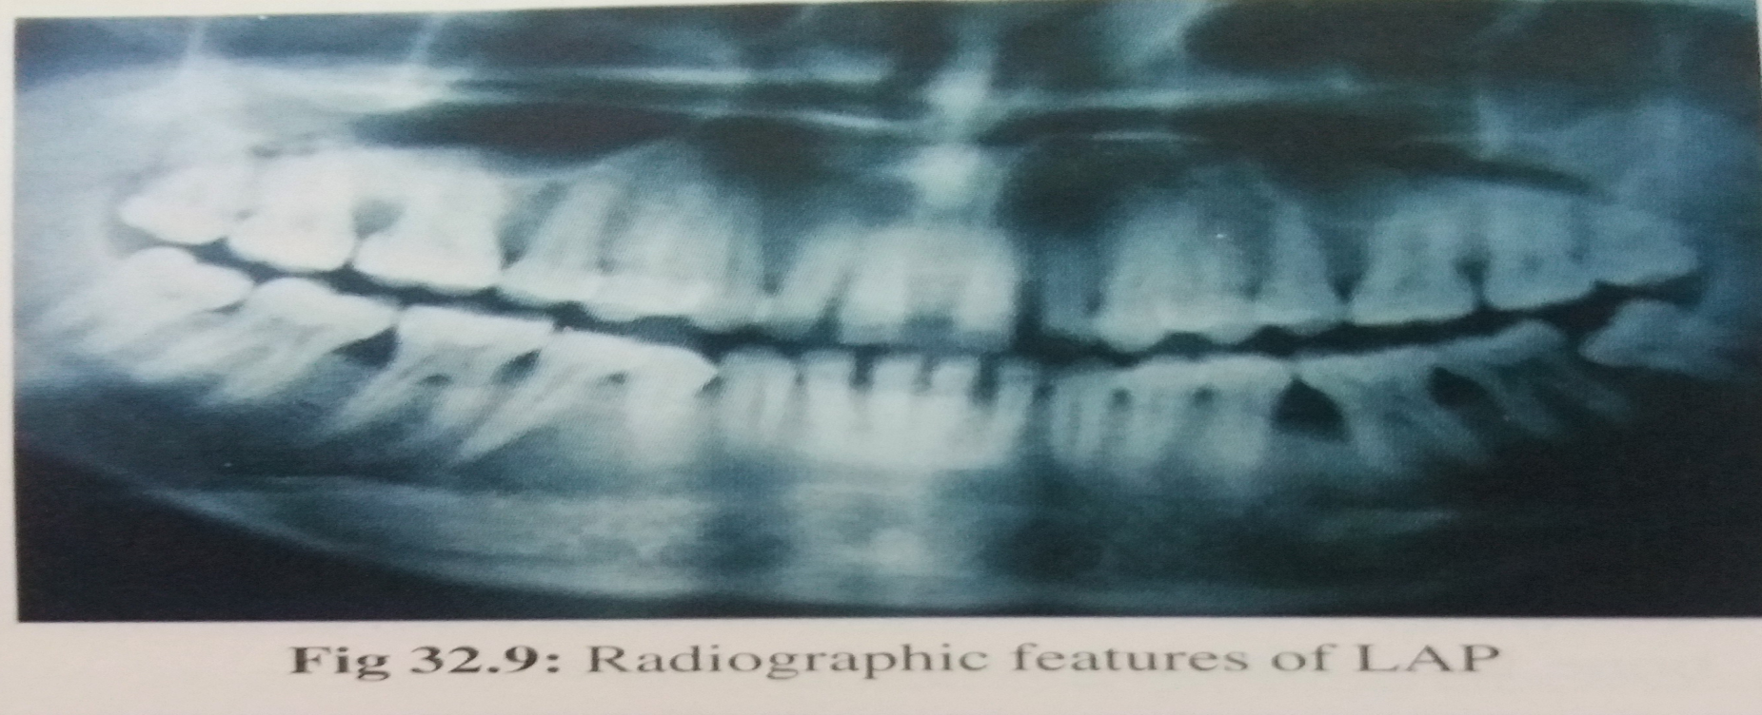
Radiographic Features:-
- Vertical loss of alveolar bone around first molar and incisors.
“Arc –shaped” loss of alveolar bone extending from distal surface of second premolar to the mesial surface of second molar.
Bone defects are usually wider than seen with chronic periodontitis.

Slide 11
2.Generalized Aggressive Periodontitis:
-“It Is clinically characterized by generalized inter-proximal attachment loss affecting at least three permanent teeth other than permanent first molar and incisors.”
-It usually affects individuals under age of 30 but also in older individuals.
-In contrast to localized periodontitis it produce poor antibody response to pathogens.

Slide 12
-The destruction appears to occur episodically , with periods of advanced destruction followed by stages of quiescence of variable length.
-It often have small amount of bacterial plaque associated with affected teeth.
-The amount of plaque seems inconsistent with amount of periodontal destruction.
-Qualitatively, P. gingivalis, A. actinomyctemcomitans, frequently detected in plaque.

Slide 13
- Two gingival tissue responses can be found :
- 1. one is severe, acutely inflamed tissue, often proliferating ,ulcerated, fiery red.
-Bleeding may occur spontaneously or with slight stimulation.
-Suppuration may be important feature.
-This mainly occurs in destructive stage in which attachment and bone are actively lost.
- 2. In other cases gingival tissue appears pink ,free of inflammation and occasionally with some degree of stippling.
-Deep pockets may present and this may coincides with period of quiescence.

Slide 14
Systemic Manifestations:
1. Weight loss
2. Mental Depression
3. General Malaise
Prevalence by Age and Gender:
Male teenagers > females.
Blacks > whites.
Most commonly under 30 years of age.

Slide 15
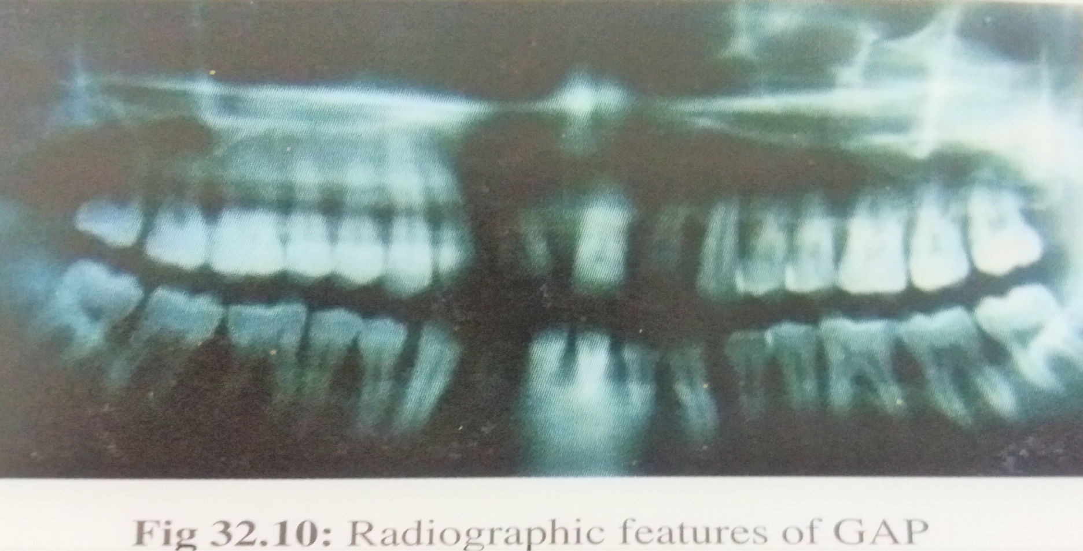
Radiographic Features:
-Radiographically it ranges from severe bone loss, associated with minimal number of teeth to advanced bone loss affecting majority of teeth in dentition.

Slide 16
Risk Factors for Aggressive Periodontitis:
1.Microbiologic Factors:
A. actinomyctemcomitans ,capnocytophaga species, Prevotella intermedia ,Campylobacter rectus are associated with localized aggressive periodontitis.
Another study found elevated levels of P. gingivalis, P. intermedia, Fusobacterium nucleatum, C.rectus , and Treponema denticola.
The invading flora has been described as morphologically mixed but mainly composed of gram negative bacteria, including cocci, rods , filaments, and spirochetes.

Slide 17
2.Immunologic Factors:
-The human leukocyte antigens (HLAs) ,which regulate immune responses, have been evaluated as candidate markers for aggressive periodontitis.
-HLA A9 and B15 antigens are consistently associated with aggressive periodontitis.
-Autoimmunity has role in generalized aggressive periodontitis.

Slide 18
3. Genetic Factors:
- Several authors have been described a familial pattern of alveolar bone loss and have implicated genetic factors in aggressive periodontitis.
- Evidence suggested that some immunologic defects associated with aggressive periodontitis may be inherited.
- Data support the concept that a gene of major effect exists for aggressive periodontitis.

Slide 19
4. Environmental Factors:
- The amount and duration of smoking are important variables that can influence the extent of destruction seen in young adults.
- Patients with generalized aggressive periodontitis who smoke have more affected teeth and more loss of clinical attachment than nonsmoking patients with generalized aggressive periodontitis.

Slide 20
Thank you

