Slide 1
Periodontal abscess

Slide 2
Learning objective
Classification
Clinical features
Diagnosis
Treatment plan

Slide 3
DEFINITION
Periodontal abscess is defined as a suppurative lesion associated with periodontal breakdown and localized accumulation of pus within the gingival wall of a periodontal pocket.
Periodontal abscess has also been defined as a lesion with an expressed periodontal breakdown, occurring during a limited period of time and with easily detectable clinical symptoms, with a localized accumulation of pus, located within the gingival wall of the periodontal pocket.

Slide 4
CLASSIFICATIONS
Depending on the location of the lesion:
• Periapical abscess
• Periodontal abscess
• Pericoronal abscess.
Depending on the course of lesion:
Acute abscess
Chronic abscess.

Slide 5
Depending on the tissue involved:
• Gingival abscess
• Periodontal abscess
• Pericoronal abscess.
Depending on the cause of the acute infectious process, two types of periodontal abscess may occur:
• Periodontitis-related abscess
• Non-periodontitis related abscess.
Depending on the number of abscess:
• Single
• Multiple.

Slide 6
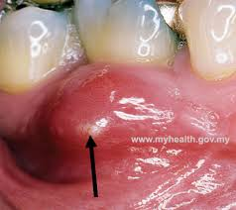
CLINICAL FEATURES
Intraoral
Pain of acute periodontal abscess is throbbing and radiating,
whereas in chronic periodontal abscess pain is dull and gnawing .
Gingiva is swollen, red in color, with a smooth and shiny surface and ovoid elevation .
Suppuration is either spontaneous or due to pressure on the outer surface of the gingiva.
Swelling.
Sensitivity to percussion of the affected tooth.
Tooth elevation.

Slide 7
During the periodontal examination, the abscess frequently lies at a site with a deep periodontal pocket.
Bleeding on probing.
Pinpoint orifice of sinus may be present.
Sinus is usually enclosed with small, pink, bead-like mass of granulation tissue .

Slide 8
Extraoral
In some patients, periodontal abscess is present with following additional clinical features:
Elevated body temperature.
Malaise.
Regional lymphadenopathy

Slide 9
MICROBIOLOGY
Polymicrobial flora of periodontal abscess consists of Gram negative, strict anaerobe rods similar to the microbiota of chronic periodontitis lesions.
Gram-negative anaerobic species mainly Porphyromonas gingivalis, Prevotella intermedia.
Gram-positive bacterial species mainly includes Peptostreptococcus micros and Actinomyces spp.

Slide 10
PATHOGENESIS AND HISTOPATHOLOGY
Obstruction to the opening of deep pocket, frequently one which is tortuous or associated with furcation defect.
Gingival injury with a foreign body, e.g. toothbrush bristles or wood stick, which carries bacteria into the tissues.
Careless subgingival scaling may also carry microorganisms into the damaged tissue, as can powerful irrigation of a pocket.

Slide 11
Incomplete removal of plaque and subgingival calculus from the depths of a pocket.
Frequently after scaling, there is a tightening of the gingival cuff which occludes pocket containing bacteria.
Infection of tissues damaged by excessive occlusal stress, which may be produced by:
• Bruxism
• Excessive orthodontic forces.

Slide 12
As a consequence of pulp disease:
Where a periapical lesion spreads up to the lateral surface of a tooth.
• Where a lateral pulp canal links with the periodontal ligament.
This is especially common in the furcation.
• Perforation of the lateral wall of a tooth during endodontics.

Slide 13
Altered host response as in diabetes.
The periodontal abscess formation takes place with the bacterial invasion of the soft-tissue wall of the pocket and further multiplication.
Infiltration of inflammatory cells in the periodontal tissues initiates destruction of the connective tissue.
This favors encapsulation of the bacterial mass and process of pus formation. The progression of disease is determined by microbial virulence, host resistance and the number of bacteria present in the lesion.
The extracellular enzymes and inflammatory cells facilitate the periodontal tissue destruction.

Slide 14
An acidic environment will favor the activity of lysosomal enzymes and promote tissue destruction.
Periodontal abscess contains bacteria, bacterial products, inflammatory cells, tissue breakdown products and serum.
Central area of the abscess is mainly constituted with neutrophils and close to soft-tissue debris.

Slide 15
DIAGNOSIS
The diagnosis of a periodontal abscess is established with understanding patient’s chief complaint, overall clinical evaluation and the assessment of clinical and radiographic findings.
Careful probing of the suspected area along the gingival margin in association with each tooth surface helps to identify a tract from the marginal area to deeper periodontal tissues.
Radiographically, the interdental bone is either normal or associated with some bone loss.

Slide 16
Bone loss usually extends from a widening of the periodontal ligament space to bone loss involving most of the affected tooth.
Radiographs taken in the earliest stage of periodontal abscess provide little useful information, but once the lesion is established its position can be identified.
Radiolucent area along the lateral surface of the root suggests the presence of periodontal abscess. A radiograph taken with Gutta-Percha point inserted gently into the suspected pocket can help to define the origin of the abscess.

Slide 17
DIFFERENTIAL DIAGNOSIS
The periodontal abscess needs to be differentiated from other abscesses occurring in the oral cavity.
Gingival abscess, periapical abscess, endo-periodontal abscess , lateral periapical cysts and vertical root fractures may have a similar appearance.
Gingival abscess is usually sudden in onset, localized, tender and rapidly spreading lesion.
It is usually restricted to the marginal gingiva or interdental papilla.
Signs such as lack of pulp vitality, the presence of deep carious lesions, the presence of a sinus tract and findings made in the radiographic examination, will aid in the distinction between abscesses of different etiologies.

Slide 18
TREATMENT
Treatment of periodontal abscess depends upon the stage of abscess development, the amount of bone loss and possibility of involvement of pulp pathology.
Gingival Abscess After topical anesthesia is applied, the fluctuant area of the lesion is incised with a Bard-Parker handle and surgical blade, and the incision is gently widened to permit drainage.
The area is cleansed with warm water and covered with a gauze pad. After bleeding stops, the patient is dismissed for 24 hours and instructed to rinse every 2 hours with a glassful of warm water.

Slide 19
Acute Periodontal Abscess (Incision and Drainage)
Drainage through the Pocket After application of a topical anesthesia, flat instrument or a probe is carefully introduced into the pocket in an attempt to distend the pocket wall.
A small curette or a Morse scaler can then be gently used to penetrate the tissue and establish drainage.

Slide 20
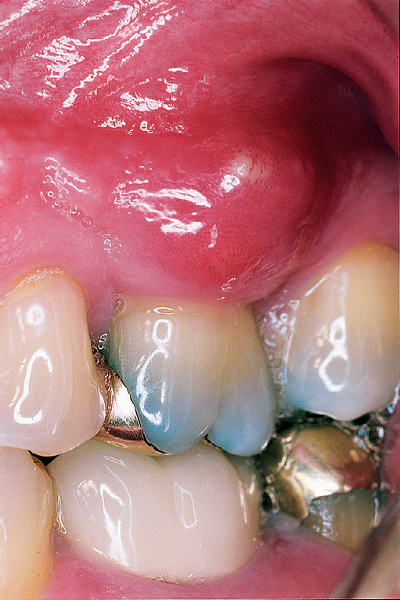
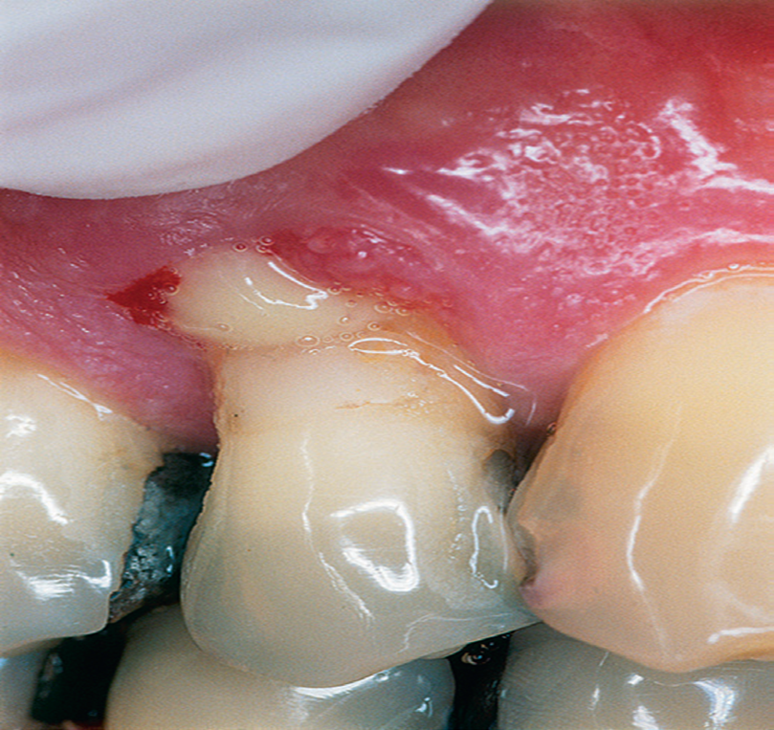

Slide 21
most fluctuant part of the lesion, extending from the mucogingival fold to the gingival margin .
If swelling is on the lingual surface, the incision is started just apical to the swelling extending through the gingival margin.
The blade should penetrate to firm tissue to be sure of reaching deep, purulent areas.

Slide 22
Drainage through an External Incision After local anesthesia is given, with a Bard-Parker handle and blade number 11, a vertical incision is made in the most fluctuant part of the lesion, extending from the mucogingival fold to the gingival margin .
If swelling is on the lingual surface, the incision is started just apical to the swelling extending through the gingival margin.
The blade should penetrate to firm tissue to be sure of reaching deep, purulent areas.

Slide 23
After initial extravasation of blood and pus, irrigate the area with warm water and gently spread the incision to facilitate drainage.
Postoperative instructions are given to rinse hourly with a solution of a teaspoon of salt in a glass of warm water.
Antibiotics penicillin and metronidazole are prescribed for a patient with systemic complications.

Slide 24
Chronic Periodontal Abscess Treatment
by Flap Operation All deposits are scaled from the teeth, and the root surfaces are planed with scalers and smoothened with curettes.
Systemic antibiotics amoxicillin and metronidazole are prescribed.
To locate the abscess area, probing is done around the gingival margin, following tortuous pockets to their termination.
If a sinus is present, the abscess may be probed through it.

Slide 25
Anesthetize: The area is anesthetized with local infiltration.
Incision: Two vertical incisions are made from the gingival margin to the mucobuccal fold, outlining the field of operation. If the lingual approach is used; the incisions are made from the gingival margin to the level of the root apices.
After the vertical incisions are made, a mesiodistal incision is made across the interdental papilla with a knife to facilitate the detachment of the flap .

Slide 26
Reflect the flap: A full thickness flap is raised with a periosteal elevator and held in the position with a retractor.
Remove granulation tissue: The granulation tissue is removed with curettes to provide a clear view of the root.
If a sinus is present, it is explored and curetted.
Control bleeding: The facial and lingual surfaces are covered with a piece of U-shaped gauze, which is held in position until the bleeding stops. Suture: The gauze is then removed, and the flap is sutured and covered with a periodontal pack.

