Slide 1
PERIODONTAL POCKET

Slide 2
Learning objective Classification clinical feature histological features Detection treatment

Slide 3
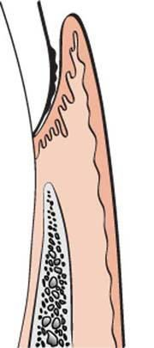
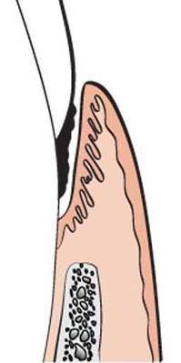
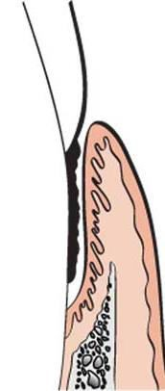
DEFINITION:
The periodontal pocket is defined as a pathologically deepened gingiva sulcus. Deepening of gingiva sulcus may occur by coronal movement of the gingiva margin, apical displacement of gingiva attachment or combination of above.

Slide 4
CLASSIFICATION 1:
POCKET
Gingival pocket
Periodontal pocket
Suprabony pocket
Infrabony pocket

Slide 5
GINGIVA POCKET | PERIODONTAL POCKET
Also known as pseudo pocket or relative pocket or false pocket Seen in the gingivitis Formed by the gingiva enlargement without extraction of the underlying periodontal tissues. The sulcus is deepened because of increased bulk of gingiva | Also known as absolute or true pocket Seen in periodontitis Occurs with destruction of the supporting periodontal tissues and loosening and exfoliation of the teeth.

Slide 6
Two types of
Periodontal Pocket
Gingival Pocket
Suprabony pocket
Infrabony pocket

Slide 7
SUPRABONY POCKET | INFRABONY POCKET
Also known as Supracrestal or Supraalveolar pocket. | Also known as Subcrestal or Intraalveolar pocket.
Bottom of the pocket is coronal to the underlying alveolar bone. | Bottom of the pocket is apical to the crest of the alveolar bone.
Lateral wall consist of the soft tissue alone | Lateral wall consist of the soft tissue and bone.
Pattern of destruction of bone is horizontal | Pattern of destruction of bone is vertical
Interproximally, transseptal fibres arranged horizontally (between the base of the pocket and the alveolar bone) | Interproximally, transeptal fibers are oblique (extend from the cementum beneath the base of the pocket along the bone and over the crest of the cementum of the adjacent tooth)
On the facial and lingual surfaces, periodontal ligament fibres, follow the horizontal-oblique course | On the facial and lingual surfaces, periodontal ligament fibres, follow the angular pattern.

Slide 8
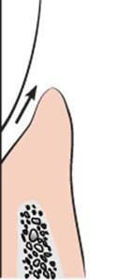
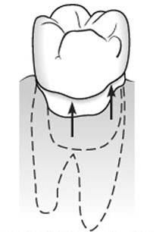
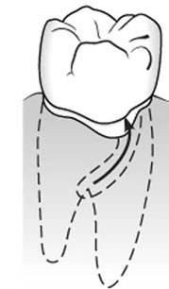
CLASSIFICATION 2:
According to the involved tooth surfaces
POCKET
Simple pocket
Compound pocket
Complex or Spiral pocket
Involve one surface
Involve more than one surface
Originating on one tooth surface
and twisting around the tooth to involve one or more additional surfaces (But open into oral cavity on the surface of its origin).

Slide 9
PATHOGENESIS OF POCKET FORMATION
Presence of bacterial plaque on tooth surface
Marginal gingiva become inflamed
Gingiva sulcus deepens due to oedematous enlargement of gingiva
Gingiva pocket
Anareobic organisms tend to colonise the subgingiva plaque
(Spirochaetes and motile rods)
(Due to an aerobic environment created in the pocket)
Large number of PMN leykocytes and macrophages migrates to the gingiva tissue in response to bacterial challenge

Slide 10
Two mechanisms of collagen loss
Lygogomal enzymes (Collagenase) released by PMN leukocytes
Destruction of collagen fibers in
gingival C.T.
Collegenase Matrix metallo
Fibroblast phagocytize collagen fibers by extending cytoplasmic process to the ligament cementum interface
Collagon
proteinases
When the collagen fibers apical to junctional epithelial get destroyed, the epithelial cells proliferate along the root surface in an apical direction until they come in contact with healthy collagen fibers.

Slide 11
At the same time – coronal portion of the junctional epithelium get detached from the tooth surface
PMN cells migrates towards the coronal portion of junctional epithelium
When volume of PMN leykocytes at the coronal portion of junctional epithelium exceeds 60%, the epithelium cells separate from the tooth surface
Pocket formation
Plaque removal is difficult or impossible from deep pocket
Favouring growth of pathogenic organism in that protected environment
Further attachment loss Horizontal bone loss
If I.F.O. present than verticle bone loss occurs (angular bone loss)

Slide 12
CLINICAL FEATURES
CLINICAL FEATURES | CAUSES
1. Bluish red discoloration of the gingiva wall of pocket. Flaccidity A smooth, shiny surface Pitting on pressure | Due to circulatory stagnation Due to destruction of gingiva fibres Due to atrophy of the epithelium and edema Due to edema and degeneration
2. Gingiva wall may be pink or firm | When fibrotic changes predominate over exudation and degeneration.
3. Bleeding on probing | Due to increased vascularity thinning and degeneration of the epithelium the proximity of the engorged vessels to the inner surface.
4. Probing is generally painful | Due to ulceration of the inner aspect of the pocket wall.
5. Pus may be present | Due to suppurative inflammation

Slide 13
OTHER CLINICAL FEATURES
Thickened marginal gingiva
Loss of stippling
Tooth mobility and diastema formation

Slide 14
HISTOPATHOLOGY
[I] Soft tissue wall/lateral wall
Epithelium:
Shows
Proliferative changes
Degenerative changes
1. Epithelial cells proliferate into the underlying connective
tissues forming deep rete pegs
Micro ulcerations develops on soft tissue wall
Pocket epithelial is infiltrated by PMN’s and oedematons fluid from inflammed connective tissues.
Bacterial invasion in intercellular space of epithelium (eg. Gram negative organism, porphysomons gingivais, provotella intermedia, actinobacillus).

Slide 15
CONNECTIVE TISSUE
Odedematous
Densely infiltrated with plasmecells (80%), lymphocytes and PMN leykocytes.
Vascularity ↑
B.V. dilated and engorged
Area of necrosis and degeneration
Suppuration is commonly seen

Slide 16
SCANNING ELECTRON MICROSCOPIC EXAMINATION OF LATERAL WALL
Seven different types of disease activity have been identified.
Areas of relative quiescence
Regions with minor depressions and elevations
Areas of Bacterial accumulation
Accumulates in depressions in epithelial surface
Areas of emergence of leukocytes
Leukocytes emerging through intercellular spaces
Areas of leukocyte bacteria interaction
Areas of intense epithelial desquamation
Areas of ulceration
Areas of haemorrhage.

Slide 17
PERIODONTAL POCKETS AS HEALING LESIONS
Periodontal pockets are inflammatory lesions and
constantly undergoing repair. Complete healing does not occurs because of persistence of bacterial attack which continue to stimulate an inflammatory response causing degeneration of new tissues.
Oedematous pocket wall
When the inflammatory component predominates the lateral wall appears soft, oedematous friable, with smooth shiny surface and bluish red discoloration.
Fibrotic pocket wall
When reparative changes predominates, the gingiva appears fibrotic and pink.

Slide 18
CONTENTS OF POCKET
Micro organisms
Bacterial products (enzymes and endotoxins)
GCF
Remnants of food
Salivary mycin
Desquamated epithelial cells
Leukocytes
Purulent exudates may be present (sec. sign)
Eg. deep pocket may have little or no pus and shallow pocket may have extensive pus formation so pus is not an indication of the depth of the pocket.

Slide 19
[II] Root surface wall of the pocket
Root surface forms the medial wall of the pocket.
The root surface that gets expose to the
oral
environment, as a result of periodontal attachment loss, undergoes following changes.
Structural changes
Chemical changes
Cytotonic changes

Slide 20
Structural changes
Exposure of cementum to the oral environment
Minerals present in salvia tend to get deposited on cementum surface (Ca⁺², F⁻, etc.)
Area of Hyper mineralization
Root surface is exposed to oral fluids and bacterial plaque Proteolysis of embedded remnants of sharpey’s fibers Areas of demineralization
Root caries (Yellowish or light brown patch)
Soft and lethargy on probing
Patient feels severe sensitivity to thermal changes and sweets
Pulp exposure may occur in severe forms

Slide 21
Chemical changes
Cementum exposed to saliva may absorb calcium,
phosphorus, magnesium and fluoride.
Increased mineral content of the root surface alters the
chemical composition of the cementum, making it
resistant to dental caries.
Cytotoxic changes
Histologic studies of periodontally involved cementum have shown the presence of bacteria in the cementum or endotonins in the cementum.

Slide 22
Five zones can be seen at the bottom of the pocket

Slide 23
DIAGNOSIS/DETECTION OF POCKETS
Careful exploration with a periodontal probe – accurate method.
Radiograph: Pockets are not detected by radiographic
examination because pocket is a soft tissue change.
Disadvantages of radiograph:
Radiograph indicates areas of bone loss where pocket may be suspected, they do not show pocket presence or depth.
Radiograph show no difference before or after pocket elimination
unless bone has been modified
Note: Gutta Percha points or Calibrated Silver points can be used with radiograph to assist in determining the level of attachment of periodontal pocket.

Slide 24
POCKET PROBING
Two different pocket depths
Biologic or histologic depth
Distance between gingiva
margin and base of the pocket
Clinical or probing depth
Distance to which a probe
penetrates into the pocket
Note: Standardized force used for penetration of a probe is
25 ponds or 25 grams (0.75 N).

Slide 25
Pocket depth versus level of attachment:
Pocket depth: Distance between the base of pocket and the gingival margin.
Level of attachment loss: Distance between base of the pocket and a fixed point on the crown such as the CEJ.
Level of attachment loss
Pocket depth

Slide 26
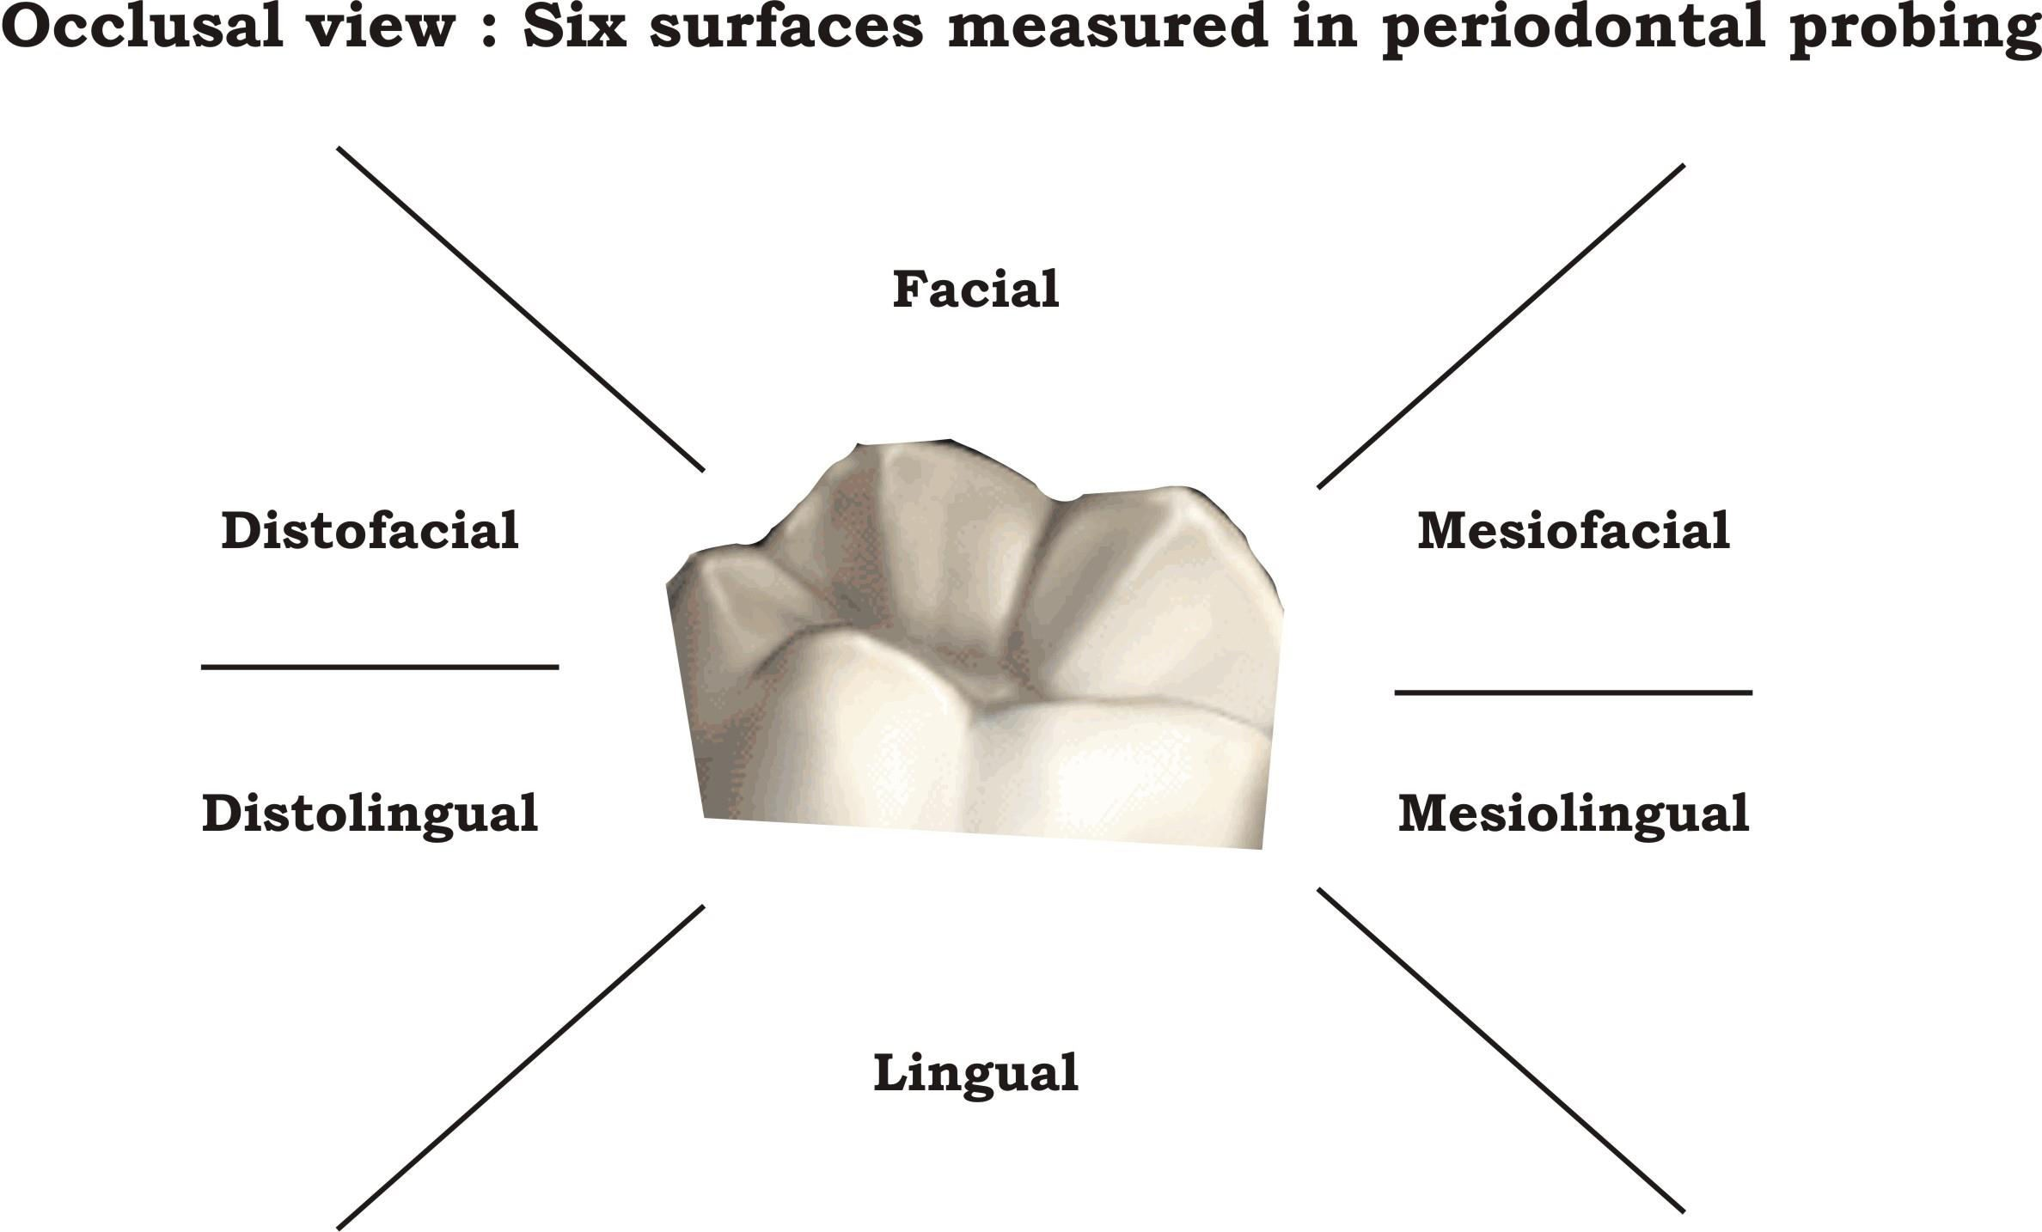
PROBING TECHNIQUES
1.

Slide 27
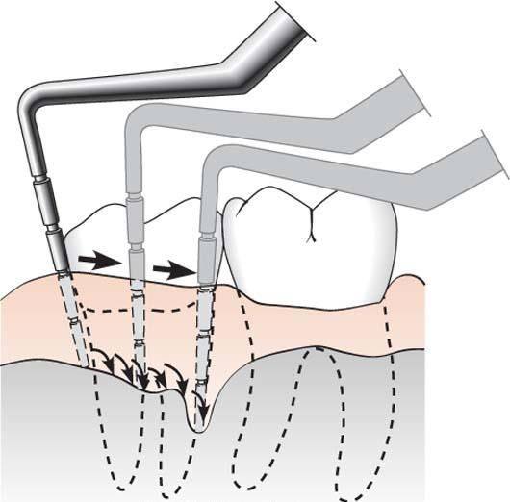
2. The probe should be inserted parallel to the vertical axis of the tooth and walked circumferentially around each tooth to detect the area of deepest penetration.

Slide 28
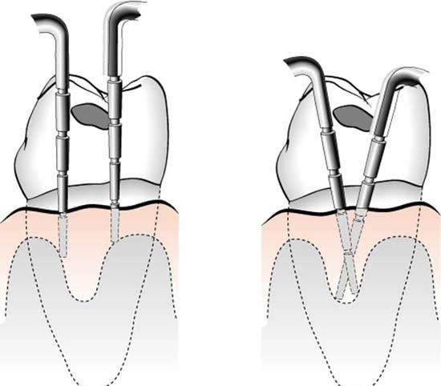
3. To detect
internal crater : Probe should be placed
obliquely from both facial and ligual surfaces so as to explore the deepest point of the pocket located beneath the contact point.

Slide 29
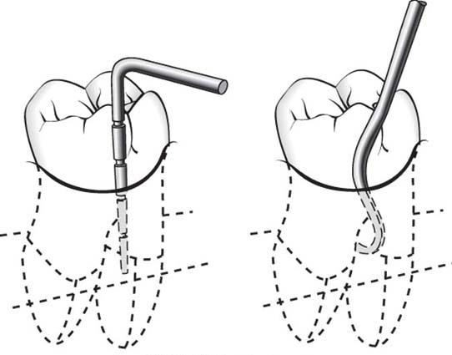
4. In the multirooted teeth the possibility of furcation
specially
involvement should be carefully explored
designed probe (eg. Nabers probe).
with

Slide 30
BLEEDING ON PROBING
If gingiva is inflamed and the pocket epithelium is atrophic or ulcerated.
To test for bleeding after probing, the probe is carefully introduced
to the bottom of the pocket and gently moved laterally along the
pocket wall.
Bleeding may appear immediately after removal of the probe or may be delayed a few seconds.
Depending on the severity of inflammation, bleeding can vary from a tenuous red line along the gingiva sulcus to profuse bleeding.

Slide 31
Thank you !!

