Slide 1
Clinical features of gingivitis

Slide 2
Learning objectives
Types of gingivitis
Clinical presentation of different types of gingivitis
Bleeding on probing
Colour changes in gingiva
Changes in consistency of gingiva
Surface texture changes in gingivitis
Position of gingiva

Slide 3
Clinical features of gingivitis can be characterized by any of the following clinical signs:
redness and sponginess of the gingival tissue,
bleeding on provocation,
changes in contour,
the presence of calculus or plaque with no radiographic evidence of crestal bone loss.

Slide 4
Gingivitis can develop with sudden onset and have a short duration, and it can be painful.
A less severe phase of this condition can also occur.
Recurrent gingivitis reappears after having been eliminated by treatment or after disappearing spontaneously.

Slide 5
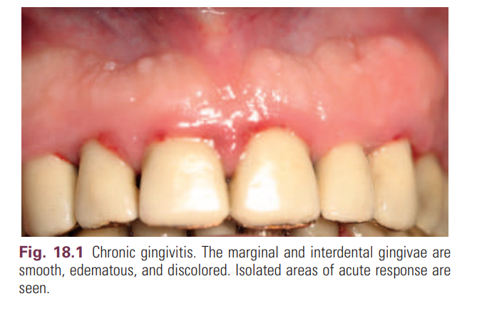
Chronic gingivitis develops slowly and has a long duration.
It is painless, unless it is complicated by acute or subacute exacerbations, and it is the type that is most often encountered .
Chronic gingivitis is a fluctuating disease in which inflammation persists or resolves and normal areas become inflamed.

Slide 6
Localized gingivitis is confined to the gingiva of a single tooth or group of teeth.
Generalized gingivitis involves the entire mouth.
Marginal gingivitis involves the gingival margin, and it can include a portion of the contiguous attached gingiva.

Slide 7
Papillary gingivitis involves the interdental papillae, and it often extends into the adjacent portion of the gingival margin.
Papillae are involved more frequently than the gingival margin
the earliest signs of gingivitis often occur in the papillae.
Diffuse gingivitis affects the gingival margin, the attached gingiva, and the interdental papillae.

Slide 8
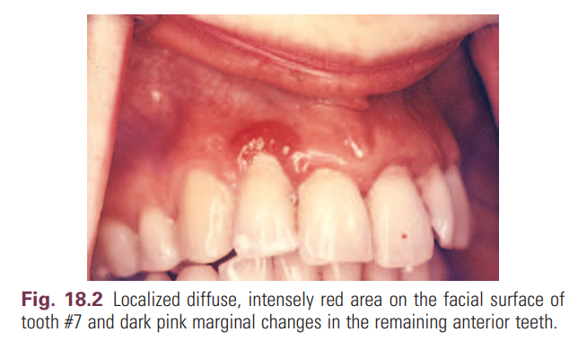
Localized marginal gingivitis is confined to one or more areas of the marginal gingiva

Slide 9
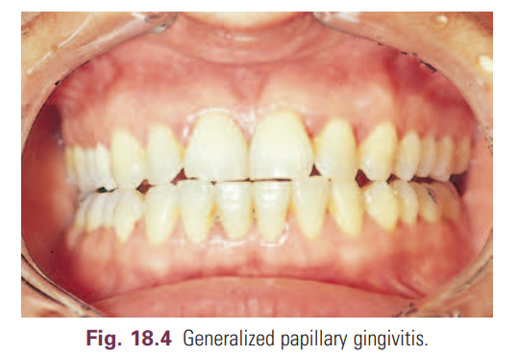
Localized papillary gingivitis is confined to one or more interdental spaces in a limited area

Slide 10
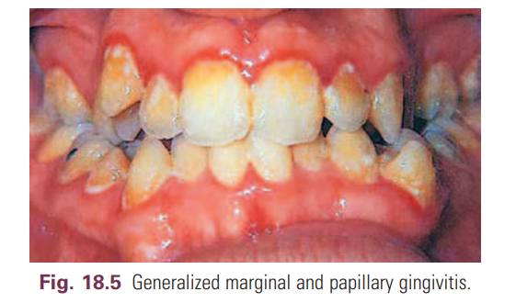
• Generalized marginal gingivitis involves the gingival margins in relation to all the teeth. The interdental papillae are usually affected

Slide 11
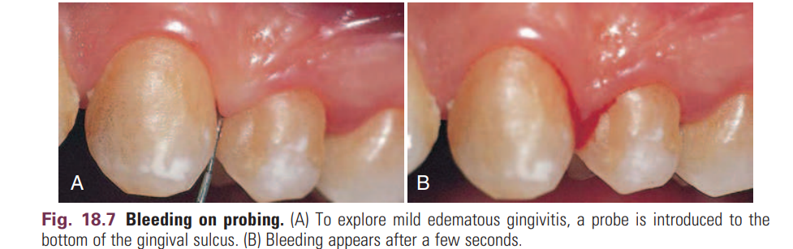
Gingival Bleeding on Probing
Two earliest signs of gingivitis are
crevicular fluid production and
bleeding from the gingival sulcus on gentle probing

Slide 12
Bleeding on probing (BOP) is easily detected clinically.
BOP appears earlier than a change in color or other visual signs of inflammation.
BOP is widely used by clinicians to measure disease prevalence and progression, measure outcomes of treatment, and motivate patients to perform necessary home care.

Slide 13
Gingival Bleeding Caused by Local Factors
Factors that contribute to plaque retention and may lead to gingivitis include anatomic and developmental tooth variations,
caries
frenum pull
iatrogenic factors,
malpositioned teeth
mouth breathing,
overhangs,
partial dentures,
lack of attached gingiva, and recession.
Orthodontic treatment and fixed retainers are associated with increased plaque retention and increased BOP.

Slide 14
Chronic and Recurrent Bleeding
The most common cause of abnormal gingival BOP is chronic inlammation.
The bleeding is chronic or recurrent, and it is provoked by mechanical trauma (e.g., toothbrushing, toothpicks, food impaction)
by biting into solid foods (e.g., apples).

Slide 15
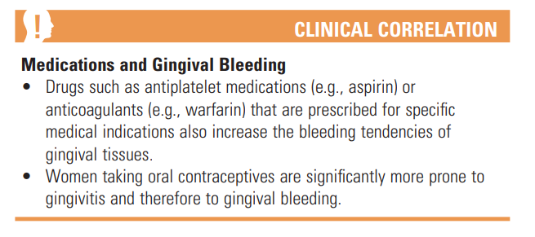

Slide 16
Color Changes With Gingivitis
Change in color is an important clinical sign of gingival disease.
The normal gingival color is coral pink, and it is produced by the tissue’s vascularity and modified by the overlying epithelial layers.
Color changes in acute gingival inflammation differ in both nature and distribution from those in patients with chronic gingivitis

Slide 17
Changes in Gingival Consistency
Chronic and acute inflammations produce changes in the normal firm and resilient consistency of the gingiva.

Slide 18
Changes in Gingival Surface Texture
The surface of normal gingiva usually exhibits numerous small depressions and elevations that give the tissue an orange-peel appearance referred to as stippling.
Stippling is restricted to the attached gingiva and is predominantly localized to the subpapillary area, but it extends to various degrees into the interdental papilla.

Slide 19
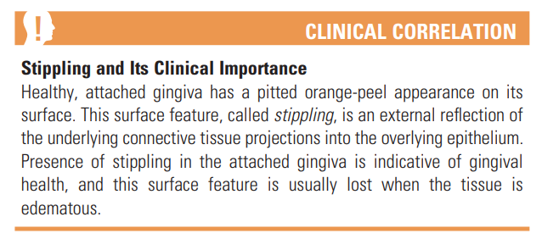
With chronic inflammation, the gingival surface is smooth and shiny or firm and nodular, and stippling is lost

Slide 20
Changes in Gingival Position
1] Traumatic Lesions- chemical, physical, or thermal
2] Gingival recession- Gingival recession is a common finding. The prevalence, extent, and severity of gingival recession increase with age, and this condition is more prevalent among males.

Slide 21
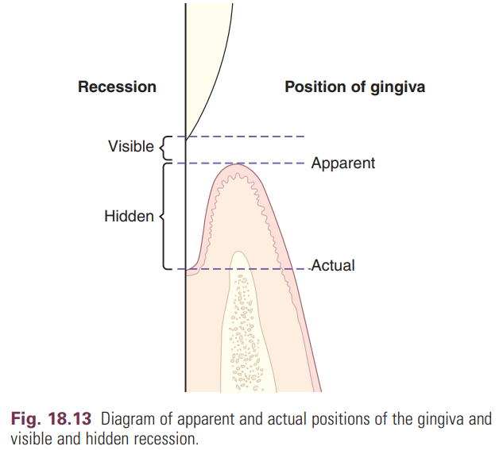

Slide 22
Changes in Gingival Contour
Changes in gingival contour are primarily associated with gingival enlargement but changes may also occur with other conditions.
Stillman cleft-specific type of gingival recession that consists of a narrow, triangular shaped gingival recession.
McCall festoon-rolled, thickened band of gingiva that is usually seen adjacent to the cuspids when recession approaches the mucogingival junction.

