Slide 1
Stages Of Gingivitis

Slide 2
Learning objectives
Stages of gingivitis
Process of initiation of gingival inflammation
Histological changes in each stage
Clinical changes seen in gingiva during inflammation

Slide 3
Gingivitis:
Early definition of gingivitis simply states that “ it was the inflammation of gingiva.”
Another definition states that, “it is the inflammation of gingiva in which the junctional epithelium remains attached to the tooth at its original level.”
In general, “gingivitis case is a person with at least mild inflammation in at least one of the gingival units.”
The unit may be any anatomic structure of gingiva such as interdental papilla, marginal or attached gingiva or any gingival site defined in relation to tooth such as facial, lingual, mesial or distal gingiva.

Slide 5
How is gingivitis measured-
It is measured by ‘Gingival Indices’.
Gingival indices is method for assessing severity and quantity of gingival inflammation in individual.

Slide 6
The most common form of gingivitis is caused by bacterial plaque.
Normal human gingiva contains inflammatory cells consisting predominantly of T cells , with very few B cells.
Under normal conditions there is normal stream of neutrophils is migrating from the vessels of gingival plexus through the junctional epithelium, to the gingival margin, and into the gingival sulcus and oral cavity.
The body responds to an infection by developing an inflammatory response, and the inflammation in gingiva is termed as Gingivitis.

Slide 8
Gingival inflammation has two components: the acute – with vasodilation, edema, and polymorphonuclear infiltration, and the chronic- with Band T lymphocytes and capillary proliferation forming a granulomatous response.
The more inflamed gingival unit appears clinically, the better the chances of therapeutic measures resulting in a return to normal gingival health.
The sequence of events resulting in clinically apparent gingivitis is categorized into:
Initial stage
Early stage
Established stage
Advanced stage
One stage evolves into the next, with no clear cut dividing lines.

Slide 9
1. The Initial Lesion:
The first manifestations of gingival inflammation are vascular changes consisting of dilated capillaries and increased blood flow.
The initial inflammatory changes occurs in response to microbial activation of resident leukocytes and subsequent stimulation of endothelial cells.
Changes occurs as early as 2 days after the plaque accumulation.

Slide 10
The changes occuring are:
In case of blood vessels: there is vascular dilation and vasculitis.
In case of junctional and sulcular epithelium: there is infiltration by polymorphonuclear leukocytes.
The predominant immune cell is polymorphonuclear leukocytes.
The perivascular connective tissue matrix becomes altered, and there is exudation and deposition of fibrin in affected area.
The increase in migration of leukocytes and their accumulation within gingival sulcus correlate with increase in flow of gingival fluid into sulcus and it is the clinical finding in initial stage of gingivitis.

Slide 11
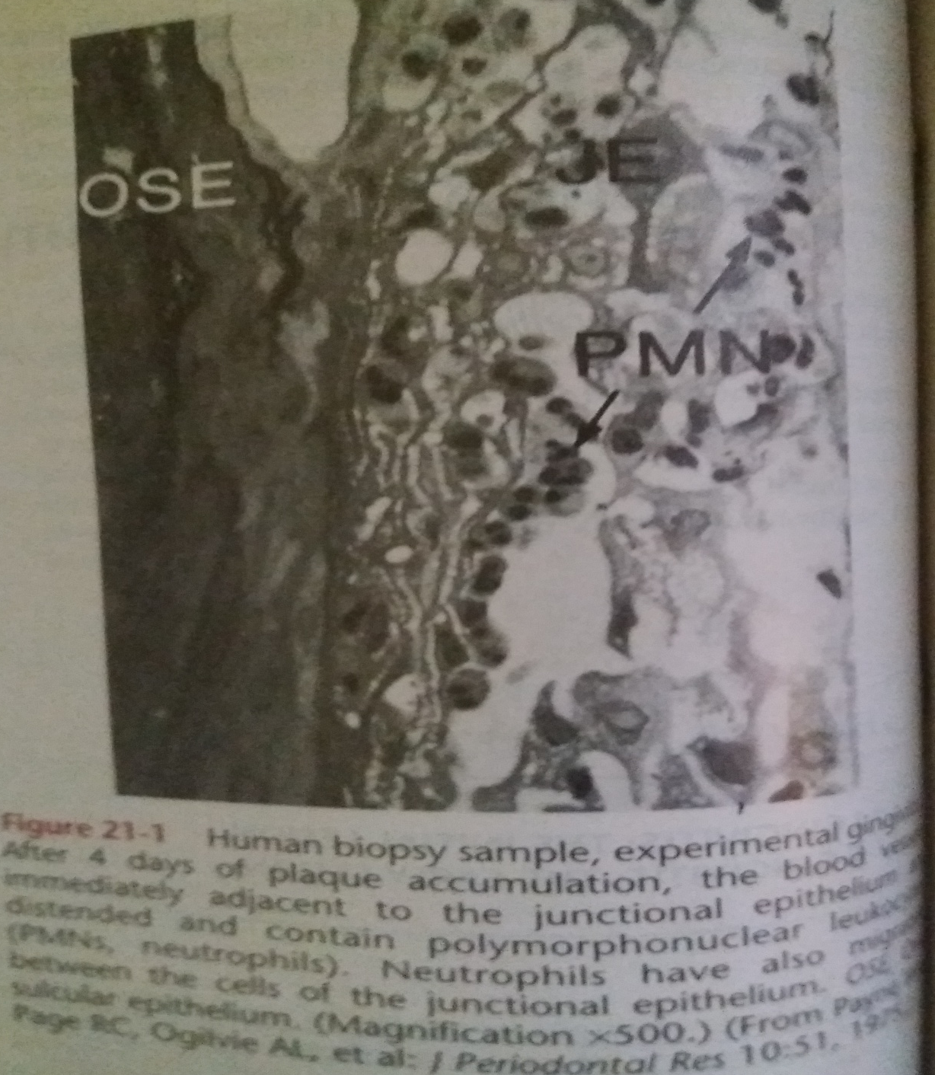

Slide 12
2. The Early Lesion:
The early lesion evolves from the initial lesion within 1 week after the beginning of plaque accumulation.
Early lesion may appear as early gingivitis and it overlaps with and evolves from initial lesion with no clear–cut dividing lines.
All the changes seen in initial lesion continue to intensify with early lesion.
Clinically, signs of erythema may appear- mainly because of proliferation of capillaries and increased formation of capillary loops between rete pegs or ridges.

Slide 13
The changes occuring are:
Bleeding on probing may be evident.
In case of blood vessels: there is vascular proliferation.
In case of junctional and sulcular epithelium: there is leukocyte infiltration mainly of lymphocytes.
The predominant immune cell is lymphocyte.
The collagen is destroyed around cellular infiltration and the main fiber groups affected appear to be the circular and dentogingival fibers.
Fibroblasts show cytotoxic alterations with decreased capacity for collagen production.

Slide 14
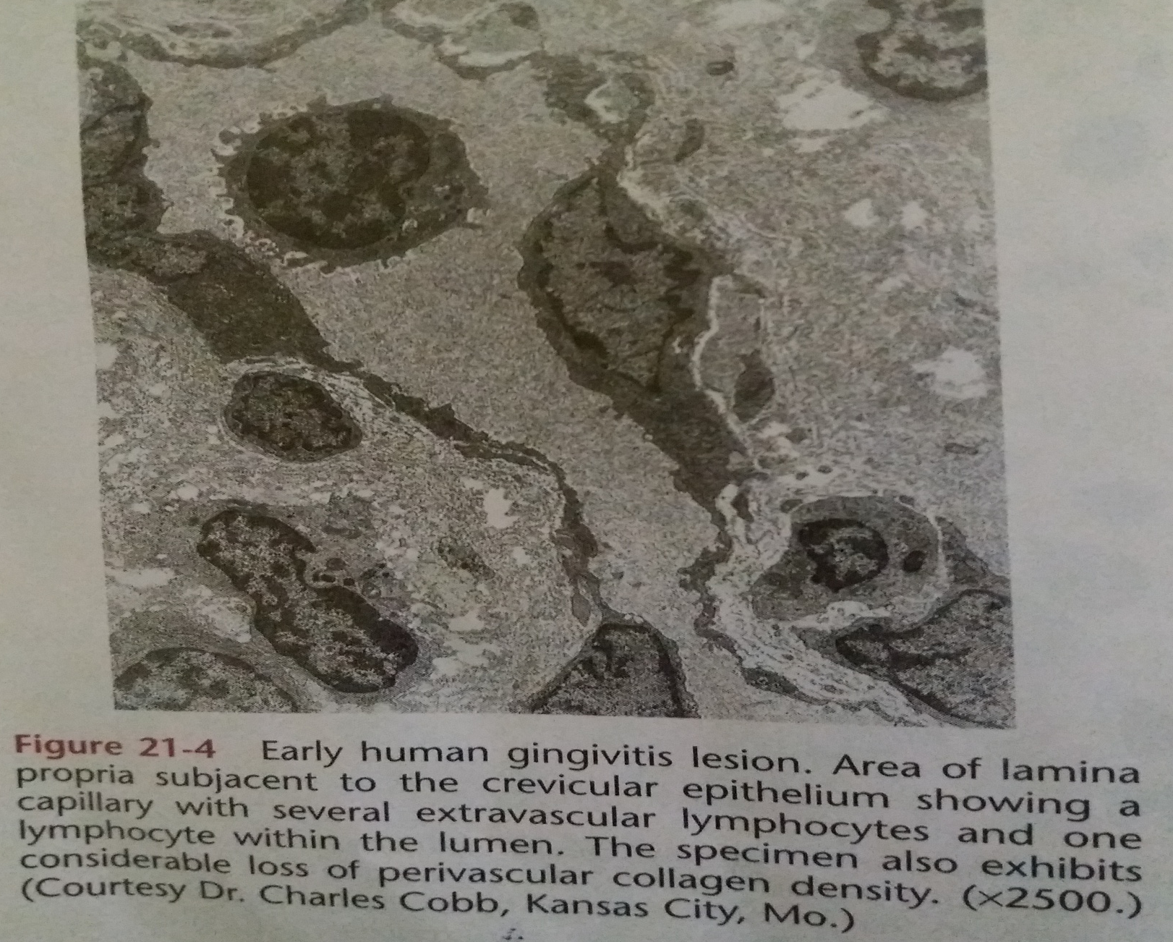

Slide 15
3. The Established Lesion:
The ‘established lesion’ is characterized by predominance of plasma cells and B lymphocytes and there is creation of gingival pocket lined with pocket epithelium.
The B cells are predominantly of the immunoglobulin G1and G3 subclasses.
Occurs 2to3 weeks after the beginning of plaque accumulation.
The established lesion can be described as moderately to severely inflamed gingiva.
The key feature that differentiates the established lesion is increased number of plasma cells, which become inflammatory cell type.

Slide 16
The changes occuring are:
In case of blood vessels- blood vessels become congested, venous return is impaired, and the blood flow become sluggish.
The result is localized gingival ‘anoxemia,’ which superimpose somewhat bluish hue on the reddened gingiva.
In case of junctional epithelium, it reveals widened intercellular spaces filled with granular, cellular debris, including lysosomes derived from disrupted neutrophils, lymphocytes, and monocytes.
The junctional epithelium develops rete ridges that protrude into connective tissue and destroys the basal lamina in some areas.

Slide 17
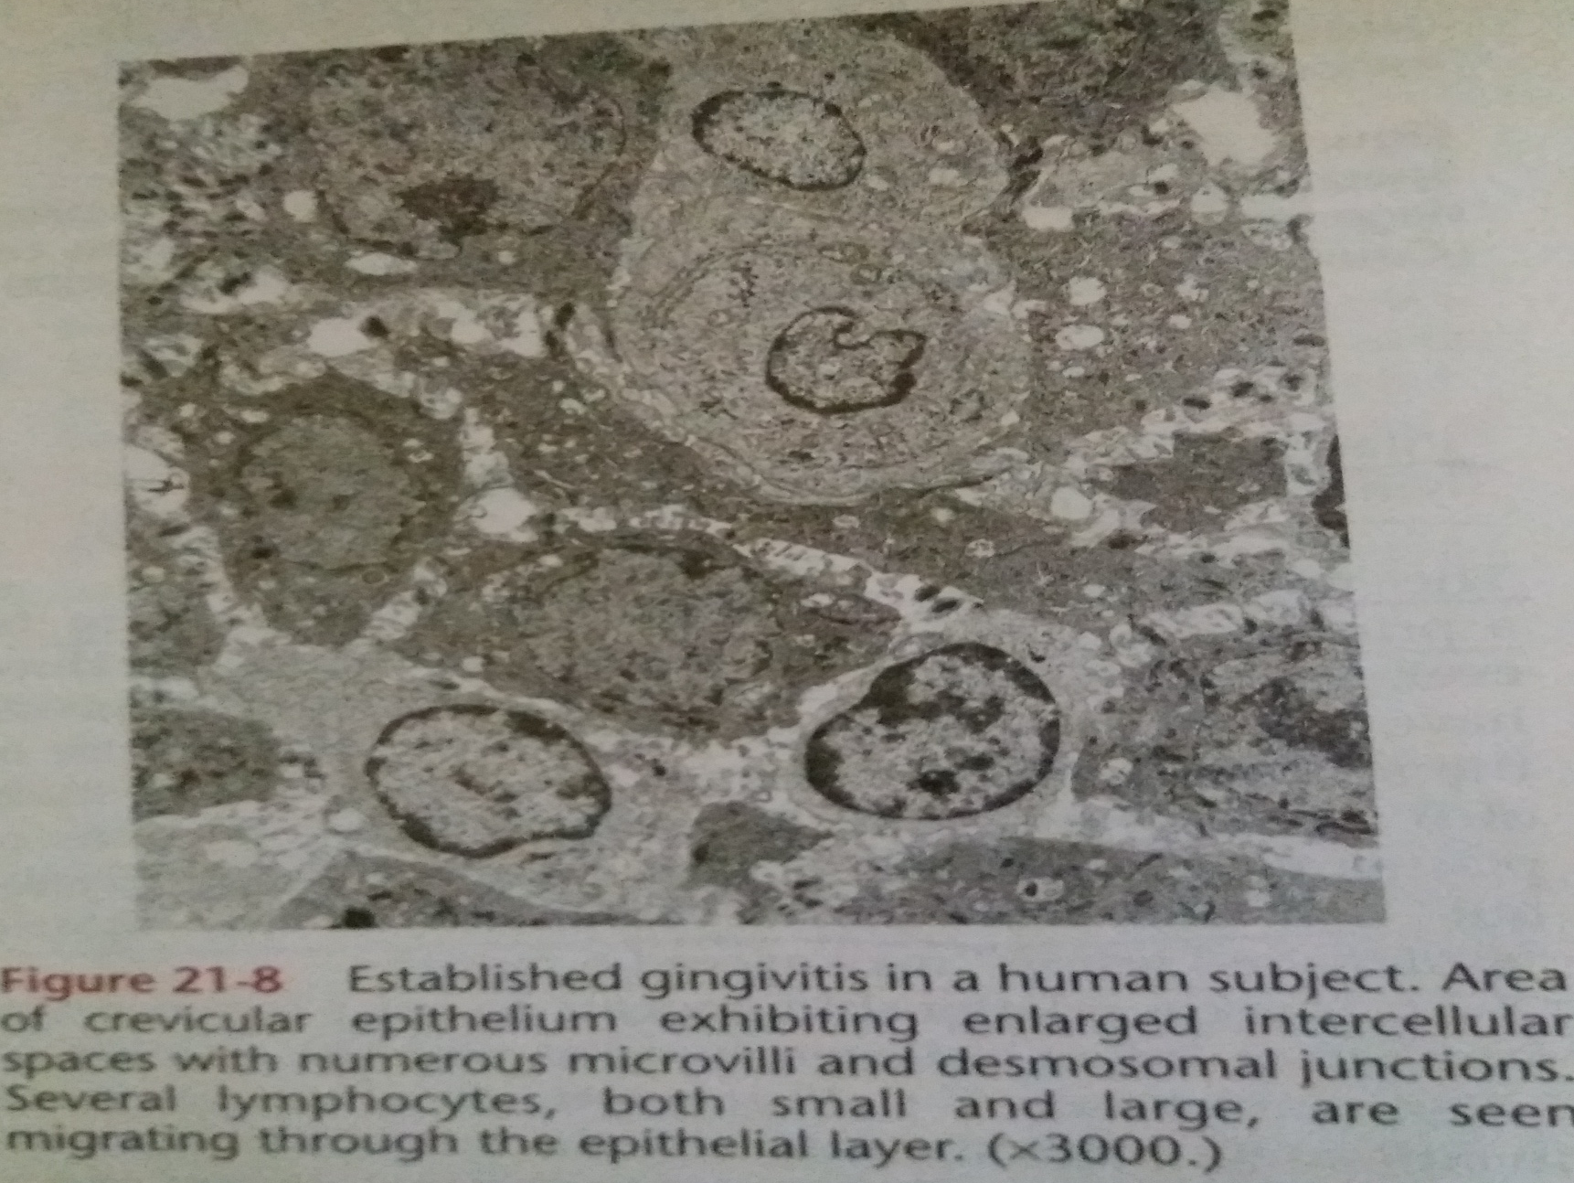

Slide 18
In case of connective tissue- collagen fibers are destroyed around the infiltrate of intact and disrupted plasma cells, neutrophils, monocytes and mast cells.
The time for development of classic ‘established lesion’ may exceed 6 months.
Established lesion is of two types- 1. some remain stable and do not progress for months or years and others, 2. seem to become more active and to convert to progressively destructive lesions.
There is change in color, size and texture of gingiva.

Slide 19
4. The Advanced Lesion:
The extension of lesion in alveolar bone is characterized by fourth stage known as ‘advanced lesion’ .
There is continued loss of collagen fibers.
Formation of periodontal pocket is seen.
There is fibrosis of gingiva .
In general, plasma cells continue to dominate in connective tissues and neutrophils continue to dominate the junctional epithelium and gingival crevice.
Gingivitis will progress to periodontitis only in individuals who are susceptible.

Slide 20
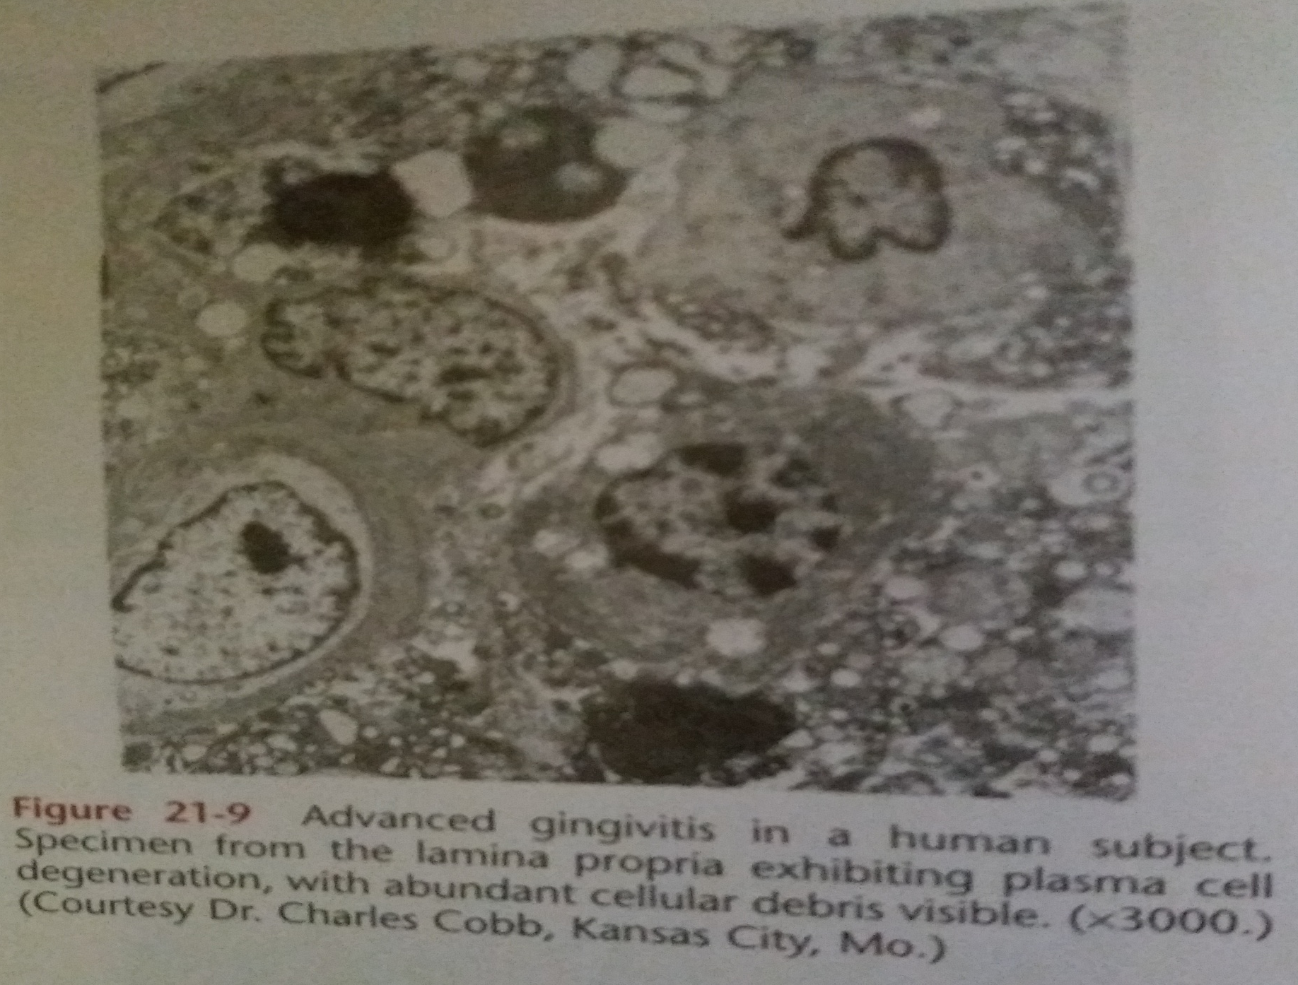

Slide 21
THANK YOU

