Slide 1
Good morning
.

Slide 2
INFLUENCE OF SYSTEMIC CONDITION ON THE PERIODONTIUM

Slide 3
Learning objectives
Systemic conditions impacting periodontitis
Endocrine disorders and hormonal changes
Hematologic disorders and immune deficiencies
Genetic disorders
Stress and psychosomatic disorders
Nutritional influences
Medications

Slide 4
Introduction
Periodontitis is a chronic bacterial infection of the supporting structures of the teeth
Host response varies between the individuals and an altered deficient response to bacterial pathogens may lead to more severe forms of disease
Systemic disorders and conditions alter host tissues and physiology , which may impair hosts barrier function and immune defense against periodontal pathogens creating opportunities for destructive periodontal disease

Slide 5
It is important to recognize that these disorders and conditions themselves do not cause periodontities ,but they may predispose, accelerate or increase its progression.

Slide 6
Various systemic factors that play role in etiology of periodontal disease are as follows :
Endocrine disorders
Hormonal changes
Hematologic disorders
Immune deficiencies
Genetic disorders
Stress and psychosomatic disorders
Nutritional influences
Medications
Other systemic conditions

Slide 7
ENDOCRINE DISORDERS AND HORMONAL CHANGES
Endocrine disturbances and hormone fluctuations affect the periodontal tissues directly , modifiy the tissue response to local factors , and produce anatomic changes in the gingiva that may favor plaque accumulation and disease progression.

Slide 8
DIABETES MELLITUS
It is a complex metabolic disorder characterized by chronic hyperglycemia
It is chronic disease caused by inherited and or acquired deficiency in production of insulin by the pancrease ,or by the ineffectiveness of the insulin produced .
Such a deficiency results in increased concentrations of glucose in the blood , which in turn damage many of the body’s systems , in particular the blood vessels and nerves.

Slide 9
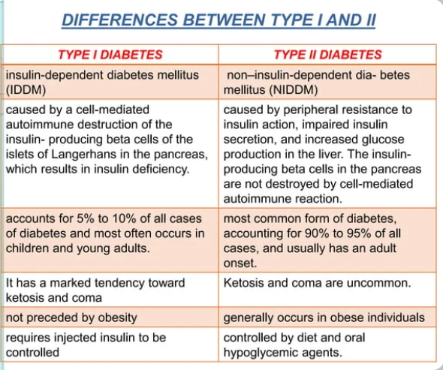

Slide 10
Oral manifestations
ORAL CHANGES IN PATIENTS WITH DIABETES :
Cheilosis
Mucosal drying and cracking
Diminished salivary flow
Alterations in the flora of oral cavity
Increased rate of dental caries

Slide 11
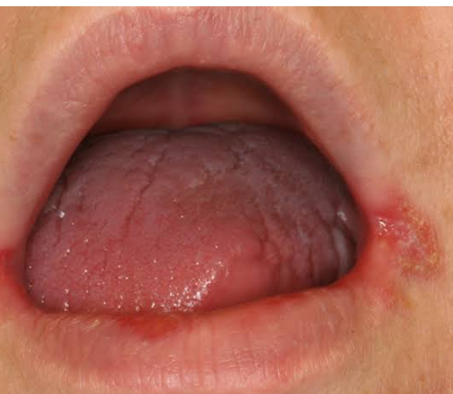

Slide 12
PERIODONTAL CHANGES IN PATIENTS WITH DIABETES
Enlarged gingiva
Sessile or pedunculated gingival polyps
Polypoid gingival proliferations
Abscess formation
Periodontitis and loosened teeth

Slide 13
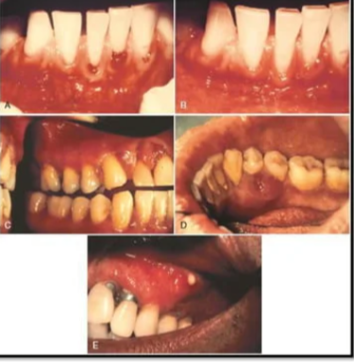

Slide 14
BACTERIAL PATHOGENS
The increased glucose in the gingival fluid and blood of diabetic patients could change the enviroment of the microflora ,inducing qualitative chages in bacteria that could contribute to the severity of periodontal disease observed in those with poorly controlled diabetes.
Patients with type 1 diabetes mellitus and periodontitis have beenreported to have a subgingival flora composed mainly of capnocytophaga , anaerobic vibrios and actinomyces species

Slide 15
Porphyromonas gingivalis ,prevotella and aggregatibacter actinomycetemcomitans which are common in periodontal lesions of individuals without diabetes are present in low number in those with the disease.
Other studies , however found scarce capnocytophaga and abundant A. actinomycetemcomitans and black pigmented bacteroides as well as P. intermedia ,p. melaninogenica and campylobacter .
Black pigmented species especially p.gingivalis ,p.intermedia and c. rectus are prominent in severe periodontal lesions of pima indians with type 2 diabetes

Slide 16
EFFECT ON HOST RESPONS
POLYMORPHONUCLEAR LEUKOCYTE FUNCTION:
The increased susceptibility of diabetic patients to infection has been hypothesized as being caused by polymorphonuclear leukocyte deficiencies resulting in:
Impaired chemotaxis
Defective phagocytosis
Impaired adherance
In patient with poorly controlled diabetes the function of PMNs monocytes and macrophages are impaired.

Slide 17
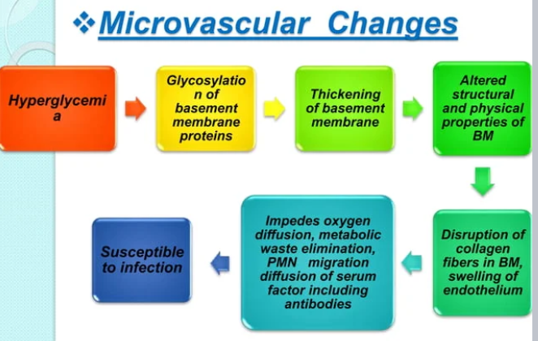

Slide 18
ALTERED COLLAGEN METABOLISM
Chronic hyperglycemia adversely affects the synthesis maturation, and maintenance of collagen and extracellular matrix
In the hyperglycemic state , numerous proteins and matrix molecules undergo a nonenzymatic glycosylation resulting in
AGEs [advanced glycation end product]

Slide 19
Collagen is cross linked by AGE molecules
Making it less soluble and less likely to be normally repaired or replaced
Cellular migrtion through cross linked collagen is impeded ,and tissue integrity is impaired as a result of damaged collagen remaining in the tissues for longer periods

Slide 20
As a result ,collagen in the tissues of patients with poorly controlled diabetes is older and more susceptible to pathogenic breakdown [i.e less resistant to destruction by periodontal infections]

Slide 21
FEMALE SEX HORMONES
Gingival alterations during puberty ,pregnancy and menopause are associated with physiologic hormonal changes in the female patient.
During puberty and pregnancy these changes are characterized by nonspecific infammatory reactions with a predominant vascular component, which leads clinically to a marked hemorrhagic tendency.
Oral changes during menopause may include thinning of the oral mucosa ,gingival recession xerostomia ,altered taste ,and burning mouth

Slide 22
puberty
Occurs between the average ages of 11 to 14 in most women
The production of sex hormones increases then remains relatively constant during the remainder of the reproductive phase .
Also, the prevalence of gingivitis increases ,without an increase in the amount of plaque

Slide 23
Clinical features
During puberty periodontal tissues may have an exaggerated response to local factors .
A hyperplastic reaction of gingiva may occur in areas where food debris ,materia alba ,plaque , and calculus are deposited .
The inflammed tissue become erythematous ,lobulated ,and retractable

Slide 24
Bleeding my occur easily with mechanical debridement of the gingival tissues .

Slide 25
Menses
During menses ,progesteron increases from the second week , peeks at approximately 10 days , and dramatically drops before menstruation
Prevalence of gingivitis increases.
Gingival tissues have been reported to be more edematous during menses and erythematous before the onset of menses in some women

Slide 26
Complains of bleeding gums .
bloated or tense feelingin the gums preceding menstrual flow .
Increased exudation from inflamed gingiva suggesting that pre-existing gingivitis in aggravated but GCF of normal gingiva not affected .

Slide 27
Pregnancy
Pregnant women ,near or at term ,produce large quantities of estradiol ,estriol and progesterone .
Gingival inflammation initiated by plaque ,and exacerbated by these hormonal changes in the second and third trimester of pregnancy ,is referred to as pregnancy gingivitis .

Slide 28
Periodontal manifestations
Pregnancy itself does not cause gingivitis .
Gingivitis in pregnancy is caused by bacterial plaque ,just as it in non pregnant women .
Pronounced ease of bleeding is most striking clinical feature .
Gingiva is inflamed and varies in color from a bright red to bluish red .

Slide 29
Marginal and interdental gingiva are edematous ,pit on pressure ,appear smooth shiny ,are soft and pliable and sometimes present a rasberry lip appearance .
Extreame redness result from marked vascularity ,and there is an increased tendency to bleed .
Gingival changes are usually painless unless complicated by acute infection

Slide 30
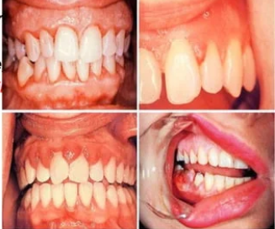

Slide 31
HEMATOLOGIC DISORDERS AND IMMUNE DEFICIENCIES
WBCs : involved in the inflammatory reactions.
RBCs : responsible for gas exchange and nutrient supply to the periodontal tissues .
Platelets : normal haemostatic as well as recruitment of cells during inflammation and wound healing .
Disorders of any blood cells or blood forming organs have profound effect on periodontium .

Slide 32
LEUKOCYTE [NEUTROPHIL] DISORDERS
NEUTROPENIA :
Neutropenia is a blood disorder that results in low levels of circulating neutrophils .
Serious condition caused by diseases ,medications ,chemical ,infections, idiopathic conditions or hereditary disorders .
May be chronic or cyclic ,severe or benign .
Mild neutropenia : ANC of 1000-1500 cells/micro.lit
Moderate : ANC of 500 -1000 cells /micro. Lit
Severe : ANC less than 500 cells /micro.lit

Slide 33
AGRANULOCYTOSIS
It is characterized by a reduction in the number of circulating granulocytes and results in severe infections, including ulcerative necrotizing lesions of the oral mucosa ,skin and gastrointestinal and genitourinary tracts .
Less severe form of the disease are called neutropenia or granulocytopenia .
Drug idiosyncrasy is the most common cause of agranulocytosis ,but in some cases,its cause cannot be explained

Slide 34
The onset of disease is accompanied by fever ,malaise, general weekness, and sore throat.
Ulceration in the oral cavity, oropharynx,and throat is characteristic.
The mucosa exhibits isolated necrotic patches that are black and grey and are sharply demarcated from adjacent uninvolved areas .
The absence of a notable inflammatory reaction caused by lack of granulocytes is a striking feature.

Slide 35
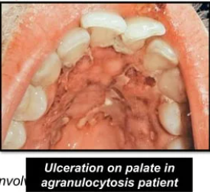

Slide 36
LEUKAEMIA
The leukemias are malignant neoplasias of WBC precursors , characterized by :
1] diffuse replacement of the bone marrow with proliferating leukemic cells .
2]abnormal numbers and forms of immature WBCs in the circulating blood
3] widespread infiltrates in the liver ,spleen, lymph nodes,and sites throughout the body.

Slide 37
CLASSIFICATION
According to the type of WBC involved
1. lymphocytic
2 .Myelocytic or myelogenous
According to their evolution
1 . Acute
2. Subacute
3 . Chronic

Slide 38
All leukemias tend to displace normal components of bone marrow elements with leukemic cells
Resulting in reduced production of
WBCs
RBCs
Platelets
Results in poorer tissue oxygenation making tissues more friable and susceptible to breakdown
Leads to an increased susceptibility to infections
Leads to bleeding tendency which can occur in any tissue

Slide 39
Periodontium in leukemic patients
Oral and periodontal manifestations of leukemia consist of :
Leukemic infiltration
Oral ulcerations and infections
Bleeding
Gingival enargement

Slide 40
Leukemic infiltration
Leukemic cells can infiltrate the gingiva and , less frequently ,the alveolar bone .
Gingival infiltration often results in leukaemic gingival enlargement .
It may be to the interdental papillae area or it may expand to include the marginal gingiva and partially cover the crowns of the teeth .

Slide 41
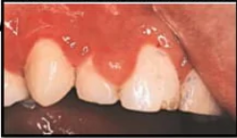
Leukemic infiltration causing localized gingival swelling of the interdental papillae between the maxillary central incisor and lateral incisor

Slide 42
Leukemic cells can infiltrate the gingiva and less frequently the alveolar bone .
Gingival infiltration often results in leukemic gingival enlargement.
The abnormal accumulation of leukaemic cells in dermal and subcutaneous CT is called leukaemia cutis and forms elevated and flat macules and papules .

Slide 43
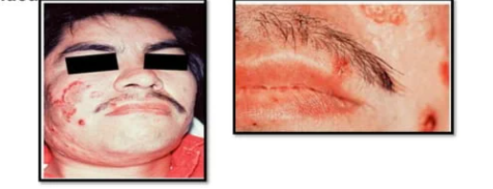

Slide 44
Gingiva appears initially bluish red and cyanotic with a rounding and tensesness of the gingival margin ; then it increases in size most often in the interdental papilla and partially covering the crowns of the teeth .

Slide 45
Genetic disorders
Many systemic conditions associated with or predisposing to periodontal destruction include genetic disorders that result in an inadequate number or function of circulating neutrophils.
Severe periodontitis has been observed in individuals with primary neutrophil disorders such as neutropenia, agranulocytosis , chediak-higashi syndrome and lazy leukocyte syndrome.

Slide 46
In addition , severe periodntitis has also been observed inindividuals who exhibit secondary neutrophil impairment as seen in down syndrome ,and inflammatory bowel disease .

Slide 47
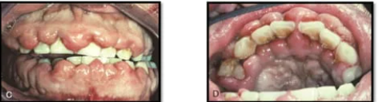

Slide 48
Stress and psychosomatic disorders
Stress and psychosomatic disorders most likely impact the periodontal health through changes in the individual’s behaviour and through complex interactions among the nervous ,endocrine and immune systems
Individuals under stress may have poorer oral hygiene , may start or increase clenching and grinding of their teeth and may smoke frequently

Slide 49
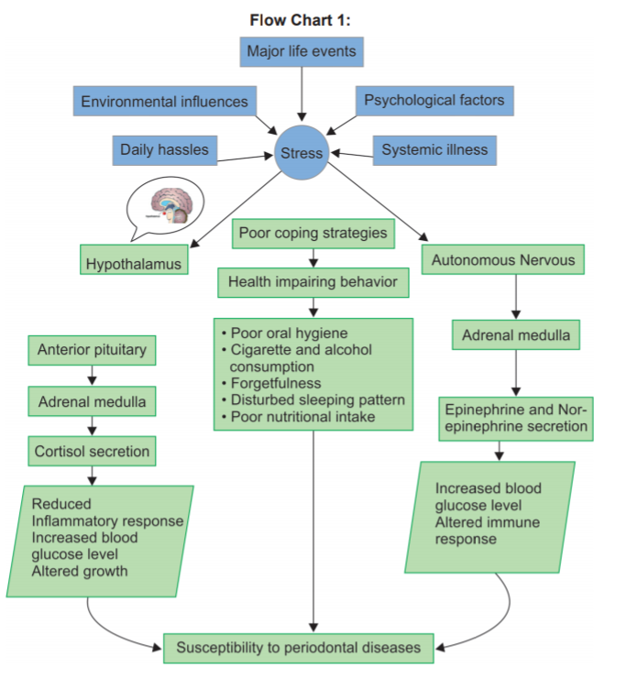

Slide 50
Nutrition and periodontal disease
There are no nutritional deficiencies that by themselves can cause gingivitis or periodontitis however ,nutritional deficiencies can affect the condition of the periodontium and therby may accentuate the deleterious effect of plaque –induced inflammation in susceptible individuals .
There are nutritional deficiencies that produce changes in the oral cavity .these changes include alteration of the tissues of the lips ,oral mucosa ,gingiva and bone

Slide 51
medications
BISPHOSPHONATES
Bisphosphonate medications are primarily used to treat cancer and osteoporosis .
They act by inhibiting osteoclastic activity which leads to less bone resorbtion ,less bone remodelling and less bone turnover .
The use of bisphosphonates in cancer treatment is aimed at preventing the often lethal imbalance of oesteoclastic activity .

Slide 52
In the treatment of osteoporosis,the goal is simply to harness osteoclastic activity to minimize or prevent bone loss and in many cases , to increase bone mass by creating an advantage for osteoblastic activity .
The major difference in the use of bisphosphonates for cancer versus osteoporosis are the route of administration of specific bisphosphonate medications used .

Slide 53
corticosteroids
In humans, the systemic administration of cortisone and adrenocorticotropic hormone appears to have no effect on the incidence or severity of gingival and peridontal disease .

Slide 54
THANK YOU

