Slide 1
GINGIVA

Slide 2
OUTCOME OF LECTURE
STUDENTS WILL COME TO KNOW MACROSCOPIC AND MICROSCOPIC STRUCTURE OF GINGIVA
GINGIVAL FIBRES AND ITS FUNCTION
VASCULAR SUPPLY OF GINGIVA
CLINICAL FEATURES OF GINGIVA

Slide 3
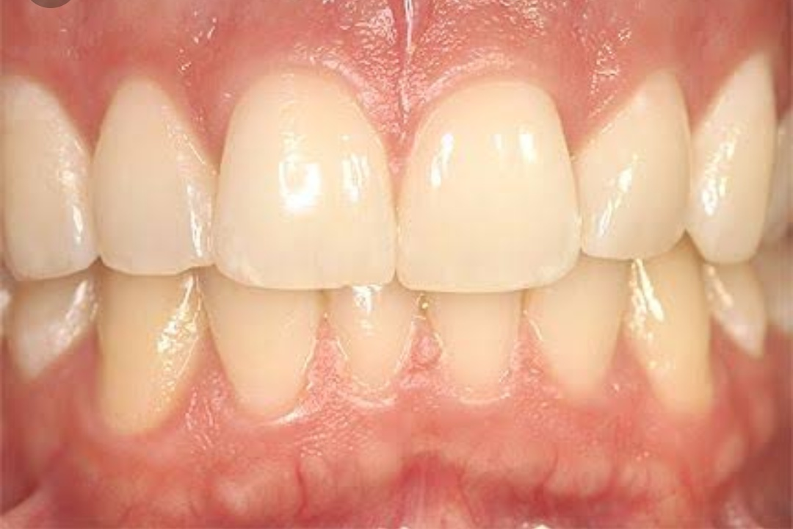
Def:
The gingiva is the part of the oral mucosa that covers the alveolar processes of the jaws & surrounds the neck of teeth.

Slide 4
Clinical Features:
-Normal gingiva covers the alveolar bone & tooth root to a level just coronal to a CEJ.
-Normal colour : Coral Pink
-Consistency; Firm & Resilient
-Surface Texture: Stipling present
-Contour: Scalloped
-Position: It is the position at which the gingival margin is attached to the tooth.
-

Slide 5
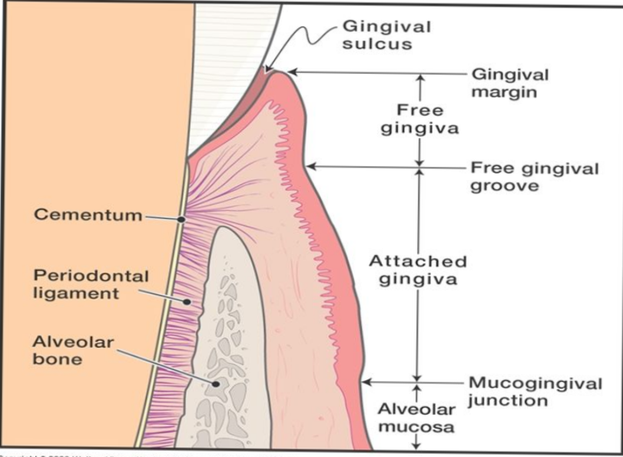
Structure of gingiva
*MACROSCOPIC FEATURES
Marginal Gingiva
Attached Gingiva
Interdental Gingiva

Slide 6
MARGINAL GINGIVA:
-also called as UNATTACHED GINGIVA.
- It is the terminal edge or border of gingiva surrounding the teeth in collar like fashion .
GINGIVAL SULCUS:
It is the shallow crevice or space around the tooth bounded by the surface of tooth on one side & epithelium lining the free margin of the gingiva on other side
It is V-shape.
-IT permits entrance of periodontal probe.

Slide 7
ATTACHED GINGIVA
- IT is firm & resilient & tightly bound to the underlying periosteum of alveolar bone
WIDTH OF ATTACHED GINGIVA:
It is distance between the mucogingival junction & the projection on the external surface of the bottom of gingival sulcus.
- It is greater in incisor region and narrower in posterior segment

Slide 8
WAG = Total distance between the crest of margin to MGJ – depth of sulcus/pocket

Slide 9
INTERDENTAL GINGIVA
-It occupies the gingival embrasure which is the interproximal space beneath the area of tooth contact.
-It can be pyramidal or col shaped

Slide 10
MICROSCOPIC FEATURES
Epithelium
Oral Epithelium
Sulcular Epithelium
Junctional Epithelium
Basal Lamina
Epithelium-Connective tissue Interface
Connective Tissue
Cells
Fibres
Neurovascular Bundles

Slide 11
Cells-
1-Mast cells
2-Fibroblast
3-Eosinophils
4-Macrophages
5-Adipose cells
6-Infammatory cells.
Fibers-
1-Collagen fibers
2-Reticulin Fibers
3-Elastic fibers.
Neurovascular bundles-
1-Nerves
2-Vessels
3-Lymphatics.

Slide 12
The principal cell type of gingival epithelium is KERATINOCYTE.
Function: Protect deep Stuctures
Act as mechanical, chemical , water, microbial barrier.
Other Cell Types
Langerhans Cells
Melanocytes
Merkel Cells

Slide 13
ORAL EPITHELIUM:
-Oral or outer epithelium covers the crest & outer surface of the marginal gingiva & attached gingiva.
-Thickness: 0.2-0.3 mm
-It is para-keratinized.
-Composed of 4 layers;
Stratum Basale
Stratum Spinosum
Stratum Granulosum
Stratum Corneum

Slide 14
SULCULAR EPITHELIUM
It lines the gingival sulcus.
It it thin, non keratinized stratified squamous epithelium without rete pegs
Extends from the coronal limit of the JE to the Crest of gingival margin
JUNCTIONAL EPITHELIUM
-It consists of collar like band of Stratified squamous non keratinized epithelium.
3-4 layer thick- early life & increases with age upto 20 layers.
Length of JE- 0.25- 1.35 mm

Slide 15
Completion of Enamel Formation
Formation of shorter ameloblast
Formation of thin membrane
Formation of primary cutical on enamel surface
Formation of REE on enamel

Slide 16
Extension of REE till CEJ
As the tooth emerges
Fusion of REE with Oral epithelium
Transfer of former ameloblast into JE
Formation of JE.

Slide 17
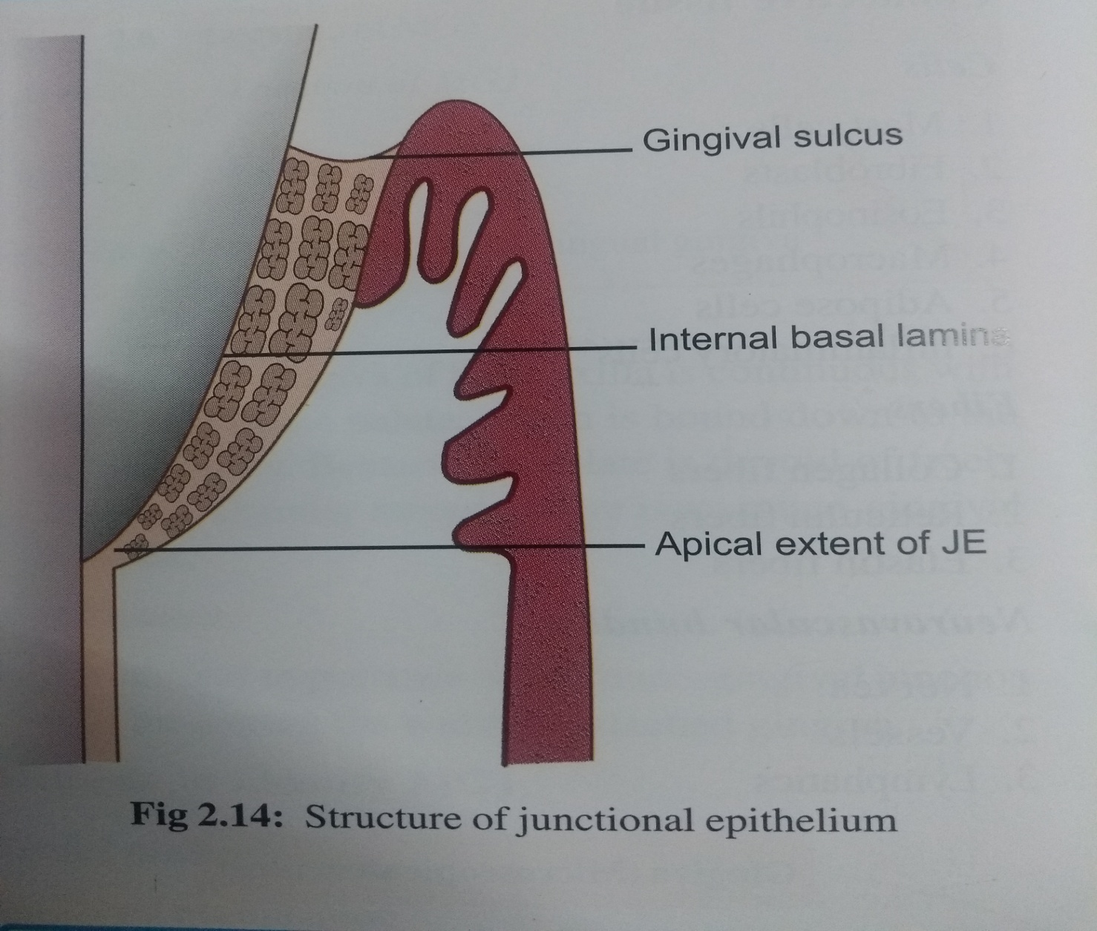

Slide 18
Gingival Connective Tissue:-
1-Major component-
A-collagen Fibers {60% by volume}
B-Fibroblast{5%}
C-Vessles Nerves and Matrix{35%}
2-also known as Lamina Propria.
3-consists of two layer-
A-Papillary layer
B-Reticular Layer.
4-Ground substance fills the space between fibers and cells and has high content of water.
5-Composed of proteoglycans,mainly hyaluronic acid and chondroitin sulfate and glycoprotins, mainly fibronectin

Slide 19
6-3 types of connective tissue fibers are-A-Collagen
B-Reticular
C-Elastic.
Type 1 collagen forms the bulk of lamina propria and provides tensile strength.
Elastic fibre system composed of oxytalan and it is distributed among collagen fibers

Slide 20
GINGIVAL FIBRES
The connective tissue of the marginal gingiva is densely collagenous , containing a prominent system of a collagen fibres bundles, called as gingival fibres.
FUNCTIONS-
To brace the marginal gingiva firmly against the tooth.
Provide rigidity.
Unite the free gingival margin with cementum & attached gingiva

Slide 21
They are arranged in 3 groups:
-Gingivodental group
-Circular group
-Trans-septal group
Gingivodental group-
-Present on facial, lingual & interproximal surface
-Embedded in cementum. just beneath the epithelium at the base of sulcus.
-On facial & lingual surface- they project from cementum in fan like conformation.
-Interproximally- entends upto crest of interdental gingiva.

Slide 22
Circular group:
-they course through the connective tissue of marginal & interdental gingiva
-Encircle the tooth in Ring like fashion.
Trans-septal group:
-Located interproximally.
-Extends between the cementum of approximating teeth

Slide 23
Semicircular Fibres:
-Attach at proximal surface ot tooth below CEJ, go around the facial & lingual marginal gingiva of tooth & attach on the other proximal surface of same tooth.
Trans-gingival Fibres:
-Arranged in and around the teeth within attached gingiva.
Function: Maintain alignment of teeth.

Slide 24
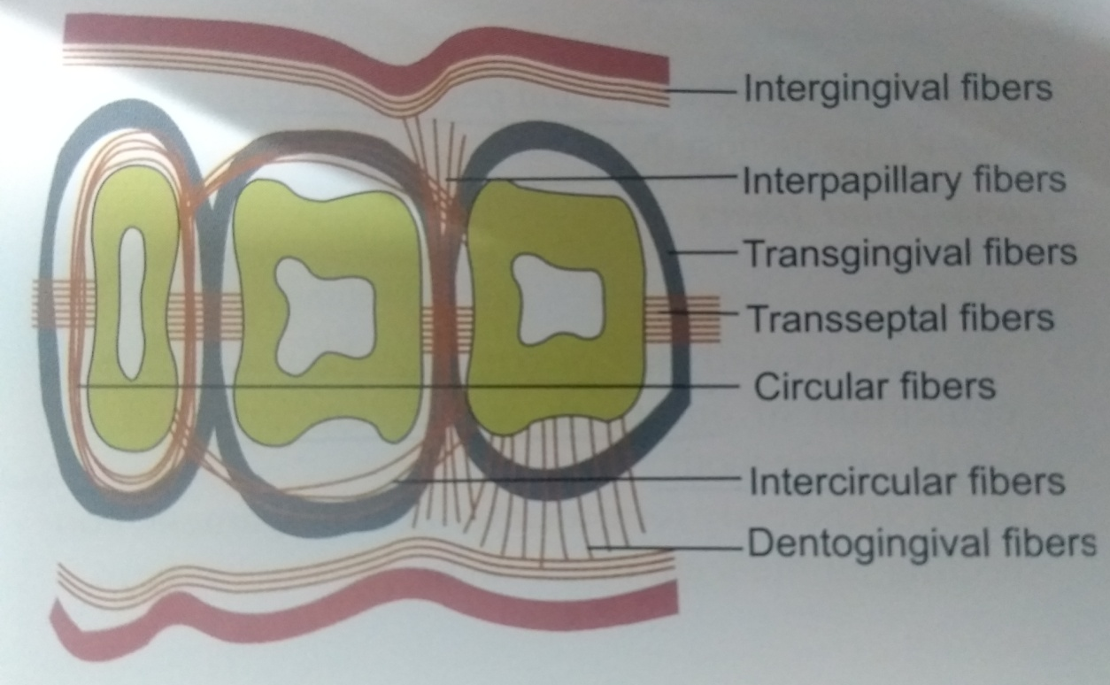
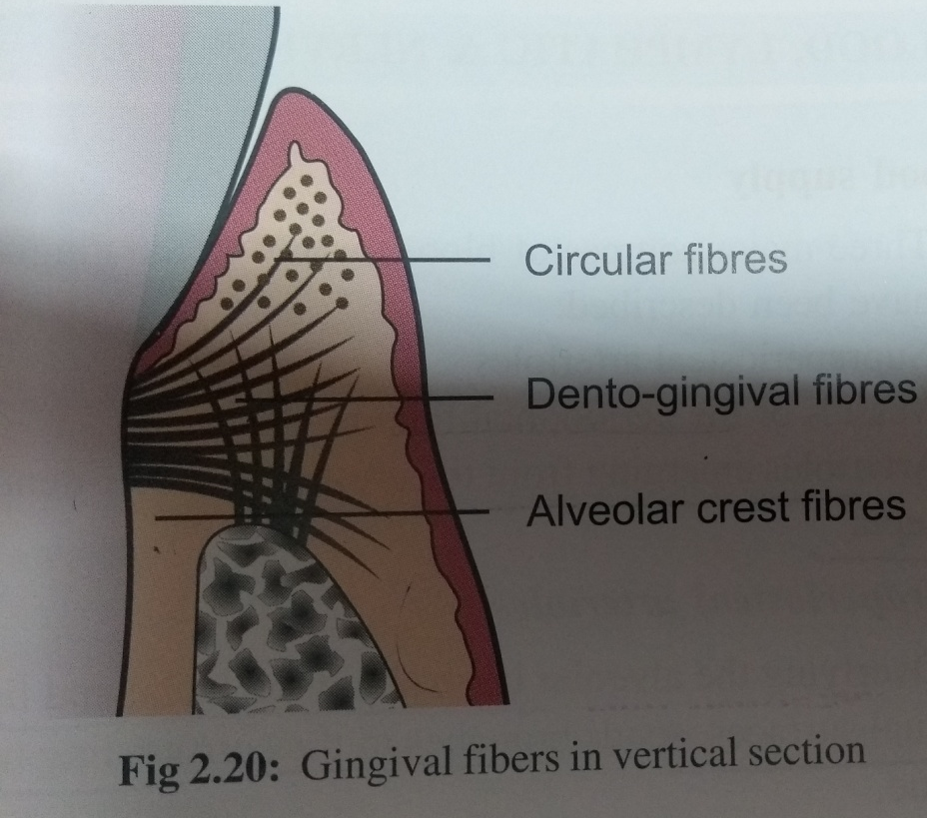

Slide 25
BLOOD SUPPLY
- Supra-periosteal Arterioles
-Vessels of Periodontal ligaments
-Arteriols emerging from the crest of
interdental septa

Slide 26
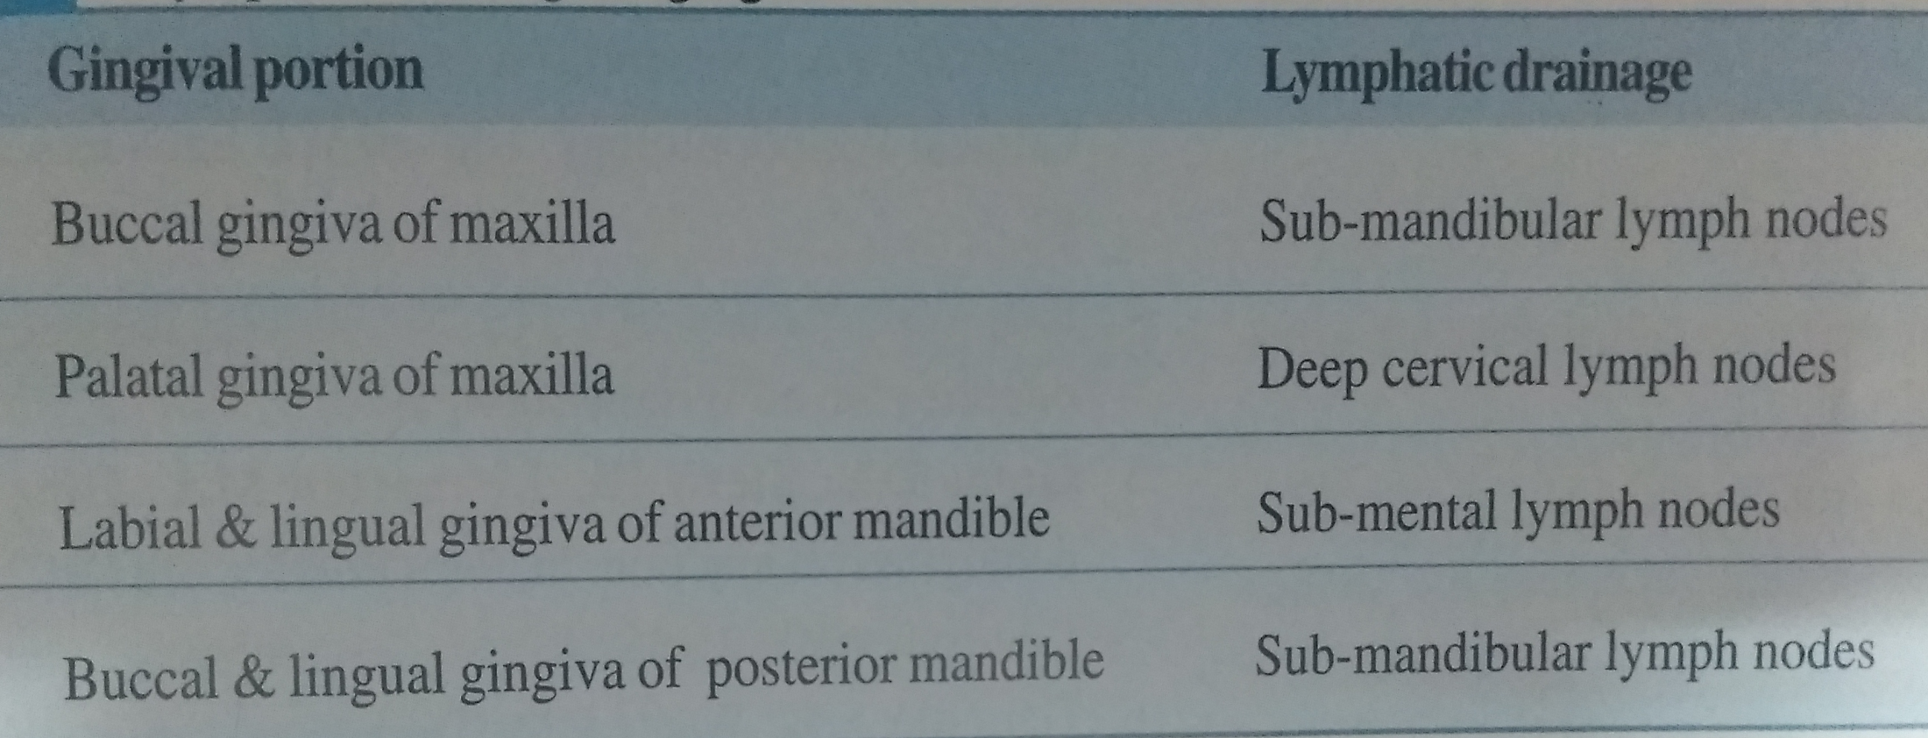
LYMPHATIC DRAINAGE:
- It brings in the lymphatics of connective tissue papilla
-Progresses to periostium of alveolar process& then to Regional lymph node.

Slide 27
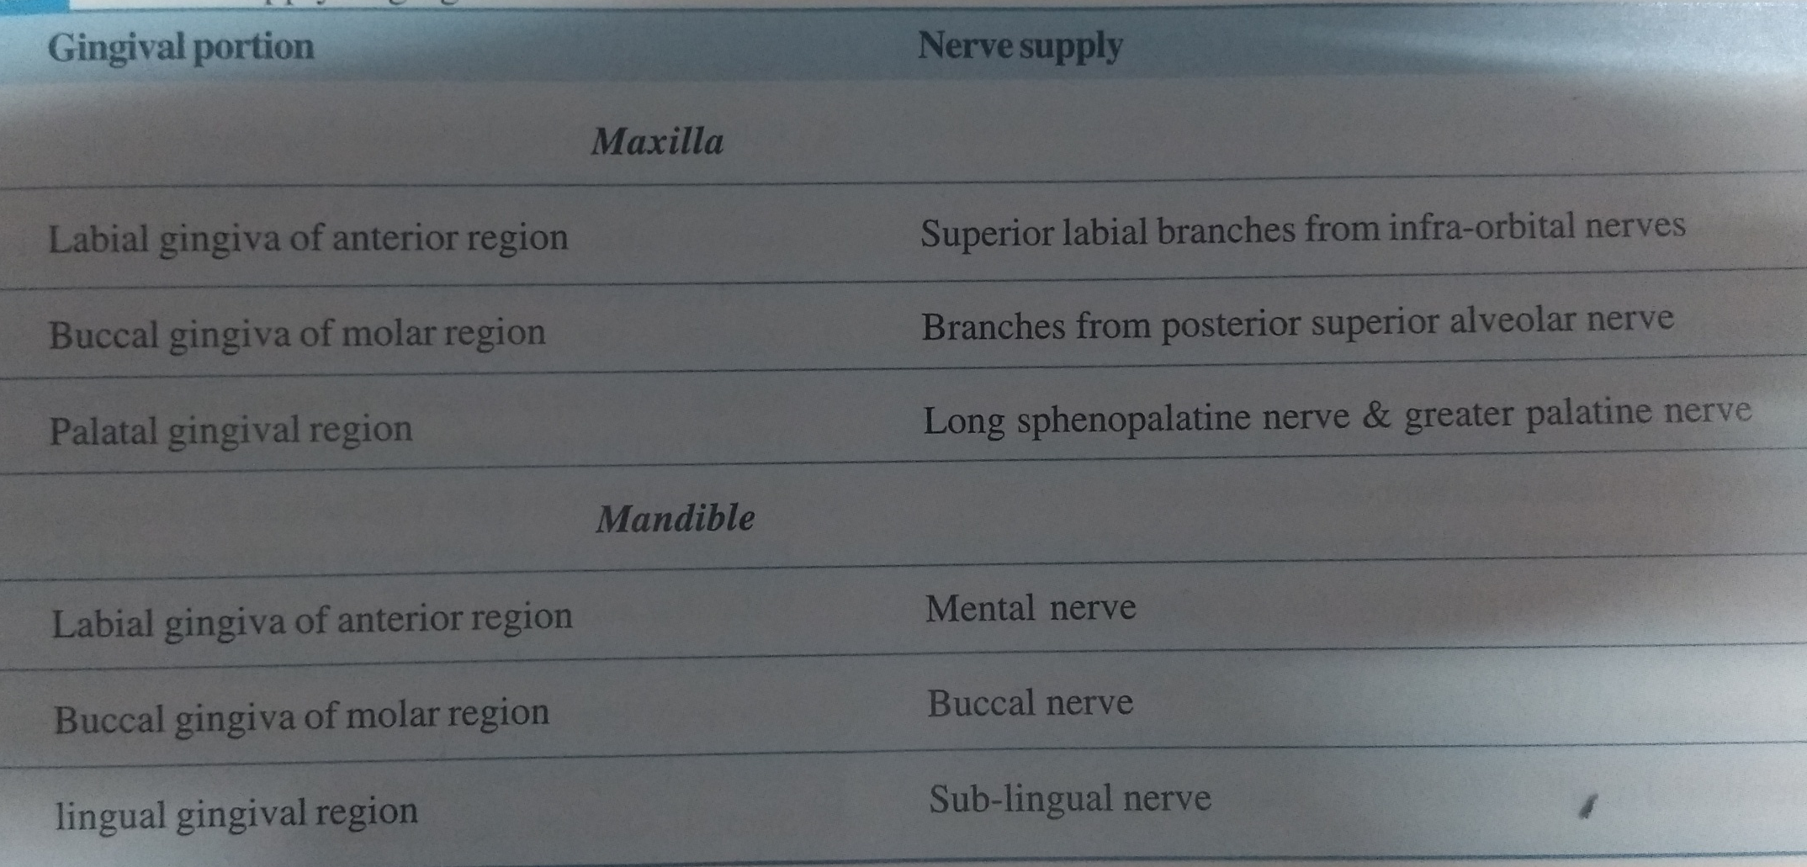
NERVE SUPPLY
-It is derived from fibers arising from nerves in the PDL & from labial, palatal, buccal nerves.

Slide 28
THANK – YOU!

