Slide 1
SPEECH

Slide 2
Purpose Statement
At the end of the lecture the student should be able to describe anatomy of speech, physiology of speech, neural basis of speech, sound production & classification, tooth position and speech and dental clinical considerations.

Slide 3
Learning Objectives
At the end of the lecture the student should be able to
S.N. | Learning Objectives | Domain | Level | Criteria | Condition
1 | Describe the anatomy Of Speech | Cognitive | Must Know | All
2 | Describe the Physiology Of Speech | Cognitive | Must Know | All
3 | Describe the Neural Basis Of Speech | Cognitive | Must Know | All
4 | Explain Sound production & classification | Cognitive | Must Know | All
5 | Explain the Tooth Position And Speech | Cognitive | Must Know | All
6 | Enlist Dental clinical considerations | Cognitive | Must Know | All

Slide 4
CONTENTS
Describe the anatomy Of Speech
Describe the Physiology Of Speech
Describe the Neural Basis Of Speech
Explain Sound production & classification
Explain the Tooth Position And Speech
Enlist Dental clinical considerations

Slide 5
INTRODUCTION
Speech can be defined as a complex psycho - physiologic process for putting thoughts into words and organizing these words into a sequence with grammatical context.
Speech is an adaptation as organs for speech production were evolved for other functions.

Slide 6
Lips, teeth, jaws and tongue are masticatory organs, the lungs, nasal cavity, soft palate and glottal folds are part of the respiratory organs.

Slide 7
ANATOMY / PHYSIOLOGY OF SPEECH PRODUCTION
Most complex sesorimotor developmental process in humans is speech/language acquisition.
Many muscles, nerves and large areas of cerebral hemispheres are involved in speech production indicating the complexity.
various muscles, nerves and the areas in the brain concerned with speech production.

Slide 8
MUSCLES AND NERVES INVOLVED IN SPEECH PRODUCTION
Sounds are produced by blowing air past the vocal cords.
The air produces vibrations in the vocal cords, forming the sounds that come out of the mouth.
The air is pushed out of the lungs by relaxing the diaphragm and contracting muscles of the abdominal wall.

Slide 9
The tonal and pitch variations occur when the vocal cord is made more tense or looser.
Tense cords produce higher pitch, loose cords form lower pitch.
The muscles involved are supplied by the recurrent laryngeal and external laryngeal nerves.

Slide 10
MUSCLES OF LARYNX INVOLVED IN SPEECH PRODUCTION
Larynx consists of muscles that change the opening of the glottis as well as the tenseness of the vocal cord, thereby keeping it open for respiration and helps us vocalize.
The cricothyroid muscle
The lateral cricoarytenoid muscle
Aryepiglottic muscle
Transverse arytenoideus muscle.
Posterior cricoarytenoid muscles
Thyroarytenoideus muscle
Vocalis muscle

Slide 11
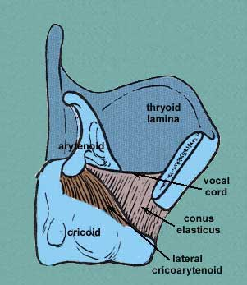
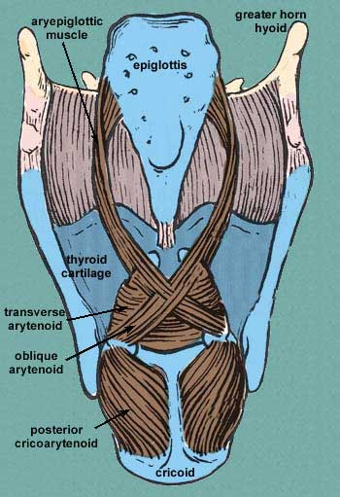

Slide 12
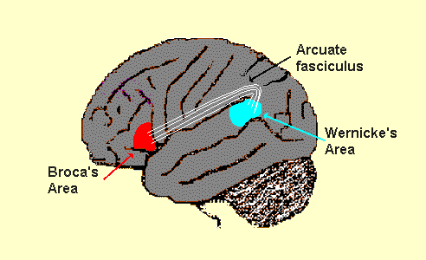
SPEECH AREAS IN THE BRAIN
Small shaded area-broca’s area
Larger shaded area-wernicke’s area

Slide 13
Speech activities are located in the temporoparietal region of dominant cerebral hemisphere (left).
Hence damage to the corresponding area on the other side of the brain leaves language abilities intact.
The unilateral control of certain functions is called cerebral dominance.

Slide 14
Specific cerebral areas in the dominant hemispheres.
BROCA’S AREA is concerned with speech production,
WERNICKE’S AREA ensures spoken language is comprehensible and
INSULA of brain coordinates the activities of speech areas.
Arcuate fasciculus is nerve bundle which connect the Broca’s area to the Wernicke’s area.

Slide 15
SPEECH PRODUCTION
When a word is heard, the output from the primary auditory area of the cortex is received by Wernicke’s area.
If the word is to be spoken, the pattern is transmitted from wernicke’s area to Broca’s area where the articulatory form is to be generated and sent to the motor area that controls the movement of the muscles of speech.

Slide 16
If the spoken word is to be spelled, the auditory pattern is sent to granular cortex, where it elicits the visual pattern
When a word is read, the output from the primary visual areas passes to the angular gyrus, which in turn generates the corresponding auditory form of the word in Wernicke’s area.

Slide 17
Written words
Heard words

Slide 18
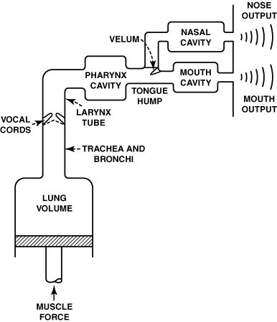
REPRESENTATION OF SPEECH PRODUCTION

Slide 19
PHONATION
It is the production of sound initially in the larynx by coordinated movements of abdominal, thoracic ,and laryngeal muscles.
Once the basic sounds are produced by the vocal tract they are modified to produce intelligible sounds by the processes of articulation and resonance.

Slide 20
VOCAL RESONATORS
The following spaces are present in the vocal apparatus and any or all which may be available as resonating chambers.
Between the true and false vocal cords
Between the larynx and the root of the tongue possibly involving the epiglottis
Between the pharyngeal wall and soft palate and uvula

Slide 21
Between the dorsum of the tongue and posterior aspect of the hard palate
Between the dorsum of the tongue and anterior aspect of the hard palate
Between the tip of the tongue and the teeth
Between the teeth and the lips
Between the nasal passages

Slide 22
CLASSIFICATION OF SOUNDS
Sounds may be classified as
Voiced – vocal folds in larynx vibrate
Breathed - vocal folds don’t vibrate

Slide 23
CLASSIFICATION OF SOUNDS
2 main groups of speech sounds are
Vowels
Produced without obstruction of air flow, air being channeled or restricted by position of tongue & lips
All vowel sounds are voiced
Are created by high amplitude waves

Slide 24
Consonants
Produced when air flow is impeded before release
May be voiced (b,d,z) or breathed (p,t,s)
Are of low amplitude

Slide 25
SPEECH DEFECTS
Aphasia
Stuttering / stammering
Dysarthria
Spasmodic dysphonia
Apraxia of speech

Slide 26
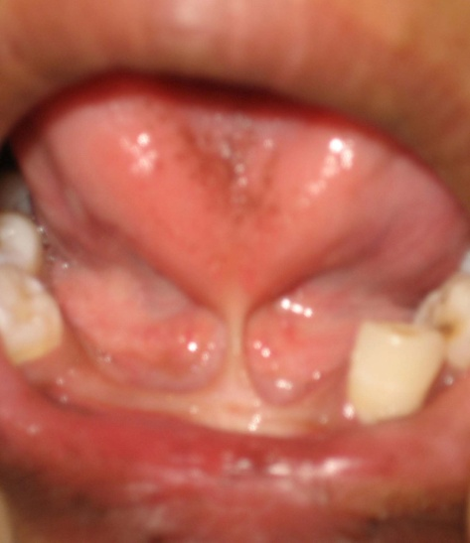
COMMON ANOMALIES AFFECTING SPEECH
Ankyloglossia
Sjogren's syndrome
Fetal alcohol syndrome
Downs syndrome
Velocardofacial syndrome
Di george syndrome
Mandibulofacial dysostosis
Pierre robin syndrome

Slide 27
Summary
Anatomy / Physiology/Neural Basis Of Speech
Sound production & classification
Tooth Position And Speech
Dental clinical considerations
Tools to evaluate speech & defects
Speech defects
Anomalies where speech is affected

Slide 28
BIBLIOGRAPHY
Wheeler’s Dental Anatomy, Physiology and Occlusion Ash, M. M. 6th edition.
Oral Development and Histology Avery, j. K.1st edition.
Color Atlas And Text Book Of Oral Anatomy, Histology Berkovitz, B. 1ST edition.
Orban's Oral Histology and Embryology Bhaskar, s. N.11th edition.
Oral Histology : Development, Structure and Funct Tencate, a. R. 4th edition.
Dental Embryology, Histology & Anatomy. Marry Bath- Balogh Inergaret. 2nd edition.

Slide 29
Thank you

