Slide 1
Dental Caries: Preventive Restorations in Pediatric Dentistry with recent advances

Slide 2
CONTENT
Pit and Fissure Sealants
Preventive Risen Restoration
Resin Modified GIC
Introduction
History of Preventive Dentistry
Scope of Preventive Dentistry
Principles of Preventive Dentistry
Objectives of Preventive Dentistry
Levels of Prevention

Slide 3
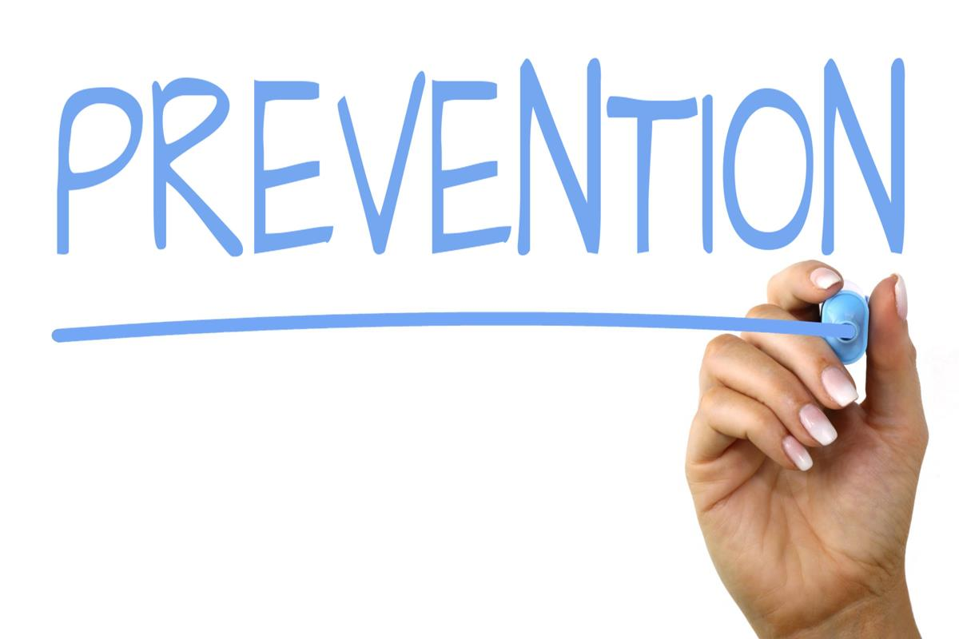
Prevention - Prevention is defined as “actions and interventions taken prior to the onset of disease, which removes the possibility that a disease will ever occur.”

Slide 4
History of Preventive Dentistry
19th century: Majority - satisfied by home care remedies
20th century – Emergence of preventive dentistry - etiologic factors of most oro-dental diseases were identified.
After the emergence of the concept of prevention-
In the first three decades- great emphasis was placed on oral hygiene
In the 4th and 5th decades, the anti-caries effect of fluorides was established, and water fluoridation and topical fluoridation started.
In the 6th and 7th decades – fluoride toothpaste, mouthwashes, rinses, gels and varnishes followed by pit and fissure sealants became popular.

Slide 5
Scope of Preventive Dentistry
Factors predisposing to disease, e.g: dental plaque and other deposits.
Complications of disease and deformity, e.g.: loosening, drifting and malposition of teeth.
Factors interfering with rehabilitation e.g.: defective restoration.
Factors causing disease recurrence, e.g., poor oral hygiene and lack of patient motivation.
Factors encouraging the advance of the disease, e.g.: host resistance and trauma from occlusion.

Slide 6
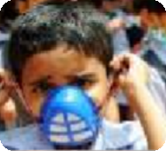

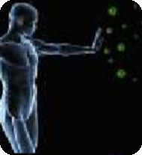
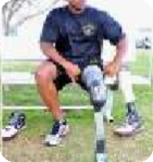
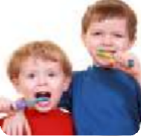
Principles of Preventive Dentistry
Control of disease
Patient education and motivation
Development of host resistance
Restoration of function
Maintenance of oral health

Slide 7
Objectives of Prevention
To avert the initiation of disease process
To intercept their progress
To control their spread
To limit their complications and after effects
To provide rehabilitation

Slide 8
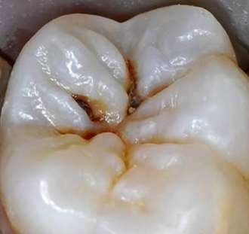
Dental Caries
Ernest Newbrun (1989)- “Dental caries is defined as a pathological process of localized destruction of tooth tissues by microorganisms.”
Shafer (1993) “Dental caries is an irreversible microbial disease of the calcified tissues of the teeth, characterized by demineralization of the inorganic portion and destruction of the organic substance of the tooth, which often leads to cavitation.”

Slide 9
Levels of Prevention
Primordial level of Prevention
Primary level of Prevention
Secondary level of Prevention
Tertiary level of Prevention

Slide 10
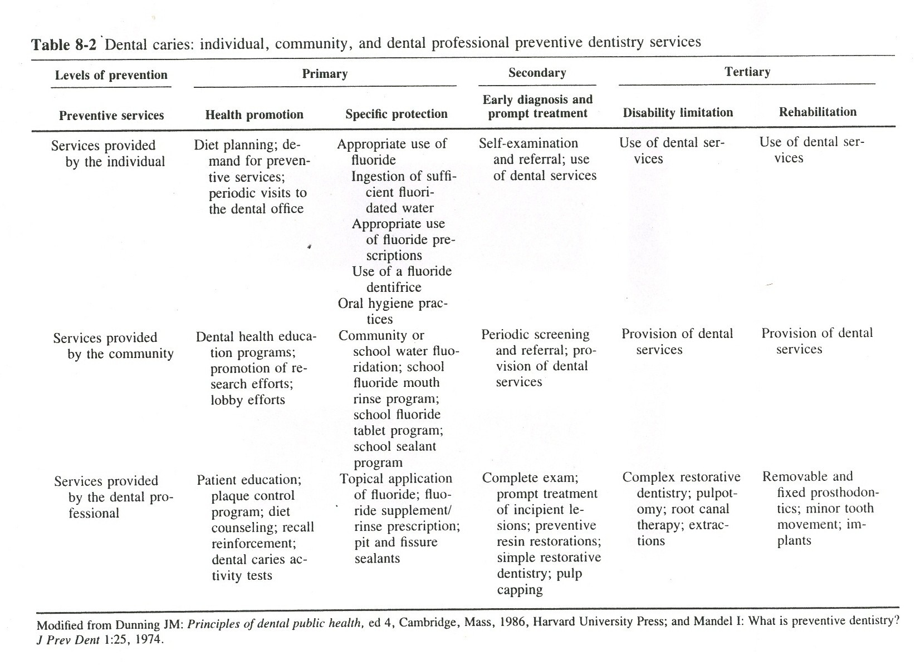

Slide 11
Need for Prevention
Cost of treatment is high
Compromised nutrition
Result in dysfunctional speech
Causes severe pain
To avoid psychological trauma and embarrassment.

Slide 12
Aims Of Prevention of dental caries
Early detection of incipient caries
Identification of high risk patients
Limiting pathogen growth and metabolism
Limitation of caries activity

Slide 13
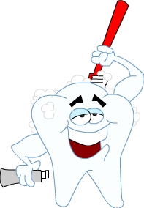
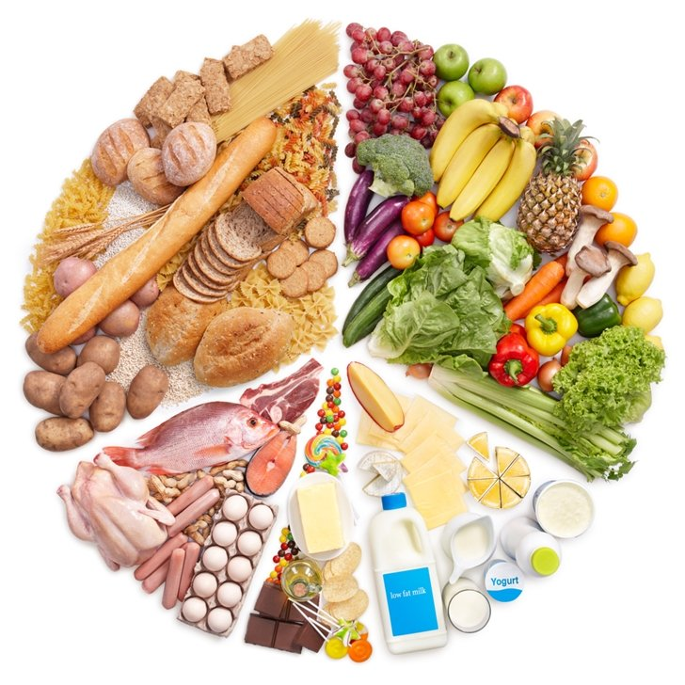
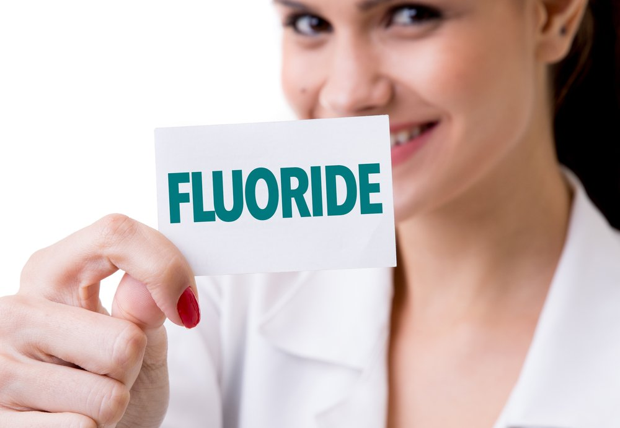
Prevention Of Dental Caries
Plaque control
Diet
Fluoride

Slide 14
PIT AND FISSURE SEALANTS

Slide 15
INTRODUCTION
Epidemiology of caries:
Significant reduction in prevalence and severity of dental caries since 1970s:
Due to:
  Water fluoridation
  Fluoride toothpaste
  Better awareness
  Funded preventive programmes
Dental caries has not been completely eliminated

Slide 16
In children (5-17 yrs) caries occurs mainly in the pits and fissures 84%. Occlusal caries by 8 yrs: 20%, 17 yrs: 70-80%

Slide 17
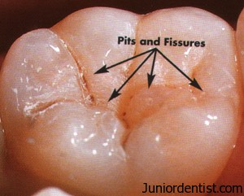
DEFINITIONS
PIT: (Tandon et al,2001)
A small pinpoint depression located at the junction of developmental grooves or at the terminals of those grooves
FISSURE: (Tandon et al, 2001)
Deep clefts running between the adjoining cusps

Slide 18
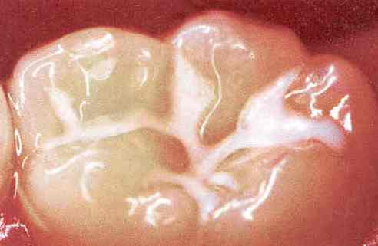
SEALANT:
A material that is introduced into the occlusal pits and fissures of caries susceptible teeth, thus forming a micromechanically bonded, protective layer cutting access of caries-producing bacteria from their source of nutrients.
1st dental sealant: Nuvaseal (L.D.Caulk) , Feb. 1971

Slide 19
NEED FOR PIT & FISSURE SEALANTS
Protected niche for plaque accumulation
Depth of the fissure close to DEJ
Inaccessibility to tooth brushing
Lower F conc of occlusal enamel
Decrease in cultivable microorganisms

Slide 20
MECHANISM OF PIT & FISSURE CARIES
Independent lesion at orifice of fissure
Fissure walls become involved
Enamel at base of the fissure affected more
Spread of caries laterally along the enamel
Inverted triangle with the apex towards outer enamel surface
Reaches dentinoenamel Junction

Slide 21
Involvement of dentin
Loss of mineral & structural support from adjacent enamel
Frank cavitation
Characteristic of pit & fissure caries: (Hicks and Maltz, 1986) organic plug: acts as buffer against acid by products of plaque, diffusion barrier, lessens acid attack at the fissural base (initial caries process)
organic plug: reduced enamel epithelium, oral debris, microorganisms

Slide 22
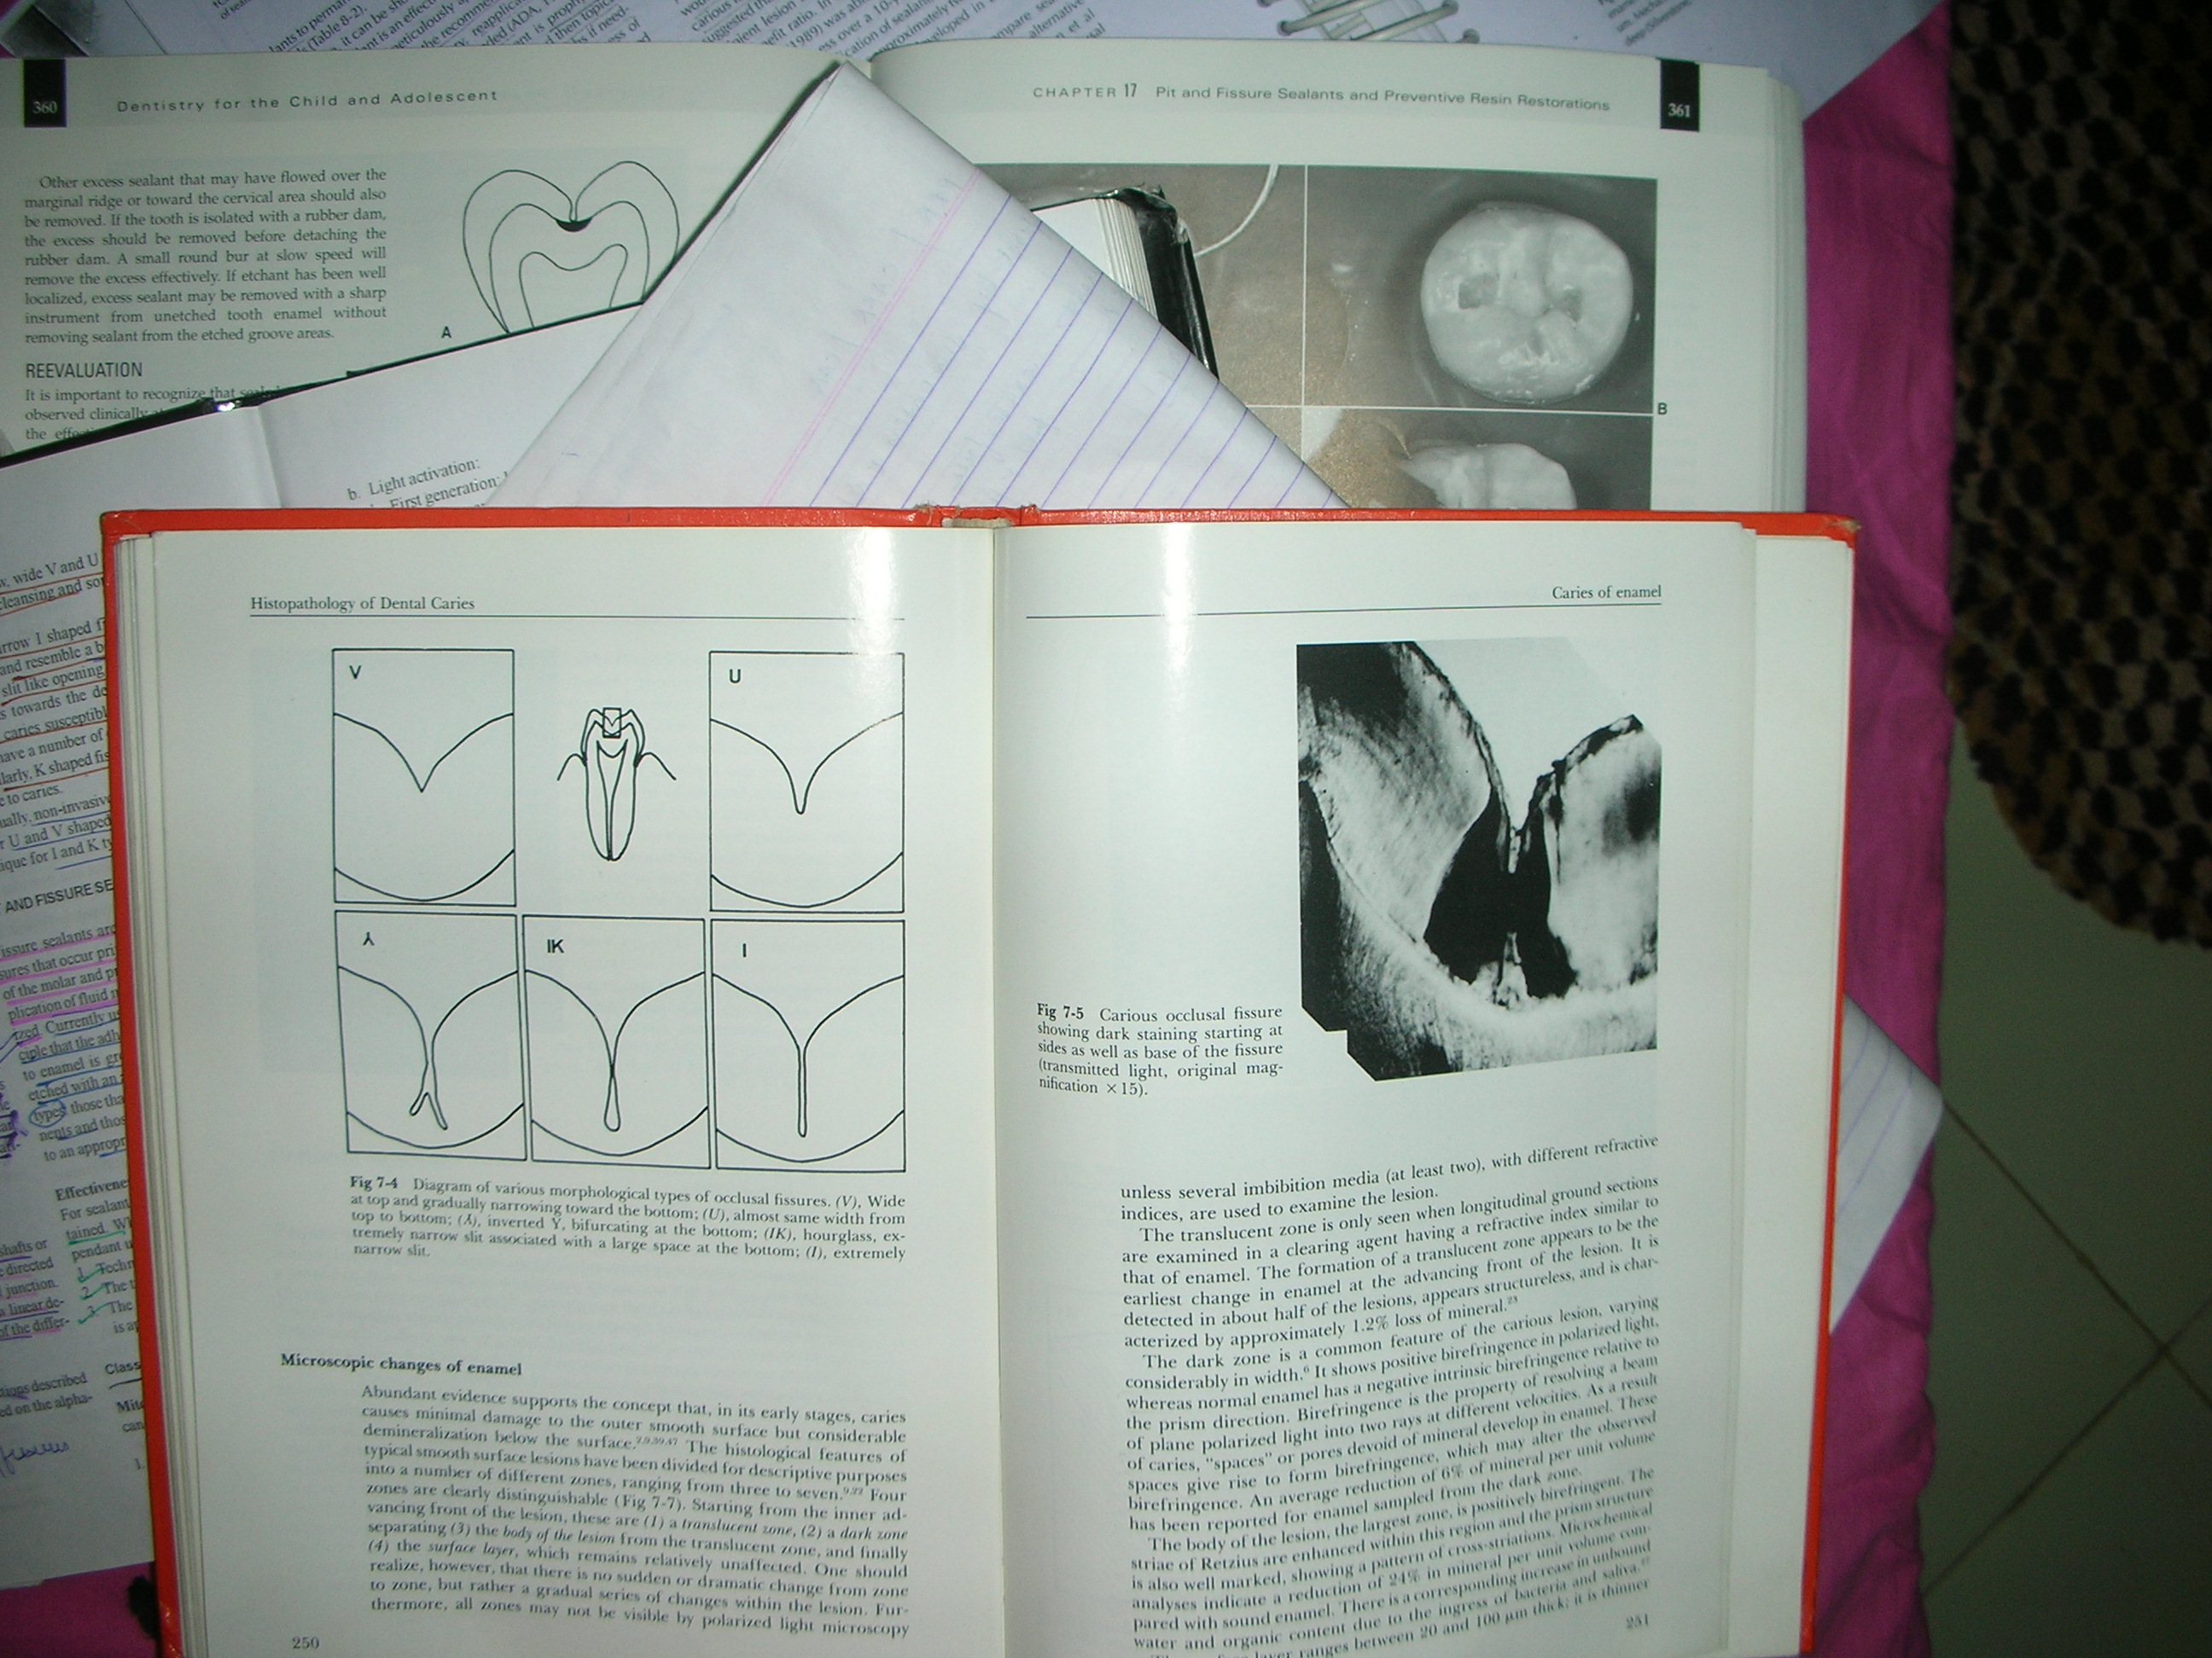
MORPHOLOGY OF FISSURES
Nango (1961):
V type : 34%
U type : 14%
IK type : 19%
I type : 26 %
Inverted Y type : 7 %

Slide 23
HISTORICAL PERSPECTIVE
G. V. Black: extension for prevention
Hyatt (1923): Prophylactic odontotomy (silver or copper oxyphosphate cement, amalgam restorations)
Bodecker (1929): Fissure eradication (shaping noncarious pits and fissures)
Gore (1939) solutions of cellulose nitrate in organic solvents

Slide 24
Application of impregnating solutions: ( inhibit proteolytic action of organisms on organic structures in enamel )
Klein & Knotson (1942) ammoniacal silver nitrate solutions (complexes with protein components of enamel & dentin and deposit reduced silver)

Slide 25
INDICATIONS (Ripa, 1985)
  Recently erupted teeth (Berman & Slack, 1973)
  Tooth can be isolated
  No, or only minimal pit and fissure staining
  No, or only minimal “catches” in the grooves
  No evidence of radiographic caries
  Minimum proximal carious lesions

Slide 26
  Mild caries activity
  Patients with medical problems
  Xerostomia
  Routine dental care with active preventive dentistry programme

Slide 27
CONTRAINDICATIONS
Many proximal lesions
General caries activity-high
Sound Broad, well-coalesced pits and fissures
Teeth without caries for 4years or longer
Teeth that cannot be isolated well

Slide 28
CLASSIFICATION
Mitchell & Gordon 1990:
Polymerization method:
Self activation (mixing two components)
Light activation :UV light (1st generation)
Self cure (2nd generation)
Visible light (3rd generation)
Fluoride releasing (4th generation)

Slide 29
2. Resin system : Bis GMA
Urethane acrylate
3. Filler content:
Filled: Kerr Pit & fissure sealant (40% quartz)
Nuva-Cote (64% Li Al silicate)
PrismaShield (Dentsply)
Unfilled: Sevrion
Nuva-Seal
Color:
Transparent : clear/pink/amber
Opaque : tooth colored/white
Color changing : 3M ESPE (Clinpro) , Ivoclar Vivadent (HelioSeal)

Slide 30
Ultraviolet light activated:
  NuvaSeal (L.D. Caulk)
  Lee Seal (Lee Pharmaceuticals) (fluorescent dye- UV detection)
  AlphaSeal (Amalgamated Dental) (fluorescent dye- UV detection)
Visible light activated:
  PrismFil
Chemically activated:
  Epoxylite 9075 (Lee Pharmaceuticals)
  Concise Enamel Bond (3M)
  Concise Brand White Sealant (3M) (Ti2O- visual detection)
  Delton (Jhonson & Jhonson)

Slide 31
REQUISITES (Braeur 1978)
Good penetration: (penetration coefficient=1.3cm/sec)
  Low viscosity & surface tension
  Good tooth wetting (concave contact)
  Prolonged adhesion to the enamel
Adequate properties:
  Adequate working time (20-30s UV, 90-180s self cure)
  Low polymerization shrinkage(2.3% UV, 2.8% self cure)

Slide 32
  High hardness, abrasion resistance & strength (filler content, C. Str: 125-160 MPa)
  Low water sorption & solubility
  Chemical stability in oral conditions
  Low volatility
  Rapid cure
  Minimum irritation to tissues (biocompatible)
Good storage properties
Cariostatic action (physical sealing, F )

Slide 33
COMPOSITION
Main component:
Bowen (1955): Bis GMA
Roydhouse (1968): Bis GMA diluted with methyl methacrylate
Buonocore (1970): 3 parts Bis GMA + 1 part methyl methacrylate
Activator:
UV light: 2% benzoin methyl ether (365nm)
Visible light: camphorquinone (480 nm)
Autopolymerization: benzoyl peroxide

Slide 34
Filler:
Quartz
Lithium Al silicate
Disadv: More viscosity, less penetration
Lesser retention
      Problematic occlusal adjustment

Slide 35
CLINICAL GUIDELINES FOR SEALANT APPLICATION (Tandon et al, 2001)
Patient selection:
Extensive caries, medically compromised
Tooth selection:
Within 3-4 yrs of eruption, occlusal surface
Do not seal: proximal caries, isolation problems
Doubted occlusal surface on clinical examination:
Bite wing radiograph:
No dentin involvement: seal: re evaluate
Early dentin involvement: minimal composite, then sealant
Extensive caries: restoration

Slide 36
Age for Sealant application:
3-4 yrs: primary molars
6-7 yrs: 1st permanent molars
11-13 yrs: 2nd permanent molars
Less than 3-4 yrs of tooth eruption
Hicks et al, 1984: sealants applied through out life on suspected pits & fissures

Slide 37
Dental Caries: Preventive Restorations in Pediatric Dentistry with recent advances
Part II
POOJA GOPALGHARE
II MDS

Slide 38
CONTENT
Definition of pit and fissure
Need for pit & fissure sealant
Historical perspectives
The basic morphology of pits & fissures
Indications
Contraindications
Classification
Composition
Step–by–step procedure
Introduction
History of Preventive Dentistry
Scope of Preventive Dentistry
Principles of Preventive Dentistry
Objectives of Preventive Dentistry
Levels of Prevention

Slide 39
Newer developments in pit and fissure sealant
Preventive resin restorations
Atraumatic restorative treatment
Lasers in caries prevention
Conclusion

Slide 40
STEP – BY – STEP PROCEDURE FOR SEALANT APPLICATION

Slide 41
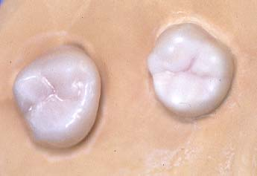
CLINICAL EXAMINATION: sharp probe, explorer, visual
ISOLATION: rubber dam, cotton rolls
Purpose: clinical confirmation, protection from oral fluids, no saliva contamination, effective sealant placement
Ferguson & Ripa, 1980: autopolymerized sealants not affected by isolation

Slide 42
PROPHYLAXIS: pumice, dentrifices, Prophy-jet
Purpose:
Removal of organic debris
Elimination of this step produces better retention
WASH: (10s) jet spray, removes debris and pumice
DRY: (10s) prevent water contamination, clean tooth appearance

Slide 43
TOOTH PREPARATION:
De Craene et al 1989: air polishing with sodium bicarbonate (Prophy-jet)
Brockmann et al 1990: air polishing + etching = best retention
Garcia-Godoy 1994: Enameloplasty Sealant Technique (EST): mechanical enlargement of the fissures with a bur (#1/4 round) : deeper sealant penetration & superior sealant adaptation

Slide 44
ENAMEL CONDITIONING
Increases surface wettability
increases approximation between sealant & substrate by removing contaminants & superficial enamel.
Increase surface energy for bonding.
Produces surface irregularities for sealant penetration.

Slide 45
EFFECT OF FLUORIDE APPLICATION
Low et al 1977: reduced sealant retention with APF application prior to sealant placement
Koh et al 1995: topical F treatment : no effect on sealant retention
Warren et al 2001: no effect on retention

Slide 46
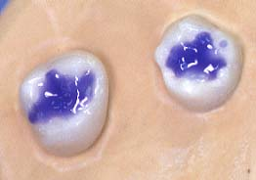
ACID ETCHING:
35-37% phosphoric acid
  Microbrush
  Plastic tip
  Dabbing with cotton pellet
  Etch the grooves and cuspal inclines
  Evaluate “frosted” enamel

Slide 47
  Acid concentration:
  Buonocore, 1955: 85% phosphoric acid for 60 seconds
  Gwinnett & Buonocore, 1969: 35-50% conc for 30 sec
  Silverstone, 1975: 20-50% for 60 sec
Purpose: Gwinnett & Buonocore, 1965
  Removes organic material & debris from surface
  Dissolves outer layer of enamel
  Produces clean, roughened surface

Slide 48
Time: 10-15 sec
Primary teeth: Longer time(60-120 s): Silverstone, 1974
Same time (60 sec): Ripa et al, 1976
Shorter time (20-30s): Tandon et al, 1989
Etch Patterns:
Type I: etching of prism periphery only
Type II: etching of prism core only
Type III: irregular etching pattern

Slide 49
Histologic appearance:
3 zones:
Etched surface (10 micro m)
Qualitative etched zone (20 micro m)
Quantitative etched zone (20 micro m)
Caution after etching:
Protection against Saliva contamination
Re etching of surface 10-15 s

Slide 50
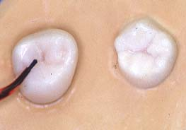
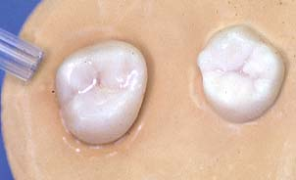
BONDING AGENT APPLICATION:
  brush tip or microtip brush.
  Gently dry
  Light cure

Slide 51
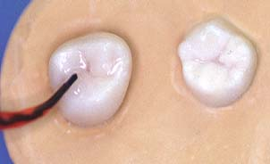
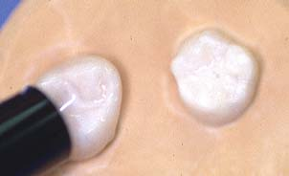
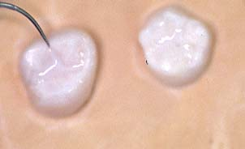
SEALANT APPLICATION: spiral brush tip, or using a microbrush.
Flow into grooves and up cuspal inclines
Cure for 20 seconds
Evaluate quality of sealant:
  Marginal integrity
  Pits or voids in sealant
  Overhangs
  Heavy occlusion
  Resin tag: 25- 50 micro m

Slide 52
After sealant placement:
Wipe surface layer (unpolymerised) with cotton swab
  Clearer inspection of sealant
Occlusal adjustments:
  Green stone

Slide 53
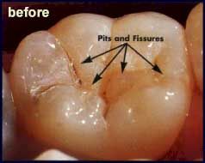
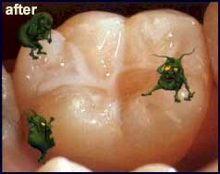

Slide 54
  PERIODIC MAINTENANCE:
    Moisture contamination secondary to incomplete eruption and difficulty in isolation - predicted 30% failure rate within 5 years in these areas.
    ADA, 1983: reapplication of sealant every 6 months
    Marginal integrity and wear.
    Retention rates on buccal pits and grooves of mandibular molars and distolinqual grooves of maxillary molars are less.

Slide 55
EFFECT OF SEALANT LOSS ON CARIES PROGRESSION
Horowitz's 1977: sealant partially missing: lower incidence of caries (7%), unsealed control teeth high incidence of caries (41 % caries).
Charbeneau et al 1977: sealant loss does not progress P & F caries
Simonsen (1991): 28% overall complete retention and 35% partial (noncarious) retention on permanent first molars.

Slide 56
COST EFFECTIVENESS
Leake & Martinello, 1976: initial cost of P & F sealant more than conventional amalgam
Simonsen et al, 1987: restoration of unsealed surface costs 1.67 times more than cost of applying sealant

Slide 57
Means to decrease cost: Ripa, 1985
  Time required for placement: 8min, 45s (amalgam: 14min)
  Auxiliary personnel (Foreman et al, 1990)
  ADA recommended highly retentive sealants
  Sealants + fluorides

Slide 58
NEWER DEVELOPMENTS
FLUORIDE RELEASING SEALANTS

Slide 59
1st was given by Swartz et al 1976
Two methods of adding F into sealants:
Fluoride added to unpolymerized resin in the form of a soluble fluoride salt (salt dissolves and fluoride ions released)
Weakening of sealant, decreased retentiveness
Organic fluoride compound chemically bound to the resin (fluoride released by exchange with other ions)
1st: Rawls & Zimmerman, 1983
Increases salivary levels of F

Slide 60
F releasing sealants:
Fluoroshield (2% naf)
Helioseal F
Modified urethane bis-gma:
Amount of f release: 1700- 3500 ppm
Burst of F release on 1st & 2nd day(burst effect)
Slow release over 12 months

Slide 61
RETENTION OF F CONTAINING SEALANTS
Carson et al 1998: 96% retention of conventional sealants and 91% of FluoroShield
Oulis 1999: lesser retention of fluoride containing sealants than conventional

Slide 62
Garcia-Godoy(1997), fluoridated sealants released greatest amount of fluoride in first 24 hours after mixing, fell sharply on second day.
Hicks et al 2000, fluoride reservoir with long-term release of fluoride into the immediately adjacent oral environment.
Simonsen 2004: no clinical benefit from adding F

Slide 63
GLASS IONOMER CEMENT AS SEALANT
IADR meeting in 1996 Singapore: less retentive but more positive for caries prevention
Type III Fuji GIC: as sealant
Mejare and Mjor: 61 % of glass ionomer sealants lost within 6-12 months, caries recorded in none of teeth restored with GI sealants
Seppa et al (1991) fissures sealed with glass ionomer are more resistant to demineralization than control fissures

Slide 64
Disadv: lost very early in comparison to resin based sealants
Use of GIC during the eruption of the molars:
    risk to plaque retention
    enamel is immaturely formed
    prolonged period for full eruption

Slide 65
MODIFIED GIC
RESIN MODIFIED GIC:
E.g. Vitremer
  Disadv: early wear, early loss, darkening of sealant after initial placement
COMPOMERS:
E.g. Dyract
  Disadv: polymerization shrinkage, microleakage

Slide 66
ADVERSE REACTIONS WITH SEALANTS
Retention problems (isolation)
Allergy to resin (Hallstrom, 1993: case report)
Leaching of bisphenol A & bisphenol A dimethacrylate
Estrogen like effects on cultures of breast cancer cells
Nathanson et al, 1997: bisphenol A below detectable levels : safe

Slide 67
PREVENTIVE RESIN RESTORATION

Slide 68
High prevalence and rapid onset of occlusal caries is related to the:
i) Bacterial and nutrient harboring capacity of pit and fissures.
ii) Close proximity of its base to the DEJ.
iii) Total inaccessibility of this area to any mechanical means of debridement.
PRR are among the newer techniques which show long term success. This treatment of resin restoration has various distinct advantages over the traditional amalgam restorations. But it requires an excellent isolation of moisture and saliva contamination.

Slide 69
PRR utilizes the invasive and non invasive treatment of borderline or questionable caries.
The resin placed in the carious areas and adjacent caries susceptible areas, seals them from the oral environment and provides a valuable treatment alternative to conventional restorations like amalgam.
PRR integrates the preventive approach of the sealant therapy for caries susceptible pits and fissures with the therapeutic restoration of incipient caries with composite resin that occurs on the same occlusal table.
Deep pits and fissures on tooth surface require sealant therapy.

Slide 70
TYPES OF PRR
Based on the extent and depth of the carious lesions:
a) Type A - Suspicious pits and fissures where caries removal is limited to enamel.
b) Type B - Incipient lesion in dentin that is small and confined
c) Type C - Characterized by the need for greater exploratory preparation in dentin
Simonson (1978) advocated an
Unfilled sealant --- type A
Diluted composite resin ---- type B
Filled composite resin ---- type C

Slide 71
TYPE A RESTORATION
Enamel fissure caries are removed with slow speed round bur.
clean the surface
isolation
remove decalcified pits and fissure
place acid – etched gel – 20 to 60 sec
wash and dry
apply the sealant
polymerize with visible light – 20 sec
adjust the occlusion, if needed

Slide 72
TYPE B RESTORATION
removal of caries with a high speed no.330 bur, followed by a slow speed no.1/2 Round bur.
After caries removal Ca(OH)2 liner is placed .
Acid etching gel is applied over the entire occlusal surface for 20 to 60 sec , then washed 20 Sec and dried 10 sec.
Bonding agent application: The walls of the preparation are coated with bonding agent which act as an intermediate Resin layer.

Slide 73
Composite resin application: Filled composite resin is injected into the preparation and placed.
Resin condensed and smoothened by plastic or Teflon instrument the composite resin is condensed and smoothed with a plastic or teflon Instrument.
Sealant application: Filled sealant material is applied over the entire occlusal surface.
Polymerization: All layers are simultaneously polymerized with visible light produced by the polymerization unit.
Occlusal adjustment: the occlusion is adjusted, where required, with finishing burs.

Slide 74
TYPE C RESTORATION
Type C is larger and deeper add additional polymerization time (30 sec).
In most cases local anesthesia will also be required.

Slide 75
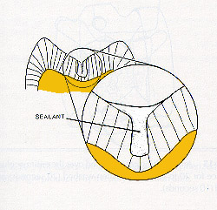
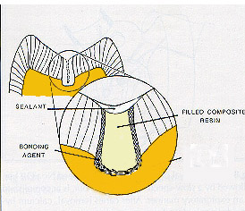
PRR “A” vs. PRR “B”
Type A
Type B

Slide 76
ADVANTAGES
Minimal cavity preparation is required thus prevents unnecessary removal of healthy tooth structure for retention.
Seals caries halting the destruction of tooth. Eg: teeth with pit and fissure
Loss of the restoration and subsequent replacement proves to be less invasive than that for conventional restoration like amalgam.

Slide 77
ATRAUMATIC RESTORATIVE TREATMENT

Slide 78
HISTORY OF ART
It was first evaluated in Tanzania in the mid 1980s.
ART was introduced in South Africa by its Dutch inventor, Prof. Jo Frencken in 1996, but still widely unknown amongst the general public -takes the dread from the dentist visit and has the potential to significantly improve the state of the nation's teeth.

Slide 79
PRINCIPLES OF ART
It is based on modern knowledge about minimal intervention, minimal invasion and minimal cavity preparation for carious lesions.
It is a procedure based on removing carious tooth tissues using hand instruments alone and restoring the cavity with adhesive restorative material

Slide 80
INDICATIONS OF ART
Only in small cavities in those cavities that are accessible to hand instruments public health programs
CONTRAINDICATIONS OF ART
Swelling, abscess or fistula near the carious tooth, exposed pulp painful for a long time. opening is inaccessible to hand instruments,cavity cant be entered from proximal or occlusal direction.

Slide 81
ESSENTIAL INSTRUMENTS FOR ART
Reflects light ,Indirect vision ,Retraction of cheek & tongue Mouth Mirror
To identify soft carious dentin: Explorer
For carrying cotton wool rolls,cotton wool pellets,wedges n articulation paper :pair of Tweezers
For removing soft carious dentin for removal of excess of GIC: Spoon Excavator
For widening the entrance to the cavity ,Slicing away thin unsupported and carious :enamel Hatchets
For inserting mixed GIC into cleaned cavity,To remove excess restorative material ,To shape GIC Applier :Carver

Slide 82
For mixing GIC: Mixing pad & spatula
To absorb saliva: Cotton wool rolls
For cleaning cavities :Cotton wool pellets
To keep moisture away from GIC,to prevent gloves from sticking to GIC:Petroleum jelly
To hold plastic strip close to the shape of the proximal surface of the tooth:Wedges

Slide 83
POWDER:Si oxide, Al oxide, Ca flouride
LIQUID:Polyacrylic acid or Demineralized water ,Type п GIC is used for restoring the cavities.
P/L ratio -3:1 Glass Ionomer Cement

Slide 84
ADVANTAGES OF USING GIC
The result is a sealed restoration with the filled cavity and sealed pits and fissures adjacent to it, which provides additional protection against recurrent caries attacks.
International research shows that ART restorations are as durable and successful as conventional restorations and are considered as permanent fillings.

Slide 85
Not only does the procedure help to reduce bacteria causing caries, but chemically bonds the filling material to cavity walls, thus preventing any further nutrient supply to remaining bacteria.
In effect bacteria ‘starve’ and become inactive. Continued fluoride release by the filling material also acts toxic against bacteria and assist in the remineralization and rebuild of weakened tooth tissues.

Slide 86
Dental Caries: Preventive Restorations in Pediatric Dentistry with recent advances
POOJA GOPALGHARE
II MDS

Slide 87
CONTENT
Introduction
History of Preventive Dentistry
Scope of Preventive Dentistry
Principles of Preventive Dentistry
Objectives of Preventive Dentistry
Levels of Prevention
Pit and Fissure Sealants
Preventive Risen Restoration
Resin Modified GIC
Fluoride Releasing Sealants
GIC as Sealants
ART

Slide 88
Resin Infiltration Technique
Compomer
Giomer
Lasers

Slide 89
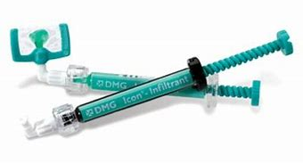
Resin infiltration technique
It is one of the newer approaches to arrest progression of non cavitated caries lesion.
These lesion are opaque and chalky white in appearance which is caused by demineralization in subsurface region.
The infiltrating resin has high refractive index and produces chameleon effect

Slide 90
It requires non shade matching and blend reasonably well with surrounding natural tooth structure.
It halts progression by surrounding them with polymerized unfilled resin
It works on capillary action - low viscosity resin is drawn deep into lesion.
Resin completely fills the pores , replacing lost tooth structure.
It also stops caries progression by blocking pathways of bacterial colonies.

Slide 91
procedure
Isolate and clean tooth surface with pumice.
Etched with 15% hydrochloric acid gel for 2 min.
Rinse the tooth with water
Alcohol liquid is applied directly on the tooth surface.
TEGMA resin is applied on dried lesion and is polymerized using manufactures instructions.

Slide 92
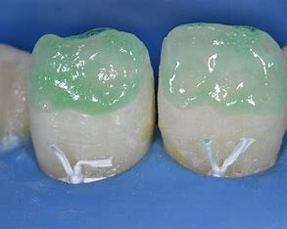
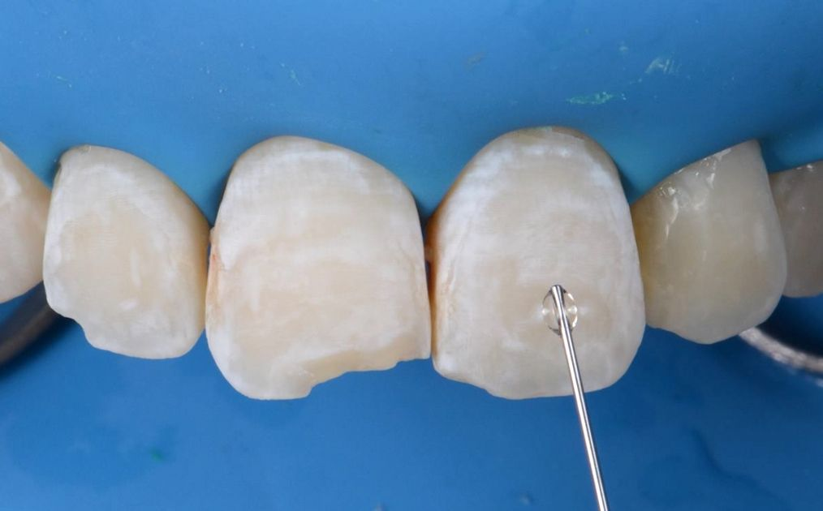
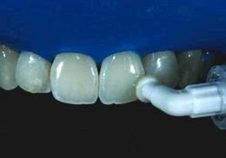

Slide 93
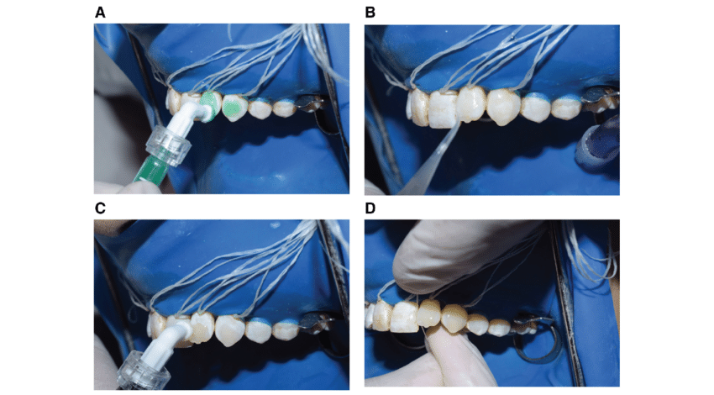

Slide 94
Compomer
The word “Compomer” comes from composite and glass ionomer.
The material itself is a polyacrylic / poly-carboxylic acid modified composite.
Compomer are composed of composite and glass ionomer components in an attempt to take advantage of the desirable qualities of both materials.
The fluoride release and ease of use of the glass ionomers and the superior material qualities and esthetics of the composites.

Slide 95
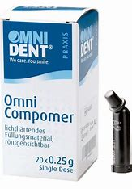
Compomer restorations have been shown to have insufficient retention without pretreatment of the dental hard tissue with an adhesive system.
Compomer are most suitable for restorations in the deciduous dentition due to their low abrasion resistance.

Slide 96
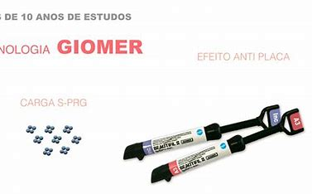
Giomer
It is a recently introduced hybrid esthetic restorative material based on pre-reacted glass ionomer technology.
Chemically it is fluro - alumina silicate glass reacted with polyalkalnic acid in water prior to inclusion into silica filled urethane resin.

Slide 97
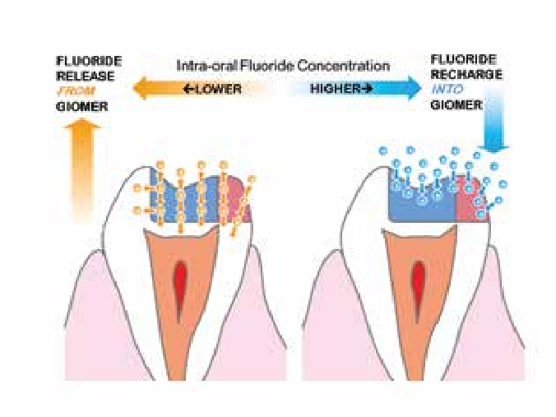
These are mainly indicated for restoration of root caries, cervical caries, class V cavities and also in restoration of primary teeth.
Its advantages include continuous fluoride release, clinical stability, high biocompatibility, highly esthetic and ease of bonding

Slide 98
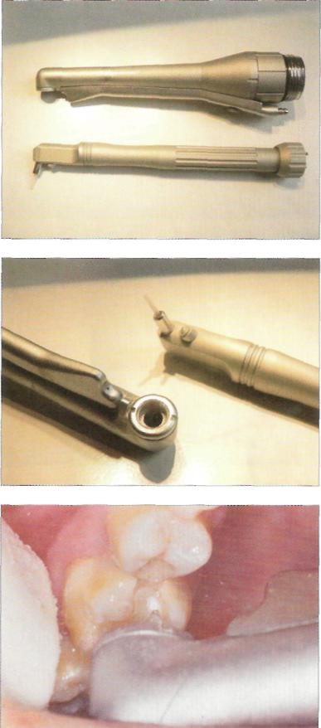
Lasers in caries prevention

Slide 99
Introduction
'Laser' is an acronym for 'light amplification by the stimulation emission of radiation'. Its theoretical basis was postulated by Albert Einstein.
First tooth exposed to laser light was in 1960.
Laser light in dentistry is a unique, non-ionizing form of electromagnetic radiation that can be employed as a controlled source of tissue stimulation, cutting or ablation, depending on specific parameters of wavelength, power and target tissue.

Slide 100
History
First LASER(Ruby laser by Theodore Maiman,at the Hughes Aircraft Company USA,1960.
Uranium laser developed by IBM Laboratories (in November 1960)
Helium-neon laser by Bell Laboratories in 1961
Semiconductor laser by Robert Hall at General Electric Laboratories in 1962
Neodymium-doped yttrium aluminium garnet (Nd:YAG) laser
CO2 laser by Bell Laboratories in 1964,
Argon ion laser in 1964

Slide 101
Laser use in dentistry
Although Maiman had exposed an extracted tooth to his ruby laser in 1960, the possibilities for laser use in dentistry did not occur until 1989, with the production of the American Dental Laser for commercial use.
This laser, using an active medium of Nd:YAG, emitted pulsed light and was developed and marketed by Dr Terry Myers, an American dentist.

Slide 102
Though low-powered and due to its emission wavelength, inappropriate for use on dental hard tissue, the availability of a dedicated laser for oral use gained popularity amongst dentists.
This laser was first sold in the UK in 1990

Slide 103
In 1989, experimental work by Keller and Hibst using a pulsed erbium YAG (2,940 nm) laser, demonstrated its effectiveness in cutting enamel, dentine and bone.
This laser became commercially available in the UK in 1995 and, shortly followed by a similar Er,Cr:YSGG (erbium chromium: yttrium scandium gallium garnet) laser in 1997, amounted to a laser armamentarium that would address the surgical needs of clinical dentistry in general practice

Slide 104
Advantages
Appreciated by patients as they are more comfortable than drilling.
With water-cooling appears to have less side effects such as vibration, heat, sound or iatrogenic damages of adjacent teeth.
Laser irradiation causes minimal damage to surrounding tissues, minimal thermal changes of dental hard tissue composition, and creates favorable surface characteristics (e.g. reduced smear layer, smooth surface, and little debris).

Slide 105
LASERS IN CARIES PREVENTION
Yamamoto and Oaya used as YAG laser at energy densities of 10 to 20 J/cm² and demonstrated that the lased enamel surface was more resistant to in vitro demineralization than non lased enamel.
Stern and Sognnaes demonstrated in vivo that enamel subjected to 10 to 15 J/cm² showed a greater resistance to dental caries than the controls.

Slide 106
Stern concluded that energy levels below 250 J/cm² did not permanently alter the pulp but necrosis could occur when energy level, reached 1800 J/cm² or higher.
Lobene and Colleagues, observed that C0₂ laser irradiation to tooth enamel caused small amounts of hydroxyapatite to be converted to more insoluble calcium orthophosphate apatite.
This paved the way for widespread use laser in prevention of caries.

Slide 107
LASERS IN CARIES PREVENTION
In 1985 Terry Myers used Nd:YAG laser for debridgement of incipient caries. When a topical fluoride treatment was performed after argon laser conditioning of enamel, an even more dramatic reduction in enamel acid demineralization was observed
Studies have demonstrated the potential of laser pre-treatment of enamel or tooth roots to inhibit subsequent acid-induced dissolution or artificial caries-like challenge in the laboratory (Westerman et al, 1994).

Slide 108
Nelson, 1987 demonstrated the potential caries-inhibitory effects of pulsed carbon dioxide laser irradiation of enamel at low frequencies.
Inhibition of subsequent demineralization of enamel of up to 50% with the laser conditions they used, and reported that these effects were wavelength-dependent.

Slide 109
Carbon dioxide laser wavelengths (9.3, 9.6, 10.3, and 10.6 nano metres) were efficiently absorbed by the carbonated apatite mineral of the tooth and that the absorbed light was rapidly transformed to heat near the surface, causing loss of carbonate from the mineral with a subsequent marked decrease in acid reactivity.

Slide 111
Use of individual lasers
Nd:YAG laser is indicated for use in superficial pigmented caries removal.
Erbium family(Er:YAG , Er:YSGG) of lasers are the lasers of choice & most efficient for enamel, dentin & caries removal.
They have shown to reduce the bacterial population & produce a analgesic effect on the tissues.
Lasers can also be used for sealant placement- to clean, sterilize ,clearly visualize & even etch the enamel grooves.

Slide 112
Effectiveness of lasers in caries prevention
Laser treatment particularly in combination with topical fluoride application (NaF, APF), increase resistance against caries, desensitization of hypersensitive dentine (Er:YAG).
C02-laser = Caries inhibition up to 82.7%

Slide 113
Er:YAG-laser = Reduction in surface lesion depth (root surfaces 39%, primary enamel surfaces 56%)
Nd:YAG-laser (with Duraphat) = Caries inhibition (pits and fissures 43%, smooth surfaces 80%).

Slide 114
Conclusion
Dental caries is a disease that usually can be successfully prevented or controlled
It is an important task for the dental team to teach individuals to take correct actions to minimize the risk for the disease.
It is also possible to identify and evaluate factors of importance for cavity formation.
By targeted actions, such risk factors can usually be changed, resulting in a reduced risk for caries.

Slide 115
In clinical practice, more emphasis is paid presently on treatment rather than prevention. A lot of time, energy and manpower can be saved if more attention is paid to prevention.
Research in new evidence based – methods in prevention would help us in reducing the morbidity associated with dental caries.

