Slide 2
PRENATAL GROWTH AND DEVELOPMENT OF CRANIOFACIAL COMPLEXS
SNEHAL

Slide 3
Contents:-
Introduction
Definition of growth and development
Factors affecting the growth
Theories of craniofacial growth
Various phases under prenatal growth and development
And its clinical aspects
Conclusion

Slide 4
INTRODUCTION
Growth and development is divided into prenatal and postnatal period.
Prenatal period of development is a dynamic phase of development of human being.
During this times,height is increased by 5000 times.

Slide 5
DEFINATIONS-
1)GROWTH
Acc to Stewart,it is a process that leads to increase in physical size of cells,tissues ,organ or organism as whole.
Acc to Krogman,it is defined as increase in size,change in proportion and progressive complexity
Acc to profit,growth is an increase in size.

Slide 6
DEVELOPMENT-
Acc to Todd-Development is defined as progress towards maturity.
Acc to Moyers-All the natural occurring unidirectional changes in life of an individual from its existence as single cell to its elaboration as a multifunctional unit terminating in death.
Acc to lowery-Development is used to indicate an increase in skill and complexity of function.

Slide 7
Factors affecting Growth
Heredity
Socioeconomic factor
Family size and Birth order
Climatic and seasonal effect
Psycological Disturbance
Exercise
Nutrition

Slide 8
Theories of Craniofacial Growth
Sicher’s theory of sutural growth
Scott’s cartilaginous theory
Functional matrix theory
Genetic theory

Slide 10
Various phases under development of growth occurs
Period of ovum
Period of embryo
Period of foetus

Slide 11
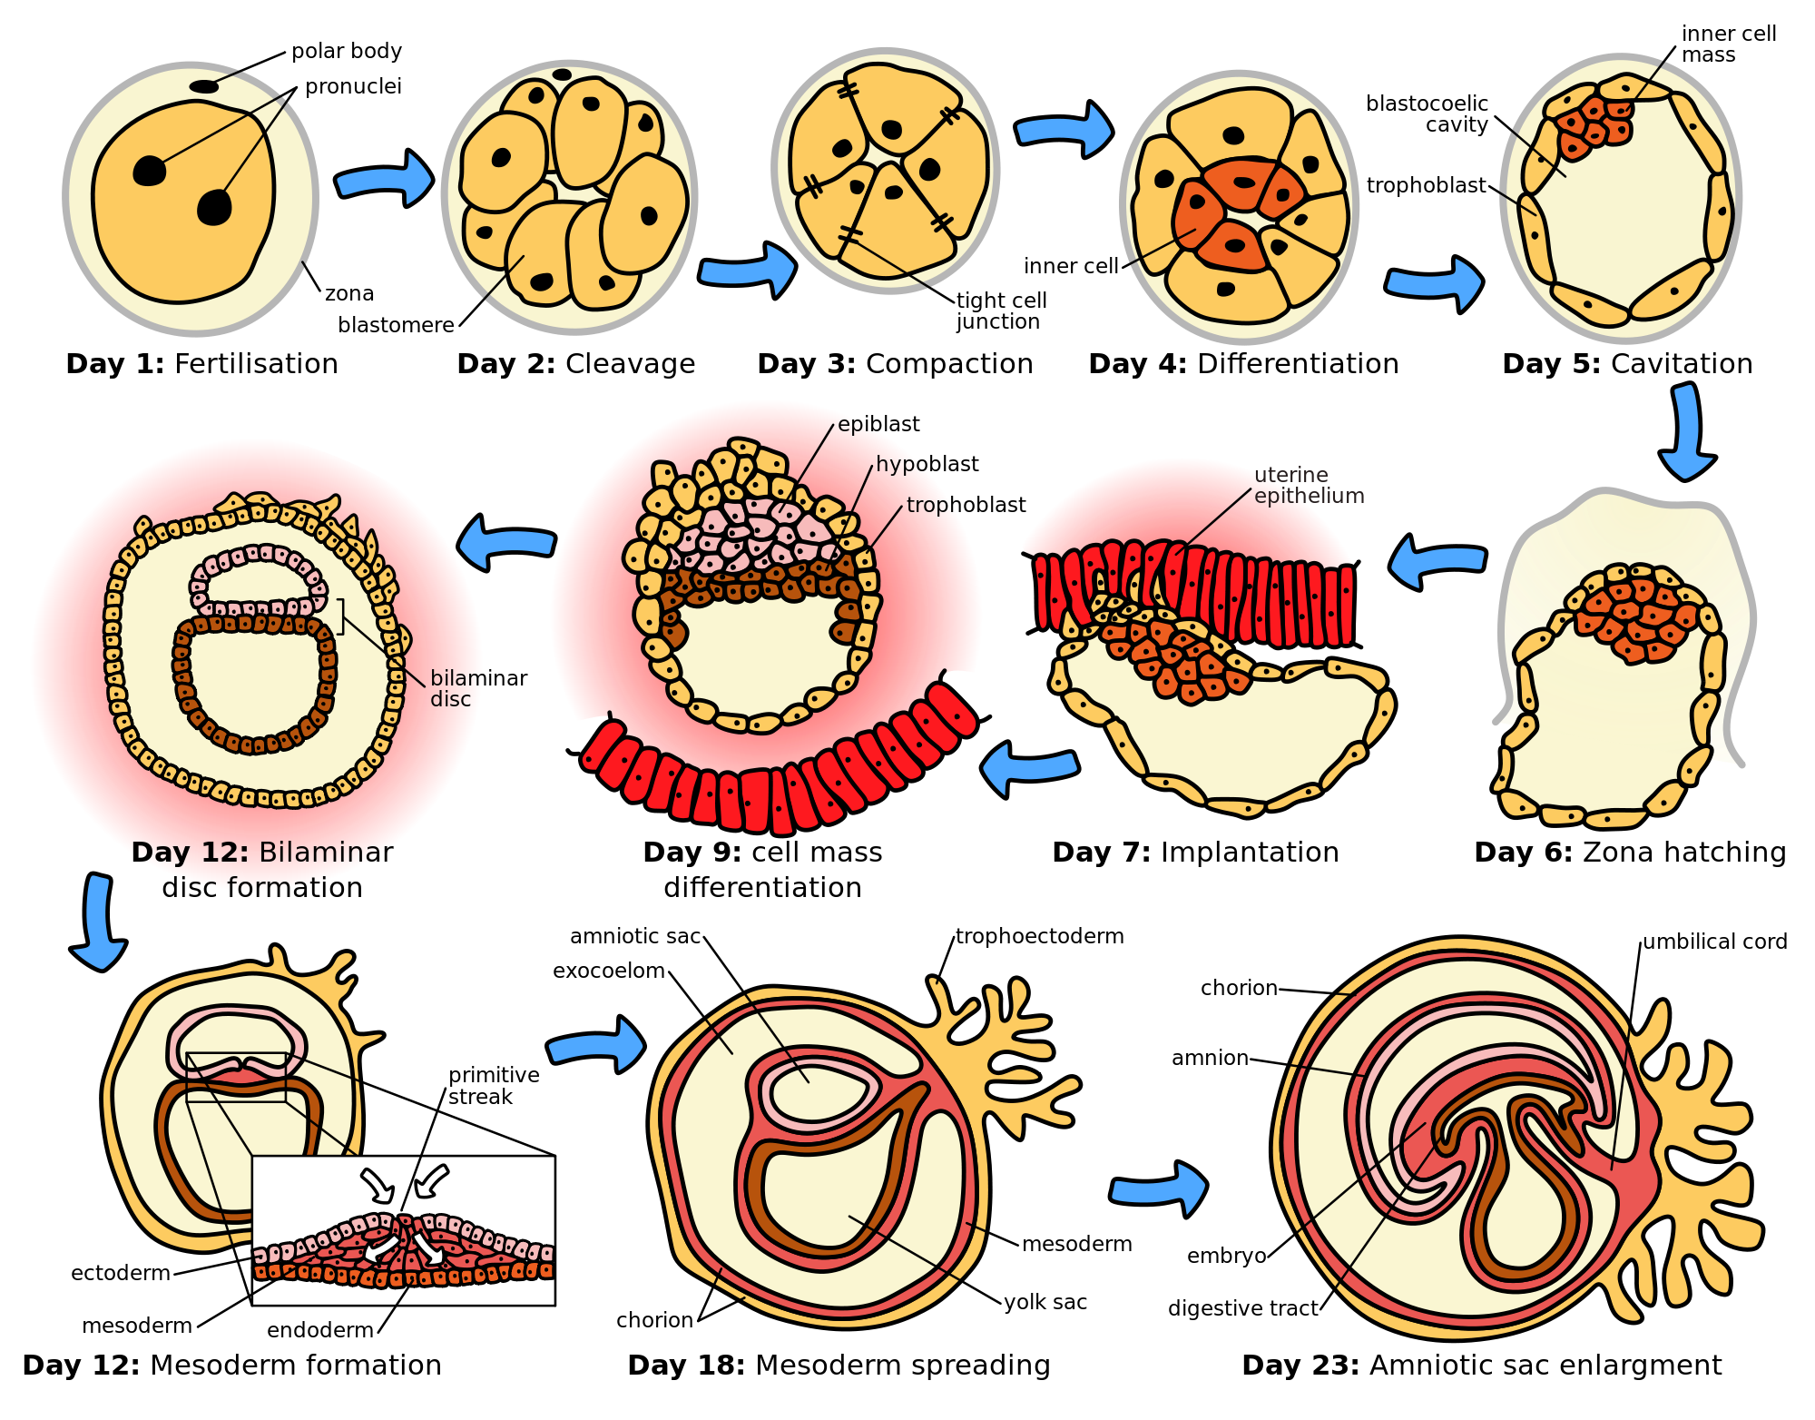
Period of ovum -extends for the period of approx.two weeks from time o of fertilozation.

Slide 12
2.Period of embryo-
From 14TH day -56th day
Major part of development and growth of cranial region
3.Period of fOEtus-
between 56th day till birth.
accelerated growth of craniofacial structures occurs resulting in various structures.
change in proportion in various region.

Slide 13
FORMATION OF GERM LAYERS-
As the blastocyst develop further, the embryoblast differanciates rapidly to form a two layer germ disc.
1)upper layer-ectoderm(columnar cell)
2) lower layer-endoderm(flattened cell)
At stage of development two cavities are see, 1) above the ectoderm-amniotic cavity
2)below the endoderm-yolk sac

Slide 14
Some endodermal cells along with central axis, proliferate to form primitive streak that bulges into amniotic cavity.
Ectodermal cells along with primitive streak proliferate and passes laterally between ectodermal and endodermal thickening layer
This forms mesodermal layer.
Brachial arches are developed from mesoderm layer.

Slide 15
FORMATION OF BRACHIAL ARCHES-.
around 4th week of intrauterine life.
Series of mesodermal thickening known as brachial arches.
This thickenings expands and pass beneath floor of pharynx.
Approach there anatomic counterpart
Formation of arches results, progressive separation of developing stomadodeum from developing heart.

Slide 16
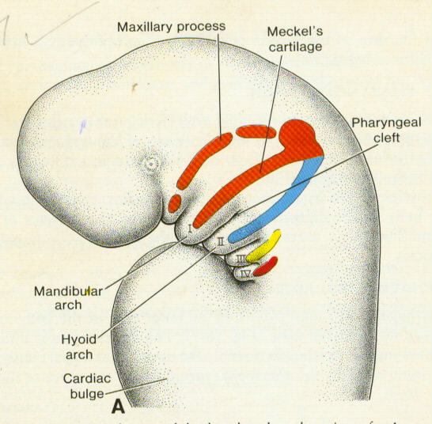
PHARYNGEAL ARCHES
THERE ARE 5 PAIRS OF PHARYNGEAL ARCHES. EACH OF THESE 5 PAIRS HAS CENTRAL CARTILAGE COMPONENT THAT FORMS THE SKELETON OF THE ARCH. MUSCULAR COMPONENT, VASCULAR COMPONENT AND NERVOUS COMPONENT
Notes:
THERE ARE 5 PAIRS OF PHARYNGEAL ARCHES. EACH OF THESE 5 PAIRS HAS CENTRAL CARTILAGE COMPONENT THAT FORMS THE SKELETON OF THE ARCH. MUSCULAR COMPONENT, VASCULAR COMPONENT AND NERVOUS COMPONENT.

Slide 17
Nerves & muscles of the arches
Arch | Nerve of the arch | Muscles of the arch
First (Mandibular arch) | Mandibular (Trigeminal) V th nerve | Medial & lateral pterygoids, Masseter, Temporalis, Mylohyoid, ant belly of digastric,tensor tympani, tensor palati
Second (Hyoid arch) | Facial VII th nerve | Muscles of face, Occipito-frontalis, platysma, Stylohyoid, Posterior belly of digastric, Stapedius, Auricular muscels
Third | Glossopharyngeal, IX th nerve | Stylopharyngeus
Fourth | Superior Larngeal | Muscles of Pharynx & larynx
Sixth | Recurrent laryngeal | Muscles of Pharynx & larynx

Slide 18
Derivatives of arch cartilages
Arch Cartilage | Derivatives
1st arch (Meckel’s cartilage) | Mallus, Incus, Anterior ligament for mallus, spenomandibular ligament & lays down the meshwork for formation of mandible & some part of it may be included in mandible
2nd arch (Reichert’s cartilage) | Stapes, Styloid process, stylohyoid ligament, smaller (lesser) cornu of hyoid bone, superior part of body of hyoid bone(S⁵)
3rd arch | Greater cornu of hyoid bone, lower part of the body of hyoid bone
4th & 6th arch | Cartilages of larynx, controversial, may have contribution from 5th arch

Slide 19
PRENATAL GROWTH AND DEVELOPMENT OF CRANIUM.

Slide 20
PRENATALGROWTH OF CRANIAL BASE:-
Formation – late somatic period(4th to 8th week)
It occurs at 4 region-
Parachrodal
Hypophyseal
Nasal
Otic.

Slide 21
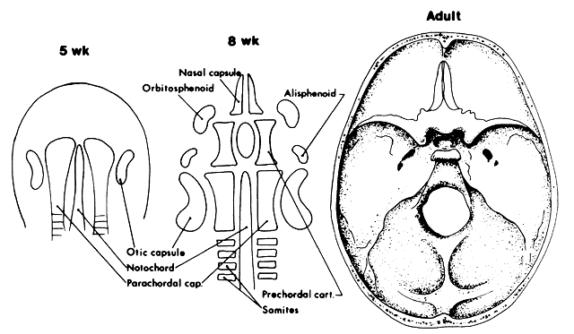

Slide 22
Chondro cranial ossification:-
Cranial base in the form of cartilages under goes ossification.
The bones of the cranial base under go both 1)Endochondral
2)Intramembranous
These bones include-
Temporal bone
Ethmoid bone
Sphenoid bone
Occipital bone

Slide 23
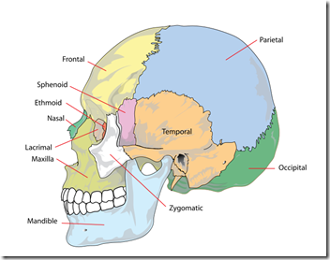

Slide 25
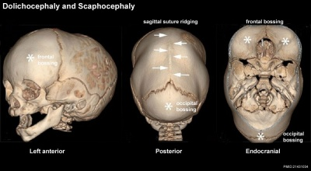
Developmental anaomolies of cranial base

Slide 26
PRENATAL EMBRYOLOGY OF MAXILLA:-
Around 4th week
It develops from 1)frontonasal process 2)medial nasal process 3)lateral nasal process

Slide 28
The maxillary process grows medially and fuses first with LATERAL NASAL PROCESS
maxillary process then moves medially to fuse with MEDIAL NASAL PROCESS.
As it fuses, the nasal pits (further called as external nares) are cut off from the stomatodeum.

Slide 29
The maxillary process undergoes considerable growth.
At the same time frontonasal process become much narrower from side to side
As a result that the two external nares come closer together

Slide 30
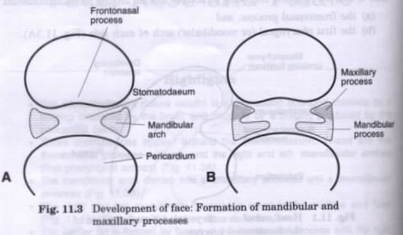

Slide 31
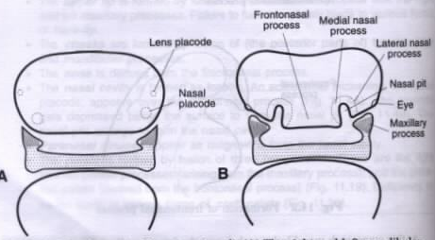

Slide 32
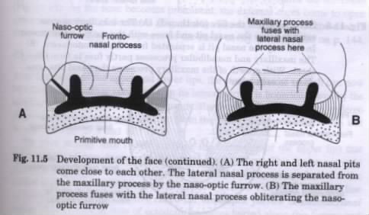
Notes:
Fusion of maxillary process with lateral nasal process.

Slide 34
DEVELOPMENT OF PALATE:-
formed by 1)premaxillary 2) Lateral palatal shelves
Two palatal shelves by 8 ½ wks of IU life are in close approximation with each other
Ossifications-from 8th week of intra uterine life.
Midpalatal suture- 12th to 14th yr.

Slide 35
The fusion of 3 palatal components initially produces a flat, unarched roof to the palate.
The site of junction of 3 components is marked by incisive papilla overlying the incisive canal
This can be traced in adult by mid palatal suture on the surface by the midline raphe of hard palate

Slide 36
ANoMaLIES / CLEFT PALATE

Slide 37
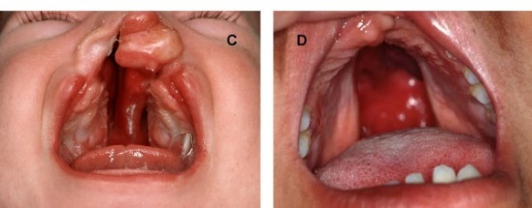
ANOMOLy OF THE PALATE-
Likely to occure during 7th and 8th week in the embryo.
Cleft palate

Slide 38
Prenatal embryology of mandible:-
Occures about 4th week of IU life.
The mandibular arch forms the lateral walls of the stomodeum,it gives of a bud from its dorsal end and this bud is called as maxillary process
It grows ventro-medially,cranial to the main part of arch which is now called the mandibular process
The mandibular processes of both sides grow towards each other and fuse in the midline
They now form the lower body of the stomodeum that is lower lip and the lower jaw

Slide 39
Meckels cartilage:-
Derived from the 1st brachial arch around 41st to 45th day.
Provide template for guiding growth of mandible
It major portion disappears during growth and remaining part develops into
Mental ossicles
Incus and malleus
Spine of the sphenoid
Anterior ligament of the malleus
Spheno-mandibular ligament

Slide 41
OSSIFICATION OF MECKEL’S CARTILAGE

Slide 42
Fate of Meckel’s cartilage
Meckel’s cartilage lacks enzyme phosphatase
Major part of it disappears by 24th week of conception
A small part transforms into sphenomandibular and anterior malleolar ligaments
Meckel’s cartilage dorsal to mental foramen gets resorbed on the lateral surface.

Slide 43
Endrochondral bone formation
Seen only in three areas
1)the condylar process
2)the coronoid process
3)mental region

Slide 44
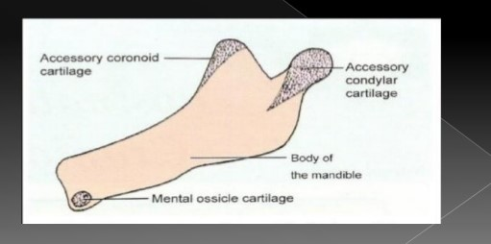
Endrochondral bone formation
Seen only in three areas
1)the condylar process
2)the coronoid process
3)mental region

Slide 45
SECONDARY ACCESSORY CARTILAGES appear between the 10th and 14th weeks of IUL
to form 1)head of the condyle
2)coronoid portion
3)portion of mental protruberance

Slide 46
Secondary cartilage of coronoid process
Develop within temporalis muscle
Incorporated into intramembranous bone of ramus
Disappear before birth

Slide 47
Secondary cartilage at Mental region
1 or 2 small cartilage→ ossify→ mental ossicles(7th month) in fibrous tissue of symphysis
It gets incorporated into intramembranous bone

Slide 48
CONGENITAL ANOMOLIES IN MANDIBLE
1)MANDIBULOFACIAL DYSOSTOSIS (TREACHER COLLINS SYNDROME)
2)DOWN’S SYNDROME (TRISOMY 21)
3)TURNERS SYNDROME(XO SEX CHROMOSOME COMPLEMENT).
MACROGNATHIA producing prognathism is generally an inherited condition but abnormal growth phenomena such as hyperpituitarism may also produce mandibular overgrowth of increasing severity with age
AGNATHIA is complete absence of mandible.

Slide 49
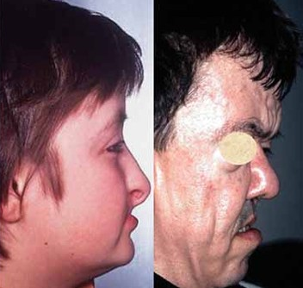
Anomalies of the mandible:-

Slide 50
Development of TMJ
Develops between 7th to 12th week of gestasion
It develops from two separate blastemas
Primary joint-occursat7th week
- exists for 4 months
- cartilage ossifies
- becomes incorporated middle ear
Secondary joint –after 3 months of gestation

Slide 53
TMJ Ankylosis

Slide 54
GROWTH AND DEVELOPMENT OF THE FACE

Slide 55
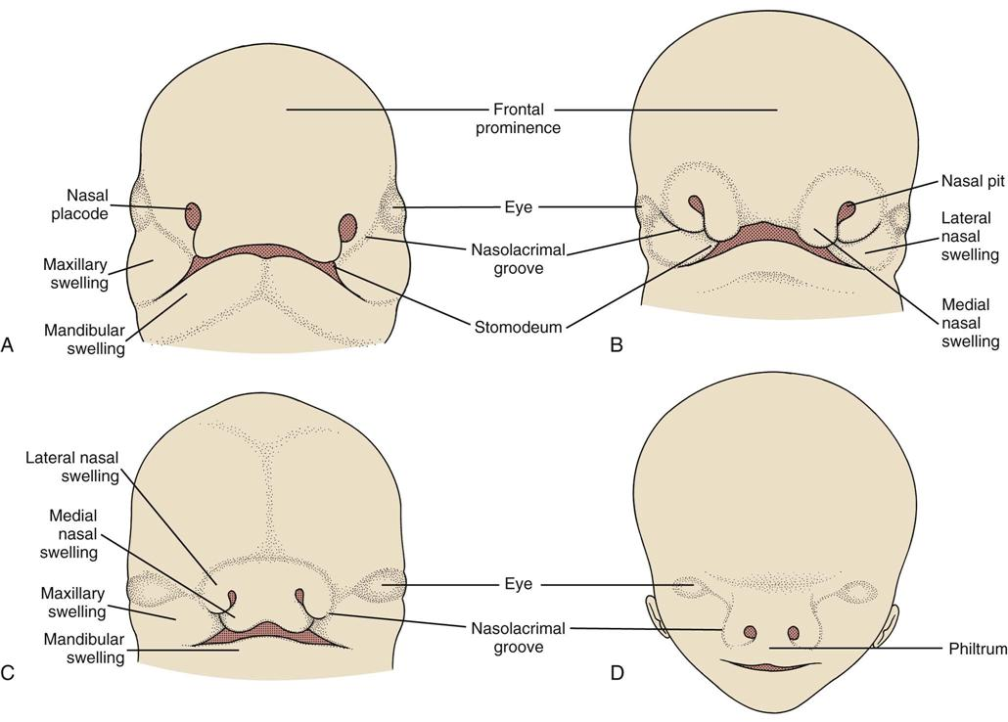
Prenatal development of face:-

Slide 56
LOWER LIP
Mandibular process of two sides grow towards each other
Fuse in mid line
Forms lower mergin of stomodeum
Lower lip forms

Slide 57
Anomoly of lower lip
Congenital lip pits & fistulae

Slide 58
UPPER LIP
Maxillary process grow medialy
Fuse with lateral nasal process
Nasal pits becomes narrow
Frontonasal process becomes much narrow from side to side
Gets separate from stomodeum
Upper lips form

Slide 59
Anamolies of upper lip and lowerlip:-
Teratogens likely to cause lip defects if the embriyois exposed to them during 5th and 6th weeks
Harelip
Congenital lip pits & fistulae
Cleft lip –

Slide 60
Nose:-
Nose receives contribution from three process
1)Fronto nasal process
2)Medial nasal process
3)Lateral nasal process

Slide 61
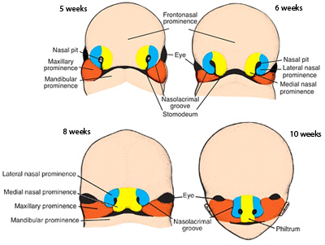

Slide 63
Cheeks:-
After formation of upper and lower lip the stomatodaeum is very broad.
In its lateral part, it is bounded above by the maxillary process and below by the mandibular process
This process undergoes progressive fusion with each other to form cheeks.

Slide 64
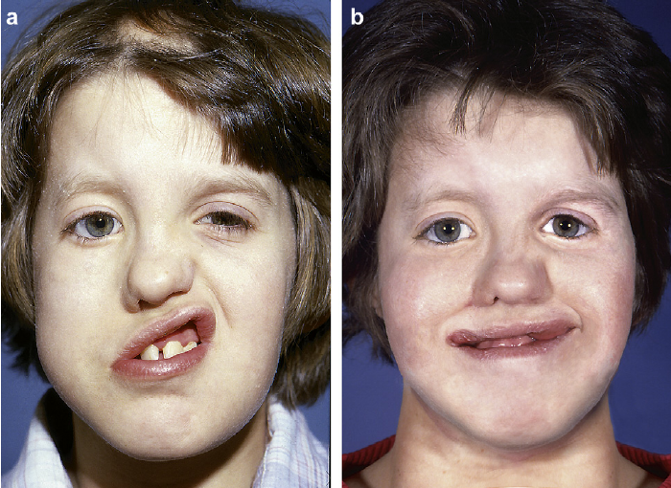
Developmental anomalies of cheeks

Slide 65
EYE.
Ectodermal thickening-Lens placode.
Appears lateral and cranial to nasal placode
lens placode sinks below and cut off ectoderm
Developing eyeball produces bulging in that portion
Bulging of the lies in angle to maxillary and lateral nasalprocess
With narrowing of frontonasal process they come to face forward
Eyelids derived from folds of ectoderm

Slide 66
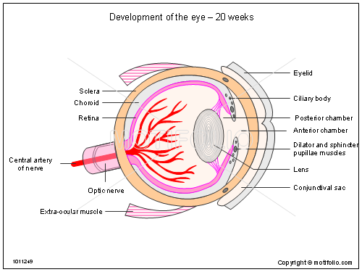

Slide 67
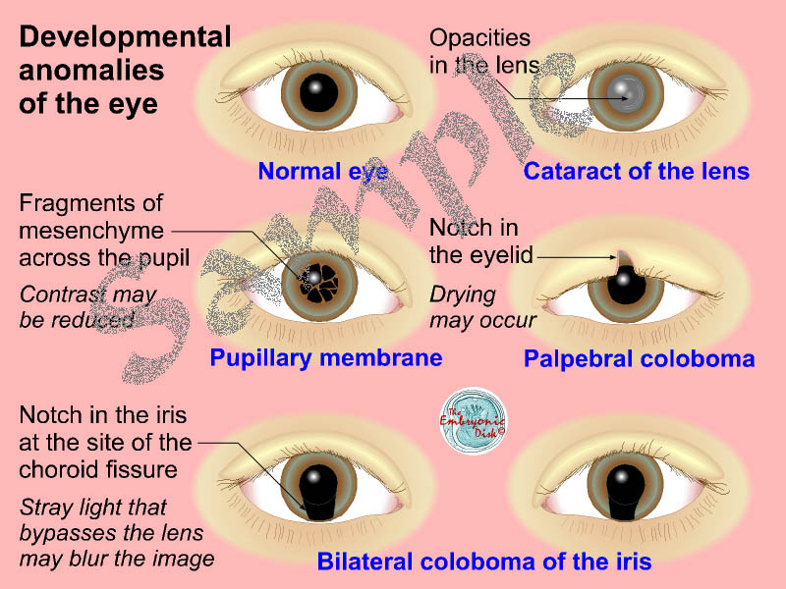

Slide 68
External ear:-
It forms around dorsal pat of first ectodermalcleft
Series of mesodermal thickening appears
They are on mandibular and hyoid arches
Joins the clefts
Pinna is formed by fusion of this thickening

Slide 69
THE EARS
FORMED FROM THE DORSAL PART OF THE 1ST ECTODERMAL CLEFT.
APPEARANCE OF SERIES OF MESODERMAL THICKENINGS OFTEN CALLED TUBERCLES OR HILLOCKS.
PINNA OF THE EAR
FUSION

Slide 71
Development of the nasal cavity:-
Formed by extension of nasal pits
These pits are in open communication with somatodeum
Medial and lateral nasal process fuses and formed partition between stomatodeum and pit this is known as primitive plate.
This nasal pits are now deepen into nasal sacs.

Slide 73
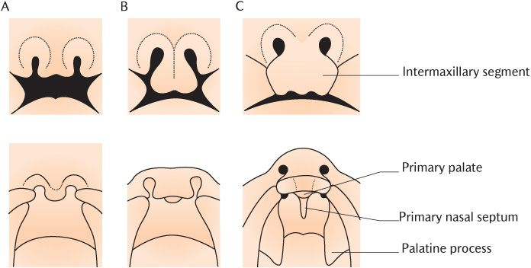

Slide 74
Anamolies of nasal cavity:-
Congenital defects in cibriform plate of ethmoid bone may lead to a communication between cranial cavity and nose
Deflected nasal septum
Nasal cavity may communicate with mouth

Slide 75
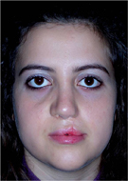
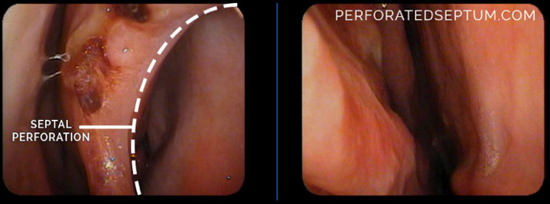
Deviated septum and perforated nasal cavity

Slide 76
Teeth
Teeth are formed in relation to alveolar process
It occurs in four stages
1)bud stage
2)cap stage
3)bell stage
4) advanced bell stage

Slide 78
Developmental anomalies of teeth

Slide 79
Development of tongue:-
Develops from the pharyngeal arches
Anterior two-thirds forms from two lingual swelling and tuberculum Ipmar
Posterior one-third from –hypobranchial eminence
Posterior most part from-fourth arch

Slide 80
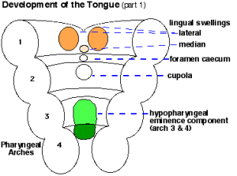

Slide 81
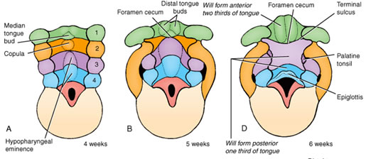

Slide 82
Anamolies of tongue:-
Macroglossia
Microglossia
Aglossia
Ankyloglossia
Fissured tongue
Bifid Tongue
Median rhomboid glossitis
Geographic tongue

Slide 83
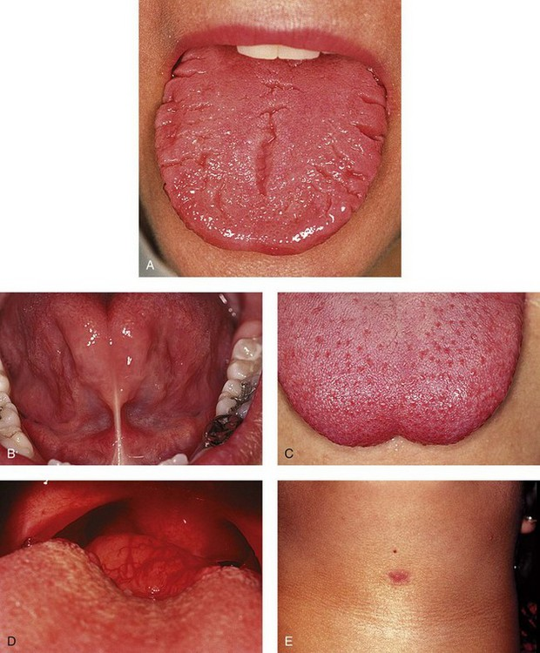

Slide 84
Salivary glands:-
Develops as outgrowths as buccal epithelium
The outgrowths are first solid and then canalized
They branch repeatedly to form duct system
Terminal part of the duct system develop in secretory acini.
Parotid gland arises in relation to line along with maxillary and mandibular processes to form cheek
The outgrowths for the submandibular and sublingual glands arise in relation to the linguo-gingival sulcus

Slide 85
Anamolies of salivary gland:-
Aberrant salivary gland
Aplasia
Hyperplasia
Autoimmune disease that Sjorens syndrome
Sialadentis

Slide 86
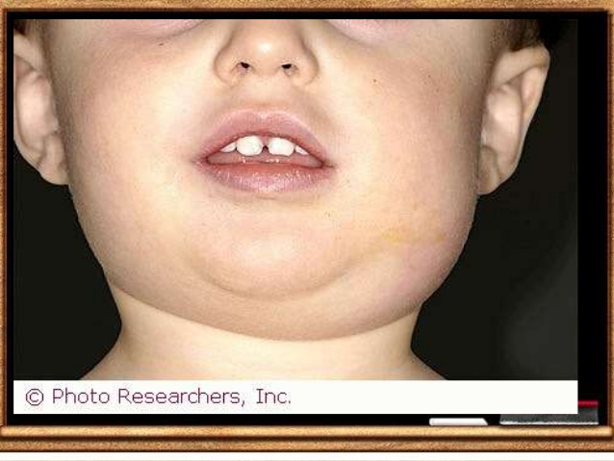
SJOGRANS SYNDROME

Slide 87
DEVELOPMENTAL ANOMOLIES OF FACE
HAIR LIP-When both maxillary process do not fuse with mesial nasal process.generally seen in upper lip.
OBLIQUE FACIAL CLEFT-Non fusion of maxillary and lateral nasal process.
MACROSTOMIA-Inadequate fusion of maxillary and madibular process with each other leads to wide mouth.
MICROSTOMIA-Too much fusion of maxillary and mandibular process.
LATERAL FACIAL CLEFT-Unilateral lack of fusion of maxillary and mandibular process.
BIFID NOSE-due to bifurcation of frontonasal process.may be associated with cleft lip.
PROBOSCIS-cylindrical projection of nose.
MANDIBULAR FACIAL DYSOSTOSIS.

Slide 88
UNUSUAL FACIAL ANOMALIES

Slide 89
SUMMURY-

Slide 90
CONCLUSION
SO,thorough understanding of complex craniofacial growth is of great importance for us
Understanding of developing craniofacial skeletal represents some of growth of its separate parts.

Slide 91
References:-
Human embryology by Inderbir singh and G.P.Pal
Orthodontics book by S.I.Bhalajhi-5th edition
Textbook of pediatric dentistry by Damle
Fundamentals of pediatric dentistry by Shobha Tandon

Slide 92
THANK YOU.

