Slide 2
HEALTH AGENCIES AROUND THE WORLD

Slide 3
Definition of Health
Health is a state of complete physical, mental and social well – being, not merely the absence of disease or infirmity (WHO)

Slide 4
Definition of International Health
“This is a health activity involving persons communities and/or institutions in two or more countries.’’

Slide 5
INTRODUCTION
THE INTERNATIONAL RED CROSS AND RED CRESCENT MOVEMENT
THE PAN AMERICAN SANITARY BUREAU(PASB)
THE OFFICE D’HYGIENE PUBLIQUE(OIHP)
THE ROCKEFELLER FOUNDATION
THE HEALTH ORGANIZATION OF THE LEAGUE OF NATIONS
INTERNATIONAL LABOUR ORGANIZATION(ILO)

Slide 6
THE FORD FOUNDATION
THE UNITED NATIONS RELIEF AND REHABILIATION ADMINISTRATION(UNRRA)
THE WORLD BANK GROUP
COOPERATIVE FOR ASSISTANCE AND RELIEF EVERYWHERE(CARE)
THE FOOD AND AGRICULTURE ORGANIZATION(FAO)

Slide 7
UNITED NATIONS CHILDREN’S FUND(UNICEF)
WORLD HEALTH ORGANIZATION(WHO)
THE COLOMBO PLAN
UNITED STATES AGENCY FOR INTERNATIONAL DEVELOPMENT(USAID)
UNITED NATIONS DEVELOPMENT PROGRAMME(UNDP)
CONCLUSION

Slide 8
INTRODUCTION
The concept of public health today has changed in a striking manner and a vast network of public health units have evolved.
The smallest of these cater to the health needs of small rural areas; the largest, the world health organization, concerns itself with the entire world.

Slide 9
Two kinds of agencies carry on public health work:
Governmental and non governmental.
Governmental agencies are those supported by public taxation and operated by national or state governments.
Non-governmental organization(NGO)
Is a legally constituted organization created by natural or legal persons that operates independently from any government.

Slide 10
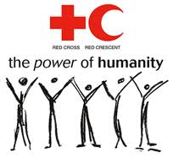
THE INTERNATIONAL RED CROSS AND RED CRESCENT MOVEMENT
The International Red Cross and Red Crescent Movement is the world’s largest humanitarian network. The movement is neutral and impartial, and provides protection and assistance to people affected by disasters and conflicts.
IT HAS THREE MAIN COMPONENTS:
The International Committee of the Red Cross(ICRC)
The International Federation of Red Cross and Red Crescent Societies
186 member Red Cross and Red Crescent Societies

Slide 11
The seven fundamental principles of the Red cross and Red crescent
1.Humanity
The International Red Cross and Red crescent Movement, born of a desire to bring assistance without discrimination to the wounded on the battlefield, endeavors, in its international and national capacity, to prevent and alleviate human suffering wherever it may be found. Its purpose is to protect human life and health and to ensure respect for human being. It promotes mutual understanding, friendship, cooperation and lasting peace amongst all people.
2.Impartiality
It makes no discriminant as to nationality, race, religious beliefs, class or political opinions. It endeavors to relieve the suffering of individuals, being guided solely by their needs, and to give priority to the most urgent cases of distress.
.

Slide 12
3.Neutrality
In order to continue to enjoy the confidence of all, the movement may not take sides in hostilities or engage at any time in controversies of a political, racial, religious or ideological nature
4.Independence
The movement is independent. The National Societies must always maintain their autonomy so that they may be able at all times to act in accordance with the Principles of the movement.

Slide 13
5. Voluntary service
It is a voluntary relief movement not prompted in any manner by desire for gain.
6. Unity
There can be only one red cross or one red crescent society in any one country. It must be open to all. It must carry its humanitarian work throughout its territory.
7. Universality
The international red cross & red crescent movement is worldwide, in which all societies have equal status & share equal responsibilities & duties in helping each other.

Slide 14
THE INDIAN RED CROSS SOCIETY
The Indian red cross is a voluntary humanitarian organization which came into existence in the year 1920 through an Indian Parliamentary Act. The mission of the Indian red cross is to inspire, encourage & initiate at all times all forms of humanitarian activities so that human suffering can be minimized & even prevented & thus contribute to creating a more congenial climate for peace.

Slide 15
The various activities of red cross society of Indian can be outlined as follows;
a) Social & Relief Work
b) Supplies Of Essential Items
c) Maintenance Of Blood Banks
d) Services For Maternal & Child Welfare
e) Medical Care For Defence Forces
f) Family Planning Services
g) First Aid Services

Slide 16
THE PAN AMERICAN SANITARY BUREAU (PASB)
The PASB, the oldest international health agency in the world, is the secretariat of the Pan American Health Organization(PAHO). It was set up in 1902 in Washington to serve the objectives for the American continent. In 1958, its name was changed to PAHO.
The Bureau is committed to providing technical support & leadership to PAHO member states as they purse their purse their goal of health for all & they values therein.

Slide 17
THE OFFICE INTERNATIONAL D’HYGIENE PUBLIQUE (OIHP)
The Office International D’Hygiene Publique (OIHP) was created under the arrangements signed in Rome on 9 December 1970 & was governed by the authority of the permanent committee composed of delegates technically qualified in the field of health, designated by the member states. Responsibilities of the office were the administration of the international sanitary conventional, the service of epidemiological intelligence & collection & dissemination to member states of information of general public health importance.
.

Slide 18
The office was dissolved under the protocol provided for OIHP in the arrangements signed on 22 July 1946. Its epidemiological service was officially transferred to the Interim Commission of WHO on 1 January 1947

Slide 19
THE ROCKEFELLER FOUNDATION
In 1913, the Rockefeller Foundation was officially founded with the purpose of promoting the well being of human populations around the world.
The Rockefeller Foundation has been active with its work in India since 1920. The first of its working this country was a project for the control of hookworm infections. The foundation is mainly responsible for the establishment of the All India Institute Of Hygiene & Public Health in Calcutta. The programs sponsored by this foundation in India includes:

Slide 20
a. Training of competent research workers.
b. Scholarships to candidates from India for trainings or research in foreign countries.
c. Financial assistance to teaching institutions & research projects.
d. Setting up of libraries in medical colleges.
e. Assistance for improvements in the field of agriculture, family planning, rural health etc.

Slide 21
THE HEALTH ORGANIZATION OF THE LEAGUE OF NATIONS
The League of Nations was an international organization founded as a result of the Treaty of Versailles in 1919-1920. The league’s goals included disarmament, preventing war through collective security, settling disputes b/w countries through negotiation, diplomacy & improving global quality of life.

Slide 22
The organization did outstanding works in the fields of nutrition, malaria, biological standardization, & rural hygiene. It gave international help to governments in fighting epidemics; it started the series of periodical epidemiological reports, now issued by the WHO. It greatly extended the epidemic intelligence service begun by the International Office of Public Health in Paris, & established a Far Eastern Bureau at Singapore for that purpose.
The League of Nations was dissolved in1939, but its health organization in Geneva continued the publication of the weekly epidemiological record.

Slide 23
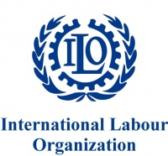
INTERNATIONAL LABOUR ORGANIZATION
The ILO is a relatively old organization dating from the end of the first world war. It was formed in 1919 with its headquarters in Geneva, Switzerland.
The main purpose of establishment of ILO was for improving the living & working conditions of the working population in different parts of the world.
.

Slide 24
The primary function of ILO is the establishment of conventions safeguarding the conditions of labour. The functions of ILO include:
Establishment of peace by promoting social justice.
2. To improve the living standards & labour conditions of working people around the world.
3.To promote economic & social stability. The ILO co-operates with WHO in industrial health, in the hygiene of ships & the health of seamen, & in the study of social & health insurance schemes

Slide 25
THE FORD FOUNDATION
The Ford Foundation was established on January 15, 1936. It stated that resources should be used “for scientific, educational & charitable purposes, all for the public welfare”.
The Ford Foundation established an office in India in 1952. Functions are providing funds to academic institutions, research organizations, government agencies & civil society groups.
Over the past 5 decades, major commitments have been made in these areas:
Agriculture & rural development
Forest & natural resource management.
Reproductive health
Microfinance & livelihood

Slide 26
Human rights.
Local-global governance
Civil society
Higher education & scholarship
Arts & culture
Regional cooperation & international security
Grants in these fields have been designed to strengthen individual & institutional capabilities, to support innovative concepts & approaches & to promote the sharing of knowledge.

Slide 27
THE UNITED NATIONS RELIEF & REHABILITATION ADMINISTRATION (UNRRA)
The UNRRA was created at 44- nation conference at the white House on November 9, 1943. Its mission was to provide economic assistance to European nations after second world war & to assist the refugees who would come under Allied control.
UNRRA was wound up in 1946-47, & some of its residual funds were given to the International Refugee Organization & The Interim Commission of the World Health Organization, with the largest share going to the United Nations Children’s Fund (UNICEF).

Slide 28
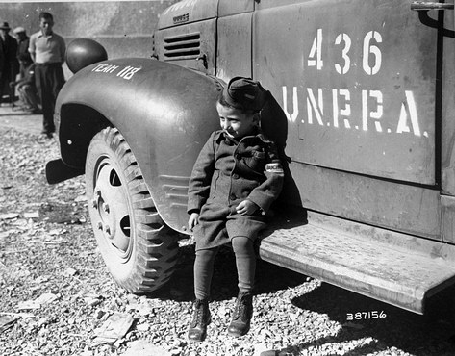

Slide 29
THE WORLD BANK GROUP
The World Bank Group comprises of 5 Organizations:
1.The International Bank for Reconstruction & Development (IBRD)
The IBRD, frequently called the “ World Bank” is the main leading organization of the World Bank Group & was conceived in July 1944 at the United Nations Monetary & Financial Conference in Bretton Woods, New Hampshire, US.

Slide 30
2.The International Finance Corporation (IFC)
The IFC formally came into existence on 14 July 1956 as a separate legal entity affiliated with the IRBD. The International Finance Corporation is the member of the World Bank Group that promotes the growth of the private sector in less developed member countries. The IFC’s principal activity is helping finance individual private enterprise projects that contribute to the economic development of the country or region where the project is located. The IFC is the World Bank Group investment bank for developing countries.

Slide 31
3.The International Development Association (IDA)
The International Developmental Association (IDA), an affiliate of the World Bank, was established in 1960 to promote economic development in the World’s poorest countries-those that cannot afford to borrow from the IBRD.
4.The International Centre for the Settlement of Investment Disputes (ICSID)
The ICSID is an autonomous institution founded in 1966 to promote increased flows of international investment by providing facilities for the conciliation & arbitration of disputes b/w governments & foreign investors.

Slide 32
5.The Multilateral Investment Guarantee Agency (MIGA)
MIGA was established in 1988. Its purpose is to promote the flow of foreign direct investment among member countries by insuring investments against non-commercial (political) risk, & by providing promotional & advisory services to help member countries create an attractive investment climate.

Slide 33
COOPERATIVE FOR ASSISTANCE & RELIEF EVERYWHERE, (CARE)
CARE is one of the world’s largest private humanitarian organizations. It was founded in 1945, when 22 American organizations came together to rush lifesaving CARE packages to survivors of second world war.
Overs the years, their work has expanded to address the world’s most threatening problems such as hunger, famine & primary health care.
,

Slide 34
In India, CARE has been involved with many feeding programs like mid-day meal scheme for school children , health care programs, educational & vacational training etc.. The CARE also provides mobile medical units, medical equipment's, medicines etc. for the health care of the rural people

Slide 35
THE FOOD & AGRICULTURE ORGANIZATION (FAO)
The FAO was formed in the year 1945 & its headquarters is situated in Rome. This is an organization concerned with human diseases of animal origin, with nutrition & with rural hygiene.
FUNCTIONS:
Providing help to all nations to fight poverty & to raise the living standards of their people.
Ensuring adequate availability of food to people of all nations through increased production of food.

Slide 36
Helping nations to increase the efficiency in the fields of farming, forestry & fishing.
Campaigning for the freedom from hunger in all nations.
Helping the nations to better the conditions of their people in rural areas.

Slide 37
UNITED NATIONS CHILDREN’S FUND (UNICEF)
The UNICEF was created by the General Assembly during its first session in 1946. It was then called United Nations International Children’s Emergency Fund. The headquarters of UNICEF is situated in New York. It has 8 regional offices in different parts of the world. The UNICEF Regional Office for South Asia (ROSA) is at New Delhi, which includes India, Srilanka, Afghanistan, Maldives, Nepal, Bangladesh, Bhutan & Pakistan. The main purpose was to meet the emergency needs of the children around the world.

Slide 38
FUNCTIONS
Combining humanitarian & development objectives, UNICEF cooperates with countries in their efforts to protect their children & to enable them to develop their full potential. UNICEF has its goal as the realization of every child of the opportunity to enjoy the basic rights & privileges, & to contribute to their country’s progress & well being.
UNICEF Cooperates with over 137 developing countries in several ways:
1.It assists in the planning & extension of services benefiting children, in consultation with the countries concerned.

Slide 39
2. It provides support to strengthen the training & orientation of national personnel including health & hygiene functionaries, teachers, nutritionists & child-welfare specialists.
3. It supports activities related to women’s empowerment as well as community participation in implementation & monitoring of services benefiting children & women.
4. It helps in the development of appropriate communication material for advocacy & information dissemination & education.
5. It delivers technical supplies, equipment & other aids.

Slide 40
UNICEF promotes a movement for basic needs & advocates with the states to promote primary education, tom protect children against diseases, to provide household food security, to promote family planning, to encourage breastfeeding, to combat specific problems such as iodine deficiency or vitamin-A disorders, to support immunization & polio eradication, to promote today’s health knowledge, & to protect children who are abused at home, at work or in difficult situations.

Slide 41
THE WORLD HEALTH ORGANIZATIONS (WHO)
The WHO is a specialized agency within the charter of the United Nations, which is non-political in its function. WHO was established in the year 1948 by 61 governments “ for the purpose of co-operation among themselves & with others to promote the health of all people”. WHO serves as the directing & coordinating authority for international health matters & public health. One of WHO’s constitutional functions is to provide objective & reliable information in the field of human health, a responsibility that it fulfills in part through its extensive program of publications.

Slide 42
The Constitution of WHO:
“The state parties to this constitution declare, in conformity with the charter of the United Nations, that the following principles are basic to the happiness, harmonious relations & security of all peoples.
‘Health is a state of complete physical, mental & social well being & not merely the absence of disease or infirmity.
The enjoyment of the higher attainable standard of health is one of the fundamental rights of every human being without distinction of race, religion, political belief, economic or social condition.

Slide 43
The health of all peoples is fundamental to the attainment of peace & security & is dependent upon the fullest co-operation of individuals & states.
The achievement of any state in the promotion & protection of health is of value to all. Unequal development in different countries, in the promotion of health & control of disease, especially communicable disease, is a common danger.
Healthy development of the child is of basic importance; the ability to live harmoniously in a changing total environment is essential to such development

Slide 44
.
The extension to all people of the benefits of medical, psychological & related knowledge is essential to the fullest attainment of health.
‘ Informed opinion & active co-operation on the part of the public care of the utmost importance in the improvement of the health of the people.
Governments have a responsibility for the health of their peoples, which can be fulfilled only by the provision of adequate health & social measures

Slide 45
. Structural organizations of who: It consists of;
1.THE WORLD HEALTH ASSEMBLY(or Parliament);
The world health Assembly is the supreme decision-making body for WHO. It generally meets in Geneva in May each year, and is attended by delegations from all 193 Member States. Its main function is to determine the policies of the organization. The Health Assembly appoints the Director-General, supervises the financial policies of the organization, and reviews and approves the proposed program budget .
It similarly considers reports of the Executive Board, which it instructs in regard to matters upon which further action, study, investigation or report may be required

Slide 46
.2. The Executive Board(or Cabinet):
The Executive Board is composed of 34 members technically qualified in the field of health. Members are elected for three-year terms. The main board meeting, at which the agenda for the forthcoming Health Assembly is agreed upon and resolutions for forwarding to Health Assembly are adopted, is held in January, with a second shorter meeting in May, immediately after the Health Assembly, for more administrative matters. The main functions of the board are to give effect to the decisions & policies of the Health Assembly, to advise it & generally to facilitates its work.

Slide 47
3.The secretariat:
The secretariat of WHO is staffed by some 8000 health and other experts & support staff on fixed-term appointments, working at headquarters, in the six regional offices, and in countries. The Organization is headed by the Director general, who is appointed for a five year term by the Health Assembly on the nomination of the Executive Board.
Regional directors are appointed by the board with the agreement of the relevant regional committee. The personnel at WHO Headquarters are appointed by the Director-General in accordance with staff regulations established by the assembly & by agreement between the Director-General and the Regional Director.

Slide 48
WHO has its own governing bodies, its own membership and its own budget. While the member making the largest contribution is assessed at one-quarter of the WHO budget,
The smallest contributors each pay only one-hundredth of it. Nevertheless, each member has one vote, irrespective of the size of its contribution. WHO receives voluntary contributions from both governmental and non-governmental sources.
The headquarters and regional offices
WHO Headquarters, situated in Geneva, Switzerland, is responsible for establishing technical and administrative policies & procedures that are applicable throughout the organization. In general, all technical activities that are of universal applicability such as biological standardization, the overall assessment of the efficiency of methods and materials, promoting the control of diseases- are the responsibility of headquarters.

Slide 49
A characteristic feature of WHO is its decentralization. Control of general policy and of finance is retained in Geneva, with certain of the statutory functions, such as quarantine, but other functions are as far as possible decentralized to the regional organizations. It has six ‘regional organizations’, each consisting of a Regional Committee & a Regional Office. The Regional offices were set up b/w 1948 & 1952.
The regional offices are responsible for formulating policies of a regional character & for monitoring regional activities. Regional Directors are normally appointed from one of the countries of the corresponding region. The Regional Director is the technical & administrative head of a regional office.

Slide 50
WHO’S Aim
The attainment of all peoples of the highest level of health.
Health is defined as a state of complete physical, mental and social well-being,& not merely the absence of disease or infirmity.

Slide 51
Functions of WHO
WHO-main UN agency that directs & coordinates health.
Six core functions, they include:
Provide leadership on global health matters.
Shaping health research agenda.
Set norms & standards& monitor implementation.
Articulate ethical & evidence based policy options.
Provide technical support.
Monitor health situations & assess health trends.

Slide 52
THE ROLE OF WHO IN PUBLIC HEALTH
Providing leadership on matters critical to health & engaging in partnerships where joint action is needed;
Shaping the research agenda & stimulating the generation, translation & dissemination of valuable knowledge;
Setting norms & standards & promoting & monitoring their implementation;
Articulating ethical & evidence-based policy options;
Providing technical support, catalyzing change & building sustainable institutional capacity; & Monitoring the health situation & assessing health trends.

Slide 53
THE COLOMBO PLAN
The organization was born out of a commonwealth conference of Foreign Ministers, held in Colombo, in January 1950. The main objective of Colombo plan is for co-operative economic & social development in Asia & the Pacific countries. The main function of Colombo plan is providing assistance to its member countries in the field of agricultural & industrial development. It also provides support for health promotion. The Colombo plan has grown from a group of 7 common wealth nations (Australia, Britain, Canada, Srilanka, India, New Zealand & Pakistan) into an international organization of 26 countries.

Slide 54
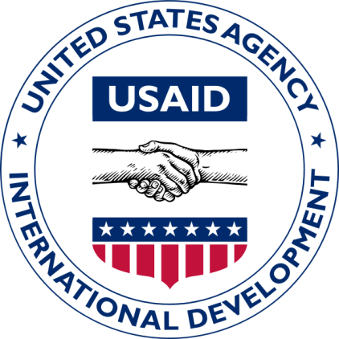
UNITED STATES AGENCY FOR INTERNATIONAL DEVELOPMENT (USAID)
The USAID was established in 1961 with the aim of helping countries in their economic & social development. The USAID assists India in a wide variety of projects for the improvement of health of the people. These projects include;
Support to National Health Programs like malaria eradication.
Supports in the field of medical, nursing & health education

Slide 55
Supports to projects related to water supply & sanitation.
Supports for projects related to the control of communicable diseases.
Supports for projects in nutrition & family planning.

Slide 56
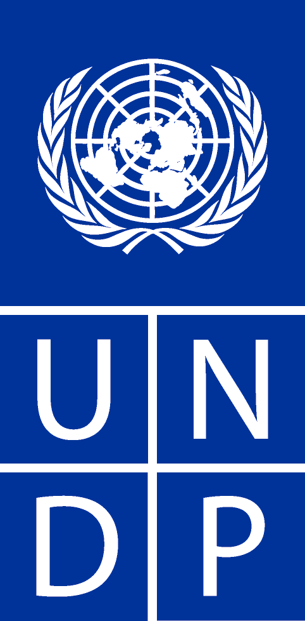
UNITED NATIONS DEVELOPMENT PROGRAM (UNDP)
The organization was established in 1966. The UNDP serves as the main source of funds for technical assistance to both developed & developing countries. The main objective of this organization is to help nations in strengthening their natural & human resources.
The UNDP takes up several projects in different parts of the world, covering economic & social sectors like agriculture industry, education & science, health, social welfare etc…

Slide 57
CONCLUSION
International Health has come to comprise those problems in the field of health, which require consideration & action by more than one country. Such problems may be dealt with officially by governments or unofficially by National or International voluntary associations.

