Slide 2
Good morning

Slide 3
Evaluation
1

Slide 4
Contents
Introduction
Definition
Types of evaluation
Steps In Evaluation – CDC Framework
Public Health significance
Conclusion
References
2

Slide 5
Introduction
It measures the degree to which objectives and targets are fulfilled and the quality of the results obtained.
It is an applied research
Involves value judgments
It measures how much output or cost effectiveness is achieved.
3

Slide 6
Definition -
4

Slide 7
Criteria used in the evaluation of dental service (1972)
4

Slide 8
Types Of Evaluation
Donabedian classified evaluation research into
Structure evaluation:
Process evaluation:
Outcome evaluation:
5

Slide 9
Structure
Process
Outcome
6

Slide 10
Scriven (1967) classified evaluation research into two types:
Formative evaluation – e.g. A fluoride rinse programme is initiated at neighberhood health centre in which paraprofessionals are trained to administer 3 types of fluoride rinse under strict sequence procedure. After 3 days work of paraprofessional is observed to determine the extent to which strict procedure is being adhered
Summative evaluation
6

Slide 11
General steps
Determine what is to be evaluated
Establishment of standards and criteria
Plan the methodology
Gather information
Analyze the results
Take action
Re-evaluate
21

Slide 12
STEPS IN EVALUATION – CDC FRAMEWORK (1999)
Step 1: Engage stakeholders
These are the individuals and agencies who personally involved in the programme, who derive income from it.
8

Slide 13
Step 2: Describe the program
How, where, when, what, who
9

Slide 14
Step 3: Focus the evaluation design:
Evaluate whether programm is resolving unmet needs, providing services, improving health
Before evaluation
10

Slide 15
Step 4: Gather credible evidence
Involves collection of credible information that presents an overall picture of the program so that it can be used by evaluation’s primary users.

Slide 16
Step 5: Justify conclusions
14

Slide 17
Step 6: Ensure use and share lessons learned
Five elements are critical for ensuring use of an evaluation
Design: Evaluation’s questions, methods, processes
Preparation: Steps taken to rehearse eventual use the results
Feedback: Communication among all stakeholders
Follow-up: Providing technical and emotional support to users
Dissemination: Timely, unbiased information to stakeholders.
15

Slide 18
CDC gave 30 speciﬁc standards grouped into four categories as guidelines for evaluating a community health program. They are:
1. Utility standards ensure that the evaluation will meet the information needs of the intended users.
2. Feasibility standards ensure that an evaluation will be practical, politically viable, and cost eﬀective.
16

Slide 19
3. Propriety standards ensure that an evaluation will be conducted legally, ethically
4. Accuracy standards ensure that an evaluation will produce ﬁndings that are considered technically correct.
17

Slide 20
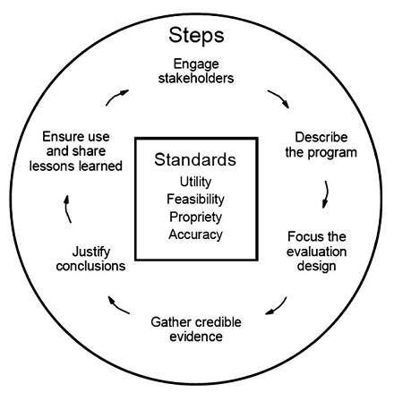
7

Slide 21
Constraints In Using Evaluation Results
Needed information was not collected.
Inappropriate timing of obtaining results
Results lack clear direction for future program
Resistance to change
Evaluation was conducted for dubious reasons
18

Slide 22
Public Health Significance
In a country like India, unmet health needs are plenty and the resources to meet them are much less than needed.
Proper planning of all community health programs is a prerequisite for efficient usage of available resources.
Community participation in planning and evaluation is essential for success of community based programs.
19

Slide 23
Public health personnel have an unique role to play in the planning process because he can understand the problem better as a physician and at the same time think in a wider perspective
20

Slide 24
^{Conclusion}
Evaluation helps to determine the worth of the programme to assess if it has been performed as prescribed and to discover whether the required performance and objectives have been achieved. It should demonstrate the extent of contribution to oral health in the target population and whether each part of the programme is relevant and appropriate.
20

Slide 25
^{References}
Park K. Textbook of Preventive and Social Medicine. 22nd edition. Banarsidas Bhanot Publications; 2013. 300-305.
Pine C, Harris R. Textbook of Community oral Health. 2nd edition. Quintessence Publication; 2007
Daly B, Watt R. Text book of Essential Dental Public Health. Oxford publishers. UK.
Jill Mason. Concepts in Dental Public Health. Lippincott Williams and wilkins publishers; 2010. 95-107
20

Slide 26
Anthony Jong. Textbook of Community Dental Health. 3rd edition. Mosby publications.
20

