Slide 1


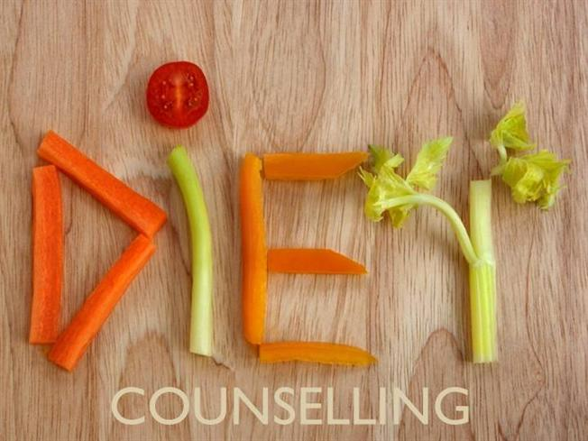

Slide 3
CONTENTS
Introduction
Diet counseling- Definition, Importance
Caries as nutritional deficiency
Current concept of caries aetiology
Concept of caries balance
Importance of diet and nutrition in pediatric dentistry
Dietary screening and education in dental practice

Slide 4
CONTENTS
Objectives of counseling
Art of counseling
Basic requirements of dietary counseling
Dental health, diet score
Food pyramid
Dietary advice
Conclusion
References

Slide 5
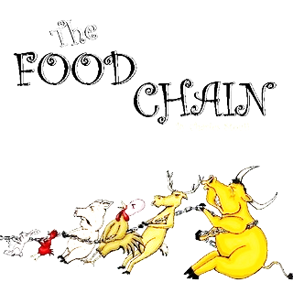
INTRODUCTION
When man broke from the natural food chain, he developed new energy resources and applied technologies to food processing, since then our dietary habits have undergone major changes.
Both the qualitative nature of our diet and pattern of eating has changed and are changing.

Slide 6
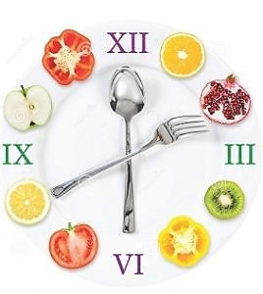
INTRODUCTION
Diet is matter of individual choice influenced by age, ethnic and religious customs, family and peer group
Ingestion of food may affect oral-dental health by both systemic and local mechanisms. Nutritional effects are mediated systematically and the dietary effects are mediated locally in the oral cavity.

Slide 7

INTRODUCTION
Dietary constituents exert their local effects by influencing the metabolism of the oral flora and by modifying salivary flow rates and, in-directly, the qualitative aspect of salivary secretions.
Also important is the manner in which food items affect taste perception and condition dietary preferences and patterns of eating.

Slide 8
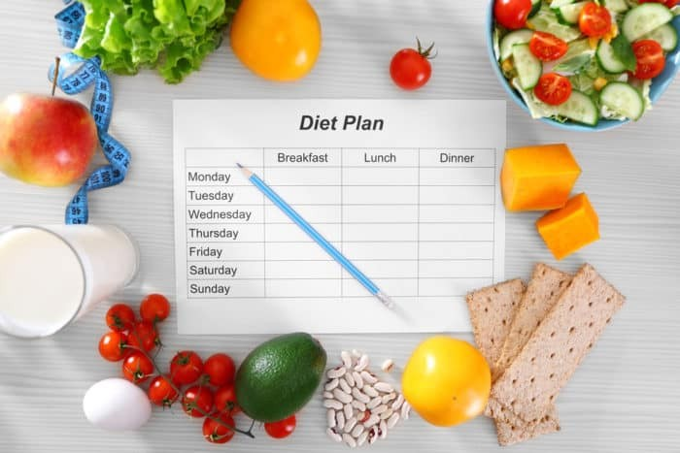
DIET COUNSELLING-
“ A Primordial Level of Prevention of Dental Caries”
Diet counselling is one of the important aspect of dental caries prevention.
The individual compliance with dietary advices given is very important
It is recommended that dietary counselling in dental disease should be comprehensive for whole human health and not just for any particular dental disease

Slide 9
DIET and NUTRITIONAL COUNSELLING-
Bunard 1992,
Defines counseling as the means by which one person helps another person to clarify his/her life situation and to decide on further lines of action
Counseling in the health care setting means a dialogue between patient and health care provider with basic aim solving problem

Slide 10
DIET AND BALANCED DIET
DIET
Nizel (1989):
Total oral intake of a substance that provides nourishment & supply.
Acc to Newbrun
One providing each nutrient in the (neither deficient nor excess)
needed to maintain optimum health.
- Stewart
Diet refers to customary allowance of food and drink taken by any person from day to day

Slide 11
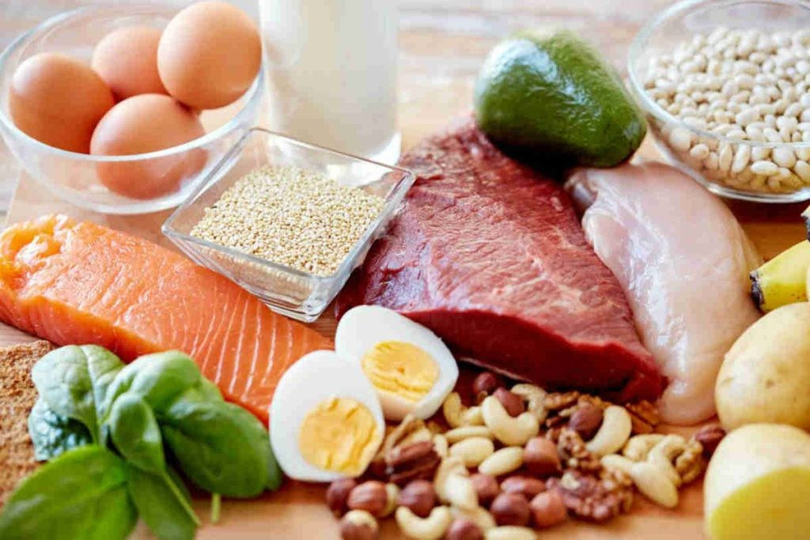
DIET AND BALANCED DIET
BALANCED DIET:
Stewart……
One providing each nutrient in the (neither deficient nor excess) needed to maintain optimum health

Slide 12
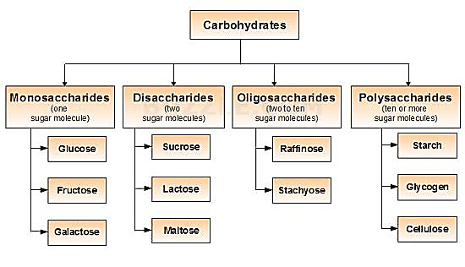
DIETARY CONSTITUENTS
POLLY SACCHARIDES AND SUGAR

Slide 13
PHYSICAL PROPERTIES OF FOOD
Mechanical properties : Hardness, cohesiveness, viscosity
Geometric properties : Particle size and shape
Others: moisture and fat content
Notes:
Food retention, food clearance, solubility, oral hygiene

Slide 14
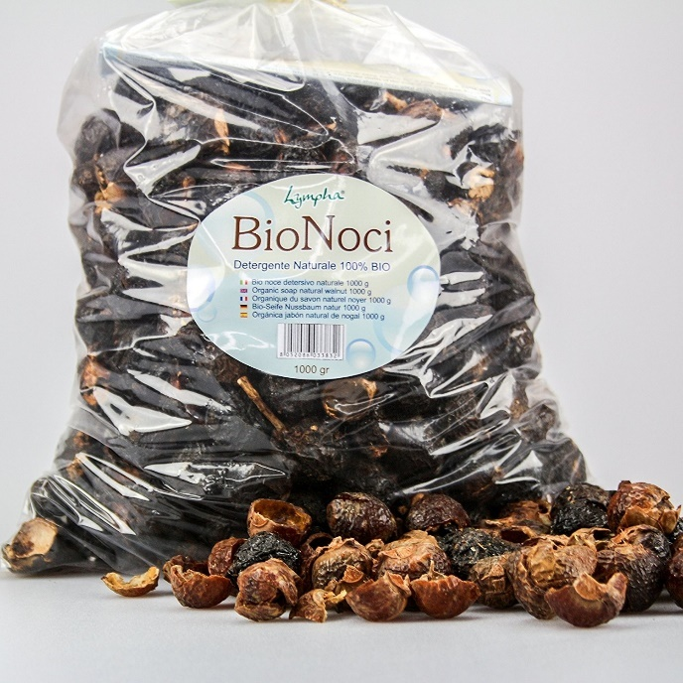
CHARACTERISTICS OF SOME FOOD
Detersive foods:
Hard or detersive foods have valuable cleansing action and remove plaque and food debris from the teeth and surrounding tissues.

Slide 15
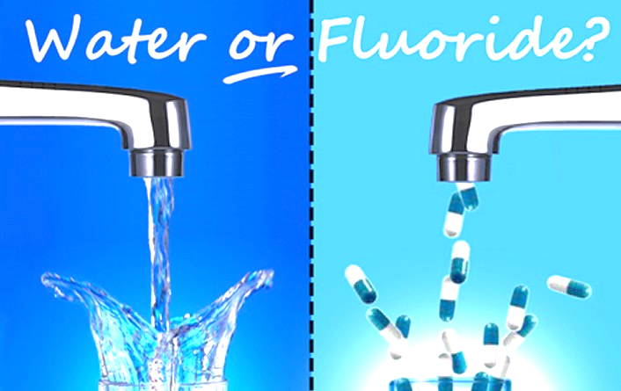
CHARACTERISTICS OF SOME FOOD
Surface acting agents:
Water fluoridation tends to reduce both the surface energy of enamel and its tendency to absorb proteins

Slide 16

ACIDITY OF FOOD
Natural Food:
Lemons, apples, fruit juices and carbonated beverages- Demineralization, etching of enamel and cavitation

Slide 17
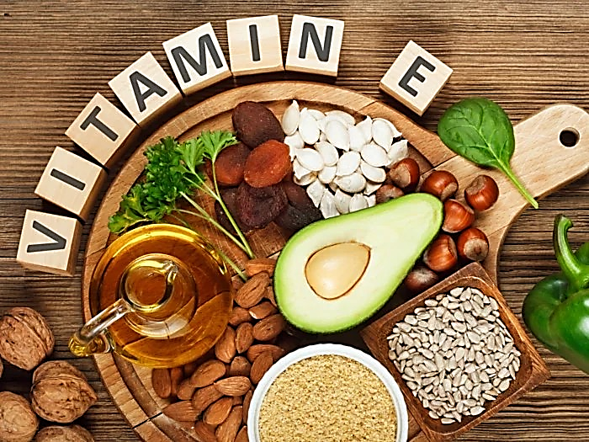
Vitamins
Vitamin D and Vitamin A- Most important aspects – development of teeth
Notes:
Vit D- Calcim and phosharas derangements- hypoplasia of teeh, Vit A- chages in ameloblast- causing alteration in tooth morphology, deleterious effect on salivary gland

Slide 18
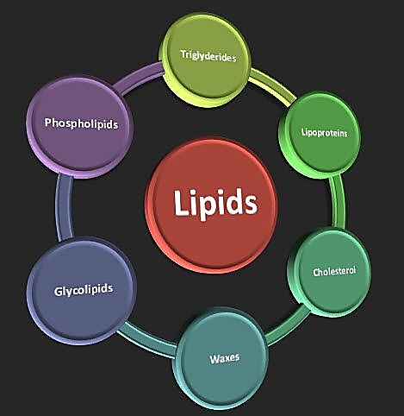
Lipids
Fat consume – Anticariogenic effect
Notes:
It protects demineralization by formation of fatty film in proximal areas

Slide 19
NUTRITION
The science which deals with the study of nutrient and foods and their effects on the nature & function of organism under different condition of age, health & disease
.
NIZEL, 1989
Nutrients are defined as the constituents of food, which perform important functions in our body.

Slide 20
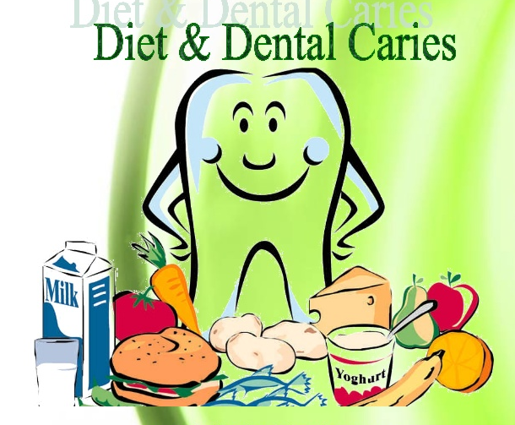
Systemic action of nutrients
General nutrition:
Mellanby,
showed that inadequate nutrition during childhood interferes with tooth development.

Slide 21
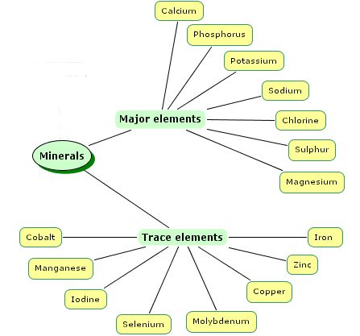
Systemic action of nutrients
SPECIFIC NUTRIENTS:
Specific nutrients such as Fluoride, trace elements like strontium, molybdenum, lithium, boron, selenium and vitamins have direct affect on subsequent susceptibility to caries.

Slide 22
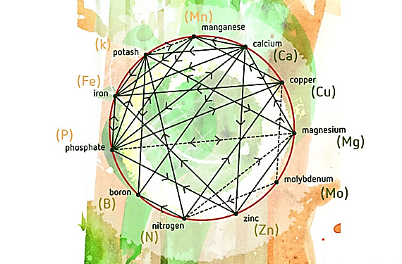
Nutrient inter-relationship

Slide 23
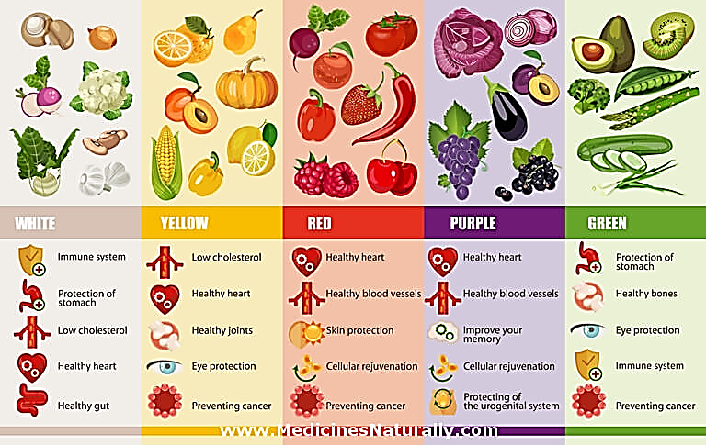
Rules for daily food selection:
“the more natural the food, the better” is a truism

Slide 24
Carcinogenicity of fermentable carbohydrate
Varies with physical form, chemical composition, route of administration and presence of other food constituents
Polysaccharides are less readily fermented by plaque bacteria than are monosaccharide.

Slide 25
Caries as Nutritional Deficiency
Some researches consider caries as nutritional deficiency caused either by sufficient phosphate intake or improper dietary calcium -phosphate ratio.
Numerous experiments on rodents have demonstrated that phosphate salts have the potential to retard dental caries.

Slide 26
Luoma 1984,
Inorganic phosphate was taken up by plaque bacteria during metabolism of carbohydrates
the phosphate being required for phosphorylation of sugars
polyphosphates store energy
steady-state equilibrium exists between the inorganic phosphate of saliva and mineral phase of enamel.

Slide 27
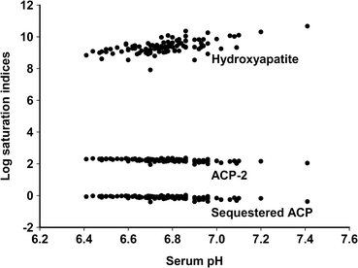
phosphate sequestration theory
  As bacteria take up phosphate, inorganic phosphate must be removed from enamel.
However, in vivo, there is a continual flow of saliva containing soluble inorganic phosphates that are more readily available to bacteria than the insoluble mineral phase of enamel, provided the saliva can diffuse through the plaque to the bacteria.

Slide 28
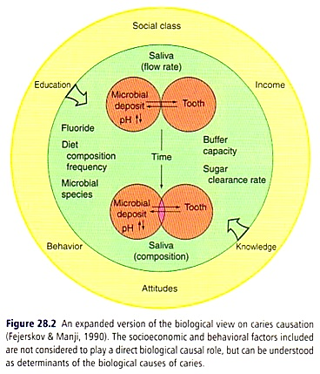
Current Concepts of Caries etiology
Fejerskov and manji concept
(1990)

Slide 29
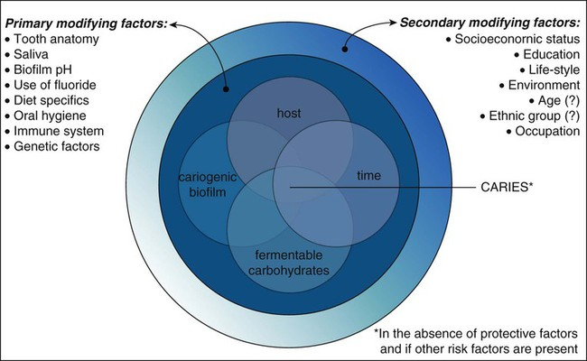

Slide 30
Concept of Caries Balance
The chronic nature of caries stems from the notion that individuals remain at risk for the development of caries throughout their lifetimes.

Slide 31
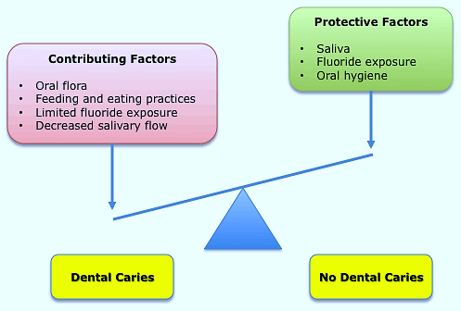

Slide 32
Importance Of Diet And Nutrition In Pediatric Dentistry
Optimal growth and development are the primary objectives of pediatric nutrition.
A child‘s diet, defined as the combination of foods consumed and the nutrients contained therein has the profound ability to influence cognition, behaviour and emotional development in addition to ultimate physical growth and development.

Slide 33
Dietary screening and education in the dental practice
Dental professionals should routinely screen patients to assess the role of diet in caries risk and management.
Dentists are not trained to conduct a complete nutritional assessment that includes
Anthropometries
Biochemical data
But……
Can use dietary screening assessment,
Analysis to provide nutrition and dietary education
Referral to registered dietitians for more in-depth nutrition counseling.

Slide 34
Objectives of Counselling
Correction of diet imbalance, that could affect the patients general health and sometimes reflect on his oral health.
Modification of dietary habits, particularly the ingestion of sucrose containing foods in forms, amount, and circumstances that cause caries formation.
Dietary recommendations must be realistic and always based on current dietary behaviours of the family .It is pointless to prescribe changes that a patient cannot or will not implement

Slide 35
Objectives of Counselling
.
Additionally, modifications to the diet can only be made over time, aided by repetition and reinforcement.
The goal must be to help caregivers develop lifelong dietary habits, which promote general and oral health for themselves and for those whom they influence

Slide 36
Art of Counselling
Counselling is ONE-ONE basis.
To be effective it should be in form of dialogues. e.g.:- Communication technique:
During a Face-face interview, keeping eye contact with the patient is persuasive and powerful device for motivating behavioural change
To communicate with a patient, a combination of interviewing, teaching, counselling and motivation is used.

Slide 37
Art of Counselling
Communication can be both verbal and non-verbal. Words transmit information.
The interviewer‘s tone of voice, facial expression and gestures convey sincerity , enthusiasm, and empathy.
The nonverbal actions can be influential in helping the patient to change his or her behavior.
Messages must be adopted to patients needs and level of understanding.

Slide 38
Basic Requisites Of Diet Counselling
A basic requisite for accomplishing dietary change is the advice that the patient not the counsellor bears the responsibility for making the change.
The counsellor should explain candidly the need for full cooperation and a sincere effort by the patient to modify the diet, and the patient should agree.

Slide 39
Model of Prenatal Counseling
Purpose :
To educate parents about dental development of the child
To educate parents about dental disease and prevention
To provide a suitable environment for the child
To strengthen and prepare the child and dentition for life

Slide 40
Methods
Education concerning development, prevention of disease
Demonstration of oral hygiene procedures
Counselling to instill preventive attitudes and motivation
Evaluation of learning, acceptance, and needs

Slide 41
Content
External Component (Parents)
Parent’s education concerning dental disease and oral hygiene
Parent’s motivation for plaque removal program changes in mother's oral health, intake of sweets, regarding pregnancy gingivitis
Myths and misconceptions about pregnancy and dentition …..parents' dental treatment

Slide 42
Internal Component (Parents and Child)
Parents' education—development of child
Effect of lifestyle on child
Habits (smoking, alcohol consumption)
Intake of sweets
Exposure to disease (e.g., rubella\ syphilis)
Effect of drugs on child—e.g., tetracyclines

Slide 43
Nutrition
Calcium
Vitamins
Fluoricles
Essential nutrients
Child's needs after birth
Breast feeding versus bottle feeding
Fluoride supplementation
Teething
Hygiene
Non-nutritive sucking
First visit

Slide 44


Honig 1975,
During prenatal counselling, teething should be mentioned because it most likely will be the first oral event that parents have to deal with.
Although the timing of eruption of teeth can usually be predicted, its occurrence frequently surprises new parents
if the infant experiences difficulties it can create parental anxiety.

Slide 45
DURING TEETHING
Lancing of tissues is usually not indicated
King 1994,
Increased fluid consumption, a non-aspirin analgesic, and palliative care consisting of teething rings to apply cold and pressure to the affected areas generally reduce the symptoms and result in a happier infant
If symptoms persist for more than 24 hours, the infant should be examined by a physician to rule out upper respiratory infection and other common diseases and conditions of infancy.

Slide 46

Nowak, 1997
Prenatal counselling programs also should provide guidelines for the parents about the timing of the first professional dental visit.
Historically, asymptomatic children were scheduled for their first dental examination between 3 and 5 years of age.
More recently, programs designed to provide comprehensive preventive measures have stressed the importance of initiating professional visits at an earlier age, at or shortly after the time of the eruption of teeth

Slide 47
Bright Futures—Guidelines for Health Supervision of Infants, Children, and Adolescents (Green, 1994) is a comprehensive and practical resource designed to assist health professionals and families to more effectively promote the health and well-being of all children and adolescents.
It recommends an initial dental appointment at around 12 months of age to assess the infant's risk for dental disease, complete a clinical examination, provide anticipatory guidance information, and schedule a follow-up appointment (Nowak and Casamassimo, 1995)

Slide 48
Diet counselling - discussion
The patient selection Five ‘W’ and one ‘H’ of diet consultation.
6 questions are to be made before making decision about which pts will benefit from diet counselling
WHO, WHAT, WHY, WHEN, WHERE AND HOW.
WHO may be benefited?
WHAT are the objectives of diet and nutrition counselling?
WHY is counselling beneficial?
WHEN is counselling conducted?
WHERE should the counselling occur?
HOW to counsel?

Slide 49
When providing dietary counselling in pediatrics, identification of the patient requires careful consideration.
Diet counselling will not succeed with every dental patient. Persons who need counselling must also want information about their potential dental caries problem and must be willing to improve current undesirable food selections and eating habits.
Potential candidates for counselling should give high priority to preventive dentistry and should be willing to expend long term efforts to maintain their natural dentition in good health for a lifetime.

Slide 50
The Dental Health Diet Score
The dental health diet score is a screening device to achieve this objective .
It is a simple scoring procedure that can disclose a potential dietary problem that is likely to adversely affect a patient‘s dental health.
From this sum points are subtracted for frequent ingestion of foods that are overtly sweet – whose sweetness is derived from added refined sugar or concentrated natural sugars .The difference is the dental health diet score.

Slide 51
The Dental Health Diet Score
A score of 60 to 100 is acceptable and dietary counselling is not usually given unless the patient requests it.
If the score is 56 or less , dietary counselling is both indicated and recommended as a part of a comprehensive preventive dentistry service to patients.

Slide 52
Instructions for calculating a dental health diet score
Step 1(food score)
To ascertain the average daily intake, list everything you eat and drink on an ordinary weekday including snacks. Record the time when the meal or snacks were eaten, the amount ingested, how the food was prepared, and the number of teaspoons of sugar added

Slide 53
STEP 2
Circle the foods in the diary that have been sweetened with added sugars or are concentrated natural sweets .
Classify the uncircled foods or mixed food dishes into one or more of the appropriate food groups
For each serving of these foods listed in the food intake dairy ,place a check mark in the appropriate food group block.

Slide 54
Add the number of checks and multiply by the number shown .
The maximum, number of points credit for the milk and meat group is 24 each and for the fruit ,vegetable and the bread cereal group is 24 each
Add the points

Slide 55
STEP 3
This is to find out how much of the nutrients are present in the food taken.
Check the food in each column then, circle the number 7 besides the nutrients that head the column.
Only 7 points are given per nutrient. Add the circled numbers. ( Perfect score-56 )

Slide 56
Step IV (Sweet Score)
List the sweet, sugared foods, and the frequency with which they are consumed.
Classify each sweet into liquid, solid and sticky or slowly dissolving.
Place check mark in the frequency column of each item as long as they are eaten 20 min apart.
Add the checks- if sweets are liquid -x5, solid- x10,slowly dissolving- x15.
(Highest Score-35)

Slide 58
Step V
All the food group scores and sweet scores summed to the totaling score.
If the food scores is barely adequate or inadequate or sweet score is ―watch out‖ zone.-NUTRITION-COUNSELING is required.
4 food group scores
72-96 -----Excellent
64-72 -----Adequate
56-64 -----Barely adequate
56 or less -----Not adequate.

Slide 60
Score 60-100 is acceptable and diet counseling is given only at patient request.
If 56 or less ,then dietary counseling is both recommended and indicated as a part of preventive program.
Dietary screening and assessment questionnaire for dental settings

Slide 62
Part A of the questionnaire includes those dietary behaviors that were most predictive of caries risk.
When responses to these are positive, part B can be initiated to identify additional information specific to understanding underlying issues that can be addressed in a targeted nutrition message.

Slide 63
Three rules
1. for motivating behavioural change.
2. verbal and nonverbal.
3. Personalization of the message is more likely to result
in a sustained change in behaviour.

Slide 64
• Interviewing
• Teaching
• Counselling
• Motivating
Notes:
Start WITH PURPOSE OF INTERVIEW. Ask ques that with enciyrage patiennts expressions. Felling about his or her current dental health condition. . Allow pt the choices regarding what has been been llearnesdwith wicih pt can cooperate. Byclosing an intervire re captutulaye what patient had learned

Slide 65
Interview
(1) the problem,
(2) the factors that contribute to it, and
(3) the personality of the patient.
Notes:
It resioues skills, tme and some background kwokdege. Of scince and practice of nutrition.

Slide 66
First, the dietary interview can serve as a valuable diagnostic aid.
Food selection and eating habits may affect a person's dental or general health or both.
• Appraisal of an individual's dietary status may provide a clue to potential difficulties.

Slide 67
• Second, knowledge of a person's daily routine is important for adapting the caries-preventive diet to an individual's lifestyle.
• This adaptation may help a patient adhere to the newly prescribed diet, the basis for achieving the health goals and rewards for diet counselling.

Slide 68
Third, many practical research contributions could be made if data from nutritional assessments could systematically be gathered to correlate dental, periodontal, or oral mucosal problems with such factors as food habits, dietary intake, physical conditioning factors, and socioeconomic status, among others.

Slide 69
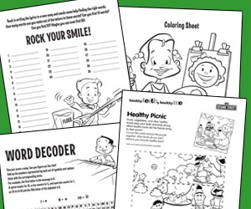
TEACHING AND LEARNING
Patient education is more imp than giving information
It requires presentation of information with sufficient impact to stimulate action by learner
Teaching aids-
Booklets on nutrition and dental health

Slide 70
Physical Setting :
Notes:
Privacy , comfortable, relaxed atmosphere are imp requisites for an interview, interview shold not take place chair side on dental operatory it can develop threatening atmosphere, endangesd fear and widhtrawa;,. Separate conference table, some chaires, black borad and visual aids.

Slide 71
FOOD PYRAMID
The food pyramid is defined as a graphic intended to illustrate the principles of good nutrition with fruits and vegetables on the bottom representing the bulk of a healthy diet and fats and oils at the top. An example of a food pyramid is a graphic used to illustrate good eating habits.

Slide 72
FOOD PYRAMID
A food pyramid or diet pyramid is a triangular diagram representing the optimal number of servings to be eaten each day from each of the basic food groups.
The first pyramid was published in Sweden in 1974
The 1992 pyramid introduced by the United States Department of Agriculture (USDA) was called the "Food Guide Pyramid".
It was updated in 2005, and then it was replaced by MyPlate in 2011

Slide 73
FOOD PYRAMID
ORIGIN :
Amid high food prices in 1972, Sweden's National Board of Health and Welfare developed the idea of "basic foods" that were both cheap and nutritious, and "supplemental foods" that added nutrition missing from the basic food
Anna-Britt Agnsäter, chief of the "test kitchen" for Kooperativa Förbundet (a cooperative Swedish retail chain), held a lecture on how to illustrate these food group
Clemes suggested a triangle displaying basic foods at the base.
Agnsäter developed the idea into the first food pyramid, which was introduced to the public in 1974

Slide 74
FOOD PYRAMID
The pyramid was divided into basic foods at the base including
Milk, cheese, margarine, bread, cereals and potato
A large section of supplemental vegetables and fruit
An apex of supplemental meat, fish and egg
The pyramid competed with the National Board's "dietary circle," which KF saw as problematic.

Slide 75
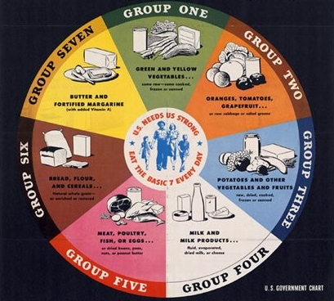
FOOD PYRAMID
While the Board distanced itself from the pyramid, KF continued to promote it, and food pyramids were developed in other Scandinavian countries, as well as West Germany, Japan and Sri Lanka. The United States later developed its first food pyramid in 1992.

Slide 76
Food pyramid published by the WHO and FAO
The World Health Organization, in conjunction with the Food and Agriculture Organization, published guidelines that can effectively be represented in a food pyramid relating to objectives to prevent obesity, chronic diseases and dental caries based on meta-analysis.
they represent it as a table rather than a "pyramid“.

Slide 77
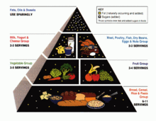
USDA food pyramid
The USDA food pyramid was created in 1992 and divided into six horizontal sections containing depictions of foods from each section's food group

Slide 78
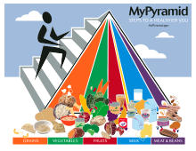
USDA food pyramid
It was updated in 2005 with colorful vertical wedges replacing the horizontal sections and renamed MyPyramid
In an effort to restructure food nutrition guidelines, the USDA rolled out its new MyPlate program in June 2011
My Plate is divided into four slightly different sized quadrants, with fruits and vegetables taking up half the space, and grains and protein making up the other half
The vegetables and grains portions are the largest of the four

Slide 79
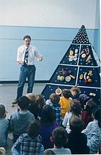
Controversy
Many nutritional experts, like Harvard nutritionist Dr. Walter Willett, believe the 1992 pyramid does not reflect the latest research on dietetics
Certain dietary choices that have been linked to heart disease, such as an 8 oz (230 g) serving of hamburger daily, were technically permitted under the pyramid
The pyramid also lacked differentiation within the protein-rich group ("Meat, Poultry, Fish, Dry Beans, Eggs, and Nuts")

Slide 80
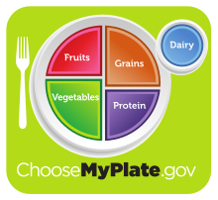
Alternatives
The Harvard School of Public Health proposes a healthy eating pyramid, which includes calcium and multi-vitamin supplements as well as moderate amounts of alcohol, as an alternative to the Food Guide Pyramid
"MyPlate"
The University of Michigan Integrative Medicine’s Healing Foods Pyramid emphasizes plant-based choices, variety and balance
It includes sections for seasonings and water as well as healthy fats

Slide 81
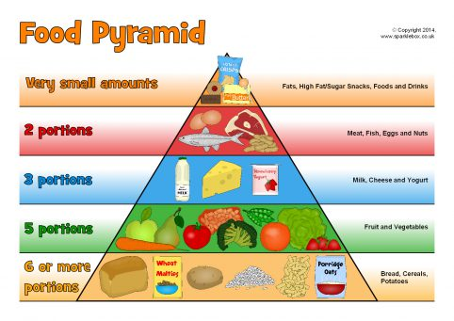

Slide 82
THE DIET INTERVIEWER:

Slide 83
• Certainly nutritionists can readily qualify with some extra course work in the nature of dental caries and periodontal disease and in preventive dentistry.

Slide 84
Ideally, as the professional authority, the dentist should be the diet interviewer, but it is probable that he or she will not be able to give adequate time to this phase of preventive services.
Consequently, clinical dental nutrition services probably will be assigned to a dental hygienist or a nutritionist.
In any event, the dentist is the responsible professional who must reinforce the advice given by the dental hygienist or nutritionist at the check up visits.

Slide 85
Teaching and Learning:

Slide 86
Even with these various aids available, teaching will not be effective if the information is not presented in small increment.
• If the patient does not understand the explanation, it should be repeated.
• The next level should not be attempted until the previous level is fully understood.

Slide 87
• The more the patient is involved in the educational process the greater is the extent of learning. People learn least well by hearing; they learn better what they can also see; and they learn best by doing, because they are totally involved.
• Any time the patient participates in evaluating his or her diet and writes his or her own diet prescription with guidance from the counselor, optimal learning and adherence to the new regimen will result.

Slide 88
GUIDELINES FOR COUNSELING:
Gather information-
Personal identifying data, likes and dislikes, and the patient's perception as to the cause(s) of the problem.
2. Evaluate and interpret information –
relative adequacy of the diet, eating habits, and the indirect environmental or systemic factors that contribute to the dietary problem - to find the reasons for the patient's dental problem.

Slide 89
GUIDELINES FOR COUNSELING:
• 3. Develop and implement a plan of action - a patient is prescribed diet consisting primarily of gradual, qualitative modifications of the diet using acceptable food exchanges. Be realistic in the types and amounts of changes made initially. The dietary frequency chart may help in determining what changes might be made.
• 4. Seek active participation
• 5. Follow up

Slide 90
MOTIVATION
• Motivation stimulates or is an incentive for action. To modify a patient's diet, the clinician can only seen and encourage the patient's own motivation.
• However, the counselor's positive attitude and conviction as to the necessity and effectiveness of nutrition counseling can stimulate the patient to initiate an improved dietary pattern.

Slide 91
MOTIVATING PATIENTS TO MODIFY FOOD
HABITS:
1. Awareness
2. Interest
3. Involvement
4. Action
5. Habit

Slide 92
MOTIVATING PATIENTS TO MODIFY FOOD
HABITS:
1. Awareness
2. Interest
3. Involvement
4. Action
5. Habit

Slide 93
Dietary advice
Giving dietary advice successfully, therefore depends on for more than providing knowledge, it requires sensitive understanding of the role of food in society and its significance for the individual patients.
Changing eating habits is one of the most difficult changes in behavious to achieve because of all pervasive nature of food.
Ideally, changes in food related behavious should be paralleled by changes in other aspects of health related behavious in order to produce healthier person in all respects.

Slide 94
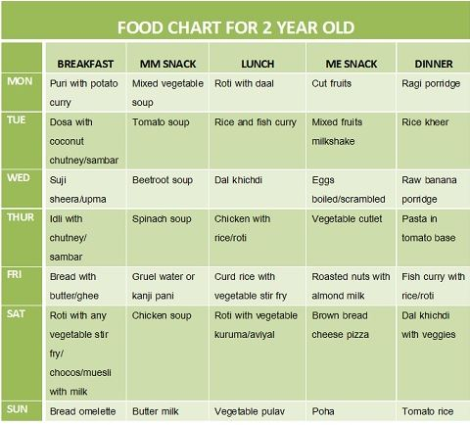
DIET CHART

Slide 95
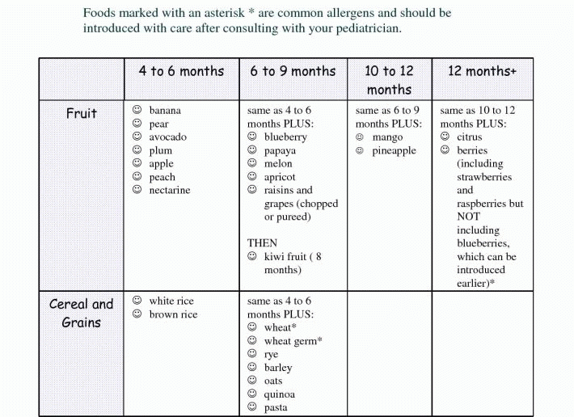

Slide 96
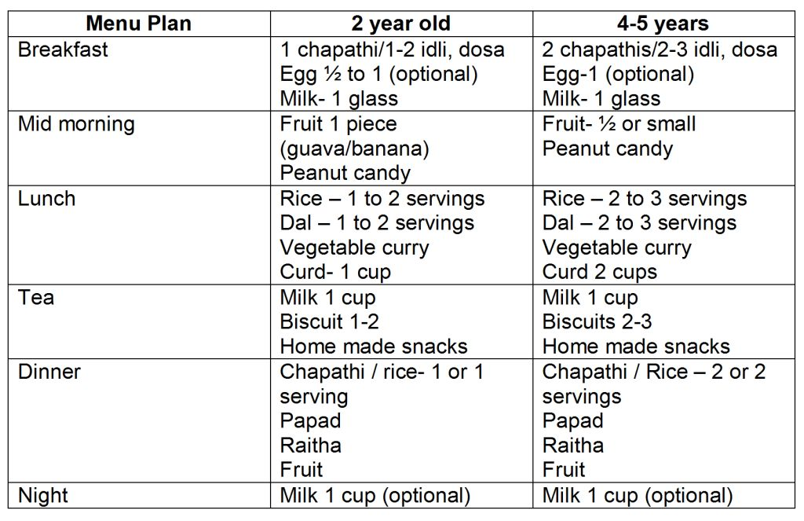

Slide 97
CONCLUSION

Slide 98
REFERANCES
Ireys HT, Nelson RP. New federal policy for children with special health care needs: Implications for pediatricians. Pediatrics 1992;90:321-7.
Baer MT, Harris AB. Pédiatrie nutrition assessment: Identifying children at risk. J Am Diet Assoc 1997;97: S107-15
Kozlowski B, Powell J. Position of the American Dietetic Association: Nutrition services for children with special health needs. J Am Diet Assoc 1995;95:809-12
Baer MT, Harris AB. Pédiatrie nutrition assessment: Identifying children at risk. J Am Diet Assoc 1997;97: S107-15

Slide 99
REFERANCES
5. Textbook of pediatric dentistry- Damle- 4th edition
6. Textbook of pediatric dentistry- Stewart and Barber- 1st edition
Diet Counselling – A Primordial Level of Prevention of Dental Caries. IOSR Journal of Dental and Medical Sciences (IOSR-JDMS) e-ISSN: 2279-0853, p-ISSN: 2279-0861. Volume 13, Issue 1
Dietary Counseling in the Prevention and Control Of Oral Diseases – A Review

Slide 100
THANKYOU

