Slide 1
DIAGNOSIS OF DENTAL CARIES
“The eyes do not see what the mind does not know”

Slide 2
Content:

Slide 3
introduction

Slide 4
Diagnosis: the art or act of distinguishing one disease from another
Modern management of caries: based on appropriate diagnosis
  Prevention
  Control
  Treatment
A diagnostic method should allow for the detection of the disease in the earliest stages and for all pathological changes.
Slow progression of the disease, hidden lesions.
Notes:
Diagnosis: the art or act of distinguishing one disease from another
Modern management of caries has three major components, that is :Prevention, Control, Treatment, and is based on appropriate diagnosis of the disease and the pathological changes, ie lesion formation in the earliest stages.
A diagnostic method should allow for detection of the disease in the earliest stages and for all pathological changes attributable to the disease to be determined from early demin to cavitation (DCNA 1999)
It is important to identify early evidence of the disease because after all there is slow progression of disease nowadays : 4 yrs to penetrate the enamel and another 4 yrs for reaching the depths of dentin. (DCNA 2005). Although accurate diagnosis of occlusal caries has been more difficult than the diagnosis of smooth-surface caries ,now lesion detection has become even more difficult due to fluoride which has slowed the progress of occ caries, strengthened occlusal enamel and inc opacity of enamel which prevents detection of dentinal caries (which is detectable only on bitewing radiographs) …this is “hidden lesions”. ocult/covert/ caries or “fluoride syndrome” are also terms used to describe this scenario.

Slide 5
Objectives of diagnosis: (Sturdevant)
  Identifying lesions requiring surgical treatment
  Identifying lesions requiring non-surgical treatment
  Persons at high risk for developing caries
Thus diagnosis is done using DCNA 1999:
  Clinical criteria
  Instruments
  Newer refined diagnostic tools

Slide 6
Ideal caries detection test:
Accurate
Sensitive
Specific
Reproducible
Reliable
Should not transfer S.mutans
Cost effective

Slide 7
Diagnosis of caries also involves determining whether the lesions are active, progressing rapidly or slowly, or whether the lesion is already arrested.
Cavitated lesions with soft dentin are active unlike cavitated lesions with hard, dark brown dentin at the base, which are inactive.
Cavitated lesions may present as micro cavities with or without greyish discoloration of the enamel.
A bitewing radiograph is essential for diagnosis of proximal lesions where contact point is present.

Slide 8
The iceberg concept
According to WHO the shape & depth of carious lesion can be scored
  D1: clinically detectable lesions, non cavitated
  D2: clinically detectable “cavities” limited to enamel
  D3: clinically detectable lesions in dentin
  D4: Lesions into pulp
Pitts (1997) – precision of caries diagnosis is illustrated as an iceberg.

Slide 9
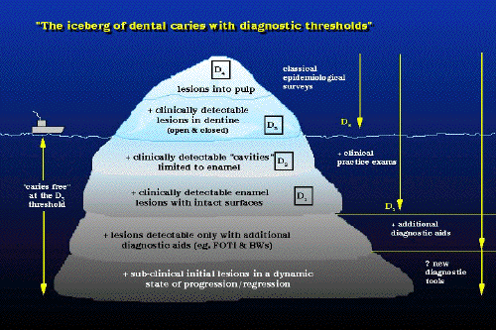

Slide 10
Diagnostic tools
Visual & tactile examination
Conventional Radiographs
Digital radiography
Trans-illumination
DIFOTI
Electronic Conductance Measurement
Diagnodent
Quantitative light fluorescence
Dye Enhanced Laser Fluorescence
Near-IR light imaging
Caries detection dyes

Slide 11
Clinical detection of dental caries:
Conventional Techniques
Visual method.
Tactile method.
Visual and tactile method.
Radiographic method.
Advanced techniques:
Dye technique.
Digital/ subtraction radiology.
Electrical Conductance Measurements.
Enhanced visual techniques.
Fluorescent Techniques.
Ultrasound techniques.

Slide 12
VISUAL EXAMINATION
Visual examination utilize compressed air (5 sec) to see chalky white lesions.
All surfaces of a tooth are cleaned of debris and plaque, the teeth are dried using an air syringe and examined visually.
An explorer is useful in caries diagnosis as a tool to remove plaque and debris and check the surface characteristics of suspected carious lesions.

Slide 13
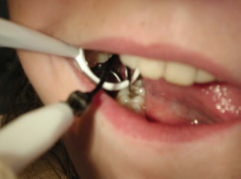
A lesion visible on a wet tooth is has mostly penetrated the enamel and maybe into the dentin.
The Visual method: use Combination of light, mirror & probe.

Slide 14
When examining the patient for cavitated or non-cavitated lesion:
we should look for:
Change in color and translucency in enamel
White spot lesions that appear chalky white
Breaks in enamel surface
Grayish white discoloration adjacent to marginal ridges and restorations
Shadowing on proximal surfaces
Black discoloration (arrested caries).

Slide 15
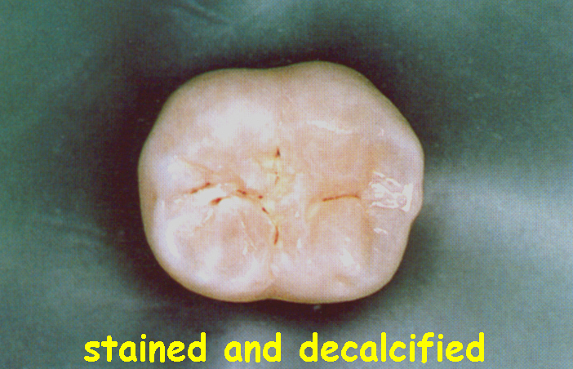
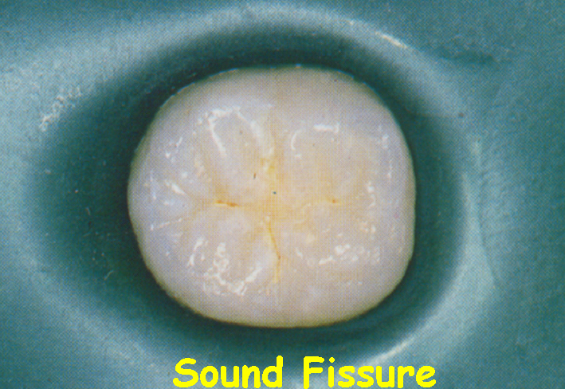
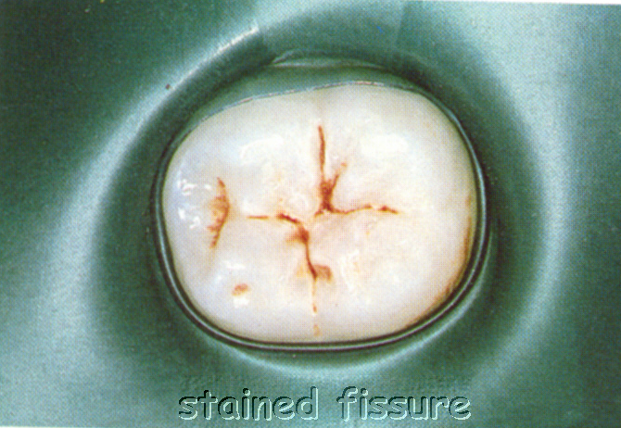
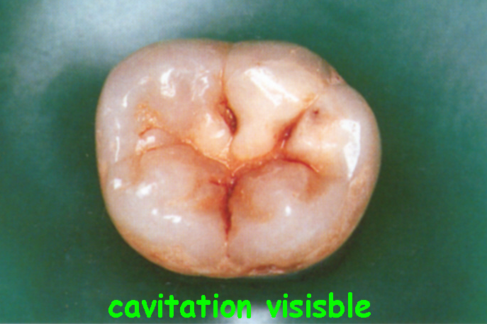

Slide 16
DISADVANTAGES:
Highly subjective.
Stained fissures can be misdiagnosed.
Variability induced due to examination between dry and wet conditions.

Slide 17
VISUAL & TACTILE EXAMINATION
G. V. Black in 1924 suggested use of sharp explorer.
ADA criteria- softened enamel, catches explorer and resists its removal.
Combination of light, mirror and gentle probing.
Requires 3 min per patient.

Slide 18
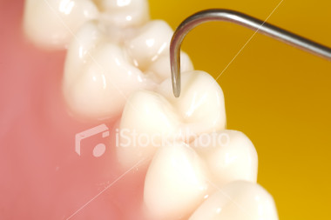
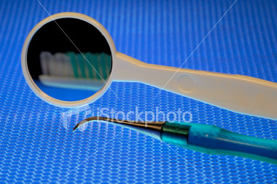
An area is carious when the explorer ‘catches’ or resists removal after the insertion into a pit or fissure with moderate to firm pressure, and when there is opacity adjacent to the pit or fissure.

Slide 19
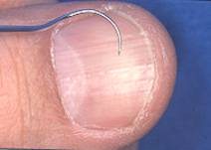
Use of explorers
There is no need to apply too much pressure on an explorer because studies have found that this does not increase the accuracy of caries detection ( Lussi, 1991).
The use of gentle pressure, defined by the force just required to blanch a fingernail without causing any pain or damage.

Slide 20
The Conventional Visual method - European studies. Pitts (1997)
Criticizes the use of probes- may cause transmission of cariogenic bacteria from infected sites.
In 1973, Loesche noted in 15 patients that Streptococcus mutans was isolated in large numbers from a dental explorer after it had been used in the examination of a carious tooth.

Slide 21
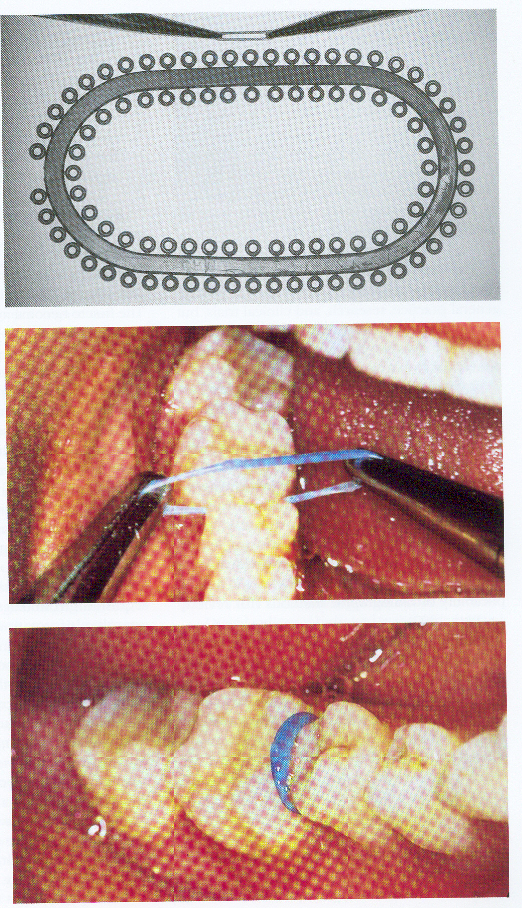
The visual method with Tooth Seperation
This method permits definite assessment of whether radiographically detectable approximal enamel and dentin lesions are cavitated.
Gap of 0.5-1mm can be gained within 48 hrs.
Method is non destructive, reversible and in expensive.

Slide 22
The Visual Method with Tooth Seperation and Impression of the lesion
Allows a more sensitive diagnosis of cavitation.
Provides replica as a reference for monitoring changes in size of lesion.

Slide 23
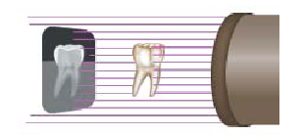
RADIOGRAPHY

Slide 24
Characteristics of proper radiograph: (DCNA 2005)
Image - all parts seen, no overlap, natural size
Area covered-sufficient surrounding area
Density
Contrast
Definition and sharpness - all should be adequate
Common Mistakes: cone cuts, overlapping, failure to include required areas.

Slide 25
Depth of lesion can be evaluated and scored by index given by Grondahl et al (1977)
0 = no radiographic changes in enamel
1 = radiographic changes in the enamel
2 = radiolucency extending to the DEJ
3 = radiolucency penetrating halfway through the dentin
4 = radiolucency close to the pulp

Slide 26
Proximal caries susceptible zone
caries
Approximately 30% demineralization is required for radiographic detection of a lesion.
As seen in the occlusal view, above right, the thickness of the tooth buccolingually masks the carious lesion when it is small.
The actual depth of penetration of a carious lesion is deeper clinically than radiographically.

Slide 27
Caries Classification
I
M
A
A
I = Incipient (Stage I)
M = Moderate (Stage II)
A = Advanced (Stage III)
S
S = Severe (Stage IV)

Slide 28
Interproximal Caries (Incipient)
Upto half the thickness of enamel
Usually not restored unless patient has high level of caries activity (high risk).
Treat with fluoride.
I

Slide 29
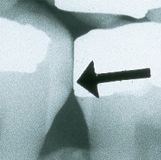
Interproximal Caries (Moderate)
More than halfway through the enamel (up to DEJ)
M

Slide 30
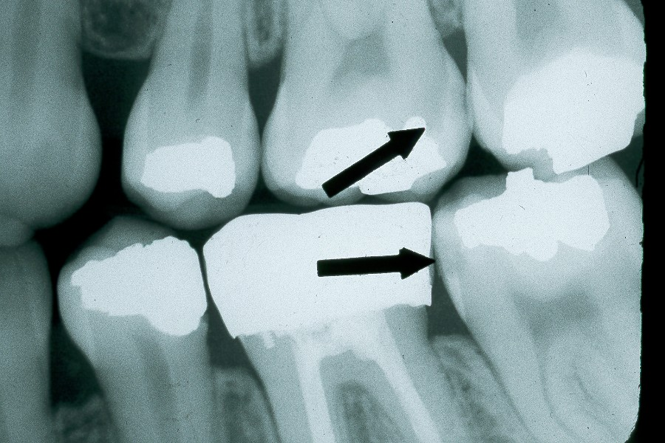
Interproximal Caries (Advanced)
From the DEJ upto half-way through the dentin
A
A

Slide 31
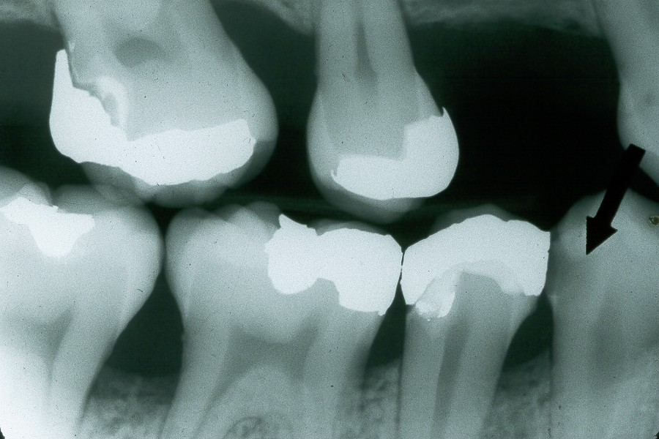
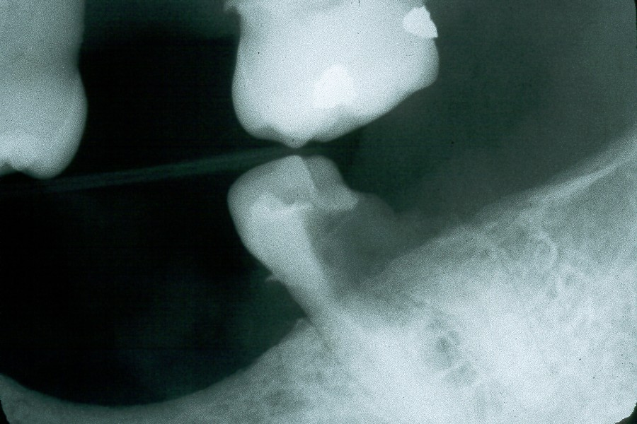
Interproximal Caries (Severe)
More than halfway through the dentin
S

Slide 32
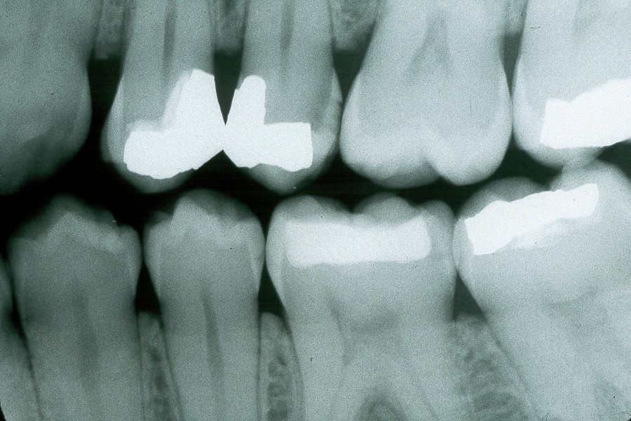
Incipient
Moderate
Advanced

Slide 33
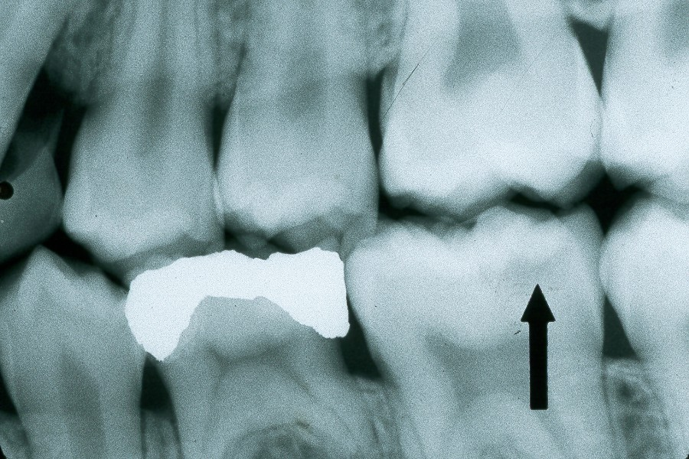
Occlusal Caries
Must have penetrated into dentin, but difficult to see on radiographs unless lesion is large.
May be seen as thin radiolucent line or cup-shaped zone underlying occlusal enamel.

Slide 34
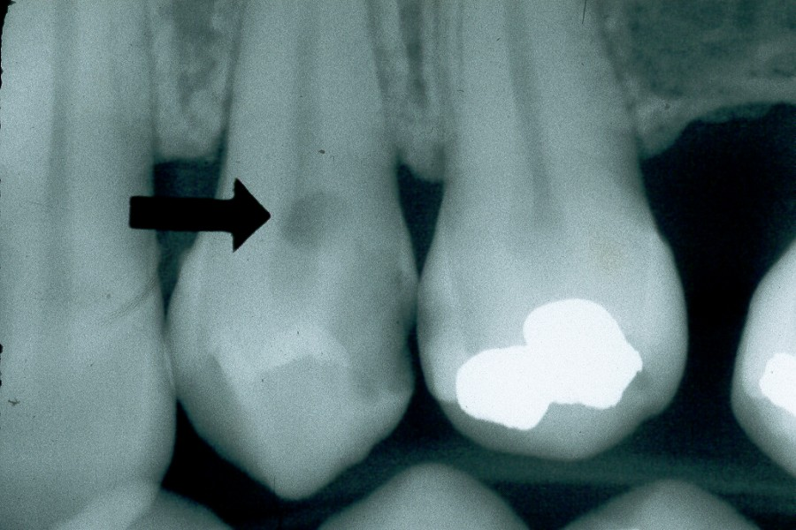
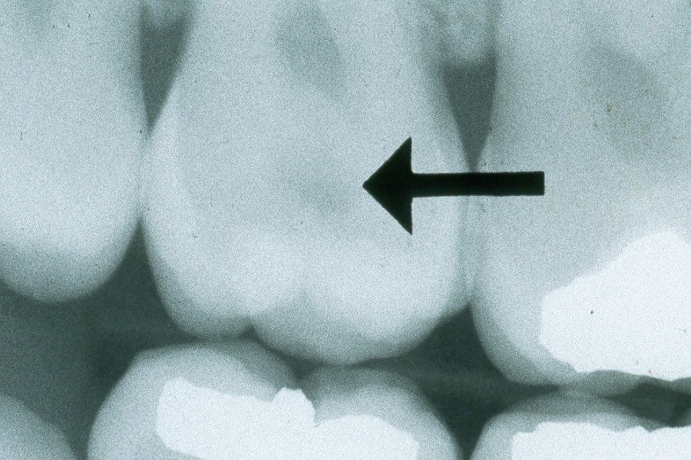
Buccal/ Lingual Caries
Should be identified from clinical exam.
Sometimes seen as well-defined circular area in middle of tooth, although it is not very radiolucent.
Depth cannot be determined radiographically.

Slide 35
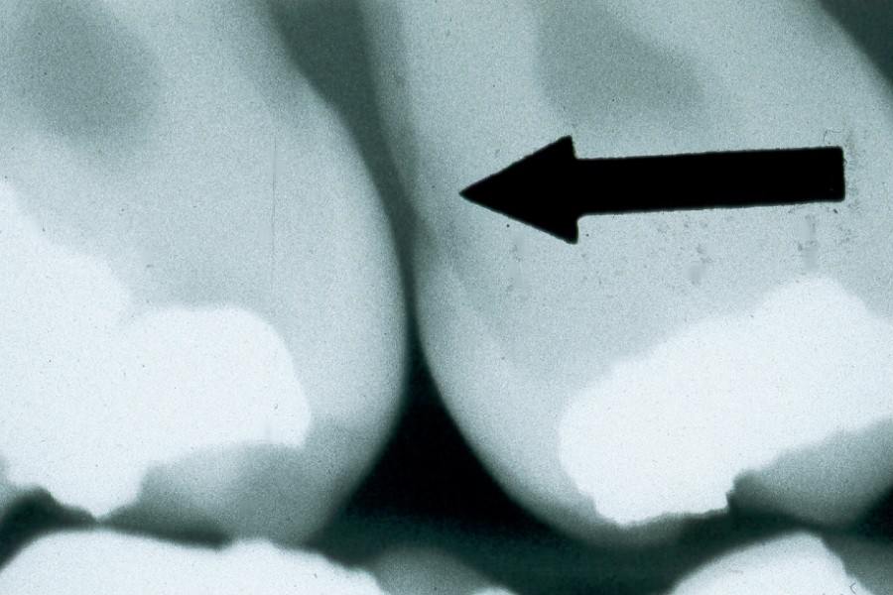
Root Caries
Saucer-like cratering on the roots of the teeth, involving the cementum.
Usually found on older individuals with prominent recession and/or periodontitis.
May have xerostomia due to medications.
May be confused with cervical burnout.

Slide 36
Cervical Burnout
Cervical burnout is an apparent radiolucency found just below the CE junction on the root due to anatomical variation (concave root formation posteriorly).
Mimics root caries.
Posteriorly, this radiolucency usually disappears when another film of the region is examined.

Slide 37
Posterior cervical burnout

Slide 38
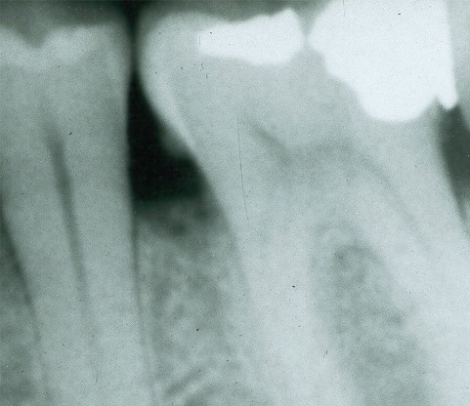
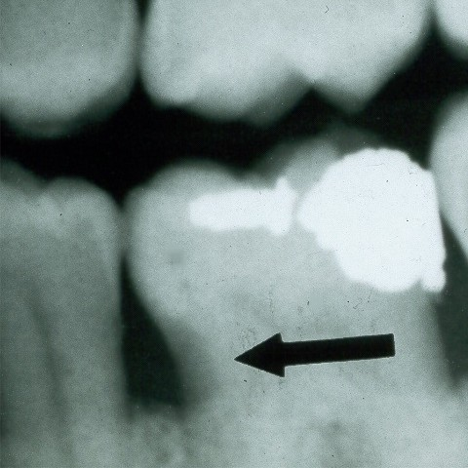

Slide 39
Anterior cervical burnout
The space between the enamel and the bone overlying the tooth will appear more radiolucent than either the enamel or the bone-tooth combination.
bone level

Slide 40
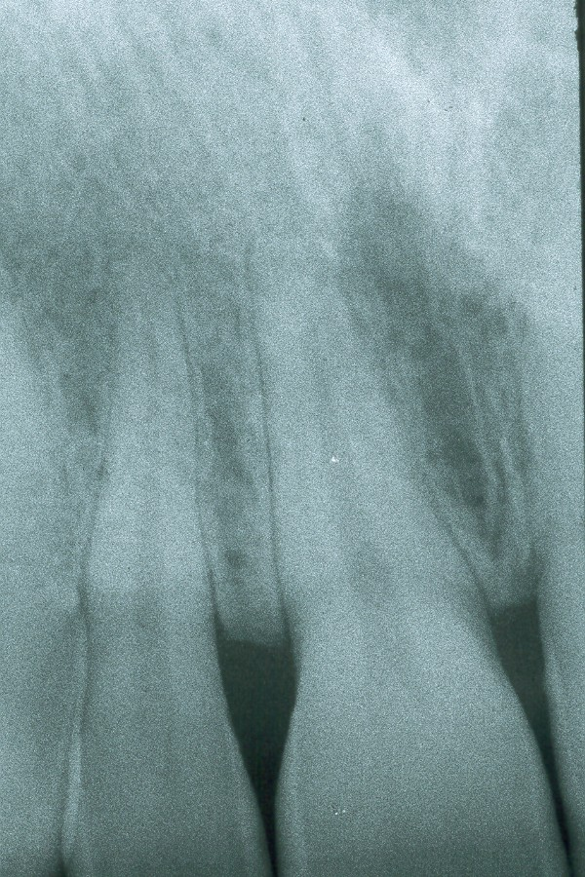
Cervical burnout in the anterior region due to gap between enamel (red arrows) and alveolar bone over root (white arrows).

Slide 41
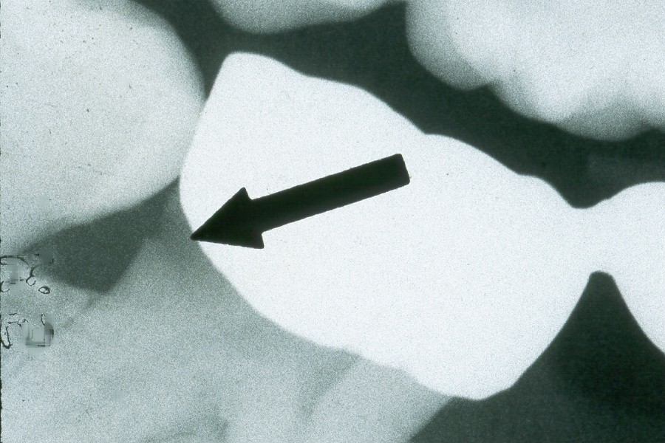
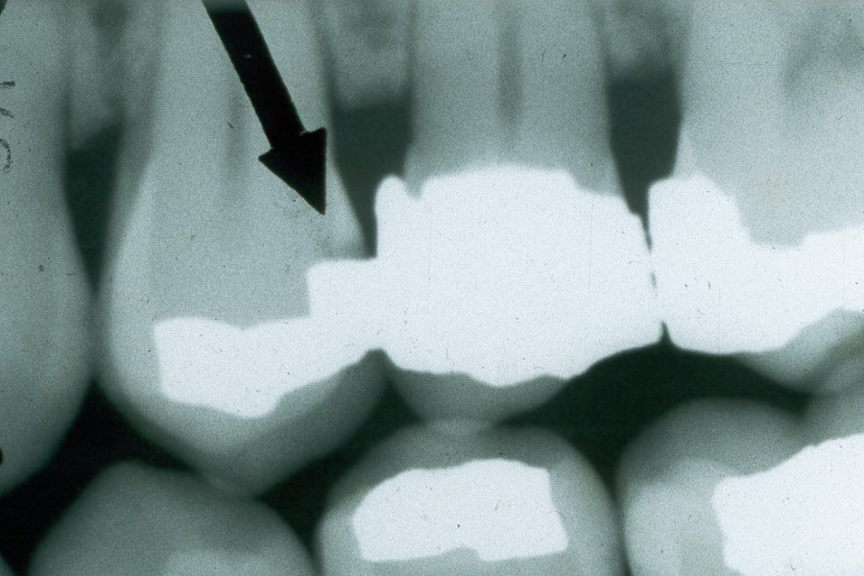
Recurrent Caries
Found around the margins of existing restorations.
May be due to unusual susceptibility to caries, poor oral hygiene, failure to remove all of the caries during cavity preparation, a defective restoration or a combination of the above.

Slide 42
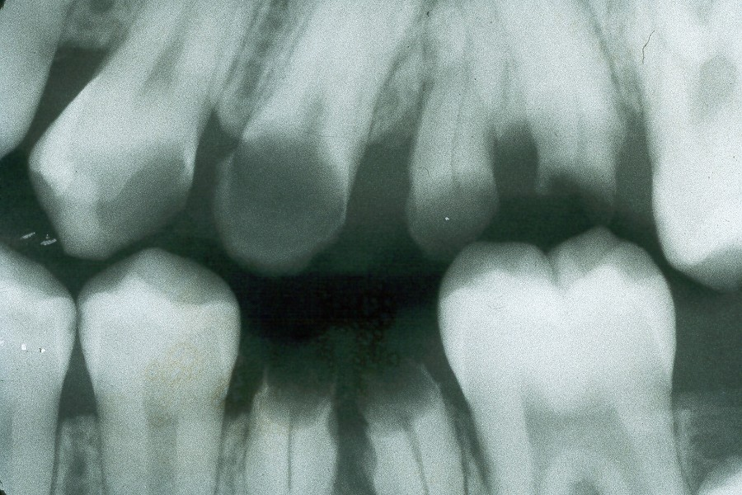
Rampant Caries
Extensive and rapidly progressing caries usually found in children and teens with poor diet and inadequate oral hygiene.

Slide 43
Digital radiographs
A digital radiograph (a traditional radiograph that has been digitized) is comprised of a number of pixels.
Each pixel carries a value between 0 and 255, with 0 being black and 255 being white.
It is easy to appreciate that a digital radiograph, with a potential of 256 grey levels has significantly lower resolution than a conventional radiograph that contain millions of grey levels.

Slide 44
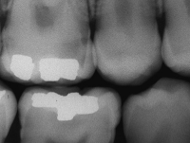
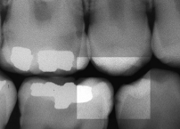
However, digital radiographs offer the potential of image enhancement by applying a range of algorithms, some of which enhance the white end of the grey scale and others the black end.

Slide 45
Subtraction radiology
The basic premise of subtraction radiology is that two radiographs of the same object can be compared using their pixel values.
If the images have been taken using either a geometry stabilizing system (i.e. a bitewing holder) or software has been employed to register the images together, then any differences in the pixel values must be due to change in the object.
The value of the pixels from the first object are subtracted from the second image.
If there is no change, the resultant pixel will be scored 0; any value that is not 0 must be attributable to either the onset or progression of demineralization, or regression.

Slide 46
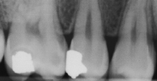

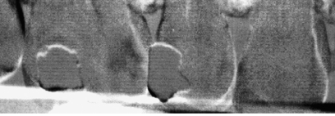
Initial radiograph
12 months later

Slide 47
Factors affecting appearance of caries:
Buccolingual thickness of tooth: thicker the tooth, the more difficult it is to see the extent of the caries.
Two-dimensional film: Cannot see the extent of carious involvement in a buccolingual direction.

Slide 48
X-ray beam angle (horizontal or vertical).
This is especially important when trying to identify recurrent caries, since changes in angulation may cause the superimposition of the existing restoration on the carious lesion.
Exposure factors.
Caries detection is improved with a lower kVp setting, which provides a higher contrast. If the density of the film is too light or too dark, the diagnostic potential of the film is limited.

Slide 49
ADVANTAGES :
  Discloses sites inaccessible to other methods
  Detects at early , reversible stage
  Permanent record
  Non-invasive

Slide 50
LIMITATIONS:
  Standardization needed for accurate reproducibility
  Does not distinguish between sound, subsurface & cavitated lesions
  Underestimation of demineralization
  Proximal caries on the apical 3rd of the restoration may noy be detected
  Can’t detect buccal/lingual caries
  Occlusal caries not seen until it reaches the DEJ

Slide 51
Advanced Techniques:
Dye technique.
Electrical Conductance Measurements.
Enhanced visual techniques.
Fluorescent Techniques.
Ultrasound techniques.

Slide 52
Dye Techniques
In 1972, a technique using a basic fuchsin red stain was suggested and developed to aid in the differentiation of the two layers of carious dentin.
Because of potential carcinogenicity, the basic fuchsin stain was subsequently replaced by another dye, acid red solution.
Since then, various protein dyes have been marketed as caries-detection agents.

Slide 53
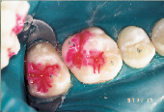
Increased porosity through the development of capillary like micro voids is the earliest change in the carious lesion.
Fluid solutions that can wet the enamel be used to deposit a fluorescent material in these pores.
Recently, a new caries detecting dye are developed to prevent excessive dentin removal.

Slide 54
It has been shown that dyes that were dispensed in higher molecular weight carriers exhibited reduced diffusional properties in porous tissues.
The use of these dyes, however, does not provide a completely objective method for assessment of caries removal and is controversial.
Excessive removal of dentin or incomplete removal of bacteria has been reported when these dyes were used to remove caries.

Slide 55
Fibre optic transillumination (FOTI and DiFOTI)
It is based upon the phenomenon of light scattering.
Sound enamel is comprised of hydroxyapatite crystals that are densely packed, producing an almost transparent structure.
Used to identify lesions on interproximal surface

Slide 56
Provides an intense light beam that is transmitted thru a fiber-optic cable to a specially designed probe to permit the use of transillumination on proximal surfaces of post teeth
The colour of teeth, for example, is strongly influenced by the underlying dentin shade.

Slide 57
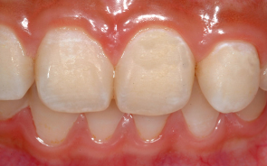
When enamel is disrupted, in the presence of demineralisation, the penetrating photons of light are scattered (i.e. they change direction, although do not lose energy) which results in an optical disruption.
In normal, visible light, this appears as a ‘whiter’ area—the so called white.

Slide 58
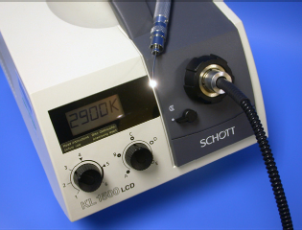
Principle of FOTI:
Fibre optic transillumination takes optical properties of enamel and enhances them by using high intensity white light that is presented through a small aperture in the form of a dental handpiece.
Light is shone through the tooth and the scattering effect can be seen as shadows in enamel and dentine.

Slide 59
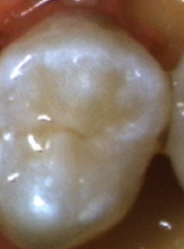
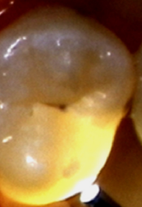
FOTI in use:

Slide 60
DiFOTI
DIFOIT –- visually observed images are captured using a digital charged-coupled device ( CCD )
This system comprises of a high intensity light and grey scale camera which can be fitted with one of two heads; one for smooth and one for occlusal surfaces.
Images are displayed on a computer monitor and can be archived for retrieval at a repeat visit.

Slide 61
Advantages of FOTI:
It can be used for the detection of caries on all surfaces; and is particularly useful at proximal lesions.
As a technique FOTI is an obvious choice for translation into general practice;
The equipment is economical,
The learning curve is short .
The procedure is not time consuming.

Slide 62
Disadvantages of FOTI
The system is subjective rather than objective.
There is no continuous data output.
It is not possible to record what is seen in the form of an image.
Not able to determine the depth of lesion

Slide 63
Electronic Caries Monitor (ECM):
The ECM device employs a single, fixed-frequency alternating current which attempts to measure the ‘bulk resistance’ of tooth tissue.
This can be undertaken at either a site or surface level.
When measuring the electrical properties of a particular site on a tooth, the ECM probe is directly applied to the site, typically a fissure, and the site measured.

Slide 64
Working Principle:
Every material possesses its own electrical signature.
In its simplest form, caries can be described as a process resulting in an increase in porosity of the tissue, be it enamel or dentine.
This increased porosity results in a higher fluid content than sound tissue and this difference can be detected by electrical measurement by decreased electrical resistance or impedance.

Slide 65
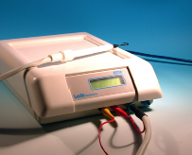
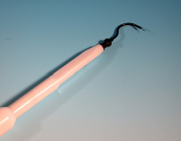
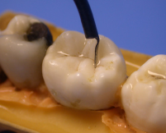
ECM Unit:

Slide 66
Visible light fluorescence—QLF
Fluorescence is a phenomenon by which an object is excited by a particular wavelength of light and the fluorescent (reflected) light is of a larger wavelength.
When the excitation light is in the visible spectrum, the fluorescence will be of a different colour.
Quantitative light-induced fluorescence (QLF) is a visible light system that can detect early caries and then longitudinally monitor their progression or regression.

Slide 67
In the case of the QLF the visible light has a wavelength (λ) of 370 nm, which is in the blue region of the spectrum.
It uses two forms of fluorescent detection (green and red) .
This produces an image that is comprised of only green and red channels (the blue having been filtered out) and the predominate colour of the enamel is green.
Demineralisation of enamel results in a reduction of this auto-fluorescence.

Slide 68
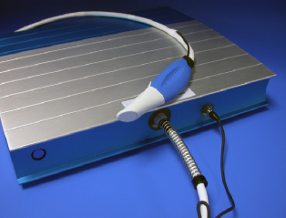
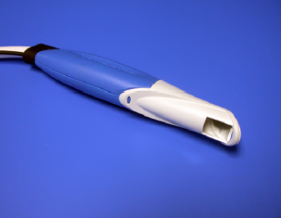
QLF Equipment:

Slide 69
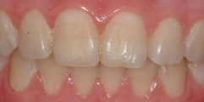
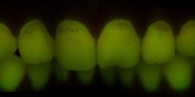
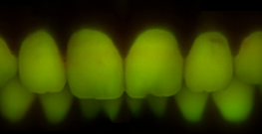
Visible light fluorescence—QLF

Slide 70
ADVANTAGES:
The QLF system offers additional benefits beyond those of very early lesion detection and quantification.
The images acquired can be stored and transmitted, perhaps for referral purposes.
The images themselves can be used as patient motivators in preventative practice.
For clinical research use, the ability to remotely analyse lesions enables increased legitimacy in trials; permitting, for example, a repeat of the analyses to be conducted by a third-party.

Slide 71
Laser fluorescence—DIAGNODent(DD):
Using a small laser the system produces an excitation wavelength of 655 nm which produces a red light.
This is carried to one of two intra-oral tips; one designed for pits and fissures, and the other for smooth surfaces.
The tip both emits the excitation light and collects the resultant fluorescence.
Unlike the QLF system, the DD does not produce an image of the tooth; instead it displays a numerical value on two LED displays.
The first displays the current reading while the second displays the peak reading for that examination.

Slide 72
Controversy:
Some believe that the system is thought to measure the degree of bacterial activity.
This is supported by the fact that the excitation wavelength is suitable for inducing fluorescence from bacterial porphyrins; a byproduct of metabolism .

Slide 73
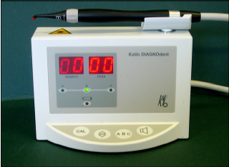

Slide 74
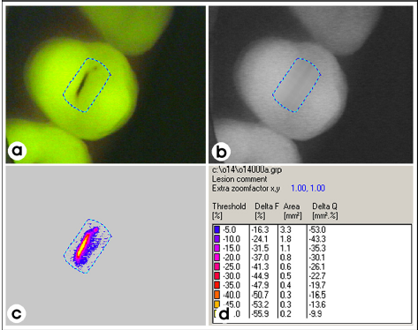

Slide 75
Infrared laser fluorescence ( DIAGNOdent )
Developed for detection and quantification of caries of occlusal and smooth surface
Uses a diode laser light source and a fiber-optic cable that transmits the light to a hand-held probe with fiber optic eye in tip.
Light is absorbed and induces infrared fluorescence by organic and inorganic materials
Emitted fluorescence probe tip ascending fiber window as an integer bet 0 - 99
fluorescence carious tooth ( > 20 )
Notes:
is collected at the ---- transmitted thru ----- displayed on

Slide 76
DIAGNOdent
Good at indicating presence deeper lesions in enamel or dentin
Identify early lesion
Unreliably in indicating depth of lesion

Slide 77
Quantitative light fluorescence ( QLF )
Early detection of caries
1978 Dental scientist in Sweden ---- laser light of selected wavelength
Portable system --- laser source was replaced by a regular light source and filter system.
Light illuminating the tooth is transported through a liquid-filled light guide
Fluorescent filtered images are captured using a color CCD camera & a frame grabber
Data collected are stored, analyzed by custom software
Notes:
***Relationship bet loss of fluorescence intensity & increasing mineral loss from the lesions compared with sound enamel ***a small portable system developed

Slide 78
Useful in monitoring the progression or regression of lesions
Unability to detect interproximal lesion
Applications
DIAGNOdent --- caries in pits & fissures and detecting deep dentinal lesions of occlusal surface
DIFOTI --- interproximal surface
QLF --- early detection of caries on occlusal, buccal, & lingual surfaces and changes in early lesions associated with various preventive Rx

Slide 79
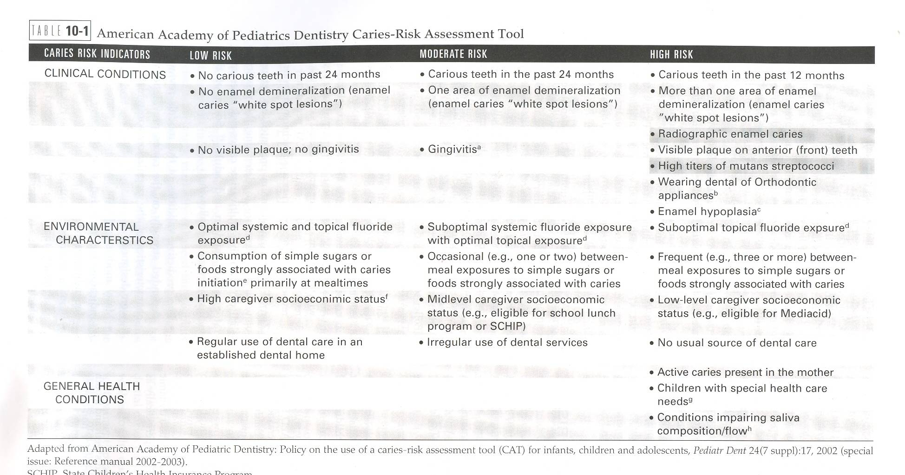
Prediction Of Patient’s Risk Of Future Disease
(Risk Assessment)

Slide 80
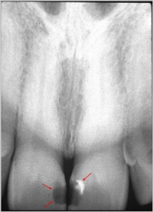
Conditions Resembling Caries
RESTORATIVE MATERIALS
Such as composites, silicates and acrylics, may appear radiolucent and resemble dental caries on a radiograph.
The appearance of an anterior cavity preparation restored with these materials differs from the appearance of interproximal caries and can be identified by the well-defined, smooth outline.

Slide 81
ABRASION:
Abrasion refers to the wearing away of tooth structure from the friction of a foreign object.
The most frequent type of abrasion is caused by tooth brushing and is seen at the cervical margin of the teeth.
On a dental radiograph, abrasion appears as a well-defined horizontal radiolucency along the cervical region of a tooth.
Tooth brush abrasion affects the root surface of a tooth and may be confused with root surface caries.
Clinically, the areas affected by abrasion appear as hard, highly polished defects in dentin and should not be confused with root caries that appears brown and leathery.

Slide 82
ATTRITION:
Attrition may be seen on the incisal or occlusal surfaces of deciduous or permanent teeth.
When the incisal or occlusal enamel is worn away, the underlying dentin wears away rapidly, and shallow concavities may form.
These concavities may resemble occlusal or incisal caries on a dental radiograph.
Clinical examination enables the dental professional to distinguish attrition from caries.

Slide 83
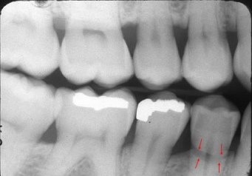
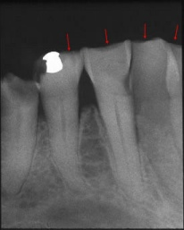

Slide 84
Conclusion
The truth about a ‘caries’ process that we cannot observe is, of course,
……………….elusive.

Slide 85
References:

