Slide 1
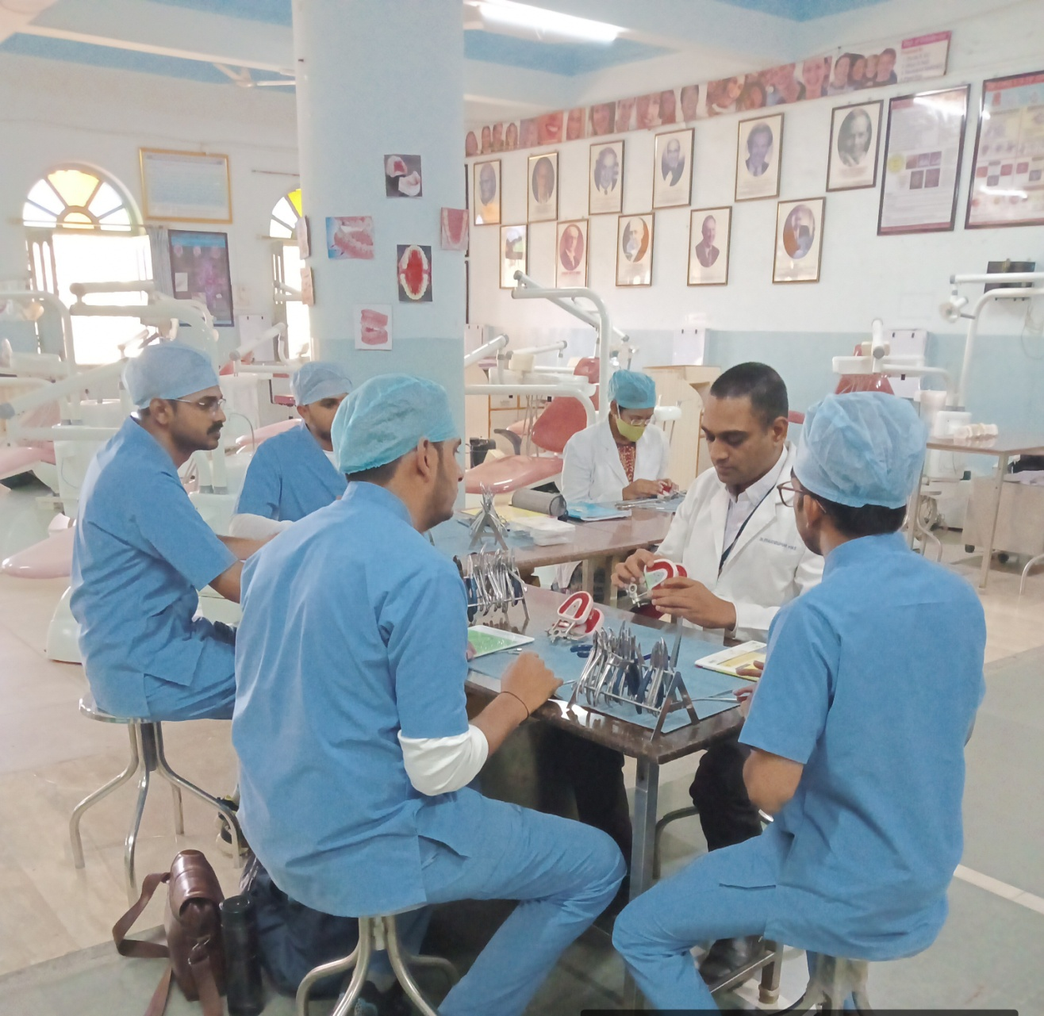
DEPARTMENTMENT OF ORTHODONTICS AND DENTOFACIAL ORTHOPAEDICS

Slide 2
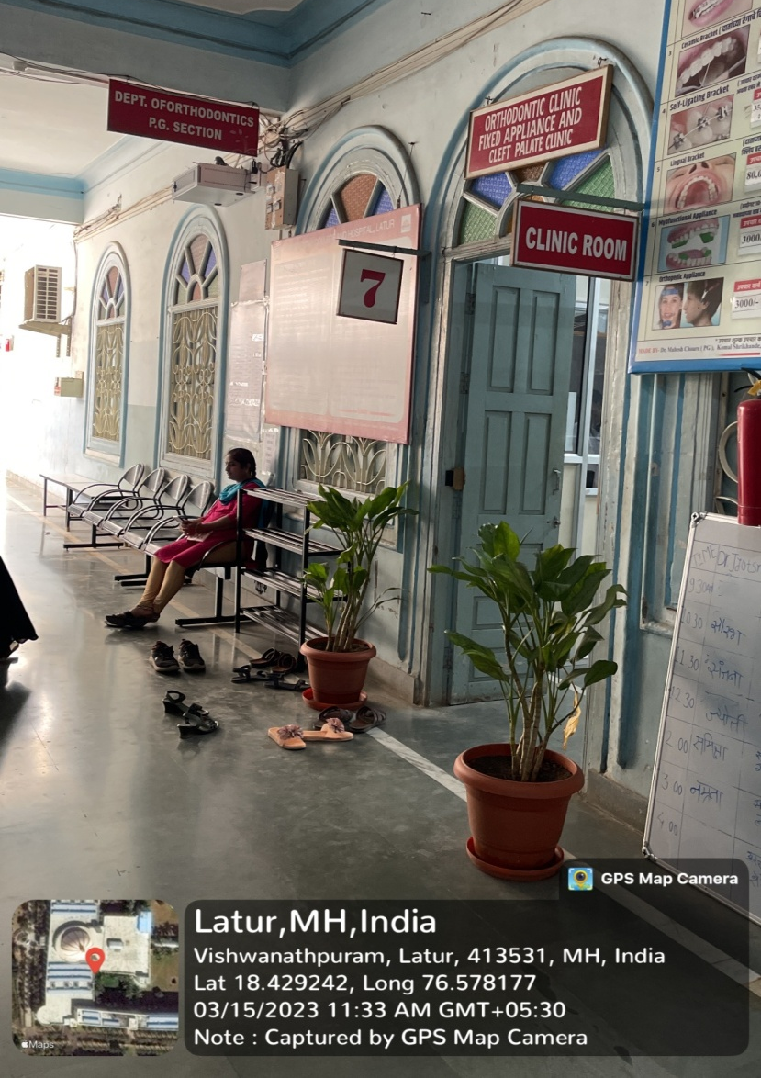
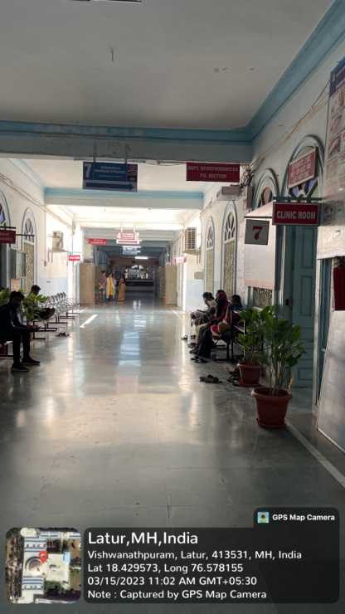
DEPARTMENT OF ORTHODONTICS
DEPARTMENT OF ORTHODONTICS
PATIENT WAITING AREA

Slide 3
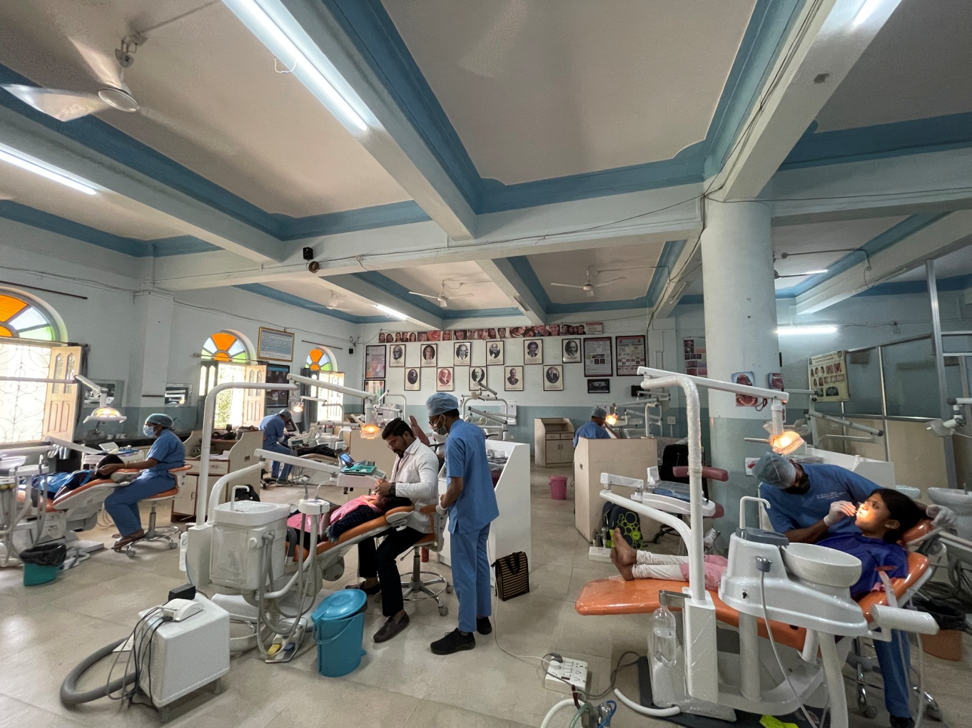
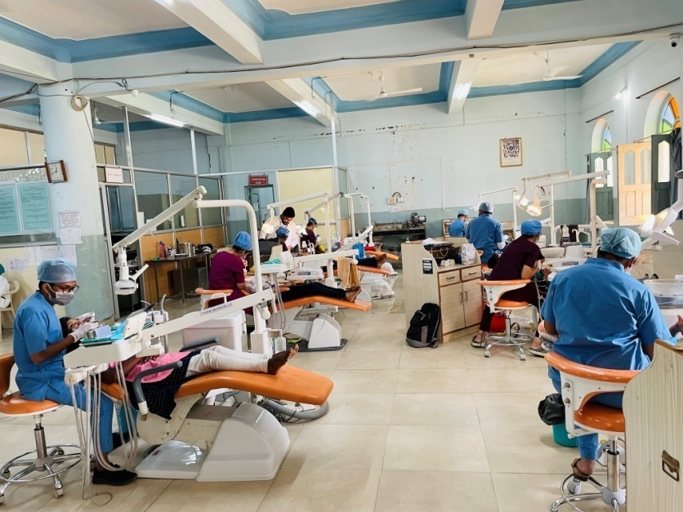
DEPARTMENT OF ORTHODONTICS
POST GRADUATE SECTION

Slide 4
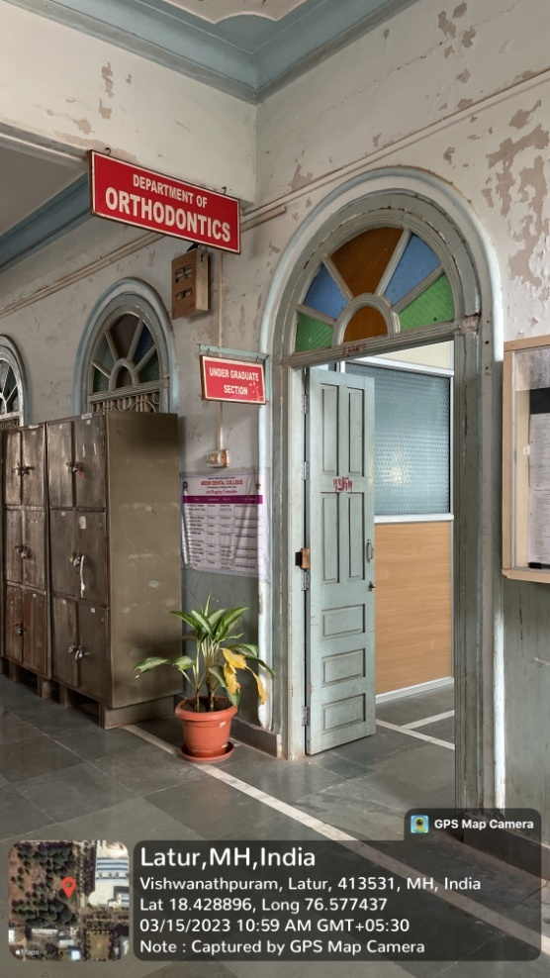
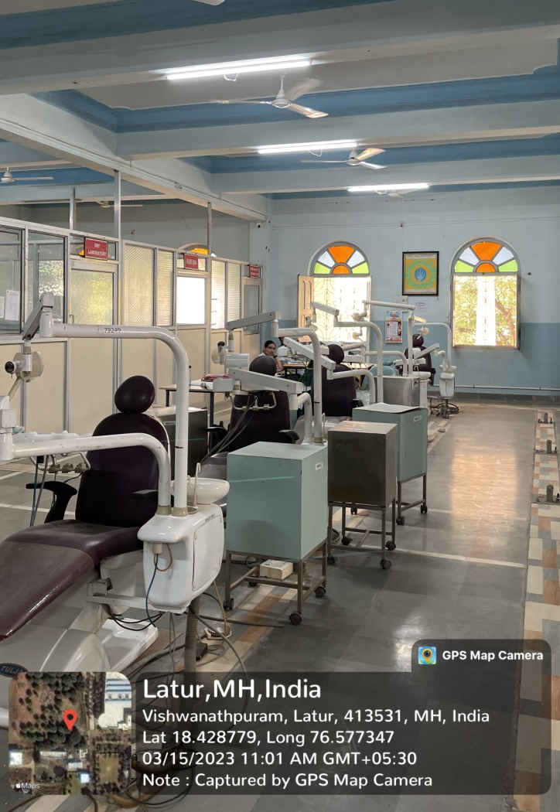
DEPARTMENT OF ORTHODONTICS
UNDER GRADUATE SECTION

Slide 5
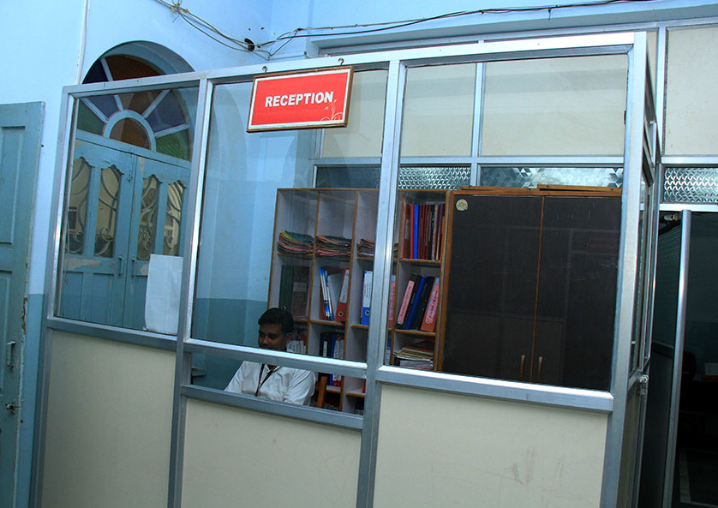
RECEPTION - DEPARTMENT OF ORTHODONTICS

Slide 6
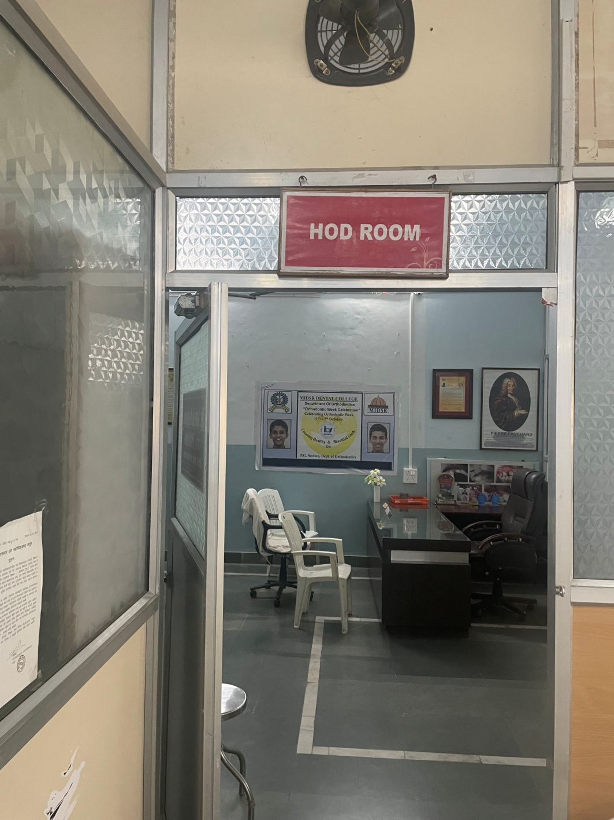
HOD ROOM - DEPARTMENT OF ORTHODONTICS

Slide 7
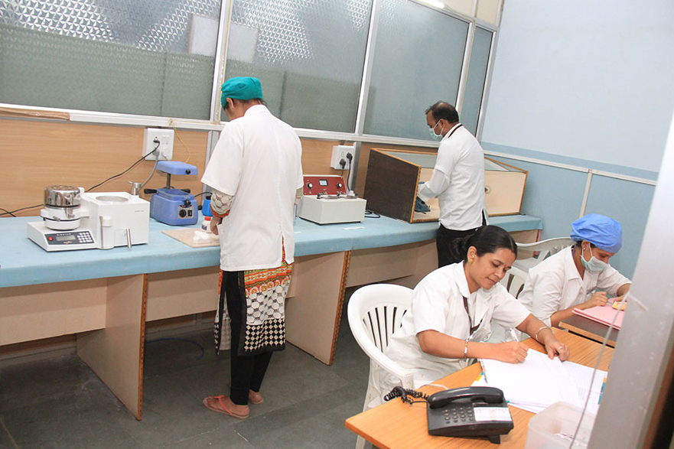
PG PRECLINICAL LABORATORY DEPARTMENT OF ORTHODONTICS

Slide 8
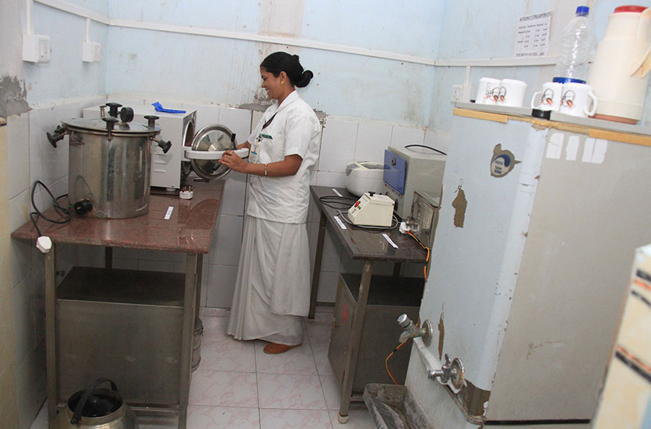
STERILIZATION ROOM - DEPARTMENT OF ORTHODONTICS

Slide 9
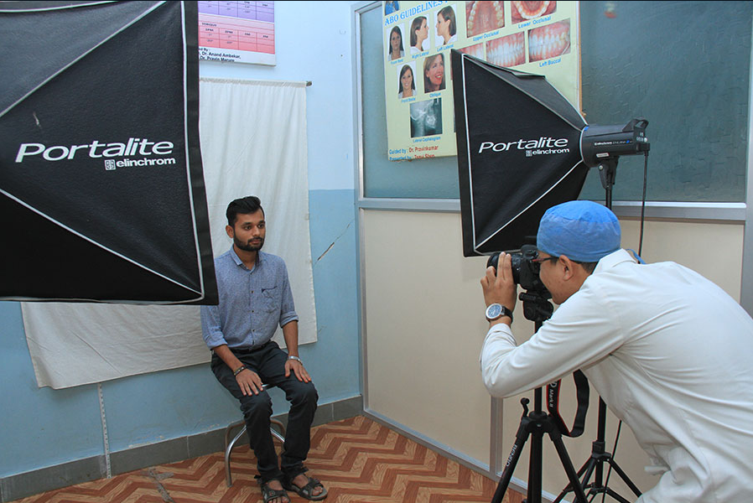
PHOTOGRAPGY SECTION - DEPARTMENT OF ORTHODONTICS

Slide 10
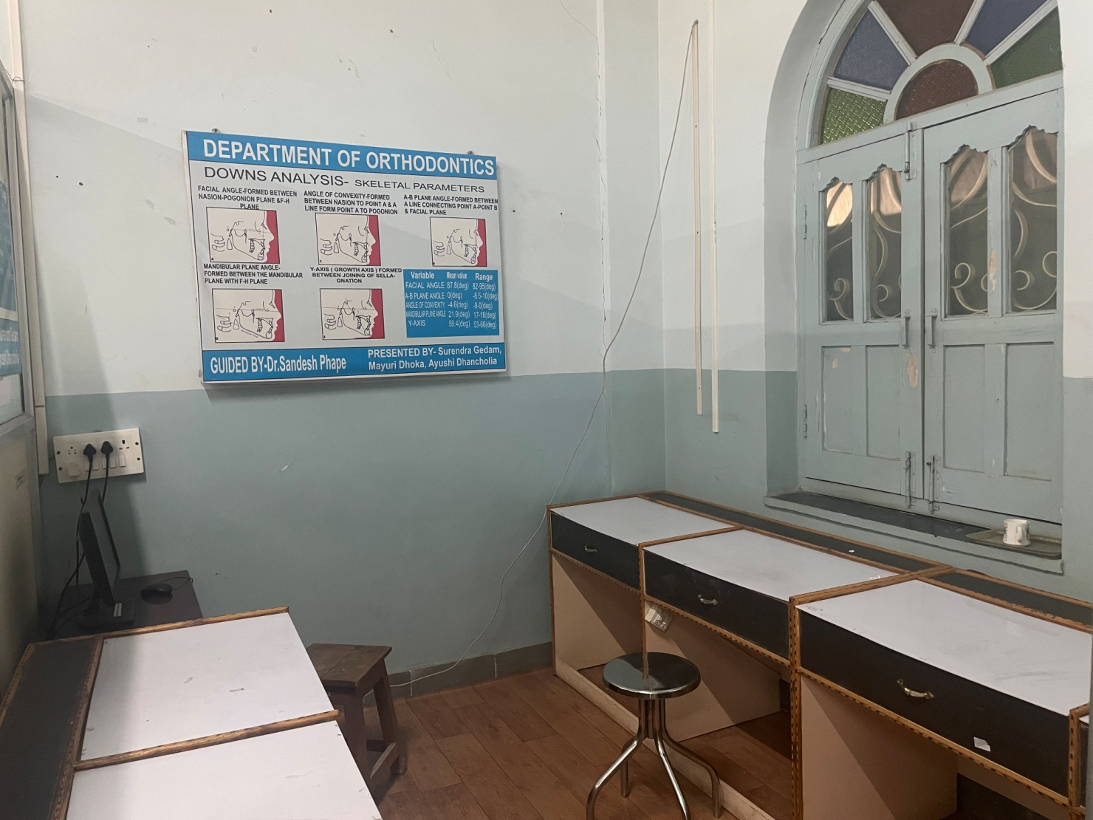
CEPH TRACING ROOM - DEPARTMENT OF ORTHODONTICS

Slide 11
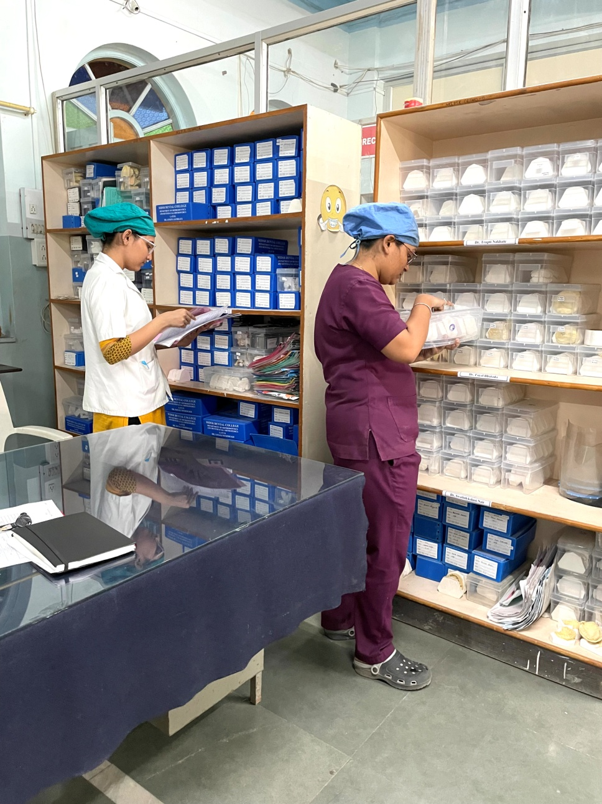
PATIENT RECORD MAINTENANCE SECTION DEPARTMENT OF ORTHODONTICS

Slide 12
DEPARTMENTAL LIBRARY

Slide 13
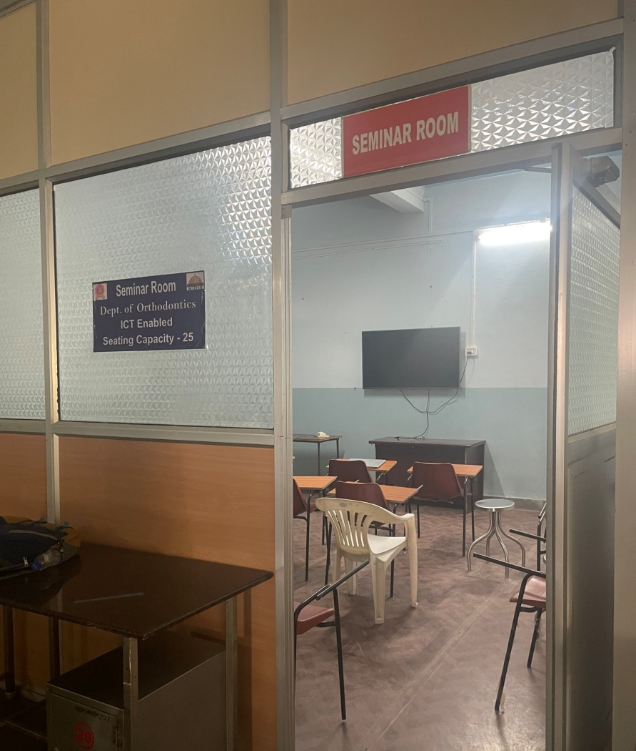
SEMINAR ROOM - DEPARTMENT OF ORTHODONTICS

Slide 14
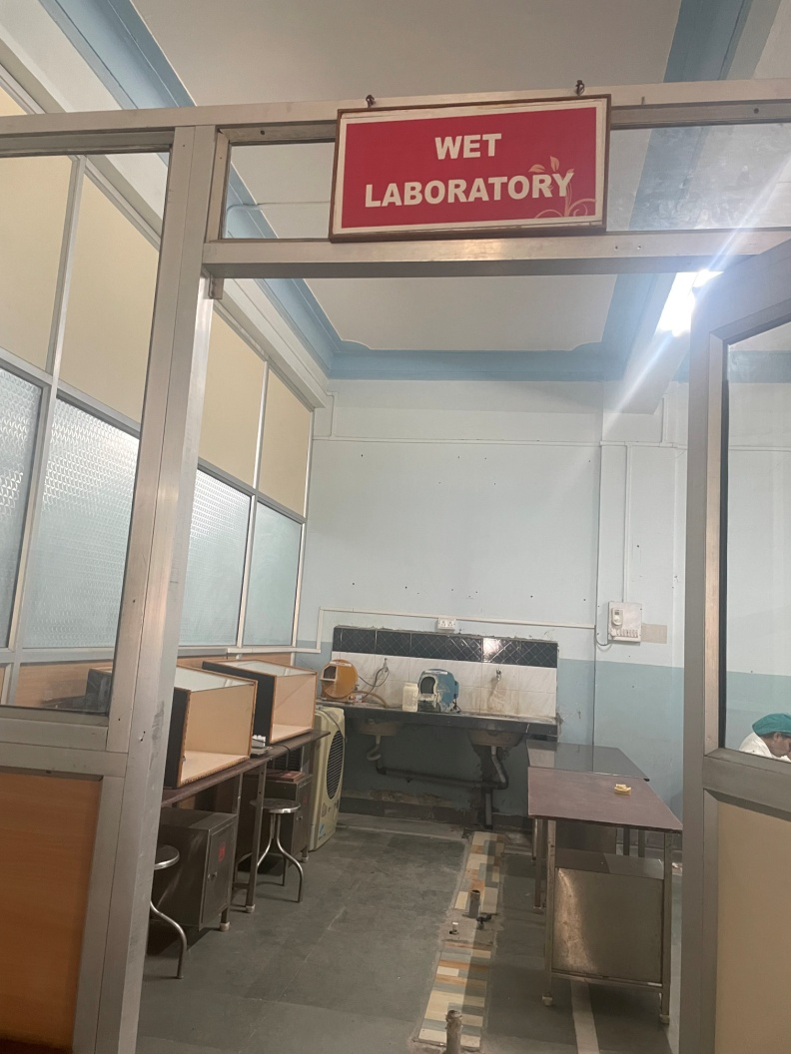
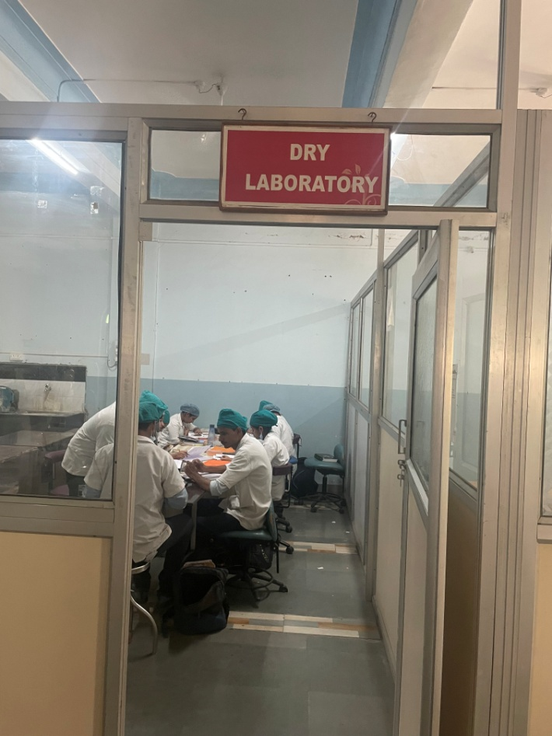
WET LABORATORY
DRY LABORATORY

Slide 15
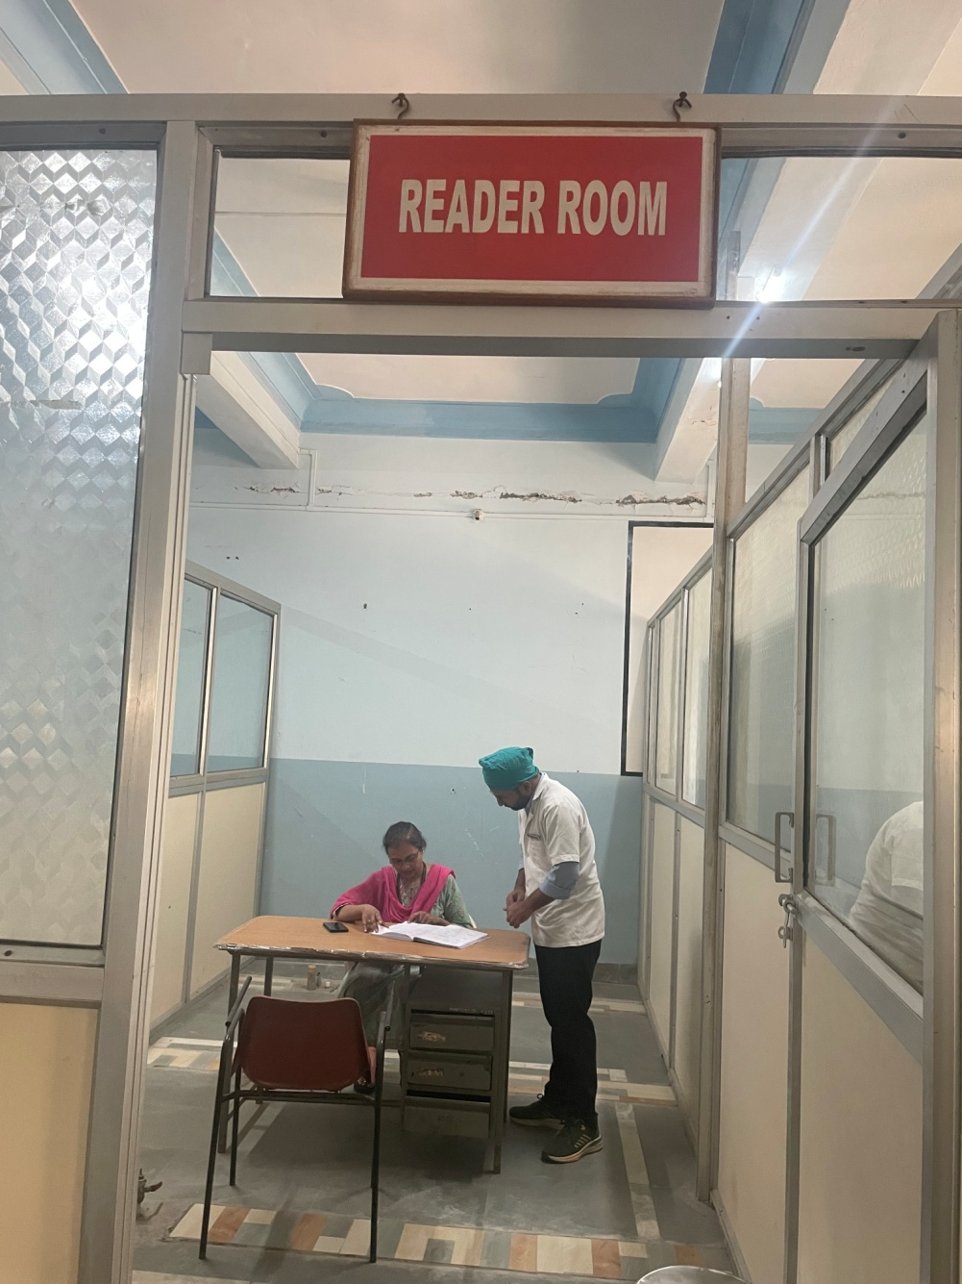
READER ROOM - DEPARTMENT OF ORTHODONTICS

Slide 16
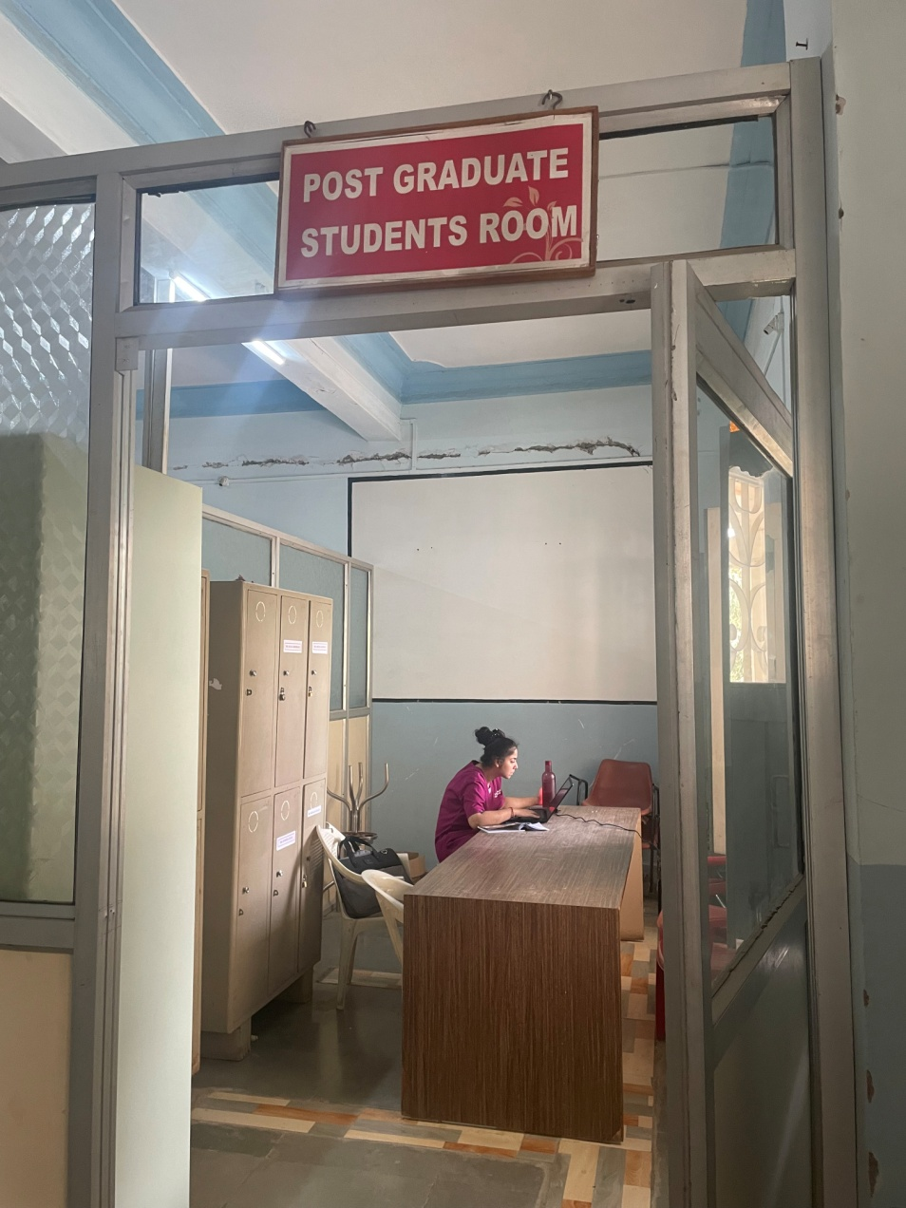
PG STUDENTS ROOM - DEPARTMENT OF ORTHODONTICS

Slide 17
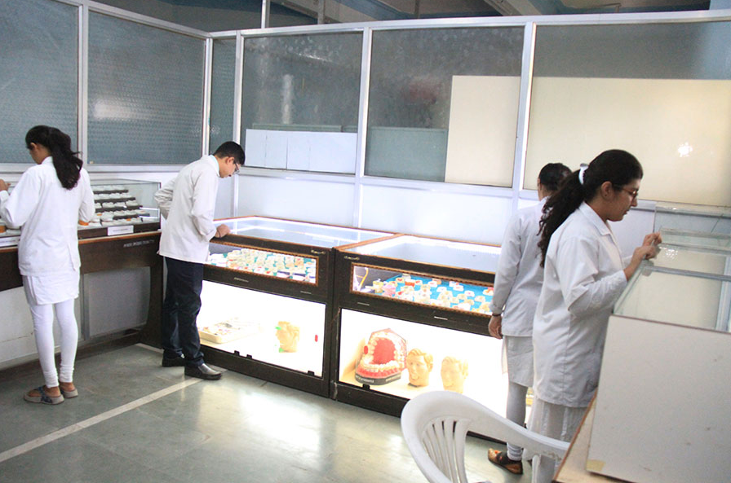
MUSEUM - DEPARTMENT OF ORTHODONTICS

Slide 18
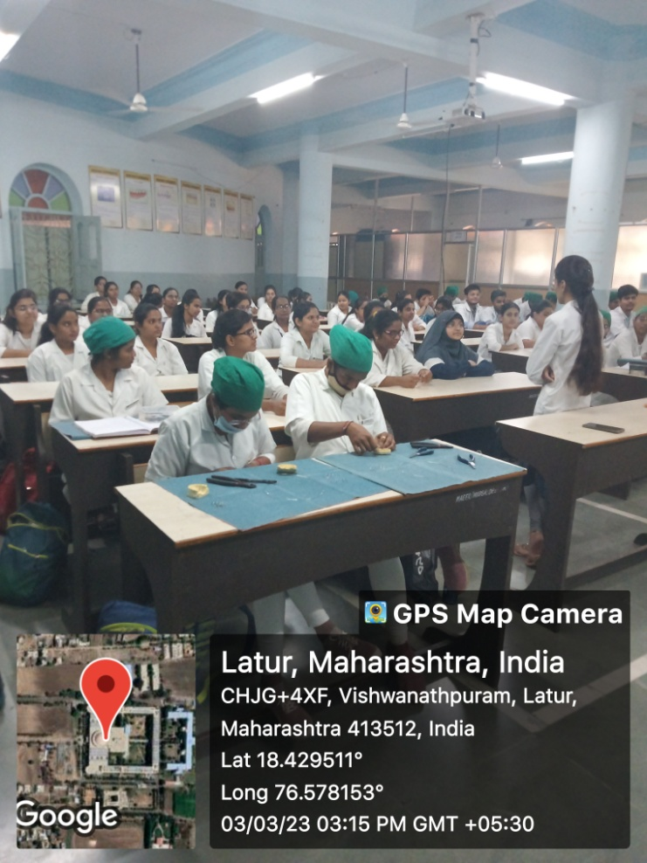
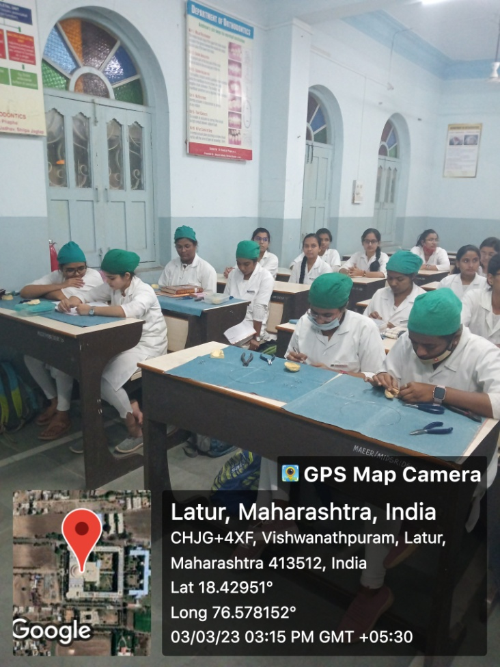
ORTHO – PEDO PRECLINICAL LABORATORY

Slide 19
LIST OF EQUIPMENTS
1 | Dental Chairs and Unit | One chair & unit per PG student and Two chairs with unit for the faculty | Availability
 |  | 2 Units
2 | Vacuum /pressure moulding unit | 1 | 1
3 | Hydrogen soldering unit | 1 | 1
4 | Lab micromotor | 5 | 5
5 | Spot welders | 5 | 5
6 | Model trimmer (Double disc) | 3 | 3
7 | Light curing unit | 2 | 2
8 | High intensity light curing unit | 2 | 2
9 | Polishing lathes | 3 | 3
10 | Tracing tables | 5 | 5
11 | SLR digital camera | 1 | 1
12 | Scanner with transparency adapter | 1 | 1
13 | X-ray viewer | 4 | 4
14 | LCD projector | 1 | 1
15 | Autoclaves for bulk instrument Sterilization vacuum (Front loading) | 1 | 1
16 | Needle destroyer | 1 | 1

Slide 20
17 | Dry heat sterilizer | 1 | 1
18 | Ultrasonic scaler | 1 | 1
19 | Sets of Orthodontic pliers | 3 | 3
20 | Orthodontic impression trays | 5 | 5
21 | Ultrasonic cleaner capacity 3.5 lts | 1 | 1
22 | Electropolisher | 1 | 1
23 | Typodonts with full teeth set | 3 | 3
24 | Anatomical articulator with face bow attachments | 1 | 1
25 | Free plane articulators | 1 | 1
26 | Hinge articulators | 4 | 4
27 | Computer software for cephalometrics | 1 | 1
28 | Computer with internet connection with attached printer and scanner | 1 | 1
29 | Refrigerator | 1 | 1

Slide 21
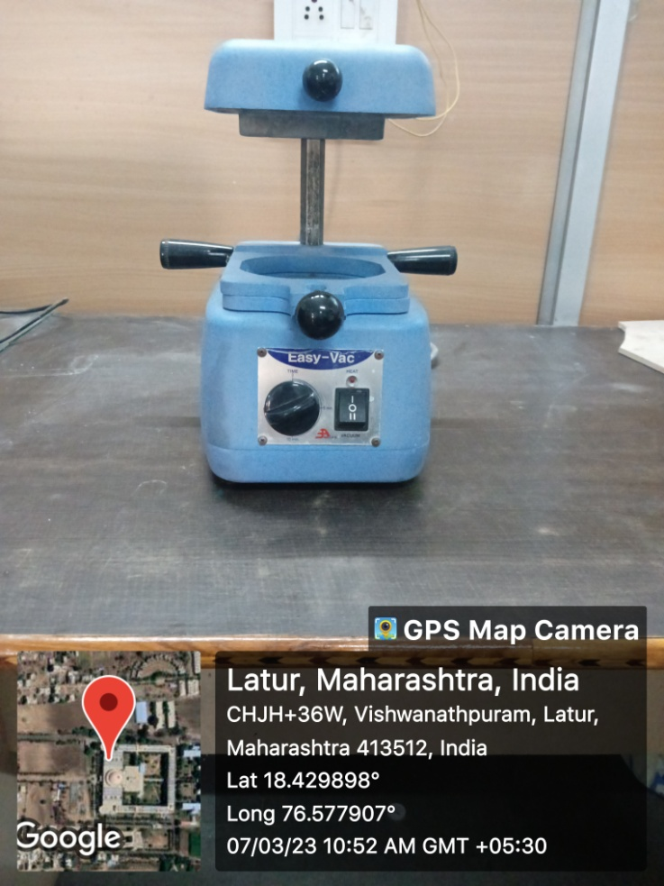
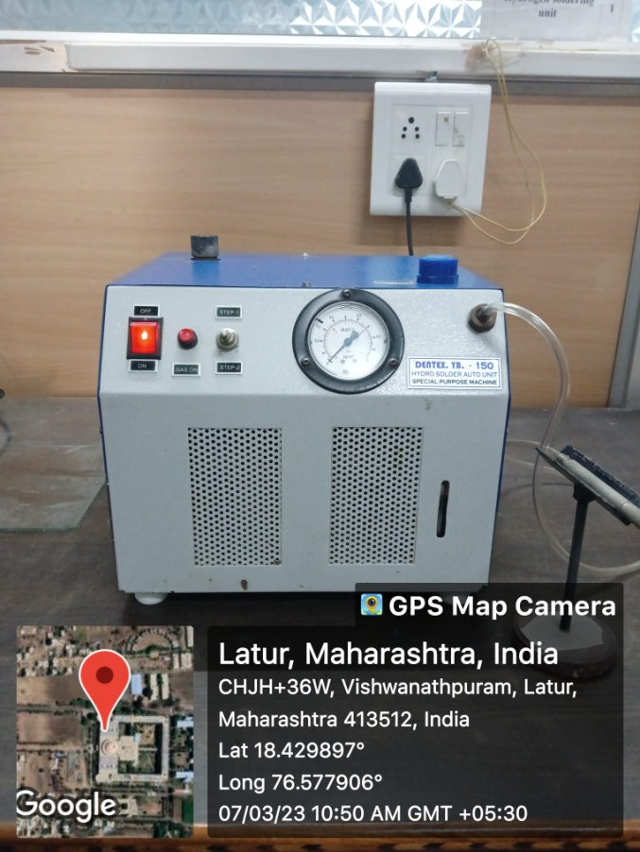
VACUUM /PRESSURE MOULDING UNIT
HYDROGEN SOLDERING UNIT

Slide 22
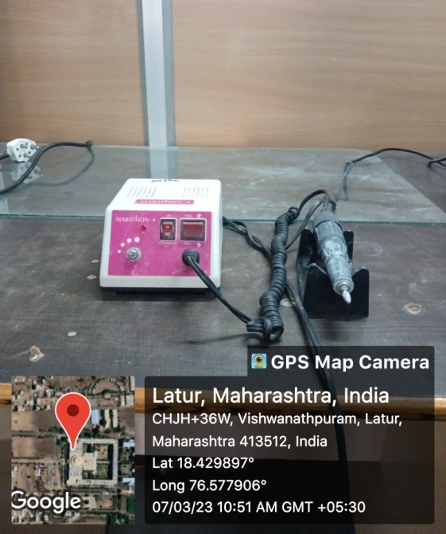
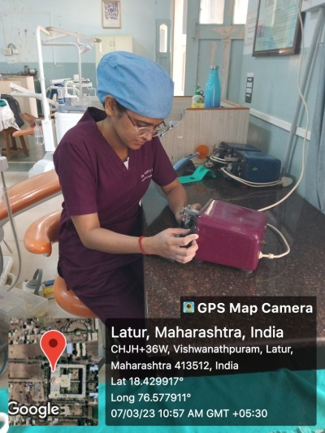
LAB MICROMOTOR
SPOT WELDERS

Slide 23
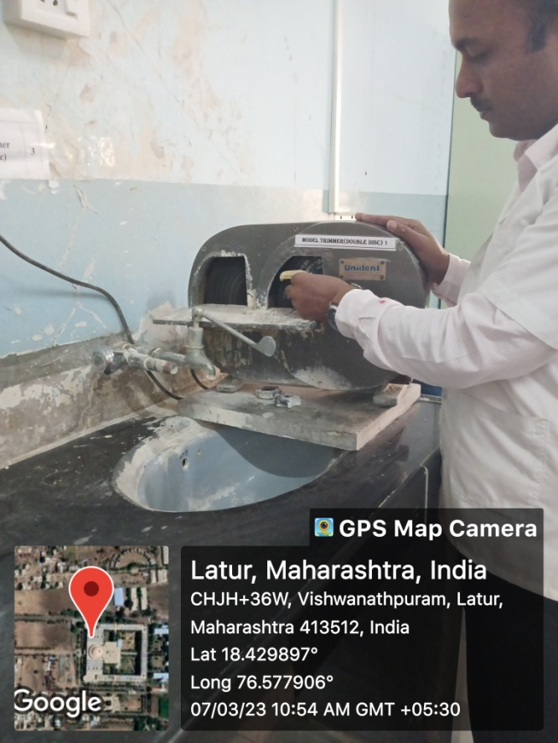
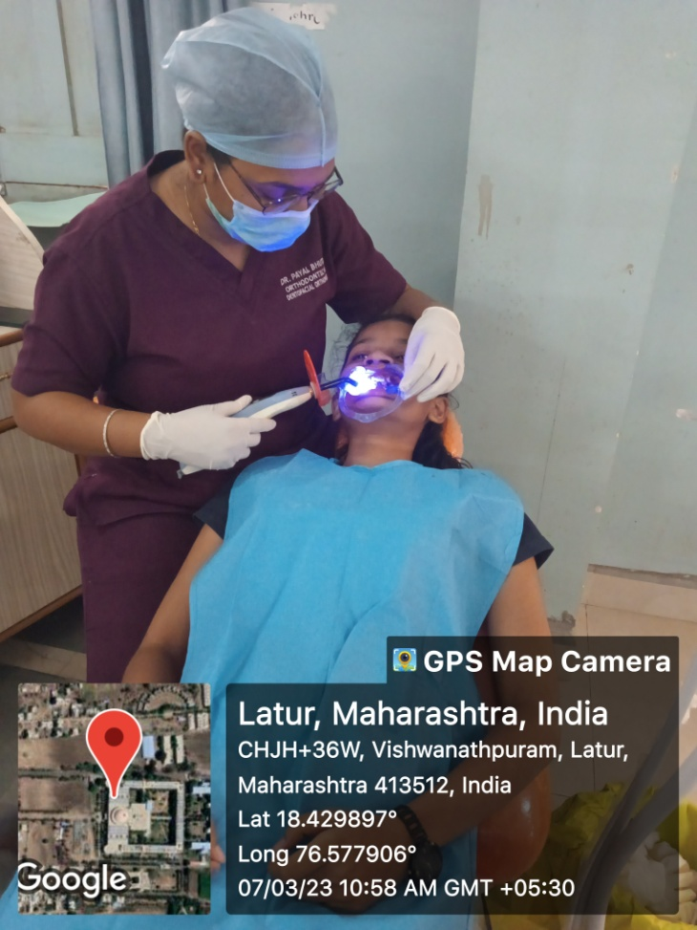
MODEL TRIMMER (DOUBLE DISC)
LIGHT CURING UNIT

Slide 24
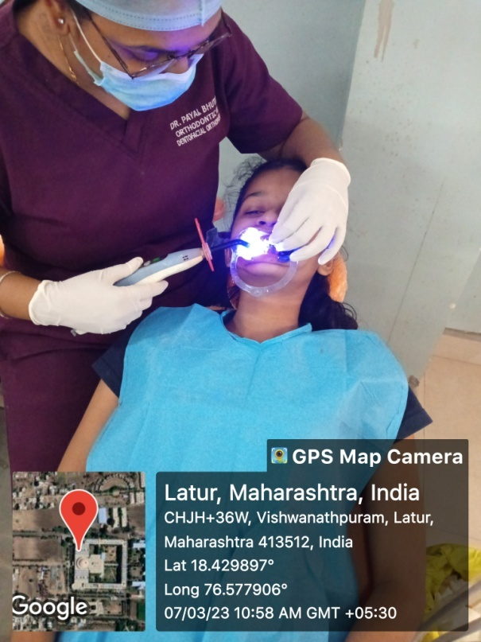
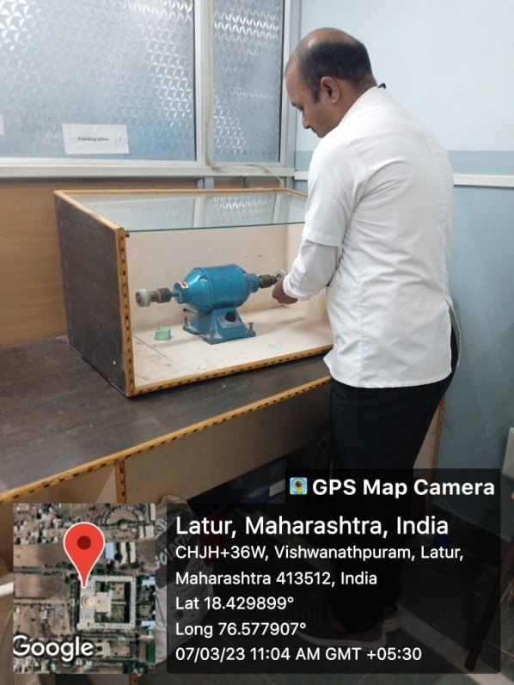
HIGH INTENSITY LIGHT CURING UNIT
POLISHING LATHES

Slide 25
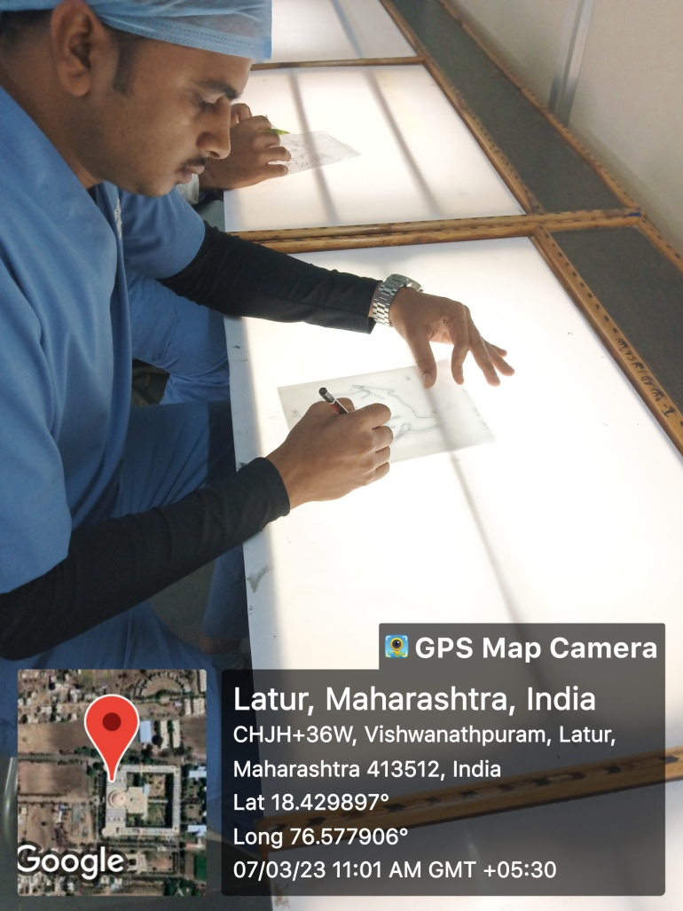
TRACING TABLES
SLR DIGITAL CAMERA

Slide 26
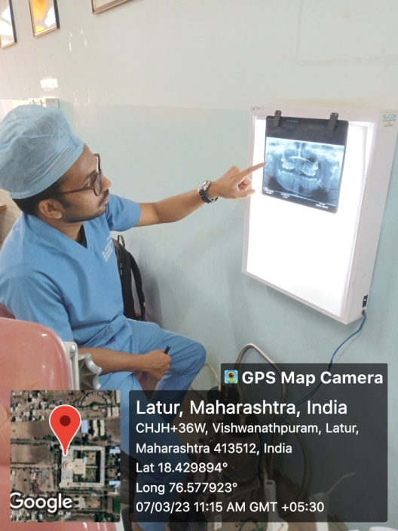
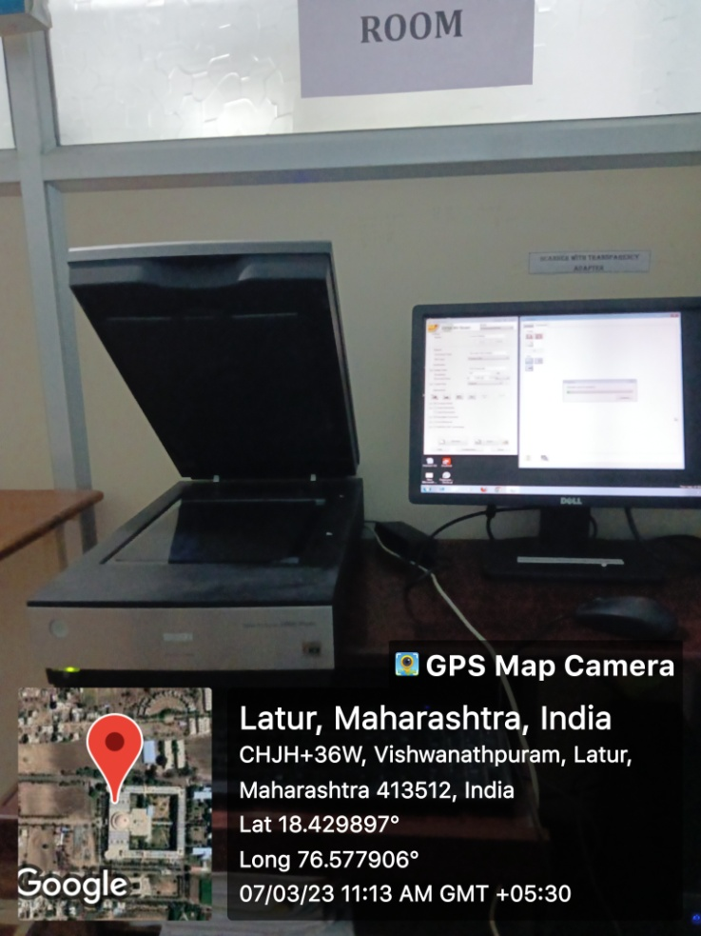
X-RAY VIEWER
SCANNER WITH TRANSPARENCY ADAPTER

Slide 27
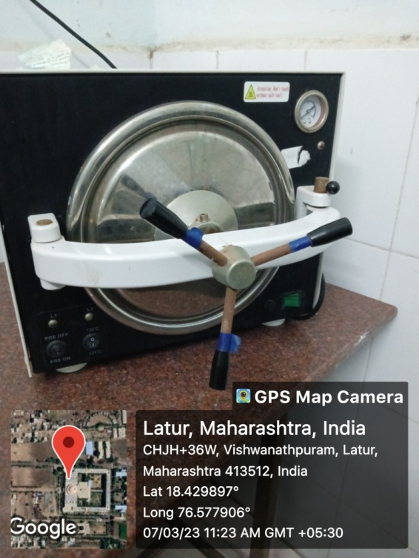
LCD PROJECTOR
AUTOCLAVE FOR BULK INSTRUMENT STERILIZATION VACUUM (FRONT LOADING)

Slide 28
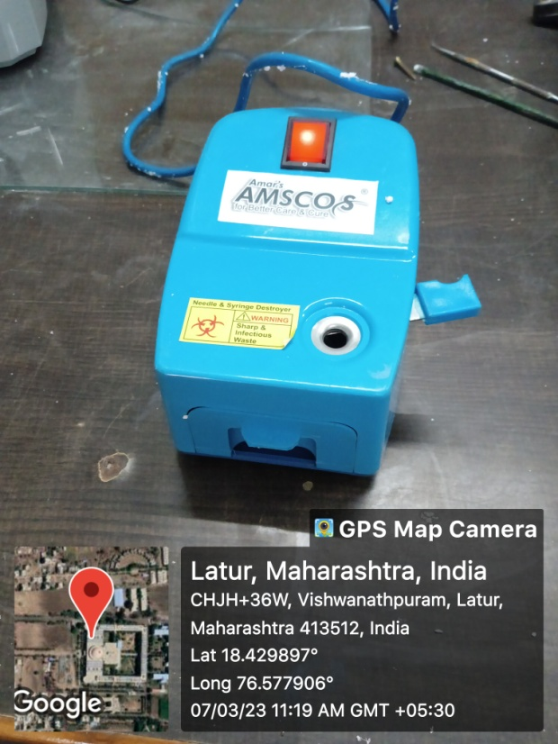
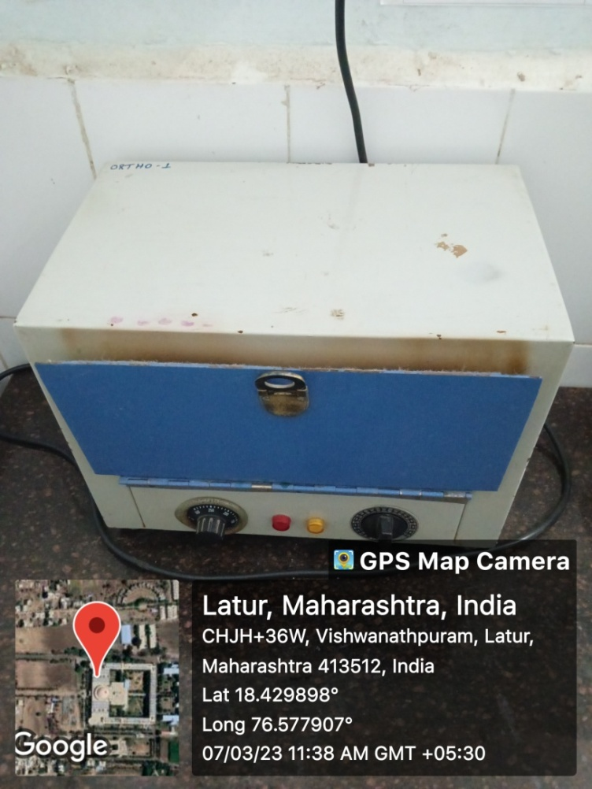
NEEDLE DESTROYER
DRY HEAT STERILIZER

Slide 29
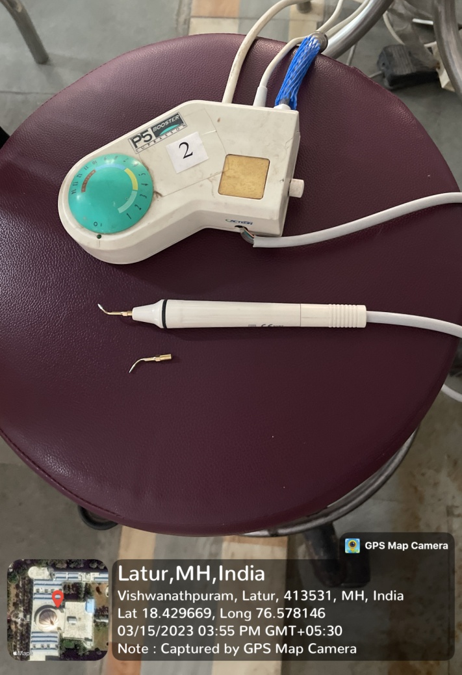
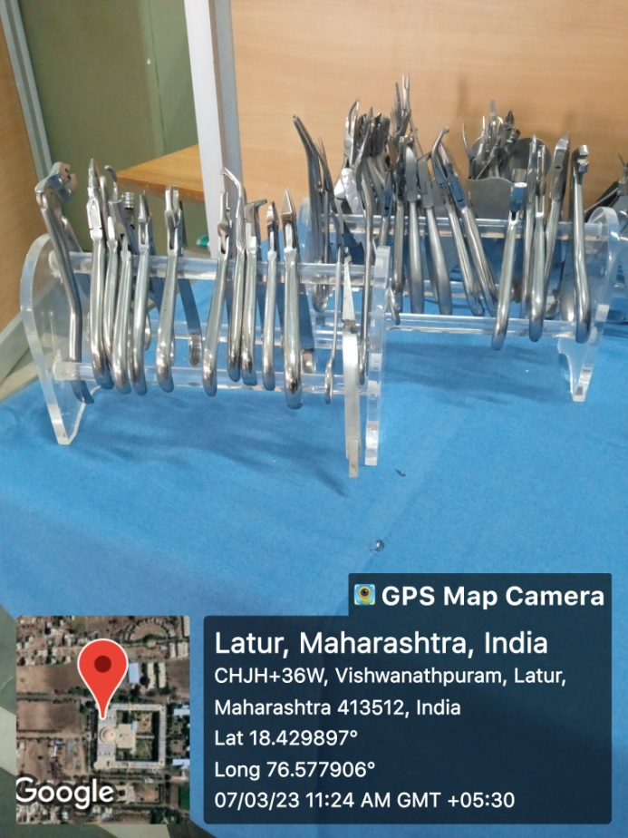
ULTRASONIC SCALER
SETS OF ORTHODONTIC PLIERS

Slide 30
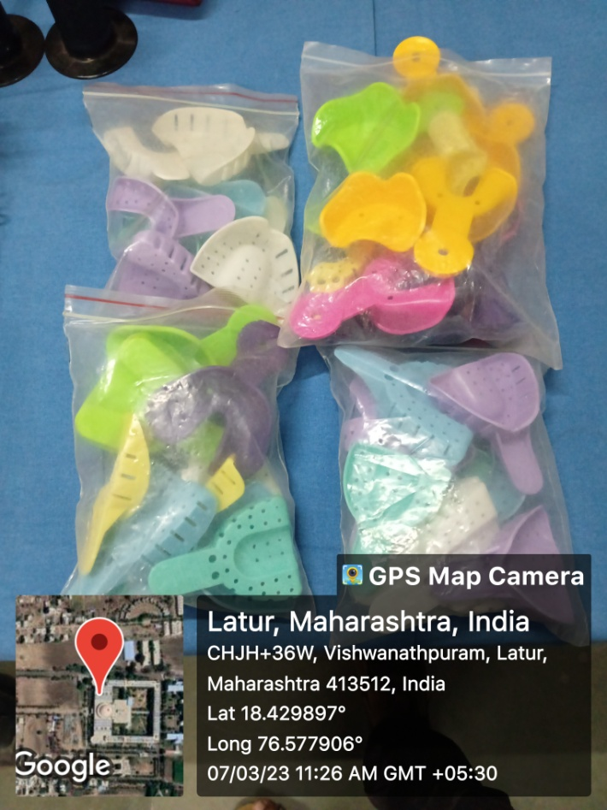
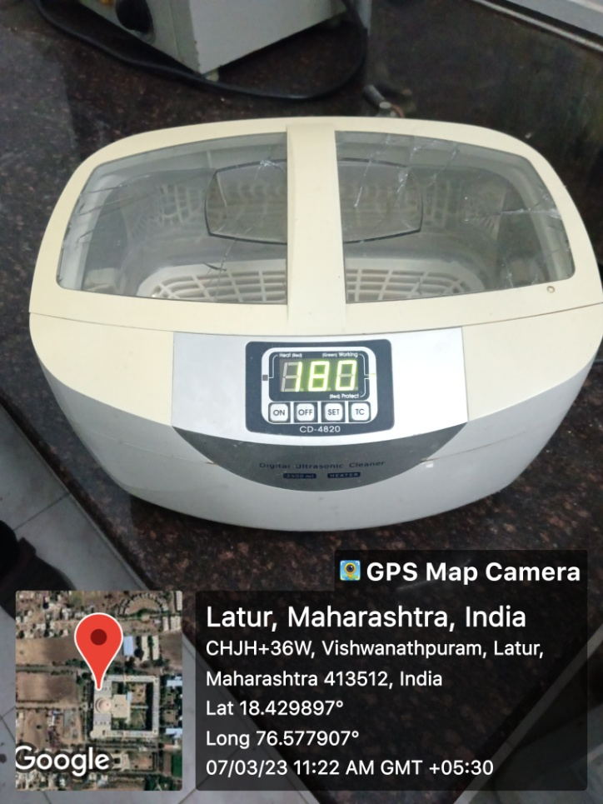
ORTHODONTIC IMPRESSION TRAYS
ULTRASONIC CLEANER CAPACITY 3.5 LTS

Slide 31
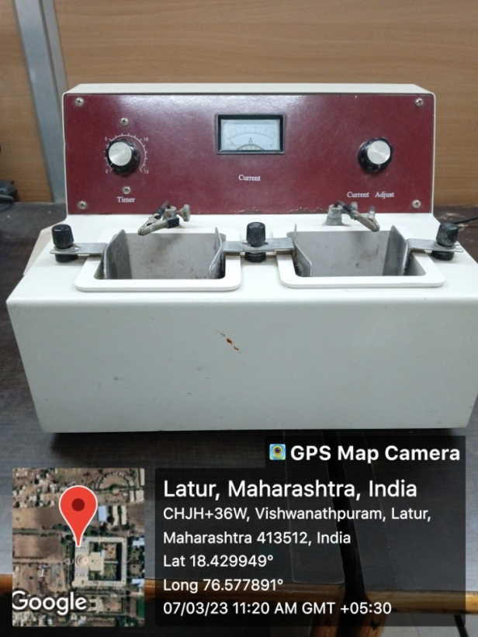
ELECTROPOLISHER
TYPODONTS WITH FULL TEETH SET

Slide 32
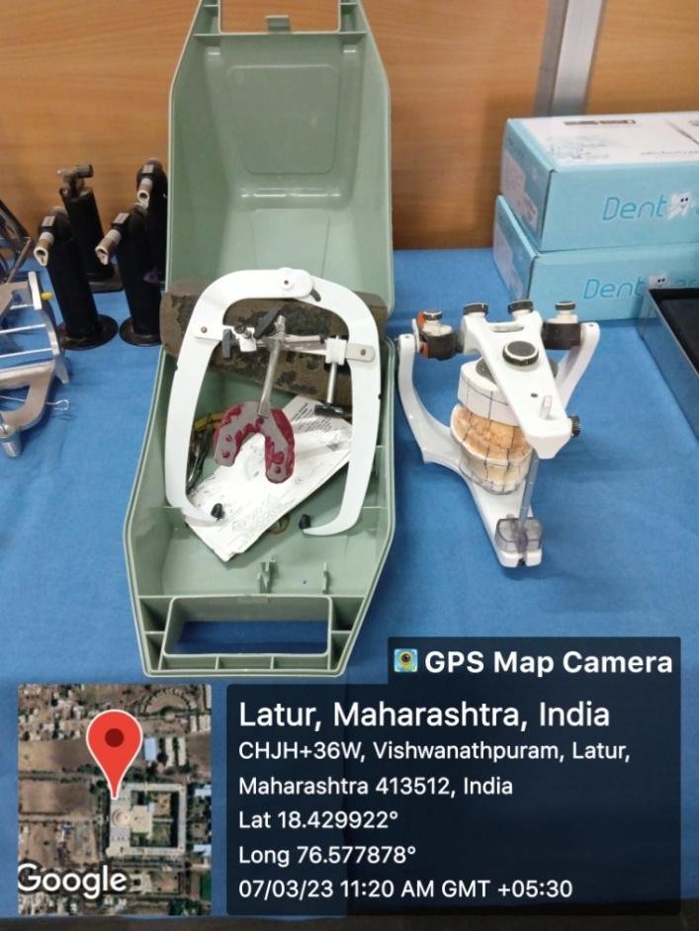
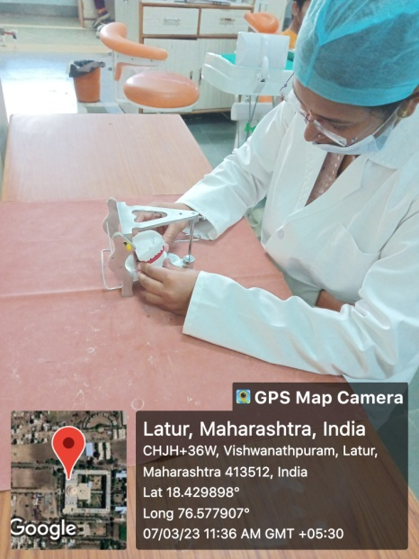
ANATOMICAL ARTICULATOR WITH FACE BOW ATTACHMENTS
FREE PLANE ARTICULATORS

Slide 33
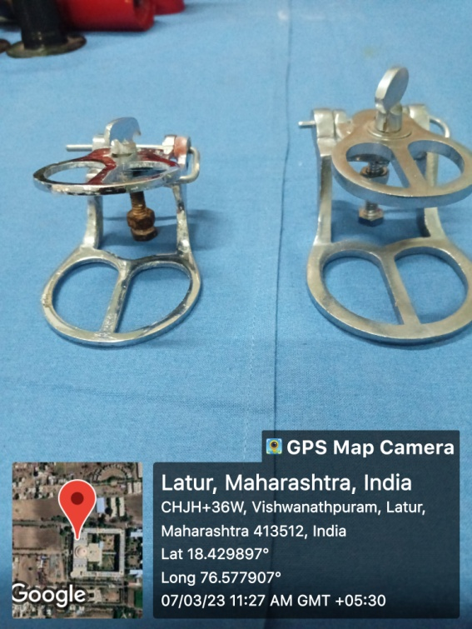
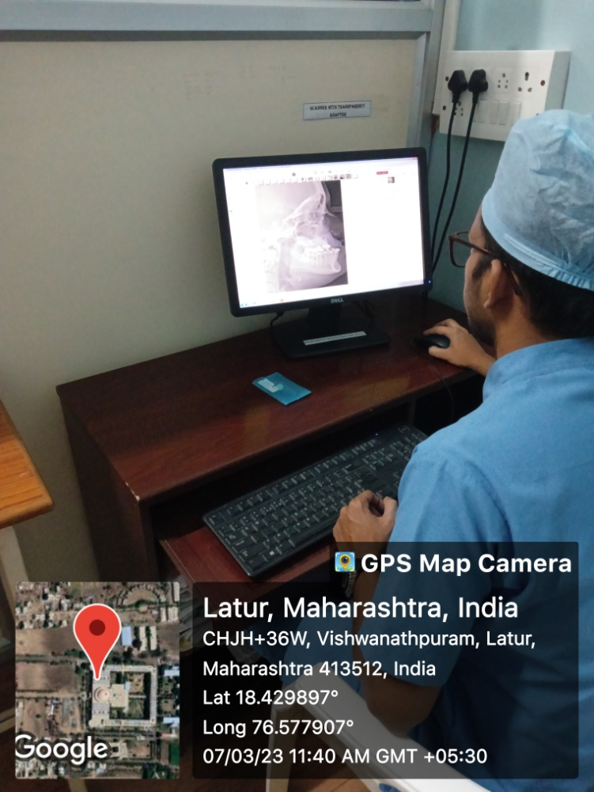
HINGE ARTICULATORS
COMPUTER SOFTWARE FOR CEPHALOMETRICS

Slide 34
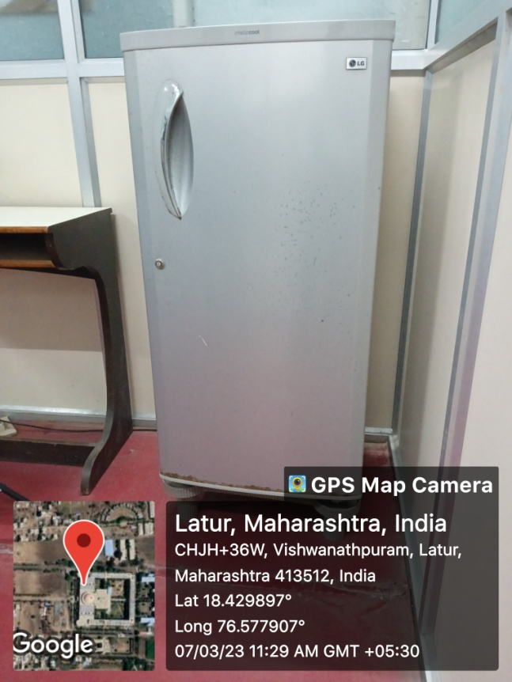
COMPUTER WITH INTERNET CONNECTION WITH ATTACHED PRINTER AND SCANNER
REFRIGERATOR

