Slide 1
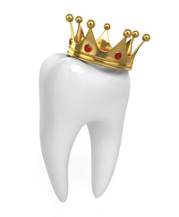
Crowns in Paediatric Dentistry

Slide 2
Contents
Defining crowns and stainless steel crowns
Historical Perspective
Indications and Contraindications
Classification
Composition
Selection of crowns
Crown preparation
Crown adaptation
Spedding’s principle

Slide 3
Indications -Mink and Bennet,1968
Badly broken down primary tooth where a satisfactory amalgam restoration is difficult to accomplish
Primary teeth which have been treated by a pulpotomy procedure
Primary teeth which have been treated by a partial pulpectomy technique
Teeth in the mouths of children where recurrent or rampant caries is anticipated
Primary and permanent teeth with hypoplastic enamel,other developmental defects
Permanent teeth requiring a semipermanent restoration

Slide 4
Temporary protection of fractured primary or permanent teeth
Semi permanent restoration of permanent teeth post endodntic therapy
Abutment for space maintainer
Bridge abutment in replacement of primary teeth

Slide 5
Indication | Author
Child patients who are unlikely to attend regular recall appointments or who are unlikely to be reliable preventive patients. | Pinkerton,2001
Single tooth cross bite correctio | Croll and Lieberman ,1999
In children with bruxism | Morris and Braham,1980
Temporary restoration of fractured tooth | Mcdonald and Avery,1950
Strong consideration should be given to the use of ssc’s in children who require GA for dental treatment | Seale,2002
Halls technique | Innes et al,2001

Slide 6
Contraindications
Contraindication | Author
Teeth approaching exfoliation within 6 to 12 months should not be fitted with a PMC | Duggal,1989
As a permanent restoration in the permanent dentition | Mink and Bennet,1968
Nickel allergies
Medically compromised patients

Slide 7
Crown preparation
Make the tooth preparation fit the crown rather rather than attempt to make the crown fit the preparation
Stewart, Barber, Troutman, Wei; Pediatric dentistry :Scientific foundation and clinical practice; 1982; The C.V. Mosby Company; London.
Mathewson.R. Fundamentals of Pediatric Dentistry. 2nd edition

Slide 8
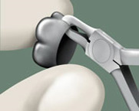
1.Examination of the patient’s occlusion 3. Local anaesthesia application
2. Topical/ infiltration
( degree of inflammation of gingival
tissue
Crown selection –Trial and error `
Measurement of internal diameter of crown 4. Rubber dam application
Measurement of greatest diameter of selected tooth
(middle of middle third of the clinical crown)
(Cast- Vernier callipers/ Oral cavity-dividers)
Charts
Radiographic measurement
Measurement of greatest diameter of contralateral tooth

Slide 9
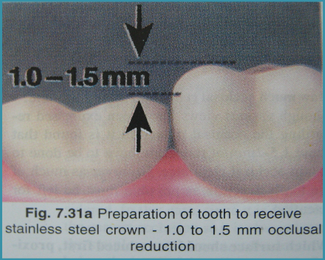
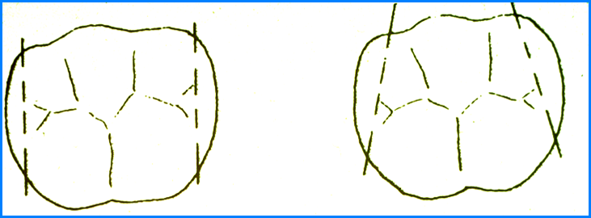
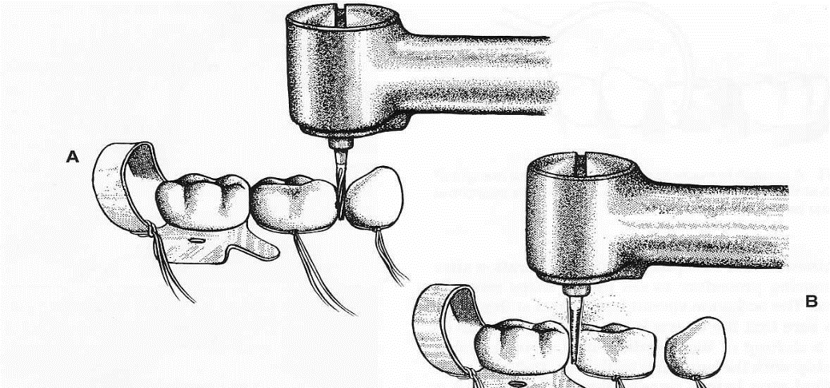
Occlusal reduction Buccal and Lingual reduction
First proximal reduction Seldom necessary to remove the buccal
followed by occlusal and lingual surfaces except in the case of a bu -Mink and Bennet,1968 of a bulging mandibular 1st molar
Occlusal reduction first, followed -Mink and Bennet,1968
By proximal reduction-Full,1974
Try the selected crown for size before
Proximal reduction carrying out any b/l reduction
-Duggal and Curzon,1984
Reduction should be done till the contact is completely
Start at the lingual surface and follow the contour
In case of primate spaces, present mesially , reduce as much
mesially as you have reduced distally

Slide 10
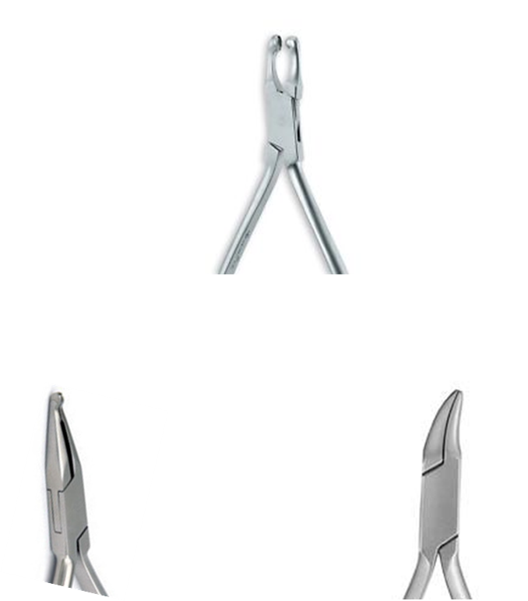
Crown adaptation
Evaluation of Initial adaptation of crown
snap into place - Should not be removed by finger pressure
should fit snugly against preparation
margin – extend 1mm into sulcus – closely engage the tooth structure
should seat without cutting or blanching the gingiva
When in occlusion – permit closure without interference
Crown contouring
114 pliers (ball and socket pliers) - middle third - produce - belling effect
112 (Abell) pliers - contour - proximal surface
gingival third of the crown is done with the 137 Gordon pliers

Slide 11
Contents
Modification of stainless steel crowns in posterior teeth
Complications
Sterilisation
Importance of anterior restorations
Difference in approach
The Demand
Classification
Stainless steel anterior crowns
Facial cut stainless steel crowns
Preveneered stainless steel crowns
Zirconia crowns
Strip crowns
Polycarbonate crowns

Slide 12
Modifications of crowns
1)ADJACENT STAINLESS STEEL CROWNS. (Nash,1981)
When more than one stainless steel crown needs to be done in a quadrant, the two or more crowns should be:
a) prepared at the same time. Pulp treatment, crown reduction and adaptation are more efficient .
b) cemented at the same time. An increase in the amount of cement may be needed.
c) Checked for proper broad contacts.

Slide 13
When a stainless steel crown and a class II amalgam restoration are to be done at one appointment, stainless steel crown preparation is done first.
However Class II amalgam preparation is done at same time to allow for proper contour of the stainless steel crown’s marginal ridge. The stainless steel crown is used as a guide in reproducing the anatomy and morphology of the silver amalgam restoration.

Slide 14
ADJACENT STAINLESS STEEL CROWNS WITH ARCH LENGTH LOSS (McEvoy,1971)
Extensive and long standing carious lesions can cause a shift of primary teeth into the interproximal contact areas.
It is very difficult to restore the lost mesiodistal dimension. The mesial shift of the permanent first molar that may occur will influence the child’s permanent occlusal relationship.

Slide 15
The tooth preparation must compensate for the need to use a small crown. Select the crowns.
Usually crowns will adjust to the tooth preparation individually but cannot be placed at the same time because of the mesial drift of the adjacent teeth.
By experimentation optimum combination of crowns are selected. A primary maxillary first molar from the opposite side will fit a primary mandibular first molar of the opposite side. Anatomically there is a similarity, advantage being that the primary maxillary first molar crown is narrower mesiodistally.

Slide 16
Contacts are flattened using no 110 plier. When the crowns are cemented, the marginal edges should be aligned. With the crowns properly aligned, patient bite on a tongue blade until the cement is completely set.

Slide 17
OVERSIZED CROWN (Mink and Hill,1971)
Try the crown on the tooth.. Use a pair of scissors to cut the crown from the gingival to the occlusal surface, either buccally or lingually as needed.
Pinch the crown together, in effect reducing the crown size. Again try the crown on the tooth. The gingival margins of the crown should approximate the gingival margins of the tooth.

Slide 18
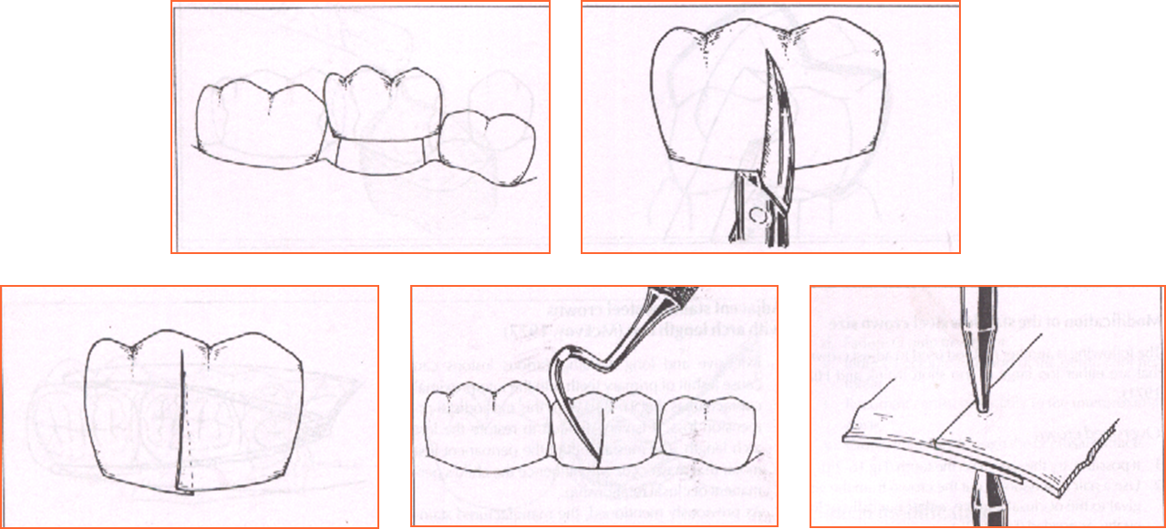

Slide 19
Undersized crowns
Check the crown on the tooth. Cut a V in the crown on the buccal and lingual side as needed. Try the crown on the tooth. Use a strip of orthodontic band material to spot weld over the V cut in the crown. Do this on one surface to allow for adjustment of the crown in the mouth.
Use no 114 pliers to adapt the bands material to the crown contour. Cut off the excess, approximating the gingival contour of the crown. Retry the crown on the tooth. Again scratch the band material where it adapts to the crown.
Reposition the scratch and the band material. Spot weld, solder and finish.
Adapt, contour and crimp the crown

Slide 21
CROWN EXTENSION FOR DEEP PROXIMAL LESIONS.
Often the interproximal caries extend beyond the length of the manufactured crowns.
One approach is to complete pulpal treatment and then restore the cavity preparation with silver amalgam.
Another method is to solder an extension on the interproximal area of the crown. In an area where the crown is deficient, spot weld a piece of orthodontic band material.

Slide 23
Modification for bruxism (Croll,

Slide 24
Modifications in crown preparation for permanent tooth (Croll,1987)

Slide 25
Hall technique
Study | Outcome
Innes et al,2006 | 73% at 3 years, 68% for 5 years
Innes et al,2011 | 92%
Sanatmaria et al ,2015 | Acceptability of halls
Ludwig et al,2014 | 97%

Slide 26
Van der Zee et al (2010) evaluated the effect of the HT on occlusal vertical dimension in the primary dentition in vivo. The vertical distance was measured between the most prominent mesio-incisal points of the opposing canine teeth on the same side of the mouth as an indicator of overbite.
Forty-eight children with 114 SSCs were evaluated with measurements taken at pre-treatment, baseline, 15, and 30 days. The authors concluded that HT-placed crowns opened the occlusion, and the occlusion returned to pretreatmentlevels after 15 to 30 days.

Slide 27
Common complications
INTERPROXIMAL LEDGE
Incorrect angulation of the tapered fissure bur can produce a ledge instead of a shoulder free slice. Further tooth reduction to remove the ledge should be attempted cautiously because of the possibility of an iatrogenic pulpal exposure. Failure to remove the ledge will result in inability to seat the crown whose margins will bind on the ledge.
When the adjacent tooth is partially erupted and the contact area is poorly established, the interproximal slice is difficult to prepare. Extensive subgingival tooth reduction is required to clear the contact area.

Slide 28
CROWN TILT
Destruction of a simple lingual or buccal wall by caries or overzealous use of cutting instrument may result in the finished crown tilting towards the deficient side. Lack of tooth support encourages this tilting. Placement of an amalgam alloy or glass ionomer cement prior to crowning provides support to prevent crown tilt.

Slide 29
Inhalation or ingestion of crown
These accidents are rare, particularly when rubber dam is used . sudden unpredictable movement may result in inhalation or ingestion of the crown if the rubber dam is not in place. If this occurs an attempt to removal can be made by holding the child upside down as soon as possible, if this is unsuccessful referral for an immediate chest X-ray is mandatory. The presence of a cough reflex in the conscious child fortunately reduces the chances of inhalation, ingestion of the crown.

Slide 30
Sterilisation
The American Academy of Pediatric Dentistry acknowledges Guidelines for Infection Control in the Dental Health-Care Setting−2003 and Guidelines for Disinfection and Sterilization in Healthcare Facilities−2008 as in-depth reviews of infection control measures for dental settings and supports the strategies therein.
According to these guidelines, a critical instrument is one which penetrates soft tissue or bone, contacts blood stream or other sterile tissue

Slide 31
SSC falls in the category of critical instrument and for all critical dental instruments that are heat stable, sterilization by steam under pressure, that is, autoclave is advocated

Slide 32
SSCs are stock crown and not customized−they have to be selected and tried-in, prior to cementation. Most situations necessitate try-in of multiple SSCs. Thus there may be a common situation where many crowns remain tried-in and not cemented. As a result, the practice of reuse is widely accepted and carried out. However, these crowns would have been contaminated with blood and saliva during the try-in process,which highlights the need for decontamination of the same prior to reuse.
-Smith et al,2005

Slide 33
The situation of reusing tried-in SSCs is complicated by the fact that they are marked for single use only.
The Medical Devices Agency defi nes reuse as ‘‘repeated episodes of use of a device in circumstances that make some form of reprocessing necessary.’Manufacturers mark crowns with the CE mark. The initials ‘‘CE’’ do not stand for anything, but are a declaration by the manufacturer that the product meets all the appropriate provisions of the relevant legislation implementing the European Directive specific to that product.

Slide 34
Farhin katge et al,2013- only 57% dentists autoclaved prior to reuse.

Slide 35
Initially, wiping and immersion of SSC in 3% sodium hypochlorite or 2% gluteraldehyde solution for 10 min, which will dissolve the organic contaminants like saliva and blood, followed by ultrasonic cleaning of SSC for 15 min.
The chemical disinfection is necessary as ultrasonic cleaning does not completely eliminate the organic contaminants from the tried-in SSCs.
Finally, autoclaving the SSC would provide complete decontamination of SSC prior to its reuse.- Katge et al,2011

Slide 36
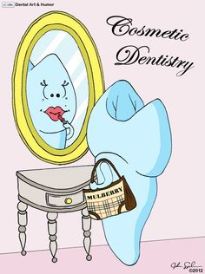
Anterior crowns in pediatric dentistry

Slide 37
“Color is unimportant to the physiologic success of a dental restoration, yet it could be the controlling factor in the overall acceptance by the patient.”
-Bergen,1985

Slide 38
Difficulties associated with restoration of anterior teeth in children:
1) the small size of the teeth
2) close proximity of pulp to tooth surface,
3) relatively thin enamel and surface area for bonding,
4) issues related to child behavior and
5) cost of the treatment
6) Early exfoliation of the tooth
-Shah et al, 2004

Slide 39
Why is it important ?
1) A compromise in esthetics,
2) Dental destruction may also lead to development of parafunctional habits like tongue
3) Thrusting and speech problems
4) Psychological problems
5) Reduced masticatory efficiency
6) Loss of vertical dimension of occlusion.
Hence it is important to restore crowns destroyed by caries to preserve the integrity of primary dentition until its exfoliation and eruption of permanent teeth.
-(Usha et al,2007)

Slide 40
Why is there lesser evidence ?
Difficulties in carrying out prospective clinical studies with anterior restorative options
The young age and cooperative abilities of the patient population
Behavior can definitely affect outcome
-Wagonner,2015

Slide 41
Is there a demand for aesthetics in children ?
Woo, Sheller et al (2005)--Parents ranked attractiveness and health similarly. They viewed SSCs as unhealthy

Slide 42
Grossly carious teeth
Grossly carious teeth with sinus tracts
Dark incisor

Slide 43
Holan, Rahme, Ram (2009)--Parents advocated dental treatment to save a primary tooth, even if chances for success were only 50%.
35.9% rejected the idea of a prosthetic replacement for a lost primary incisor

Slide 44
Indications for full coverage restorations
Caries present on multiple surface.
Extensive cervical decalcification
Anteriors that have received pulp therapy
Anteriors that have fractured and lost most of the tooth structure
Anterior teeth with multiple hypoplastic defects or developmental disturbances
Discolored teeth that are aesthetically unpleasing
High risk patients where the oral hygiene is poor but caries is minimal.
The child’s behavior makes moisture control difficult in placing class III restorations
-(Waggoner,2002)

Slide 46
Stainless steel crowns
Preformed stainless steel crowns (SSCs) are considered to be the most durable and reliable for restoring severely carious or fractured primary incisors. –Lee,2002
Advantages | Disadavantages
Easy to place | Unsightly silver metallic appearance
Fracture proof
Wear resistant, firmly attached to tooth till exfoliation -Croll,1998

Slide 47
Croll reported that some parents preferred to have the incisors extracted if the SSCs were the only restorative option.
-Croll,1998

Slide 48
Advantages
The time for placement is fast compared to other techniques.
They are fairly inexpensive (approximately $6/ crown).
They may be used when gingival hemorrhage or moisture is present or when the patient exhibits less than ideal cooperation.
-Schwartz

Slide 49
Steps
Selection of crown
Removal of caries
169 L bur or fine tapered diamond

Slide 50
Incisal edge | 1.5m
Facial | 1mm
lingual | 0.5mm
Gingival margin | 1 mm

Slide 51
Retention of stainless steel crowns
93% after a follow up of 26 months
-Lopez Loverich et al, 2015

Slide 52
Modifications
Facial cut out Stainless steel crowns
This involves placement of composite material in a labial fenestration of SSC
-
-Lee et al,2002
Disadvantages | Advantages
Time consuming | Improvement in appearnce
Metal margins are visible
Difficult to control haemorrhage during application of composite

Slide 53
Steps
Cutting of a labial window with no 330 or 35 no bur

Slide 54
Extend the window:
1. Just short of the incisal edge.
2. Gingivally to the height of the gingival crest.
3. Mesio-distally to the line angles.
Using a no. 35 bur remove the cement to a depth of 1mm.
Place undercuts at each margin with a no. 35 bur or with a no. ½ round bur

Slide 57
Pre-veneered stainless steel crowns
Recently, resin-veneered SSCs have been introduced.
In these crowns, the composite resins and thermoplastics are“bonded” to the metal
The stainless steel crown is covered on its buccal or facial surface with a tooth colored coating of polyester/epoxy hybrid composition

Slide 58
Disadvanatges | Advantages
They are relatively inflexible as the resin facing is brittle and tends to fracture when subjected to heavy forces or crimping | They are aesthetically pleasing.
The lingual portion of the crown can be adjusted (crimped), significant removal of tooth structure must be performed to fit the tooth to the crown rather than the crown to the tooth | They require relatively short operating time.
There is limited shade choice | They have the durability of a steel crown.
. They are more expensive to purchase than stainless steel crowns and strip crown forms (approximately $18 vs. $6) yet less expensive than zirconia crowns ($18 vs. $25). | They are less moisture sensitive during placement than composite strip crowns.
Fracture of veneer

Slide 59
Disadvantages
Limited shade choice
Difficulty placing multiple approximating crowns in patients with crowding or space loss due to bulk.

Slide 60
Still,
Use of anterior veneered stainless steel crowns by pediatric dentists.
Oueis H¹, Atwan S, Pajtas B, Casamassimo PS
Pediatr Dent. 2010 Sep-Oct;32(5):413-6
A questionnaire was sent to 2,600 active members of the American Academy of Pediatric Dentistry with a follow-up request after 8 weeks. Respondents were asked about the utilization of AVSSCs in their practice and during their graduate training program.
RESULTS:
51% utilized AVSSCs in their practice;
41% selected AVSSCs as their first choice for the complete coverage for primary anterior teeth
71% concerned about durability

Slide 61
Parental satisfaction was good in all three studies
Study | Retention | Partial loss of facing | Complete loss of facing
Shah, Lee, Wright, 2004 | 100% | 26% | 13%
Roberts, Lee, Wright 2004 | 100% | 3% | 24%
MacLean, Champagne, Waggoner et al, 2007 | 99% | 12% | 0%

Slide 62
Increased overbite was significantly associated with an increased facing failure rate indicating tooth position influences treatment outcome.
-Roberts, Lee, Wright 2004

Slide 63
Brands available
1) Cheng crowns
2) Kinder krowns
3) Nu-smile and
4) Whiter biter
5) Pedo compu crowns
6) Dura crowns
-Lee et al,2002

Slide 64
Cheng | Kinder | Dura | Pedopearls
These are Stainless steel pediatric anterior crowns faced with a high quality composite, mesh-based with a light cured composite. It presents a unique solution for natural-looking Stain-resistant Crowns. It is available for the right and left central and lateral as well as cuspids. Manufacturer claims it to be Color stable, plaque resistant and matches pedo-shades. It doesn’t cause wear of opposing teeth. | Kinder Krowns offer the most natural shades and contour available for the pediatric patient They come in 2 aesthetically pleasing shades, Pedo 1 and Pedo 2. Pedo 2 shade is the most natural shade While Pedo 1 shade is for those cases when the bleached white shade is wanted. Kinder Krowns are designed with IncisaLock™ - the optimal union of state-of the-art bonding procedures and mechanical retention. | Crowns can be crimped labially and lingually, can be easily trimmed with crown scissors, easily festooned has got a full-knife edge | These are beautiful heavy gauge aluminum crowns coated with FDA food grade powder coating and epoxy-resin. Features include: ➢ Universal anatomy--use on either side ➢ Easy to cut and crimp, without chipping or peeling. ➢ Composite can be added Disadvantages include less durability and the crowns are relatively soft.

Slide 65
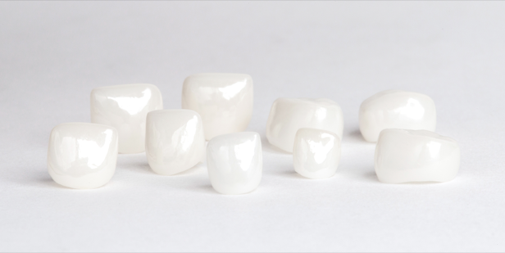
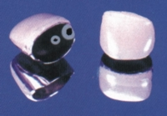
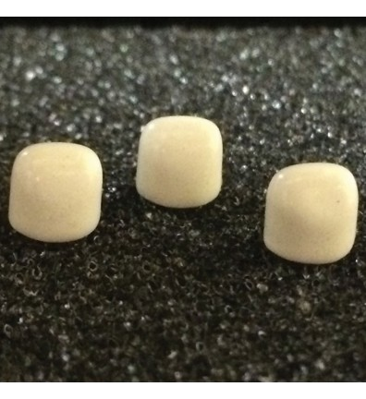
Cheng crowns
Dura
Pedo pearls
Kinder

Slide 66
Waggoner and Cohen, in 1995, tested 4 brands of veneered SSCs, Kinder Krowns, Whiter Biter Crown II, NuSmile, and Cheng Crowns.
They found that veneers on the Whiter Biter II exhibited the greatest shear force and retention compared to the other brands.
They believed that in Whiter Biter Crown II, the plasticity of the veneer material on the crown allows the material to flex under force.
Moreover, the meshwork was spot welded to the crown. Then, the veneer material was poured onto the mesh, mechanically retained via finger-like projections incorporated into the meshwork

Slide 67
Wickhersham et al (1998), has shown that preveneered Kinder Krowns and Nu Smile SSCs can undergo heat sterilization without deleterious effect on their bond strength.

Slide 68
New findings have been the development and availability of esthetic preveneered SSCs and zirconia posterior crowns.
Only two investigations, however, were available to assess the clinical outcomes, over time, of preveneered posterior SSCs compared with traditional SSCs
In both studies, all the crowns were generally satisfactory for gingival health and occlusion. However, both studies reported some degree of chipping, which resulted in a poor esthetic appearance; also, the incidence of fractured facings rose with increasing years of service. Kinder Krowns tended to fracture more often and more extensively than NuSmile crowns, but the difference was not statistically significant. These authors concluded that SSCs preveneered with composite resin provided an esthetic alternative to traditional SSCs
Ram,2002
O’Connel,2014

Slide 69
Zirconia crowns for anterior teeth
Zirconia (zirconium dioxide) crowns are made of solid monolithic zirconia ceramic material.
Although discovered in 1789 by the German chemist Martin Heinrich Klaproth, zirconia has been used as a biomaterial since the late 1960s. Its use as a dental restorative material became popular in the early 2000s with the advent of CAD-CAM technology.
-Schwartz

Slide 70
Zirconia: This are polycrystalline ceramic without glass component. It is polymorph that occurs in three from:
Monoclinic - pure zirconia stable at 1107 oC
Tetraclonic – above 1107 oC
Cubic face – at 2370 oC
The volume expansion caused by different forms of zirconia induces large stress which leads Zirconia to crack. By adding small amount of yttria these phase changes are eliminated and the resulting material has high compressive strength, high fracture resistance, corrosion resistance, durability and biocompatibility.

Slide 71
Yttria-stabilized tetragonal zirconia polycrystal, Y-TZP, has a unique ability to resist crack propagation by being able to transform from one crystalline phase to another.
-Tote et al,2015

Slide 72
Advantages | Disadvanatges
Esthetically pleasing, natural appearance | Inability to crimp
Highest strength/fracture resistance of any ped crown | Prepare the tooth to fit the crown, rather than fitting the crown to the tooth
Biocompatible | Cost/crown $22-25
 | Need for good hemorrhage control
Color stable | Need for remaining tooth structure
-Wagonner,2015 | Longer prep and fit time for most practitioners

Slide 73
Contraindications
They are not recommended in patients that are heavy bruxers.
Indications
Good occlusion with opposing dentition
Adequate crown height
Adequate spacing
Cooperative Patient
-Biber et al

Slide 74
Brands available
EZ Pedo, Loomis CA
Cheng Crowns, Exton PA
Kinder Krowns, St Louis Park, MN
NuSmile Pediatric Crowns, Houston, TX

Slide 75
Selection of crown
Reduce the incisal edge 1.5 - 2mm.
Reduce the labial surface a minimum of 0.5- 1.0 of tooth structure in three planes (gingival-middle-incisal thirds). These three planes extend from 1-2mm subgingivally all the way to the middle of the incisal edge of the prep

Slide 76
Reduce the lingual surface by removing .75- 1.25mm of tooth structure from the lingual surface, extending from 1-2mm subgingivally to the middle of the incisal edge of the prep following the natural contours of the existing clinical crown. The facial and lingual preps should meet in a thin incisal edge

Slide 77
The circumference of the overall prep should be ovoid when viewed from the incisal edge. Facial and lingual surfaces should not be prepared flat, but rather curved interproximally. Removing extra material in these areas will insure an easier fit with less internal interference and allow mesia/ distal rotation for a better alignment of the crown during final cementation.

Slide 78
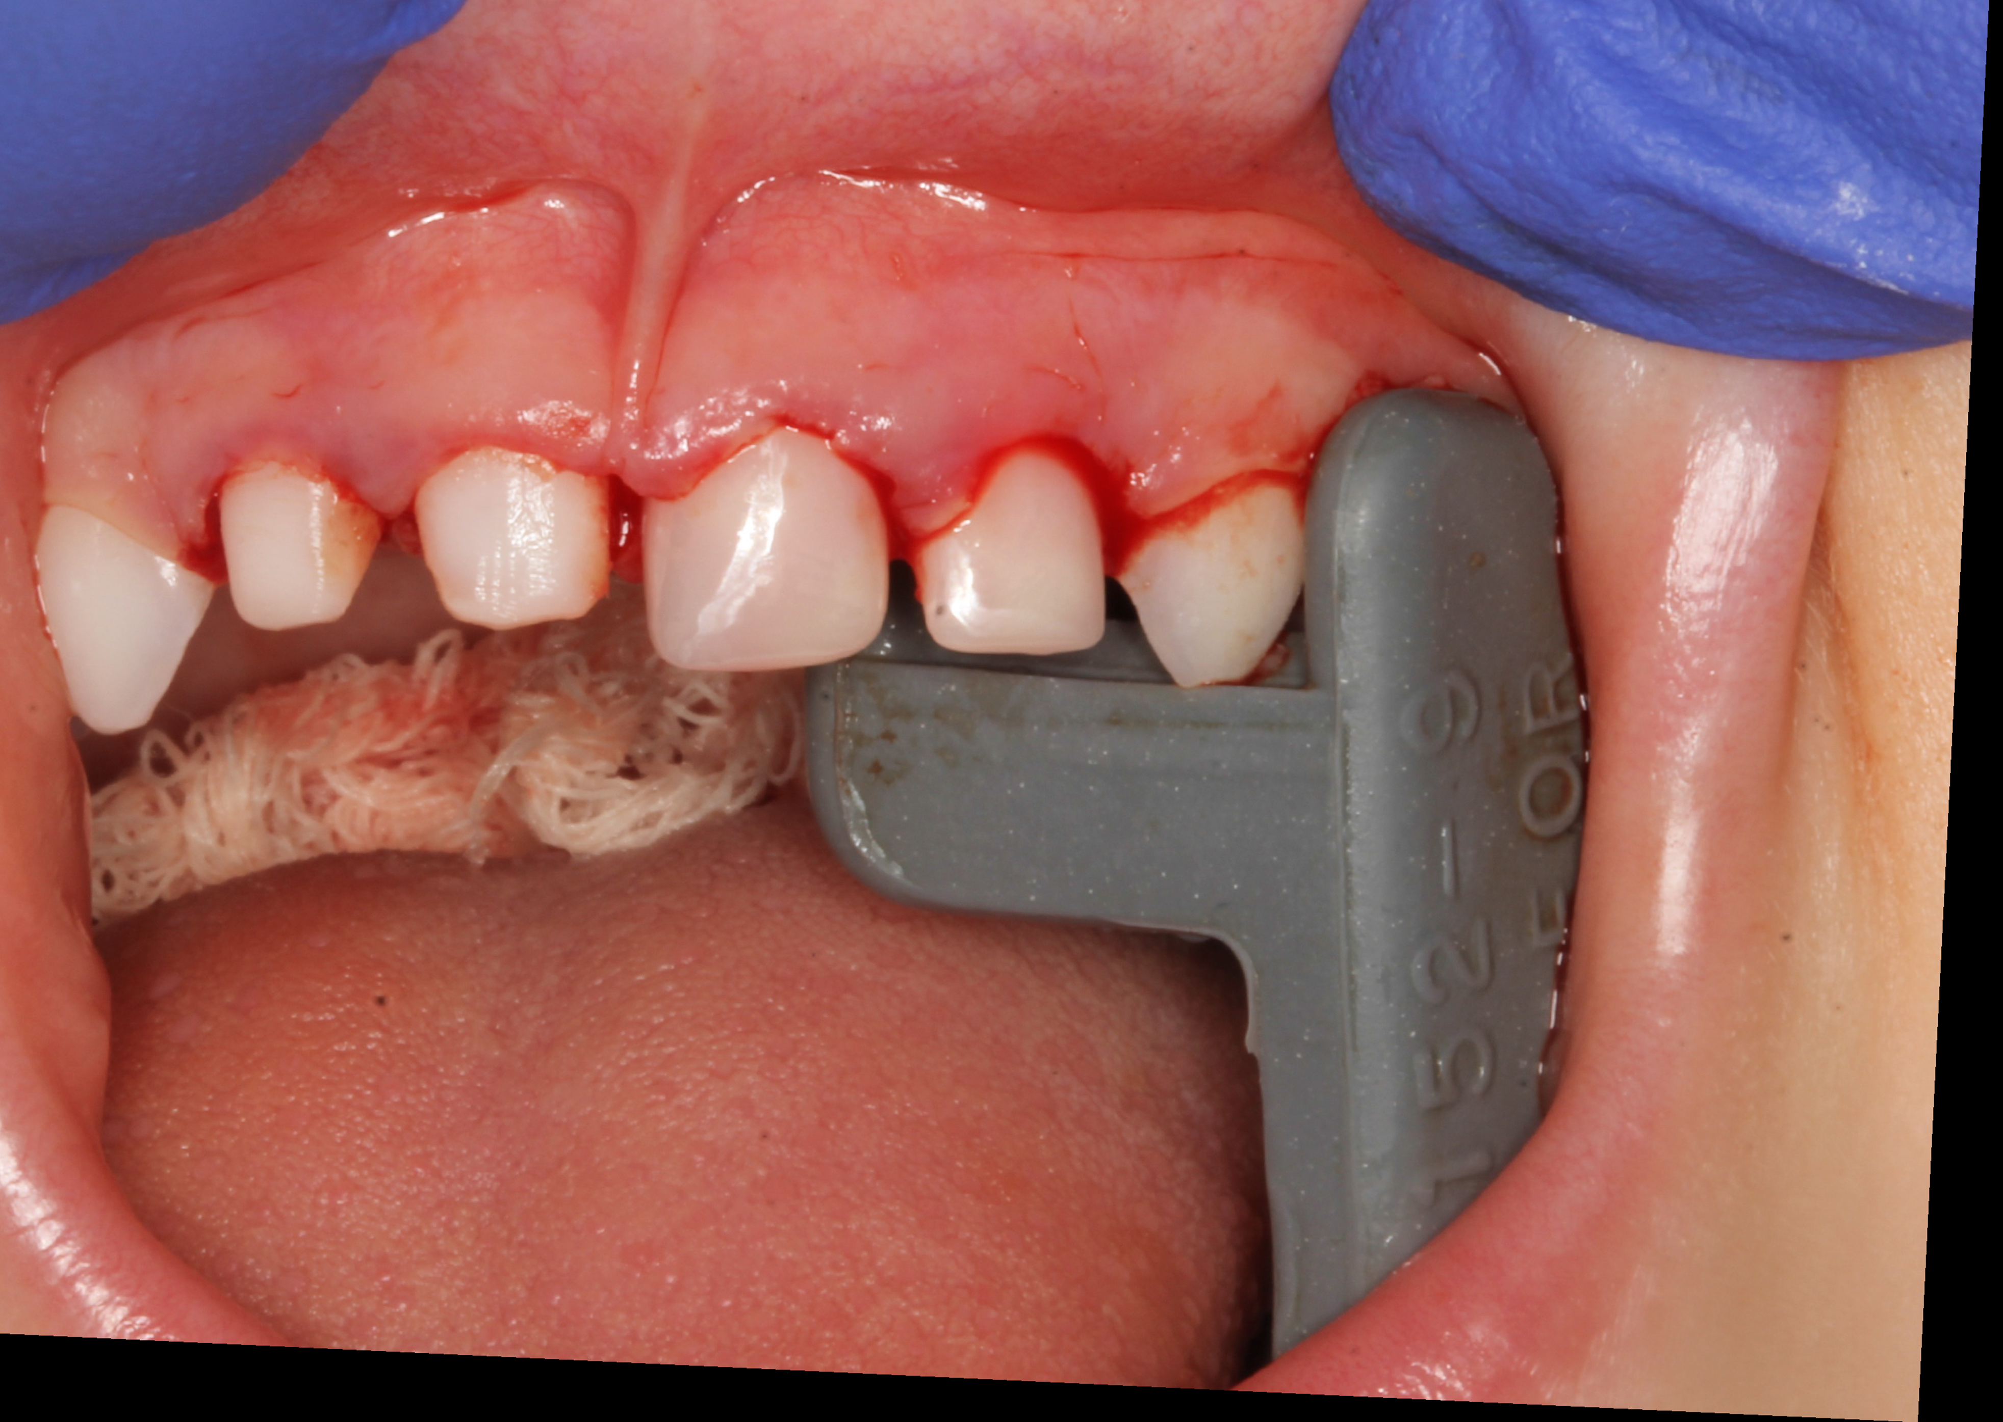

Slide 79
This randomised clinical trial (RCT) compared the clinical outcomes of three aesthetic full-coronal restorations (composite strip crowns, pre-veneered stainless steel crowns (SSCs) and pre-fabricated primary zirconia crowns) in carious and traumatised primary maxillary incisors.
MATERIALS AND METHODS:
One hundred and twenty nine teeth in 39 children aged between 3 to 5 years were included.
RESULTS:
The retention rate was highest for zirconia crowns (100%) followed by pre-veneered SSCs (95%). Strip crowns were the least retentive (78%). Zirconia crowns showed low grade abrasion in four opposing teeth.
-Walia et al,2014

Slide 81
Strip crowns
Composite strip crowns are composite filled celluloid crowns forms.
They have become a popular method of restoring primary anterior teeth because they provide superior aesthetics as compared to other forms of anterior tooth coverage

Slide 82
Advantages
Parent/patient pleasing
Ideal for ankylosed tooth build –ups
Simple to fit & trim
Removal is fast & easy
Easily matches natural dentition
Leaves smooth shiny surface
Easy shade control with composite
Superior esthetic quality
Ideal for photo cure
Crystal clear and thin
Large selection of size
Easy to repair

Slide 83
Disadvantages
Technique sensitive
adequate tooth structure is required
any lapses in patient selection, moisture and haemorrhage control, tooth preparation and resin placement can lead to failure
It is not as durable or retentive as stainless steel/open faced crowns, pre-veneered crowns or zirconia crowns and is not recommended on
-Kupietzky et al,2003

Slide 84
Reduce the interproximal surfaces by 0.5 to 1.0mm.
• The interproximal walls should be parallel and the gingival margin should have a feather edge.
• Reduce the facial surface by 1mm and the lingual surface by 0.5mm.
• Create a feather-edge gingival margin

Slide 86
Retention rate
88%
Kupietzky,2003

Slide 87
More than 80% of the restorations were judged to be successful at the final follow-up examination.
Only the number of carious surfaces of the tooth at baseline influenced the treatment outcome. The failure rate was higher in central incisors with four affected surfaces (P = 0.005), and in lateral incisors with four carious surfaces (P = 0.0003), than in those presenting one or two carious surfaces in both central and lateral incisors (P = 0.002).
-Ram and Fuks,2006

Slide 88
Parental satisfaction was excellent, but loss of crown or part of crown most likely lead to dissatisfaction
-Kupietzky and Waggoner 2004

Slide 89
Bonding to dentin in primary teeth
Dentin of the primary teeth is less mineralized, despite the presence of a gradient of mineralization.
Nör et al, discovered the dentin surface in the primary teeth to be more reactive to acid etching than permanent teeth, and the reported lower bond strengths found in primary teeth were attributed to a thicker hybrid layer that is not completely penetrated by the bonding agent

Slide 90
They recommended that a shorter etching time for primary dentin be used to reproduce the hybrid layer seen in etched permanent dentin.
In utilizing the total-etch technique, and with an etching time of 15 seconds, de Araujo et al, observed through SEM the formation of a resin-reinforced hybrid layer in primary teeth.

Slide 91
Skaleric et al, reported the enamel of primary teeth to have more organic matter and less mineral salts
They have a lower degree of microcrystal arrangement primarily attributed to the difference in time allotted for mineralization–1 year in the primary incisor and 7 to 8 years in the permanent incisor.
Moreover, the prismless layer of primary teeth recommended that a diamond bur be used to remove the enamel’s prismless layer before acid etching

Slide 92
Polycarbonate crowns
These are heat molded acrylic resin used to restore primary anterior teeth
They are made up of polycarbonate resin combined with microglass fibres.

Slide 93
Fracture strength – 470-585 N
Greater than biting force of prechoolers

Slide 94
Advantages
1) It is esthetic
2) than SSC, easy to trim and can be adjusted with pliers
Disadvantages
1) The polycarbonate crowns do not resist strong abrasive forces, leading to occasional fracture ordislodgement.
-Nitkin,1977

