Slide 1
CLOTTING DISORDERS Dept. of oral pathology

Slide 2
Learning Objectives
At the end of the lecture student should be able to-
Describe mechanism of haemostasis
Enlist Clotting disorders
Describe clinical & laboratory assessment

Slide 3
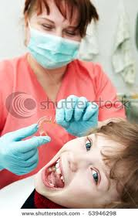
Dental procedures resulting in bleeding can have serious consequences in a pt. having bleeding disorder……… severe hemorrhage or even death.

Slide 4
BASIC MECHANISM OF HAEMOSTASIS
Vascular phase.
Platelet phase.
Coagulation phase.
Fibrinolytic phase.(rate limiting step)

Slide 5
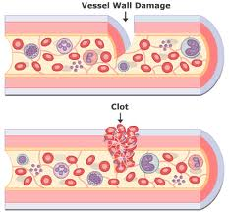
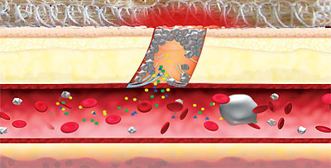
VASCULAR PHASE:
After tissue injury immediate vasoconstriction occurs.
Serotonin,histamine,PG’s etc causes vasoconstriction of the micro vascular bed.

Slide 6
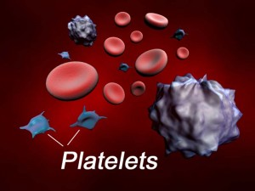
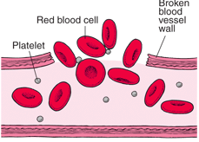
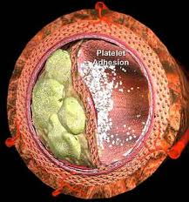
PLATELET PHASE:
Circulating blood platelets are activated
Aggregates Primary vascular plug( es blood loss from small blood vessels & capillaries)
Adheres to exposed basement membrane.

Slide 7
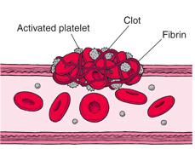
COAGULATION PHASE:
Generation of THROMBIN and FIBRIN.
INVOLVES VARIOUS PROTEINS: Fibrinogen,prothrombin,FS-V,VII,IX,X,XI,XII & XIII.--------- Vitamin K dependant-FS-II,VII, IX & X.
Involves 3 separate pathways
FIBRIN polymerizes to a gel stabilizes the platelet plug.
INTRINSIC PATHWAY
EXTRINSIC PATHWAY
COMMON PATHWAY.

Slide 8
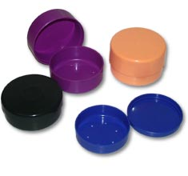
2 theories:::
Prothrombin to thrombin & fibrinogen to fibrin conversion system ( MARKOWITZ----1903)
CASCADE / WATERFALL theory(1964)-the coagulation mechanism results in a final explosive change of a liquid to a gel.

Slide 10
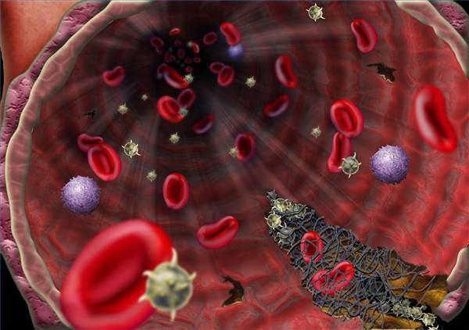
COAGULATION FACTORS:

Slide 11
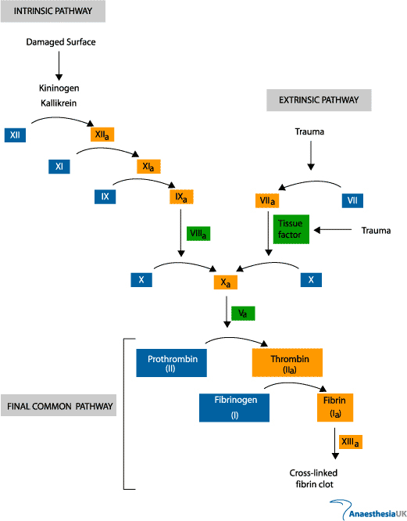

Slide 12
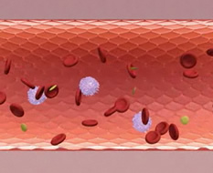
FIBRINOLYTIC PHASE:
Propagation of the clot is limited by fibrinolysis.
Tissue plasminogen activator(tPA) released from the endothelial cells converts PLASMINOGEN to PLASMIN.
Plasmin degrades fibrinogen & fibrin to fibrin degradation products [FDPs] .

Slide 13
CLINICAL & LABORATARY FINDINGS

Slide 14
CLINICAL FEATURES
Bleeding from superficial cuts & scratches.
Delayed bleeding.
Spontaneous gingival bleeding.
Petechiae.
Ecchymoses.
Epistaxis.
Deep dissecting hematomas.
Hemarthroses.

Slide 15
CLINICAL LABORATARY TESTS
Help to
Identify deficiency of required elements
Dysfunction of the phases of coagulation
Platelet count
Bleeding time
PFA-100 CT
PT/INR aPTT
TT
FDPs
Factor assays
Tests of capillary fragility

Slide 16
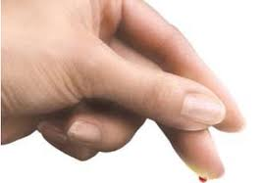
PLATELET COUNT:
Normal-150,000 to 450,000/mm3
If < 50,000/mm3
In such cases platelet transfusion may be necessary.
Bleeding time{ 1-6 mins}-modified Ivy’s test.
Hemorrhagic stroke
Surgical/traumatic hemorrhage
etc. may occur.

Slide 17
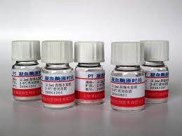
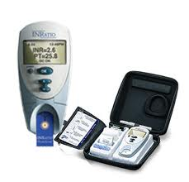
PT & INR
Normal-11 to 30 secs
its now commonly reported with its INR.
INR Intro.by WHO(1983):itz the ratio of PT that adjusts for the sensitivity of the thromboplastin reagants,such that normal coagulation profile is reported as an INR of 1.0

Slide 18
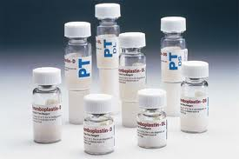
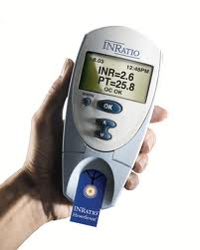

Slide 19
USES of PT/INR:
Evaluates extrinsic coagulation system.
Measures the presence/absence of Fs-I,II,V,VII & X.
Reduction of vit K dependant Fs-I,II,VII & X.

Slide 20
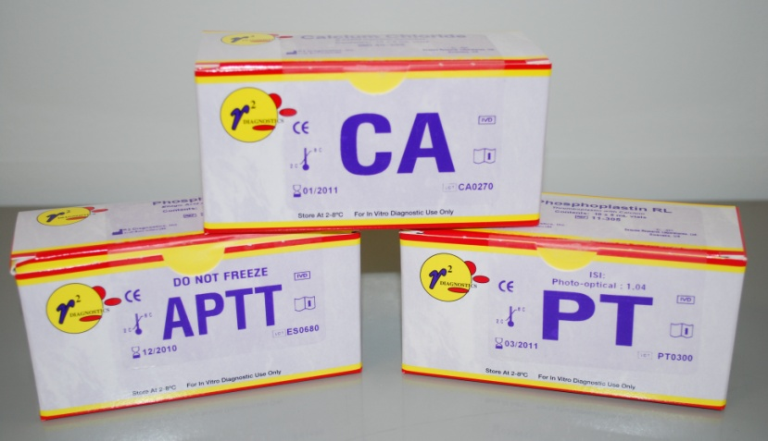
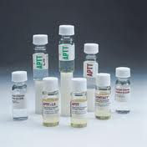
Activated partial thromboplastin time:
Considered normal if the control aPTT & test aPTT are within 10 secs of each other.
Control aPTT = 15-35secs.
Itz altered in hemophilias A & B. and with the use of heparin.

Slide 21
THROMBIN TIME:
Normal-9 to 13 secs.
Measure the activity of heparin,FDPs,other para proteins that inhibit conversion of fibrinogen to fibrin.

Slide 22
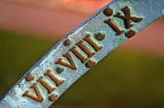
FACTOR ASSAYS:
IDENTIFY FACTOR DEFICIENCIES.

Slide 23
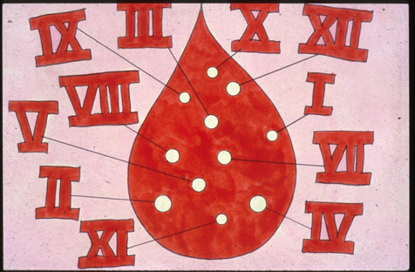
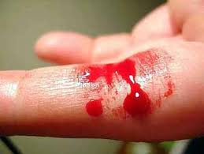
CLASSIFICATION OF BLEEDING DISORDERS:
Vessel wall disorders.
Platelet disorders.
Coagulation disorders.
CONGENITAL COAGULOPATHIES:
Hemophilia A
Hemophilia B
Factor XI deficiency
Factor XII ,,
Factor X ,,
Factor V ,,
Factor XIII & I deficiencies.
Von Willebrand’s disease.

Slide 24
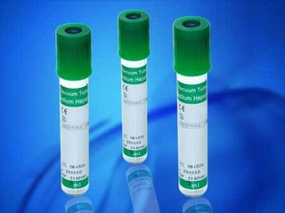
ANTI COAGULANT RELATED COAGULOPATHIES:
Heparin
Coumarin.
DISEASE RELATED COAGULOPATHIES:
Liver disease
Vitamin K deficiency
DIC
Fibrinolytic disorders.

Slide 25
COAGULATION DISORDERS
CONGENITAL--→
ACQUIRED-→.Secondary to drugs (Heparin , Coumarin) or disease process(Liver disease, Vit K deficiency ,DIC).
HEMOPHILIA A
HEMOPHILIA B
F XI DEFICIENCY
F XII ,,
F X ,,
F V ,,
F XIII & I ,,
VON-WILLEBRAND’S DISEASE.

Slide 26
SUMMARY
Mechanism of haemostasis
Clotting disorders
Clinical & laboratory assessment

Slide 27
References
Basic Pathology. Kumar, Cortan, Robbin. sixth edition.
Shafers Oral Pathology.
Basics of hematology. Kwathilkar.3rd edition.
Neville Oral Pathology

Slide 28
THANK YOU

