Slide 1
GOOD MORNIING

Slide 2
Piaget’s Cognitive-Stage Theory

Slide 3
contents
General orientation of theory
Description of stages
Process of cognition
Demerits of theory
Conclusion
References

Slide 4
Who was Jean Piaget

Slide 5
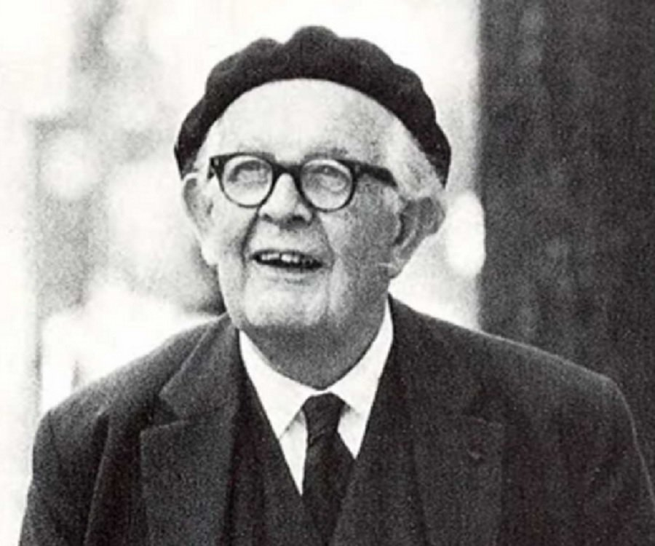
INTRODUCTION
No theorist has contributed more to understanding of children’s thinking than Jean Piaget (1896–1980), a Swiss scholar who began to study intellectual development during the 1920s.

Slide 6
Piaget was a precocious child who developed an
interest in biology and the natural world.
His early interest in zoology earned him a
reputation among those in the field.
At age 10, he published his first scientific article
about the behavior of a rare albino sparrow.
He had published several articles on mollusks by
the age of 15

Slide 7
His early interest led him to pursue a doctoral degree in zoology
Piaget’s secondary interest was epistemology
Psychology was the answer

Slide 8
Piaget journeyed to Paris, where he accepted a position at the Alfred Binet laboratories, working on the first standardized intelligence test.
However, Piaget soon found that he was more interested in children’s incorrect answers than their correct ones.
He first noticed that children of about the same age produced the same kinds of wrong answers.

Slide 9
As he questioned children about their misconceptions, he began to realize that young children are not simply less intelligent than older children—rather, their thought processes are completely different.
Piaget then set up his own laboratory and spent 60 years charting the course of intellectual growth and attempting to determine how children progress from one type (or stage) of thinking to another.

Slide 10
Piaget’s View of Intelligence
and Intellectual Growth
Piaget (1950) defined intelligence as “a basic life process that helps an organism adapt to its environment.”
By adapting, Piaget means that the organism is able to cope with the demands of its immediate situation.

Slide 11
For example, the hungry infant who grasps a bottle and brings it to her mouth is behaving adaptively, as is the adolescent who successfully interprets a road map while traveling.
As children mature, they acquire ever more complex “cognitive structures” that aid them in adapting to their environments.

Slide 12
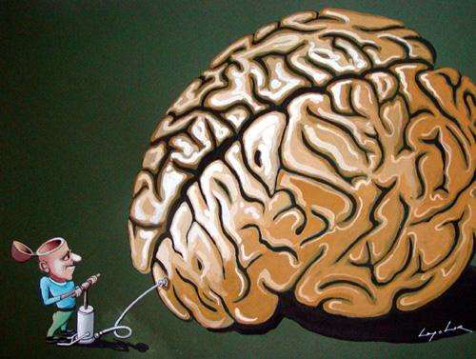
Cognitive development of child
• Cognition refers to mental activities involved in acquisition, processing, organization and use of knowledge.
• This includes detecting, interpreting, classifying and remembering information, evaluating ideas, inferring principles, reducing rules, imagining possibilities, generating strategies, fantasizing and dreaming

Slide 13
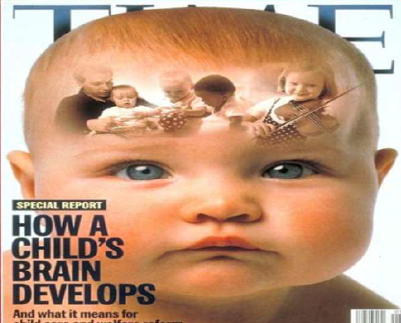
"The brain is wider than the sky." Emily Dickinson (1830-1886)

Slide 14
General Orientation to Theory
Five salient characteristics of the theory:
1. Genetic epistemology
2. The biological approach
3. Structuralism
4. The stage approach
5. Piaget’s methodology.

Slide 15
genetic epistemology
The branch of philosophy concerned with the study of knowledge is called epistemology.
Piaget’s journey to developmental psychology brings us to the “genetic” part of the term genetic epistemology.
In this context, the word genetic refers not to what is innate, but to “development” or “emergence

Slide 16
The biological approach
Beginning with the early boyhood interest in shells and birds, Piaget’s thinking was firmly rooted in biology.
In the humble mollusk he saw general principles of how living organisms adapt to the world.
Just as human and nonhuman organisms adapt physically to the environment, so does thought adapt to the environment at a psychological level.

Slide 17
Structuralism
Because children’s thinking seemed systematic to Piaget, he turned to structuralism.
An infant’s cognitive structures are labeled “schemes” (sometimes translated “schemas” or “schemata”).
A scheme is an organized pattern of behavior; it reflects a particular way of interacting with the environment.

Slide 18
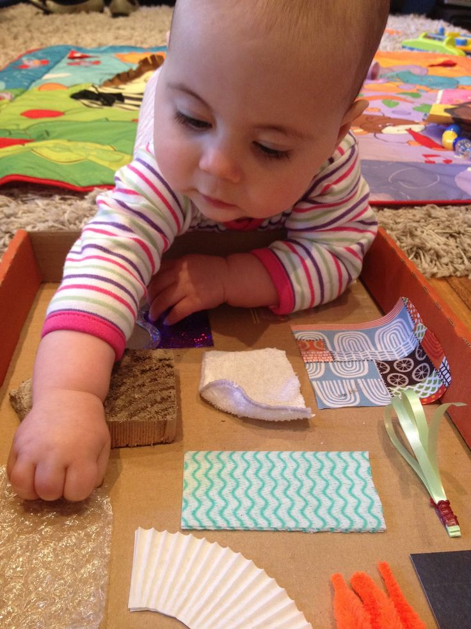
The earliest schemes, formed in infancy, are motor habits such as rocking, grasping, and lifting.

Slide 19
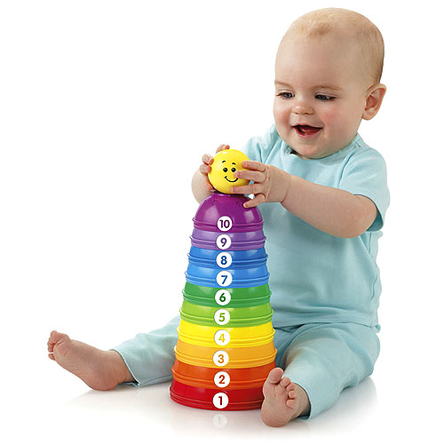
They permit infants to operate toys, to turn dials, to open cabinets, and to otherwise master their environments.
Later in childhood, cognitive schemes take the form of “actions of the head”

Slide 20
At any age, children rely on their current cognitive schemes to understand the world around them.
And because cognitive schemes take different forms at different ages, younger and older children may often interpret and respond to the same objects and events in very different ways.

Slide 21
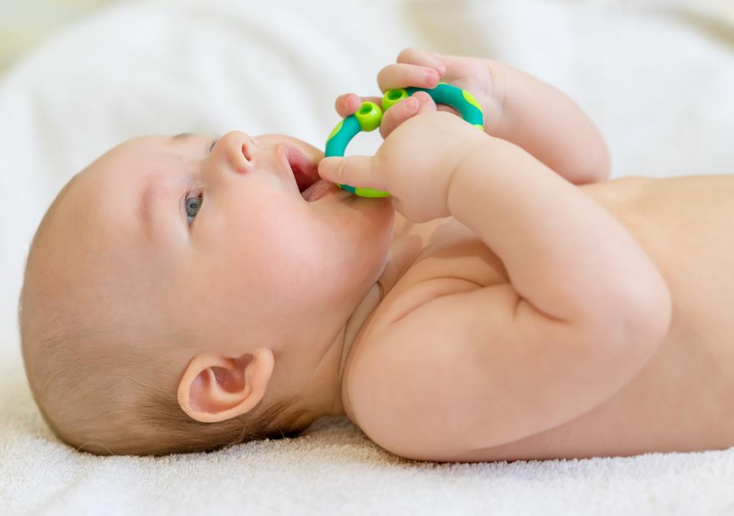
The sucking scheme, describes the systematic way that children put various objects into their mouths and suck them.
As the scheme becomes more differentiated, children classify objects into “suckables” and “nonsuckables,” with various subcategories such as hard suckables, soft suckables, good-tasting suckables.

Slide 22
How do children grow intellectually?
Piaget claimed that infants have no inborn knowledge or ideas about reality, as some philosophers have claimed.
Nor are children simply given information or taught how to think by adults.
Instead, they actively construct new understandings of the world based on their own experiences.

Slide 23
Stage Approach
Cognitive development proceeds through a series of stages.
For Piaget, a stage is a period of time during which the child’s thinking and behavior in a variety of situations tend to reflect a particular type of underlying mental structure.

Slide 24
There are five salient characteristics;
A stage is a structured whole in a state of equilibrium.
Each stage derives from the previous stage, incorporates and transforms that stage, and prepares for the next stage.
The stages follow an invariant sequence.
Stages are universal.
Each stage includes a coming-into-being and a being.

Slide 25
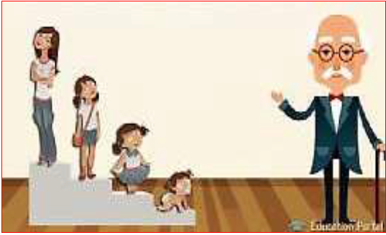
Description of the Stages
To understand each stage, we need to know not only where it came from but also where it is going.
Each stage holds both the fruits of the past and the seeds of the future.

Slide 27
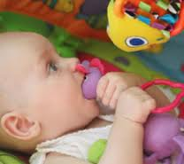
Sensorimotor stage

Slide 29
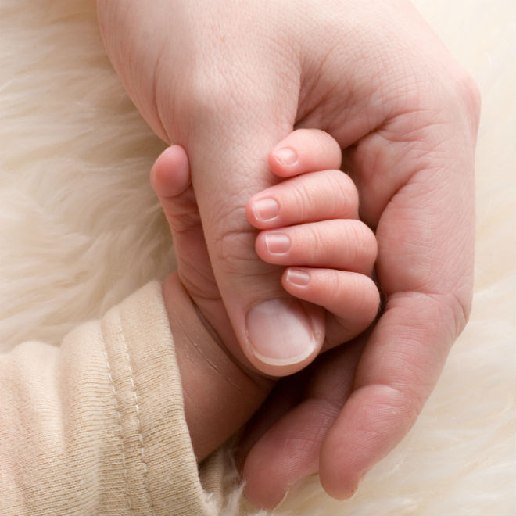
Sensorimotor reflexes
A newborn is a bundle of reflexes, or “wired-in” responses that are triggered by particular stimuli.

Slide 30
Behaviors such as sucking, grasping, and looking babies can produce them spontaneously.
In fact, they sometimes suck when there is nothing to suck.
Piaget claimed that there is an innate tendency for humans to exercise their skills.
Sucking strengthens the sucking skill and leads to further sucking.

Slide 31
Primary circular reaction(1-4months) :
Learning through already known object describes recreating an already known satisfying action, such as thumb sucking.

Slide 32
As the behavior and its results are successfully repeated, it can be said that a “habit” is formed.
These circular reactions are called “primary” because they involve response consequences that are centered on or around the infant’s body rather than other objects.

Slide 33
Secondary circular reactions 4-8 months :
• Recreating of an accidentally discovered cause and
effect.
• Responds to own name.

Slide 34
For example ;
-Child shakes a rattle, which produces a
noise; he slaps a ball, which causes it to
roll.
-In the previous stage, the shaking or
slapping itself was of interest; now the
environmental consequences are.

Slide 35
TERTIARY CIRCULAR REACTIONS 12-18 MONTHS :
-Deliberately varies behavior to create novel effect.
-Reactions involve experimentation.

Slide 36
They perform miniature experiments in which they deliberately vary an action in order to see how this variation affects the outcome.
They exploit each object’s potential. They seem to be asking, “Is there anything new about this object?”
As in earlier circular reactions, there is repetition with variation

Slide 37
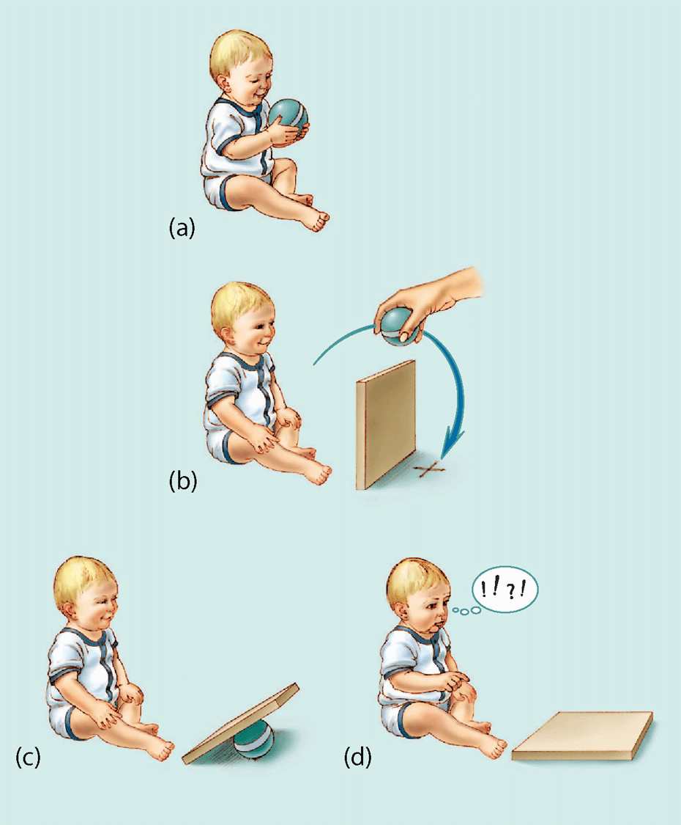
OBJECT PERMANENCE

Slide 38
OBJECT PERMANENCE
Perhaps the most important concept acquired during
the sensorimotor period is the notion of object
permanence
An object continues to exist even when one cannot
see, hear, or feel it.

Slide 39
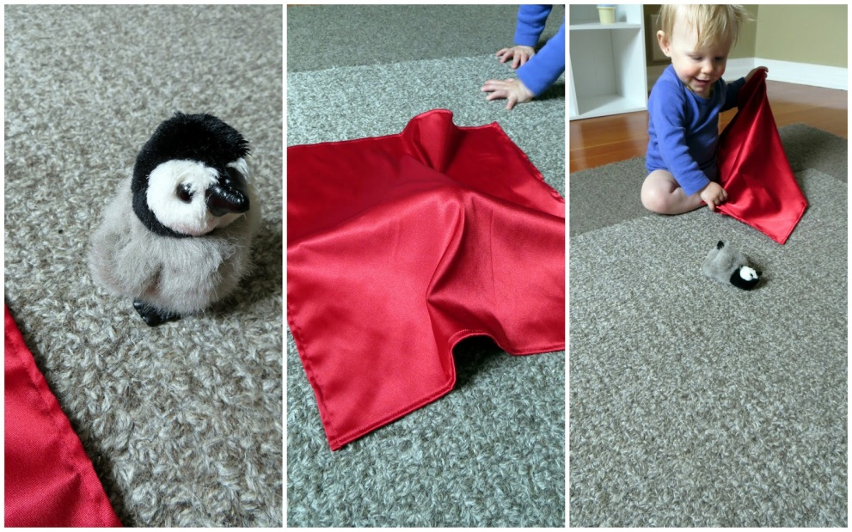
For example;
when Piaget hid a toy parrot twice under a mattress to
his daughter’s left and then hid it to her right (as she watched).
Piaget’s interpretation of this so-called A-not-B error was that she defined an object partly in terms of its position—a “parrot-under-the-mattress.”

Slide 40
Clinical implications of Sensorimotor
Stage
• The dental home concept says treat the child as soon as the first tooth erupts in the oral cavity
• This can be done by taking advantages of exemplary modeling by mother or sibling in procedures like scaling done on them.

Slide 41
• Those being treated should display courage and smile
throughout the procedure, giving an impression to the child
that dentistry is not a place of threat instead can be enjoyable.
• So, appropriate conduct of pediatric dentists is extremely
important during the treatment of children in situations that
can lead to fear, helping to avoid dental fear.

Slide 42
PRE OPERATIONAL STAGE
• Preschool children are considered as not having acquired the cognitive ability to think logically.
• Acquire the ability to form mental images of objects and events.
• Language develops to the point at which they begin to think in terms of verbal symbols – words.

Slide 43
The main characteristics of preoperational thought are;
- Egocentrism
- Rigidity of thought
- Semilogical reasoning
- Limited social cognition.

Slide 44
Egocentrism
The word egocentrism does not refer to selfishness or arrogance.
(a) the incomplete differentiation of the self and the
world, including other people
(b) the tendency to perceive, understand,
and interpret the world in terms of the self.

Slide 45
For example ;
A child holding a book upright points to a picture and asks,
“What is this?” He is unaware that his mother, who is facing him, can see only the back of the book.

Slide 46
Rigidity of thought.
Piaget characterizes preoperational thought as
frozen.
One example is centration, the tendency to attend to or think about one salient feature of an object or event and ignore other features.

Slide 47
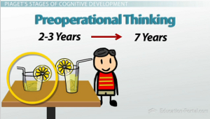
If two identical containers have equal amounts of water and the contents of one container are poured into a taller, thinner container, children center on the heights of the liquids, while ignoring their widths.

Slide 48
Semilogical reasoning.
The child tries to explain the mysterious natural events of everyday life.
One solution is to explain natural events in terms of human behavior.
The sun and moon, like people, are alive, are created by a humanlike action (a god lighting a match), and are tied to human activities (the moon began because people began to exist).

Slide 49
Limited social cognition.
a boy who breaks 15 cups while trying to help his mother set the table is considered guiltier than a boy who breaks only 1 cup while trying to steal cookies from the cabinet.

Slide 50
Clinical implication of egocentrism
• It will be useless to point out how proud his parents will be if he cooperated for the dental treatment as the child can't see the parent's point of view.
• Instead if the dentist shows the decayed discolored teeth and says "your teeth will be better if these germs are out of them" it is accepted by the child.

Slide 51
Period of Concrete Operations. (6-12
years)
• An improved ability to reason
emerges during this period.
• The thinking process becomes
logical.
• He develops the ability to use
complex mental operations
such as additions and
Subtraction
• The child is able to
understand others point of
view and animism declines.

Slide 52
FEATURES ;
• Conservation
• Decentration
• Seriation

Slide 53
Decentration:
• To focus their attention on several attributes of an object or event simultaneously & to understand the relation between dimensions.
Conservation :
• Understanding that quantity, length or no. of items is unrelated to the arrangement or appearance of the object or items. the child can successfully pass through the conservative experiments.

Slide 54
Conservation of Length
The preoperational child would say the one on
the top is longer. Pre-operational children
base their concepts on perception, not logic.

Slide 55
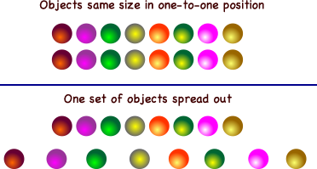
CONSERVATION IN NUMBER

Slide 56
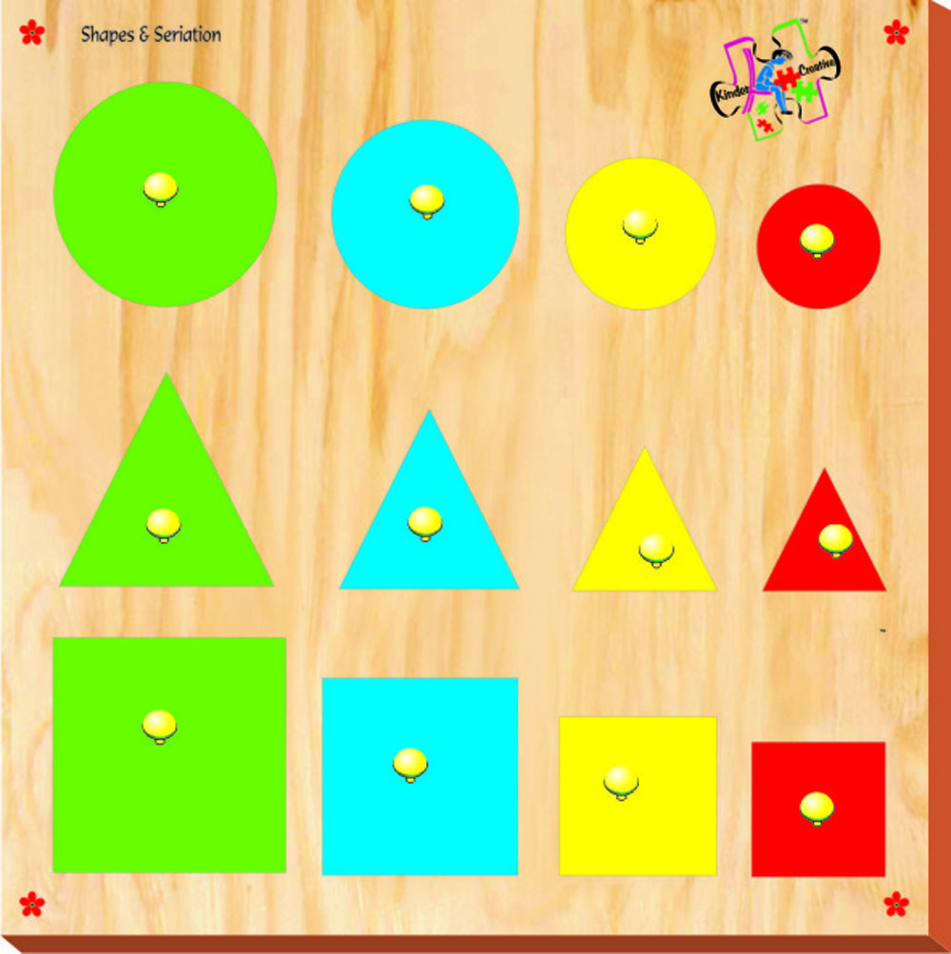
Seriation:
• A characteristic of the concrete operational child is the ability to arrange objects according to some quantified dimensions such as weight or size.
This ability is called Seriation.
• An 8 year old can arrange eight sticks of different lengths in
order from shortest to longest

Slide 57
Clinical implication
• During dental treatment, instructions should be based on concrete objects. " Brush your teeth in up and down strokes for front teeth; back and forth strokes for back teeth, twice a
day" may be less understood than saying and demonstrating" This a model of your teeth.

Slide 58
Period of Formal Operations (11 –
Adolescence)
• At this stage, the child's thought process has become similar to that of an
adult, and the child is capable of understanding concepts like health, disease,
and preventive treatment.
• He will begin to think abstractly, reason logically and draw conclusions from
the information available, as well as apply all these processes to hypothetical
situations.
• This makes them susceptible to peer influence but, in the latter adolescents
sense of personal uniqueness and invincibility makes them think "because I
am unique, I am not subject to consequences others will experience”.

Slide 59
Period of Formal Operations: 11-18
Years
• During this stage the young adult is able to understand such things as love, logical proofs and values.
The young adult begins to entertain possibilities for the future and is fascinated with what they can be.

Slide 60
Hypothesis formulation
Children formulate a hypothesis about a present or potential event and test this hypothesis against reality.
If necessary, they can generate all possible outcomes at the beginning.
By testing predictions from each hypothesis,
they demonstrate hypothetico-deductive thought.

Slide 61
Ability to come up with different hypothesis about a problem and weigh data to make judgment

Slide 62
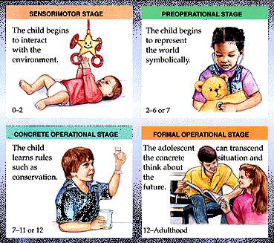

Slide 63
Processes of cognition
Developing a mental schemata–child take in new experiences through their own system of knowledge.
It is now known that infants can from the first day of life smell, see, and hear.
Even very young infants have the ability of perceiving movement, facial relationships, and color.

Slide 64
ACCOMODATION
• Complementary process for intelligence to develop child goes on adding newer information to the original schemata.
MODIFYING SCHEMA

Slide 65
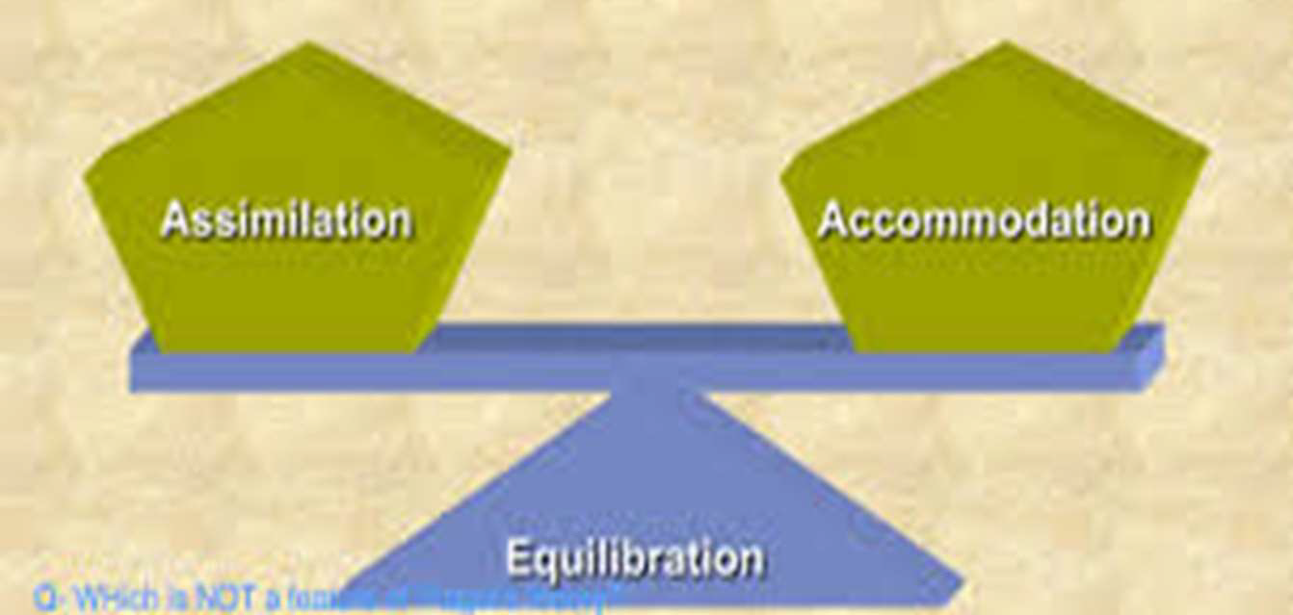
Equilibration
A balanced , harmonious relationship between one’s cognitive structures & the environment.

Slide 66
EQUILIBRATION
• Changing basic assumption following adjustments in assimilated knowledge

Slide 67
DEMERITS
• Children are consistently inconsistent in their approach to problem solving despite using the same cognitive structures.
• Lately it has been suggested that this inadequacy in problem solving are related to memory power of the child rather than cognitive ability.
• Piaget was better at describing processes than explaining how they operate.

Slide 68
Conclusion
• The dentist's message must be presented in terms that correspond to the stage of cognitive development that a particular child has reached.
• It is the job of the dentist to carefully evaluate the development of the child, and adapt his or her language so that concepts are represented in a way that the patient can understand them.

Slide 69
references
• Theories of developmental psychology, Petricia Miller 5th Edi.
Developmental Psychology Childhood and Adolescence, David
R. Shaffer, 8th Edi, 2010.
• Pinkham .Pediateric Dentistry; 4th Edi, 2005.Elsevier
• McDonald. Dentistry for the child and adolescent .8th Edi,
.2004;Elsevier
Textbook of Pedodontics Shobha Tondon 2nd Edi. 2008

