Slide 1
Good Morning

Slide 2
Caries Activity tests

Slide 3
Lesson Plan
Topic – Caries Activity Tests
Target group – 3rd year Students
Time limit – 20 mins
Aids used – Audio - visual

Slide 4
Objectives
At the end of the session :
Need to assess caries activity.
Different types of caries activity tests available.

Slide 5
Contents
Introduction
Why caries activity tests…?
Ideal requisites
Background data
Clinical examination
Caries activity tests
Summary
Conclusion

Slide 6
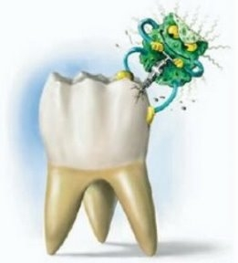
Introduction

Slide 7
Introduction
Degree of caries activity
Caries activity tests

Slide 8
Caries Activity
Caries Susceptibility
Refers to the increment of active lesions over a period of time.
It is a measure of the speed of progression of a carious lesion.
refers to the inherent tendency of the host and the target tissue, the tooth, to be afflicted by the caries process. This is the susceptibility of a tooth to a caries-producing environment.

Slide 9
Caries Activity Tests
Measure the degree to which the local environment challenges favors the probability of carious lesion.

Slide 10
Why caries activity tests…..?
To assess:
The need and extent of preventive measures
The success of therapeutic measures
The progress of restorative measures
The effectiveness of health education relating to dietary and oral hygiene procedure.

Slide 11
Ideal requisites (according to Snyder)
Reliability and validity i.e. the test must be consistently accurate and reproducible.
Maximum co-relation between predicted and actual caries development.
Simplicity with regard to technical procedures and skills required.

Slide 12
Rapidity- the results should be obtained, within hours or few days.
In-expensive, non-invasive, easy to evaluate and applicable to any clinical setting

Slide 13
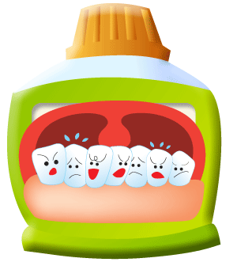
Pre - requisites
Background data
Clinical examination
Caries activity tests

Slide 14
Background data
General disease
Medication
Social-economic level
Dietary habits
Oral hygiene practice
High activity

Slide 15
Background data
General disease
Medication
Social-economic level
Dietary habits
Oral hygiene practice
Low activity

Slide 16
Clinical examination
No. of teeth
No. of fillings
No. of enamel lesions and cavities
Oral hygiene
Plaque retentive factors
High activity
Low activity

Slide 17
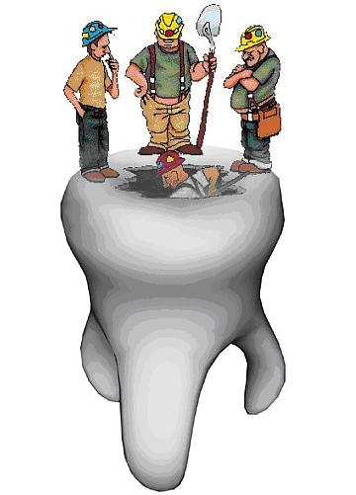
Caries activity test for the dental office
Based on following factors:
Bacterial challenges
Diet
Remineralization potential

Slide 18
Bacterial challenge :
Streptococcus Mutans count
Snyder test
Strip Mutans test (Dentocult- SM)

Slide 19
Diet:
Lactobacillus tests
Lactobacillus colony count
Dip slide Method (Dentocult-LB)

Slide 20
Salivary buffer capacity tests:
Dentobuff method
The Swab test

Slide 21
To summarize……

Slide 22
Need of preventive measures
Success of therapeutic measures
Progress of restorative measures
Effectiveness of health education
Reliability and Validity
Simplicity
In – expensive
Non- invasive
Rapidity
Caries Activity Tests
General disease
Medication
Social-economic level
Dietary habits
Oral hygiene practice
Snyder test
Strip Mutans test
Lactobacillus colony count
Dentocult LB
Salivary buffer tests

Slide 24
Mutans streptococcus count
Caries activity tests are used to assess the effectiveness of ………
Health education program
Caries activity tests should be valid and ……………
Reliable
Caries activity tests for Streptococcus Mutans are…………..
Snyder test and Strip Mutans test

Slide 25
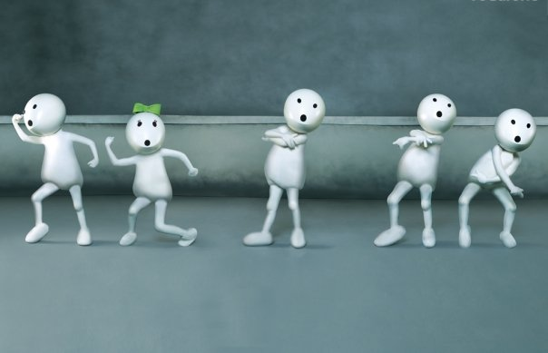
THANQ…..

Slide 26
Mutans streptococcus count
1. Calorimetric Snyder Test:
It measures the ability of salivary microorganisms to form organic acids from a carbohydrate medium.
The medium contains an indicator dye, bromocresol green which changes colour from green to yellow in the range of pH 5.4-3.8.
Procedure:
0.2ml stimulated saliva collected by chewing paraffin before breakfast is thoroughly mixed with 10ml melted agar containing medium in a test tube(cooled to 50⁰ C), allowed to solidify and then incubated at 37 degrees .

Slide 27
Amount of acid produced by acidogenic organisms is detected by changes in pH indicator.
This is compared to an inoculated control tube after 24, 48 and 72 hrs of incubation.
The rate of colour from green to yellow is indicative of caries activity..
24 hrs 48 hrs 72 hrs
If yellow
IF YELLOW
IF YELLOW
GLUCOSE AGAR MEDIUM WITH BROMOCR-ESOL +
0.2 C.C OF SALIVA
Marked caries Definite caries Limited caries
susceptibility susceptibility susceptibility
If green
If green
If green
Incubate & observe after 48 hrs
Incubate & observe after 72 hrs
Caries inactive

Slide 28
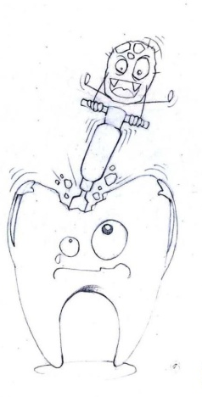
Advantages:
Relatively simple to carry out
Tests are of value in assessing the oral environment cariogenic challenge
Only one tube required and no serial dilutions are required
Disadvantages:
Time consumed is more
Sometimes the color changes are not so clear

Slide 29
2. Strip Mutans method:
Procedure:
Undiluted paraffin- stimulated saliva is poured on a specific plastic slide that is coated with MSA(Mitis salivarius agar) containing 20% sucrose.. Two discs containing 5mg of bacitracin are placed on the agar 20mm apart. The slide is tightly screwed into a cover tube and incubated at 37 degrees for 48 hrs in a sealed candle jar.
Evaluation:
SCORE 1= LOW, the colonies less than 200
Score 2= MEDIUM, the colonies more than 200
Score 3 = HIGH, the colonies are tiny and almost

