Slide 1
CYSTS OF ODONTOGENIC ORIGIN-V
Dept. of Oral Pathology& Microbiology

Slide 2
Purpose Statement
At the end of the class the students will be able to,
Describe classification, clinical features, pathogenesis, radiographic features, histologic features, differential diagnosis, treatment & prognosis of the lesion.

Slide 3
Learning Objectives
S.N. | Learning Objectives | Domain | Level | Criteria | Condition
1 | Enumerate clinical features | Cognitive | Must Know | All
2 | Write classification | Cognitive | Must Know | All
3 | Write pathogenesis | Cognitive | Must Know | All
4 | Write radiographic features | Cognitive | Must Know | All
5 | Write histologic features | Cognitive | Must Know | All
6 | Enumerate differential diagnosis | Cognitive | Nice to Know | All
7 | Write treatment & prognosis | Cognitive & Psychomotor | Must Know | All

Slide 4
Contents
Botryoid odontogenic cyst
Gingival cyst of adult
Glandular odontogenic cyst

Slide 5
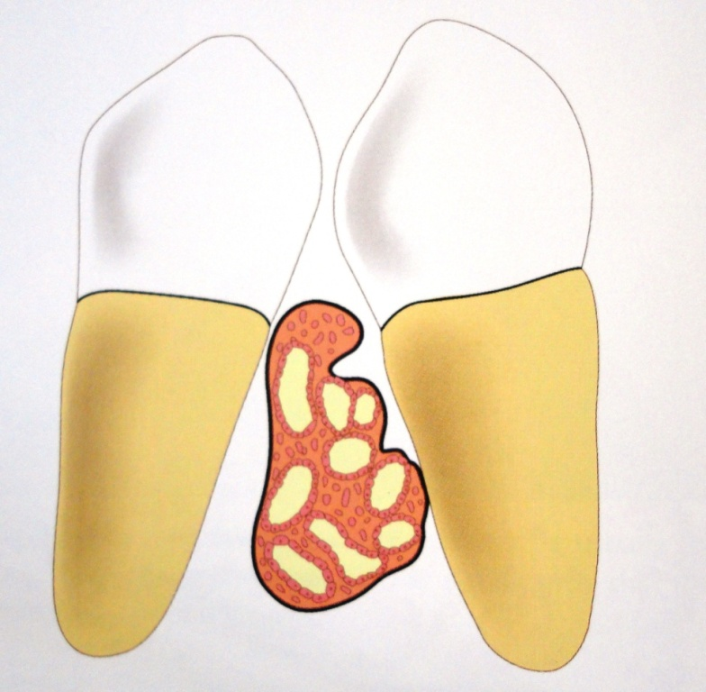
Botryoid odontogenic cyst
Gross resemblance of cystic cavities to that of a cluster of grapes

Slide 6
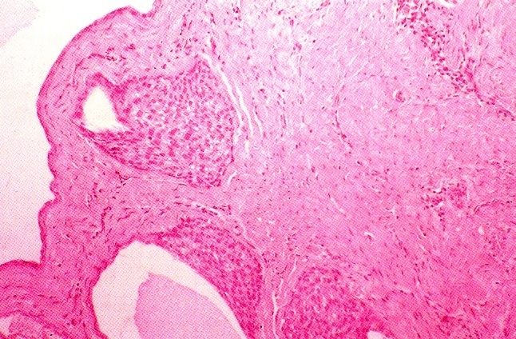
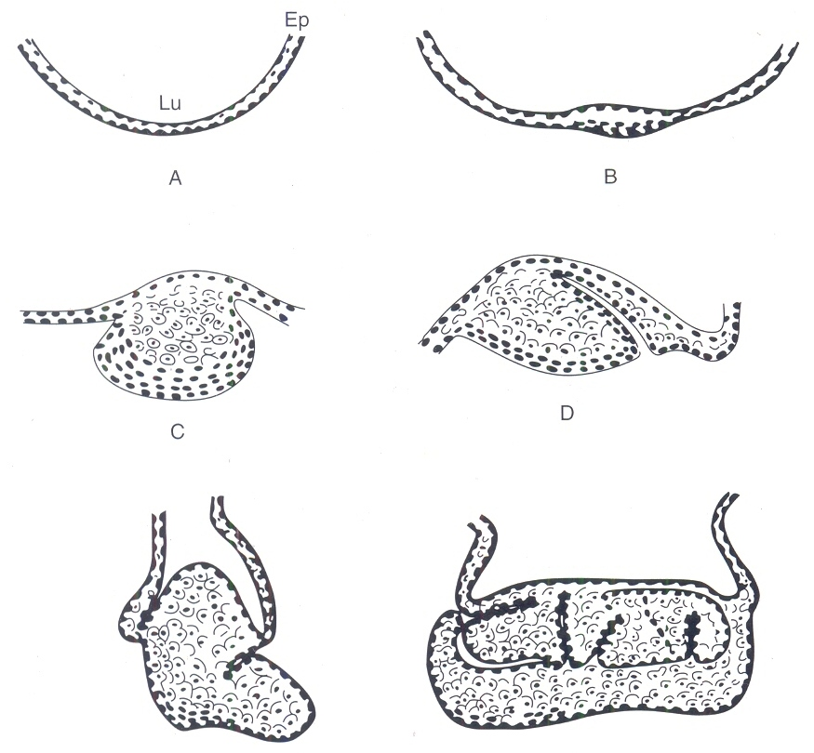
Mode of epithelial plaque formation by localized proliferation of cells
Pinched-off ’ plaques forming microcysts

Slide 7
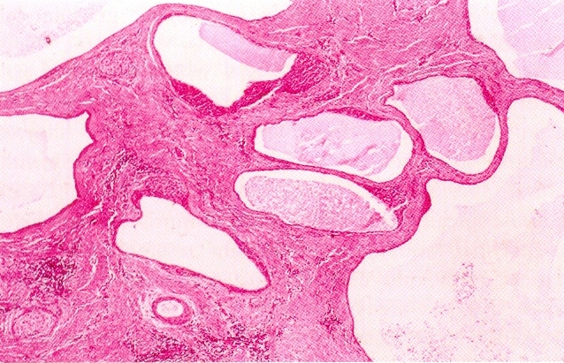
Numerous daughter cysts

Slide 8
Gingival cysts of adults
Pathogenesis
Odontogenic epithelial cell rests
Traumatic implantation of surface epithelium
Cystic degeneration of deep projections of surface epithelium
Heterotrophic glandular tissue
Clinical Features
Slow growing ,Painless swelling
5th – 6th decades
Mandible > maxilla
Premolar – canine region

Slide 9
Dome-like swelling < 0.5 cm in diameter
Normal or bluish in color
Soft, smooth, fluctuant.
Occur in attached gingiva or interdental papilla on the facial aspect
Adjacent teeth vital
Radiographic features
No radiographic change
Faint shadow indicative of superficial bone erosion or cupping out of bone

Slide 10
Histopathology

Slide 11
Gingival Cyst Of Adult
OR
Lateral Periodontal Cyst?
Gingival cyst of adult
Lateral periodontal cyst

Slide 12
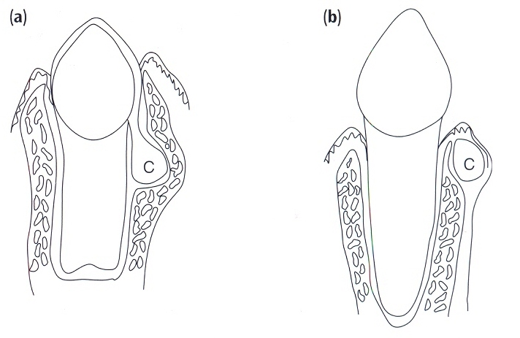
Lateral Periodontal Cyst (a) –formed from the REE by dilatation of the follicle before eruption of the tooth
Gingival Cyst Of Adult (b) - formed from the REE after eruption of the tooth

Slide 13
Gingival Cyst Of Adult :Extra-osseous counterpart of the intra-osseous Lateral Periodontal Cyst
Origin from postfunctional epithelium (REE) ,explains the unaggressive nature compared with the OKC

Slide 14
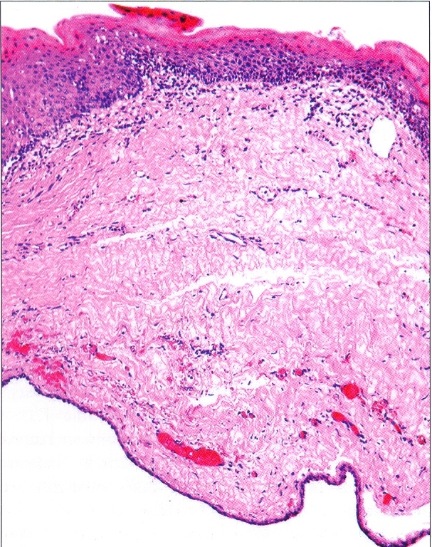
Variable pattern
Ranges in thickness from simply one flattened cell to several cells
A thin stratified squamous epithelium, closely resembling REE.

Slide 15
Focal areas of plaque like thickenings that may contain clear cells.
Nests of these glycogen -rich clear cells, represent rests of dental lamina
The attachment of epithelium to connective tissue is tenous & easily peels off, leaving epithelial discontinuties.
The fibrous connectine tissue wall is usually relatively uninflammed.

Slide 16
Glandular o Glandular odontogenic cyst Glandular odontogenic cyst dontogenic cyst
Derived from odontogenic epithelium with characteristics including salivary gland features such as mucus producing cells
Diagnosis made when ---
Epithelial lining consists of
columnar & cuboidal cells with cilia
Epithelium has glandular & pseudoglandular structure with intraepithelial crypts and microcysts

Slide 17
Clinical features:
Rare
Aggressive
Female predominance
Wide age range -- Middle age
(Rare before 20 yrs of age)
In either jaws, mandible > maxilla
Strong predilection for anterior region of jaw

Slide 18
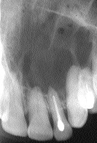
Radiographic features
Radiolucency with corticated boundary
Outline-smooth or scalloped
Unilocular or multilocular

Slide 19
Effect on surrounding structures:
Expansion of cortical plates with areas of perforations
Displacement of teeth

Slide 20
Differential Diagnosis
Ameloblastoma
Odontogenic keratocyst

Slide 21
Pathogenesis
Similar to lateral periodontal cyst

Slide 22
Histopathology
Non-keratinized stratified squamous epithelium of variable thickness.
Epithelium has a glandular or pseudoglandular structure with goblet cells as well as intraepithelial crypts or microcysts containing mucus.

Slide 23
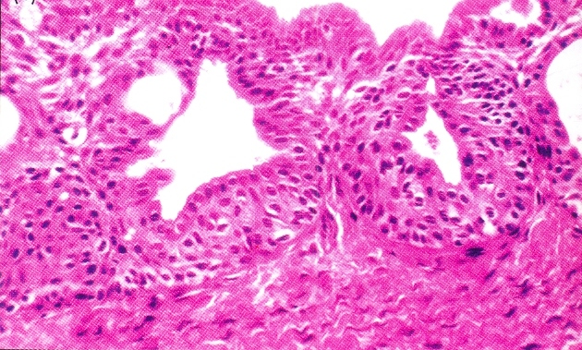
Microcysts may open onto the surface of epithelium giving a papillary or corrugated appearance.

Slide 24
Sometimes cells may be ciliated .
Occasionally epithelium is thinner, similar to REE.
Epithelial plaques may be present.
Interface between epithelium & connective tissue is flat.

Slide 25
SUMMARY
Clinical features,Pathogenesis, Radiological
features,Histopathological features & Treatment of
Botryoid cyst,Gingival cyst of adult & Glandular
odontogenic cyst

Slide 26
BIBLIOGRAPHY
Text book of oral pathology Shafer's, 5 & 6th edition
Cysts of the Oral Regions Shear M 3rd edition
Color Atlas of Oral Diseases Cawson, R. 2nd edition
Oral and Maxillofacial Pathology Neville, Brad W. 2nd
Lucas’s Pathology Of Tumor’s of the Oral Tissues
Cawson, R. A., Bennie, W. H 5th edition

Slide 27
THANK U

