Slide 1
CYSTS OF ODONTOGENIC ORIGIN-IV
Dept. of Oral Pathology& Microbiology

Slide 2
Purpose Statement
At the end of the class the students will be able to,
Describe classification, clinical features, pathogenesis, radiographic features, histologic features, differential diagnosis, treatment & prognosis of the lesion.

Slide 3
Learning Objectives
S.N. | Learning Objectives | Domain | Level | Criteria | Condition
1 | Enumerate clinical features | Cognitive | Must Know | All
2 | Write classification | Cognitive | Must Know | All
3 | Write pathogenesis | Cognitive | Must Know | All
4 | Write radiographic features | Cognitive | Must Know | All
5 | Write histologic features | Cognitive | Must Know | All
6 | Enumerate differential diagnosis | Cognitive | Nice to Know | All
7 | Write treatment & prognosis | Cognitive & Psychomotor | Must Know | All

Slide 4
Contents
Radicular cyst
Residual cyst
Gingival cyst of new born
Lateral periodontal cyst

Slide 5
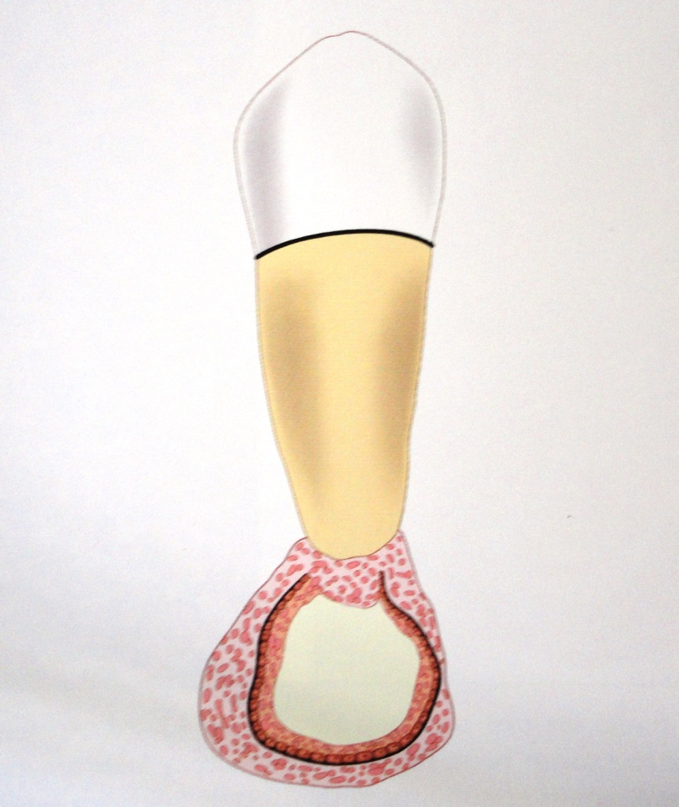
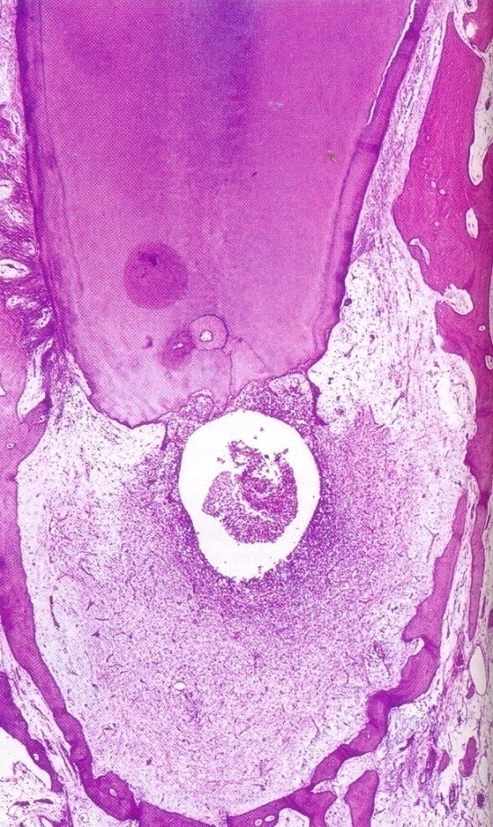
Radicular Cyst/Periapical Cyst
Pathogenesis
Pulp necrosis
Periapical inflammation
Periapical granuloma
Stimulation of epith.
Rests of Malassez
Periapical cyst

Slide 6
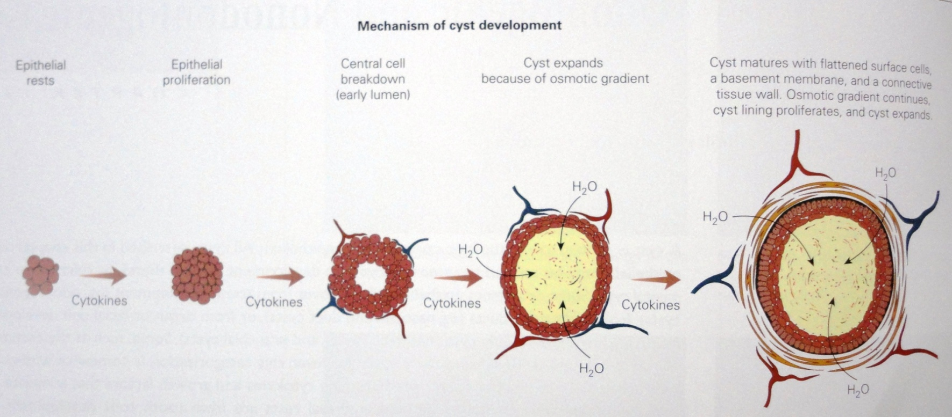
Respiratory epithelium of maxillary sinus
Oral epithelium from fistulous tract
Oral epithelium proliferating apically from a periodontal pocket

Slide 7
Clinical features
Most common inflammatory cyst
Mostly Asymptomatic
Sometimes with Pain & swelling
Age-20-60 yrs
Most common-permanent maxillary anteriors
Less frequently in deciduous teeth
Associated tooth-Non-vital/deep carious lesion/restoration
Sine qua non = presence of tooth with non-vital pulp = diagnosis of R.C.

Slide 8
Radiographic features
Pulpless, nonvital tooth
Small well-defined periapical radiolucency, surrounded by radiopaque line, indicating reaction of bone to slowly expanding mass
Size of radiolucency?
5 mm = periapical granuloma
More than 5 mm = periapical cyst

Slide 9
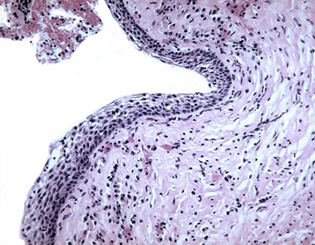
Histopathologic features
Cystic cavity is lined by non-keratinized stratified squamous epithelium which is sometimes hyperplastic

Slide 10
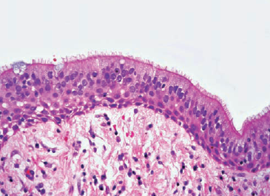
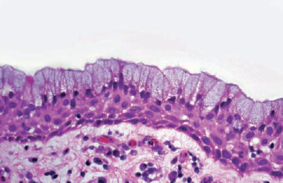
Hyperplastic Proliferative cystic lining show arcading pattern
Inflammatory cell infiltration, predominantly lymphocytic in fibrous connective tissue capsule
Pseudostratified ciliated columnar epithelium-maxillary teeth involving maxillary sinus
Presence of mucous cells

Slide 11
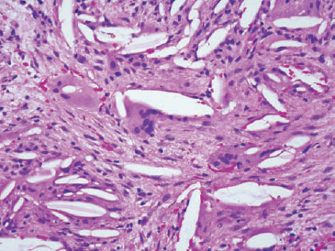
Presence of Rushton bodies
Multinucleated Giant cells with cholesterol clefts
Treatment
R.C.T.
Extraction of involved tooth & curettage of periapical tissue

Slide 12
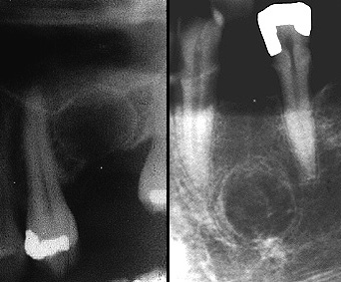
Residual cyst
Occurs in edentulous alveolar ridge due to extraction of tooth ,leaving periapical pathology untreated or incomplete removal of periapical granuloma / periapical cyst
Round to ovoid radiolucency in alveolar ridge
Radiographic features

Slide 13
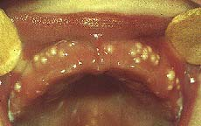
Dental lamina cyst of Newborn/ Gingival cyst of newborn
Epstein’s pearl
Alois Epstein
Arise from dental lamina
Formed during development of palate by entrapped epithelium (fissural cyst).

Slide 14
Heinrich Bohn
Epithelial remnants of dental lamina
Clinical features
Appearance : They are small white or yellow cystic papules.
Size : 1 to 3 mm in size
Site : Seen in median palatal raphe region
Occurrence: It occur in 65-85% of newborns.
Bohn’s nodule

Slide 15
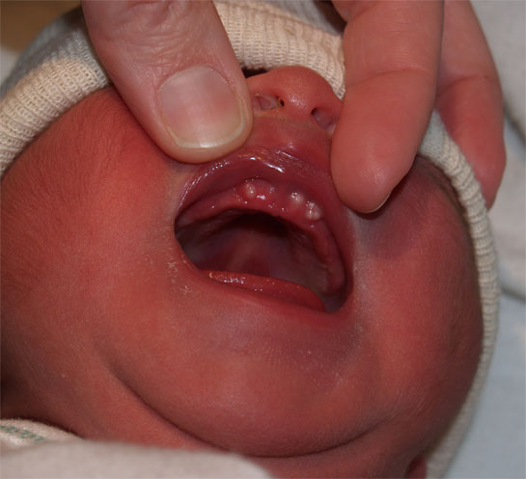
Smooth whitish bumps or cystic nodules
Site : At the junction of the hard and soft palate, and along lingual and buccal parts of the dental ridges, away from the midline
Size : 1-3 mm

Slide 16
Histopathological features
Round or ovoid.
Smooth or undulating outline.
Thin lining of stratified squamous epithelium with parakeratotic surface without reteridges

Slide 17
Cystic cavity is filled by keratin, usually in concentric laminations containing flattened cell nuclei
Dystrophic calcification & Rushton bodies seen
Basal cells are flat, unlike those in OKC.
Epithelium lined clefts may developed between the cyst & surface oral epithelium.
Due to pressure from cyst ,the oral epithelium may be atrophic.

Slide 18
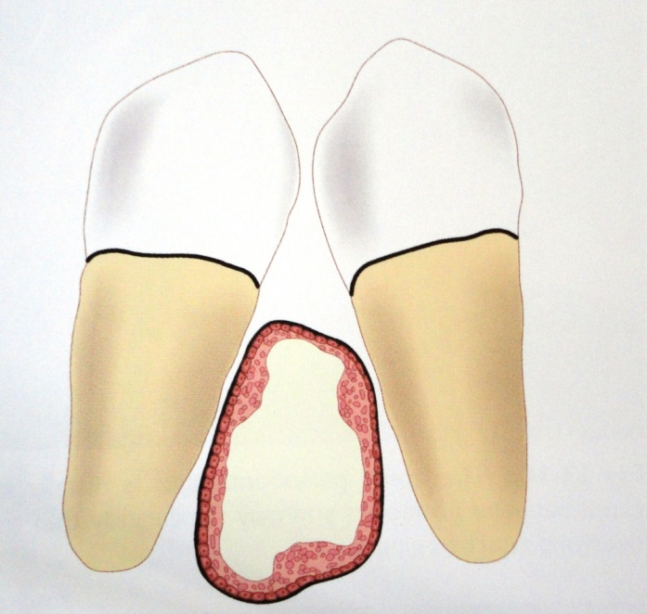
Lateral Periodontal Cyst Lateral Periodontal Cyst
Occur in lateral periodontal position
Arises from epithelial rests on lateral periodontal position
Intrabony counterpart of gingival cyst of adult

Slide 19
Clinical features
Peak age in 5^{th -} 6th decade
Fluctuant swelling < 1cm
Commonly seen in mandibular lateral incisor
to premolar area followed by maxillary anterior
region
Asymptomatic
Associated teeth are vital

Slide 20
Radiographic features
Well-defined circumscribed radiolucency
Round to oval
Hyperostotic border
Rarely large and irregular

Slide 21
Internal Structure
Completely radiolucent
Unilocular
(Multilocular--Botryoid odontogenic cyst)

Slide 22
Origin & Mode Of Development
Proliferation of rests of Malassez in the PDL
Primordial cyst of a supernumerary tooth germ
Proliferation & cystic transformation of rests of dental lamina
A Dentigerous cyst developing along the lateral aspect of crown

Slide 23
Pathogenesis
Notes:
a.,b.Expansion of follicle on lateral surface of crown ,c. tooth erupts leaving behind the follicle

Slide 24
Histopathology
Thin, non -keratinized squamous or cuboidal epithelium ,ranging from 1-5 cell layer thick, resembling REE

Slide 25
Localized plaques or thickenings of epithelium.
Extend into the surrounding cyst wall & also protrude into cyst cavity as mural bulge.

Slide 26
The cells of the plaque are fusiform with their long axis parallel to the basement membrane.
Foci of glycogen-rich clear cells, interspersed among the lining epithelium.

Slide 27
SUMMARY
Clinical features,Pathogenesis, Radiological
features,Histopathological features & Treatment of
Radicular cyst,Residual cyst,Gingival cyst of infant & Lateral PDL cyst

Slide 28
BIBLIOGRAPHY
Text book of oral pathology Shafer's, 5 & 6th edition
Cysts of the Oral Regions Shear M 3rd edition
Color Atlas of Oral Diseases Cawson, R. 2nd edition
Oral and Maxillofacial Pathology Neville, Brad W. 2nd
Lucas’s Pathology Of Tumor’s of the Oral Tissues
Cawson, R. A., Bennie, W. H 5th edition

Slide 29
THANK U

