Slide 1
CYSTS OF ODONTOGENIC ORIGIN-I
Dept. of Oral Pathology& Microbiology

Slide 2
Purpose Statement
At the end of the class the students will be able to,
Describe classification, clinical features, pathogenesis, radiographic features, histologic features, differential diagnosis, treatment & prognosis of the lesion.

Slide 3
Learning Objectives
S.N. | Learning Objectives | Domain | Level | Criteria | Condition
1 | Enumerate clinical features | Cognitive | Must Know | All
2 | Write classification | Cognitive | Must Know | All
3 | Write pathogenesis | Cognitive | Must Know | All
4 | Write radiographic features | Cognitive | Must Know | All
5 | Write histologic features | Cognitive | Must Know | All
6 | Enumerate differential diagnosis | Cognitive | Nice to Know | All
7 | Write treatment & prognosis | Cognitive & Psychomotor | Must Know | All

Slide 4
learning objectives
Student should be able to -
DEFINE CYST
CLASSIFY CYSTS
Describe -Clinical features,Pathogenesis, Radiological features,Histopathological features & Treatment of
DENTIGEROUS Cyst & ERUPTION cyst
Differentiate between DENTIGEROUS Cyst & ERUPTION cyst

Slide 5
Contents
Classification of cyst
Dentigerous cyst
Eruption cyst

Slide 6
Cyst
Kramer (1974) has defined a cyst as ‘a pathological cavity having fluid, semifluid or gaseous contents and which is not created by the accumulation of pus’.
Most cysts, but not all, are lined by epithelium.
Classification
Cysts of jaws
Odontogenic
Non-odontogenic

Slide 7
Classification by Etiology
Developmental
Dentigerous cyst
Eruption cyst
Odontogenic keratocyst
Gingival cyst of newborn
Gingival cyst of adult
Lateral periodontal cyst
Calcifying odontogenic cyst
Glandular odontogenic cyst
B. Inflammatory
Periapical cyst
Residual cyst
Paradental cyst

Slide 8
Classification by Tissue of origin
Derived from rests of Malassez
Periapical cyst
Residual cyst
Derived from reduced enamel epithelium
Dentigerous cyst
Eruption cyst
Derived from dental lamina (rests of serre)
Odontogenic keratocyst
Gingival cyst of newborn
Gingival cyst of adult
Lateral periodontal cyst
Glandular odontogenic cyst
Unclassified
Paradental cyst
Calcifying odontogenic cyst

Slide 9
Classification by Shear
I Cysts of the jaws
Epithelial lined cysts
Developmental origin
Odontogenic
Gingival cyst of infant
Odontogenic keratocyst
Dentigerous cyst
Eruption cyst
Gingival cyst of adult
Developmental lateral periodontal cyst
Botryoid odontogenic cyst
Glandular odontogenic cyst
Calcifying odontogenic cyst

Slide 10
b) Non- odontogenic
Midpalatal raphe cyst of infants
Nasopalatine duct cyst
Nasolabial cyst
2. Inflammatory origin
Radicular ,apical & lateral
Residual cyst
Paradental cyst & juvenile paradental cyst
Inflammatory collateral cyst

Slide 11
B. Non-Epithelial lined cysts
Solitary bone cyst
Aneurysmal bone cyst
II Cysts associated with the maxillary antrum
Mucocele
Retention cyst
Pseudocyst
Postoperative maxillary cyst

Slide 12
III Cysts of the soft tissues of the mouth, face and neck
Dermoid & epidermoid cysts
Lymphoepithelial (branchial) cyst
Thyroglossal duct cyst
Anterior median lingual cyst(intralingual cyst of foregut origin)
Oral cysts with gastric or intestinal epithelium ( oral alimentary tract cyst)
Cystic hygroma
Nasopharyngeal cyst
Thymic cyst
Cysts of the salivary glands: mucous extravasation cyst; mucous retention cyst;ranula;polycystic (dysgenetic) disease of the parotid
Parasitic cysts: hydatid cyst; Cysticercus cellulosae;trichinosis

Slide 13
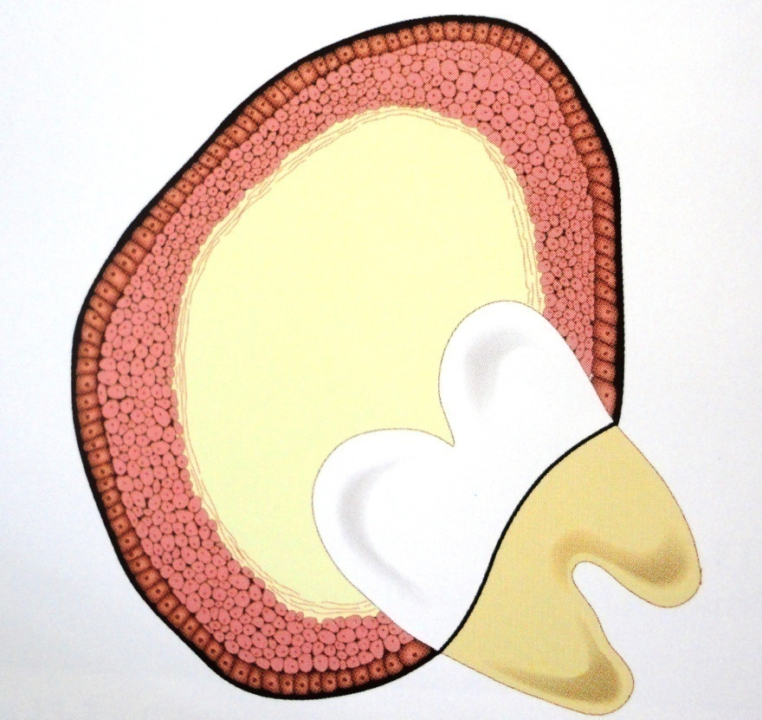
Dentigerous cyst (Follicular cyst) Dentigerous=Tooth bearing
Definition: An odontogenic cyst that surrounds the crown of an impacted tooth; caused by fluid accumulation between the REE & the enamel surface ,resulting in a cyst in which the crown is located within the lumen
Notes:
Dentigerous cyst preferable Not follicular cyst -1. dental follicle –mesodermal origin.2. more commonly used to refer ovary cyst & hair follicle cyst

Slide 14
Pathogenesis
Originates after the crown of the tooth has been completely formed by accumulation of fluid between the REE & the tooth crown
May originate initially by proliferation & cystic
transformation of islands of epithelium in the connective tissue wall of the dental follicle or even outside the follicle & this transformed epithelium then unites with the lining follicular epithelium forming a solitary cystic cavity around the tooth crown

Slide 15
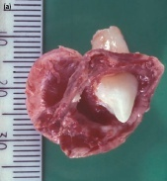
Most common among developmental odontogenic cysts
Associated with
Crown of impacted, embedded, or unerupted permanent tooth
Complex compound odontoma
Supernumerary tooth
Seldom deciduous tooth
May have inflammatory pathogenesis
Periapical infection of overlying primary tooth
Pericoronitis around partially erupted third molars

Slide 16
Clinical features
Site
Maxillary & Mandibular third molar
Maxillary canine
Mandibular II PM
Age
2nd & 3rd decade
Gender
M>F-3:2
Mostly solitary
Syndromic- bilateral & multiple (Cleidocranial dysplasia & Maroteaux-Lamy syndrome )

Slide 17
Clinical features
Expansion of the bone with facial asymmetry
Hollowing out of ramus
Displacement of teeth – mandibular third molar towards inferior alveolar canal, maxi. Canine towards maxilla
Resorption of adjacent teeth
Pain or discomfort if secondarily infected

Slide 18
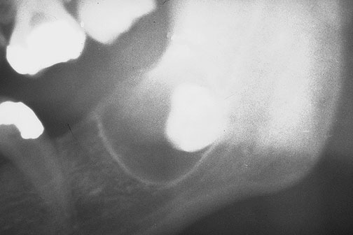
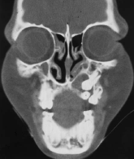
Radiographic features
Unilocular radiolucent area associated with crown of unerupted tooth
Well defined & sclerotic border

Slide 19
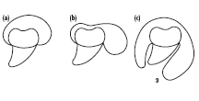
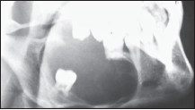
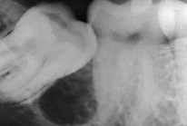
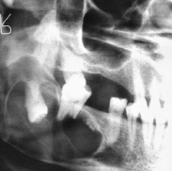
Three radiological varients
Central
Lateral
Circumferential
Central
Lateral
Circumferential

Slide 20
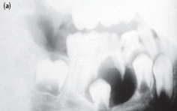
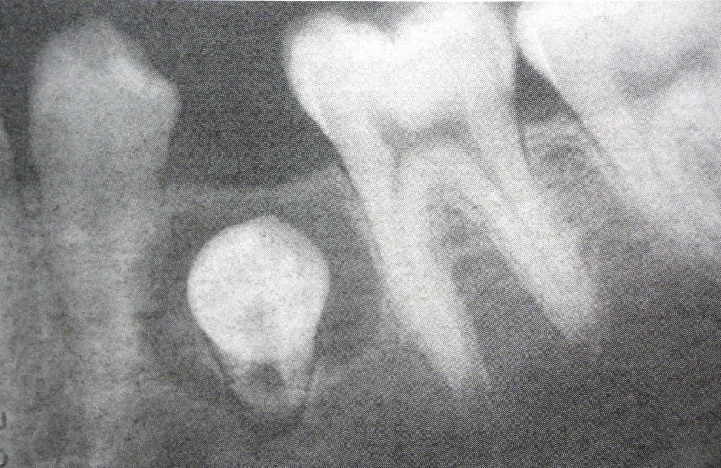
Distinction between a small dentigerous cyst & enlarged follicle ?
3-4 mm –follicular space
More than 5 mm - dentigerous cyst

Slide 21
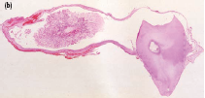
Histopathological features
A thin layer of stratified Squamous epithelium lining the lumen ( as derived from REE)
Thin connective tissue wall composed of loose fibrous connective tissue
Retepeg formation is generally absent ( flat epithelium –C.T. interface)

Slide 22
Rushton bodies – linear, often curved hyaline bodies
Presence of islands of odontogenic epithelium

Slide 23
Inflammed dentigerous cyst –thicker epithelial lining with hyperplastic rete ridges
Focal areas of mucous cells

Slide 24
Treatment
Smaller - surgically removed
Larger – surgical drain or marsupialization
Potential complications
Development of Ameloblastoma
Development of Epidermoid carcinoma
Development of Intraosseous mucoepidermoid carcinoma

Slide 25
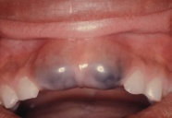
Eruption cyst/ Eruption Hematoma
An odontogenic cyst with histologic features of a Dentigerous cyst that surrounds a tooth crown that has erupted through bone but not soft tissue & is clinically visible as a soft fluctuant mass on the alveolar ridges
Dentigerous cyst occurring in soft tissue

Slide 26
Clinical features
Children of different age group
Adults-delayed eruption
Circumscribed,translucent, fluctuant swelling overlying the crown of erupting deciduous or permanent tooth
Purple or deep blue = Eruption hematoma
Usually painless

Slide 27
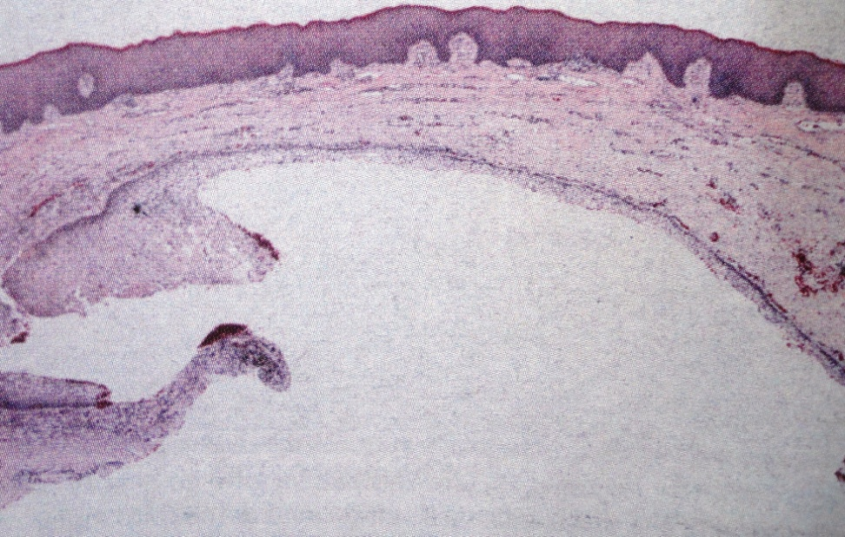
Histological features
Superficial aspect covered by keratinized stratified squamous epithelium of overlying gingiva
Dense C.T. strip separates from cyst
Cystic cavity is lined by 2-3 cell layers of nonkeratinized stratified squamous epithelium (REE)

Slide 28
Connective tissue –densely cellular, less collagenous & basophilic hue due to presence of higher content of acid mucopolysaccharides in ground substance
If inflamed, presence of inflammatory infiltrate
No treatment, as cyst ruptures spontaneously

Slide 29
SUMMARY
1.DEFINITITION & CLASSIFICATION OF CYSTS
2Clinical features,Pathogenesis, Radiological features,Histopathological features & Treatment of
DENTIGEROUS Cyst & ERUPTION cyst

Slide 30
BIBLIOGRAPHY
Text book of oral pathology Shafer's, 5 & 6th edition
Cysts of the Oral Regions Shear M 3rd edition
Color Atlas of Oral Diseases Cawson, R. 2nd edition
Oral and Maxillofacial Pathology Neville, Brad W. 2nd
Lucas’s Pathology Of Tumor’s of the Oral Tissues
Cawson, R. A., Bennie, W. H 5th edition

Slide 31
THANK U

