Slide 1
GOOD MORNING

Slide 2
DEVELOPMENT OF DENTITION AND OCCLUSION

Slide 3
contents
INTRODUCTION
EVOLUTIONARY CONCEPTS OF OCCLUSION AND DENTITION
CHARACTERISTICS OF HUMAN DENTITION
PRENATEL DENTAL DEVELOPMENT
MOUTH OF NEONATE
DECICUOUS DENTITION STAGE
PRIMARY OCCLUSION
MIXED DENTITION STAGE
PERMANENT DENTITION
CONCLUSION
REFERENCES

Slide 4
introduction
The formation of the teeth, development of the dentition and growth of the craniofacial complex are closely related in the prenatal as well as postnatal developmental period.

Slide 5
The formation, emergence , resorption and shedding of deciduous teeth and the formation and emergence of permanent teeth constitute a continuous series of maturational events from before birth to adulthood available for the assessment of dental maturation and even for prediction of development in individuals.
Dentist must be familiar with the manifestations and functions that occur during the normal development --- so that he may better evaluate the dentitions in both the child and the adult.

Slide 6
OCCLUSION

Slide 7
What is Occlusion and Why is it important?
The study of occlusion is an important aspect of dentistry--- the study and practice of all branches of dentistry should be based on a strong foundation of the knowledge of occlusion
There is no escape. Dentists cannot:
Repair
Move teeth
Remove
without being involved in occlusion.

Slide 8
The orthodontist should know and understand what constitutes normal occlusion in order to be able to recognize and thereby treat a malocclusion.

Slide 9
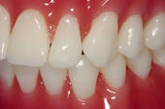
Very simply defined Occlusion means the contacts between teeth.
The masticatory (or stomatognathic) system is generally considered to be made up of three parts:
the Teeth,
the Periodontal tissues, and
the Articulatory system.

Slide 10
Dentition
The term dentition is used to describe the natural teeth in the jaw bones. It may be defined as the type, number and arrangement of the teeth or it refers to all the upper and lower teeth collectively
Humans have 2 sets of teeth during their lifetime--- Primary and Permanent.

Slide 11
Evolutionary Concept of dentition
During evolution several significant changes took place in the jaws and teeth. When the reptilian evolve to mammalian , the dentition went from
“polyphydont ” (many set of teeth)
“diphydont ” (only two sets of teeth)
“homodent ” (all of same teeth)
“heterodent”(different types of teeth like incisors, canines , premolars and molars)

Slide 12
STAGES OF TOOTH EVOLUTION
GRAPHICALLY THERE ARE 4 STAGES OF TOOTH EVOLUTION:
1) the reptilian stage (haplodont)
2) early mammalian stage (triconodont)
3) triangular stage (tritubercular molars)
4) quadritubercular molars

Slide 13
THE REPTILIAN STAGE-simplest tooth form-single cone type confined to single hinge movement of jaw.
EARLY MAMMALIAN STAGE-exhibits three cusps in the line of development of posterior teeth.
TRITUBERCULAR STAGE-found in dogs and other carnivorous animals.
QUADRITUBERCULAR STAGE-projection is created on the triangular form that finally occludes with the antagonist teeth.
THE ANIMALS WITH DENTITION SIMILAR TO THAT OF HUMANS ARE ANTHROPOID APES- chimpanzees, gibbon, gorilla and orangutan.

Slide 14
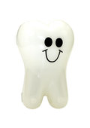
Characteristics of human dentition:
TEETH OF VERTEBRATES ARE CHARACTERIZED DEPENDING UPON:
--MODE OF ATTACHMENT
--NUMBER OF SUCCESSIVE SETS
-- SHAPE OF TEETH

Slide 15
THE WAY TEETH ARE ATTACHED TO JAW
--ACRODONT-- teeth are attached to the jaw by connective tissue
--PLEURODONT-- teeth are set inside the jaw
--THECODONT-- teeth are inserted into a bony socket
DEPENDING ON NUMBER OF TEETH OF SUCCESSIVE SETS
--POLYPHYODONT-- teeth are replaced throughout life. E.g- shark
--DIPHYODONT-- two sets of teeth e.g- human beings
--MONOPHYODONT-- one set of teeth e.g-sheep, goat.
ACCORDING TO TYPE OR SHAPE OF TEETH
--HOMODONT– a single type of teeth
--HETERODONT– various type of teeth e.g- human beings.

Slide 16
Dental formula
ORIGINAL FORMULA OF MAMMALS
PRESENT DENTAL FORMULA- teeth number reduced
PERMANENT DENTITION
I3/3, C1/1, PM4/4, M3/3
=44teeth
DECIDOUS DENTITION
I2/2, C1/1, M2/2
=20teeth
PERMANENT DENTITION
I2/2, C1/1, PM2/2, M3/3
=32 teeth
DECICOUS DENTITION
I2/2, C1/1, M2/2
=20 teeth

Slide 17
Origin of teeth
The mammalian dentition is 100, 000 million yrs old
THE THEORIES BEHIND MAMMALIAN DENTITION ARE
Theory of Concrescence – derived by fusion of 2 or more primitive conical teeth.
Theory of trituberculy – each tooth derived from single reptilian tooth by secondary differentiation of tubercle and root.
Theory of multituberculy – derived from reduction and condensation of primitive tuberculate teeth.

Slide 18
PRENATAL DENTAL DEVELOPMENT

Slide 19
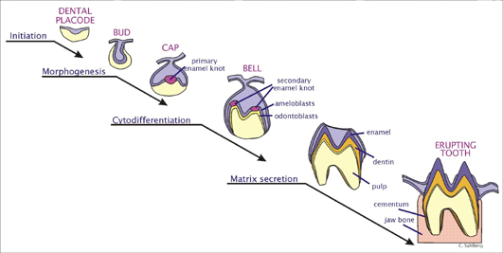
STAGES OF TOOTH DEVELOPMENT

Slide 20
Initiation of odontogenesis
3rd week of IUL - first sign of tooth dev.
Epithelial thickening seen
6 wk IUL Dental lamina is formed.

Slide 21
Morphologic changes - 6wks IUL till 4-5 yrs.
Occurs in 3 main phases-
Initiation of entire deciduous dentition at 2nd month IUL
Initiation of permanent teeth in successional lamina from 5th month IUL
The dental lamina elongates distal to 2nd decid. Molar and give rise to permanent molar tooth germs

Slide 22
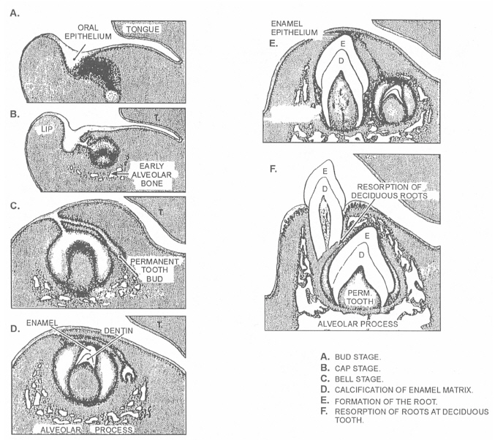

Slide 23
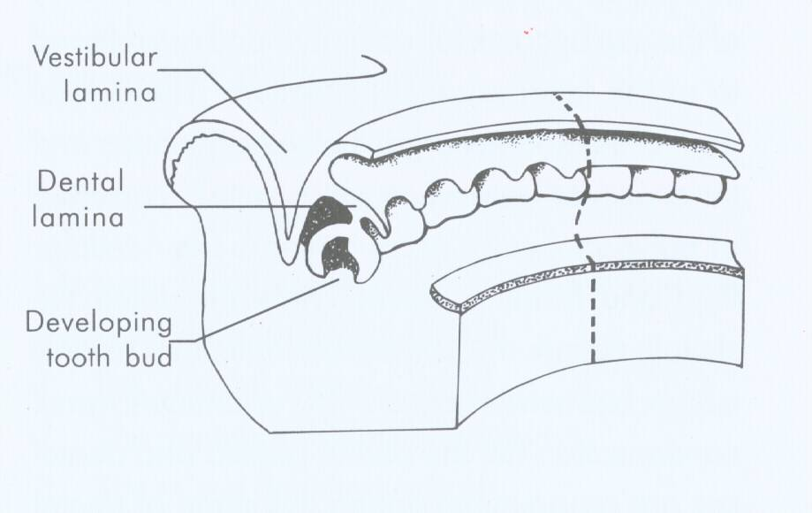
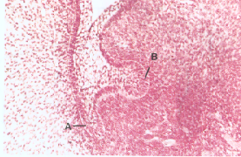
Initiation of Odontogenesis-
3rd Embryonic week
Epithelial thickening
6th week- ‘c’ shaped epithelial arches (Enamel organ)

Slide 24
INITIATION
The very 1st sign of tooth development appears late in the 3rd embryonic week.
At 6 weeks, the 4 maxillary odontogenenic zones coalesce to form the dental lamina.
Morphological changes in the dental lamina occurs in 3 main phases:
Initiation of the entire deciduous dentition –during 2nd month in utero
Initiation of the entire permanent dentition –from 5th month in utero
Initiation of the 1st permanent molar–4 months in utero
Initiation of the 2nd permanent molar-1 yr
Initiation of the 3rd permanent molar-4 to 5 yrs

Slide 25
BUD STAGE
Enamel organ
Peripheral columnar cells
Central Polygonal cells
Dental sac and Dental papilla
7th week- first mand. Tooth bud formation

Slide 26
Immediately after the formation of Dental lamina, the following take place :
Division for cheek & lip from the Dental arches at the Vestibular furrow.
Increased mitotic activity( knob-like ) corresponding to each deciduous tooth position .
Between the 7th & 8th week both max. & mand. Deciduous tooth buds form.
The 1st buds to form are the mand. Anterior teeth.

Slide 27
CAP STAGE
Proliferation of tooth bud into cap form
Outer enamel epithelium
Inner enamel epithelium
Stellate reticulum

Slide 28
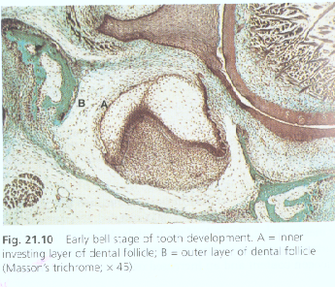
BELL STAGE
Inner enamel epithelium –Ameloblast
Stratum intermedium
Dental papilla-Odontoblast formation
PDL formation

Slide 29
Sequence pattern of development
CI-LI-C-M1-M2
25% - Postnatal variations
Mand. Incisor eruption before max. incisor
Molar tooth germ development at same maturation
Sexual dimorphism
Deciduous dentition
Male-faster growth
Permanent dentition
Female-Faster growth

Slide 30
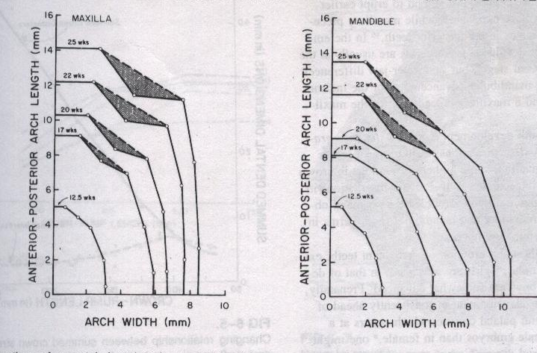
SPATIAL PATTERN
Arch shape
6-8 week- Flat anteroposterior
4th month- Elongation of Ant. Segment - Catenary curve

Slide 31
ROOT FORMATION
Just before the ameloblasts deposit their matrix, the Cervical loop lengthens due to a proliferation of cells & forms the Hertwigs epithelial root sheath (determines no., size & shape of roots ).
Dentin matrix is deposited against the root sheath & covered by cementum due to the invasion of cementoblasts, which eventually form the PDL

Slide 32
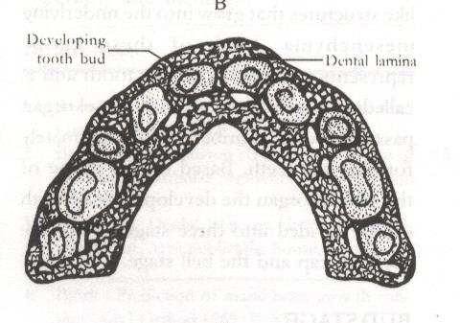
Prenatal Dental Development : Spatial pattern: Fields
Maximum occupancy of tooth field-
80%-1st Dec. Molar, Lateral incisors
More occupancy
Rotation - DI-2 lingual displacement

Slide 33
THE MOUTH OF THE NEONATE

Slide 34
The mouth of the Neonate
The gum pads
Neonatal jaw relationship
Status of dentition

Slide 35
Predentition stage
UPPER
GUM PADS
LOWER

Slide 36
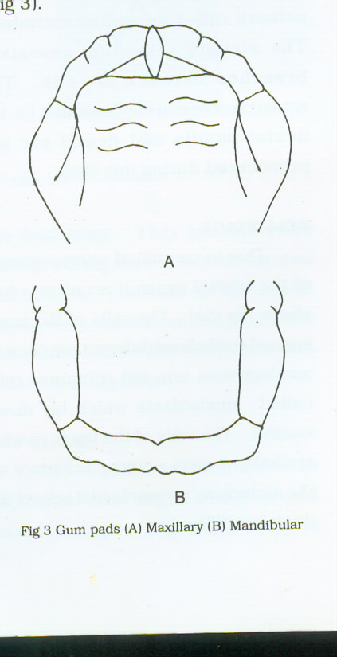
At birth alveolar processes are covered by firm and pink gum pads
Divided in to 10 segments by transverse
grooves.
Groove b/w canine and dm1 crypt –
lateral sulcus – assessing relation of jaws.
Maxillary arch is horse shoe shape and
extend buccally and labially
Mandibular arch is positioned posterior to max. arch

Slide 37
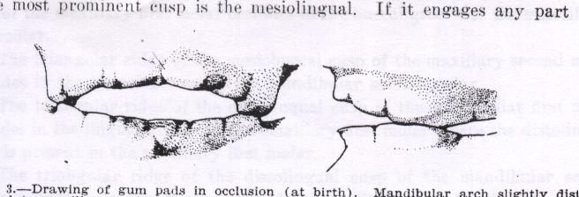
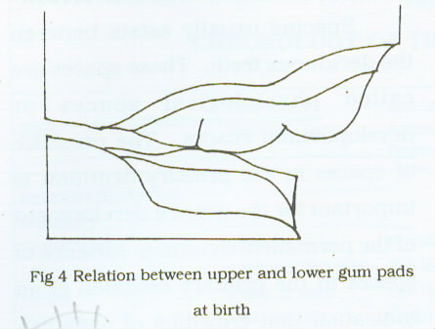
Neonatal jaw relationship
Arch is horse shoe shaped
Complete overjet/
Anterior openbite is seen.
Contact mainly occur at molar region.
Infantile open bite is normal as it helps in suckling.
INFANTILE ANTERIOR OPEN BITE

Slide 38
Predentate Period
Dental arch width (AJO: 1997:401-9)
Preeruptive
Significant increase between 6 week to 1 year

Slide 39
The status of dentition
Neonates are without teeth for 6mths.
Occasionally teeth seen in this period –
Natal
Neonatal
Pre-erupted
These teeth are always mandibular incisors.
Familial tendencies.

Slide 40
Natal and neonatal teeth

Slide 41
SYNONYMS :
Congenital teeth
Fetal teeth
Pre deciduous
Dentitia precox
DEFINITION: masler and savara (1950)
Teeth that are present at birth are natal teeth and teeth that emerge through the gingiva during first month of life are neonatal teeth.

Slide 42
ETIOLOGY:
Superficial position of tooth germ
Infection or malnutrition
Febrile illness
Heredity
Hyper activity of dental lamina
Hypovitaminosis
Environmental factors
Common teeth (90-99% primary)
Mand. incisors > maxillary incisors > mand cuspid > molars

Slide 43
CLINICAL FEATURES:
Normal or shell like structure.
Enamel hypoplasia
Occurs in pairs
No root growth
As root grows it becomes firmer
Ulceration of tongue-
RIGA-FEDE DISEASE
TREATMENT:
Extraction
Trimming
Retained

Slide 44
SELF CORRECTING ANOMALIES
RETROGNATHIC MANDIBLE
Differential and forward growth of mandible
ANTERIOR OPEN BITE
Eruption of primary incisors

Slide 45
INFANTILE SWALLOWING PATTERN
--Introduction of solid food in diet

Slide 46
Deciduous dentition stage

Slide 47
Development of primary teeth
INITIAL CALCIFICATION
Central incisor- 14 week
1st molar- 15 week
Lateral incisor- 16 week
Canine- 17 week
2nd molar- 18 week
GENETIC CONTROL
Morphology, rate and sequence of growth, pattern of calcification, mineral content

Slide 48
Size and shape of primary teeth
Male- More larger
No marked sexual dimorphism as in permanent dentition
ANOMALIES
Less frequent
1% congenital absence-- most frequently missing being
MAXILLARY LATERAL INCISORS >
MAXILLARY CENTRAL INCISORS >
FIRST PRIMARY MOLAR.

Slide 49
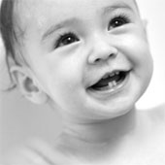
ERUPTION
Eruption stages
Eruption timings
Eruption sequence
Eruption disturbances
Primary tooth resorption

Slide 50
Eruption:
Movement of tooth towards occlusion
Sexual differences
Male- early eruption till 15 month
Female- Surpass after 15 months
Hatton study
Heredity- 78%
Environmental factors- 22%
Height and weight (Clin.Pediatr.J:2005)
Notes:
TOOTH EMERGENCE IS MOST HIGHLY ASSOCIATED WITH HEIGHT THAN WEIGHT AND HEAD CIRCUMFERENCE.

Slide 51
Theories of eruption
BLOOD PRESSURE
GROWTH OF THE ROOT
EPITHELIAL COILS( by WARWICK JAMES)
HAMMOCK LIGAMENT (by SICHER)

Slide 52
INTRA ORAL FORCES
PHYSICAL FORCES INFLUENCING POSITION OF TOOTH
BUCCOLINGUAL--- from musculature of lips, cheeks and tongue.
MESIODISTAL--- exerted through adjacent teeth

Slide 53
CLASSIFICATION OF TOOTH ERUPTION---- stages
: PRE EMERGENT ERUPTION
: POST EMERGENT ERUPTION
PRE EMERGENT ERUPTION:
FOLLICULAR PHASE: Labial or buccal drift of the tooth follicle within the bone.
Eruptive movements begin soon after root begins to form. Thus the “PRE EMERGENT SPURT PHASE” of eruption begins.

Slide 54
Two processes are necessary
1)There must be resorption of bone and primary tooth roots overlying the crown of the erupting tooth.
2)The eruption mechanism itself then must move the tooth in the direction where the path has been cleared.
POST EMERGENT ERUPTION:
EMERGES 3/4th of its root development is complete.
EMERGES erupts rapidly approaches the occlusal level and is subjected to masticatory forces. Now eruption slows.

Slide 55
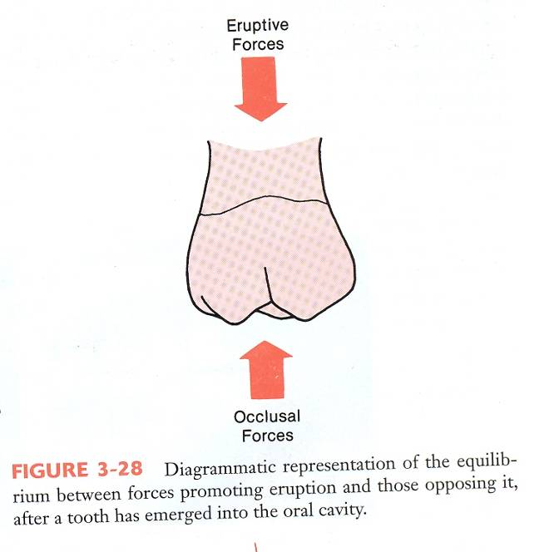
POST EMERGENT SPURT
The stage of relatively rapid eruption from the time a tooth first penetrates the gingiva until it reaches the occlusal level is called as the POST EMERGENT SPURT.
The phase which follows this comprises of very slow eruption and is called as JUVENILE OCCLUSAL EQUILIBRIUM.

Slide 56
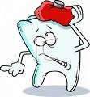
TEETH THAT ARE IN FUNCTION ERUPT AT A RATE THAT PARALLELS THE RATE OF VERTICAL GROWTH OF MANDIBULAR RAMUS.
MOST ORTHODONTIC PROBLEMS ARISE WHEN ERUPTION DOES NOT COINCIDE WITH GROWTH.

Slide 57
ADULT OCCLUSAL EQUILIBRIUM
A final phase in tooth eruption .Ending of the pubertal growth spurt
Adult teeth continue to grow at a slow rate.
Antagonist is lost, tooth erupts more rapidly.
Thus eruption mechanism is capable of producing tooth movement late in life.
Wear of teeth is compensated by additional eruption and face height remains constant.

Slide 58
Orthodontic implications
SPACE MAINTAINERS AND REGAINERS

Slide 59
Eruption timings--- rhythm
Critical period 8PM to1AM.—circadian rhythm related to cycle of growth hormone release.
Excessive eruption of posterior teeth is a characteristic of long face. Since teeth erupt primarily at night and early morning it is possible that wearing an appliance during this time would be helpful.
Notes:
Doubt. Find out. Appliance for long face.

Slide 60
ERUPTION SEQUENCE ABDCE
“7+4” RULE
7 Months = First Tooth Erupts
11 Months = 4 Erupted Teeth
15 Months = 8 Erupted Teeth
19 Months = 12 Erupted Teeth
23 Months = 16 Erupted Teeth
27 Months = 20 Erupted Teeth

Slide 61
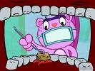
Eruption disturbances
CLEIDOCRANIAL DYSPLASIA– Failure of tooth eruption due to failure in resorption.
“PRIMARY FAILURE OF ERUPTION”– Rare human syndrome– affected posterior teeth fail to erupt even though bone resorption is normal--- do not respond to orthodontic force and cannot be moved into position.
DILACERATION– mechanical block of eruption causing distortion of root form.

Slide 62
CLINICAL SIGNIFICANCE OF PRIMARY TOOTH RESORPTION
Primary tooth resorption may occur even in the absence of the permanent successor
Primary tooth resorption is HASTENED by inflammation and occlusal trauma
DELAYED by
--splinting (as when a space maintainer is attached to the crown)
-- absence of permanent successor

Slide 63
ANKYLOSIS
primary teeth more likely to be ankylosed
particularly Molars
Mand: Max - 2:1
Occurs during physiologic resorption
Osseous bridging and fusion between bone and dentin occurs
FAILURE OF VERTICAL DEVELOPMENT--- LEADING TO POSTERIOR OPEN BITE
Notes:
Mostly maxi. Lateral, maxi central, 1st molar

Slide 64
Development of primary occlusion

Slide 65
NEUROMUSCULAR CONSIDERATION
Sequential interdentation
Guidance of teeth in occlusal position by muscular functional matrix.
Role of low cusp ht. and attrition
PRIMARY DENTAL ARCHES
Ovoid in shape
Role of tongue
In maxilla
Increased intercanine width by 6 mm between 3-13 yrs
Increased Intermolar width of 2 mm between 3-5 yr

Slide 66
Occlusal relation---by moyers
FLUSH TERMINAL PLANE
Distal surface of U/L
Favourable to guide permanent molars
59.1%

Slide 67
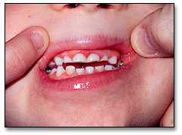
MESIAL STEP
Distal surface of lower more mesial to upper
Eating habit, Attrition and growing mandible
Favourable
19.1%

Slide 68
DISTAL STEP
Distal surface of lower more distal to upper
Sucking habits
Prognostically unfavourable
4.8%

Slide 69
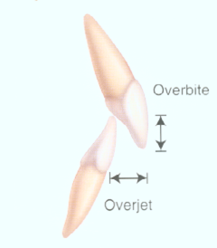
Normal characteristics
OVER BITE
Vertical Incisor overlap
Average- 1- 2mm
10-40% variation
Foster study
Ideal- 19%
Reduced- 37%
Openbite-24%
Excessive overbite- 20%

Slide 70
OVERJET
Horizontal relationship
Normal
1-2mm
Effects
Habits
Mandibular forward growth
Excess wear

Slide 71
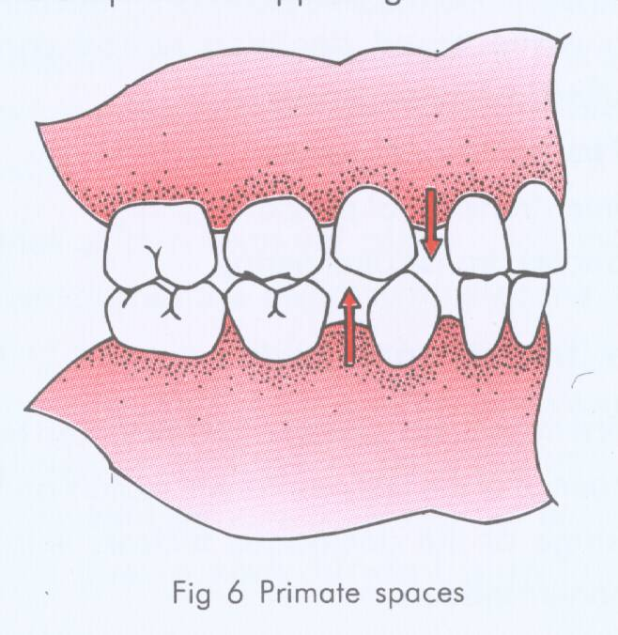
SPACING
According to Baume
Closed dentition
Spaced dentition
Localized –Primate spaces (anthropoid/ simian spaces)
Generalized- Physiologic Pressure from the tongue (Barber)
Total space-
Maxi-0 to 8mm
Mandible-0 to 7mm

Slide 72
Normal signs of Deciduous dentition
Spaced anteriors
Primate space
Shallow overbite and overjet
Straight terminal plane
Cl-I molar and cuspid relationship
Almost vertical inclination of anterior teeth
Ovoid arch form

Slide 73
Self correcting anomalies
ANTERIOR DEEP BITE
Cause- Incisors more upright
Correction:
Attrition of incisal edges
Eruption of permanent molars
Forward and downward growth of mandible

Slide 74
PHYSIOLOGIC SPACES
Permanent incisor accommodation
Maxilla-7mm
Mandible-5mm

Slide 75
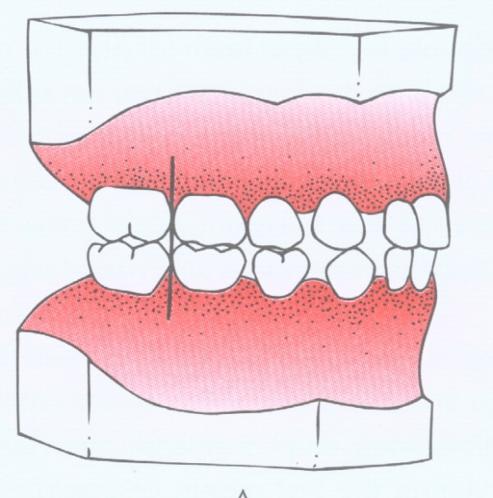
PRIMATE SPACE
Early mesial shift
FLUSH TERMINAL PLANE
Early mesial shift
Late mesial shift (Leeway space)

Slide 76
Mixed dentition period

Slide 77
The period during which both primary and permanent teeth are in the mouth together.
Those permanent teeth that follow into place in the arch once held by a primary tooth are called SUCCESSIONAL TEETH.( Incisors, cuspids and bicuspids)
Those teeth that erupt posteriorly to the primary teeth are termed as ACCESSIONAL TEETH.

Slide 78
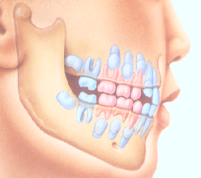
CLINICAL IMPORTANCE
Utilization of arch perimeter
Adaptive changes in occlusion that occur during transition from one dentition to another
Ideal time for most major orthodontic interventions.

Slide 79
DENTAL ARCH PERIMETER UTILIZATION
1)The alignment of the permanent incisors since they arrive crowded.
2)Space for cuspids and premolars.
3)Adjustment of molar occlusion.

Slide 80
phases
THE FIRST TRANSITIONAL PHASE: The incisors are exchanged.(6-9years)The 1st permanent molars erupt.
THE INTER TRANSITIONAL PERIOD: Lasts about 1.5 years.
THE SECOND TRANSITIONAL PERIOD:(9-12years)Primary molars and the cuspids are lost and replaced by permanent bicuspids and cuspids. These are followed by the eruption of the second permanent molars.

Slide 81
OCCLUSAL CHANGES IN THE MIXED DENTITION
FIRST TRANSITIONAL PERIOD :-
Emergence of first permanent molars.
Exchange of deciduous incisors with permanent incisors.
Establishment of occlusion

Slide 82
MANDIBULAR 1st MOLAR
1st emerging tooth- 6 years
Erupts prior to max.1st molar. Preferable since it prevents the excessive extrusion of max. molars.
Prior to their eruption-positioned lingually and mesially in their bony crypts at an angle between the mandibular body and anterior border of the ramus.

Slide 83
The movement of the first molar towards the occlusal plane combined with the resorption of the border of the ramus which lengthens the body provides space necessary for the molars.
More or less perpendicular orientation characterized by a slight mesial tilt and lingual inclination.

Slide 84
MAXILLARY IST MOLAR
Erupts at about 6 ¼ years of age.
In the crypts the crowns of the maxillary permanent molars tend to point distally and bucally.
The lengthening of the maxillary arch due to the appositional growth at the tuberosities molar rotates upright and move vertically towards the occlusal plane.
Inclined mesially on their long axis and bucally in the transverse axis.

Slide 85
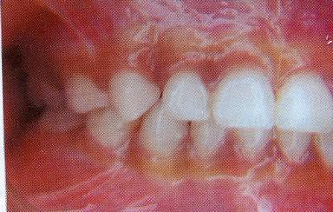
MESIAL STEP
Opposing 2nd dec. molars
have the same M.D dimensions
then the terminal plane of the
deciduous dentition would
have MESIAL STEP since
the mandibular molars are
more ventrally positioned than
the maxillary one.

Slide 86
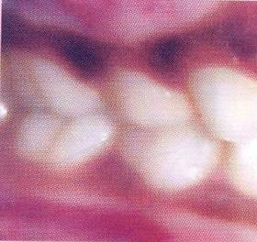
FLUSH TERMINAL
If the mesiodistal crown
of the mandibular 2nd dec.
molar is a few mm larger
than the opposing max.
Molar, the terminal plane is
FLUSH.
After emergence the 1st
permanent molars get
oriented in an END TO
END position

Slide 87
How?
1)Early mesial shift
2)Late mesial shift
3)Greater forward growth of the mandible than the maxilla.
4)Combination of the above.

Slide 88
Early mesial shift
If the dec. dentition is spaced with a flush terminal relation of the 2nd dec. molar, then the eruptive force of the 1st permanent molar causes the closing of any existing spaces.
Closure of the PRIMATE SPACES.
Mesial to the dec. canine in the max. arch and distal to the dec. canine in the mandiular arch.

Slide 89
Anthropoid/ simian spaces

Slide 90
Late mesial shift
When no spaces exist the erupting 1st molar migrates mesially to use up the LEEWAY SPACE.
The difference between the mesiodistal width of the primary canine,1st molar,2nd molar and their permanent successors.
Maxilla:1.5mm each side
Mandible:2.5mm each side
Notes:
Values from profit. Even if incisor crowding Is present, the leeway space is normally taken up by the mesial movement of the permanent molars. An opportunity for orthodontic treatment is created at this time, since crowding can be relieved by using the leeway space.

Slide 91
Differential growth of maxilla and mandible
Rate: Growth between the maxilla and the mandible is not the same.
The growth of the mandible is twice that of the maxilla during development of dentition.
Shift which brings the mandible forward causing the END TO END molar relation of the mixed dentition to change into a class1 in the permanent dentition.

Slide 92
combination
A modest change in the molar relationship can be produced by a combination of
1)Differential growth of the jaws
2)Forward movement of the lower jaws.

Slide 93
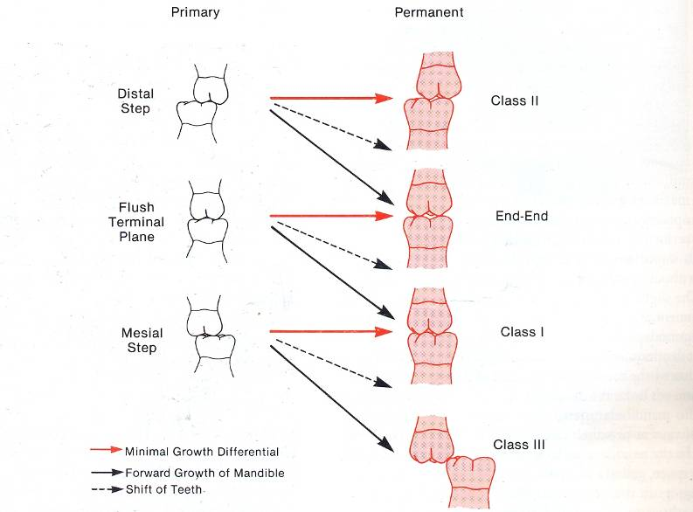

Slide 94
Incisor translation
Mandibular central incisors erupt at 6 ¼ years of age.
The permanent mandibular incisors develop lingually to the resorbing roots of the primary incisors forcing the latter to be exfoliated.
Exfoliation of the primary central incisor is followed by the further eruption and lingual activity moving the permanent incisors labially to their normal balanced position between the tongue, lip and facial musculature.

Slide 95
Obligate spaces
Size of the permanent incisor is bigger than the primary incisor.
Counterpart of the Nance leeway space.
PROVIDED BY:
1)The interdental spacing present.
2)Greater labial inclination. Thus they are position on the perimeter of a larger circumference.

Slide 96
ANGULATION
150 degrees in the primary dentition.
123 degrees in the permanent dentition.
There usually an increase in the primary intercuspid width of both the dental arches in concert with the eruption of the larger permanent incisor.

Slide 97
Maxillary central incisor
Erupt at about 7 ½ years of age.
They are positioned more labial and oblique than that of mandibular lateral incisor. This is in accordance to their greater labiolingual thickness and wider mesiodistal diameter.
The max. LI experience difficulty in assuming their normal position, since the roots of the developing cuspids lie labial and distal to their roots.

Slide 98
UGLY DUCKLING STAGE
Eruption of canine and premolars

Slide 99
Late mixed dentition phase (9-11 yrs)
EXAGGERATED MESIAL PATH OF ERUPTION OF MAXILLARY CUSPID

Slide 100
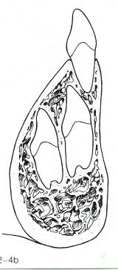
PERMANENT MANDIBULAR LATERAL INCISOR
Erupt at 7 ½ years of age.
More problems on eruption since they are positioned further lingually.
They erupt after the centrals.
HOW IS THIS OVERCOME?
As it erupts it displaces the primary cuspid distally and buccally to occupy the primate space thereby increasing the intercanine width.

Slide 101
WHAT IF NO PRIMATE SPACE?
The permanent lateral incisor follows either of the 2 paths:
1)They may erupt lingually out of alignment and the primary incisors may be retained.
2)Pressure on the roots of the primary cuspids inducing root resorption and cause premature exfoliation. Then they may acquire their correct position.

Slide 102
PREMATURE EXFOLIATION OF THE PRIMARY CUSPIDS
Anterior arch is less stable and the incisors may be tipped lingually by the hyperactivity of the mentalis.
Developing cuspids slide labially and erupt in labioversion.

Slide 103
TRANSITION OF THE INCISORS
Max. LI nearer to the
occlusal plane
distoincisal corners
of the max CI are in
contact mesial surface
of the laterals.
Mand. perm. incisors
are situated more lingually.
Incisal edges of the lower CI
near the occlusal plane.

Slide 104
The mandibular primary
CI shed first.
Their successors emerge in close contact.
Contact between the max CI and the LI roots result in the displacement of the latter.
Diastema mesial to canine reduces in width. more space is available for the larger permanent teeth.

Slide 105
The max CI are lost & their successors have erupted further.
In the mandible the CI have reach the level of occlusal plane before the laterals begin to erupt.

Slide 106
Max CI continue to emerge move the dec. LI distally.
Causes movement of dec. canine Intercanine width increases.
Erupting mand. LI contacts the dec canine, causing an increase in the intercanine width.
Processes occur simultaneously.

Slide 107
Max LI does not erupt before the CI have reached the occlusal plane.
While erupting if they make contact with CI, diastema reduces.
More space is available for the roots of the centrals to move distally once the laterals erupt.

Slide 108
The max LI reach the occlusal plane last.
It erupts in a more labial direction.

Slide 109
CHANGES IN THE INCISOR AND MOLAR REGION
The dec. incisors are oriented perpendicular to the occlusal plane.
The perm. incisors are located lingually to the roots of their predecessors.

Slide 110
The mandibular 1st molar is the 1st permanent tooth to erupt, followed by the Mandibular CI.
The maxillary CI has erupted further and resorption of its roots has proceeded.
The lower lip touches the incisal edges of the maxillary dec. incisors and covers the labial surface slightly.

Slide 111
The max.1st permanent molar has emerged and attained contact with its antagonist.
Intercuspation is End to End.
The 1st molar will not attain intercuspation before the transition of posterior teeth completed.
The mand. CI erupts further.

Slide 112
The position of the mand. CI is influenced by the tongue and the lower lip.
The upper lip makes contact with the max. CI shortly after its emergence thus reducing its labial inclination.

Slide 113
The max. and mand. incisors erupt until they achieve mutual contact.
The lower lip also supports the max CI and covers a distance of about 1-3mm thus reducing its labial inclination.
The lower lip also contacts the Mand. incisor.
The upper incisors are also supported by the mand. Incisors.

Slide 114
The max. and mand. incisors have now attained a steeper inclination due to the effect of the perioral musculature.

Slide 115
summary
Transition takes more than 3years.
Upon emergence the permanent tooth migrates to its future position.
Perm. LI erupts in a more labial direction than the perm. CI. Subsequently its inclination reduces.
The mand. LI emerges lingually in the dental arch and subsequently it moves labially under the influence of the pressure exerted by the tongue

Slide 116
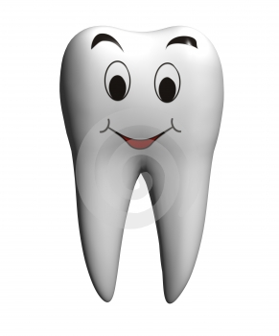
The process of eruption is influenced by certain factors such as:
A) Local space conditions in the dental arch.
B) The position and the functional activity of the tongue lips and buccal musculature.

Slide 117
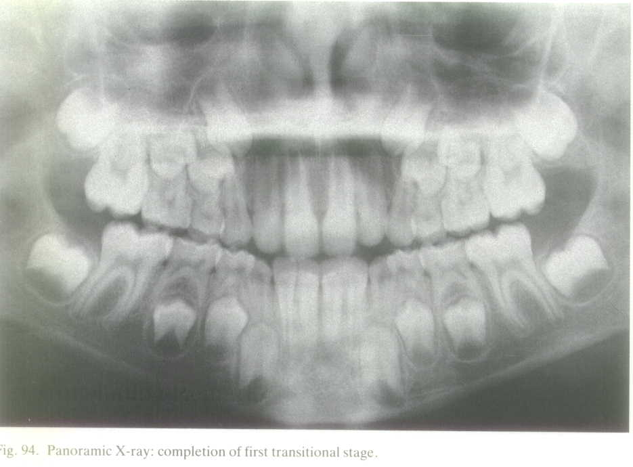

Slide 118
INTERTRANSITIONAL PERIOD
Lies between the 1st and 2nd transitional period.
Stable phase and is characterized by:
A) Contains both sets of dentition.
B) Comprises of permanent molars and incisors.
C) Deciduous canines and deciduous 1st and 2nd molars.

Slide 119
The max. CI are labially inclined with a central diastema.
Diastema is present mesial to the dec canine in the max arch.
Mand. incisors are less labially inclined than the max. CI and are usually in contact with each other.
The dec. teeth still present are quite worn out. The occlusal morphology appears of a plane.

Slide 120
Due to the absence of distinct intercuspation the relation between the two jaws is not fixed.
Ventral development of the mandible exceeds the Maxilla, the Mandibular teeth have more mesial position.
The M.D crown dimension reduce further due to attrition.
The M.D angulation of the max. and mand. perm. incisors is determined partly by the perm. canines that have not emerged.

Slide 121
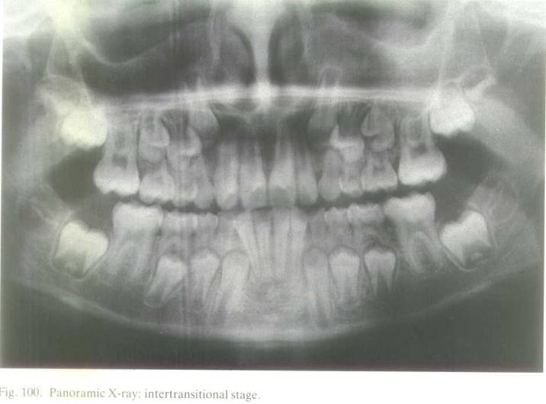

Slide 122
THE SECOND TRANSITIONAL PERIOD
Characterized by the transition of posterior teeth and the emergence of second permanent molars.
LATE MIXED DENTITION PERIOD (9-12YEARS)

Slide 123
CUSPID AND BICUSPID ERUPTION
Favorable development of occlusion.
Favorable sequence of eruption.
Satisfactory tooth size space ratio.
Attainment of normal molar relationship.
Favorable bucco-lingual relationship of the alveolar process

Slide 124
MANDIBLE-CUSPIDS
Sequence of eruption – 6,1,2,3,4,5,7.
IMPORTANCE – Cuspid should erupt before the bicuspids since it tends to maintain the arch perimeter and prevent lingual tipping of the incisors.
Lingual tipping of the incisors Over erupt since they lose their centric stops with the maxillary incisors.

Slide 125
EARLY LOSS OF MAND. DEC.CUSPID
Eruption of perm. LI may resorb the roots of the primary cuspids during eruption due to lack of space.
LOSS OF SPACE
UNILATERAL BILATERAL

Slide 126
UNILATERAL SPACE LOSS
The perm. Incisors tend to shift towards the side of missing cuspid.
They will change their axial inclination.
The midline shift .
Further they may block the eruption of the perm. Cuspid.

Slide 127
BILATERAL SPACE LOSS
Lingual tipping of the incisors.
The perm. Cuspids erupt in a labial direction.

Slide 128
THE 1ST MAND. BICUSPID
Erupts at 10 ½ years after the mand. Cuspids.
The path of eruption is straight and vertical.
In either of the jaws the erupting premolars move up to the crown of its predecessor and finally enter it. Thus the crown of the dec. molar appears as a HAT on the premolar crown.
The buccal surface of the premolar is visible prior to the loss of the covering dec. molar crown.

Slide 129
MANDIBULAR 2ND BICUSPID
Last tooth to erupt anterior to the 1st molar and is often at the mercy of the available space.
Their will be no room for it if there is shortening of the dental arch.
Tooth size-space available ratio is poor.
11 ¼ years of age.

Slide 130
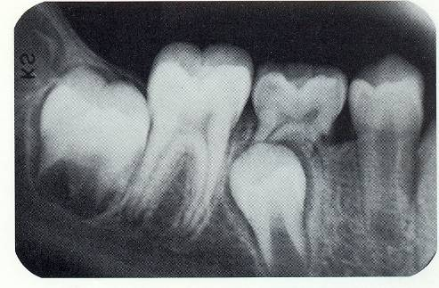
PATH OF ERUPTION
DISTAL PATH OF ERUPTION
BEST, since it ensures no space loss due to the exfoliation of its predecessors.
As it erupts distally it resorbs the distal root of the 2nd primary molar and glides along the mesial surface of the 1st perm. molar to erupt into the dental arch.

Slide 131
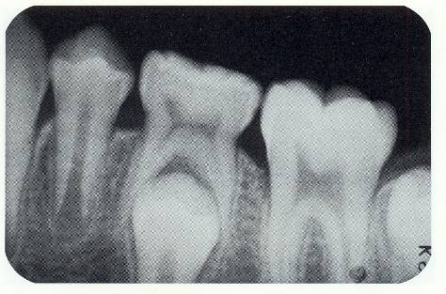
OCCLUSAL PATH OF ERUPTION
COMMON
NOT BE CONSIDERED NORMAL-since there is space loss due to the mesial shifting of the 1st perm. Molars at the time of exfoliation of the prim.2nd molar

Slide 132
MESIAL PATH OF ERUPTION
LEAST DESIRABLE
Too much time elapses between the exfoliation of the 2nd primary molar and the eruption of the 2nd bicuspid, the 1st perm. Molar will tip mesially, causing a space loss with the resultant “BLOCKING OUT ”of the bicuspid.
The 2nd bicuspid does not follow immediately.

Slide 133
EARLY LOSS OF 2nd PRIMARY MOLARS.
When a long interval elapses between the loss of the 2nd primary molar and the eruption of the 2nd bicuspid – the condition is referred to as “ EARLY TOOTH LOSS”.
This breaks the continuity of the dental arch.
The 1st permanent molar would tip mesially and the 1st bicuspid will migrate distally.
Thus there is loss of space required for the 2nd bicuspid.

Slide 134
maxilla
SEQUENCE OF ERUPTION- 6,1,2,4,5,3,7 or 6,1,2,4,3,5,7
Maxillary anterior region is not prone to collapse palatally since it is supported by the mandibular arch.
But it is displaced labially very easily by habits such as thumb sucking and tongue thrusting.

Slide 135
MAXILLARY 1ST BICUSPID
Erupts at about 10 ¼ years of age.
Path of eruption is directed towards occlusal plane.
Since the maxillary bicuspid approximates the 1st primary molar size and because of the sequence of eruption the attainment of their final position in the dental arch is quite uneventful.

Slide 136
IMPORTANCE OF MAXILLARY 1st BICUSPID.
“KEY TEETH”. Since they are usually the first teeth to erupt in the developing late mixed dentition, thus they regulate the adult occlusal relationship of the dental arch anterior to the 1st perm molar.

Slide 137
RELATION OF THE MAXILLARY 1st BICUSPID TO THE MANDIBULAR 1st BICUSPID
Maxillary 1st bicuspid distal to the mandibular 1st bicuspid.
Most desirable.
“ KEY TO THE DEVELOPMENT OF NORMAL OCCLUSION.”
An end to end occlusal relation of the 1st bicuspids is not normal. On the other hand the end to end relationship of the 1st perm molar at this phase of occlusal development is normal.
Notes:
CHEK

Slide 138
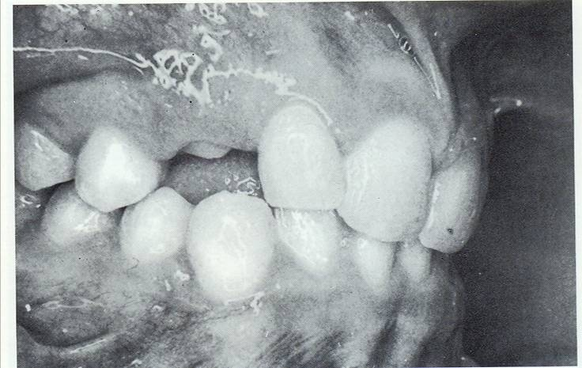

Slide 139
TRANSITION OF POSTERIOR TEETH AND THE ERUPTION OF 2ND PERM.MOLAR
PM are located b/w roots
Max.1st PM closer than 3
Distal corner of 3 closer to
Concavity of 1stPM(canine fossa)
Terminal plane: MESIAL STEP
2ND molar: distobucally in max.
Mesiolingually in mand.

Slide 140
Mand. dec. canine is shed
Surpassed 1st PM
Diastema distal to canine
Provides space
Max. 1st PM further erupted.

Slide 141
1st PM both the jaws
attained harmonious position.
Both 2nd PM continue to erupt
Max. perm. canine continues to erupt.

Slide 142
Roots of 2nd dec. mand molarsare resorbed.
2nd PM erupt further
Flush terminal changes
to solid intercuspation.

Slide 143
Max. canine last tooth tobe lost.
Successor follows shortly.

Slide 144
Max. canine arrive at proper place
Mand.2nd molar followed by max. emerge.
Mand.2nd molar-mesiolingual
Max.2nd molar-distobuccal

Slide 145
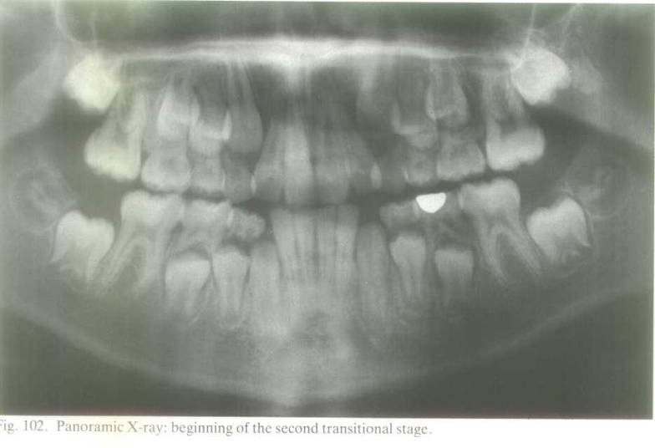

Slide 146
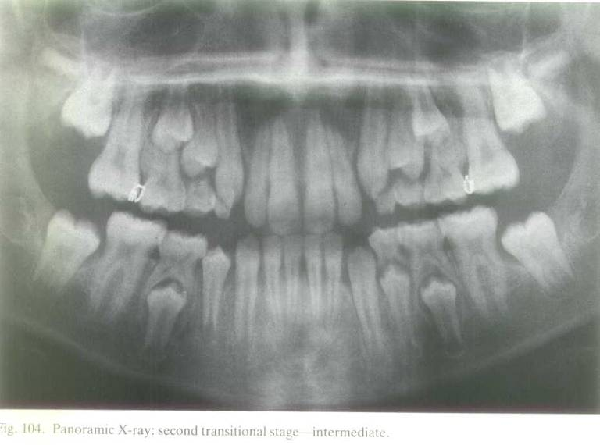

Slide 147
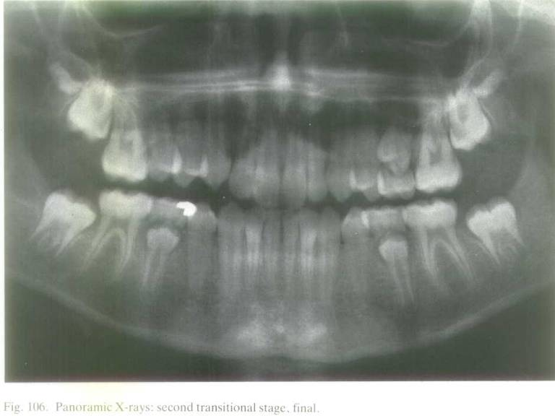

Slide 148
ERUPTION TIMING
DENTAL AGE:
I) Which teeth have erupted?
2)The amount of resorption of the primary teeth
3)The amount of development of the permanent teeth.
Notes:
PROFFIT PAGE93

Slide 149
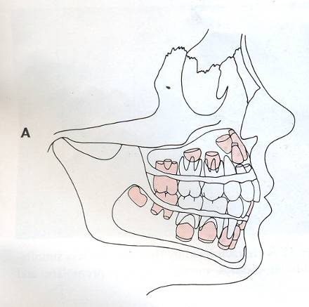
DENTAL AGE-6
Mand. CI, max. and mand. 1st perm. molar

Slide 150
DENTAL AGE-7
Max. CI followed by mand.LI-7 ½ Years.
Root formation of max. LI advanced.
PM and canine in stage of crown completion.

Slide 151
DENTAL AGE-8
Eruption of max. LI
Delay of 2-3 years before any more perm. teeth erupt.

Slide 152
DENTAL AGE-9
Primary canine,1st and 2nd dec. molar present
Root formation of 1st perm. molar &incisor nearly completing
Root dev. begin on mand.2nd PM
Root dev. has begun on max.1ST PM & just beginning on canine & 2nd PM.

Slide 153
DENTAL AGE 10
Greater amount of resorption of primary canine and molars followed by the root development of permanent successors.
One half of the root development of mandibular canine, mandibular 1st premolar and upper 1st premolar is completed.
Completion of roots of mandibular incisor teeth.
Near completion of roots of maxillary laterals.

Slide 154
DENTAL AGE - 11
Eruption of mand canine, mand 1st premolar and max 1st premolar.

Slide 155
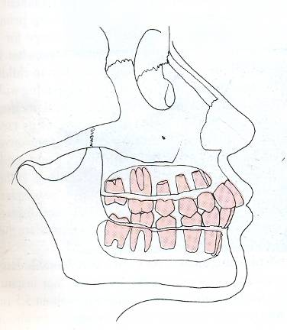
DENTAL AGE - 12
There is eruption of max canine, max and mand 2nd premolar.
Second permanent molars in both the arches are nearing eruption.
Early beginning of formation of third molars.

Slide 156
DENTAL AGE-13,14,15
Completion of roots of perm. teeth.
If 3rd molar is present crown formation is complete.

Slide 157
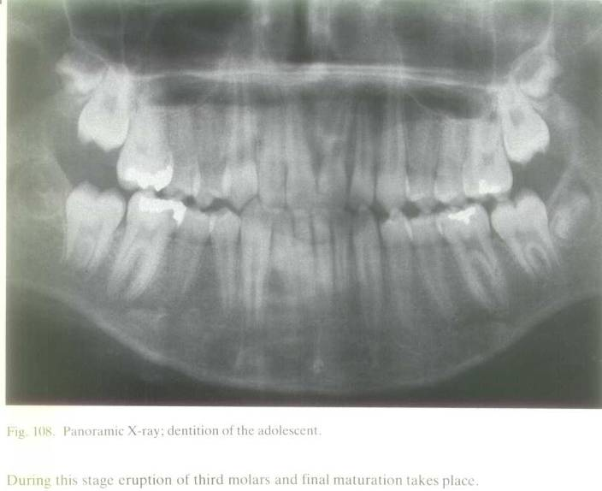

Slide 158
CHRONOLOGY OF TOOTH DEVELOPMENT
Notes:
Insert chart for chronology

Slide 159
Permanent dentition

Slide 160
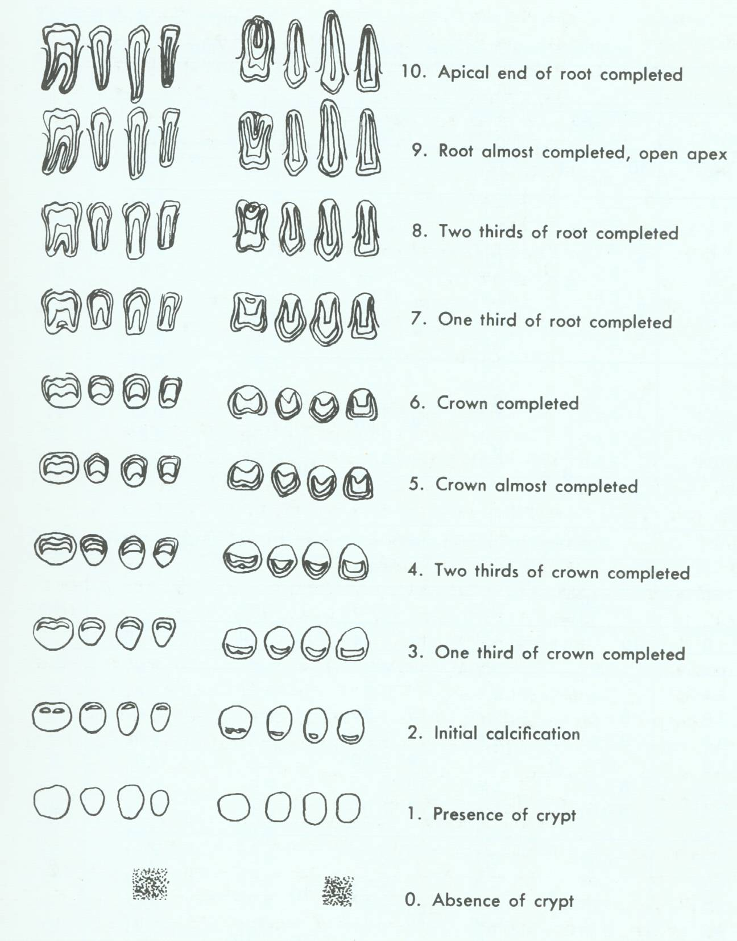
All perm. teeth are present in the arches often by age 12-14 years.
NOLLA’S STAGES OF CALCIFICATION

Slide 161
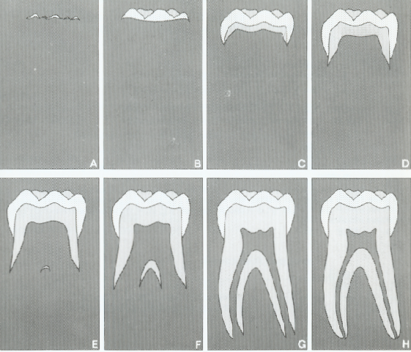
Stages of tooth development :-
Eight stages of tooth formation are distinguished by Demerjian in 1973

Slide 162
ERUPTION
Interrelation between calcification and eruption
Developmental process that moves a tooth from it’s crypt position through the alveolar process into the oral cavity and to occlusion with it’s antagonist
Onset of Movement of tooth after crown formation
2 to 5 years for the posterior teeth to reach the alveolar crest following completion of their crown.
12 to 20 months to reach occlusion after reaching alveolar margin.

Slide 163
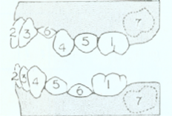
SEQUENCE OF ERUPTION :-
Maxillary-
6-1-2-4-3-5-7 or 6-1-2-4-5-3-7
Mandibular-
6-1-2-4-3-5-7 or
6-1-2-3-4-5-7

Slide 164
SIZE OF THE TEETH
COMBINED M.D DIAMETER OF DEC. TEETH
Max. arch - 68.2mm
Mand. Arch – 64.4mm
PERM.DENTITION:74mm in the max.
:64.4mm in the mand.
5.8mm space is required in the max. arch and 2.6mm is required in the mand. arch.

Slide 165
NUMBER OF TEETH
MISSING TEETH
Complete absence of teeth is called ANODONTIA.
The absence of one or more teeth is called as HYPODONTIA OR OLIGODONTIA.
The congenital absence of teeth in modern man may be an expression of ANISOMERISM.(A reduction of no. of teeth by loss or fusion.)
Total absence of primary and perm. teeth is seen in ECTODERMAL to DYSPLASIA.

Slide 166
SUPERNUMARARY TEETH
Teeth formed in excess of normal number.
SUPPLEMENTAL TEETH.
Result from disturbance in the initiation and proliferative stages in dental development.
Splitting of the perm. bud itself.
Dental lamina near the perm. bud.
Hereditary factors.

Slide 167
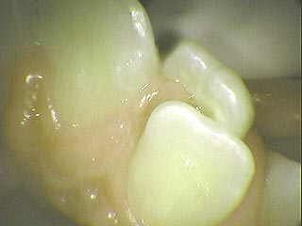
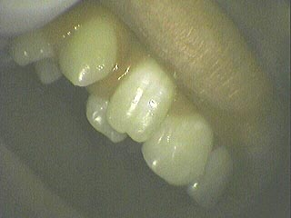
Common: Mesiodens,4th molar, max. Para molar, mand. PM, max. LI.
RARELY PRESENT IN THE DEC. DENTITION.
Encountered less frequently than congenitally missing teeth.
GARDENERS SYNDROME

Slide 168
DIMENSIONAL CHANGES IN THE DENTAL ARCHES
A) Width
B) Length
C) Circumference

Slide 169
WIDTH
BURDI AND MOYERS pointed out
A) Width dimensional increase involves alveolar process growth totally since there is little skeletal width increase at this time.
B) Maxilla-max. alveolar process diverge.
Mandible-alveolar process diverge.
C) Dental arch width increases are related to events in the dental development and less due to endocrinally mediated events.

Slide 170
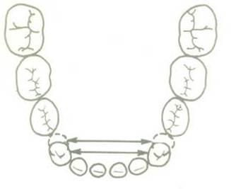
INTERCUSPID WIDTH
Determined by measuring the distance between the crown tips of the cuspids.

Slide 171
Arch width changes from 6 weeks-45yrs (A J O-1997:111:401-409)
BISHARA et al
PRE-ERUPTIVE
MAXILLA: increases b/w 6 weeks to 1yr.& b/w 1-2yrs in both boys and girls.

Slide 172
BIMOLAR WIDTH
The bi-molar width is obtained by measuring the distance b/w the mesio-lingual cusp of the 1st permanent molar.

Slide 173
PRE ERUPTIVE CHANGES
Maxilla: increases b/w 6 weeks -1yr. & b/w 1-2 yrs of age in both boys and girls.
Mandible: increases b/w 6 weeks – 1year & not b/w 1-2 yrs.

Slide 174
POST ERUPTIVE CHANGES
Males: increases in both the mandible and the maxilla.3-13 yrs. Thereafter no changes b/w 13-26,26-45 years.
Females: increases up to 13yrs.b/w 13-26,26-45 years there was a slight decrease.

Slide 175
Dental arch dimensions in the mixed dentition: A study of Italian children born in the 1950s and the 1990s.
Angle ortho. Vol 76,No 3, May 2006
DEFRAIA et al: subjects showed a smaller width of the upper arch. This was due to: Lack of function as a consequence of processed food.
Amplified prevalence of mouth breathing.
Simultaneous presence of unworn teeth and &underdeveloped arches- GREATER
PROBABILITY TO DEVELOP MALOCCLUSION.

Slide 176
ANDREWS
6 KEYS TO NORMAL OCCLUSION
AJO 1972;62:296-309

Slide 177
These are a set of six characteristics that were consistently present in collection of 120 casts of naturally optimal occlusion, identified by
Dr. Lawrence F Andrews.

Slide 178
MOLAR RELATION: Mesiobuccal cusp of upper 1st molar occluding in the mesiobuccal groove of lower 1st molar
CROWN ANGULATION: Gingival part of the long axis of the crown must be distal to that of Occlusal part
CROWN INCLINATION: gingival portion of crown labial to occlusal portion
Labio-lingual crown inclination
Maxillary incisors
Positive inclination
Mandibular incisors
Slightly negative inclination.

Slide 179
ABSENCE OF ROTATIONS
ABSENCE OF SPACING
CURVE OF SPEE: Curve of Spee not exceeding 1.5cm.
The depth of the curve of Spee ranges from a flat plane to slightly concave surface.

Slide 180
CONCLUSION
Occlusion ,good or bad is the result of an intricate and complicated synthesis of genetic and environmental relationship at work through out the early developmental stages of childhood and young adulthood.
Understanding the concept can have a far reaching implications in diagnosis, treatment planning and prognosis of malocclusion

Slide 181
THANK YOU

