Slide 1
MASTICATION

Slide 2
Purpose Statement
At the end of lecture student should be able to know/describe–
Mastication
Significance of mastication
Chewing cycle
Masticatory sequence
The muscles of mastication
Muscle activity

Slide 3
Learning Objectives
At the end of the lecture the student should be able to
S.N. | Learning Objectives | Domain | Level | Criteria | Condition
1 | Define mastication | Cognitive | Must Know | All
2 | Describe the significance of mastication | Cognitive | Must Know | All
3 | Describe the chewing cycle | Cognitive | Must Know | All
4 | Enlist masticatory sequence | Cognitive | Must Know | All

Slide 4
DIGESTIVE SYSTEM
Functions
Prehension, ingestion
Mastication
Deglutition
Digestion
Absorption of nutrients
Elimination of undigestible/undigested food products
Other

Slide 5
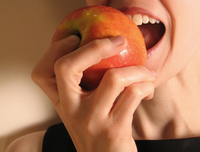
MASTICATION
Cutting the food substances into small particles and grinding them into a soft bolus is called mastication .

Slide 6
Mastication of food is the initial stage in the process of digestion.
It is the first step of digestion and it increases the surface area of foods to allow more efficient break down by enzymes.

Slide 7
During the mastication process, the food is positioned between the teeth for grinding by the cheek and tongue.

Slide 8
SIGNIFICANCE OF MASTICATION
Breakdown of foodstuffs into smaller particles.
Mixing of saliva with food substances thoroughly.
Lubrication and moistening of dry food by saliva so that, the bolus can be easily swallowed.
Appreciation of taste of the food.

Slide 9
Jaw moves downward slowly
Fast opening phase
Jaw moves upward in a fast closing phase
Slow closing during which the food is crushed
CHEWING CYCLE
Jaw moves downward slowly
Fast opening phase
Jaw moves upward in a fast closing phase
Slow closing during which the food is crushed
CHEWING
CYCLE

Slide 10
Chewing in humans is actually asymmetrical and unilateral.
At the working side –It possesses the greatest adductor force but articular emminence is less substantially loaded.
At the balancing side –It possesses the less adductor force and the articular emminence is substantially loaded.

Slide 11
At the initial action , contraction of inferior head of lateral pterygoid muscle occurs to initiate mandibular deviation to working side.

Slide 12
Mastication : The crushing & grinding
1 chewing cycle
= opening + closing + power stroke
chewing sequence
= numerous chewing cycle
chewing sequence could be divided into
preparatory series
reduction series
pre-swallow series

Slide 13
The masticatory sequence consists of a number of chewing cycles and extends from ingestion to swallowing.
The masticatory sequence can be divided into three consecutive periods –

Slide 14
1)Initial and preparatory period – food is transported back to the posterior teeth.
2) Reduction period – food is ground during this period.
3) Preswallowing period – The bolus is then formed during this period.

Slide 15
Chewing

Slide 16
Chewing

Slide 17
During chewing the tongue plays an essential role in controlling the movement of the food and forming the bolus .
For food to be broken down , it is positioned by the tongue in conjunction with the buccinator muscles of the cheek between the occlusal surfaces of the teeth.

Slide 18
The tongue is important in collecting and sorting food that is suitable for swallowing , while returning larger pieces of food to the occlusal table for further reduction.

Slide 19
Extrinsic Tongue Muscles

Slide 20
Tongue
Consist of 2 groups: intrinsic and extrinsic muscles.
Intrinsic muscle: change in tongue shape
Extrinsic muscle (eg. Genioglossus): response for protrusion and retrusion of the tongue Three major muscles that anchor and move the tongue

Slide 21
Innervated by cranial nerve XII (hypoglossal nerve)
Complete tongue activity occurs in jaw movements and respiration, speech, taste, mastication, swallowing, and sucking.

Slide 22
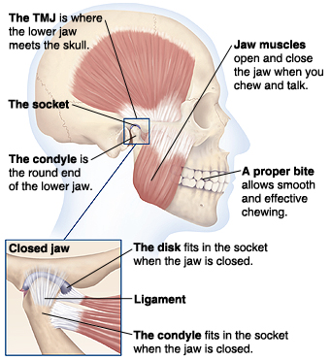

Slide 23
Summary
Definition
Significance of mastication
Chewing cycle
Masticatory sequence
Muscles of mastication
Muscle activity

Slide 24
BIBLIOGRAPHY
Wheeler’s Dental Anatomy, Physiology and Occlusion Ash, M. M. 6th edition.
Oral Development and Histology Avery, j. K.1st edition.
Color Atlas And Text Book Of Oral Anatomy, Histology Berkovitz, B. 1ST edition.
Dental Embryology, Histology & Anatomy. Marry Bath- Balogh Inergaret. 2nd edition.

Slide 25
THANK YOU !!

