Slide 1
Histochemistry
Dept.of Oral Pathology
& Microbiology

Slide 2
Purpose Statement
At the end of the lecture student should be able to describe the
Processing Technique
Procedure For Ground Sections
Advantages and procedure of frozen sections
Maintenance of laboratories
Advantages and procedure of microwave fixation

Slide 3
Learning Objectives
At the end of the lecture the student should be able to
S.N. | Learning Objectives | Domain | Level | Criteria | Condition
1 | Enumerate Processing Technique | Cognitive | Desirable to Know | All
2 | Enumerate steps in procedure For Ground Sections | Cognitive & Psychomotor | Desirable to Know | All
3 | Enumerate Advantages and procedure of frozen sections | Cognitive | Nice to Know | All
4 | Give maintenance of laboratories | Cognitive | Nice to Know | All
5 | Give advantages and procedure of microwave fixation | Cognitive | Nice to Know | All

Slide 4
PROCESSING TECHNIQUE

Slide 5
Wax embedding
Formalin fixation. - 24 Hr
70% alcohol - 30 mins
80% alcohol - 30 mins
95% alcohol - 30 mins
95% alcohol - 1 hr
100% alcohol - 1 hr
100% alcohol - 1 hr
100% alcohol - 1 hr
Xylene - 1 hr
Xylene - 1 hr
Wax bath - 2 hr
Wax bath - 2 hr
Embedding

Slide 6
Wax embedding (Rapid technique)
Carnoy’s fluid - 45 mins
100% alcohol x6 - 15 mins each
Xylene - 10 mins
Xylene - 15 mins
Wax - 20 mins
Wax - 45 mins

Slide 7
Acrylic embedding
Fixation
Rinse in buffer.
Dehydration with increasing conc of alcohol, for 15-30 mins each.
Impregnating solution for 1 hour
Embedding in medium.

Slide 8
Epoxy embedding
Dehydration: Ethanol or acetone.
Infiltration with transitional solvent.
Gentle agitation.
Embedding and curing.

Slide 9
BLOCK FORMING
Mold prepared.
Wax poured.
Tissue placement and orientation.
Labeling.
Immersion in cold water.

Slide 10
AUTOMATIC PROCESSOR

Slide 11
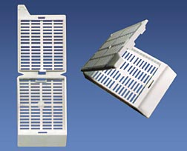
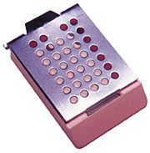
Processing cassette
Made of Acetyl polymer
Metal processing cassette

Slide 12
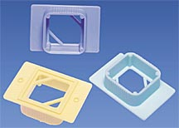
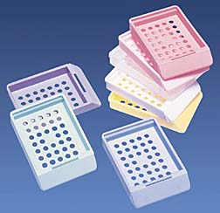
Embedding rings
Made of Polystyrene
Embedding cassette
Made of Polypropylene

Slide 13
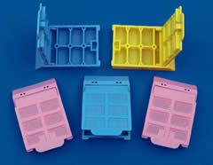
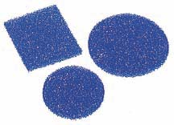
Micro processing cassette
Polyester urethane foam pads

Slide 14
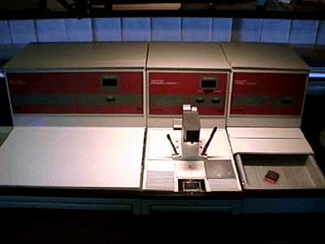
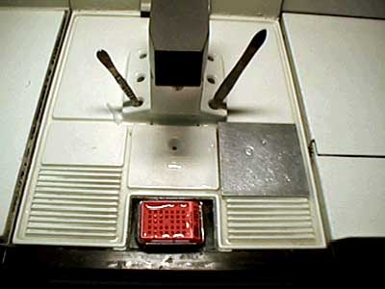

Slide 15
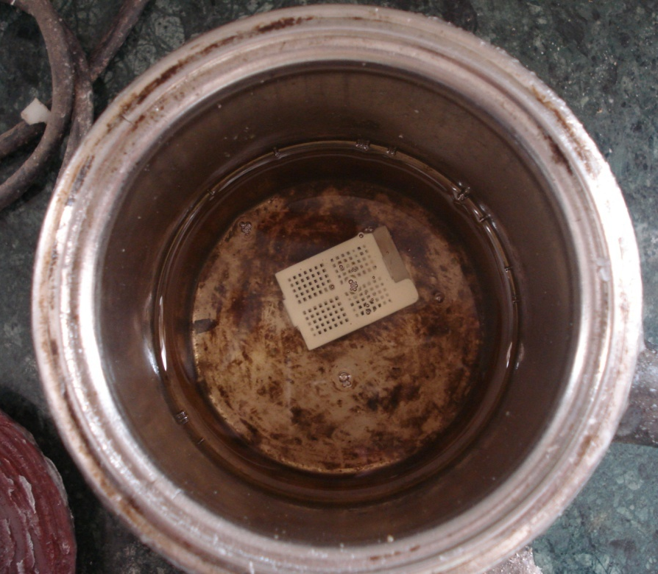
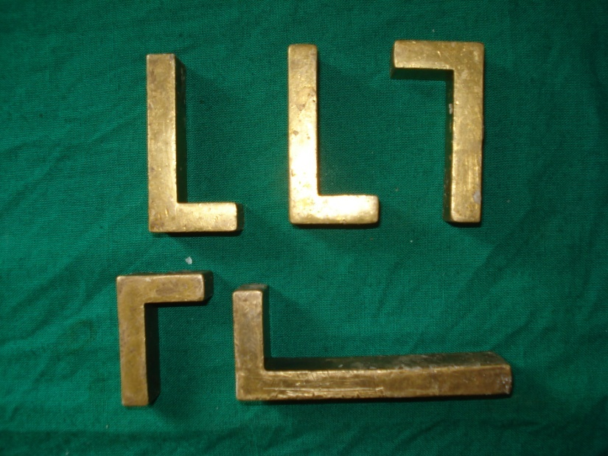

Slide 16
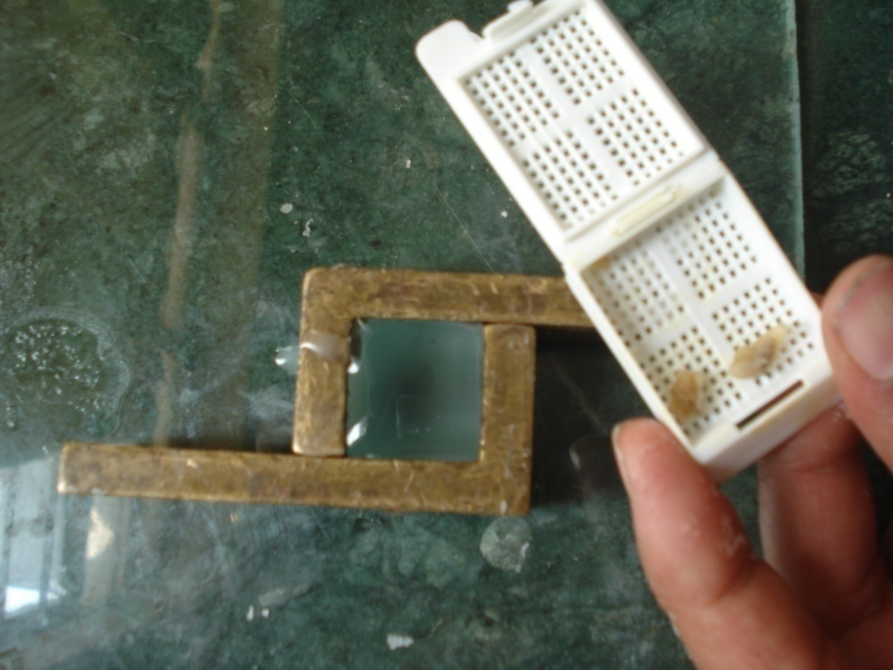
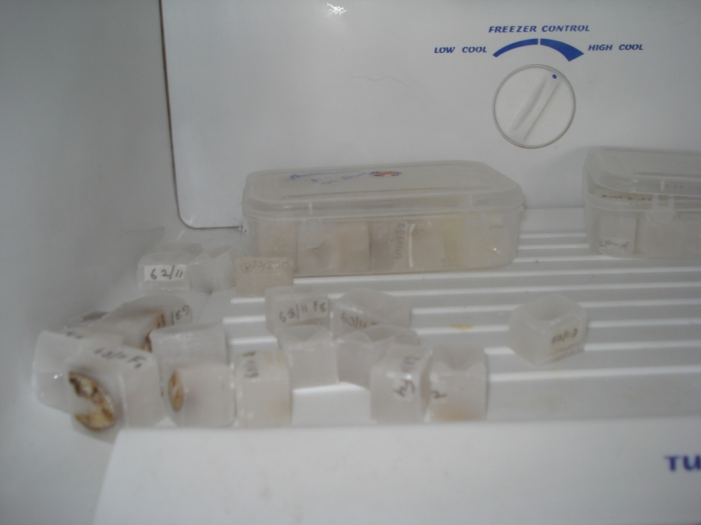
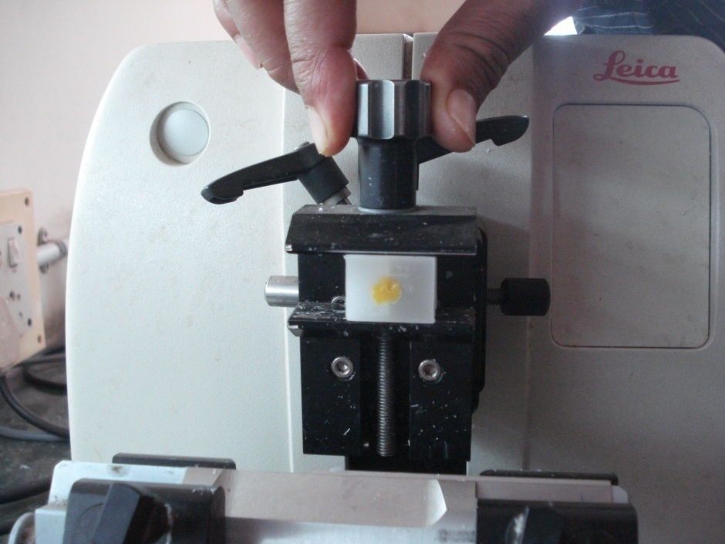

Slide 17
Procedure For Ground Sections
Equipment – Lathe
Coarse & Fine
Spray of water,
Wooden block & adhesive tape.
Hold tooth adjacent to a rotating coarse-abrasive wheel.
Reduce half of the tooth surface
On a wooden block wrap adhesive tape with the adhesive end facing outward.

Slide 18
Stick the ground surface of the tooth over the wooden block & grind the opposite surface.
Grind the tooth to approx. thickness of 0.5mm.
Use the fine abrasive wheel for further grinding the section till it becomes as thin as desired. (approx. 30-50µm.)

Slide 19
Ground section is soaked in ether/alcohol to remove water.
Mounted on a slide & viewed under the microscope

Slide 20
Frozen sections
Rapid diagnosis.
Study of tissues lost during conventional processing.
Tissue components that are heat liable.
Immunoflourescent study.
SEM
IHC
.

Slide 21
PROCEDURE
Fresh unfixed tissues are cut into 10-15µm sections by freezing the block of tissue with liquid/solid carbon dioxide
Quench tissue at -160 Deg C
Drying: Vacuum 133mPa
Fixation: Vapors
Embedding: Wax

Slide 22
Lab maintainance
Changing of solutions.
Depends on No. & Vol. of tissue.
Changed at least every week.
Downgrade solutions.
Storage & Disposal of solutions.

Slide 23
General advice
If at any stage it is felt that the processing has been done inadequately or erroneously tissue is to be transferred to a sealed container containing,
70% alcohol - 70 ml
Glycerol - 30 ml
Dithionite - 1 gm
And kept overnight. Processing to be started afresh.

Slide 24
MICROWAVE PROCESSING
PRINCIPLE
The usage of microwave energy to speed up the process of diffusion of liquids in and out of the specimen.

Slide 25
PROCEDURE
Dehydration done in one step.
67 Deg C - 5 mins
Addition of intermedium.
74 Deg C - 3 mins
Paraffin added in liquid form.
Paraffin brought to boiling point of intermedium to flash evaporate the same.
60 Deg C – 2 mins
85 Deg C - 5 mins
Embedding in paraffin.

Slide 26
ADVANTAGES
Time and material saviour:
100% ethyl alcohol for dehydration.
Isopropanol for inter-medium.
Liquid paraffin at 67 Deg C.
Liquid paraffin at 82 Deg C.
Eliminates the usage of Xylene.

Slide 27
Summary
Processing Technique
Procedure For Ground Sections
Advantages and procedure of frozen sections
Maintenance of laboratories
Advantages and procedure of microwave fixation

Slide 28
bibliography
Oral Development and Histology Avery, j. K.1st edition.
Cellular Pathology TechniqueCulling Barr Allison 4th edi
Theory & Practice of Histological Techniques John D Bancroft 6th edi
Orban's Oral Histology and Embryology Bhaskar, s. N.11th edition.
Oral Histology : Development, Structure and Funct Tencate, a. R. 4th edition.
Dental Embryology, Histology & Anatomy. Marry Bath- Balogh Inergaret. 2nd edition.

Slide 29
Thank You

