Slide 1
Histochemistry
Dept Of Dental Anatomy, Embryology & Histology

Slide 2
Purpose Statement
At the end of the lecture student should be able to describe the
Classification of fixatives
Various dehydrating and clearing agents and their functions
Techniques of impregnation and embedding
Processing technique and formation of wax block

Slide 3
Learning Objectives
At the end of the lecture the student should be able to
S.N. | Learning Objectives | Domain | Level | Criteria | Condition
1 | Give classification of fixatives | Cognitive | Nice to know | All
2 | Enumerate Various dehydrating and clearing agents and their functions | Cognitive & Psychomotor | Nice to know | All
3 | Enumerate techniques of impregnation and embedding | Cognitive | Nice to know | All
4 | Describe processing technique and formation of wax block | Cognitive | Nice to Know | All

Slide 4
Classification of Fixatives.
Baker’s Classification(1960):
Coagulants.
Non-Coagulants.
Hopwood’s Classification:
Aldehydes: Formaldehyde, Glutaraldehyde, Acrolein, Glyoxal.
Oxidizing Agents: Osmium tetraoxide, Potassium permanganate, Potassium dichromate.
Protein-Denaturing Agents(Coagulants): Acetic acid, Methyl alcohol, Ethyl alcohol.

Slide 5
Other Cross Linking Agents: Carbodiimides.
Physical Agents: Heat, Microwaves.
Miscellaneous: Mercuric chlorides, Picric acid, non-aldehyde containing fixatives, Dye stuffs.

Slide 6
Reaction of Fixatives with PROTEINS:
The most important reactions for maintaining morphology are those which stabilize the Proteins.
Fixatives have the property of forming crosslinks between proteins, thereby forming a gel.
Soluble proteins are fixed to structural proteins & thus rendered insoluble.

Slide 7
Reaction of Fixatives with NUCLEIC ACIDS:
Fixation of tissues brings about a change in the chemical & physical state of DNA & RNA.
Ethanol & Methanol are commonly used in fixative solutions for Nucleic Acids. They bring about little chemical change.

Slide 8
Reaction of Fixatives with LIPIDS:
More difficult to manipulate & analyse biochemically than proteins.
They are largely removed during preparation of tissues.
Frozen section should be usedto demonstrate lipids.

Slide 9
Reaction of Fixatives with CARBOHYDRATES:
Losses of glycogen can be high yet they are satisfactory for diagnosis.
Alcoholic fixatives recommended.

Slide 10
Hydrogen Ion Concentration(pH):
Physiological range of pH is adjusted by suitable buffer.
pH: 6-8
Specific purpose-Specific pH.
TEMPERATURE:
Room temperature preferable.
Electron microscopy & some histochemistry : 0-4degree C

Slide 11
PENETRATION:
Important phenomenon
As process is slow, blocks taken should be Small.
OSMOLALITY:
Hypertonic solution give rise to cell shrinkage.
Isotonic & Hypotonic solution results in cell swelling & poor fixation.

Slide 12
CHANGES IN VOLUME:
Tissues fixed in Formaldehyde & embedded in paraffin wax shrink by some 33%.
Prolonged fixation in formalin can give rise to Secondary Shrinkage.
CONCENTRATION:
Most commonly used are Formaldehyde (gas) as 4% buffered Formaldehyde or 10% buffered Formalin.
Glutaraldehyde is normally used as 3% solution.

Slide 13
Duration:
Duration:2-6hours.
Prolonged fixation in Formaldehyde is known to cause shrinkage & hardening of tissue.

Slide 14
DEHYDRATING AGENTS:
The first stage of processing is the removal of aqueous fixative fluids from the tissues. This process is known as Dehydration.
Increasing strength of agents used.
Time taken depends on vol & density of tissue.
Commonly used dehydrating fluids are: Ethanol, Denatured alcohol, Methanol, Isopropyl alcohol, Acetone.

Slide 15
CLEARING AGENTS:
To replace Dehydrating fluids:- Clearing is done.
Fluids miscible with both Dehydrating agents and paraffin wax are used.
When the dehydrating agent has been entirely replaced by most of these solvents the tissues has a translucent appearance, hence the term Clearing Agent.

Slide 16
Requisites of clearing agent are
Speedy removal of dehydrating agent.
Allow easy impregnation by molten paraffin.
Minimal tissue damage
Low toxicity
Low inflammability
Economical
Routine Clearing Agents Used: Xylene, Toluene, Chloroform, Paraffin, Methyl benzoate & Methyl salicylate, Citrus fruit oils.

Slide 17
IMPREGNATION
Done to remove clearing agent and allow embedding medium to flow in.
Impregnation agent acts as supporting medium by keeping tissue firm.
Done with or without vacuum. Vacuum used 500 mm Hg.

Slide 18
IMPREGNATION
Paraffin:
Inexpensive, easy to use, melting point 40-70 Deg C, good for 4-6 micron section.
Resin:
Used for ultrastructural studies.
Agar:
Used for small tissue, followed by paraffin embedding.
Celloidin:
Specific use.
Gelatin:
Used in frozen section.

Slide 19
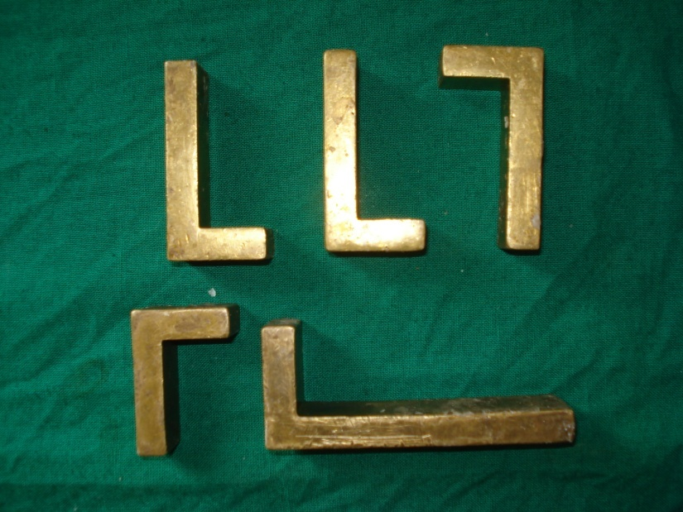
EMBEDDING
Block formation:
Paraffin embedding.
Plastic embedding -
When section thickness less than 4 micron.
More support required eg. Undecalcified bone.
Electron microscopy.
Molds:
Leuckhart’s L piece.
Glass/metal petridish.
Commercially available molds.

Slide 20
Plastic embedding
Used when Paraffin can not be used
When section thickness less than 4 micron.
More support required eg. Undecalcified bone.
Electron microscopy.

Slide 21
Types of Plastic embedding medium
Epoxy resin:
Mixture of plastic, catalyst and accelerator.
Hydrophobic and subsequent oxidation by peroxidase causes tissue damage.
Catalyst reduces antigenicity.
Sensitization of handlers.
Toxic.
Long curing time.
Used in TEM.

Slide 22
Embedding medium
Polyester plastic: not used anymore.
Acrylic plastic:
Commonly used.
Allows for various staining procedures.

Slide 23
Orientation
Embedding blocks of homogeneous tissue from large organs such as liver, kidney and brain usually presents no problem. There are, however, structures which require special attention.

Slide 24
Epithelium:- Skin or mucosa covered tissue must be cut at right angles to the surface, so that the full thickness of the epithelium is visualized. Wedge-shaped biopsies may present special problems.

Slide 25
Muscle biopsies:- Muscle should be embedded so that both longitudinal and transverse sections are obtained.
Tubular structures:- should be sectioned at right angles so that the lumen is clearly visible
A particular tissue feature may be present on one aspect only.

Slide 26
Summary
Classification of fixatives
Various dehydrating and clearing agents and their functions
Techniques of impregnation and embedding
Processing technique and formation of wax block

Slide 27
BIBLIOGRAPHY
Oral Development and Histology Avery, j. K.1st edition.
Cellular Pathology TechniqueCulling Barr Allison 4th edi
Theory & Practice of Histological Techniques John D Bancroft 6th edi
Orban's Oral Histology and Embryology Bhaskar, s. N.11th edition.
Oral Histology : Development, Structure and Funct Tencate, a. R. 4th edition.
Dental Embryology, Histology & Anatomy. Marry Bath- Balogh Inergaret. 2nd edition.

Slide 28
Thank You

