Slide 1
Histochemistry
Dept Of Dental Anatomy, Embryology & Histology

Slide 2
Purpose Statement
At the end of the lecture student should be able to describe the
Composition of tissues
Histochemical techniques

Slide 3
Learning Objectives
At the end of the lecture the student should be able to
S.N. | Learning Objectives | Domain | Level | Criteria | Condition
1 | Write about the composition of different tissues | Cognitive | Nice to know | All
2 | Write in detail about various procedures in histotechnique | Cognitive | Nice to know | All

Slide 4
Definition : Study of qualitative identification & quantitative assessment of chemical groups within cell, tissues & their histology.

Slide 5
Oral soft tissues are composed of epithelium, connective tissue and associated glands
Connective tissue – Ground substance.
- cells & fibers.
Hard tissues

Slide 6
Composition of tissues
Epithelium
Cells – form the basis of exfoliative cytology
Salivary glands – staining of mucins
Epithelial component of tooth germ.
Enzymes
Mostly alkaline PO₄ & acid PO_{4.}

Slide 7
Connective Tissue
Ground Substance- mixture of macromolecules. Interact with other cells & fibers composed of -
Proteoglycans – protein core & GAG side chain. GAG’s – unsulfated (hyaluronic acid)
- sulfated (heparan SO₄)
Glycoproteins – fibronectin, laminin, chondronectin, osteonectin etc.

Slide 8
Hard tissues – bone – carbohydrates & protein
- enamel
- dentin
- cementum

Slide 9
Introduction
For microscopic examination, the specimen must be thin enough to permit the passage of transmitted light & ,
For Detailed morphological examination, no more than one cell thickness.

Slide 10
Tissue slices approx. 4-6 µm,
Highly cellular tissues such as lymph node -2-3 µm.
Larger cells & processes (nervous system) 10 –20 µm.

Slide 11
Section cutting or microtomy- Preparation of thin slices of tissues
Tissue processing- Preparatory treatment for impregnation of the specimen with an embedding medium to provide support & suitable consistency for microtomy.

Slide 12
Paraffin-wax processing & embedding
Since most of the tissue fixatives employed are in aqueous solution, the water has to be removed in order to embed the tissue in paraffin wax.
This is generally achieved by immersion in increasing strengths of ethyl alcohol (ethanol), & is known as dehydration.

Slide 13
Alcohol and wax are not miscible
Clearing- Alcohol must be replaced by a wax solvent
Majority of wax solvents have the effect of raising the refractive index of tissue, which makes them appear clear-Clearing

Slide 14
Histochemical Techniques
Processing tissue for microscopic examination.
Aim- To embed the tissue in a solid medium firm enough to support the tissue and give it sufficient rigidity to enable thin sections to be cut and yet soft enough not to damage the knife or tissue.

Slide 15
Hard tissue – Ground section.
- Decalcified section.
- Parloidin embedded & sectioning.
Soft tissue – Paraffin embedding.
- Frozen sections.

Slide 16
Preparation of sections for paraffin-embedded specimen
Obtaining the specimen
Fixation of the specimen-Hard tissue- Decalcification
- Soft tissue
Dehydration of the specimen.
Clearing of the specimen.
Infiltration with paraffin.
Embedding the specimen.
Cutting sections.
Mounting cut sections.
Staining the sections.

Slide 17
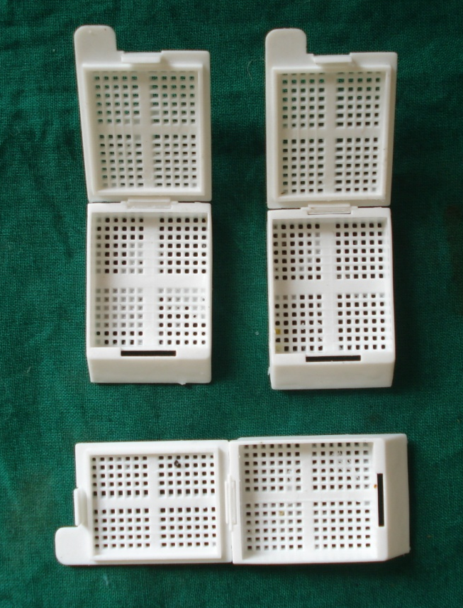
Obtaining the specimen
Assigning proper Biopsy number

Slide 18
Fixation
The purpose of fixation is the preservation of cells and tissue constituents in a condition identical to that existing during life and to keep in such a way that will allow the preparation of thin, stained sections.

Slide 19
aims of fixation are:
To prevent or arrest autolysis and bacterial decomposition and putrefaction.
To so coagulate the tissue as to prevent loss of easily diffusible substances.
To fortify the tissue against the deleterious effects of the various stages in the preparation of sections.

Slide 20
4. To leave the tissue in a condition which facilitates differential staining with dyes and other reagent.
5. Normal tissue processing requires 10% neutral buffered formalin.

Slide 21
Factors Affecting Fixation
Hydrogen Ion Concentration(pH).
Temperature.
Penetration.
Osmolality.
Changes in Volume.
Concentration.
Duration.

Slide 22
CLASSIFICATION
I. Based on Processing technique:
Conventional (Wax)
Plastic
Microwave
Frozen
II. Based on Microscope to be used:
Electron microscope
Light microscope
III. Based on Technique:
Automatic
Manual

Slide 23
PRINCIPLE
To embed the tissue in a solid medium firm enough to support the tissue
To give it sufficient rigidity to enable thin sections to be cut and yet soft enough not to damage the knife or tissue.

Slide 24
FACTORS AFFECTING
Agitation: Reduces time by 30%
Heat: Upto 45 deg C
Viscosity
Vacuum: Dense & Fatty tissue

Slide 25
Classification of Fixatives.
Baker’s Classification(1960):
Coagulants.
Non-Coagulants.
Hopwood’s Classification:
Aldehydes: Formaldehyde, Glutaraldehyde, Acrolein, Glyoxal.
Oxidizing Agents: Osmium tetraoxide, Potassium permanganate, Potassium dichromate.
Protein-Denaturing Agents(Coagulants): Acetic acid, Methyl alcohol, Ethyl alcohol.

Slide 26
Other Cross Linking Agents: Carbodiimides.
Physical Agents: Heat, Microwaves.
Miscellaneous: Mercuric chlorides, Picric acid, non-aldehyde containing fixatives, Dye stuffs.

Slide 27
Reaction of Fixatives with PROTEINS:
The most important reactions for maintaining morphology are those which stabilize the Proteins.
Fixatives have the property of forming crosslinks between proteins, thereby forming a gel.
Soluble proteins are fixed to structural proteins & thus rendered insoluble.

Slide 28
Reaction of Fixatives with NUCLEIC ACIDS:
Fixation of tissues brings about a change in the chemical & physical state of DNA & RNA.
Ethanol & Methanol are commonly used in fixative solutions for Nucleic Acids. They bring about little chemical change.

Slide 29
Reaction of Fixatives with LIPIDS:
More difficult to manipulate & analyse biochemically than proteins.
They are largely removed during preparation of tissues.
Frozen section should be usedto demonstrate lipids.

Slide 30
Reaction of Fixatives with CARBOHYDRATES:
Losses of glycogen can be high yet they are satisfactory for diagnosis.
Alcoholic fixatives recommended.

Slide 31
Hydrogen Ion Concentration(pH):
Physiological range of pH is adjusted by suitable buffer.
pH: 6-8
Specific purpose-Specific pH.
TEMPERATURE:
Room temperature preferable.
Electron microscopy & some histochemistry : 0-4degree C

Slide 32
PENETRATION:
Important phenomenon
As process is slow, blocks taken should be Small.
OSMOLALITY:
Hypertonic solution give rise to cell shrinkage.
Isotonic & Hypotonic solution results in cell swelling & poor fixation.

Slide 33
CHANGES IN VOLUME:
Tissues fixed in Formaldehyde & embedded in paraffin wax shrink by some 33%.
Prolonged fixation in formalin can give rise to Secondary Shrinkage.
CONCENTRATION:
Most commonly used are Formaldehyde (gas) as 4% buffered Formaldehyde or 10% buffered Formalin.
Glutaraldehyde is normally used as 3% solution.

Slide 34
Duration:
Duration:2-6hours.
Prolonged fixation in Formaldehyde is known to cause shrinkage & hardening of tissue.

Slide 35
DEHYDRATING AGENTS:
The first stage of processing is the removal of aqueous fixative fluids from the tissues. This process is known as Dehydration.
Increasing strength of agents used.
Time taken depends on vol & density of tissue.
Commonly used dehydrating fluids are: Ethanol, Denatured alcohol, Methanol, Isopropyl alcohol, Acetone.

Slide 36
CLEARING AGENTS:
To replace Dehydrating fluids:- Clearing is done.
Fluids miscible with both Dehydrating agents and paraffin wax are used.
When the dehydrating agent has been entirely replaced by most of these solvents the tissues has a translucent appearance, hence the term Clearing Agent.

Slide 37
Requisites of clearing agent are
Speedy removal of dehydrating agent.
Allow easy impregnation by molten paraffin.
Minimal tissue damage
Low toxicity
Low inflammability
Economical
Routine Clearing Agents Used: Xylene, Toluene, Chloroform, Paraffin, Methyl benzoate & Methyl salicylate, Citrus fruit oils.

Slide 38
IMPREGNATION
Done to remove clearing agent and allow embedding medium to flow in.
Impregnation agent acts as supporting medium by keeping tissue firm.
Done with or without vacuum. Vacuum used 500 mm Hg.

Slide 39
IMPREGNATION
Paraffin:
Inexpensive, easy to use, melting point 40-70 Deg C, good for 4-6 micron section.
Resin:
Used for ultrastructural studies.
Agar:
Used for small tissue, followed by paraffin embedding.
Celloidin:
Specific use.
Gelatin:
Used in frozen section.

Slide 40
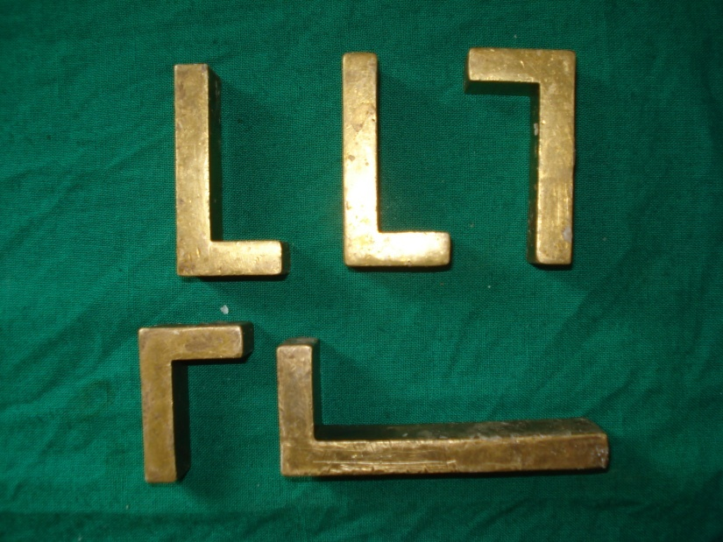
EMBEDDING
Block formation:
Paraffin embedding.
Plastic embedding -
When section thickness less than 4 micron.
More support required eg. Undecalcified bone.
Electron microscopy.
Molds:
Leuckhart’s L piece.
Glass/metal petridish.
Commercially available molds.

Slide 41
Plastic embedding
Used when Paraffin can not be used
When section thickness less than 4 micron.
More support required eg. Undecalcified bone.
Electron microscopy.

Slide 42
Types of Plastic embedding medium
Epoxy resin:
Mixture of plastic, catalyst and accelerator.
Hydrophobic and subsequent oxidation by peroxidase causes tissue damage.
Catalyst reduces antigenicity.
Sensitization of handlers.
Toxic.
Long curing time.
Used in TEM.

Slide 43
Embedding medium
Polyester plastic: not used anymore.
Acrylic plastic:
Commonly used.
Allows for various staining procedures.

Slide 44
Orientation
Embedding blocks of homogeneous tissue from large organs such as liver, kidney and brain usually presents no problem. There are, however, structures which require special attention.

Slide 45
Epithelium:- Skin or mucosa covered tissue must be cut at right angles to the surface, so that the full thickness of the epithelium is visualized. Wedge-shaped biopsies may present special problems.

Slide 46
Muscle biopsies:- Muscle should be embedded so that both longitudinal and transverse sections are obtained.
Tubular structures:- should be sectioned at right angles so that the lumen is clearly visible
A particular tissue feature may be present on one aspect only.

Slide 47
PROCESSING TECHNIQUE

Slide 48
Wax embedding
Formalin fixation. - 24 Hr
70% alcohol - 30 mins
80% alcohol - 30 mins
95% alcohol - 30 mins
95% alcohol - 1 hr
100% alcohol - 1 hr
100% alcohol - 1 hr
100% alcohol - 1 hr
Xylene - 1 hr
Xylene - 1 hr
Wax bath - 2 hr
Wax bath - 2 hr
Embedding

Slide 49
Wax embedding (Rapid technique)
Carnoy’s fluid - 45 mins
100% alcohol x6 - 15 mins each
Xylene - 10 mins
Xylene - 15 mins
Wax - 20 mins
Wax - 45 mins

Slide 50
Acrylic embedding
Fixation
Rinse in buffer.
Dehydration with increasing conc of alcohol, for 15-30 mins each.
Impregnating solution for 1 hour
Embedding in medium.

Slide 51
Epoxy embedding
Dehydration: Ethanol or acetone.
Infiltration with transitional solvent.
Gentle agitation.
Embedding and curing.

Slide 52
BLOCK FORMING
Mold prepared.
Wax poured.
Tissue placement and orientation.
Labeling.
Immersion in cold water.

Slide 53
AUTOMATIC PROCESSOR

Slide 54
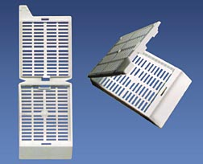
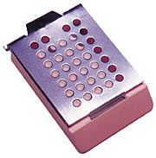
Processing cassette
Made of Acetyl polymer
Metal processing cassette

Slide 55
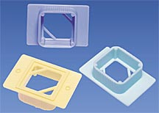
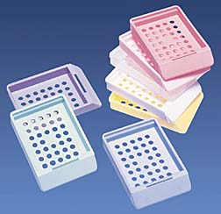
Embedding rings
Made of Polystyrene
Embedding cassette
Made of Polypropylene

Slide 56
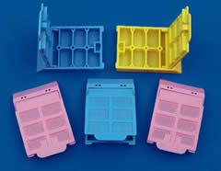
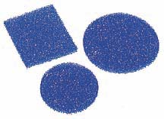
Micro processing cassette
Polyester urethane foam pads

Slide 57
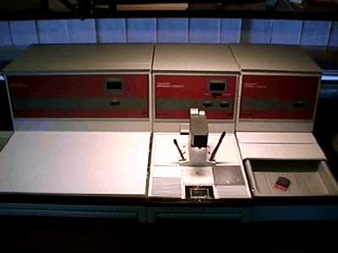
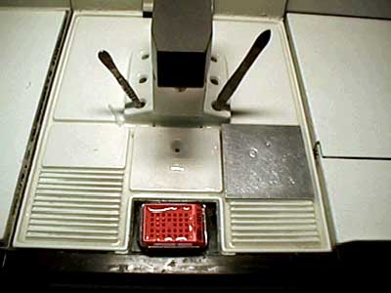

Slide 58
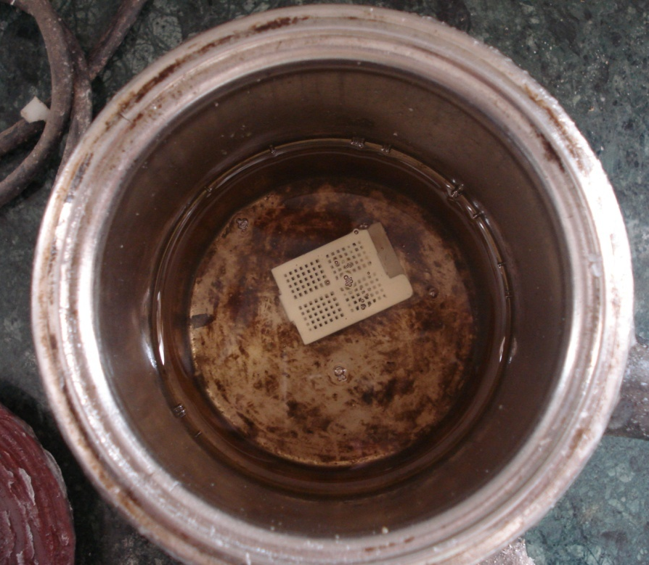

Slide 59
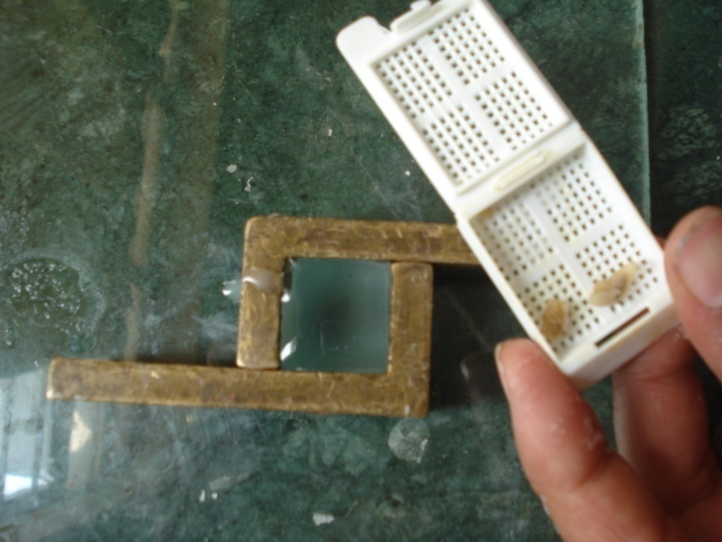
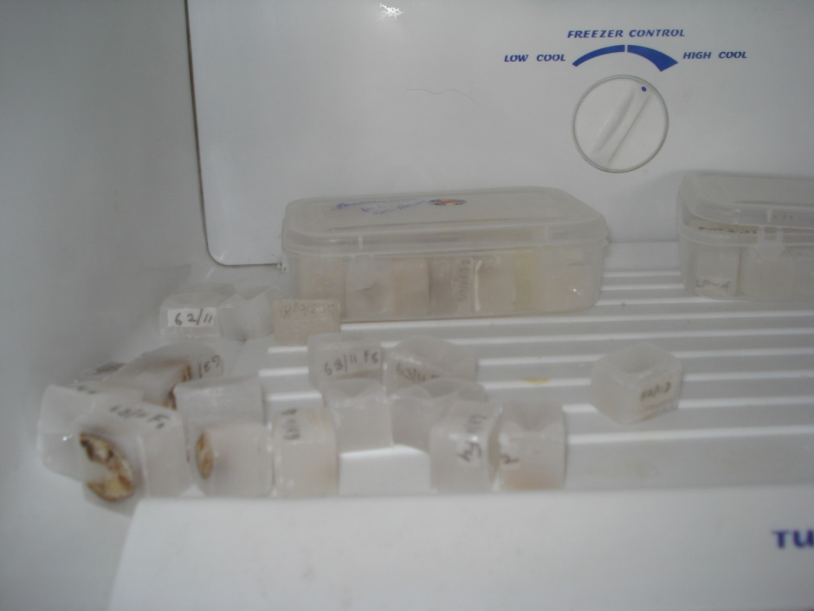
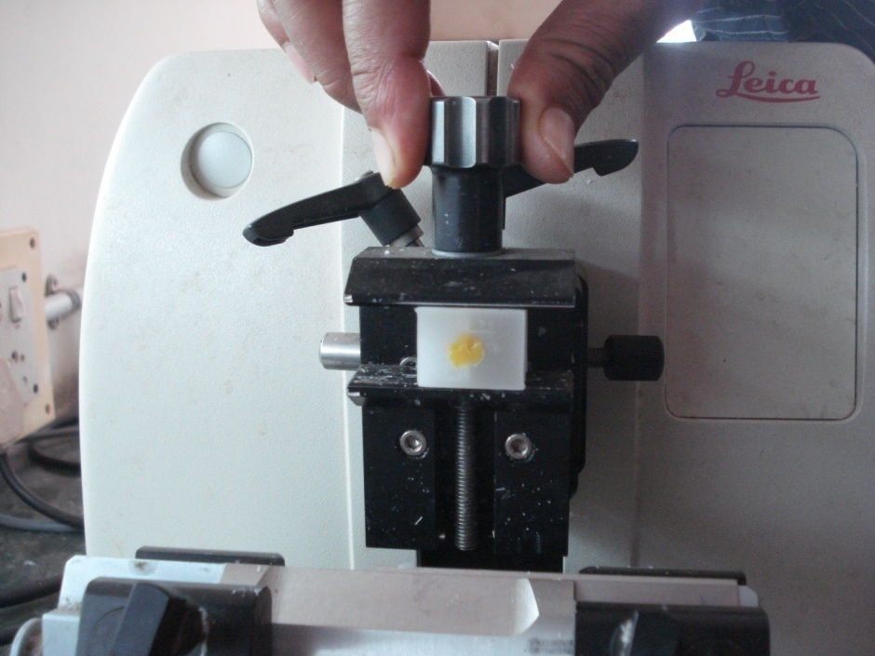

Slide 60
Procedure For Ground Sections
Equipment – Lathe
Coarse & Fine
Spray of water,
Wooden block & adhesive tape.
Hold tooth adjacent to a rotating coarse-abrasive wheel.
Reduce half of the tooth surface
On a wooden block wrap adhesive tape with the adhesive end facing outward.

Slide 61
Stick the ground surface of the tooth over the wooden block & grind the opposite surface.
Grind the tooth to approx. thickness of 0.5mm.
Use the fine abrasive wheel for further grinding the section till it becomes as thin as desired. (approx. 30-50µm.)

Slide 62
Ground section is soaked in ether/alcohol to remove water.
Mounted on a slide & viewed under the microscope

Slide 65
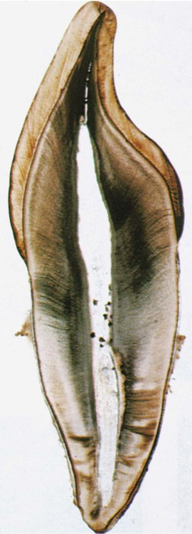

Slide 67
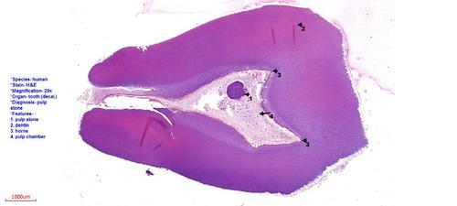

Slide 68
Frozen sections
Rapid diagnosis.
Study of tissues lost during conventional processing.
Tissue components that are heat liable.
Immunoflourescent study.
SEM
IHC
.

Slide 69
PROCEDURE
Fresh unfixed tissues are cut into 10-15µm sections by freezing the block of tissue with liquid/solid carbon dioxide
Quench tissue at -160 Deg C
Drying: Vacuum 133mPa
Fixation: Vapors
Embedding: Wax

Slide 70
Lab maintainance
Changing of solutions.
Depends on No. & Vol. of tissue.
Changed at least every week.
Downgrade solutions.
Storage & Disposal of solutions.

Slide 71
General advice
If at any stage it is felt that the processing has been done inadequately or erroneously tissue is to be transferred to a sealed container containing,
70% alcohol - 70 ml
Glycerol - 30 ml
Dithionite - 1 gm
And kept overnight. Processing to be started afresh.

Slide 72
MICROWAVE PROCESSING
PRINCIPLE
The usage of microwave energy to speed up the process of diffusion of liquids in and out of the specimen.

Slide 73
PROCEDURE
Dehydration done in one step.
67 Deg C - 5 mins
Addition of intermedium.
74 Deg C - 3 mins
Paraffin added in liquid form.
Paraffin brought to boiling point of intermedium to flash evaporate the same.
60 Deg C – 2 mins
85 Deg C - 5 mins
Embedding in paraffin.

Slide 74
ADVANTAGES
Time and material saviour:
100% ethyl alcohol for dehydration.
Isopropanol for inter-medium.
Liquid paraffin at 67 Deg C.
Liquid paraffin at 82 Deg C.
Eliminates the usage of Xylene.

Slide 75
Summary
Processing Technique
Procedure For Ground Sections
Advantages and procedure of frozen sections
Maintenance of laboratories
Advantages and procedure of microwave fixation

Slide 76
bibliography
Oral Development and Histology Avery, j. K.1st edition.
Cellular Pathology TechniqueCulling Barr Allison 4th edi
Theory & Practice of Histological Techniques John D Bancroft 6th edi
Orban's Oral Histology and Embryology Bhaskar, s. N.11th edition.
Oral Histology : Development, Structure and Funct Tencate, a. R. 4th edition.
Dental Embryology, Histology & Anatomy. Marry Bath- Balogh Inergaret. 2nd edition.

Slide 77
Thank You

