Slide 1
HEALING OF ORAL WOUNDS
Dept of Oral Pathology & Microbiology

Slide 2
PURPOSE STATEMENT
At the end of the lecture the student should be able to:
Define the healing.
Factors affecting wound healing.
Describe Healing of gingivectomy wound

Slide 3
CONTENTS
Introduction
Healing of biopsy wounds
Healing of oral wounds

Slide 4
Introduction
The restoration of tissue architecture & function after injury - Repair/Healing
Factors affecting wound healing –
Location .
Circulatory factors.
Physical factors.

Slide 5
4. Nutritional factors.
5. Immobilisation.
6. Others – age, infection, hormones.
1. Location of wound-
Area with good vascular bed heal more rapidly

Slide 6
Immobilisation also helps in rapid healing eg. corner of mouth
2. Circulatory factors -
Anemia & Dehydration - delay healing
3. Physical factors
Severe trauma to tissue slows healing

Slide 7
Local temperature increases rate of healing through effect of circulation and cell multiplication.
Hyperthermia- healing accelerated
Hypothermia- healing delays
X-ray radiation-low doses-stimulates
high focal dose - supresses

Slide 8
4. Nutritional factors -
Hypoproteinemia - delays healing slows new fibroblasts proliferation and multiplication in the wounds
Scurvy- delays healing

Slide 9
Interruption in regulation of collagen formation of normal intercellular ground substance of the connective tissue and Interruption in formation of mucopolysaccharides
Vit. A and D- retards healing

Slide 10
Age of the Patient -
Younger patient- rapid healing
Older patient- delay healing
Infection-
Bacterial irritation- slows healing
Germ- free state- also slows healing

Slide 11
Hormonal factors -
ACTH and Cortisone- slows healing
Growth of granulation tissue was inhibited by depression of inflammatory reaction- inhibition of proliferation of new fibroblast, endothelial sprouts
Diabetes mellitus- slows healing

Slide 12
Healing of Biopsy wound-
Primary healing – Healing which occurs after excision of a small piece of a tissue with close apposition of the edges of the wound
Wound heals rapidly
Occurs in clean, uninfected, surgically incised, without much loss of cells and tissue and in which edges of wound are approximated by surgical sutures.

Slide 13
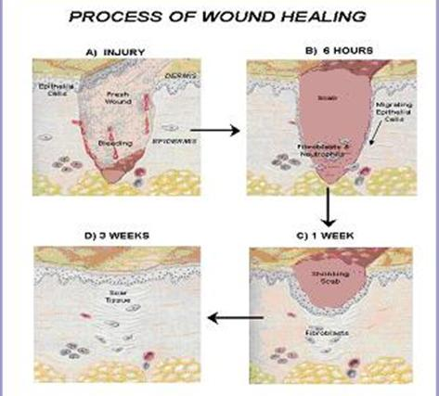

Slide 14
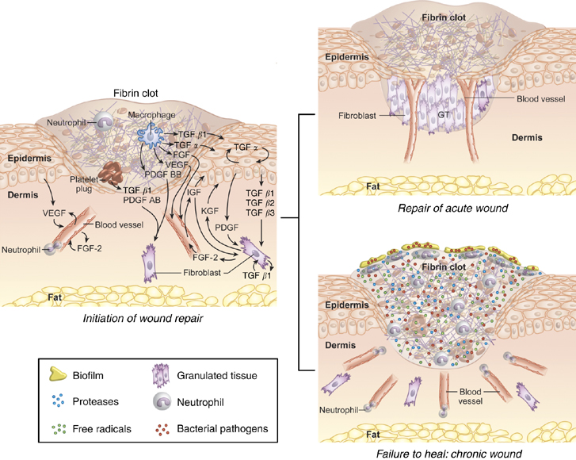

Slide 15
Events in primary healing
Initial hemorrhage – immediately bleeding which then clots
Acute inflammatory response – within 24 hrs appearance of polymorphs, which then is replace by macrophages by the 3rd day
Epithelial changes – basal layer proliferate and covers the wounds in 48 hrs

Slide 16
Organization – by 3rd day fibroblast invades, by 5th day new collagen fibrils starts forming, 4th week scar tissue forms and full epithelisation occurs.

Slide 17
Wound heals slowly and forms scar
Occurs in open wounds with large tissue defect, with extensive loss of cells and tissues and wounds not approximated by surgical sutures.
Secondary healing – healing by granulation or healing of an open wound occurs when there is loss of tissue and the edges of the wound cannot be approximated

Slide 18
Events in secondary healing
Initial haemorrhage
Acute inflammatory response
Epithelial changes
Granulation tissue formation
Wound contracture

Slide 19
Healing of Oral Wounds Gingivectomy Wound
Early healing phase –
After 2nd day- surface covered by greyish blood clot, below there is delicate connective tissue proliferation and changes preparatory to epithelization
4th day – organization and epithelization

Slide 20
Healing of Oral Wounds Gingivectomy Wound
Late healing phase –
8 to 10 days- nearly complete organization
10 to 14 days- nearly complete epithelization
2 weeks- mature epithelium formed
Healing of interproximal tissue lags behind that adjacent to the labial or buccal surfaces as the interproximal tissue must grow in from the labial and lingual areas.

Slide 21
Healing of Oral Wounds Extraction Wounds
Immediate Reaction following extraction-
Bleeding and clot formation in the socket
RBCs entrapped in the fine fibrin meshwork ends of torn BV becomes sealed off
First 24 - 48 hrs - vasodialatation and engorgement of BV, mobilisation of leukocytes

Slide 22
Healing of oral wounds extraction wounds
First week wound
Proliferation of fibroblasts from connective tissue cells in the remnants of PDL into the clot around the entire periphery (clot acts as scaffold)
Clot is gradually replace by granulation tissue

Slide 23
Epithelium shows evidence of proliferation at the periphery
Crest of alveolar bone shows beginning of osteoclastic activity
Endothelial cell proliferation in PDL

Slide 24
Summary
Definition.
Factors affecting wound healing
Healing of gingivectomy wound.

Slide 25
Thank You

Slide 26
BIBLIOGRAPHY
Text book of oral pathology Shafer's, 5 & 6th edition
Color Atlas of Oral Diseases Cawson, R. 2nd edition
Oral and Maxillofacial Pathology Neville, Brad W. 2nd
Lucas’s Pathology Of Tumor’s of the Oral Tissues
Cawson, R. A., Bennie, W. H 5th edition

