Slide 1


Slide 2
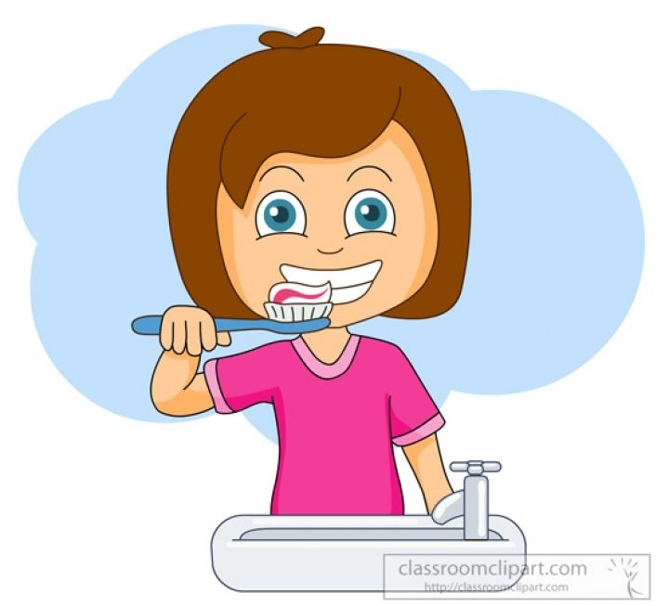

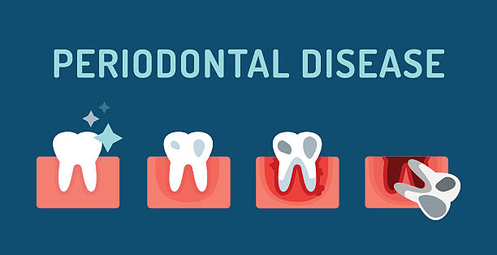
GINGIVAL DISEASES IN CHILDREN

Slide 3
Contents
Introduction
Normal Periodontium
What is Gingiva?
Anatomy of gingiva
Anatomic differences of gingiva in children and adults
Classification of gingival diseases
Epidemiology of gingival diseases in children
Gingival diseases in children & their treatment protocol
Conclusion
References

Slide 4
Introduction
Children and adolescents are subjected to a wide variety of gingival infections.
Epidemiological studies indicate that gingivitis of varying severity is nearly a universal finding in children and adolescents.
The shorter life span of the primary dentition may be the reason why in general little attention is given to periodontitis in children.

Slide 5
The early detection and early treatment of gingival diseases are important from a preventive aspect since, they have a potential to progress further, causing a severe breakdown of periodontal support.
Therefore, it is imperative that children receive a periodontal examination as part of their routine dental visit.
Furthermore, presence of destructive periodontal disease in children may be an early sign of systemic disease.

Slide 6
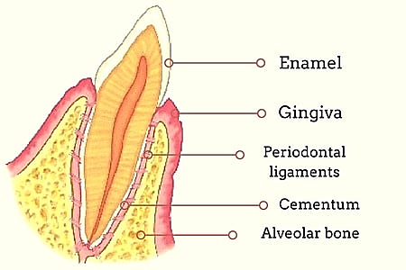
Normal Periodontium

Slide 7
What is GINGIVA??
“Gingiva is that part of oral mucous membrane that covers the alveolar bone and portions of the teeth.”
Caranza defines Gingiva as that part of the oral mucosa that covers the alveolar procesess of the jaws and surrounds the necks of teeth.
- Loe, Listgarten and Terranova 1990

Slide 8
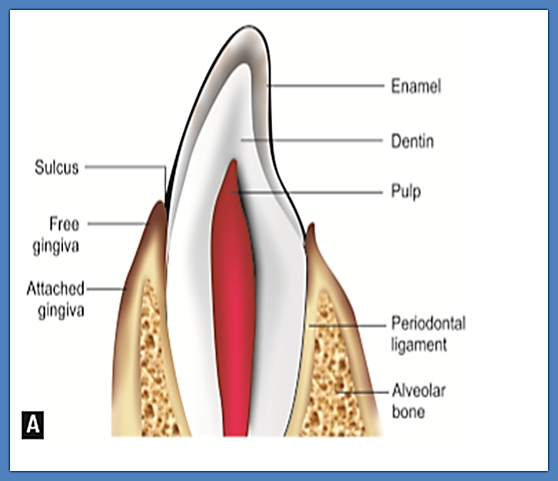
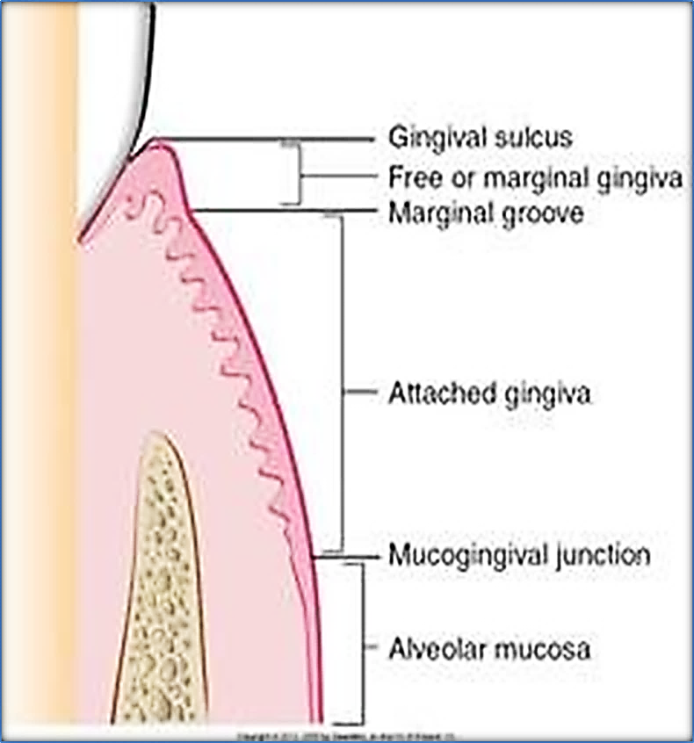
Gingiva
Marginal Gingiva
Attached Gingiva
Interdental Gingiva

Slide 9
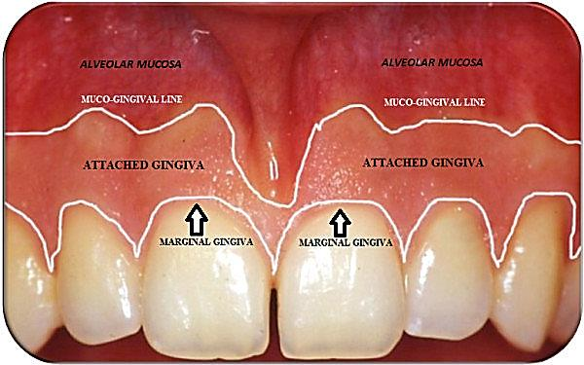
Marginal/Unattached Gingiva
Terminal edge or border of the gingiva that surrounds the teeth in collar-like fashion.
In about 50% of cases- demarcated from the adjacent attached gingiva- shallow linear depression- the free gingival groove.
Usually about 1 mm wide, and may be separated from the tooth surface with a periodontal probe.
Marginal gingiva

Slide 10
Attached Gingiva
The attached gingiva is continuous with the marginal gingiva.
It is firm, resilient, and tightly bound to the underlying periosteum of alveolar bone.
The facial aspect of the attached gingiva extends to the relatively loose and movable alveolar mucosa- demarcated by the mucogingival junction.
Notes:
The gingiva lacks stippling, due to shorter and flatter papillae from the lamina propria. Normally, stippling appears at 3 years of age and occurs in 35% of children between ages of 5 and 15 years

Slide 11
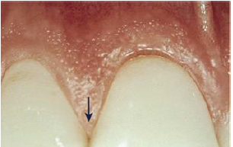
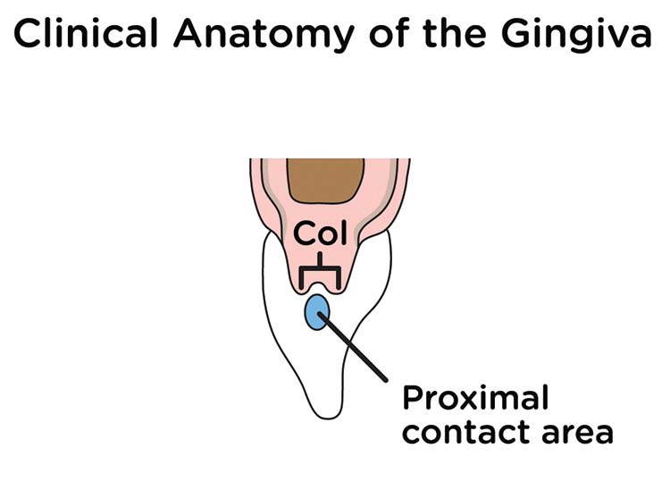
Interdental Gingiva
Occupies the gingival embrasure, which is the interproximal space beneath the area of tooth contact.
can be pyramidal, or it can have a “col” shape.
In the former, the tip of one papilla is located immediately beneath the contact point;
the latter presents a valley-like depression that connects a facial and lingual papilla- conforms to the shape of the interproximal contact (Figs. A and B).

Slide 12
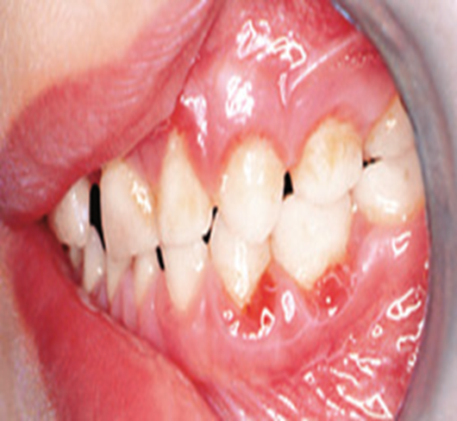
Interdental Cleft
It is normal anatomic features found in the inter-radicular zones underlying the saddle areas.

Slide 13
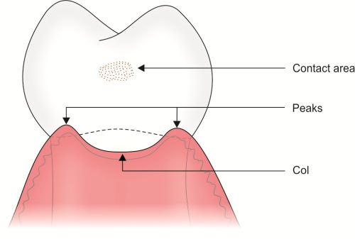
COL
Non-keratinized
Valley like depression in interdental area which connects the facial and lingual gingiva_ lies just apically of contact area
Notes:
In primary dentition, interdental spacing is common. Hence, saddle area is present with well keratinized interdental surface. This may be the reason for lower prevalence of periodontal lesions in children.

Slide 14
Anatomic differences of gingiva in children and adults:
The clinical and radiographic images of gingiva and periodontium in children and adolescent differ from those seen in adults, owing to the significant changes taking place during growth and development.
The periodontium during childhood is in constant state of change due to the exfoliation and eruption of teeth-Thus making a general description of the normal periodontium difficult (Baer and Benjamin, 1974)

Slide 15
Features Children Adults
Gingival Colour | More Reddish | Coral Pink
Consistency | Flabby | Firm and resilient
Surface Texture | Stippling absent in Infancy. Mostly seen by age of 6yrs | Stippling present
Contour of free gingival margin | Rounded & thicker | Knife edge
Notes:
Free gingival margin is rounded and thicker around primary teeth than permanent teeth, because of cervical bulge and the underlying constriction at cemento-gingival junction.

Slide 16
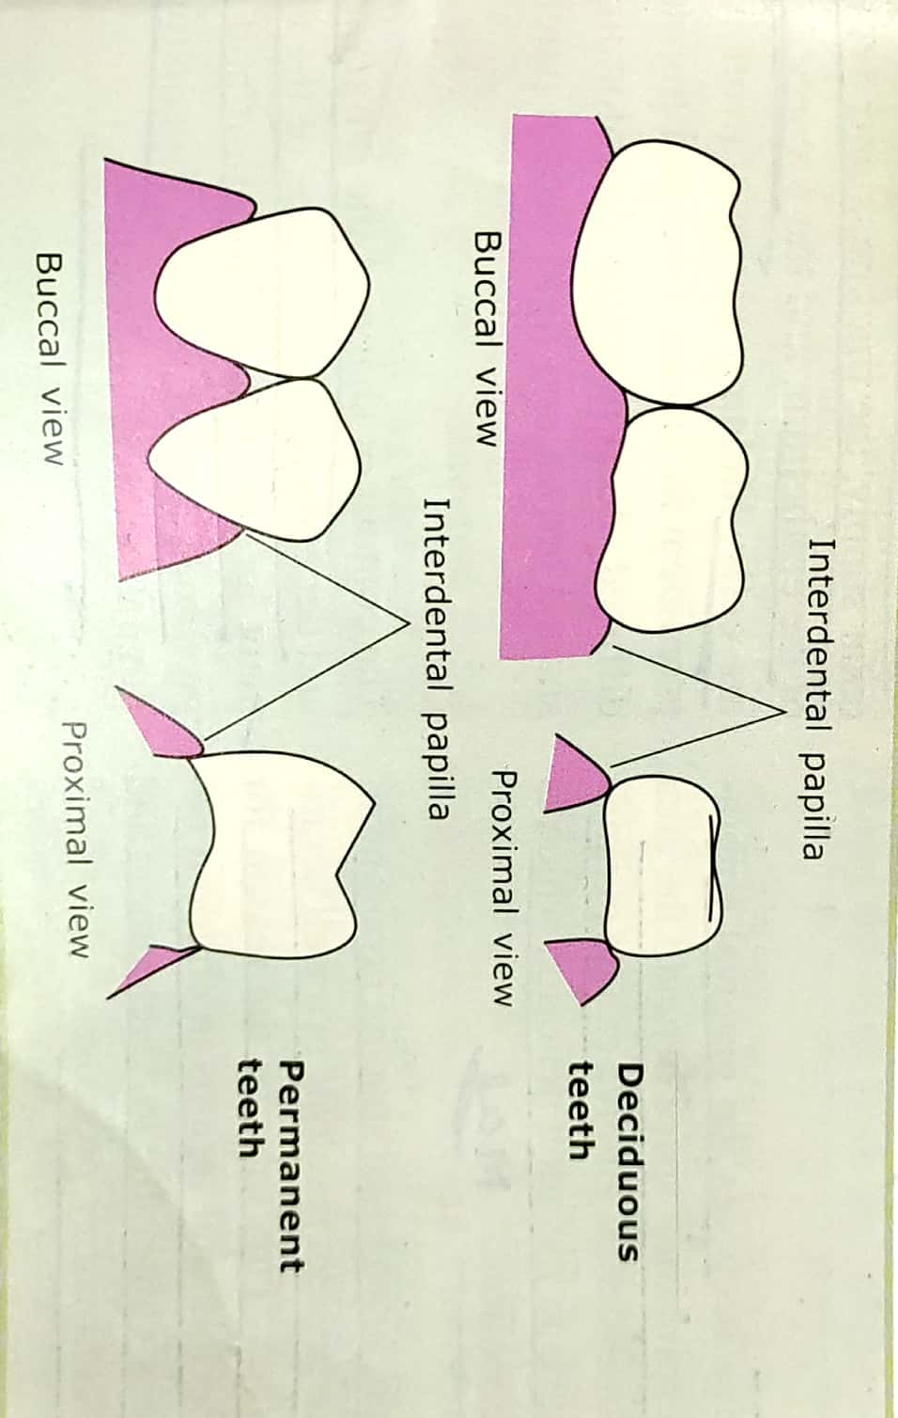
Features | Children | Adults
Interdental gingiva | (spacing is common) Saddle shaped-well keratinized | well keratinized except Col area
Gingival Sulcus | Newly erupted teeth - is greater than deciduous teeth* | 1-2mm
*Mitova et al. 2020, Mitova et al. 2018,Shayeb et al. 2014
Notes:
In primary dentition, interdental spacing is common. Hence, saddle area is present with well keratinized interdental surface. This may be the reason for lower prevalence of periodontal lesions in children.

Slide 17
Features | Children | Adults
Attached Gingiva | Width increases with age and concomitant decrease in sulcus depth less dense and redder- less keratinized epithelium with greater vascularity. More flaccid-lesser connective tissue texture is less stippled | Greater in adults More dense and pale Less flaccid More stippled
Notes:
In children, it appears less dense and redder than in adults due to
More flaccid because of and texture is less stippled.

Slide 18
PHYSIOLOGIC CHANGES IN GINGIVA ASSOCIATED WITH TOOTH ERUPTION
During the transition period in the development of the dentition,
changes associated with eruption of the permanent teeth occur in
the gingiva.

Slide 19
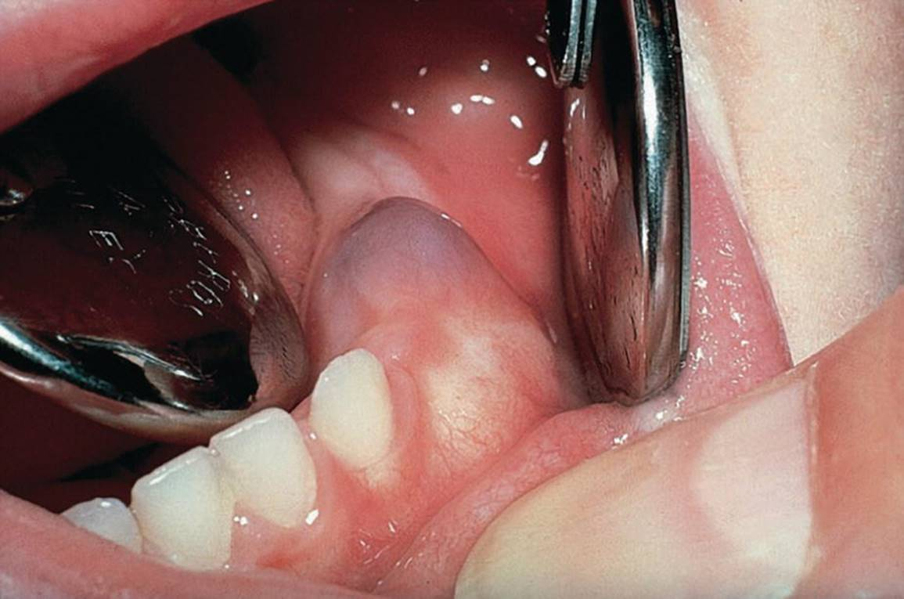
Pre-eruption bulge
Pre-eruption bulge: Before crown appears
gingiva presents firm bulge, slightly blanched and confines to contour of underlying crown.

Slide 20
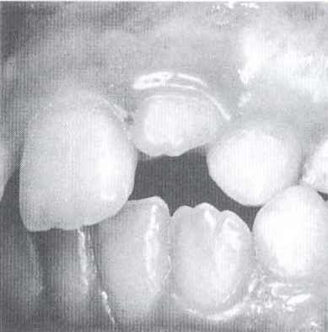
Formation of gingival margin
As the crown penetrates oral mucosa, marginal gingiva and sulcus develop.
Usually edematous, rounded and slightly reddened.

Slide 21
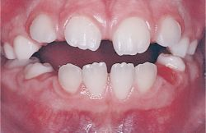
Normal prominence of gingival margin
During the period of mixed dentition it is normal for marginal gingiva around permanent teeth to be prominent, particularly maxillary anterior region.
At this stage of tooth eruption gingiva is still attached to crown
it appears prominent when superimposed on the bulk of underlying enamel..

Slide 22
Epidemiology
• The prevalence of gingivitis in developed countries was about 73% among the children between 6 and 11 years of old. This rate raises with increasing in age from 6 to 11.*
• Several studies have shown that the prevalence of gingivitis increases markedly during puberty.
• During adolescence- an increase in the prevalence of gingivitis figures varying from 50-99%.
• The prevalence of gingivitis is less in girls than boys, which is probably related the levels of oral hygiene.
* M. Ketabi , M. Tazhibi, S. Mohebrasool. The Prevalance and Risk Factors of Gingivitis Among the Children Referred to Isfahan Islamic Azad University (Khorasgan Branch) Dental School, In Iran. Dental Research Journal Vol. 3, No.1, Spring - Summer 2006.

Slide 23
Epidemiology
• In India, 67% of rural and 33% of the urban population of 5 year old children had gingivitis. This depicts the association of socio economic status. (Kaur et al., 2014)
Dhar et al. 2018, who did a study on school-going children of rural areas of India have reported 84.3% overall prevalence in gingivitis.
The overall prevalence of gingivitis was77.52% among schools children of 8-17 years of age in Lucknow region of Uttar Pradesh, India. The younger age group children had comparatively lesser percentage of gingivitis than older age group children.(Singh et al., 2014)
* M. Ketabi , M. Tazhibi, S. Mohebrasool. The Prevalance and Risk Factors of Gingivitis Among the Children Referred to Isfahan Islamic Azad University (Khorasgan Branch) Dental School, In Iran. Dental Research Journal Vol. 3, No.1, Spring - Summer 2006.

Slide 24
Classification of Gingival Diseases
Notes:
Periodontal ligament- Periodontal ligament space is wider in children…….It is less fibrous and more vascular.
Cementum- Thinner
Alveolar bone-Thinner cortical plates, Larger marrow spaces, Greater vascularity. Fewer trabeculae

Slide 25
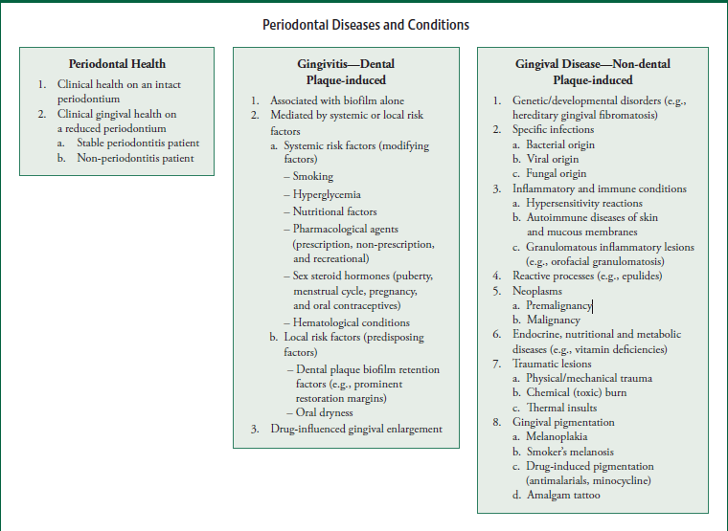
Chapple et al. 2018- Classified- GINGIVAL HEALTH AND GINGIVAL DISEASES AND CONDITIONS
1
© 2018 American Academy of Periodontol and European Federation of Periodontology. J Periodontol 2018;89(Supp 1):S74-S84. John Wiley and Sons. Available at: “https://aap.onlinelibrary.wiley.com/doi/full/10.1002/JPER.17-0719”.
Chapple ILC, Mealey BL, Van Dyke TE, et al. Periodontal health and gingival diseases and conditions on an intact and a reduced periodontium: Consensus report of work-group 1 of the 2017 World Workshop on the Classifica-tion of Periodontal and Peri-Implant Diseases and Conditions. J Periodontol 2018;89(Suppl 1):S74-S84.

Slide 26
2
Ranney et al. 2000
A. Gingival Diseases Associated With Plaque
I. Without Local Contributing Factor
Plaque - Induced Gingivitis
II. With Local Contributing Factor
Eruption Cyst & Hematoma
Eruption Gingivitis
Gingivitis Associated With Orthodontic Appliance
Other Factors
RR Ranney, Classification of periodontal diseases, Periodontology 2000, 1993; 2(1): 3–25

Slide 27
B. Gingival Diseases Modified By Systemic Factors
I. Associated With Endocrine System
Puberty Gingivitis
II. Associated With Blood Dyscrasias
Leukemia
III. Associated With Nutritional Deficiency
Scorbutic Gingivitis
C. Gingival Diseases Modified By Medication
Drug Influenced Gingival Enlargement

Slide 28
D. Non Plaque Induced Gingival Diseases
i. Viral- Acute Herpetic Gingivostomatitis
ii. Fungal
Linear Gingival Erythema
Candidiasis
iii. Bacterial- Acute Necrotizing Ulcerative Gingivitis
E. Congenital Anomalies
Congenital Epulis
Congenital Gum Synechiae
F. Trauma
G. Gingival Diseases Associated With Heredity

Slide 29
H. Foreign Body Reaction
I. Gingival Manifestations Of Systemic Conditions
Gingival Lesions Associated With Chicken Pox
Gingival Lesions Associated With Mononucleosis
Soft Tissue Lesions Associated with Herpangina
Soft Tissue Lesions Associated with Hand, Foot and Mouth Disease
Wegeners Granulomatosis
Kindlers Syndrome

Slide 30
Gingival Diseases in children

Slide 31
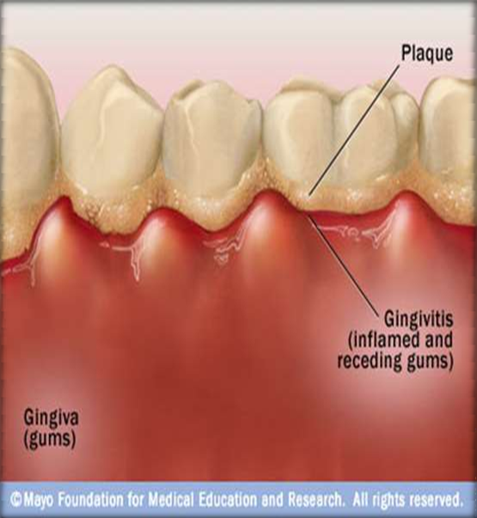
Gingival Diseases associated With Plaque
I. Without Local Contributing Factor:
Plaque - Induced Gingivitis:
Usually confined to the marginal aspects of the gingiva and with time, progresses to other tissues of the periodontium.

Slide 32
Clinical Features:
• A fiery red surface discoloration is often superimposed on underlying chronic changes.
• Gingival color change and swelling appear to be more common expressions of gingivitis in children than bleeding and increased pocket depth.*
• Long term exposure can cause plaque induced gingival enlargement also.**
* Marsh PD Dental Plaque. Biological significance of a biofilm and community life style. J Clin Periodontol. 2005; 32:7-15.
** Dental plaque-induced gingival diseases, Annals of periodontology, 1999.

Slide 33
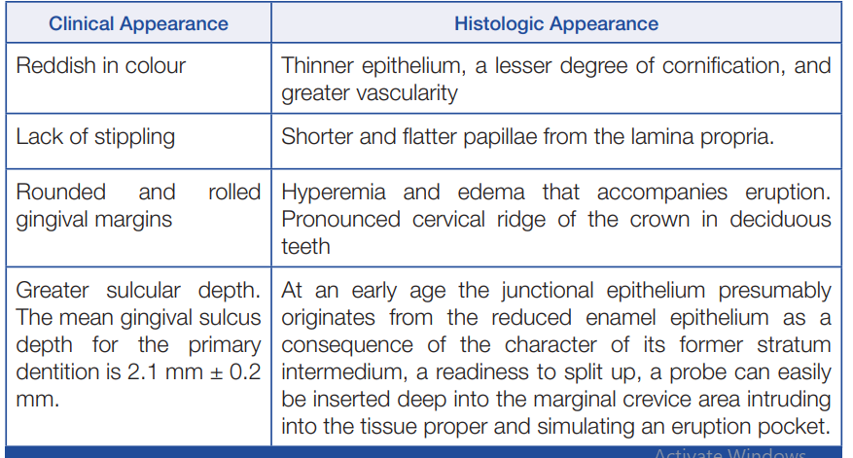
Arul Pari et al., Gingival Diseases in Childhood. Journal of Clinical and Diagnostic Research. 2014 Oct, Vol-8(10): ZE01-ZE04

Slide 34






Treatment of Plaque-induced gingivitis
Brushing and bacterial plaque is removed from the teeth
Early gingivitis is quickly reversible and can be treated with adequate mouth hygiene and cleanliness of the teeth.
Favorable occlusion and the chewing of coarse, detergent-type foods, such as raw carrots, celery, and apples, have a beneficial effect on oral cleanliness

Slide 35
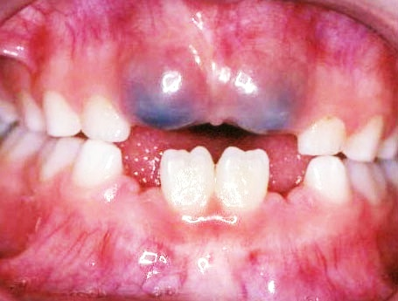
a) Eruption Cyst & Hematoma
II. With Local Contributing Factors:
It is common for erupting teeth to be associated with a form of dentigerous cyst called an eruption cyst.
It is usually translucent, fluctuant and circumscribed swelling.
When cystic cavity contains blood, swelling appears as purple/deep-blue fluctuant, circumscribed swelling termed as eruption hematoma.
Shafer, Hine, Levy. Shafer’s textbook of oral pathology. 6th ed. India: Elsevier; 2009. Chapter 4, Cysts and tumours of odontogenic origin: p.254-310

Slide 36
Dhawan, Preeti et al. “Eruption cysts: A series of two cases.” Dental research journal vol. 9,5 (2012): 647-50. doi:10.4103/1735-3327.104889
Pathogenesis-
seem to arise from the separation of the epithelium from the enamel of the crown of the tooth due to an accumulation of fluid or blood in a dilated follicular space.
Treatment-
Majority of these cysts disappear on their own and usually does not require any treatment.
If they hurt, bleed or are infected they may require surgical treatment to expose the tooth and drain the contents.

Slide 37
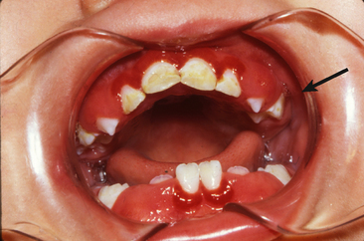
b) Eruption gingivitis
A transitory type of gingivitis in young children- when the primary teeth is erupting.
Often localized and associated with difficult eruption, subsides after the tooth emerges in the oral cavity.
May be caused by a greater risk of plaque accumulation in areas of shedding primary teeth and erupting permanent teeth, since oral hygiene may be difficult or even unpleasant to perform.
Enrique Bimstein, CD Lars Matsson. Growth and development considerations in the diagnosis of gingivitis and periodontitis in children. American Academy of Pediatric Dentistry 21:3: p.186-191, 1999.
Notes:
However tooth eruption does not cause gingivitis.

Slide 38
The inflammatory changes accentuate the normal prominence of the gingival margin- create the impression of a marked gingival enlargement.
Etiopathogenesis:
The gingival margin receives no protection from the coronal contour of the tooth during the early stage of active eruption.
The continual impingement of food debris, collection of materia alba, and bacterial plaque around and beneath the free gingival tissue partially cover the crown of the erupting tooth, and exacerbates inflammatory process.

Slide 39
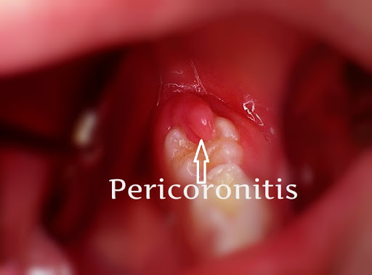
Treatment:
Mild eruption gingivitis- no treatment other than improved oral hygiene.
Painful pericoronitis- when the area is irrigated with a counterirritant, such as Peroxyl. Operculectomy or extraction (usually not done in children) are the treatment choices.
Pericoronitis accompanied by swelling and lymph node involvement should be treated with antibiotic therapy.

Slide 40
c) Gingivitis associated with orthodontic appliance
Access of interproximal tooth brushing is reduced considerably during fixed appliance therapy- The problem is compounded when teeth are banded rather than bonded.
Supragingival plaque deposits are shifted into a subgingival location by tipping movement. Conversly, bodily movements are less likely to induce a relocation of supragingival plaque.
Thus, gingival changes can occur within 1-2 months of appliance placement and are generally transient.

Slide 41
d) Other Factors:
Excessive overjet and overbite- cause severe shearing of gingival tissues and food impaction on labial surface of mandibular anteriors.
Nasal obstruction,
Mouth breathing habit- encourage dry mouth and the growth of plaque biofilm.
Partially exfoliated, Loose deciduous, malposed, eroded margin of partially resorbed and carious teeth can frequently cause gingivitis.

Slide 42
GINGIVAL DISEASES MODIFIED BY SYSTEMIC DISORDERS

Slide 43
I. Gingival diseases associated with the Endocrine system
Puberty gingivitis:
It is a distinctive type of gingivitis that occasionally develops in children in the prepubertal and pubertal period.
The gingival enlargement is marginal in distribution and, in the presence of local irritants, was characterized by prominent bulbous inter proximal papillae far greater than gingival enlargements.

Slide 44
The relationship between elevated levels of circulating sex hormones and prevalence of gingivitis in puberty is strengthened by the observation that, during adolescent, gingivitis peaks earlier in girls (11-13 years) than in boys (13-14 years) .
Proportions of P. intermedius correlated with levels of plasma estrogen and progesterone, and in vivo evidence is obtained indicating that these hormones are nutrients for P. intermedius
Pari A, Ilango P, Subbareddy V, Katamreddy V, Parthasarthy H. Gingival diseases in childhood–A review. Journal of clinical and diagnostic research: JCDR. 2014 Oct;8(10):ZE01.

Slide 45
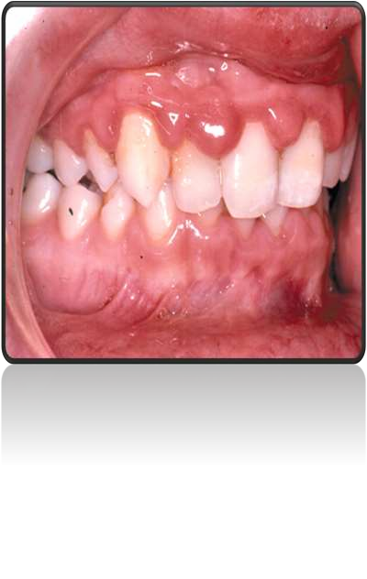
Associated with local factors.
Anterior segment and may be present in only one arch.
characterized by prominent bulbous interproximal papilla
ballooning distortion of the interdentally papillae
Siddharth T. Puberty Induced Gingival Enlargement. Biomed J Sci & Tech Res. 1(1)-2017

Slide 46
Gingival tissues and the subgingival microflora respond to the increasing hormone level at the onset of puberty
a variety of changes in the microenvironment
some species of bacteria to capitalize on the higher concentration of hormones present
Pubertal gingivitis- marginal and interproximal destruction
Pari A, Ilango P, Subbareddy V, Katamreddy V, Parthasarthy H. Gingival diseases in childhood–A review. Journal of clinical and diagnostic research: JCDR. 2014 Oct;8(10):ZE01.

Slide 47
Treatment
Improved oral hygiene,
Removal of all local irritants,
Restoration of carious teeth,
Dietary changes necessary to ensure an adequate nutritional status.
Oral administration of 500 mg of ascorbic acid. However, the improvement did not occur until the vitamin had been taken for approximately 4 weeks.

Slide 48
Leukemia:
II. Gingival Diseases Associated with Blood Dyscrasias
It is a malignant disease caused by the proliferation of the WBC- forming tissues, especially those in the bone marrow.
It may be acute or chronic and can affect any of the WBC – granulocytes (myeloid), lymphocytes, or monocytes.
Most childhood leukemias are acute lymphocytic leukemia (ALL)
Gingival symptoms are common in AML.

Slide 49
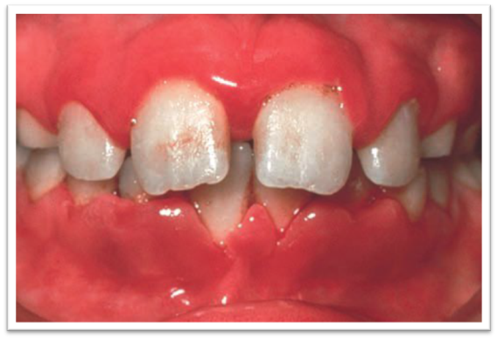
Leukemia-associated gingivitis: AML
Clinical features
Gingiva appears as swollen, glazed, and spongy tissue which is red-deep purple in appearance with gingival bleeding.
Hypertrophy of gingiva- result of direct infiltration by malignant leucocytes.
May appear as a diffuse enlargement of the gingival mucosa, an oversized extension of the marginal gingiva, or a discrete tumor like interproximal mass.
It is moderately firm in consistency, but there is a tendency toward friability and hemorrhage, occurring either spontaneously or on slight irritation .

Slide 50
Treatment:
Oral prophylaxis
Advised brushing with soft bristle toothbrush
Maintenance of oral hygiene
Little et al. [2007] and Elad et al. [2015] reinforce that the role of the dentist should occur at three different moments:
(1)pre-antineoplastic treatment evaluation and preparation of patients for this,
(2)guidelines and oral health care during treatment,
(3)post-treatment care.

Slide 51
Ascorbic Acid Deficiency Gingivitis (Scorbutic Gingivitis)
III. Associated With Nutritional Deficiency
Associated with Vitamin C deficiency- involvement is usually limited to the marginal tissues and papillae- in the absence of local predisposing factors.
The child with scorbutic gingivitis may complain of severe pain, and spontaneous hemorrhage is evident.
Severe clinical scorbutic gingivitis is rare in children.

Slide 52
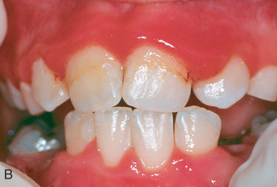
Inflammation and enlargement of the marginal gingival tissue and papillae in the absence of local predisposing factors are possible evidence of scorbutic gingivitis.
Treatment: Improved dental hygiene, and supplementation with Vitamin C – improves gingival conditions.
Daily administration of 250-500mg. Older children and adults may require 1 g, of vitamin C for 2 weeks to speed recovery. Dietary advices are given to increase vitamin C uptake.

Slide 53
ACUTE GINGIVAL DISEASE

Slide 54
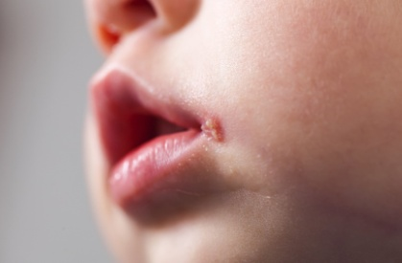
Herpes Simplex Virus Infection:
It is a viral infection of the oral mucosa caused by herpes simplex virus.
The primary infection usually occurs in a child who has had contact with the type 1 herpes simplex virus (HSV-1).
99% of all primary infections are of the subclinical type.
In some preschool children the primary infection may be characterized by only one or two mild sores which may go unnoticed.
Transmission of the virus is by droplets and the incubation period is about 1week.

Slide 55
Clinical Features
In children, the primary infection may be manifested by acute symptoms (acute herpetic gingivostomatitis).
Acute disease can occur in children with clean mouths and healthy oral tissues.
symptoms of the disease develop suddenly and include:
1.Gingiva appears to be diffuse red, erythematous, with varying degree of edema and gingival bleeding.
2. In the initial stage, it appears to be discrete, spherical grey vesicles involving labial and buccal mucosa, soft palate, pharynx and tongue, approximately after 24 hours the vesicles rupture leaving painful ulcers.

Slide 56
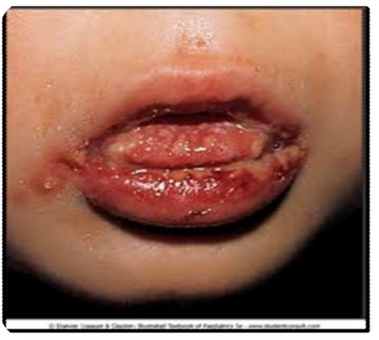
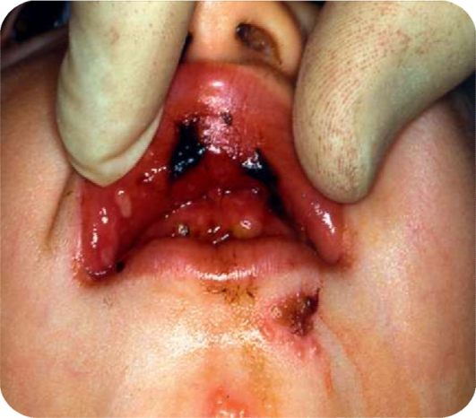
3. The ulcers appear to be red, elevated with halo-like margins and a depressed yellowish or grayish-white central portion.
4. The course of the disease is 7 to 10 days.
5. Generalized soreness of the oral cavity, which interferes with the eating and drinking.
6. The ruptured vesicles are sensitive to touch, thermal changes and food.

Slide 57
Diagnosis
The clinical features, history, and age group of the affected children are so characteristic that diagnosis is rarely problematic.
If in doubt, however, smears from recently ruptured vesicles reveal “Ballooning degeneration” epithelial cells with intranuclear inclusions.
Four fold rise of serum antibodies to HSV-1
Lesion culture will also show positive results for HSV-1

Slide 58

Treatment
Bed rest and a soft diet are recommended during the febrile stage and the child should be kept well hydrated.
Pyrexia is reduced using a paracetamol suspension.
secondary infection of ulcers may be prevented using chlorhexidine mouthrinse (0.2%, two to three times a day)- in older children who are able to expectorate, but in younger children (under 6 years of age) a chlorhexidine spray can be used (twice daily) or the solution applied using a sponge swab.

Slide 59
The application of a mild topical anesthetic, such as dyclonine hydrochloride (0.5%) (dyclone), before mealtime temporarily relieves the pain
In severe cases of herpes simplex, systemic acyclovir can be prescribed as a suspension (200 mg) and swallowed, five times daily for 5 days. In children under 2 years the dose is halved.
Isolation from other children .
Ref : Welbury R, Duggal MS, Hosey MT. Pediatric dentistry , ed 4, Oxford, 2012

Slide 60
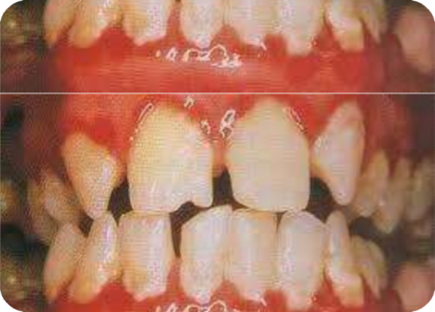
NECROTIZING ULCERATIVE GINGIVITIS
(VINCENT INFECTION)
Rare among preschool children, occurs occasionally in children from 6 to 12 years old
ANUG can be easily diagnosed because of the involvement of the interproximal papillae and the presence of a gray pseudomembranous necrotic covering of the marginal tissue.
Two microorganisms, Borrelia vincentii and fusiform bacilli, referred to as spirochetal organisms, are generally believed to be responsible for the disease.

Slide 61
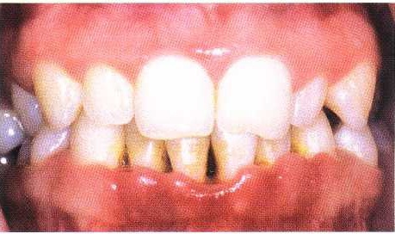
Characteristics lesion are punched out crater like lesions at the crests of the inter dental papillae extending to marginal gingiva, and rarely to attached gingiva.
The clinical manifestations of the disease include inflamed, painful, bleeding gingival tissue, poor appetite, fever as high as 104° F, general malaise, and a fetid odor.
The lesions are extremely sensitive to touch.
Constant radiating, gnawing pain that is intensified by eating spicy or hot food and chewing.
CRATERING

Slide 62
Metallic foul taste and the patient is conscious of anexcessive amount of “pasty saliva”.
Predisposing factors—local and systemic.
Local predisposing factors include:
• Pre-existing gingivitis, e.g. incubation zones.
• Injury to the gingiva, e.g. malocclusion
• Smoking.
a. Direct toxic effect of tobacco
b. Vascular or other changes induced by nicotine or other substances
c. As a reflection of stress.
Systemic predisposing factors include:
• Nutritional deficiency, Debilitating diseases, Psychosomatic factors.

Slide 63
Extraoral and systemic signs and symptoms:
In mild to moderate stages—local lymphadenopathy and slight elevation in temperature is seen.
In severe cases—high fever, increased pulse rate,
leucocytosis, loss of appetite is seen.
In very rare cases, severe sequlae may follow:
• Noma or gangrenous stomatitis.
• Fusospirochetal meningitis.
• Toxemia and fatal brain abscess.

Slide 64
Treatment
Should follow an orderly sequence.
First visit: Treatment is confined to the acutely involved areas,
after applying topical anesthesia- the areas are gently swabbed to remove the pseudomembrane.
Superficial calculus is removed with ultrasonic scaler.
The patient is instructed to rinse the mouth every 2 hours with a glassful of an equal mixture of warm water and 3 percent hydrogen peroxide (chlorhexidine rinses are also recommended).
In the presence of systemic symptoms penicillin or erythromycin or Metronidazole is prescribed.

Slide 65
Second visit: Scaling is performed (After 1 to 2 days).
Third visit: After 1 to 2 days of second visit.
Scaling and root planing are repeated with plaque control instructions, hydrogen peroxide rinses are discontinued, but chlorhexidine rinses can be maintained for 2 to 3weeks.
NOTE-
All minor surgical procedures including extractions should be carried out 1 week and major surgical procedures after 3 weeks of complete recovery

Slide 66
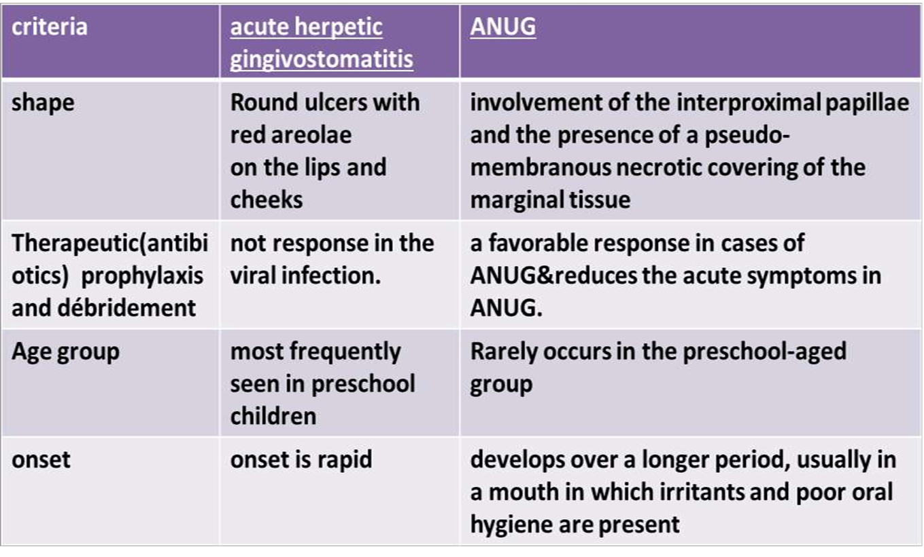
Distinguishing ANUG From
Acute Herpetic Gingivostomatitis

Slide 67
ACUTE CANDIDIASIS /THRUSH, CANDIDOSIS, MONILIASIS
Candida (Monilia) albicans is a common inhabitant of the oral cavity that multiply rapidly and cause a pathogenic state when tissue resistance is lowered.
Young children sometimes develop thrush after local antibiotic therapy, which allows the fungus to proliferate.
It occurs mainly as a secondary infection in patients with some underlying immunosuppression and the primary form of disease is rare. It affects skin, mucous membrane, nails and internal organs.
It is mainly caused by yeast-like fungus Candida albicans but other species, such as C. tropicalis, C. parapsilosis, and C. krusei. C. rugosa, and C. glabrata, may also be involved.

Slide 68
The oral lesions are characterized by the appearance of soft, white, slightly elevated plaques most frequently occurring on the buccal mucosa and tongue, but may also be seen on gingiva and floor of the mouth.
The plaques, which have often been described grossly as resembling milk curds, consist chiefly of tangled masses of fungal hyphae with intermingled desquamated epithelium, keratin, fibrin, necrotic debris, leukocytes and bacteria
.
The white plaque can usually be wiped away with a gauze, leaving either a relatively normal appearing mucosa or an erythematous area. In severe cases, the entire oral cavity may be involved.

Slide 69
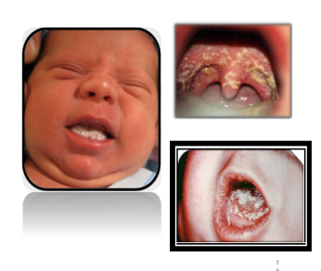
Predisposing factors
Acute and chronic diseases like tuberculosis, diabetes mellitus and anaemia, Myxoedema, hypoparathyroidism and Addison disease
Immunodeficiency like AIDS Nutritional deficiency like Fe, vitamin A and vitamin B6 deficiencies, etc.
Prolonged hospitalization for chronic illness and debilitating diseases• Prolonged use of antibiotics, corticosteroids and cytotoxic drugs
Radiation therapy Use of intravenous tubes, catheters, heart valves and poorly maintained dentures, heavy smoking
Old age, infancy and pregnancy
Xerostomia: The protective antifungal proteins, like histatins and calprotectin, present in the saliva are absent in patients with xerostomia
Dentistry For The Child & Adolescent, MCDONALD, 10TH EDITION.

Slide 70
Treatment
For infants and very young children, a suspension of 1 mL (100,000 U) of nystatin (Mycostatin) may be dropped into the mouth for local action four times a day. The drug is nonirritating and nontoxic.
Clotrimazole suspension (10 mg/mL), 1 to 2 mL applied to affected areas four times daily, is an effective antifungal medication.
Systemic fluconazole suspension (10 mg/mL) is safe to use in infants at a total dosage of 6 mg/kg or less per day.

Slide 71
Ketaconazole is not recommended for the infant, due to risk of liver toxicity.
The use of pacifiers may act as source of infection, so appropriate measures should be taken to prevent infection, such as treating the pacifiers in water and bleaching solution in between uses.
Shafer’s Textbook of Oral Pathology , 8th edition

Slide 72
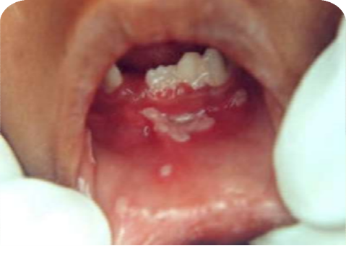
R E C UR RENT A P HT HOUS U L C E R
(CANKER SORE)
It is a painful ulceration on the unattached mucous membrane that occurs in school-going children and adults.
Peak age is between 10 and 19 years of age.
Recurrent Aphthous Stomatitis (RAS)

Slide 73
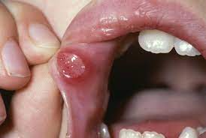
Characterized by :
Recurrent ulcerations on the moist mucous membranes of the mouth, in which both discrete and confluent lesions form rapidly in certain sites and feature .
Round to oval crateriform base,
raised reddened margins, and pain.
Preeti L. J Oral Maxillofac Pathol. 2011 Sep-Dec; 15(3): 252–256.

Slide 74
Predisposing factors
genetic predisposition: strongly suggested as about 40% of patients have a family history and these individuals develop ulcers earlier and are of more severe nature.
Trauma to the oral mucosa due to local anesthetic injections, sharp tooth, dental treatments, and tooth brush injury. Wray et al. in 1981 proposed that mechanical injury may aid in identifying and studying patients prone to aphthous stomatitis.
Tobacco: Several studies reveal negative association between cigarette smoking, smokeless tobacco and RAS. Possible explanations given include increased mucosal keratinization; which serves as a mechanical and protective barrier against trauma and microbes.

Slide 75
Drugs: include angiotensin converting enzyme inhibitor captopril, gold salts, nicorandil, phenindione, phenobarbital, and sodium hypochloride. NSAIDS such as propionic acid, diclofenac, and piroxicam may also cause oral ulceration similar to RAS.
Deficiencies of iron, vitamin B12, and folic acid predispose development of RAS.
Gluten sensitive enteropathy/celiac disease, inflammatory bowel disease Gluten sensitive enteropathy (GSE) - an autoimmune inflammatory disease of small intestine - characterized by aphthous oral ulcers, glossitis, and stomatitis. RAS may be the sole manifestation of the disease.

Slide 76
Sodium lauryl sulfate - containing toothpaste An increased frequency in the occurrence of RAS has been reported on using sodium lauryl sulfate (SLS)-containing tooth paste with some reduction in ulceration on use of SLS-free tooth paste.
Hormonal changes: Conflicting reports exist- Studies state association of oral ulceration with onset of menstruation or in the luteal phase of the menstrual cycle. Mc Cartan et al. in 1992 established no association between apthous stomatitis and premenstrual period, pregnancy, or menopause.
Stress -as a causative factor in RAU-may induce trauma to oral soft tissues by parafunctional habits such as lip or cheek biting and this trauma may predispose to ulceration.
Jurge S, Kuffer R, Scully C, Porter SR. Recurrent aphthous stomatitis. Oral Dis. 2006;12:1–21. [
Notes:
A more recent study shows lack of direct correlation between levels of stress and severity of RAS episodes and suggests that psychological stress may act as a triggering or modifying factor rather than etiological factor in susceptible RAS patients.

Slide 77
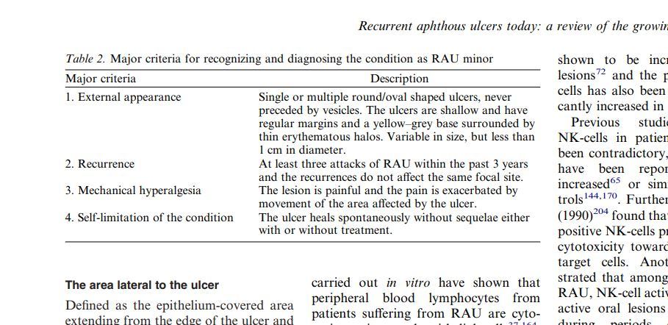
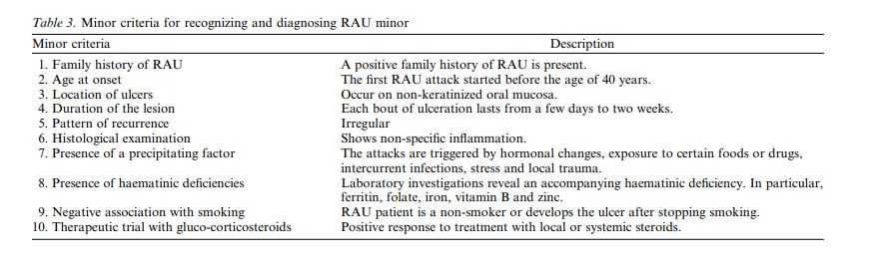
Natah SS, Konttinen YT, Enattah NS, Ashammakhi N, Sharkey KA, Häyrinen-Immonen R. Recurrent aphthous ulcers today: a review of the growing knowledge. Int J Oral Maxillofac Surg. 2004 Apr;33(3):221-34.

Slide 78
Treatment
Lesions persist for 4 to 12 days and heal uneventfully, leaving scars only rarely and only in cases of unusually large lesions .
Current treatment is focused on:
Promoting ulcer healing,
Reducing ulcer duration and patient pain,
Maintaining the patient’s nutritional intake,
And preventing or reducing the frequency of recurrence of the disease.

Slide 79
Topical corticosteroid (eg. 0.5% fluocinonide, 0.025% triamcinolone, 0.5% clobetasol) is applied to the area with a mucosal adherent (e.g., Isobutyl cyanoacrylate, orabase) before meals and bedtime may also be helpful.

Slide 80
The major form (RAS) is less common and has been referred to as Periadenitis mucosa necrotica recurrens and sutton disease. RAS has been associated with other systemic diseases:
PFAPA (periodic fever, aphthous stomatitis, pharyngitis, adenitis),
Behçet disease, Crohn disease, ulcerative colitis, celiacdisease, neutropenia, immunodeficiency syndromes,
Reiter’s syndrome, systemic lupus erythematosus, and
MAGIC (mouth and genital ulcers with inflamed cartilage)syndrome.

Slide 81
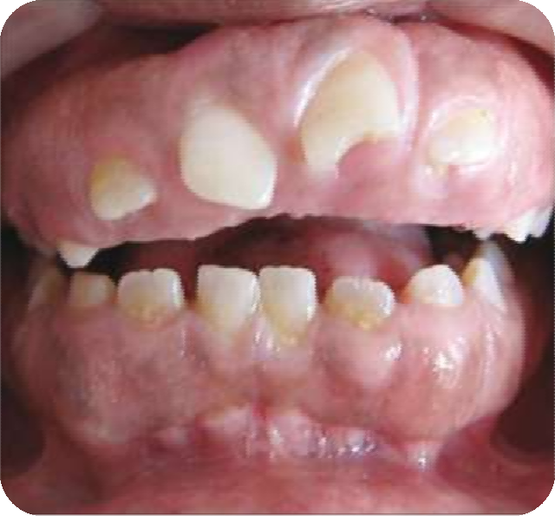
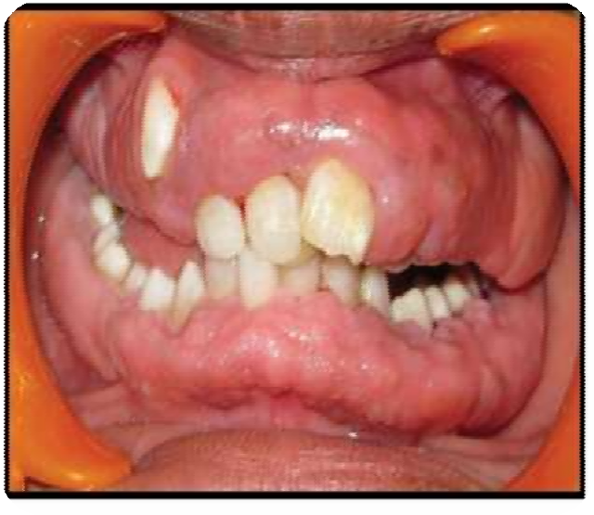
Gingival Lesions Of Genetic Origin
Hereditary gingival fibromatosis (HGF) :
Rare type of gingivitis
benign, non-hemorrhagic, fibrous gingival overgrowth that can appear in isolation or as part of a syndrome.
Excessive production of collagen
Notes:
Elephantiasis gingivae, diffuse fibroma, familial elephantiasis, idiopathic fibromatosis; hereditary gingival fibromatosis, congenital familial fibromatosis
Rutherfurd, Cross, Cowden syndrome, multiple hamartomas, tuberous sclerosis

Slide 82
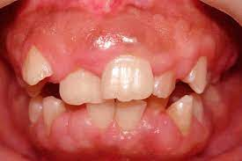
Normally appears with the eruption of the permanent teeth, although cases - in primary teeth and even at birth
The dense fibrous tissue - displacement of the teeth and malocclusion.
Extensive pseudo pockets
Notes:
giving rise to a condition that can have negative psychological effects at that age. The condition is not painful until the tissue enlarges to the extent that it partially covers the occlusal surface of the molars and becomes traumatized during mastication.

Slide 83
Treatment-
Surgical removal of gingival tissues/ Gingivectomy
Hyperplasia can recur within a few months after the surgical procedure and can return to the original condition within a few years.
Importance of excellent plaque control should be stressed to the patient because this delays the recurrence of the gingival overgrowth.
Notes:
Surgical removal of gingival tissues achieve more favorable oral and facial appearance.

Slide 84
TRAUMATIC GINGIVITIS
(GINGIVITIS ARTEFACTA/ FACTITIOUS GINGIVITIS)
Gingivitis artefacta has minor and major variants.
The minor form results from rubbing or picking the gingiva using the fingernail, or perhaps from abrasive foods such as crisps, and
the habit is usually provoked by a locus of irritation such as an area of persistent food packing or an already inflamed papilla

Slide 85
The injuries in gingivitis artefacta major are more severe and widespread and can involve the deeper periodontal tissues , lips and tongue.
Treatment-
Dressing and protection of oral wounds
A psychological or psychiatric consultation
Self-mutilation by biting has been associated with severe-
Emotional disturbances such as Lesch-Nyhan syndrome,
Congenital insensitivity to pain,
Autism.

Slide 86
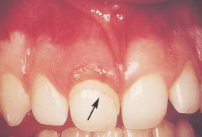
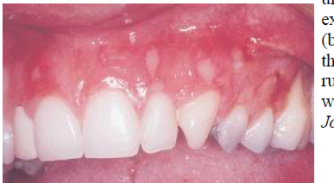
Traumatic gingival injury
inflicted by the fingernail that
has been teased from the gingival crevice.
Generalized, self-inflicted
ulceration of the attached gingiva

Slide 87
Congenital Anomalies
Congenital Epulis:
Congenital Epulis of newborn is a rare gingival tumour that occurs along the alveolar ridge.
It is usually without associated abnormalities of the teeth or additional congenital malformations.
Clinically it presents as a smooth well defined erythmatous masses arising from gum pad. Size may be large enough to lift the upper lip. The unerupted teeth are not affected usually and can be seen in MRI

Slide 88
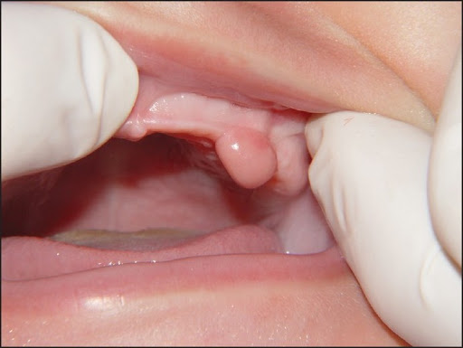
Treatment- Surgical excision.

Slide 89
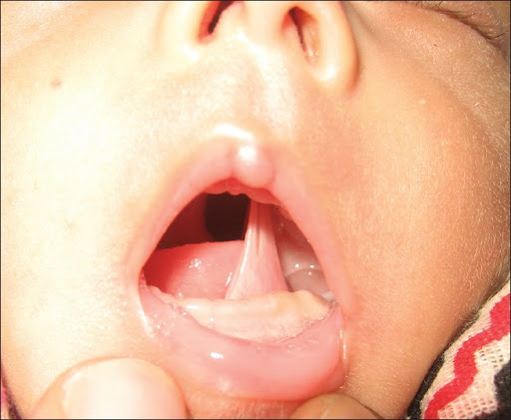
Congenital Gum Synechiae:
It is characterized by congenital adhesions between different parts of oral cavity. It is rare type of disease. It causes difficulty in breathing and respiration soon after birth.

Slide 90
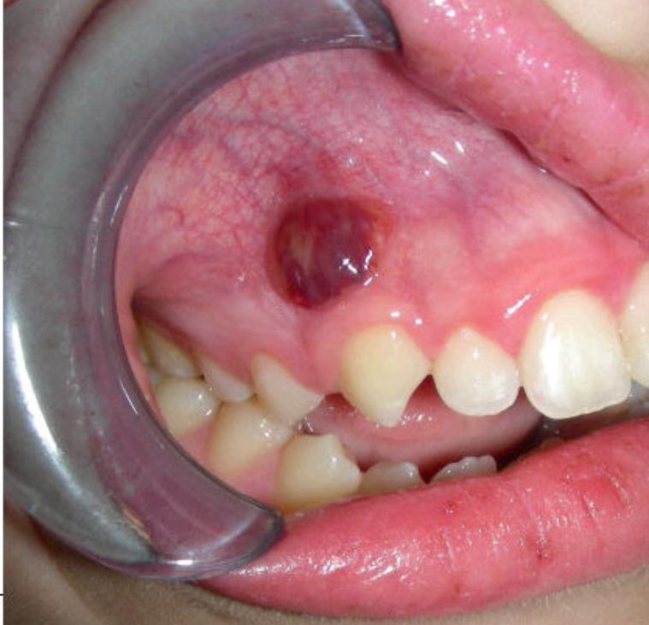
LOCALIZED GINGIVAL LESIONS
Parulis or Gumboil-
It is a localized area of inflamed granulation tissue that occurs at the end point of a sinus tract that is draining from a nonvital tooth.
It appears as a soft , solitary reddish papule, located apical and facial to a chronically abscessed tooth, usually on or near the labial mucogingival junction.

Slide 91
The parulis can be slightly yellow in the center and emit a purulent yellowish exudate on palpation.
Acute swelling and pain may accompany the condition in the sinus tract is obstructed.
To locate the nonvital tooth which the parulis arises,a sterile gutta-percha point may be inserted into the sinus-tract.
Periapical radiographs are then taken to demonstrate the proximity of the gutta-percha point to the apex of the offending tooth.

Slide 92
Treatment-
After the nonvital tooth is diagnosed, the treatment of choice is root canal therapy or extraction.

Slide 93
Conclusion
Irrelevant of age, gingival diseases have been found to occur right from children to older individuals.
Either incomplete knowledge about gingival diseases in childhood or ignoring them would put the periodontium in adults at risk.
Thus, regular oral health check-ups, patient education, parent counselling is the key for maintaining a healthy and hygienic oral cavity in childhood

Slide 94
References
Dentistry For The Child & Adolescent, MCDONALD, 10TH EDITION.
Newman Takei, Klokkevold, Carranza. Carranza’s clinical periodontology,11th edition, India, Elsevier, 2012
Common Oral Diseases, Robert Langlais ,5th edition
Shafer’s Textbook of Oral Pathology , 8th edition
Ranney rr. Classification of periodontal diseases. Periodontology 2000. 1993 jun;2(1):13-25.

Slide 95
THANK YOU

Slide 96
Gingival Diseases Modified By Systemic Factors
Gingival diseases associated with endocrine system.
Associated with Blood Dyscrasias.
Gingival lesions of genetic origin.
Associated with nutritional deficiency.
Pari A, Ilango P, Subbareddy V, Katamreddy V, Parthasarthy H. Gingival diseases in childhood–A review. Journal of clinical and diagnostic research: JCDR. 2014 Oct;8(10):ZE01.

Slide 97
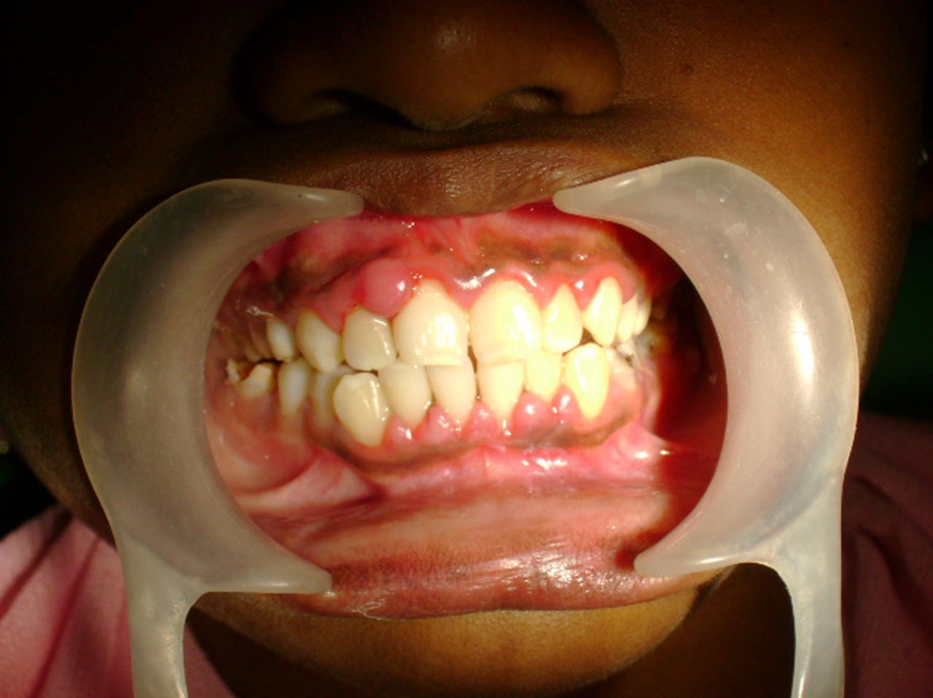
Gingival diseases associated with the Endocrine system
Puberty gingivitis
Distinctive type of gingivitis- marginal and interdentally
Often, only the facial gingival are involved and the lingual surfaces are relatively unaltered.
The inflamed tissues are deep red and may be lobulated
Notes:
the mechanical action of the tongue and the excursion of food present a heavy accumulation of local irritants on the lingual surface
Bleeding may occur when patients masticate or brush their teeth.

Slide 98
Leukemia:
Gingival Diseases Associated with Blood Dyscrasias
It is a malignant disease caused by the proliferation of the WBC- forming tissues, especially those in the bone marrow.
It may be acute or chronic and can affect any of the WBC – granulocytes (myeloid), lymphocytes, or monocytes.
Most childhood leukemias are acute lymphocytic leukemia (ALL)
Gingival symptoms are common in AML.

Slide 99
Leukemia-associated gingivitis: AML
Clinical features
Gingiva appears as swollen, glazed, and spongy tissue which is red-deep purple in appearance with gingival bleeding.
Hypertrophy of gingiva- result of direct infiltration by malignant leucocytes.
May appear as a diffuse enlargement of the gingival mucosa, an oversized extension of the marginal gingiva, or a discrete tumor like interproximal mass.
It is moderately firm in consistency, but there is a tendency toward friability and hemorrhage, occurring either spontaneously or on slight irritation .

Slide 100
Treatment:
Oral prophylaxis
Advised brushing with soft bristle toothbrush
Maintenance of oral hygiene
Little et al. [2007] and Elad et al. [2015] reinforce that the role of the dentist should occur at three different moments:
(1)pre-antineoplastic treatment evaluation and preparation of patients for this,
(2)guidelines and oral health care during treatment,
(3)post-treatment care.

