Slide 1
DEVELOPMENT OF MANDIBLE

Slide 2
Purpose Statement
At the end of the lecture, the students should be able to
Discuss the development of facial tissues and pharyngeal arches. ,Describe the prenatal and postnatal development of mandible.,Enumerate the Common Anomalies Related To Mandibular Development.

Slide 3
Learning Objectives
At the end of the lecture the student should be able to
S.N. | Learning Objectives | Domain | Level | Criteria | Condition
1 | Discuss the development of facial tissues and pharyngeal arches. | Cognitive | Must Know | All
2 | Describe the prenatal and postnatal development of mandible. | Cognitive | Must Know | All
4 | Enumerate the Common Anomalies Related To Mandibular Development. | Cognitive | Must Know | All

Slide 4
CONTENTS
FORMATION OF MANDIBLE
FATE OF MECKELS CARTILAGE
OSSIFICATION
AGE CHANGES IN MANDIBLE
CONGENITAL DEFECTS

Slide 6
The mandible is an irregular bone and it is partly intramembranous and partly intracartilagenous in orgin.
Greater part of the body,ramus,condyloid and coronoid processes are intramembranous in origin.
Only the tip of the condyloid and coronoid processes and symphyseal region are of endochondral origin.

Slide 7
The neural crest cells undergo extensive differentiation to give rise to various structures. -Those cells migrating to the trunk region form neural,endocrine and pigment cells.

Slide 8
Those cells that migrate to the head and neck form the skeletal and connective tissues like bone, cartilage, dentin and others except the enamel which is formed by the ectoderm lining the oral cavity.

Slide 10
The major part of the 1st arch gives rise to mandibular prominence ventrally that forms the mandible.
The rostral extension of the arch gives rise to maxillary promience laterally that forms the maxilla,zygomatic bone and squamous part of temporal bone.

Slide 14
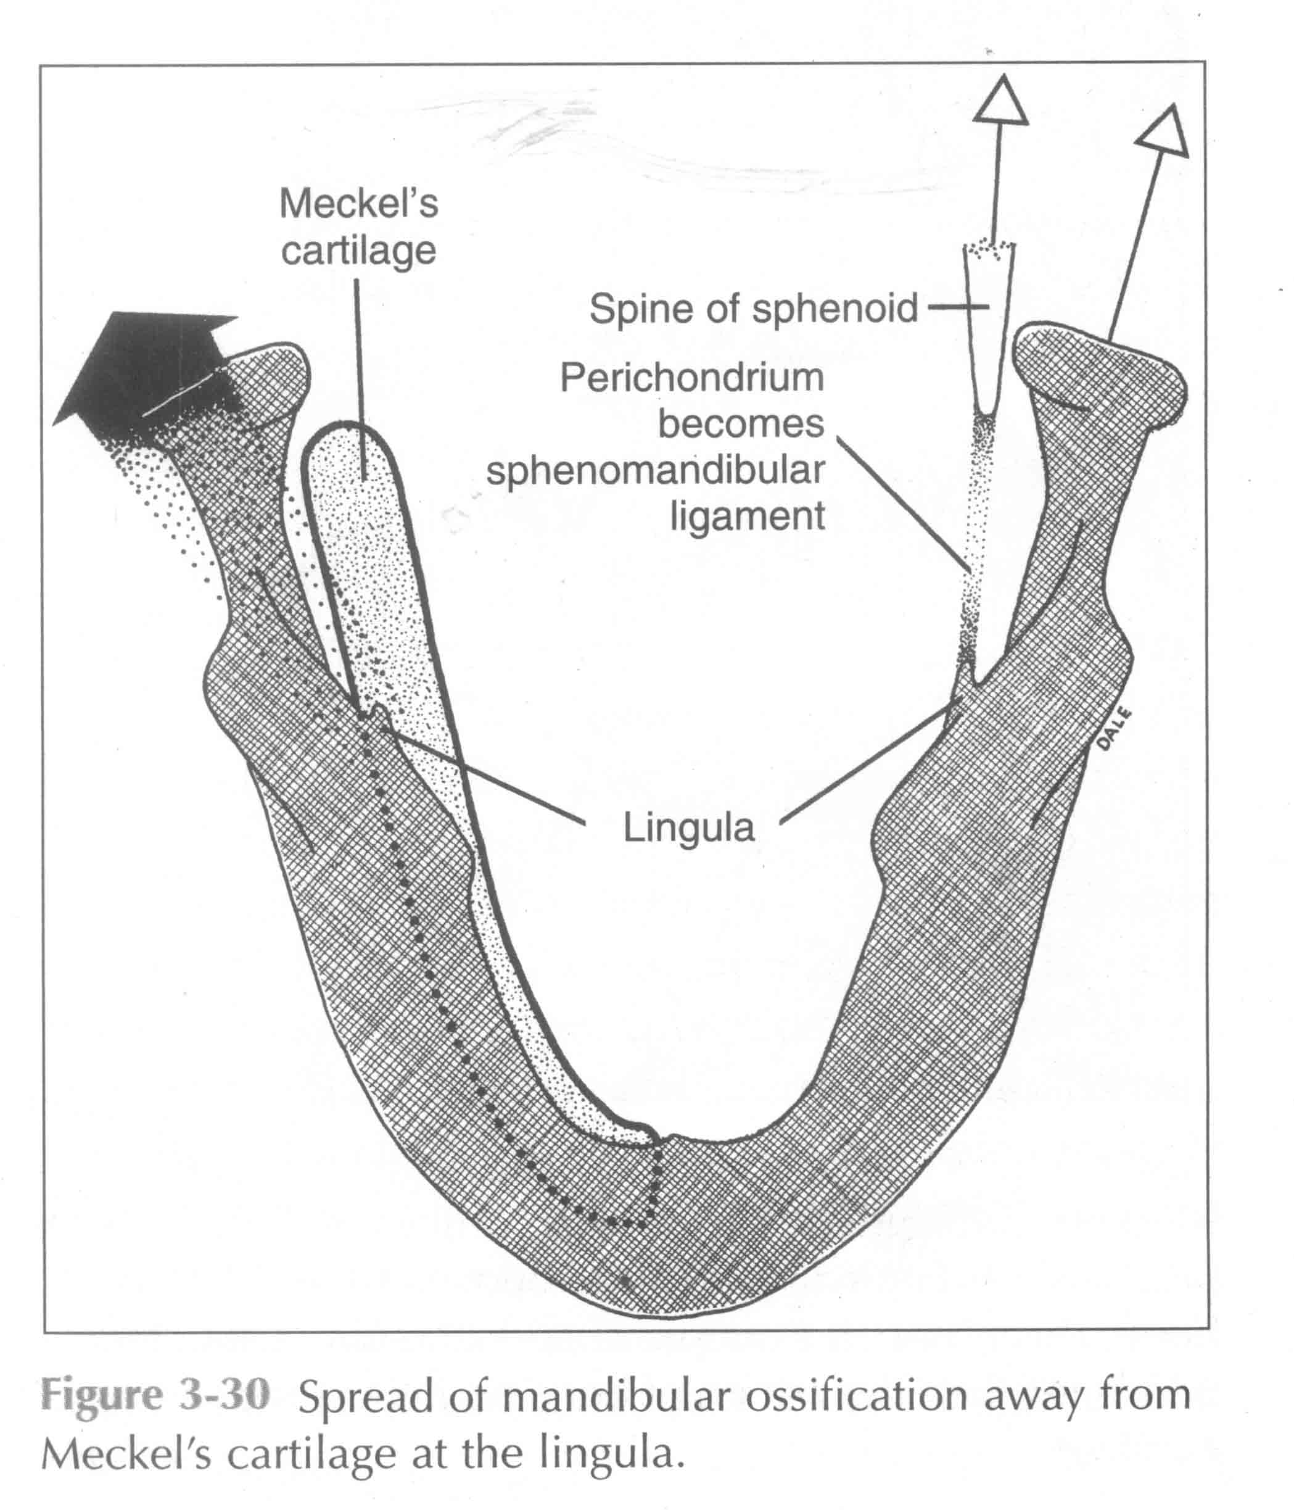

Slide 15
MECKELS CARTILAGE
Derived from 1st pharyngeal arch
Its development extends as solid hyaline cartilagenous rod, surrounded by fibrocellular capsule.

Slide 16
FORMATION OF MANDIBLE
Mandibular branch of trigeminal nerve as close relationship with meckels cartilage.
Nerve get divided into
i) Lingual
ii) Inferior alveolar :- incisive and mental branches.
At 7th week of intramembranous ossification begins.

Slide 17
FATE OF MECKELS CARTILAGE
Most posterior extremity forms the malleus of the inner ear and sphenomalleolar ligament
Fibrocellular capsule persist as the sphenomandibular ligament

Slide 18
FATE OF MECKELS CARTILAGE
Further :- growth of mandible untill birth influenced by secondary cartilage.
i) Condylar cartilage
Ii) Coronoid cartilage
Iii) Symphyscal cartilage

Slide 19
SKELETAL UNITS OF MANDIBLE
The mandible is developmentally and functionally divisible into skeletal subunits.
1. The basal bone of the body
2. Alveolar, coronoid, and angular process
3. Condylar processes and the chin.

Slide 20
Formation of bone within the condylar heads causes the manduibular ramii to grow upwards and backwards, displacing the entire mandible in an opposite downward and forward direction
Bone resorbtion subjacent to condylar heads account for narrowed condylar neck.

Slide 21
Deposition – new bone is added on surfaces facing the direction of growth
Resorption – bone is taken away on surface facing away from direction of growth
Displacement – physical movement of the whole bone as it remodels. This is brought about as a result of two or more bones and contiguous soft tissues growing in relation to one another

Slide 22
OSSIFICATION
2nd most bone to ossify after clavicle in the body
Ossification in cartilage :- 1. Incisive part below incisor
2. Coronoid and condyloid processes

Slide 23
Upper half of the ramus
Ossifies from only one center :- appears at 6th week of I.U.L
At birth mandible consist of two halfs connected at the symphysis menti by fibrous tissue.

Slide 24
AGE CHANGES IN MANDIBLE
In infant and children
- two half fuses
- mental foramen and mandibular canal runs near lower border – gradually shifts upwards
- angle of mandible obtuse – 140 degree
In adults
- mental foramen midway between upper and lower border
- mandibular canal parallel to mylohyoid line
- angle of mandible decreases to 110 to 120 degree
In old age
- alveolar border resorbed
- mental foramen and mandibular canal close to alveolar bone
- angle 140 degree

Slide 25
Common Anomalies Related To Mandibular Development Include-
a] Macrognathia of mandible-
b] Mandibular micrognathia
c] Median mandibular cleft-in the mild type only the
lower lip is affected
d] Hypoplasia of condyle

Slide 26
CONGENITAL DEFECTS
Agnathia – characterized by absence of mandible/maxilla.
Microstomia - an excessive merging of the mandibular and maxillary processes.
Macrostomia - an oblique facial cleft resulting from the failure of the maxillary and mandibular processes to fused.
Mandibular clefts is rare defect as shown in the figure

Slide 27
Summary
Discuss the development of facial tissues and pharyngeal arches.
Describe the prenatal and postnatal development of mandible.
Enumerate the Common Anomalies Related To Mandibular Development .

Slide 28
Bibliography
Color Atlas And Text Book Of Oral Anatomy, Histology Berkovitz, B. 1ST edition.
Oral Development and Histology Avery, j. K.1st edition.
Orban's Oral Histology and Embryology Bhaskar, s. N.11th edition.
Oral Histology : Development, Structure and Funct Tencate, a. R. 4th edition.
Dental Embryology, Histology & Anatomy. Marry Bath- Balogh Inergaret. 2nd edition.

Slide 29
Thank You

