Slide 1
DENTIN

Slide 2
Purpose Statement
At the end of the lecture student should be able to describe the Innervation of dentin,Theories of pain transmission in dentin , Clinical implications

Slide 3
Learning Objectives
At the end of the lecture the student should be able to
S.N. | Learning Objectives | Domain | Level | Criteria | Condition
1 | Write about innervation of dentine | Cognitive | Must Know | All
2 | Draw various histological features of dentine | Cognitive & Psychomotor | Must Know | All
3 | Enumerate Clinical considerations | Cognitive | Must Know | All

Slide 4
CONTENTS
INNERVATION OF DENTIN
THEORIES OF DENTIN SENSITIVITY

Slide 5
INNERVATION OF DENTIN
Intratubular nerves: nerve fibers accompany 30-70% odontoblastic processes,known as Intratubular nerves.
Dentinal tubules contain numerous nerve endings in the predentin & inner dentin upto 100 to 150 μm from the pulp.
Vesiculated endings are located in tubules in the coronal zone, specifically in the pulp horns.

Slide 6
DENTIN SENSITIVITY
Three theories of dentin sensitivity:
Dentin contains nerve endings that respond when it is stimulated.
The odontoblasts serve as receptors & are coupled to nerves in the pulp.
Tubular nature of dentin permits fluid movement to occur within the tubule when a stimulus is applied.

Slide 7
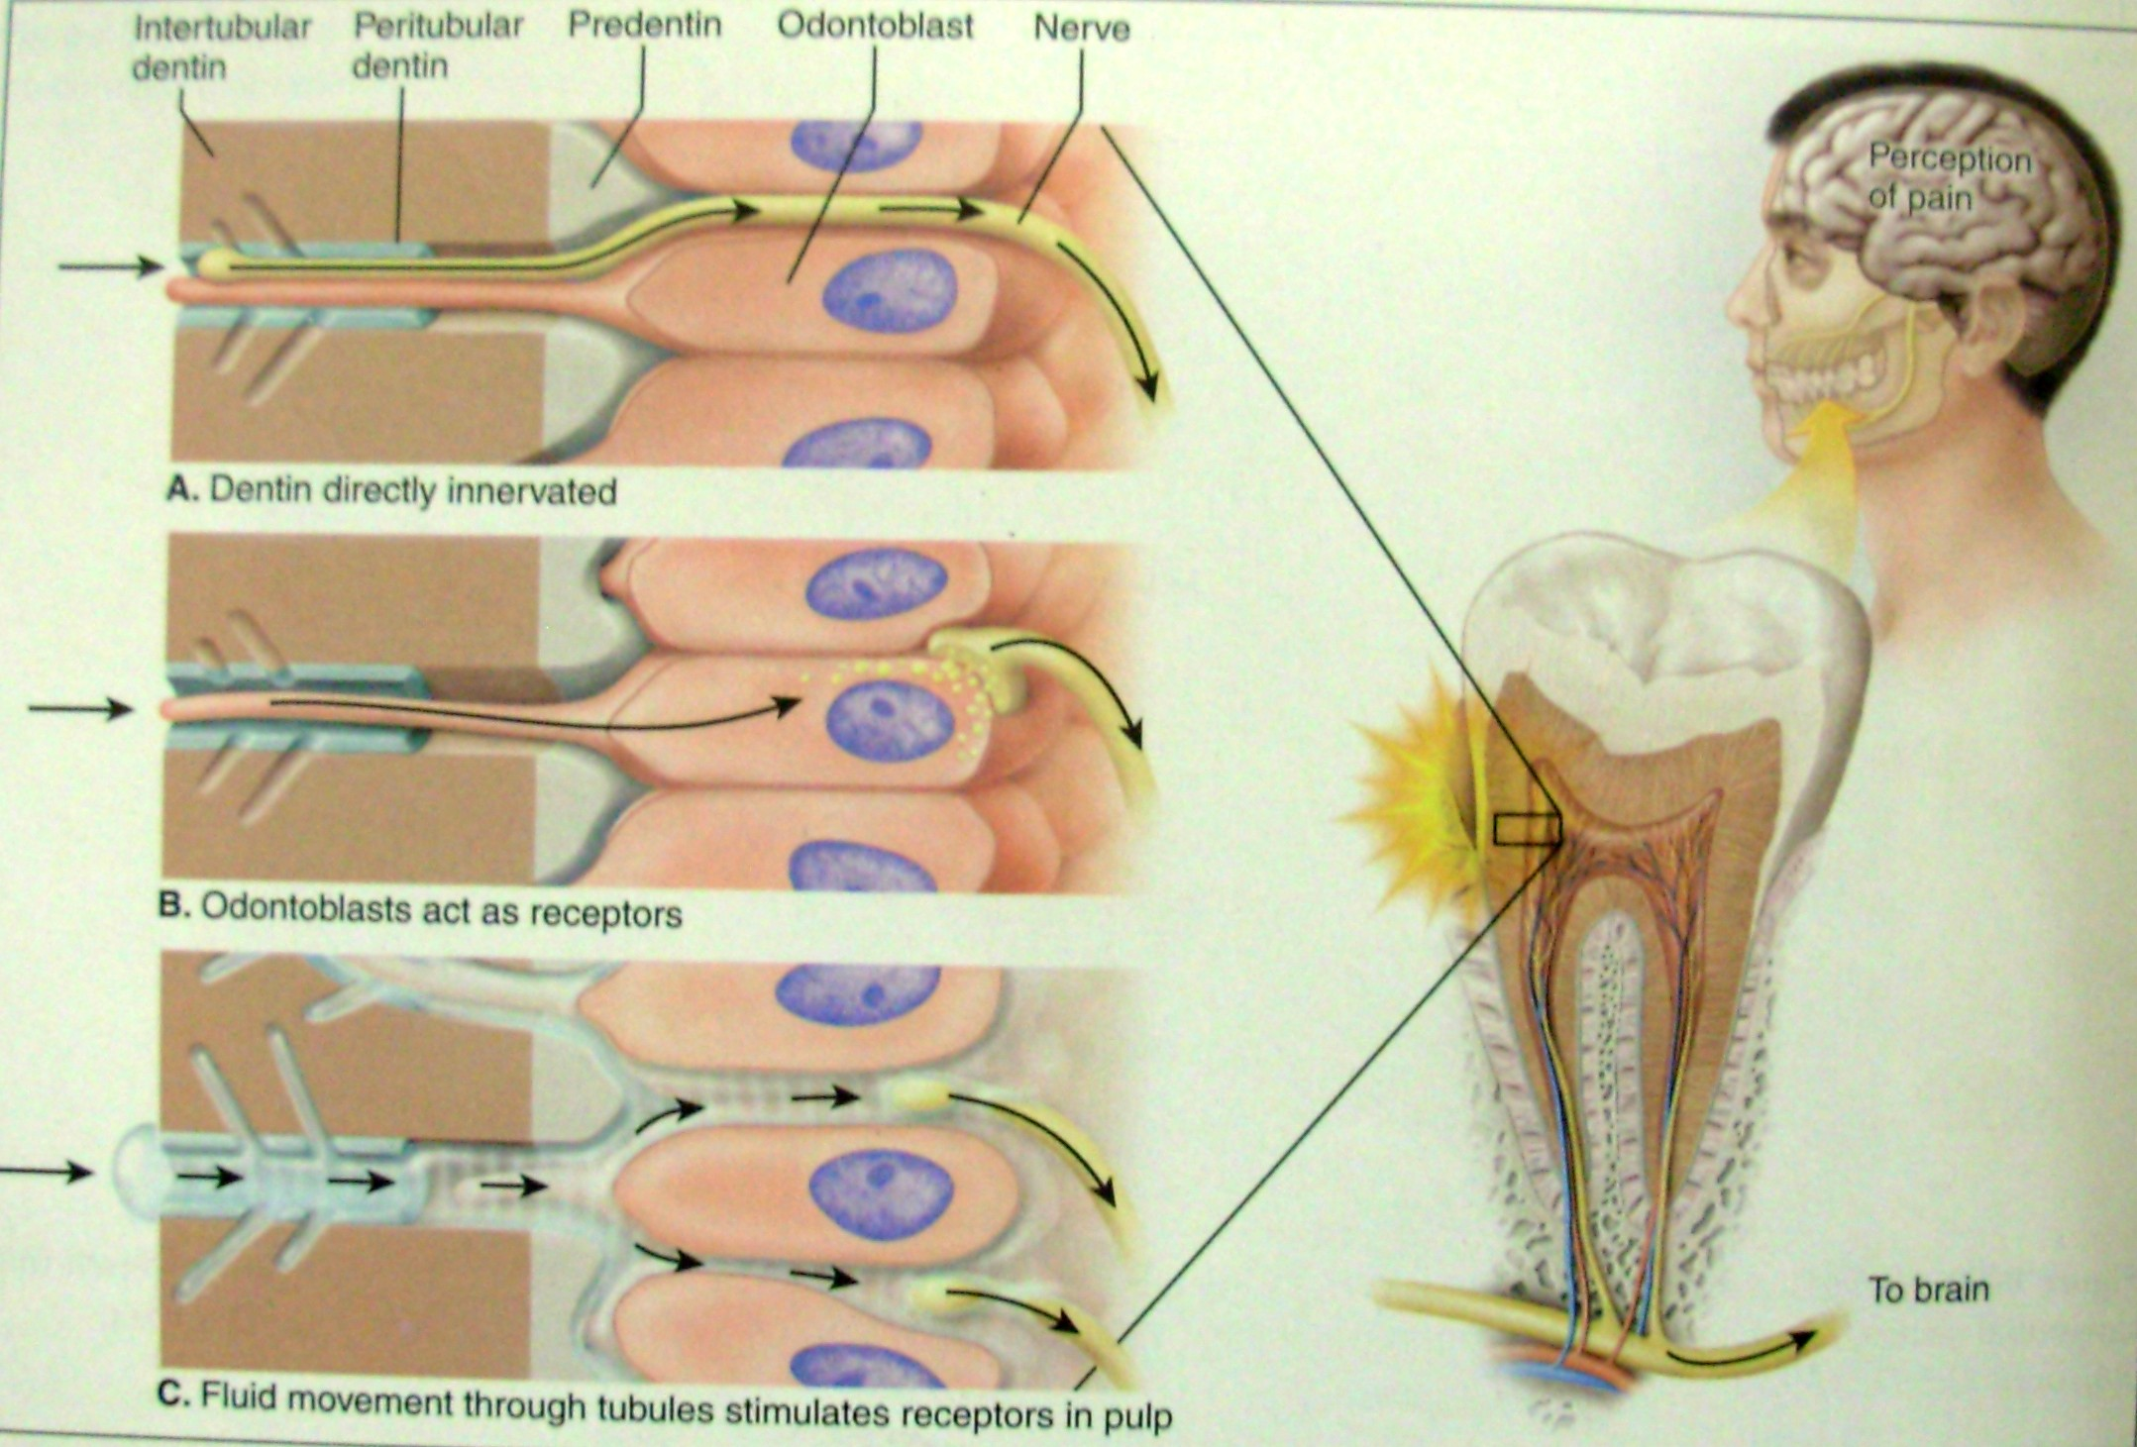
THEORIES OF DENTIN SENSITIVITY

Slide 8
Direct innervation theory (Direct neural stimulation )
Nerves in the dentin gets stimulated BUT nerves in the dentinal tubules are not commonly seen & & even if present they do not extend beyond inner dentin
NOT ACCEPTED

Slide 9
Hydrodynamic theory
Various stimuli such as heat ,cold, air blast dessication, mechanical or osmotic pressure affect fluid movement in the dentinal tubules.
Fluid movement stimulates the pain mechanism in the tubules by mechanical disturbance of the nerves.
Nerve endings may act as mechanoreceptors

Slide 10
Transduction theory
Odontoblast process –primary structure excited by the stimulus & impulse is transmitted to the nerve endingss

Slide 11
Direct innervations Transduction Hydrodyanamic

Slide 13
Primary & Secondary Dentin

Slide 14
Predentin

Slide 15
Interglobular Dentin

Slide 16
Tome’s Granular Layer

Slide 17
Dead Tracts

Slide 18
Peritubular & Intertubular Dentin

Slide 19
Y-Shaped Dentinal Tubules

Slide 20
Summary
Innervation of dentin
Theories of pain transmission in dentin
Clinical implications

Slide 21
BIBLIOGRAPHY
Color Atlas And Text Book Of Oral Anatomy, Histology Berkovitz, B. 1ST edition.
Oral Development and Histology Avery, j. K.1st edition.
Orban's Oral Histology and Embryology Bhaskar, s. N.11th edition.
Oral Histology : Development, Structure and Funct Tencate, a. R. 4th edition.
Dental Embryology, Histology & Anatomy. Marry Bath- Balogh Inergaret. 2nd edition.

Slide 22
Thank you

Slide 23
DENTIN
Dept Of Dental Anatomy, Embryology & Histology Sharad Pawar Dental College
DMIMS(DU)

Slide 24
Purpose Statement
At the end of the lecture student should be able to describe the Incremental lines of dentin, Age and functional changes in dentin, Theories of pain transmission in dentin &
, Clinical implications

Slide 25
Learning Objectives
At the end of the lecture the student should be able to
S.N. | Learning Objectives | Domain | Level | Criteria | Condition
1 | Write about Incremental lines of dentin | Cognitive | Must Know | All
2 | Enumerate Age and functional changes in dentin | Cognitive | Must Know | All
3 | Described Theories of pain transmission in dentin & | Cognitive | Must Know | All
4 | Enumerate Clinical implications | Cognitive | Must Know | All

Slide 26
CONTENTS
INCREMENTAL LINES OF DENTIN
AGE & FUNCTIONAL CHANGES
SCLEROTIC DENTIN: (TRANSPARENT DENTIN)
DEAD TRACTS

Slide 27
INCREMENTAL LINES OF DENTIN
Dentinogenesis proceeds rhythmically, with alternating phases of activity & quiescence.
Daily increment is 4-8 μm. So the lines produced by this daily incremental deposition of dentin are called as imbrication lines/ Incremental lines of von Ebner.

Slide 28
INCREMENTAL LINES OF VON EBNER
The distance between lines varies.
More in the crown than the root.
Crown :8 μm/day
Root :3-4 μm/day

Slide 29
INCREMENTAL LINES OF DENTIN
The incremental lines run at right angles to dentinal tubules.
According to some investigators, there is also a 5-day rhythmic pattern associated with dentin deposition, represented as incremental lines separated by 20 μm interval - Contour lines of owen

Slide 30
CONTOUR LINES OF OWEN

Slide 31
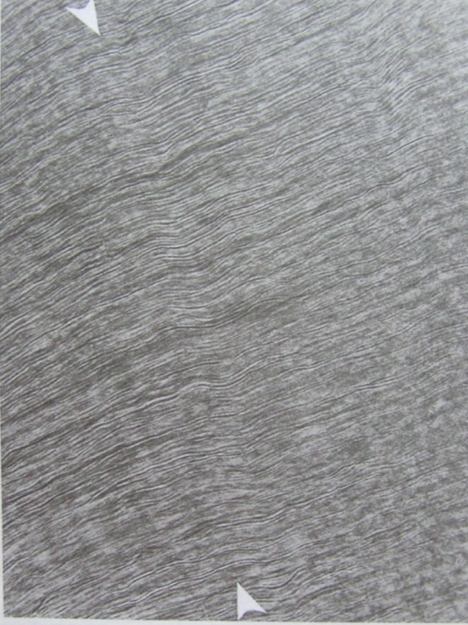

Slide 32
CONTOUR LINES OF OWEN
It is a optical phenomenon.
They are produced due to coincident of secondary curvatures between neighboring dentinal tubules.
Accentuated incremental lines of von Ebner.
Due to disturbances in matrix & mineralization process.

Slide 33
NEONATAL LINE
An accentuated incremental line .
Deciduous teeth & first permanent molars.
Reflects the abrupt change in environment at birth.
Demarcates the prenatal & postnatal dentin.
Prenatal better than postnatal.
May be a zone of hypocalcification.

Slide 34
AGE & FUNCTIONAL CHANGES
Reparative dentin.
Sclerotic dentin /Transparent dentin.
Dead tracts.

Slide 35
Various stimuli, such as attrition, abrasion, erosion, caries or restorative procedures:
Induce formation of reparative dentin.
Protective changes in the existing dentin.

Slide 37
SCLEROTIC DENTIN: (TRANSPARENT DENTIN)
It is the dentin where the dentinal tubules have become occluded with calcific material.
When this occurs in several tubules in same area, the dentin assumes a glassy appearance.
The contents of the tubule acquire the same R.I. as the intertubular dentin & so appear transparent.

Slide 39
Amount of sclerotic dentin increases with age & is most common in the apical 3rd of the root.
Also seen frequently – just below the exposed dentin. (above reparative dentin & near dead tracts)

Slide 40
It is believed :-
Response to stimulus (attrition, caries, fractures)
Physiologic response -Age changing process
A defensive reaction of the dentin.
Reduces the permeability of dentin & help to prolong pulp vitality.

Slide 41
Assumed that :
Occlusion of the dentinal tubules is achieved by continued deposition of intratubular dentin.
Deposition of mineral within the tubule without any intratubular dentin formation.
A diffuse mineralization occurs with a viable odontoblast process still present.
Mineralization of both the process & the tubular content.

Slide 42
DEAD TRACTS
Due to an external stimulus, dentinal tubules are emptied either by complete retraction of the odontoblastic process from the tubule or through death of odontoblast cell.
In ground section the empty dentinal tubules are filled with air & hence appear:

Slide 43
Transmitted light Reflected light

Slide 44
It is believed : --
Response to stimulus
Age changing process
Dead tracts occur most often in coronal dentin & are bound by sclerotic dentin.
.

Slide 45
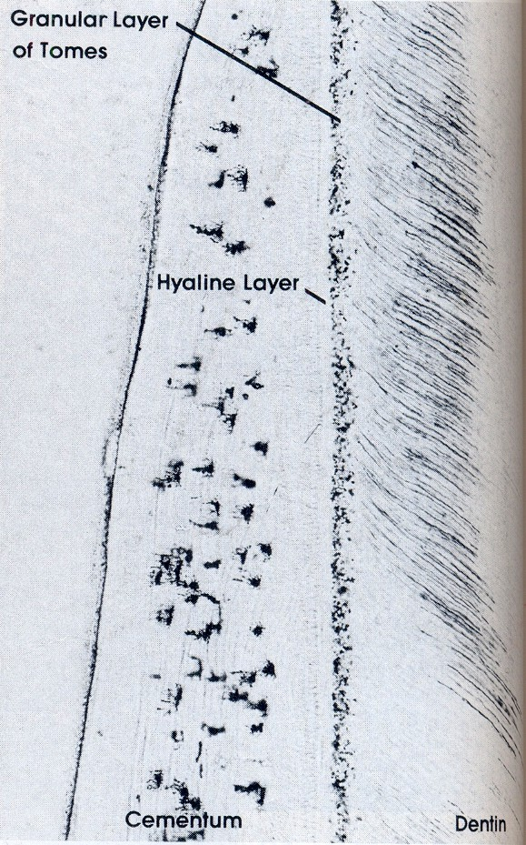

Slide 46
GRANULAR LAYER OF TOMES
In dry ground section of root dentin, a zone adjacent to the cementum appears granular in transmitted light ,known as –granular layer of Tomes .
Increases slightly in amount from the CEJ to the root apex.
Hypominaralised as compared to circumpulpal dentin

Slide 47
Believed to be caused by:
Coalescing & looping of the terminal portions of the dentinal tubules.
Profuse branching of dentinal tubules.
Differences in the rate of formation of coronal & root dentin (lower rate of dentin formation in root).
Cementum
Granular layer of Tomes
Dentin

Slide 49
HYALINE LAYER
Peripheral to the granular layer of Tomes, and separating it from cementum is a thin structureless layer,(20 μm ) known as Hyaline layer of Hopewell Smith.
May serve to bond cementum to dentin.

Slide 51
Summary-
Incremental lines of dentin
Age and functional changes in dentin

Slide 52
BIBLIOGRAPHY
Color Atlas And Text Book Of Oral Anatomy, Histology Berkovitz, B. 1ST edition.
Oral Development and Histology Avery, j. K.1st edition.
Oban's Oral Histology and Embryology Bhaskar, s. N.11th edition.
Oral Histology : Development, Structure and Funct Tencate, a. R. 4th edition.
Dental Embryology, Histology & Anatomy. Marry Bath- Balogh Inergaret. 2nd edition.

Slide 53
Thank you

