Slide 1
DISEASES INVOLVING BLOOD PLATELETS -I
DEPARTMENT OF ORAL PATHOLOGY

Slide 2
LEARNING OBJECTIVES
At the end of the lecture student should be able to
Describe definition, types,classification, etiology, clinical features,lab. Findings & treatment of purpura
Describe clinical features & lab.Findings of thrombotic thrombocytopenic purpura
Describe clinical features & lab.Findings of Wiscott aldrich syndrome

Slide 3
INTRODUCTION
Platelets, also known as thrombocytes are the smallest of blood cells varying in diamteter from 2-4μm.
They are spherical or oval discoid structures, look pinhead under oil immersion.
Blood smear stained with Leishman stain stains platelet mauve-pink.

Slide 4
Formation of platelets-
Produced in the bone marrow.
The pluripotent stem cell destined to form the platelets is converted into colony forming unit called Meg-CFU.
Meg-CFU is converted into Megakaryoblast.

Slide 5
Megakaryoblast converted to Promegakaryocyte.
Promegakaryocyte converted to megakaryocyte .
Megakaryocyte converted to platelets.
Formation of platelets from stem cell takes about 10 days.
Lifespan varies from 8-12 days.

Slide 6
Functions –
When activated,they perform following functions-
Role in hemostasis.
Role in clot formation.
Role in clot retraction.
Role in repair of injured blood vessel and defence mechanism.

Slide 7
PURPURA
Characterized by decreased number of circulating blood platelets.
Defination :Purplish discoloration of the skin and the mucous membrane due to the spontaneous extravasations of blood and itself is a symptom rather than disease. Normal count is 1,50,000-4,50,000/mm³ of blood.Average being 2.5lac per cubic milimeter.

Slide 8
Classification :
Nonthrombocytopenic Thrombocytopenic
Primary Secondary

Slide 9
Nonthrombocytopenic purpura-
This type of purpura is not mediated through changes in the blood platelets but rather through damage to capillary endothelium that may result in their increased permeability.
Thrombocytopenic purpura-
A hematologic disorder characterized by markedly decreased number of circulating blood platelets.

Slide 10
Causes of nonthrombocytopenic purpura-
Drug induced damage to the capillary wall as seen in patients with prolonged treatment with corticosteroids,penicillin,sulphur drugs and aspirin.
Deficiency of vitamin C leading to less stable capillary basement membrane.
Damage to the capillary wall by antibodies.

Slide 11
PRIMARY THROMBOCYTOPENIA (Werlhof’s disease, purpura hemorrhagica and idiopathicpurpura)
Autoimmune disorder in which a person becomes immunized and develop the antibodies against his own blood platelets

Slide 12
It appear due to absence of platelet stimulating factor.
Reduced platelet production
Increased platelet destruction
Sequestration in a spleen
Etiological factors for secondary thrombocytopenia
1. Condition associated with the reduction of the platelet production

Slide 13
Hypoplasia or aplasia of megakaryocytes
Ionizing radiation
Drugs & chemicals
Congenital hypoplastic anemia
b. Infiltration of marrow by abnormal cells
Leukemia
Multiple myeloma

Slide 14
c. Megaloblastic anaemia
d. Metabolic disorder like hypothyroidism
e. Infection
Conditions associated with a reduction of platelet lifespan due to
Certain drugs intake like sedatives,antipyretic etc.
Infection
Hemolytic anaemia.

Slide 15
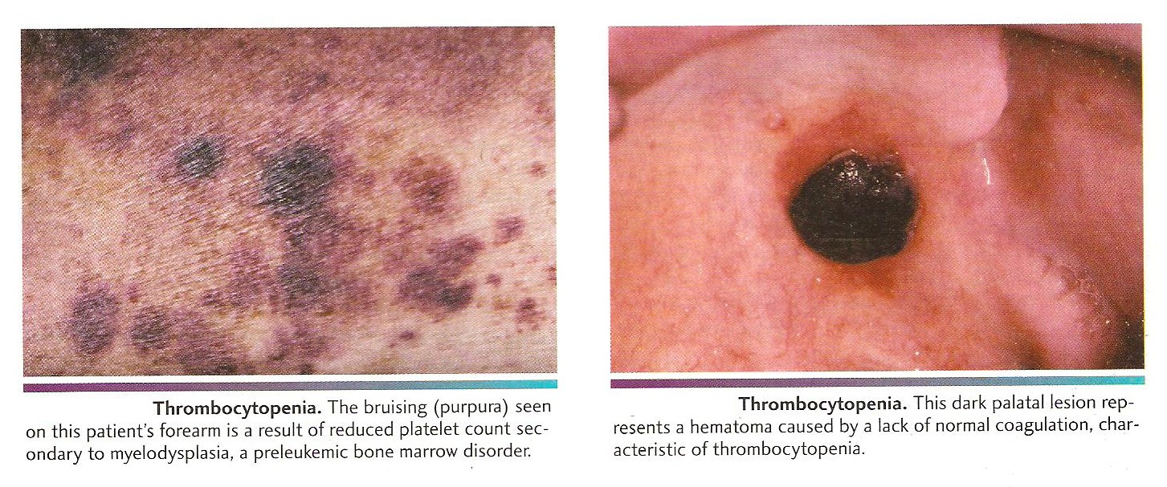
Clinical features
Spontanous appearance of purpuric or hemorrhagic lesions.
Timy red pinpoint petchiae to large purplish ecchymoses & even massive haematoma.
Epistaxis or bleeding from nose – common manifestation of a disease.

Slide 16
Oral manifestations
Severe and often profuse gingival haemorrhage
Petechiae on palate
Oral surgical procedures particularly tooth extraction contraindicated
Lab findings
Thrombocytes count < 60,000/mm³
Bleeding time > 1 hr.
Coagulation time is normal
Capillary fragility increase
Torniquet test strongly positive

Slide 17
Gingival biopsy
Gingival biopsy shows fibrin deposits in small vessel
Treatment
No specific treatment
Symptomatic relief from the bed rest and blood transfusion.
Corticosteroids
Prognosis → Fairly good

Slide 18
THROMBOTIC THROMBOCYTOPENIC PURPURA (Moschcowitz disease)
Uncommon type of thrombocytopenic purpura.
A life threatening immunologically mediated multisystem disorder described by Eli Moschowitz in 1924.
C/F-Young adults, more common in females.
Characterized by thrombocytopenia, hemolytic anemia, transitory neurological dysfunction and renal failure.

Slide 19
H/P-Microthrombi in arterioles,venules,capillaries in all tissues and organs.
Presence of occlusive subintimal deposits of PAS positive material at arteriocapillary junctions is seen in biopsy of gingival tissue
L/F -Blood examination : Thrombocytopenia and anemia.
Peripheral smear- Fragmented RBCs (schistocytes)
Prothrombin time and activated partial thromboplastin time are within normal limits.

Slide 20
Treatment-Corticosteroid,Platelate aggregation
inhibitors, splenectomy and exchange transfusions.

Slide 21
WISKOTT-ALDRICH SYNDROME- It is X-linked genetic defect in a protein termed Wiskott-Aldrich Syndrome Protein. (WASp).
It resides in Xp11.22-23.
Associated with deficiency of IgM.
C/F- Thrombocytopenic Purpura,eczema beginning on the face.
Susceptibility to infection.

Slide 22
Petechiae purpuric rash or ecchymoses of the skin may be early signs of the disease.
Patients manifest boils, otitis media, bloody diarrhea, and respiratory infection.
Increased susceptibility to infection as patient is unable to form antibodies against polysaccharide-containing organisms.
Malignant lymphoma.

Slide 23
O/M-Spontaneous bleeding from gingiva.
Palatal petechiae.
L/F: Prolonged bleeding time as the number of platelets is reduced between 18000-80000per cubic milimeter.
Anisocytosis –the platelets appear smaller than the normal.
Treatment-
Antibiotic and platelet transfusion
Bone marrow transplantation .

Slide 24
SUMMARY
Definition, types,classification, etiology, clinical features,lab. Findings & treatment of purpura
Clinical features & lab.Findings of thrombotic thrombocytopenic purpura
Clinical features & lab.Findings of wiscott aldrich syndrome

Slide 25
BIBLIOGRAPHY
Shafer’s-6th edition- Oral Pathology
Sembulingam- Physiology

Slide 26
THANK YOU

