Slide 1
Clinical procedures performed in Department of Periodontology

Slide 2
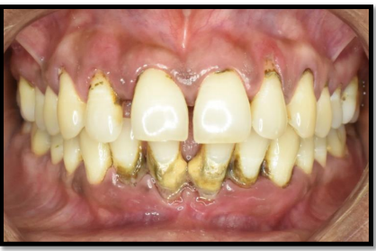
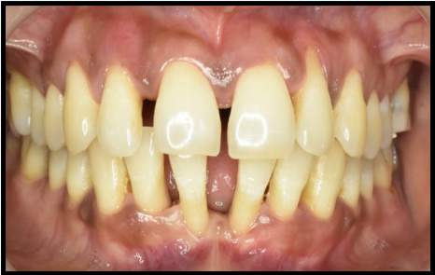
SCALING
PREOPERATIVE
POSTOPERATIVE

Slide 3
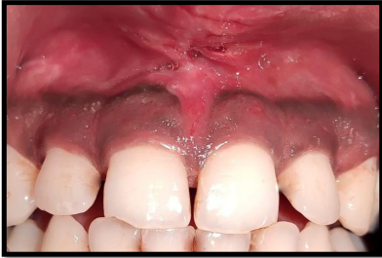
FRENECTOMY
PREOPERATIVE
POSTOPERATIVE

Slide 4
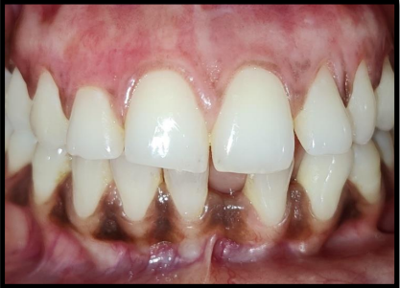
DEPIGMENTATION
PREOPERATIVE
AFTER

Slide 5
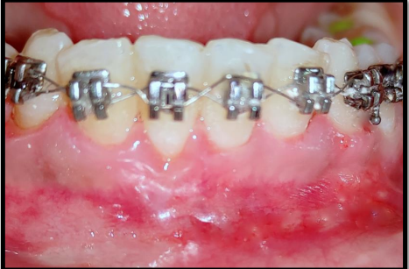
GINGIVECTOMY
PREOPERATIVE
POSTOPERATIVE

Slide 6
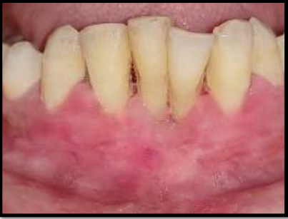
VESTIBULAR DEEPENING
PREOPERATIVE
POSTOPERATIVE

Slide 7
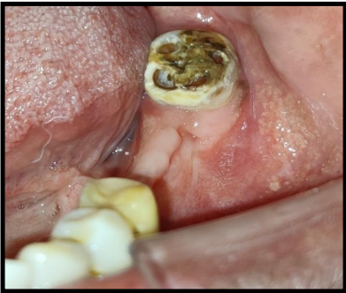
CROWN LENGTHENING
PREOPERATIVE
POSTOPERATIVE

Slide 8
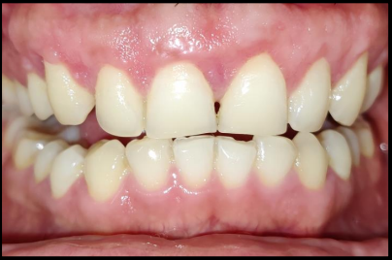
ALTERED PASSIVE ERUPTION
PREOPERATIVE
POSTOPERATIVE

Slide 9
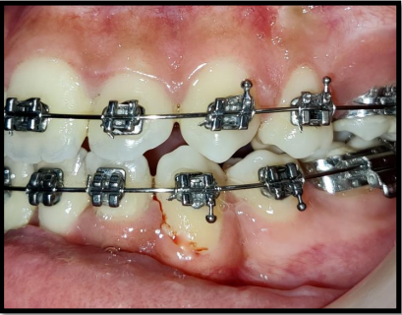
APICALLY REPOSITIONED CROWN LENGTHENING
PREOPERATIVE
POSTOPERATIVE

Slide 10
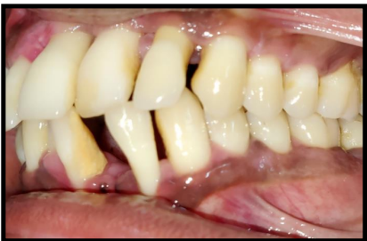
KIRKLAND FLAP
PREOPERATIVE
POSTOPERATIVE

Slide 11
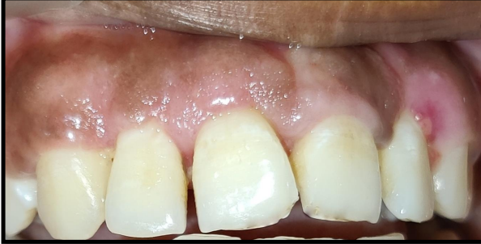
MODIFIED WIDMAN FLAP
PREOPERATIVE
POSTOPERATIVE

Slide 12
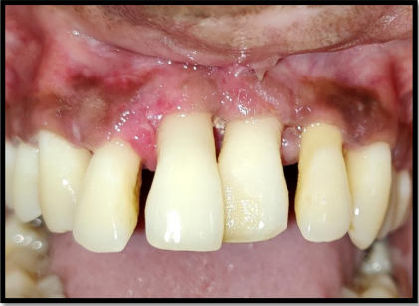
REGENERATIVE FLAP SURGERY WITH GTR AND BONE GRAFT
PREOPERATIVE
POSTOPERATIVE

Slide 13
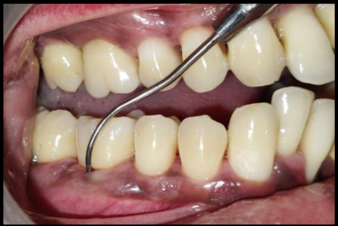
FURCATION TREATMENT
PREOPERATIVE
POSTOPERATIVE

Slide 14
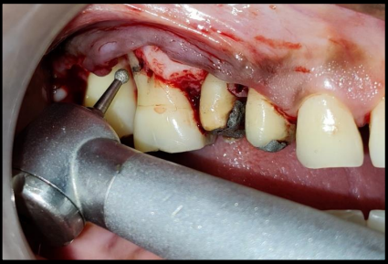
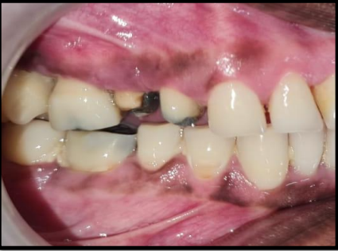
ROOT RESECTION
PREOPERATIVE
POSTOPERATIVE

Slide 15
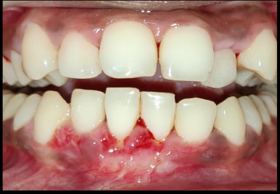
MUCOGINGIVAL SURGERY
PREOPERATIVE
POSTOPERATIVE

Slide 16
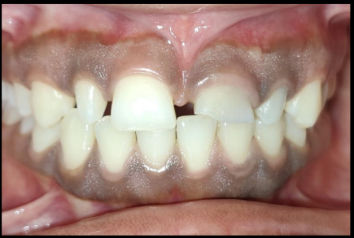
ESTHETIC CROWN LENGTHENING
PREOPERATIVE
POSTOPERATIVE

Slide 17
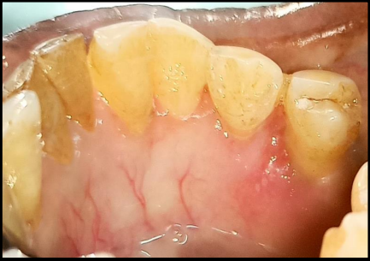
EPULIS EXCISION
PREOPERATIVE
POSTOPERATIVE

Slide 18
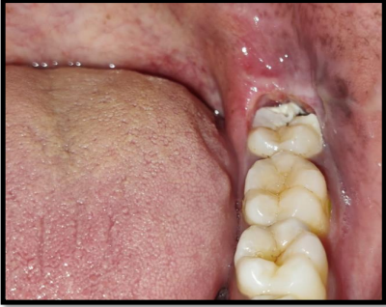
OPERCULECTOMY
PREOPERATIVE
POSTOPERATIVE

Slide 19
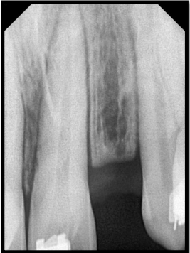
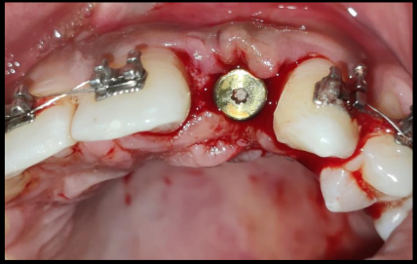
IMPLANT PLACEMENT
PREOPERATIVE
POSTOPERATIVE

Slide 20
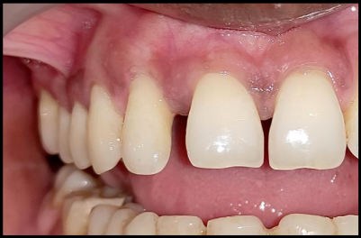
TUNELLING PROCEDURE
PREOPERATIVE
POSTOPERATIVE

Slide 21
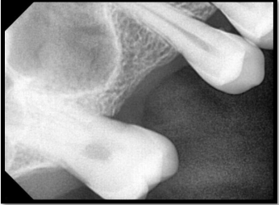
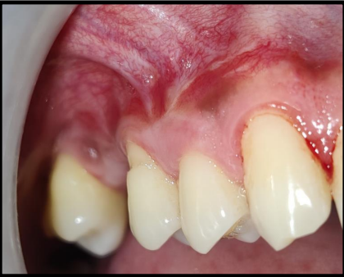
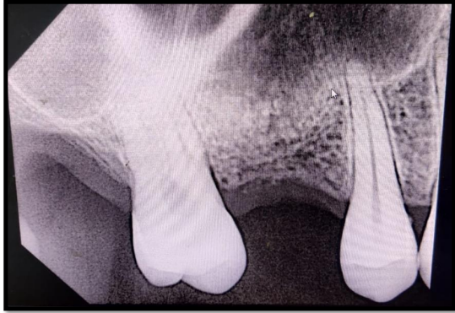
DIRECT SINUS LIFT WITH RIDGE AUGMENTATION
PREOPERATIVE
POSTOPERATIVE

Slide 22
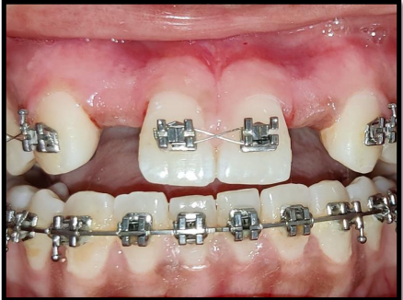
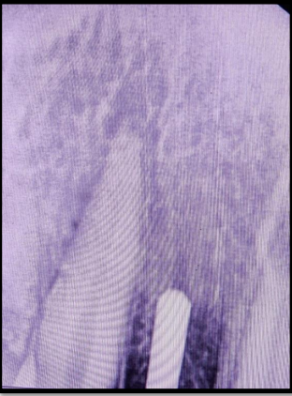
GUIDED BONE REGENERATION WITH IMMEDIATE IMPLANT PLACEMENT
PREOPERATIVE
POSTOPERATIVE

Slide 23
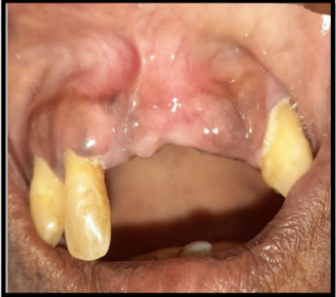
GRANULOMA EXCISION
PREOPERATIVE
POSTOPERATIVE

Slide 24
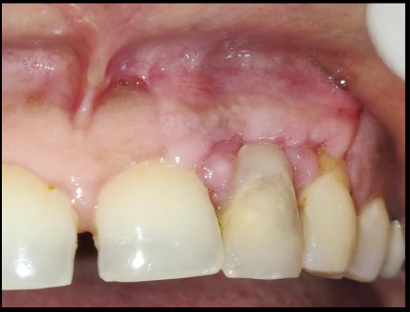
ROOT COVERAGE
PREOPERATIVE
POSTOPERATIVE

Slide 25
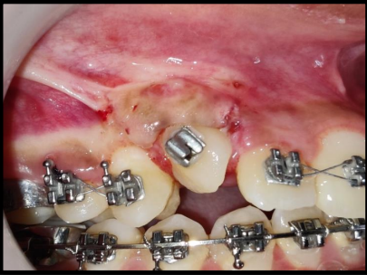
CROWN EXPOSURE
PREOPERATIVE
POSTOPERATIVE

