Slide 1
Dental caries vaccine

Slide 2
contents
Introduction
Vaccines
Immunity
The Immune Response
Mechanism of action of vaccine
Antigenic Components of Streptococcus mutans
Routes of Immunization
Risks of Using Caries Vaccine
Conclusion

Slide 3
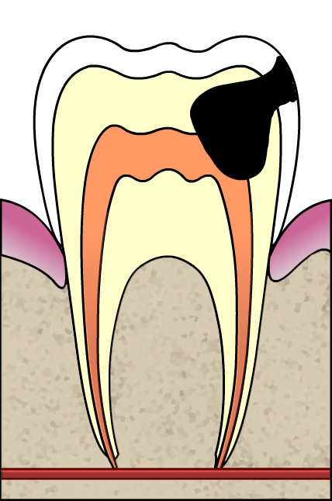
introduction
Definition Of Dental Caries: -
“ It is an irreversible disease of the teeth, characterized by demineralization of inorganic portion and destruction of organic substance of the tooth, which often leads to cavitation”
Prevalence of dental caries is almost 90% in developing countries.
left untreated can cause considerable pain discomfort, and treatment costs are too high.

Slide 4
Microorganism
Environment /
Diet
Time
Host
Caries

Slide 5
Main pathogenic species
Streptococcus mutans ,
Lactobacillus acidophilus, and
Actinomyces viscosus
Various preventive measures have been implicated for the prevention of dental caries, among which is immunization of the population against the disease.

Slide 6
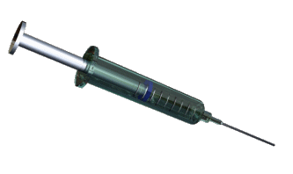
Vaccines
“ An immuno-biological substance designed to produce specific protection against a given disease.”
Stimulates the production of a protective antibody and other immune mechanisms.
Prepared from live modified organisms, inactivated or killed organisms, extracted cellular fractions, toxoids, or a combination there of.

Slide 7
immunity
Active immunity | Passive immunity
Produced actively by the immune system. Induced by infections or contact with immunogenes. Long lasting and effective protection. Immunity is effective only after a lag period. Immunological memory present, therefore subsequent challenge is more effective Used for prophylaxis to increase body resistance | Received passively by the host, hosts immune syste does not participate. Conferred by administration of readymade antibodies. Protection short lived and less effective No immunological memory. Subsequent administration of antibody is less effective due to immune elimination Used for treatment of acute infections

Slide 8
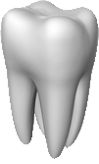
The Immune Response
Cell -Mediated Immune Response
Humoral Immune Response
Primary response
Secondary response

Slide 9
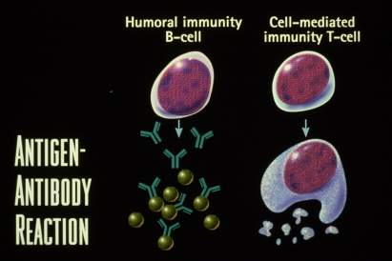

Slide 10
Mechanism of action of vaccine
Saliva aproximately 1-3% of immunoglobulin,
It also contains the humoral immunoglobulin IgG and IgM from the gingival sulcular fluid.
In addition, cellular components of the immune system such as lymphocytes, macrophages, and neutrophils are also present in gingival sulcus.

Slide 11
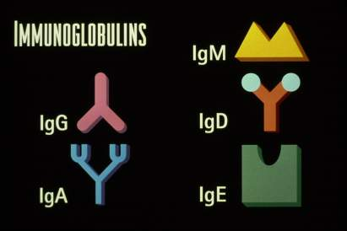

Slide 12
Some of the possible ways antibodies might control bacterial growth are listed below:
The salivary immunoglobulin act as a specific agglutinin interacting with the bacterial surface receptors inhibits colonization and subsequent caries formation
The salivary glands produce secretory IgA antibodies They may prevent S. mutans from adhering to the enamel surface or they may prevent formation of dextran by inhibiting the activity of glucosyltransferase (GTF).
The gingival crevicular mechanism involves all the humoral and cellular components of the systemic immune system, which may exert its function at the tooth surface.

Slide 13
Antigenic Components of Streptococcus Mutans
S. mutans posses various cell surface substances including
Adhesins, GTFs, and glucan binding proteins (GBP). These substances are used for vaccine preparation.

Slide 14
caries

Slide 17
Adhesins:-
From the two principal human pathogens of S. Mutans (variously identified as antigens I/II, pac, or P1) and streptococcus sobrinus, (spa-a or pag) has been purified.
Despite homology between the two mutans streptococcal adhesins, each appears to bind with separate component in pellicle

Slide 18
Glucosyltransferase:- S. mutans has three forms of glucosyltransferases (GTFs):
Water insoluble glucan synthesizing enzyme: GTF-I
Water insoluble and water-soluble glucan synthesizing enzymes: GTF-S-I
Water-soluble glucan synthesizing enzymes: GTF-S
The genes encoding GTF-I, GTF-SI, and GTF-S are called the GTF-B, GTF-C, and GTF-D genes, respectively.
All three GTF genes are important for smooth surface caries formation in the pathogen-free rat model system.
Thus presence of antibody to glucosyltrnsferase in oral cvity prior to infection can significantly influence the disease outcome

Slide 19
Glucan binding protein (GBP): S. mutans & S.sobrinus posses glucan binding protiens protection can be achieved by producing antibodies against them
Dextranases:
Dextranase is an enzyme produced by mutans Streptococcus.
They destroy dextran and thus the bacteria can invade dextran-rich early dental plaque.
Dextranase, when used as an antigen, can prevent the colonization of the organism

Slide 20
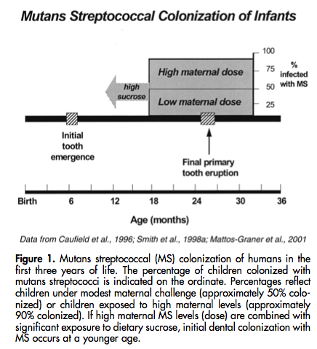

Slide 21
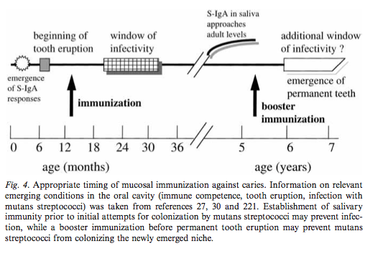

Slide 22
Routes of Immunization
Common mucosal immune system
Oral route
Intranasal route
Tonsillar route
Minor salivary gland
Rectal
Systemic (subcutaneous)
Active gingivo-salivary
Passive dental immunization

Slide 23
Newer methods
Synthetic peptides
Coupling with cholera toxin subunits
Fusing with salmonella
Microcapsules and microparticles
Liposomes

Slide 24
Synthetic peptides:
Any antigen derived from animals or humans has the potential for hypersensitivity reaction. The chemically synthesized peptides hold an advantage in that this reaction can be avoided. This has been found to enhance the immune response. In humans, synthetic peptides elicited both IgG and T-cell proliferative responses, and the antibodies were both anti-peptide and anti-native. The synthetic peptides give antibodies not only in the GCF but also in the saliva. The synthetic peptide used is derived from the Glucosyltransferase enzyme.

Slide 25
Coupling with Cholera Toxin Subunits
Cholera toxin (CT) is a powerful mucosal immunoadjuvant, which is frequently used to enhance the induction of mucosal immunity to a variety of bacterial and viral pathogens in animals systems. Mucosal application of a soluble protein or peptide antigen alone rarely results in elevated or sustained IgA responses. However, the addition of small amounts of CT or the closely related E. coli heat-labile enterotoxins (LT) can greatly enhance mucosal immune responses to intragastrically or intranasally applied mutans Streptococcal antigens or to peptides derived from these antigens. The coupling of the protein with the nontoxic unit of the cholera toxin was effective in suppressing the colonization of S. mutans.

Slide 26
Fusing with Salmonella :
The a virulent strains of salmonella are an effective vaccine vector; fusion using recombinant techniques have been used.

Slide 27
Microcapsules and microparticles:
Combinations of antigens in or various types of particles have been used in an attempt to enhance mucosal immune responses.
The microcapsules and microparticles made of poly lactide-co-glycolide (PLGA) have been used as local delivery systems because of their ability to control the rate of release, evade preexistent antibody clearance mechanisms, and degrade slowly without eliciting an inflammatory response to the polymer.

Slide 28
Risks of Using Caries Vaccine
Most serious is that sera of some patients with rheumatic fever who show serological cross-reactivity between heart tissue antigens and certain antigens from hemolytic Streptococci.
Because of the potential of Streptococcal whole cells to induce heart reactive antibodies, the development of a sub-unit vaccine for controlling dental caries has been the focus of intense research interest.

Slide 29
conclusion
Despite increase aids in management of dental caries many of the population is under the risk of extensive tooth decay.
Although several methods such as topical or systemic use of fluorides, fissure sealants, and dietary control have been developed to prevent dental caries, the efficacy of these methods is not enough to eradicate dental caries in humans
Caries vaccine has the potential of making a highly valuable contribution to control the disease

Slide 30
Thank you

