Slide 1
CONCEPTS of HEALTH

Slide 2
INTRODUCTION
“Health” is a common theme in most cultures. In fact, all communities have their concepts of health, as part of their culture.
“Health is the absence of disease“
“Harmony”
“Being at peace with the self, the community, God and Cosmos''

Slide 3
Definition of Health
"The condition of being sound in body, mind or spirit especially freedom from physical disease or pain” _{Webster}
“Soundness of body or mind; that condition in which its functions are duly and efficiently discharged'‘ _{Oxford English} _{Dictionary}

Slide 4
WHO Definition - 1948
“Health is a state of complete Physical, Mental and Social wellbeing and not merely an absence of disease or infirmity”
In past few decades, this definition is supplemented by “the ability to lead socially and economically productive life.”

Slide 5
Changing concepts
Biomedical concept:
Traditionally, health has been viewed as an “absence of disease'' and if one was free from disease, then the person was considered healthy.
This concept, known as the "Biomedical concept'' has the basis In the "germ theory of disease'' which dominated medical thought at the turn of the 20th century.
Human Body: Machine
Disease: Breakdown of machine
Doctor’s task is to repair the machine

Slide 6
Ecological concept:
The ecologists put forward an attractive hypothesis which viewed Health as a dynamic equilibrium between man and his environment, and Disease a maladjustment of the human organism to environment
The ecological concept raises two issues:
imperfect man
imperfect environment
improvement in human adaptation to natural environments can lead to longer life expectancies and a better quality of life - even in the absence of modern health delivery services.

Slide 7
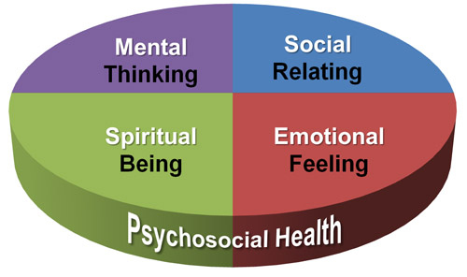
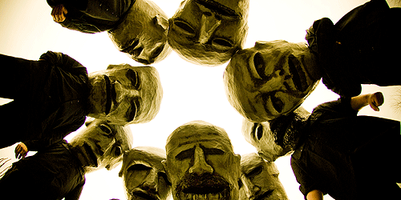
Psychosocial concept:
Developments in social sciences revealed that Health is not only a biomedical phenomenon, but one which is influenced by social, psychological, cultural, economic and political factors of the people concerned.

Slide 8
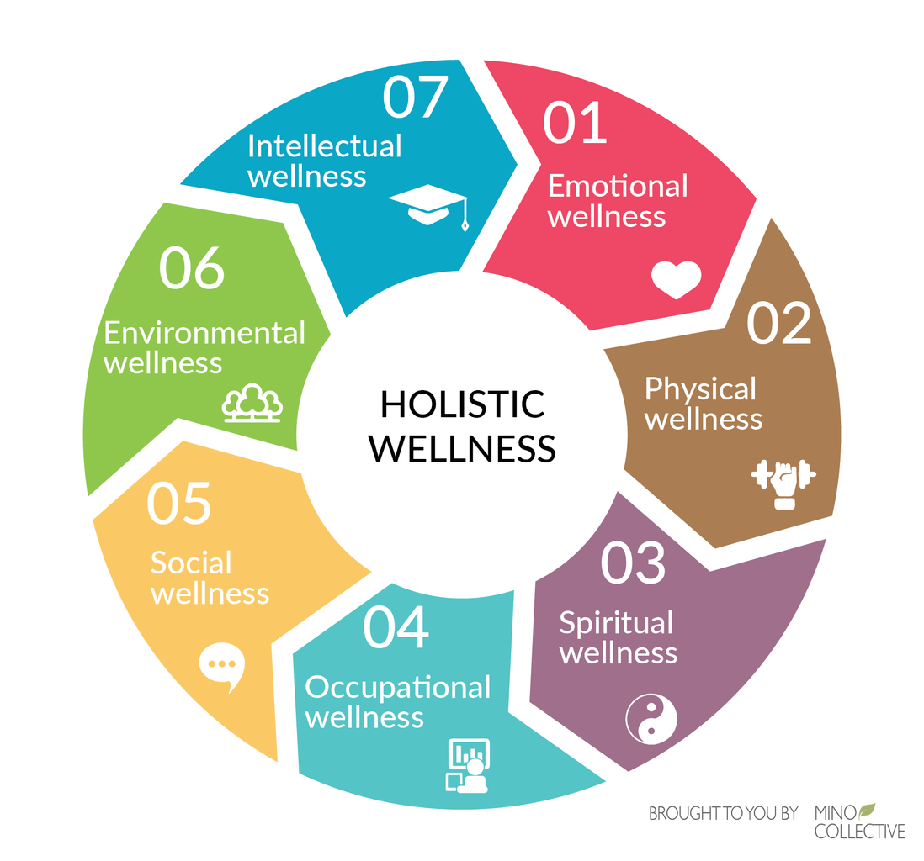
Holistic concept:
The holistic approach Implies that all sectors of society have an effect on health, in particular:
agriculture
animal husbandry
food
Industry
Education
Housing
public works
communications

Slide 9
Dimensions of Health
Health is Multidimensional.
WHO – 3 dimensions
Physical
Social
Mental

Slide 10
Physical dimension:
State of physical health implies the notion of "perfect functioning'' of the body…….
Signs of physical health in an individual are:
good complexion
clean skin
bright eyes
lustrous hair
well clothed with firm flesh not too fat
sweet breath
good appetite
sound sleep
regular activity of bowels and bladder
smooth, easy, coordinated bodily movements.

Slide 11
Mental dimension
Mental Health: state of balance between the individual and the surrounding world.
state of harmony between oneself and others
Co-existance between the realities of the self and that of other people and that of environment.

Slide 12
Depression
Schizophrenia
Hypertension
Peptic Ulcer

Slide 13
Mentally healthy person :
free from internal conflicts; he is not at war 'with himself
well adjusted i.e. he is able to get along well with others
accepts criticism and is not easily upset
searches for identity
has a strong sense self-esteem
knows himself his needs problems and goals (this is known a self-actualization)
good self-control-balances rationality and emotionality
faces problems and tries to solve them intelligently i.e. coping with stress and anxiety

Slide 14
Social dimension
"quantity and quality of an individual's inter personal ties and the extent of involvement with the community '‘.
levels of social skills one possesses
social functioning and the ability to see oneself as a member of a larger society
In general, social health takes into account that every individual is part of a family and of wider community and focuses on social and economic conditions and well-being of the "whole person'' in the context of his social network.

Slide 15
Spiritual dimension
It includes
Integrity
Principles
Ethics
purpose in life
commitment to some higher being
belief in concepts that are not subject to "state of the art'' explanation

Slide 16
Emotional dimension
Mental health : "knowing'' or "cognition“
Emotional health : relates to "feeling"

Slide 17
Vocational dimension
Importance of this dimension is exposed when individuals suddenly lose their jobs or faced with mandatory retirement.
may be merely a source of income
culmination of the efforts of other dimensions as they function together to produce what the individual considers life "success''

Slide 18
Spectrum of Health

Slide 19
Positive Health
Better Health
Freedom from Sickness
Unrecognized sickness
Mild Sickness
Severe Sickness
Death

Slide 20
Lowest point on the health-disease spectrum is death and the highest point corresponds to the WHO definition of positive health
Health fluctuates within a range of optimum well-being to various levels of dysfunction, including the state of total dysfunction i.e death

Slide 21
……i.e. a person may function at maximum levels of health today, and diminished levels of health tomorrow.
Health is a state not to be attained once and for all but ever to be renewed.
There are degrees or "levels of health" as there are degrees or severity of illness.
As long as we are alive there is some degree of health in us.

Slide 22
Determinants of Health

Slide 23
Determinants of Health
Multifactorial……..
genetic factors
environmental factors

Slide 24
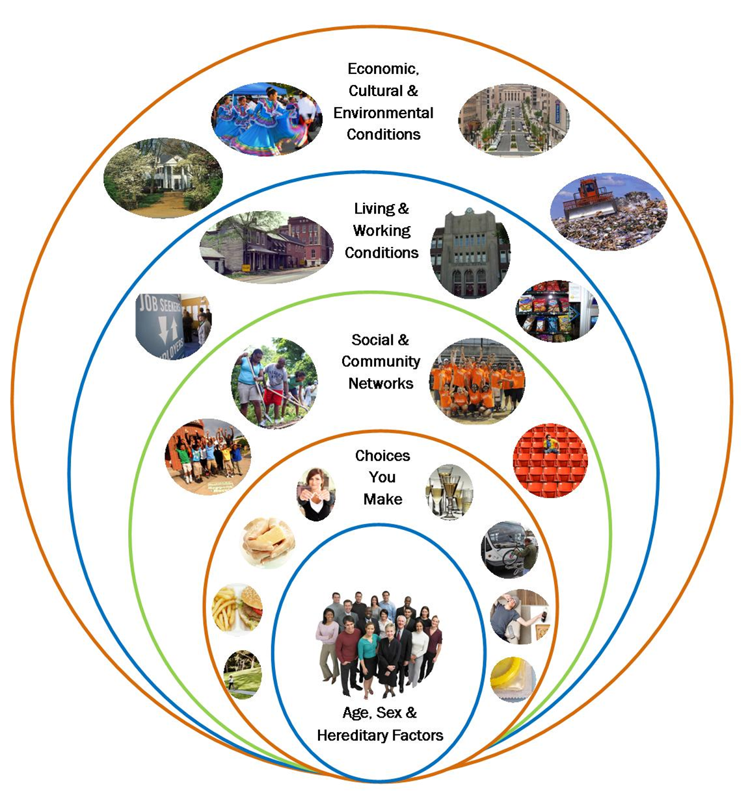

Slide 25
Biological determinants:
Physical and mental traits of an individual is determined by the genes
Unique and can not be altered
…..A number of diseases are now known to be of genetic origin e.g., chromosomal anomalies, errors of metabolism, mental retardation, diabetes, etc.

Slide 26
Behavioral and Socio-cultural Conditions

Slide 27
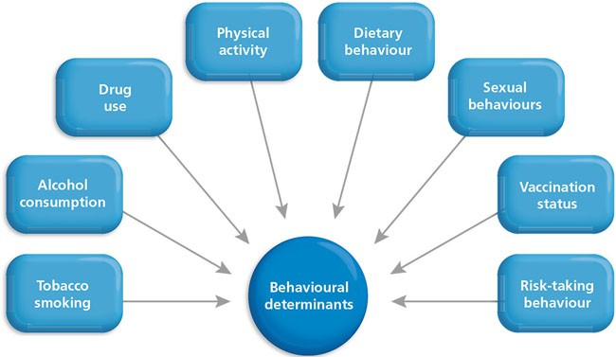

Slide 28
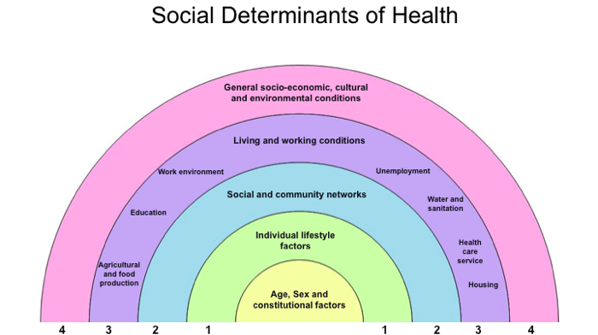

Slide 29
Behavioral and Socio-cultural Conditions
''lifestyle'' - "the way people live"
….cultural and behavioural patterns and lifelong personal habits (smoking, alcoholism) that have developed through processes of socialization.
Lifestyles are learnt through social Interaction
Parents
peer groups
friends
siblings
school
mass media.

Slide 30
….Developed countries
coronary heart disease
Obesity
lung cancer
drug addiction….
All lifestyle factors are not harmful, There are many that can actually promote health.
adequate nutrition
enough sleep
sufficient physical activity
The achievement of optimum health demands adoption of healthy lifestyles.

Slide 31
Environment
Hippocrates - disease & environment
e.g , climate, water, air
Pettenkofer in Germany – disease environment association
Environment - "Internal” and "External"
Internal Environment - "each and every component part, every tissue, organ and organ-system and their harmonious functioning within the system".

Slide 33
External or Macro-environment - "all that which is external to the individual human host'' .
Physical
Biological
Chemical
Psychosocial components
Protection and promotion of family and environmental health is one of the major issues In the world today

Slide 34
Socio-economic Conditions
Economic status : ….
Purchasing power
Standard of living
Quality of life
Family size
Pattern of disease
Behavior in the community
Affluence may also be a contributory cause of illness…….
Coronary heart disease
Diabetes
Obesity in the upper socio-economic groups

Slide 35
Education :
Education, to some extent compensates the effects of poverty on health, Irrespective of the availability of health facilities.
E.g. Kerala :
Estimated Infant Mortality Rate of 14 compared to 71 for ALL-INDIA in 1999.
A major factor in the low Infant Mortality of Kerala is its Highest Female Literacy Rate
87.86 % to
54.16 % for all-lndia

Slide 36
Occupation :
….the unemployed usually show a higher incidence of ill health and death.
Loss of work
Loss of income
Psychological damage
Loss of status
social damage.

Slide 37
Political system

Slide 38
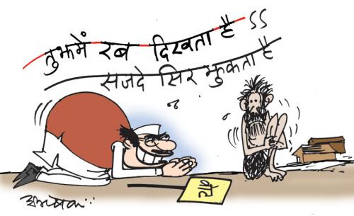
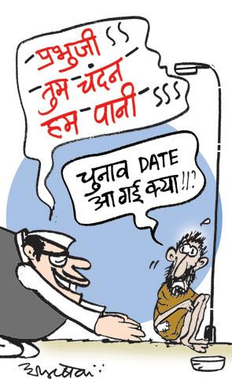

Slide 39
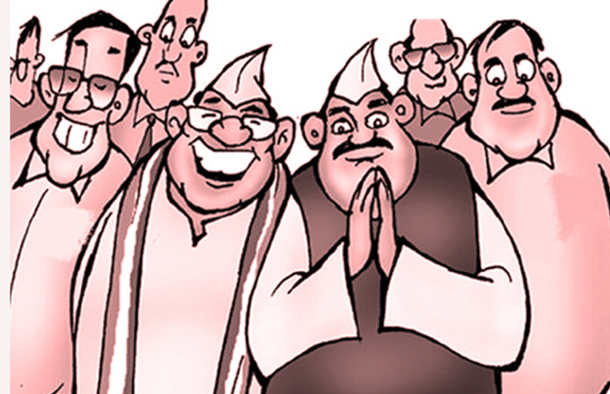

Slide 40
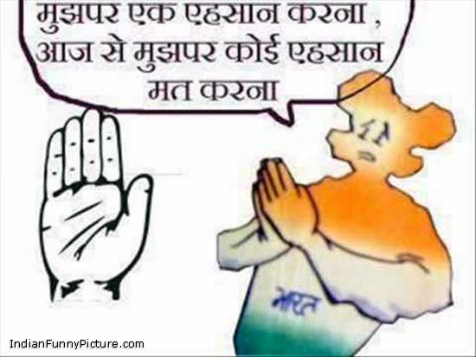
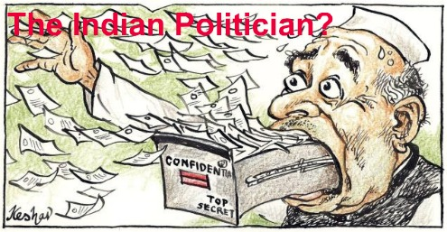

Slide 41
Political system :
….resource allocation, manpower policy, choice of technology and the degree to which health services are made available and accessible to different segments of the society….
To achieve the goal of health for all, WHO has set the target of at least 5 % expenditure of each country's GNP on health care……
….Political commitment and leadership
social development
economic development

Slide 42
Health Care
Health care is an expression of concern for fellow human beings.
"Multitude of services rendered to individuals, families or communities by the agents of the health services or professions, for the purpose of promoting, maintaining monitoring or restoring health'‘

Slide 43
Health care includes medical care.
Medical care is a subset of a health care system.
The term medical care (which ranges from domiciliary care to resident hospital care) refers chiefly to those personal services that are provided directly by physicians or rendered as a result of the physician's instructions.

Slide 44
Characteristics of Health Care:
Appropriateness i.e. whether the service is needed at all in relation to essential human needs, priorities and policies
Comprehensiveness i.e. whether there is an optimum mix of preventive, curative and promotional services
Adequacy, i.e. if the service is proportionate to requirement
Availability, i.e. ratio between the population of an administrative unit and the health facility e.g.
population per centre
doctor-population ratio

Slide 45
Accessibility, i.e. geographic, economic or cultural accessibility
Affordability, i.e. cost of health care should be within the means of the individual and the state
Feasibility, i.e. operational efficiency of certain procedures, logistic support, manpower and material resources

Slide 46
Levels of Health Care
Primary
Secondary
Tertiary

Slide 47
Levels of Health Care:
Primary Health Care :
Individual and the health system where "essential'' health care (primary health care) is provided.
Closest to the people
INDIA - Primary health centres and their subcentres, with community participation.

Slide 48
Secondary Health Care:
Curative services
provided by district hospitals and community health centre.
First referral level in the health system.

Slide 49
Tertiary Health Care:
Super-specialist care
provided by regional/central level institutions
highly specialized care
planning and managerial skills
teaching for specialized staff
This level supports and complements the actions carried out at the primary level.

Slide 50
CONCEPT OF DISEASE

Slide 51
Disease is a dynamic process and it is just opposite to the health.
Health denotes perfect harmony and normal functioning of all the body system or state of complete wellness whereas disease denotes disharmony and deviation from normal functioning of various body functioning system.

Slide 52
DEFINATION OF DISEASE
According to Webster,
“Disease is a condition in which body health is impaired, a departure from state of health, an alteration of human body function and interrupting the performance of vital function.”

Slide 53
EARLY THEORIES OF CAUSATION OF DISEASE
Up to the time of Louis Pasteur (1822-1895) various concept of disease causation were in vogue.
Super natural theory
Miasmic theory
Christian science theory
Psychogenic theory
Sub luxation theory
Stress theory

Slide 54
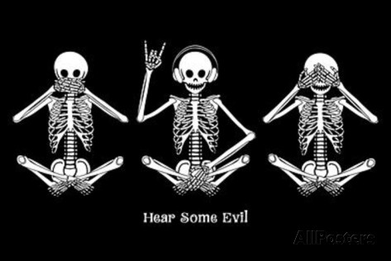
Super natural theory :- diseases caused by good or evil (good vs satan)
Miasmic theory :- illness is caused by bad smell, odours, foul smell.

Slide 55
Christian science theory:- reality only exist in the mind. You are only sick if your mind think you are sick.
Psychogenic theory:- some people are stronger, some are weak psychological those who are weaker are more susceptible to disease.

Slide 56
Sub luxation theory:- pressure on spinal nerve causes the manifestation of disease. On removal of pressure, the disease will disappear.
Stress theory:- Upsetting the homeostasis leads to disease. Occurrence of disease depend on length of stress.

Slide 57
THE GERM THEORY
According to this theory, there is one single specific cause of every disease. This refers to one to one relationship between the causative agent and disease.
Disease Agent
Man
Disease

Slide 58
GERM THEORY

Slide 59
EPIDEMIOLOGICAL TRIAD
According to this theory, every one exposed to disease agent did not contract the disease.
This means it is not only the causative agent that is responsible for disease but there are another factors also, related to man and environment which contribute to disease.

Slide 60
Environment
Host
Agent

Slide 61
Agent
Bacteria
Fungi
Viruses
Amoeba

Slide 62
Host
Genetic Mutation
Age
Health Behaviour
Immunity
Sex

Slide 63
Environment
Sanitation
Water
Air
Customs
Noise

Slide 65
MULTIFACTORIAL CAUSATION THEORY
Multifactorial causation- this concept was put forth by Pettenkofer of Munich (1819-1901)
Epidemiological theory is not applicable for non infectious and chronic diseases like coronary artery diseases etc. because it has many causes or multiple factors.
It is now known that diseases such as Coronary heart disease and lung cancer are due to multiple factors for ex. Excess of fat in take, smoking, lack of physical exercise, obesity.
This theory offers multiple approaches for the prevention of disease.

Slide 66
WEB OF CAUSATION
Given by Macmohan and Pugh.
According to them, disease never depends upon single isolated cause rather it develops from a chain of causation, in which each link itself. It is a result of complex interaction of preceding events. These chain of causation which may be the fraction of the whole complex is known as web of causation.

Slide 68
NATURAL HISTORY OF DISEASE
This model signifies the way in which a disease evolves over time from a period of its earliest stage to its termination as recovery or death.
It consist of 2 phases
Period of pre pathogenesis
Period of pathogenesis

Slide 69
Period of pre-pathogenesis
The process in the environment. The disease agent has not yet entered man but the factors which favor its interaction with the human host are present in the environment.

Slide 70
Period of pathogenesis-
The process in man. This phase begins with the entry of the disease agent into the human host, the final outcome may be recovery, disability or death.

Slide 71
SPECTRUM OF DISEASE
“Spectrum of disease” is the graphical representation of variation in the manifestations of disease.

Slide 72
At one end of disease spectrum are subclinical infections which are not ordinarily identified and at the other end are fatal illness. In the middle of the spectrum lie illness ranging in severity from mild to severe.

Slide 73
ICEBERG OF DISEASE
To this the disease can be closely related with an iceberg. The floating tip of the iceberg represents what the physician sees in the community i.e. clinical cases.

Slide 74
The vast submerge portion of the iceberg represents the hidden mass of disease i.e. latent, unapparent, presymptomatic and undiagnosed cases and carrier in the community.
The waterline represents the demarcation between apparent and unapparent diseases

Slide 75
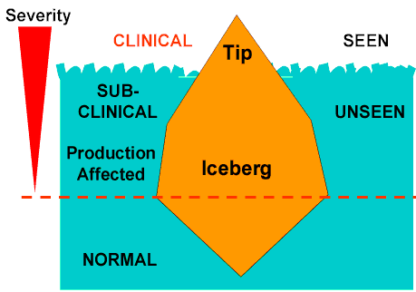

Slide 76
RISK FACTORS AND RISK GROUPS
The term “risk factors” may be an attribute or exposure that is significantly associated with the development of a disease.
Risk factors may be causative as in smoking for lung cancer and lack of physical exercise in coronary heart disease
Notes:
Y be

Slide 77
DISEASE
RISK FACTORS
HEART DISEASE
CANCER
STROKE
Smoking, high blood pressure, elevated serum cholesterol, diabetes, obesity, lack of exercise
Smoking, alcohol, solar radiation , ionizing radiation, work –site hazards, environmental pollution, medications, infectious agents
High blood pressure, elevated cholesterol, smoking

Slide 78
Alcohol, non-use of seat belts, road way design, speed
Obesity, diet
Alcohol
MOTOR VEHICLE ACCIDENTS
DIABETES
CIRRHOSIS OF LIVER

Slide 79
RISK GROUPS AND RISK APPROACH
Risk groups are those who are exposed to risk factors.

Slide 80
Concept of Prevention

Slide 81
Actions aimed at eradicating, eliminating or minimizing the impact of disease and disability, or if none of these are feasible, retarding the progress of the disease and disability.
The concept of prevention is best defined in the context of levels, traditionally called primary, secondary and tertiary prevention. A fourth level, called primordial prevention, was later added.

Slide 82
Concepts of prevention
The goals of medicine are to promote health, to preserve health, to restore health when it is impaired, and to minimize suffering and distress.
The objectives of preventive medicine is to intercept or oppose the “cause” and thereby the disease process.
This epidemiological concept permits the inclusion of treatment as one of the modes of intervention.

Slide 83
Level of prevention
In modern day, the concept of prevention has become broad- based. It has become customary to define prevention in terms of four level.
1. primordial prevention.
2. primary prevention.
3. secondary prevention.
4. tertiary prevention.

Slide 84
Primordial prevention
Primordial prevention, a new concept is receiving special attention in the prevention of chronic diseases.
For example, many adult health problems( e.g. obesity, hypertension) have their early origins in childhood, because this is the time when lifestyles are formed( for example, smoking, eating patterns, physical exercise)

Slide 85
The main intervention in Primordial prevention is through individual and mass education.

Slide 86
Primary prevention.
Primary prevention can be defined as “ action taken prior to the onset of disease, which removes the possibility that a disease will ever occur”.
It signifies intervention in the prepathogenesis phase of a disease or health problem.

Slide 87
primary prevention may be accomplished by measure designed to promote general health and well being, and quality of life of people or by specific protective measure.
A concept that encourages achievement and maintenance of “an acceptable level of health that will enable every individual to lead a socially and economically productive life”.

Slide 88
The concept of primary prevention is now being applied to the prevention of chronic disease such as coronary heart disease, hypertension and cancer based on elimination or modification of “risk factor” of disease.

Slide 89
Primary prevention
Health promotion
Specific protection
Immunization and seroprophylaxis
Health education
chemoprophylaxis
Environmental modifications
Use of specific nutrients or supplementations
Protection against occupational hazards
Life style and behavioral changes
Safety of drugs and foods
Control of environmental hazards,
e.g. air pollution
Nutritional interventions

Slide 90
Secondary prevention
Secondary prevention can be defined as “action which halts the progress of a disease of a disease at its incipient stage and prevents complication”.
Early diagnosis (e.g. Screening tests, case finding programmes) and adequate treatment.

Slide 91
Secondary prevention attempts to arrest the disease process: restore health by seeking out unrecognized disease and treating it before irreversible pathological changes have taken places;.
It may also protect others in the community from acquiring the infection and thus provide, at once. Secondary prevention for the infected individual and primary prevention for their potential contacts.

Slide 92
Secondary prevention is an imperfect tool in the control of transmission of disease.
It is often more expensive and less effective than primary prevention.

Slide 93
Tertiary prevention
When the disease process has advanced beyond its early stages, it is still possible to accomplish prevention by what might be called “tertiary prevention”.
Tertiary prevention can be defined as “all measures available to reduces or limit impairments and disabilities, minimise suffering caused by existing departure from good health and to promote the patient’s adjustment to irremediable condition”.

Slide 94
Intervention that should be accomplished in the stage of tertiary prevention are
Disability limitation,
Rehabilitation.

Slide 95
Disability limitation
disease
impairment
disability
handicap

Slide 96
Impairment
Impairment is “any loss or abnormality of psychological, physiological or anatomical structure or function.”

Slide 97
Disability
Disability is “any restriction or lack of ability to perform an activity in the manner or within the range considered normal for the human being.”

Slide 98
Handicap
Handicap is termed as “a disadvantage for a given individual, resulting from an impairment or disability, that limits or prevents the fulfillment of a role in the community that is normal (depending on age, sex, and social and cultural factors) for that individual.”

Slide 100
Rehabilitation
Rehabilitation is “ the combined and coordinated use of medical, social, educational, and vocational measures for training and retraining the individual to the highest possible level of functional ability.”

Slide 101
Thank You

