Slide 1
Canalicular Adenoma
Distinctive variant of the monomorphic adenoma
Clinical Features
Primarily in intraoral accessory salivary glands i.e. upper lip.
Slowly growing well circumscribed, firm nodule
Not fixed.

Slide 2
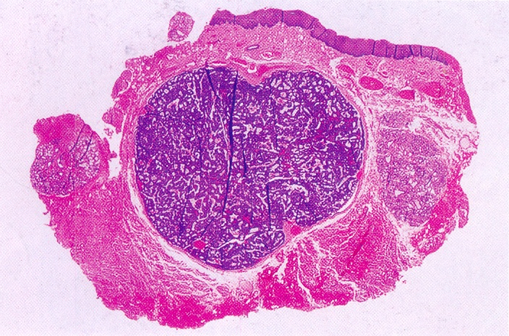
Histopathology
Benign Salivary Gland Tumors
Strikingly characteristic
Long strands or cords of epithelial cells
Arranged in double row; showing a ‘party wall’
Sometimes show cystic space; enclosed by these cords.
Cystic spaces are filled with eosinophilic coagulum.

Slide 3
Supporting stroma is loose and fibrillar, delicate vascularity
Frequently mistaken for adenoid cystic carcinoma But ACC is rarely on upper lip and not freely movable
Tall columnar and small basal cells closely resemble salivary gland excretory duct.
Also basal lamina is not multilayered as it is observed in ACC.
Treatment and Prognosis
Simple surgical excision.
Recurrence is rare.

Slide 5
Warthin’s Tumor
(Papillary Cystadenoma Lymphomatosum)
Benign neoplasm
Almost exclusively in the parotid gland occasionally submaxillary
Less common than pleomorphic adenoma.
Also K/as adenolymphoma

Slide 6
Histogenesis
Numerous theories are put forward
Proliferation of salivary gland ductal epithelium that is associated with secondary formation of lymphoid tissue
Tumor arises in salivary gland tissue entrapped within paraparotid or intraparotid lymph node during embryogenesis

Slide 7
Allegra suggested:- warthins tumors is a delayed hyper sensitivity disease.
Lymphocytes are immune response to oncocytic change occurring in salivary duct.
Smoker have an 8 fold greater risk for warthin’s tumor than to nonsmokers
Epstein- Barr virus also implicated in the pathogenesis

Slide 8
Clinical Features
Slow growing, painless, nodular mass of parotid gland.
Firm/ Fluctuant to palpation.
Most frequently occur in the tail of parotid near the angle of the mandible.
Does not exceed 3-4 cm in diameter.
It occur bilaterally :- A unique feature of warthin’s tumor

Slide 9
These bilateral tumors do not occur simultaneously. But occur at different times.
Older adults peak prevalence in 6th and 7th decade of life
Male predilection.

Slide 10
Histopathology
Benign Salivary Gland Tumors
Made up of two components
Epithelial
Lymphoid tissue
The lesion is an adenoma exhibiting cyst formation with papillary projections into the cystic spaces & lymphoid matrix showing germinal centers.

Slide 11
Benign Salivary Gland Tumors
The epithelial cells covering the papillary projections are columnar or cuboidal, arranged in two rows.
Inner layer may be several cells thick.
The lining epithelium have multiple papillary infoldings protruding in cystic spaces.

Slide 12
Benign Salivary Gland Tumors
These cells have abundant, finely granular eosinophilic cystoplasm, hyperchromatic nucleus and many mitochondria. The nucleus is centrally placed and palisaded.
Beneath these is a second layer of cuboidal or polygonal cells. Nuclei are more vesicular.

Slide 13
Epithelium is supported by a lymphoid stroma, frequently showing germinal center formation.
Eosinophilic coagulum is frequently present within the cystic spaces. It appear as chocolate coloured fluid in the gross specimen.
Treatment and Prognosis
Surgical removal is the treatment of choice
Tumor is well encapsulated
Malignant transformation is rare.

Slide 15
Oxyphilic Adenoma
Rare
Common in parotid gland
Remains small in size
Tumor of large epithelial cells k/as oncocytes. These cells appear normal found in a great number of location i.e. salivary gland, resp. tract, breast, thyroid etc.
These cells are predominantly seen in ductal lining in elderly.
Electron microscop study show that cytoplasm of oncocyte is packed by mitochondria.

Slide 16
Clinical Features
Older adults
8th decade of life
Firm, slow growing, painless mass.
Rarely more than 4cm in diameter.
Histopathology
Well circumscribed tumor.
Composed of large polyhedral cells; in sheets
Granular, eosinophilic cytoplasm.

Slide 17
Cells form an alveolar or glandular pattern.
Nucleus, centrally placed
Little stroma.
Lymphoid tissue is present.
Treatment
Surgical excision
Does not recur

Slide 19
Myoepithelioma
An Uncommon
I/O Palate E/O parotid gland.
Histopathology
Spindle shaped / plasmacytoid cell / combination
Myxomatous stroma scanty to copious

Slide 20
Definitive - Ultra structural study based.
Myoepithelial cell exihibit basal lamina and fine intracytoplasmic myofilaments.
Treatment
Surgical excision

Slide 22
Ductal Popillomas
Arise from excretory ducts of major and minor salivary glands.
3 forms:
Simple ductal papilloma
Inverted ductal papilloma
Sialadenoma papilliferum

