Slide 1
Histological Classification of Salivary Gland Tumors
Adenomas
Pleomorphic Adenoma
Myoepithelioma
Basal cell Adenoma
Warthin’s Tumor (Adenolymphoma)
Oncocytoma (Oncocytic Adenoma)
Canalicular Adenoma
Sebaceous Adenoma

Slide 2
h. Ductal Papilloma :
Inverted Ductal Papilloma
Intraductal Papilloma
Sialadenoma Papilleferum
i. Cystadenoma
a. Papillary cystadenoma
b. Mucinous Cystadenoma

Slide 3
Carcinomas
a. Acinic cell carcinoma
b. Mucoepidermoid carcinoma
c. Adenoid cystic carcinoma
d. Polymorphous low grade adenocarcinoma (Terminal duct Adenocarcinoma)
e. Epithelial myoepithelial carcinoma

Slide 4
f. Basal cell adenocarcinoma
g. Sebaceous carcinoma
h. Papillary Cystadenocarcinoma
i. Mucinous Cystadenocarcinoma
j. Oncocytic Carcinoma
k. Salivary duct Carcinoma
l. Adenocarcinoma

Slide 5
m. Malignant myoepithelioma (Myoepithelial carcinoma)
n. Carcinoma in pleomorphic adenoma ( Malignant mixed tumor)
o. Squamous cell carcinoma
p. Small cell carcinoma
q. Undifferentiated carcinoma
r. Other carcinomas

Slide 6
3) Non Epithelial Tumors
4) Malignant Lymphomas
5) Secondary Tumors
6) Unclassified Tumors
7) Tumor Like Lesions:
a. Sialadenosis
b. Oncocytosis
c. Necrotizing Sialometaplasia
d. Benign Lymphoepithelial tumors
e. Salivary Gland cyst
f. Chronic sclerosing sialadenitis of submandibular gland (Kuttner tumor)
g. Cystic Lymphoid hyperplasia in AIDS

Slide 7
Pleomorphic Adenoma (Benign Mixed Tumor)
Most common
53-77% - Parotid gland
44- 68% - Submandibular gland
38- 43% - Minor glands
Derived from a mixture of ductal and myoepithelial elements

Slide 8
That is reserve cells in intercalated duct
Intercalated duct reserve cell differentiate into ductal and myoepithelial cell
Myoepithelial cell can undergo mesenchymal metaplasia and gives rise to morphologic diversity of this tumor
Not truly a mixed neoplasm

Slide 9
Clinical Features
Parotid gland is most common site
4th to 6th decade ,female predilection i.e. 6:4
Also common in young adults, children.
Small, painless quiescent nodule
Slowly grow and increase in size
Sometimes show intermittent growth

Slide 10
Do not show fixation to deeper tissue or the overlying skin
It is an irregular nodular lesion that is firm in consistency.
Areas of cystic degeneration may be palpated if superficial.
Skin seldom ulcerates.
Pain is not a common symptom.
Local discomfort is frequently present

Slide 11
Most pleomorphic adenomas of parotid gland occur in the superficial lobe
It presents as a swelling overlying the mandibular ramous in front of ear
Facial palsy in rare
Tumor initially is mobile, but becomes less mobile as it grows larger

Slide 12
Intraoral Tumors
< 1- 2 cm in diameter
Palate is the most common site for minor gland followed by upper lip and buccal mucosa
Causes difficulty in mastication, talking and breathing
Palatal Tumors – on posterior lateral aspect
Present as smooth surfaced, dome shaped mass
If traumatized – ulcerates
Appear fixed to underlying bone but is noninvasive

Slide 13
Histopathology
Well circumscribed encapsulated tumor
Capsule may be incomplete/ show infiltration
Commonly seen in minor gland tumors
tumor is composed of mixture of glandular epithelium and myoepithelial cells in mesenchyme like background

Slide 14
The epithelium often forms ducts and cystic structures or may from islands or sheets of cell.
Keratinizing sq. cells i.e. mucous producing cells can also be seen.
Myoepithelial Cells – Present in large number
Have variable morphology – angular/ Spindle

Slide 15
Some are rounded ; eccentric nucleus and hyalinized eosinophilic cytoplasm; resembling plasma cell.
Characteristically; plasmacytoid appearance of myoepithelial cell is seen in minor gland tumors.
Stromal change is produced by the myoepithelial cells.
Collection of mucoid material in tumor cells result in myxomatous background

Slide 16
Vacuolar degeneration of cells produce chondroid appearance.
At places eosinophilic hyalinized change
At times, fibrous, fat or osteoid is seen
Presence of entirely myoepithelial cell as myoepitheliomas

Slide 17
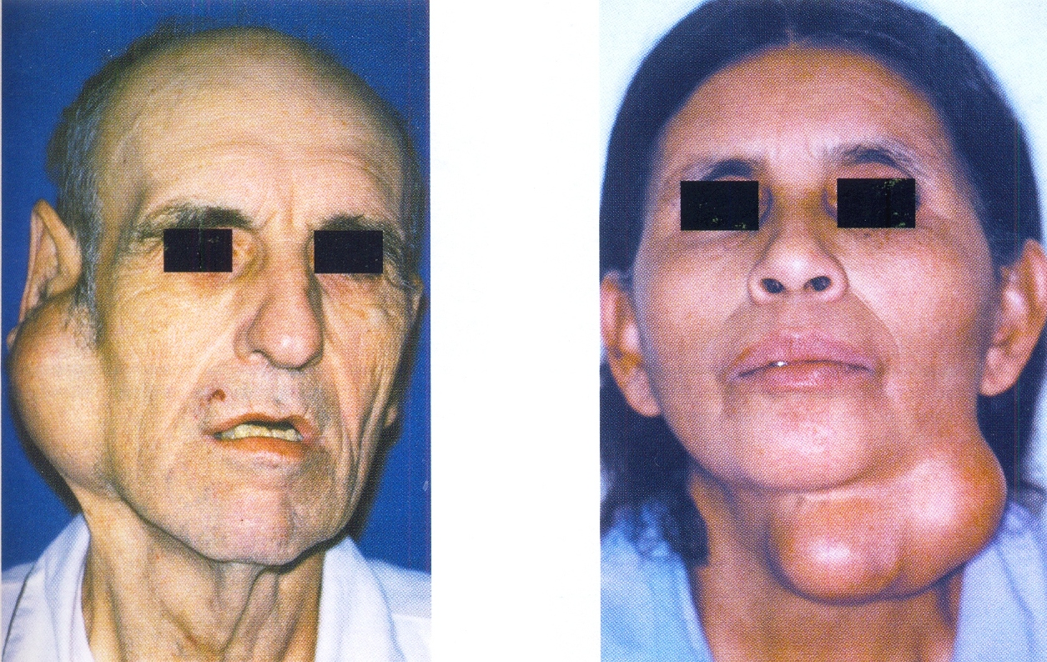
Benign Salivary Gland Tumors

Slide 19
Treatment
Surgical Excision
In Parotid – The tumor and involved lobe of the gland is removed.
Submax gland tumors are treated by removal of gland and tumor in continuity
Intraoral – by extracapsular excision
Palatal tumor- excised overlying mucosa
Lining mucosa enucleation/ extracapsular excision

