Slide 3
Types of liners: 1.thin film liners:
A . Solution liners: varnishes, 2 - 5 µm thick.
B . Suspension liners: 20-25 µm.
2.thicker liners:
also known as Cement liners: 200-1000 µm (0.2-1mm) used for thermal protection, pulpal medication.
BASES:
Cement bases, typically 1-2 mm.
Used to provide thermal protection for the pulp and supplement mechanical support for the
Restoration → by the stress distribution on the underlying dentin surface e.g. forces of amalgam condensation.

Slide 4
Varnish
Material applied in thin film thickness usually 2 – 5 microns.
It could be applied to all prepared cavities on both enamel and dentin.
Protective coating and Barrier to leakage
Seals the dentinal tubules and reduces leakage around a restoration.
Provides no thermal insulation

Slide 7
DENTAL AMALGAM
Dr. Abhishek R Badade
Dept. Of Conservative and Endodontics

Slide 8
Introduction
Dental amalgam is an alloy made by mixing mercury with a silver tin alloy. Dental amalgam alloy is a silver tin alloy to which varying amount of copper and small amount of zinc has been added.
Amalgam is a special type of alloy in which one of its constituent is mercury. In dentistry, it is common to use the term amalgam to mean dental amalgam.

Slide 9
Classification
I. According to number of alloy metals:
1. Binary alloys (Silver-Tin)
2. Ternary alloys (Silver-Tin-Copper)
3. Quaternary alloys (Silver-Tin-Copper-Indium).

Slide 10
II. According to the shape of the powdered particles.
1. Spherical shape (smooth surfaced spheres).
2. Lathe cut (Irregular ranging from spindles to shavings).
3. Combination of spherical and lathe cut (admixed).

Slide 11
III. According to copper content of powder
1. Low copper content alloy - Less than 4%
2. High copper content alloy - more than 10%

Slide 12
IV. According to Presence of zinc.
Zinc containing (more than 0.01%).
Non zinc containing (less than 0.01%).

Slide 13
INDICATIONS OF AMALGAM
Class I and class II cavities.-moderate to large restorations.
As a core build up material.
Can be used for cuspal restorations (with pins usually)
Restorations that have heavy occlusal contacts.
Restorations that cannot be well isolated
In teeth that act as an abutment for removable appliances

Slide 14
INDICATIONS OF AMALGAM
Class 3 in unaesthetic areas e.g. distal aspect of canine. especially if Preparation is extensive with minimal facial involvement
Class 5 lesions in non esthetic areas especially when access is limited and moisture control is difficult and for areas that are significantly deep gingivally.

Slide 15
CONTRA INDICATIONS OF AMALGAM
Anterior teeth where esthetics is a prime concern
Esthetically prominent areas of posterior teeth.
Small –to-moderate classes I and II restorations that can be well isolated.
Small class VI restorations

Slide 16
Advantages
Ease of use, Easy to manipulate
Relatively inexpensive
Excellent wear resistance
Restoration is completed within one sitting without requiring much chair side time.
Well condensed and triturated amalgam has good compressive strength.

Slide 17
Advantages
Sealing ability improves with age by formation of corrosion products at tooth amalgam interface.
Relatively not technique sensitive.

Slide 18
Disadvantages
Unnatural appearance (non esthetic)
Tarnish and corrosion
Metallic taste and galvanic shock
Discoloration of tooth structure
Lack of chemical or mechanical adhesion to the tooth structure.
Mercury toxicity
Promotes plaque adhesion
Delayed expansion

Slide 19
Composition of amalgam
Conventional Amalgam Alloys: (G.V. Black’s: Silver- tin alloy or Low copper alloy).
Low copper alloys are available as comminuted particles (Lathe -cut and Pulverized) and spherical particles.
Low copper composition:
Silver : 63-70%
Tin : 26-28%
Copper : 2- 5%
Zinc : 0-2%

Slide 20
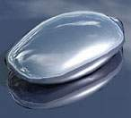
Role of individual component
Silver:
Constitutes approximately 2/3rd of conventional amalgam alloy.
Contributes to strength of finished amalgam restoration.
Increases expansion on setting and offers resistance to tarnish.
To some extent it regulates the setting time.

Slide 21
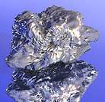
Tin:
Second largest component and contributes ¼th of amalgam alloy.
Readily combines with mercury to form gama-2 phase, which is the weakest phase and contributes to failure of amalgam restoration.
Reduce the expansion but at the same time decreases the strength of amalgam.
Increase the flow.
Controls the reaction between silver and mercury.
Tin reduces both the rate of the reaction and the expansion to optimal values.

Slide 22
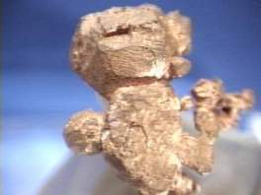
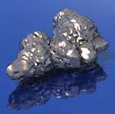
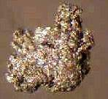
Copper:
Contributes mainly hardness and strength.
Tends to decrease the flow and increases the setting expansion
Zinc:
Acts as Scavenger of foreign substances such as oxides.
Helps in decreasing marginal failure.
The most serious problem with zinc is delayed expansion, because of which zinc free alloys are preferred now a days.
Indium/Palladium: They help to increase the plasticity and the resistance to deformation.

Slide 23
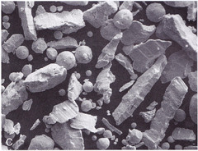
I. Admixed alloy powder:
Also called as blended alloys.
Contain 2 parts by weight of conventional composition lathe cut particles plus one part by weight of spheres of a silver copper eutectic alloy.
Made by mixing particles of silver and tin with particles of silver and copper.
The silver tin particle is usually formed by the lathe cut method, whereas the silver copper particle is usually spherical in shape.

Slide 24
I. Admixed alloy powder:
Composition:
Silver-69 %
Copper-13 %
Tin-17 %
Zinc-1 %

Slide 25
II. Single composition alloy (Unicomposition):
It is so called as it contains particles of same composition.
Usually spherical single composition alloys are used.
As lathe cut, high copper alloys contain more than 23% copper.

Slide 26
II. Single composition alloy (Unicomposition):
1. Ternary alloy in spherical form, silver 60%, tin 25%, copper 15%.
2. Quaternary alloy in spheroidal form containing Silver: 59%, copper 13%, tin: 24%, indium 4%.

Slide 27
AMALGAMATION REACTION/ SETTING REACTION
Low copper conventional amalgam alloy
Dissolution and precipitation
Hg dissolves Ag and Sn from alloy
Inter metallic compounds formed
Ag-Sn Alloy
Hg
Hg
Sn
Ag
Ag
Ag
Sn
Ag-Sn Alloy
Sn
Ag-Sn Alloy
Mercury (Hg)
Ag₃Sn + Hg ⇒ Ag₃Sn + Ag₂Hg₃ + Sn₈Hg
γ
γ1
γ2
γ

Slide 28
Low copper conventional amalgam alloy
Gamma (γ) = Ag₃Sn
unreacted alloy
strongest phase and corrodes the least
forms 30% of volume of set amalgam
Hg
Ag-Sn Alloy
Hg
Hg
Ag
Sn
Ag
Ag
Sn
Ag-Sn Alloy
Sn
Ag-Sn Alloy
Mercury

Slide 29
Low copper conventional amalgam alloy
Gamma 1 (γ₁) = Ag₂Hg₃
matrix for unreacted alloy and 2nd strongest phase
10 micron grains binding gamma (γ)
60% of volume
Ag-Sn Alloy
γ₁
Ag-Sn Alloy
Ag-Sn Alloy

Slide 30
Low copper conventional amalgam alloy
Gamma 2 (γ₂) = Sn₈Hg
weakest and softest phase
corrodes fast, voids form
corrosion yields Hg which reacts with more gamma (γ)
10% of volume
volume decreases with time due to corrosion
Ag-Sn Alloy
Ag-Sn Alloy
Ag-Sn Alloy
γ₂

Slide 31
Single Composition High-Copper Alloys
η
ε
Ag-Sn Alloy
Ag-Sn Alloy
Ag-Sn Alloy
γ₁
Ag₃Sn + Ag-Cu + Hg ⇒ Ag₂Hg₃ + Cu₆Sn₅ + Ag -Cu
γ
γ
γ1
η

Slide 32
The factors affecting strength of amalgam are:
1) Temperature:
Amalgam looses 15% of its strength when its temperature is elevated from room temperature to mouth temperature
looses 50% of room temperature strength when temperature is elevated to 60^{O}C e.g. hot coffee or soup.

Slide 33
2) Trituration:
Effect of trituration on strength depends on the type of amalgam alloy, the trituration time and the speed of the amalgamator.
Either, under trituration or over-trituration decreases the strength for both traditional and high copper amalgams.
More the trituration energy used, more evenly distributed are the matrix crystals over the amalgam mix and consequently more the strength pattern in the restoration.
Excess trituration after formation of matrix crystals will create cracks in the crystals, lead to drop in strength of set amalgam

Slide 34
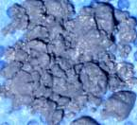
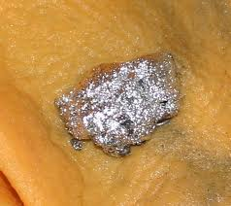
3) Mercury Content:
Low mercury alloy content, contain stronger alloy particles and less of the weaker matrix phase, therefore more strength
Mercury is too less -- dry, granular mix, results in a rough, pitted surface that invites corrosion.

Slide 35
Moisture contamination (Delayed Expansion):
Certain zinc containing low copper or high copper amalgam alloys which get contaminated by moisture during manipulation results in delayed expansion or secondary expansion
Occur 3-5 days after insertion and continues for months.
Zinc reacts with water, forming zinc oxide and hydrogen gases.

Slide 36
Complications that may result due to delayed expansion are:
Protrusion of the entire restoration out of the cavity.
Increased micro leakage space around the restoration.
Increased flow and creep.
Pulpal pressure pain.
Such pain may be experienced 10-12 days after the insertion of the restoration

Slide 37
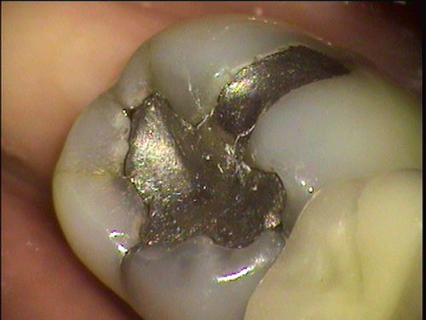
Creep:
Time dependent plastic deformation
When a metal is placed under stress, it will undergo plastic deformation.
The high copper alloys, as compared with conventional silver tin alloys, usually tend to have lower creep values.

Slide 38
Factors influencing creep:
A) γ₂ is associated with high creep rates.
B) Manipulations:
Low mercury: alloy ratio, greater the condensation pressure and time of trituration, will decrease the creep rate.

Slide 39
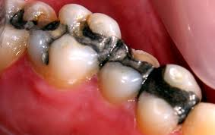
Corrosion
Excessive corrosion can lead to:
Increased porosity.
Reduced marginal integrity.
Loss of strength.
Release of metallic products in to the oral environment.

Slide 40
Low copper amalgam system:-
Most corrodible phase is tin-­mercury or γ₂ phase.
Neither the γ nor the γ₁ phase is corroded as easily.
The high copper admixed and unicomposition alloy :-
Do not have any γ₂ phase in the final set mass

Slide 41
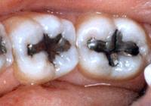
Types of Corrosion:
Galvanic corrosion:
Dental amalgam is in direct contact with an adjacent metallic restoration such as gold crown
2) Crevice Corrosion:
Local electrochemical cells may arise whenever a portion of amalgam is covered by plaque on soft tissue.
The covered area has a lower oxygen and higher hydrogen ion concentration making it behave anodically and corrode.

Slide 42
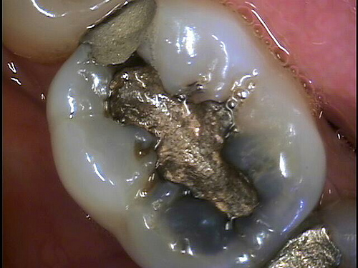
Stress Corrosion:
Regions within the dental amalgam that are under stress display a greater probability for corrosion, thus resulting in stress corrosion.
For occlusal dental amalgam greatest combination of stress and corrosion occurs along the margins.

Slide 43
MANIPULATION OF DENTAL AMALGAM

Slide 44
PROPORTIONS OF ALLOY TO MERCURY
Correct proportioning of alloy and mercury- essential for forming a suitable mass of amalgam
Some alloys require mercury – alloy ratios in excess of 1:1 (Eames technique)
whereas others use ratios of less than 1:1 with the percentage of mercury varying from 43% to 54%.

Slide 45
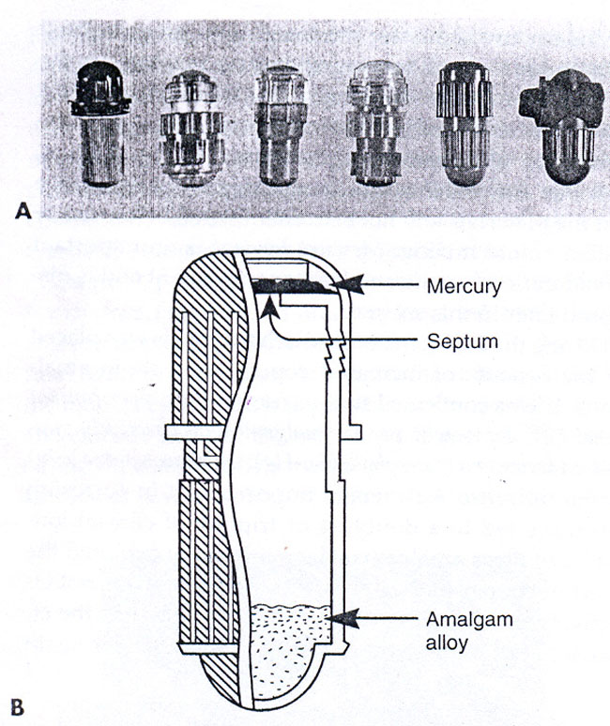
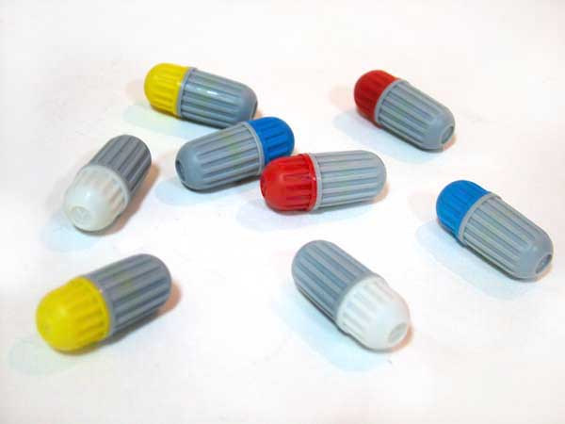
Automatic mechanical dispensers for alloy & mercury have been used in the past
Capsules with pre proportioned amounts of alloy & mercury have been substituted

Slide 46
TRITURATION
Process of mixing the amalgam alloy particles with mercury
Originally, the alloy and mercury were mixed, and was triturated by hand with a mortar and pestle
Mechanical amalgamation saves time and standardizes the procedure.

Slide 47
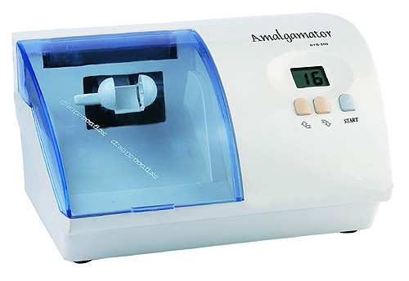
Amalgamator

Slide 48
Mechanical amalgamators are available in the following speeds:
Low speed: 32-3400 cpm.
Medium speed: 37-3800 cpm.
High speed: 40-4400 cpm.
Spherical/irregular low-copper alloys – triturated at low speed
High copper alloys – high speed
Time of trituration on amalgamation ranges from 3-30 seconds. Variations in 2-3 seconds can also produce a under or over mixed mass.

Slide 49
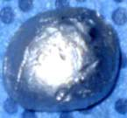
Over-trituration: Alloy will be hot, hard to remove from the capsule, shiny wet and soft.
Under-trituration: Alloy will be dry, dull and crumbly; will crumble if dropped from approx 30 cm.
Normal Mix: Shiny appearance separates in a single mass from the capsule.
Under-trituration
Normal Mix

Slide 50
Objectives of Trituration are:
To achieve a workable mass of amalgam within a minimum time
To remove the oxide layer
To pulverize pellets into particles, that can be easily attacked by the mercury.
To reduce particle size
To keep the amount of γ₁ or γ₂ matrix crystal as minimal as possible, yet evenly distributed

Slide 51
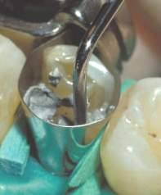
Condensation
Refers to the incremental placement of the amalgam into the prepared cavity and compression of each increment into the others
Amalgam should be condensed into the cavity within 3 min after trituration.

Slide 52
Aims of condensation
Adapt amalgam to the margins, walls and line angles of the cavity.
Minimize voids and layering between increments within the amalgam.
Develop maximum physical properties.
Remove excess mercury to leave an optimal alloy: mercury ratio.

Slide 53
Purpose of Condensation
To get a continuous homogenous mass that is well adapted to all margins, walls and line angles.
Best carried out using hand instruments.

Slide 54
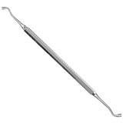
Hand condenser :
Should allows a operator to readily grasp it & exert a force of condensation
Size of condenser tip & direction & magnitude of the force placed, depends on the type of amalgam alloy selected

Slide 55
Mechanical Condensers:
Useful for condensing irregular shaped alloys when high condensation forces are required
Need was eliminated with the advent of spherical alloys
Tend to lead to unreliable condensation as well as generation of heat and mercury vapor, both of which are undesirable.

Slide 56
Ultrasonic Condensers:
Not recommended
Causes the release of considerable quantities of mercury vapor in the dental office

Slide 57
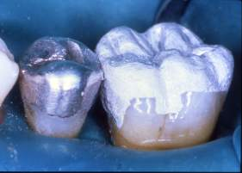
Burnishing
First Burnish (Pre-carve Burnish)
Carried out using a large burnisher for 15 seconds
Use light force and move from the center of the restoration outwards to the margins.

Slide 58
Objectives of pre-carve burnishing :
Continuation of condensation, further reduce the size and number of voids on the critical surface and marginal area of the amalgam.
Brings any excess mercury to the surface, to be discarded during carving.
Adapt the amalgam further to cavo-surface anatomy.

Slide 59
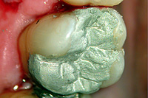
Carving
Using remaining enamel as a guide, carve gently from enamel towards the center and recreate the lost anatomy of the tooth.
Amalgam should be hard enough to offer resistance to carving instrument
A scarping or "ringing" (amalgam crying) should he heard.
If carving is started too soon, amalgam will pull away from margins.

Slide 60
Objectives of carving :
To produce :
A restoration with the proper physiological contours.
A restoration with adequate, compatible marginal ridges.
A restoration with proper size, location, extend and interrelationship of contact areas.

Slide 61
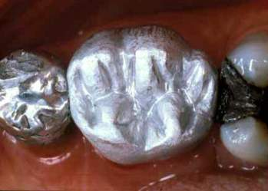
Final Burnish (Post carve burnishing)
Following carving, check the occlusion and carry out a brief final burnish.
Use a large burnisher at a low load and burnish outwards towards the margins
Improves smoothness
Heat generation should be avoided
If temp raises above 60⁰C, causes release of mercury accelerates corrosion & fracture at margins

Slide 62
Finishing & Polishing
Finishing can be defined as the process, which continues the carving objectives, removes flash and overhangs and corrects minimal enamel underhangs.
Polishing is the process which creates a corrosion resistant layer by removing scratches and irregularities from the surface.
Can be done using descending grade abrasive, eg. rubber mounted stone or rubber cups.
A metallic lusture, is always done with a polishing agent (precipitated chalk, tin or zinc oxide).
.

Slide 63
Usually, 24 hours should pass after amalgam insertion before any finishing and polishing commences.
However, some new alloys can be polished after 8-12 hours still others require only a 30-minute wait after insertion.

Slide 64
BIO-COMPATIBILITY –MERCURY TOXICITY

Slide 65
Mercury in urine
Body cannot retain metallic mercury, but passes it through urine
Skare I et al (1990) –
urine mercury level peak at 2.54 μg/L 4 days after placing amalgam restorations, return to zero after 7 days
On removal of amalgam, urine mercury levels reach a maximum value of 4μg/L, return to zero after 7 days

Slide 66
Mercury in blood
Maximum allowable level of mercury in blood is 3 μg/L
Chang SB et al(1992) showed that freshly placed amalgam restorations elevated blood mercury levels to 1 to 2 μg/L
As with urine mercury levels, there is first an increase of around 1.5 μg/L, which decreases in about 3 days

Slide 68
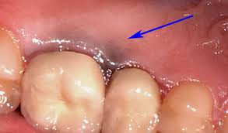
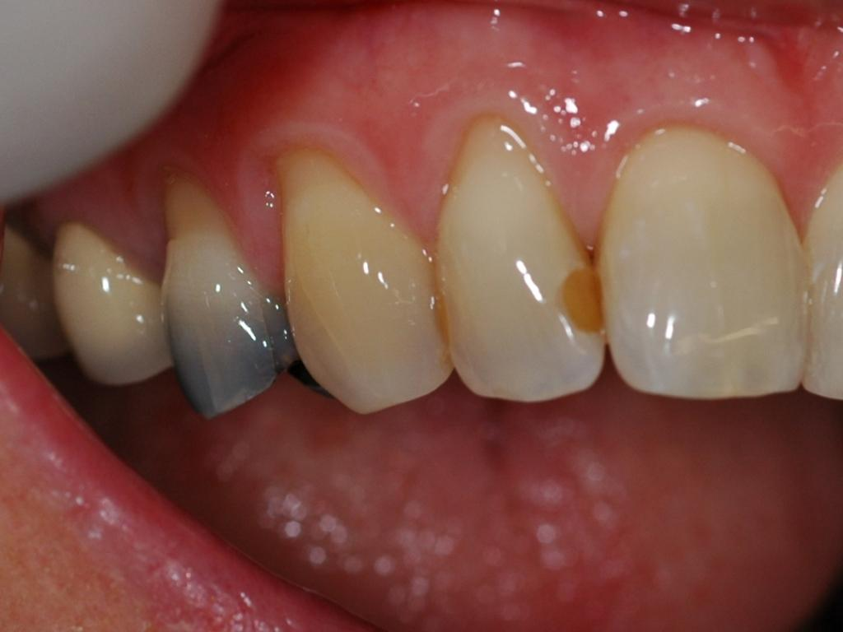
BIO-COMPATIBILITY –MERCURY TOXICITY
AMALGAM TATTOO
AMALGAM HUE

Slide 69
AMALGAM TATTOO
Possible causes are:
Scraps of amalgam may fall into open surgical or extraction wounds.
Excess amalgam may be left in the tissues following sealing the apex of a root canal with a retrograde amalgam.
Pieces of amalgam may be forced into the mucosa.

Slide 70
Sources of Mercury Exposure in Dental Office:
Dental amalgam raw materials being stored for use.
Mixed but unhardened dental amalgam during triturations, insertion and intraoral setting.
Dental amalgam scrap that has insufficient alloy to completely consume the mercury present.
Dental amalgam undergoing finishing and polishing procedure.
Dental amalgam restoration being removed.

Slide 71
DENTAL MERCURY HYGIENE
Recommendations from the ADA include the following:
The work place should be well ventilated, with fresh air exchange and outside exhaust
Use only pre capsulated alloy, discontinue use of Bulk mercury & bulk alloy
Avoid the need to remove excess mercury before or during packing by selecting an appropriate alloy: mercury ratio
Use an amalgamator with a completely enclosed arm.

Slide 72
Mercury and unset amalgam should not be touched by the bare hands.
Floor coverings should be non absorbent & easy to clean
Spilled mercury should be cleaned up using trap bottles, tape or freshly mixed amalgam to pick up droplets
Do not use a house hold vacuum cleaner to clean spilled mercury.
Skin accidentally contaminated by mercury should be washed thoroughly with soap and water.

Slide 73
If a mercury hygiene problem is suspected, personnel should undergo urine analysis to detect mercury levels
Remove professional clothing before leaving the work place

Slide 74
Scrap amalgam disposal
In a tightly closed container
Under radiographic fixer solution
Dispose mercury contaminated items in sealed bags
Do not dispose mercury contaminated items in medical waste containers or bags or along with the waste that will be incinerated

Slide 75
RECENT ADVANCES
1) BONDED AMALGAMS
During the 1990’s some clinicians began to routinely bond amalgam restorations to enamel and dentine
After preparation of the cavity, enamel and dentine etched using a conventional etchant, a chemically cured resin-bonding agent applied to the walls of the cavity.
Amalgam is immediately condensed into the cavity before the resin bond has cured

Slide 76
2) Gallium alloys
Mercury free metallic restorative materials proposed as substitute for mercury containing amalgam are gallium containing materials and pure silver and/or silver based alloys
Puttkammer (1928), suggested the use of gallium in dental restoration
Attempts to develop satisfactory gallium restorative materials were unsuccessful until Smith et al in 1956, showed that improved Pd-Ga and Ag-Ga materials has physical and mechanical properties that were similar to or even better than those of silver amalgam.

Slide 77
3) Fluoride releasing amalgam
Have been shown to have anticaries properties sufficient to inhibit the development of caries in cavity walls.
Concentration of fluoride is sufficient to enhance remineralization
Tviet and Lindh (1980) -- greatest concentration of fluoride i.e. about 4000µg/mL in enamel surfaces exposed to fluoride-containing amalgams were found in the outer 0.05µm of the tissue.

Slide 78
Repair Of Amalgam Restorations
When an amalgam restoration fails, as from marginal fracture, it is repaired
A new mix of amalgam is condensed against the remaining part of the existing restoration
The strength of the bond between the new and the old amalgam is important

Slide 79
Factors contributing to strength of repair
Presence of porosity and γ2 phase at the junction.
Inadequate condensation.
Contamination of the surface of the existing amalgam.
Corrosion & contamination from saliva.

Slide 80
CONCLUSION
There are certain advantages inherent with amalgam such as technique insensitive, excellent wear resistance, less time consuming, less expensive which are not present in the newer materials, these factors will continue to make amalgam the material of choice for many more years to come.

